Slide 1
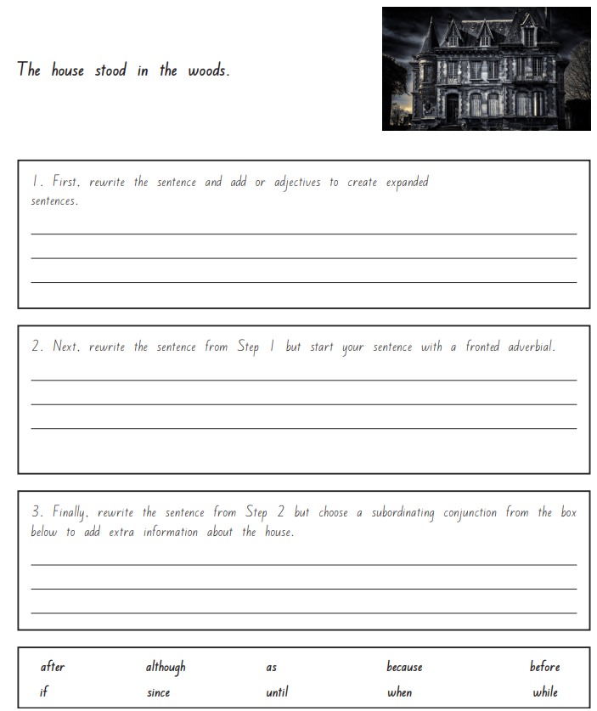
Morning challenge

Slide 3
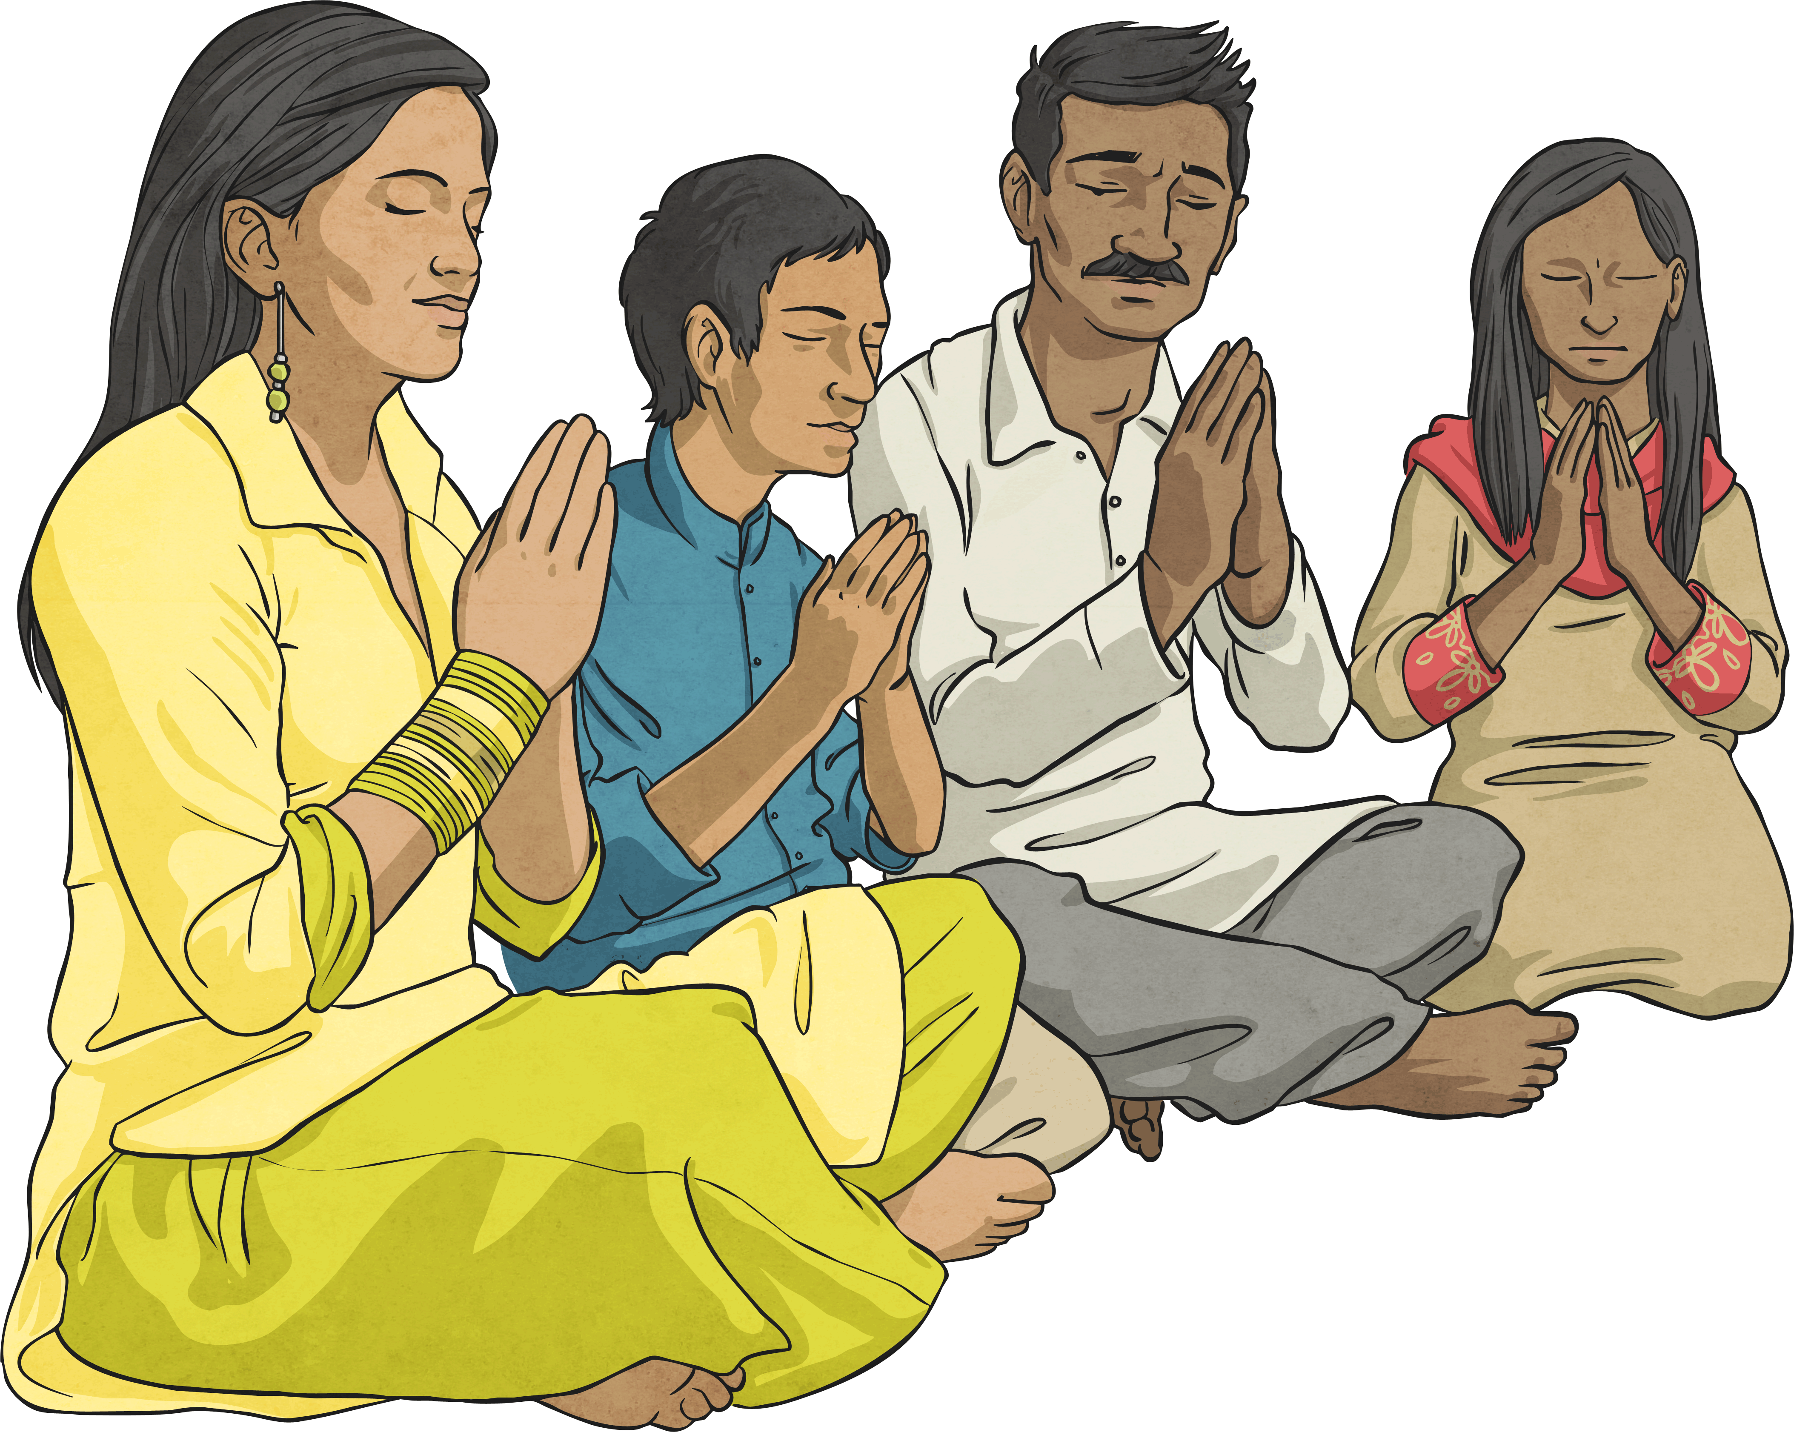
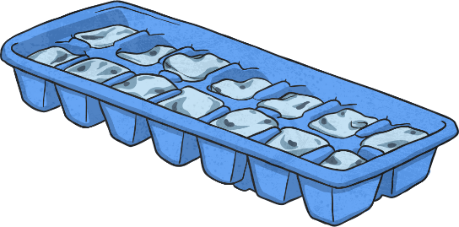
This week, we are again looking at how nouns and adjective root words can be changed into verbs using suffixes.
For these week’s spellings, we are going to concentrate on using the suffix –ify such as:
amplify
solidify
glorify

Slide 4
Many –ify suffix words are just created by simply adding the –ify suffix to a noun or adjective root word, e.g.
However, sometimes we need to remove the ‘e’ from the end of noun or adjective root word before adding –ify, e.g.
Root words that end in ‘y’ also usually remove this letter before adding –ify, e.g.
solid (noun) → solidify (verb).
ample (adjective) → amplify (verb).
glory (noun) → glorify (verb).

Slide 5
Are you a spelling genius when it comes to this week’s -ify spelling words? WHITE BOARDS
Work as a team to play Who Wants to be a Spelling Genius. Can you win the big points?

Slide 6
Question 1
Which is the correct –ify spelling to fit into this sentence?
During the biology lesson, the children had to __________ the types of animals.
A
C
Incorrect Answer
Incorrect Answer
clasify
classiffy
B
D
Correct Answer!
classify
Incorrect Answer
classefy

Slide 7
Question 2
Which is the correct –ify spelling to fit into this sentence?
The athlete needed to _________ his training regime if he was going to make to the Olympic Games.
A
C
Incorrect Answer
Incorrect Answer
intenseify
intenssify
B
D
Correct Answer!
intensify
Incorrect Answer
intinsify

Slide 8
Question 3
Which is the correct –ify spelling to fit into this sentence?
In the Crown Court, the nervous witness had to ________ against the criminal.
A
C
Correct Answer!
Incorrect Answer
testify
testtify
B
D
Incorrect Answer
testeify
Incorrect Answer
tesstify

Slide 9
Question 4
Which is the correct –ify spelling to fit into this sentence?
“Please could you ______ us if you wish to cancel your booking?” asked the receptionist politely.
A
C
Correct Answer!
Incorrect Answer
notify
noteify
B
D
Incorrect Answer
nottify
Incorrect Answer
nootify

Slide 10
Question 5
Which is the correct –ify spelling to fit into this sentence?
“We praise thee, we bless thee, we worship thee, we _____ thee,” cried the priest during the service.
A
C
Incorrect Answer
Incorrect Answer
gloryify
glourify
B
D
Incorrect Answer
glorrify
glorify
Correct Answer!

Slide 11
Question 6
Which is the correct –ify spelling to fit into this sentence?
The unruly investigator had been caught red-handed trying to _______ the evidence.
A
C
Incorrect Answer
Incorrect Answer
falssify
falseify
B
D
Correct Answer!
falsify
Incorrect Answer
faulsify

Slide 12
Question 7
Which is the correct –ify spelling to fit into this sentence?
The spokesperson used a loudspeaker to ________ his voice for the crowds.
A
C
Correct Answer!
Incorrect Answer
amplify
ammplify
B
ampplify
D
Incorrect Answer
Incorrect Answer
ampleify

Slide 13
Question 8
Which is the correct –ify spelling to fit into this sentence?
The melted chocolate quickly began to ________ when it was back in room temperature.
A
C
Correct Answer!
Incorrect Answer
solidify
soliddify
B
sollidify
D
Incorrect Answer
Incorrect Answer
solidiffy

Slide 14
Question 9
Which is the correct –ify spelling to fit into this sentence?
White doves are often used to ________ peace and love.
A
C
cignify
Incorrect Answer
Incorrect Answer
siggnify
B
signify
D
Incorrect Answer
Correct Answer!
ciggnify

Slide 15
Points
100 000
50 000
10 000
5000
2000
1000
500
200
100
100
100
100
100
100
100
100
100
100
Notes:
Click the tick to change the score when a correct answer is chosen. If an incorrect answer is chosen, click the arrow to go to the next question ☺

Slide 16
2.4.25 TBAT- read, write and plot coordinates. 1) 5.907 x 1000 = 2) 5/6 x 3 = 3) 2, 453 Nearest 10= Nearest 100 = Nearest 1, 000=

Slide 17
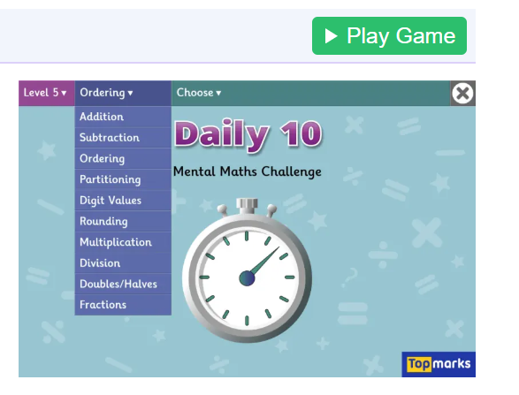
Daily 10 Daily 10 - Mental Maths Challenge - Topmarks

Slide 18
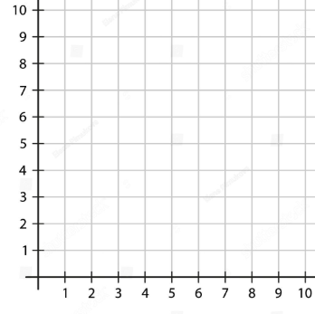
Talk partners: Which axis is 'x' and which is 'y'?

Slide 19
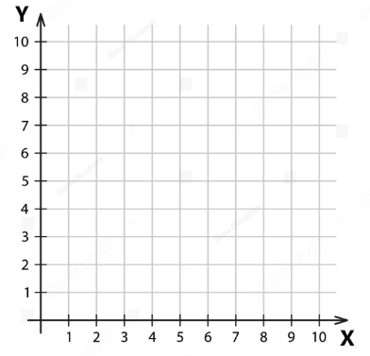
Talk partners: Which axis do you read or plot first?

Slide 20
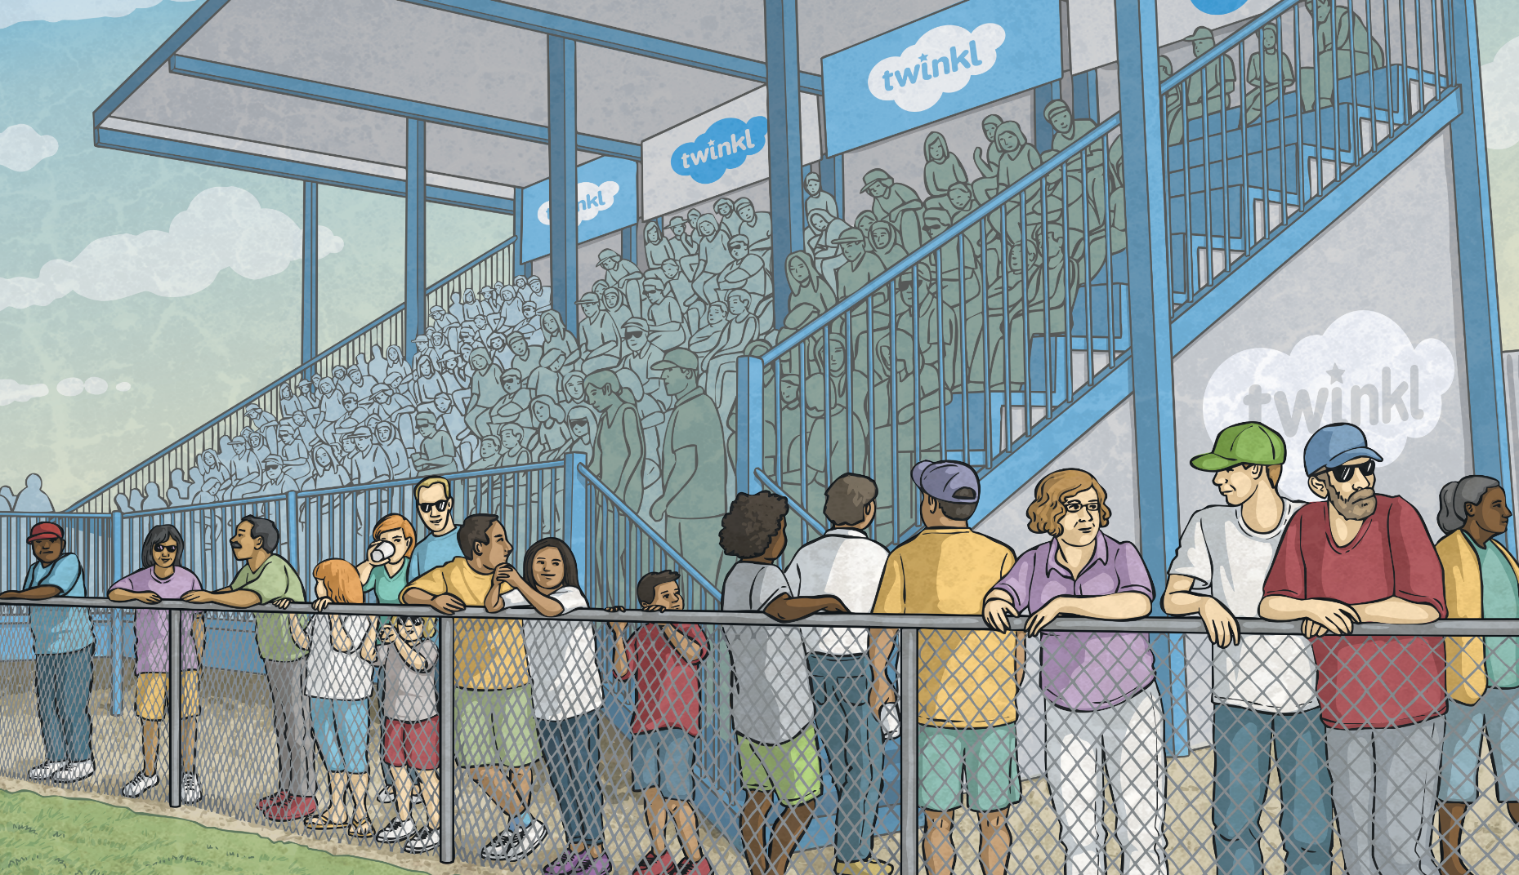
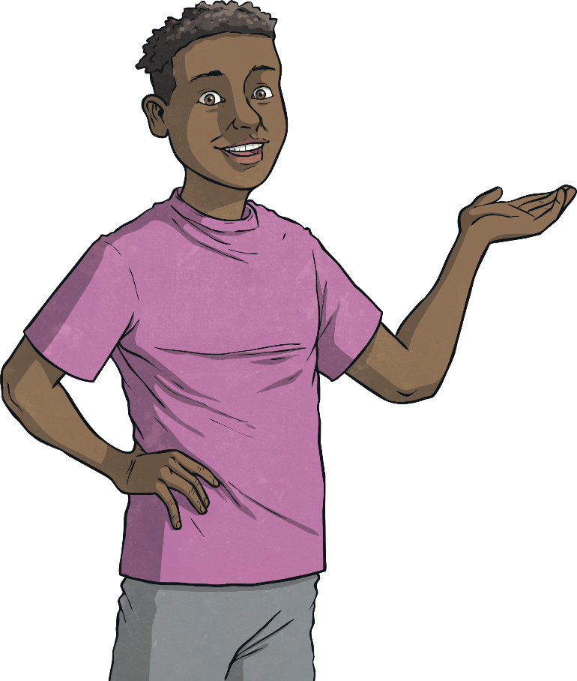
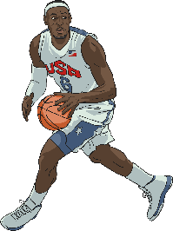
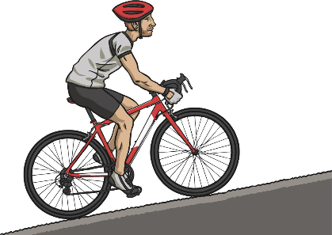
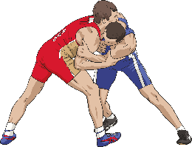
Olympic Sports Coordinates
6
My favourite sports to watch are (5,3), (2,5) and (0,1).
?
?
?
?
?
?
?
5
?
?
?
?
?
?
?
4
?
?
?
?
?
?
?
3
?
?
?
?
?
?
?
2
?
?
?
?
?
?
?
1
?
?
?
?
?
?
?
?
?
?
?
?
?
?
0
?
?
?
1
2
3
4
5
6
Click the correct coordinates to find Joe’s favourite Olympic sports:

Slide 21
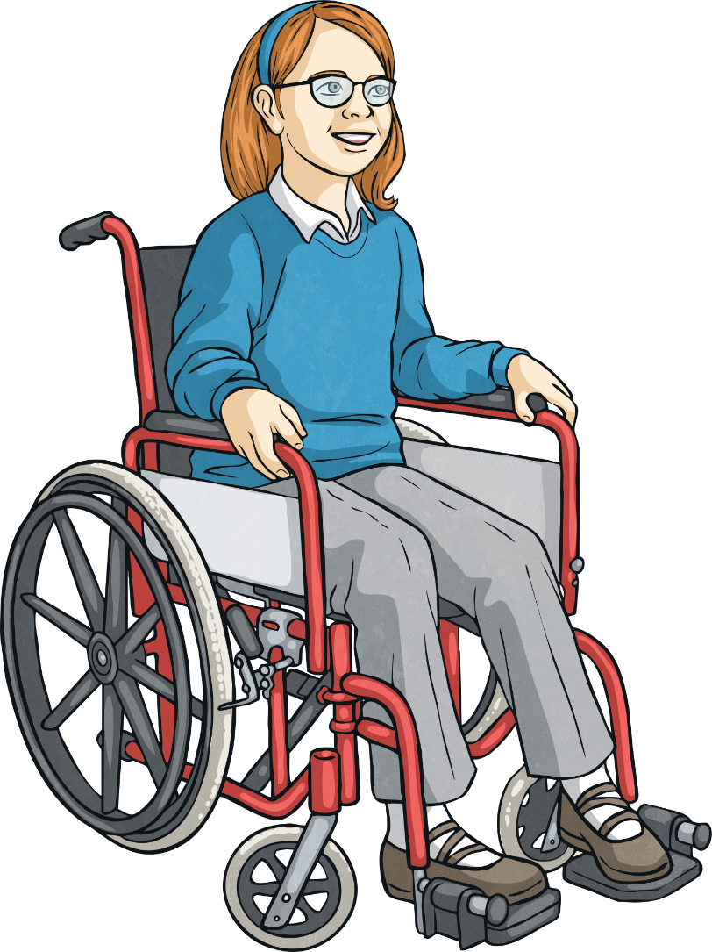
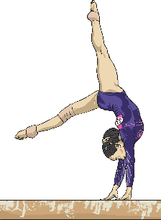
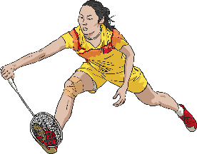
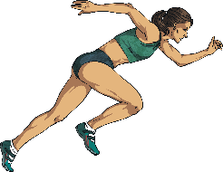
Olympic Sports Coordinates
6
My favourite sports to watch are (6,2), (1,6) and (3,3).
?
?
?
?
?
?
?
5
?
?
?
?
?
?
?
4
?
?
?
?
?
?
?
3
?
?
?
?
?
?
?
2
?
?
?
?
?
?
?
1
?
?
?
?
?
?
?
?
?
?
?
?
?
?
0
?
?
?
1
2
3
4
5
6
Click the correct coordinates to find Anika’s favourite Olympic sports:

Slide 22
The Four Quadrants
6
In the first activity, you were identifying coordinates in the first quadrant, using the horizontal x-axis and vertical y-axis.
5
4
second
quadrant
3
first
quadrant
2
The point where the horizontal and vertical axes intersect is at (0,0). This is called the origin.
1
-6
-5
-4
-3
-2
-1
0
1
2
3
4
5
6
-1
When the x-axis and y-axis number lines are extended beyond the origin, into negative numbers, a much larger coordinate grid is created, made of four areas called quadrants.
-2
third
quadrant
-3
fourth
quadrant
-4
-5
-6

Slide 23
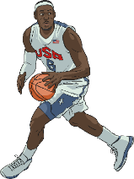
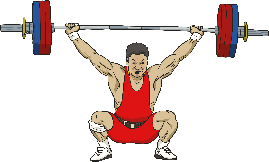
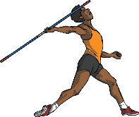
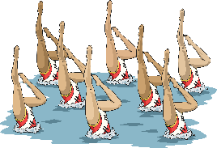
The Four Quadrants
6
5
Which quadrant should each Olympic sport be positioned in?
4
3
(-1,6)
first quadrant
(-3,4)
2
second quadrant
1
third quadrant
-6
-5
-4
-3
-2
-1
0
1
2
3
4
5
6
(5,-2)
-1
(6,1)
fourth quadrant
-2
-3
(-4,-1)
-4
(2,-2)
-5
-6

Slide 24
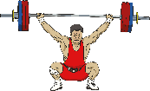
Missing Coordinates
6
5
Identify the missing coordinate for each Olympic sport:
4
3
(-2,-4)
?
2
(4,5)
1
?
-6
-5
-4
-3
-2
-1
0
1
2
3
4
5
6
(-3,-2)
-1
?
-2
(2,-4)
?
-3
-4
(-5,4)
?
-5
-6

Slide 25
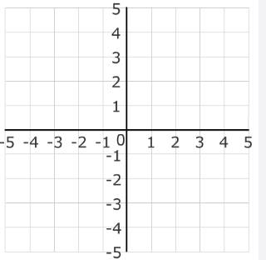
Read coordinates and translate.

Slide 26
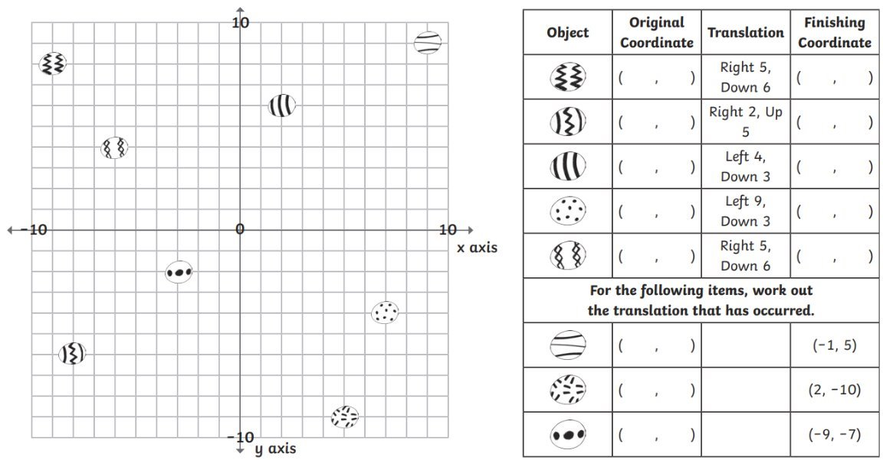
Independent:

Slide 27
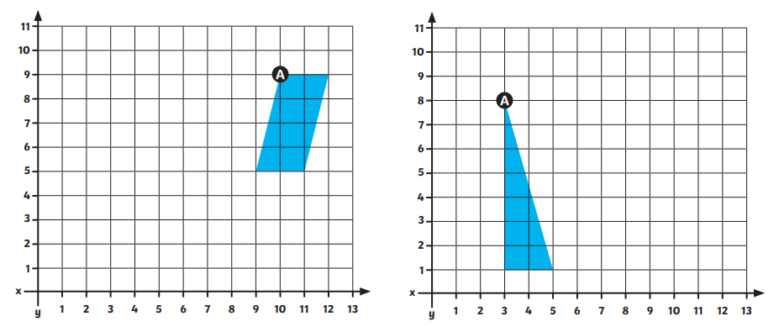
Translate shape A 5 left and 3 down. Translate shape A 2 up and 6 right.

Slide 28
TBAT: Use persuasive techniques in my writing. In conclusion, I trust that you share my belief that I am the most suitable candidate to embark on this extraordinary journey with the children. With the skills I have outlined - the ability to ignite others' passions, motivate individuals to reach their highest potential, and lead effectively - I am fully equipped to contribute to the success of this mission. This trip holds immense significance to me; moreover, it would be my honour to be the selected adult to support the children on this trip. Talk partners: What is the purpose of a closing paragraph? Task: Write your closing paragraph. Summarise why you are the best person for the role. Use the final sentence from Thursday's lesson.

Slide 29
TBAT: Create an information page on earth and space. What could be your sub-headings for your information page? What would you include in your introduction?

Slide 30
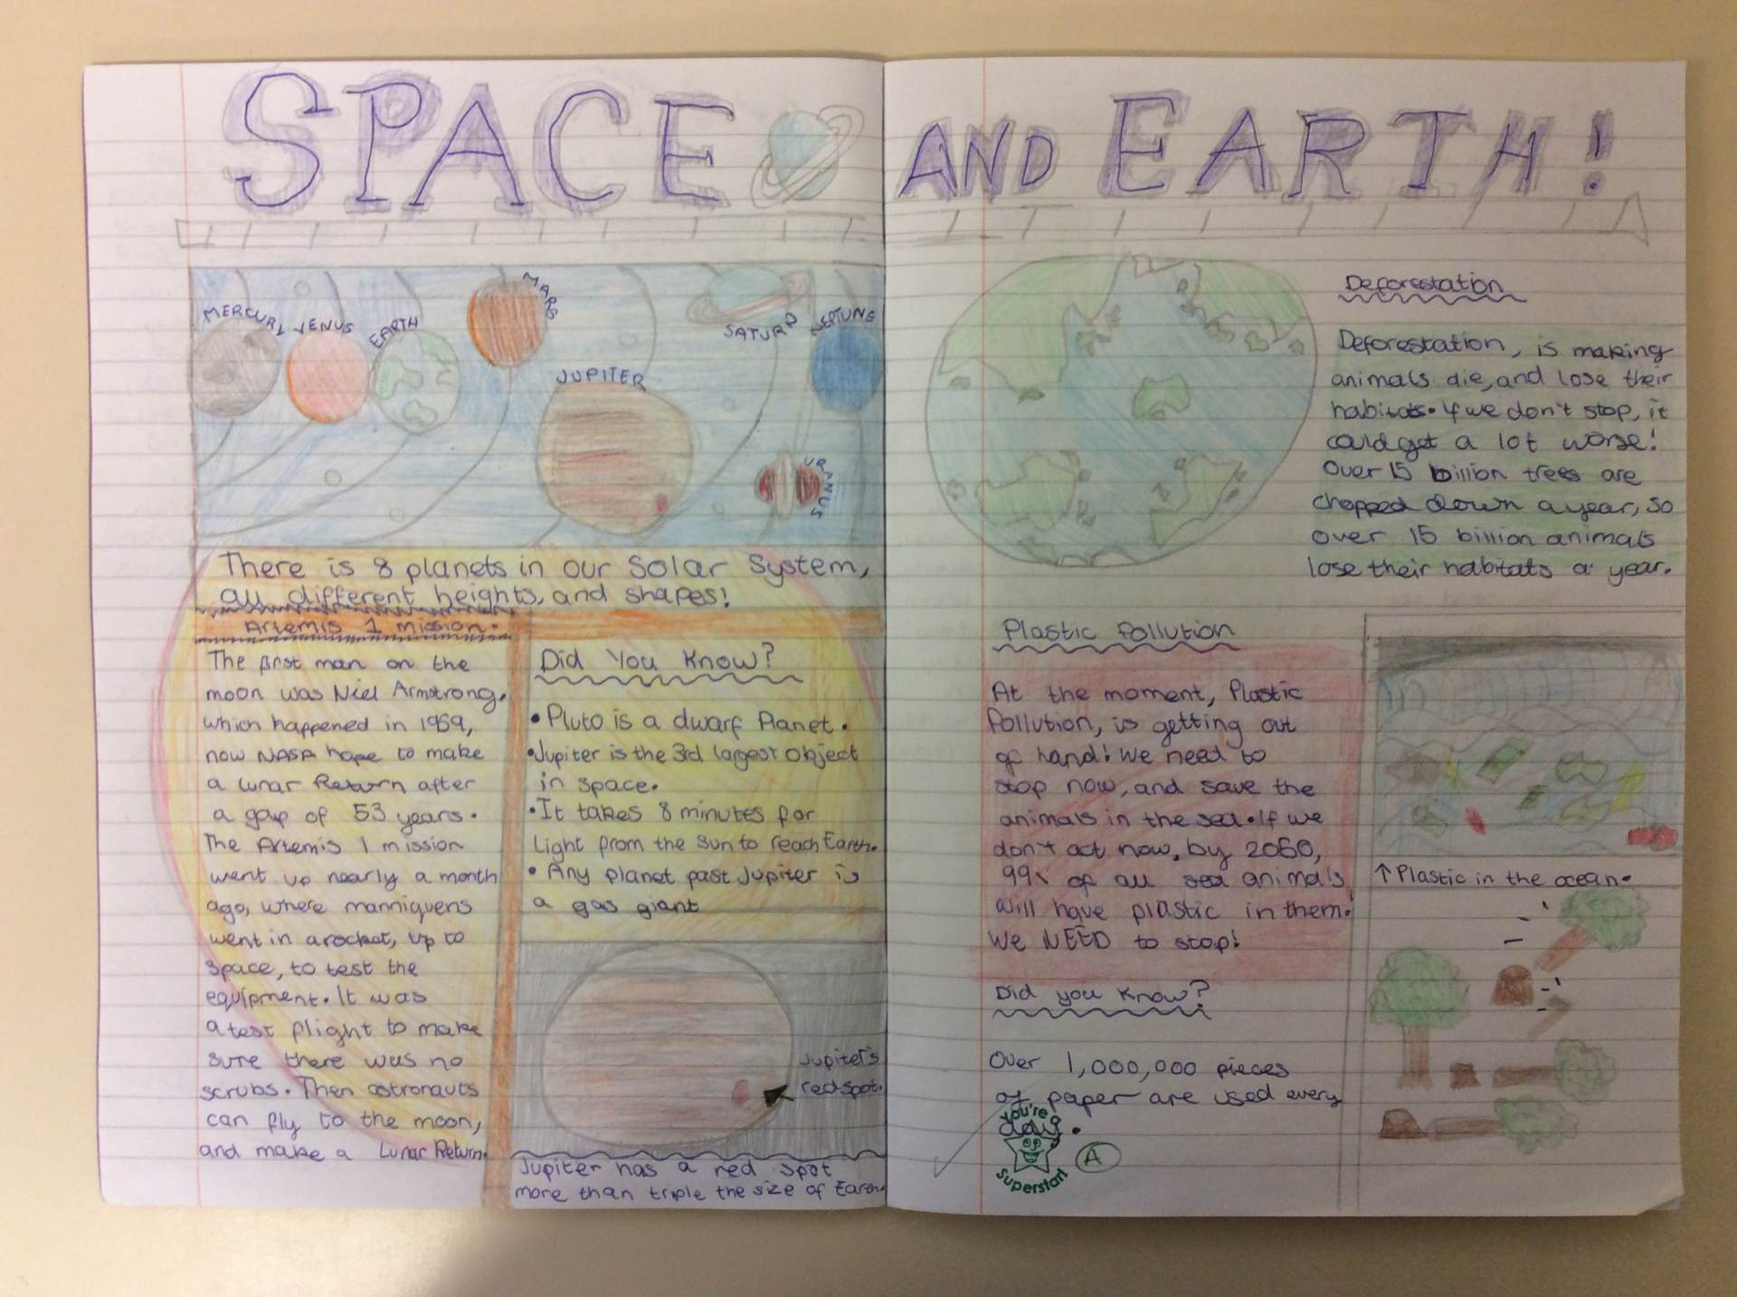
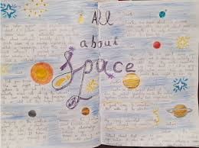
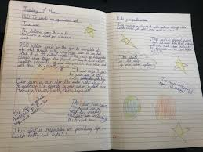
TBAT: Create an information page on earth and space.

Slide 31
TBAT: Create an information page on earth and space.
Introduction
Our solar system is a fascinating and ever-moving place, filled with planets, moons, and one powerful star—the Sun. For centuries, humans have studied space, uncovering incredible discoveries about how the planets move and how Earth experiences day, night, and seasons. The Greek philosopher Aristotle was one of the first to prove that Earth is a sphere, not a flat surface as once believed. But what else makes our solar system so unique? Let’s explore!

Slide 32
TBAT: Create an information page on earth and space.
The Solar System and Its Planets
At the heart of our solar system is the Sun, a giant, burning star that provides light and heat to the planets that orbit around it. The planets, arranged in order of their distance from the Sun, are: Mercury, Venus, Earth, Mars, Jupiter, Saturn, Uranus, and Neptune. Each planet follows its own orbit, which is the path it takes around the Sun.
The time it takes for a planet to complete one full orbit is called a year, and this varies from planet to planet. For example, Earth takes 365 days to orbit the Sun, whereas Neptune takes an astonishing 165 Earth years! This is because planets that are further away have much larger orbits to complete.

Slide 33
TBAT: Create an information page on earth and space. The Earth, the Moon, and Their Movements
Earth is constantly moving in two ways: it orbits the Sun, creating the different seasons, and it rotates on its axis, causing day and night. It takes 24 hours for Earth to complete one full spin (on its axis), which is why we experience sunrise and sunset. The Sun appears to move across the sky, but in reality, it is Earth that is turning!
The Moon is Earth’s only natural satellite and the largest object that orbits our planet. It takes around 28 days to complete one orbit of Earth. Interestingly, we only ever see one side of the Moon because it rotates at the same speed as it orbits Earth.

Slide 34
TBAT: Create an information page on earth and space. The Changing Moon
When we look up at the night sky, the Moon appears to change shape—but this is just an illusion caused by its position relative to the Earth and Sun. As the Moon orbits Earth, different amounts of sunlight reflect off its surface, creating the lunar phases. These include:
New Moon (when the Moon is not visible),
Crescent Moon (a small glowing curve),
Half Moon or First Quarter,
Full Moon (when the whole Moon is visible),
and Last Quarter, before it starts the cycle again.
Each phase occurs because of the way sunlight hits the Moon as it moves around Earth.

Slide 35
TBAT: Create an information page on earth and space. Conclusion
Earth and space are full of fascinating wonders, from the movement of the planets to the glowing Moon above us. Without the Sun, life on Earth would not be possible, and without the Moon, our nights would be much darker. Scientists continue to study space, uncovering new mysteries beyond our solar system. Who knows what else we might discover in the future?

Slide 36
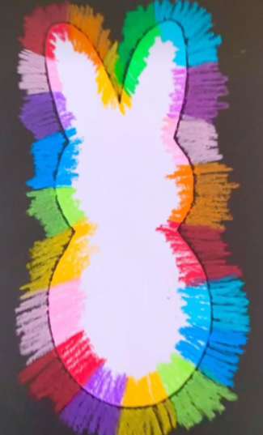
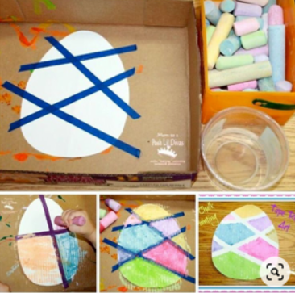
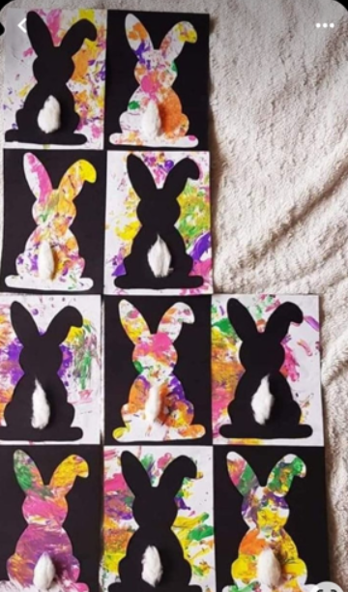
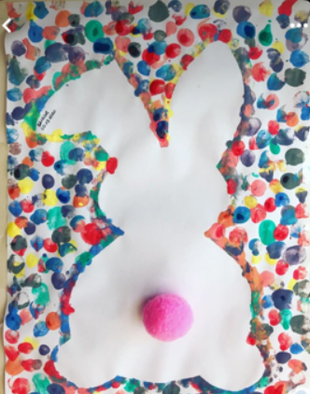
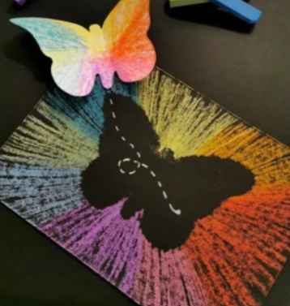
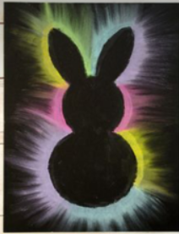
Easter crafts

