Slide 1
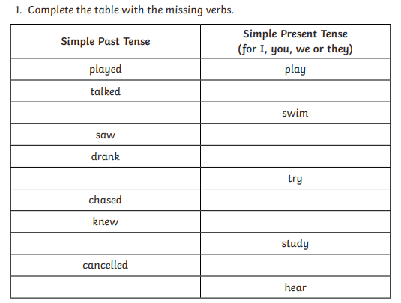
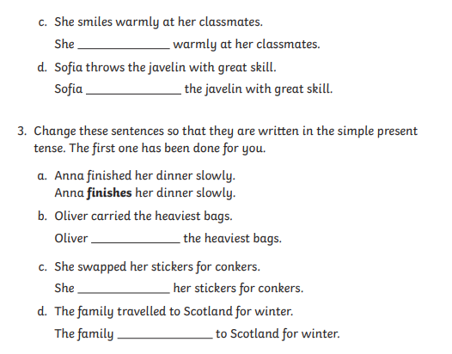
Morning challenge

Slide 2
Tuesday 1st April 2025
TBAT: Use joins consistently.
amplify
solidify
signify
falsify
glorify
classify
notify
testify
purify
intensify
Are there any words you are unsure of? Use a dictionary to look them up and then use them in a sentence.

Slide 3
1.4.25 TBAT- use the appropriate method to solve arithmetic problems.
3 in 3
456 x 12 =
¾ + 5/6 =
1 2/3 + 5/6 =
Challenge:
10% of 120 =
10% off 120=

Slide 4
Talk partners: How would we solve these problems? 2/5 x 45 = 2/5 of 45 =

Slide 6
Tuesday 1st April TBAT- use persuasive techniques in my writing. (Whiteboards) 2 in 2 – Make the corrections to the sentences below: I am writing to express my interest in accompanied the children to space I am the best person for this role cos i am a caring motivating and adventurous individual.

Slide 7
TBAT- use persuasive techniques in writing. Identify an example of the following in your writing: adverbial parenthesis expanded noun phrase rhetorical question Challenge: Have you used a conjunctive adverb with a semi-colon? moreover, therefore, furthermore, however
Task: Edit your work to ensure you include at least one example of each of the features.

Slide 8
Think it, say it... Use your plan, to verbally share your second and final point with your partner. Sentence 1 – why you should be chosen. Sentence 2- Elaborate, give an example of what you have done. Sentence 3- Why does this make you the best person for the role? Sentence 4 – Remind Dr Drax that you are the best person for the position.

Slide 9
Like it, write it... Write your second point as to why you are the best father to be chosen to accompany the children to space. Sentence 1 – why you should be chosen. Sentence 2- Elaborate, give an example of what you have done. Sentence 3- Why does this make you the best person for the role? Sentence 4 – Remind Dr Drax that you are the best person for the position.

Slide 10
Like it, write it... Write your final point as to why you are the best father to be chosen to accompany the children to space. Sentence 1 – why you should be chosen. Sentence 2- Elaborate, give an example of what you have done. Sentence 3- Why does this make you the best person for the role? Sentence 4 – Remind Dr Drax that you are the best person for the position.

Slide 11
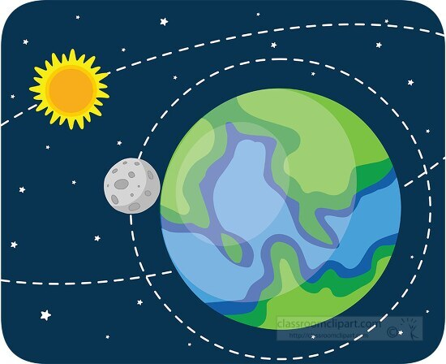
Articulate: Orbit

Slide 12
Articulate: 28 days

Slide 13
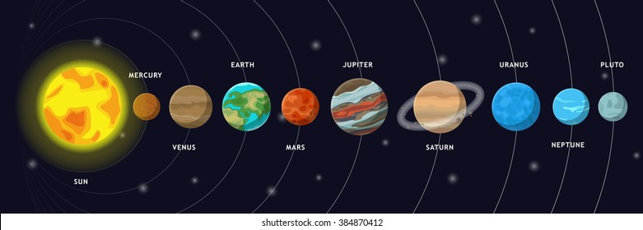
Articulate: My Very Easy Method Just Speeds Up Nothing

Slide 14
Articulate: Gravity

Slide 15
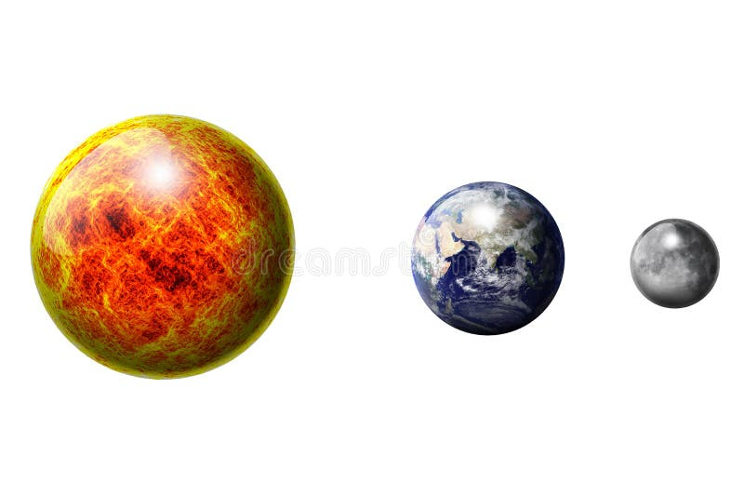
Articulate: Sphere

Slide 16
Articulate: Day time

Slide 17
Articulate: Night time

Slide 18
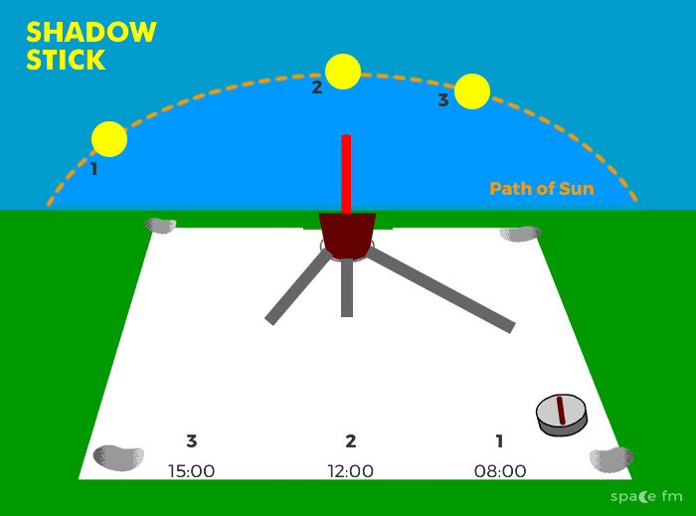
Articulate: Shadow (Hint – It is shortest at lunchtime – when the sun is highest)

Slide 19
Articulate: Axis

Slide 20
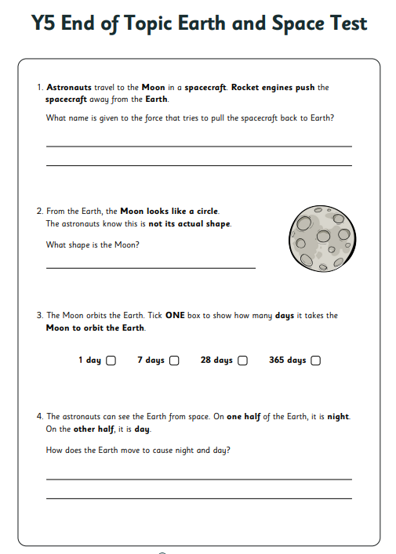
QUIZ TIME! Earth and space

Slide 21
Group Work: 1)Using the heading you have been given, what information do you think the reader needs to know? Record on the A3 paper and be ready to share. Planets and their orbits, day and night, phases of the moon Use your books to help. 2) Identify the most important three facts that you have written.

