Slide 1
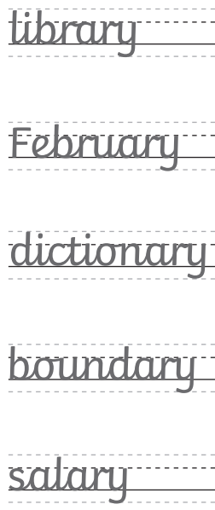
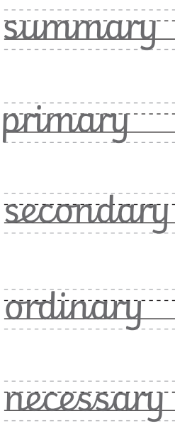
Monday 31st March - Spellings
Copy the spelling words into your challenge books, think carefully about your handwriting.
Ch – put each word into a correctly punctuated sentence.

Slide 2
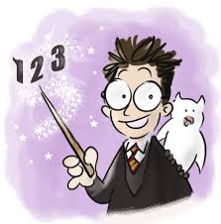
31.03.25 Times tables
Harry Potter Maths!
8 Times Table Song | Skip Counting by 8 Multiplication Song

Slide 3
31.03.25 TBAT: multiply a 2-digit number by a 1-digit number.
3 in 3
Partition 635
3/8 + 2/8 =
What 3D shape am I?
I have 5 faces.
I have 6 vertices.
I have 9 edges.
Challenge
Add together the day in September, December and February.

Slide 4
31.03.25
Daily 10 - Mental Maths Challenge - Topmarks

Slide 5
31.03.25
TBAT: multiply a 2-digit number by a 1-digt number.
Talk partners​
How would you solve the following questions?​
​
​
33 x 4 = 65 x 3 =

Slide 6
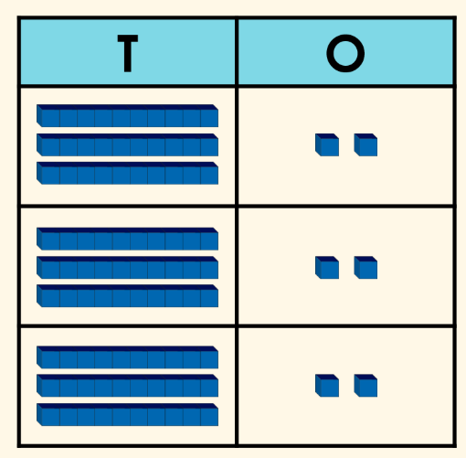
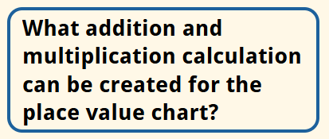
31.03.25
TBAT: multiply a 2-digit number by a 1-digt number.
Like addition, when we multiply a number by another number the answer will always get bigger!
32 + 32 + 32 =
32 x 3 =

Slide 7
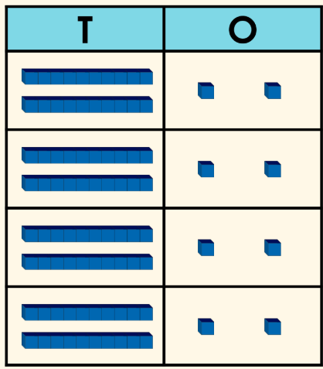
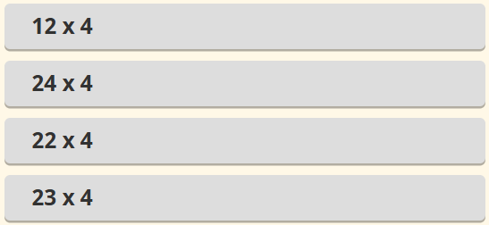
31.03.25
TBAT: multiply a 2-digit number by a 1-digt number.
What calculation does this representation show?

Slide 8
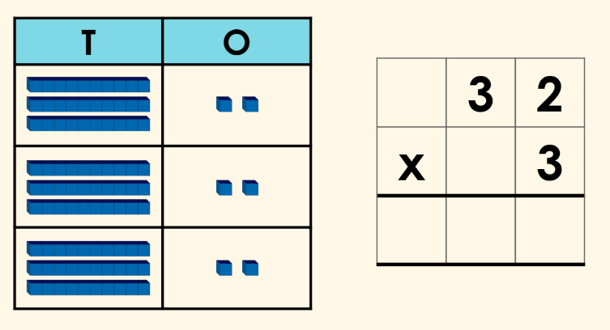
31.03.25
TBAT: multiply a 2-digit number by a 1-digt number.
We can also work out the total of this calculation using column multiplication.
Using the column method, we start by multiplying the column on the right which is the ones.
3 x 2 = 6 3 x 30 = 90 6 + 90 = 96

Slide 9
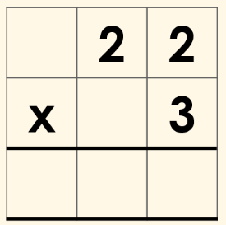
31.03.25
TBAT: multiply a 2-digit number by a 1-digt number.
Whiteboard work
3
3

Slide 10
31.03.25
TBAT: multiply a 2-digit number by a 1-digt number.
Blue Green
3
3
2
2
2

Slide 11
31.03.25
TBAT: multiply a 2-digit number by a 1-digt number.
Independent – set your calculations out with the column method.
43 x 2 =
33 x 3 =
22 x 3 =
41 x 2 =
31 x 2 =
RP
Easter eggs are sold in packs of 3. How many eggs would there be in 32 packs?

Slide 12
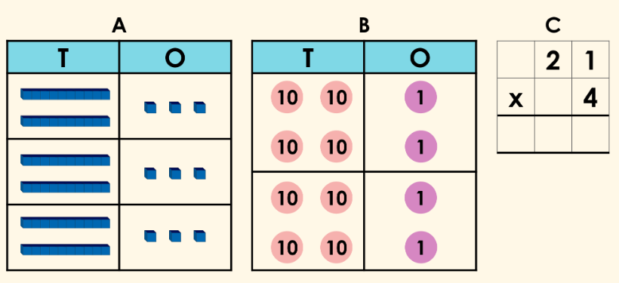
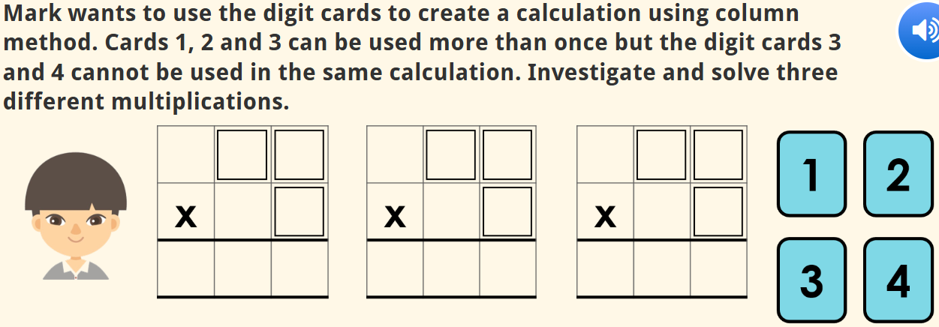
31.03.25 TBAT:
Mastery
Challenge
Greater depth
Identify the odd one out.

Slide 13
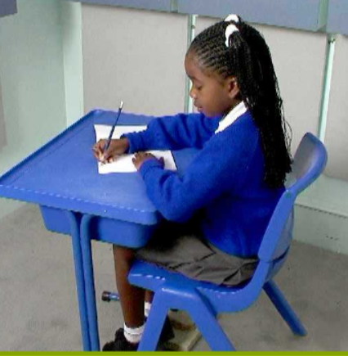
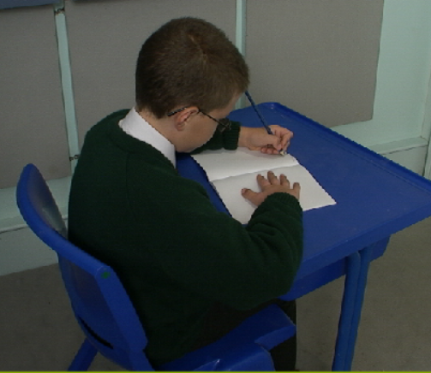
Monday 31st March 2025
Handwriting
Warm up – fine warm up – interlinking fingers
Posture – are you sitting reading to write?
Right-handed posture
Left-handed posture

Slide 14
Monday 31st March 2025
Handwriting - Unit 2
Practice joins:
Unit 2– First – relative size and consistency, ly, less, ful
Then - practice writing the words – airless,fearless,beautiful

Slide 15
Monday 31st March TBAT: retrieve information from a text. On a sunny Saturday, Emily visited the zoo with her family. They saw lions, tigers and giraffes. After that, they had lunch at the zoo's café. Emily's favourite animal was the playful monkeys swinging from tree to tree. 3 in 3 1. What did Emily do on Saturday? 2. Who did Emily visit the zoo with? 3. Name one animal they saw at the zoo. Where did they eat lunch? What was Emily's favourite animal at the zoo?

Slide 16
Monday 31st March TBAT: retrieve information from a text. What are the features used in a recount? Is this non-fiction or fiction writing? What does that mean?

Slide 17
Monday 31st March TBAT: retrieve information from a text. We are going to look at a recount in our reading lesson today to help us!

Slide 18
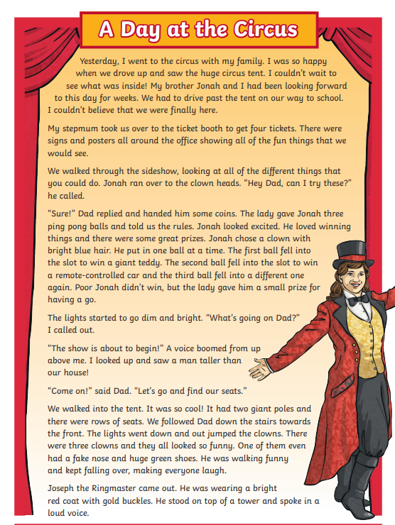
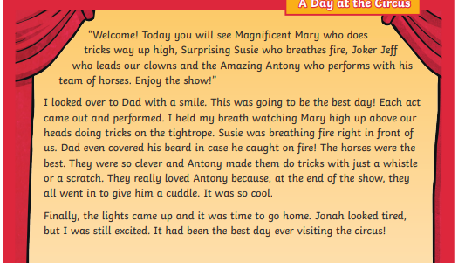
Monday 31st March TBAT: retrieve information from a text.

Slide 19
Monday 31st March TBAT: retrieve information from a text. Multiple choice questions How did they get to the circus? Walk Cycle Drive What did the lady give Jonah? Ping Pong Balls Juggle Sticks Some good for lunch How did the clowns come out? Walk Bounce Jump

Slide 20
Monday 31st March TBAT: retrieve information from a text. Independent questions 1. When did the author go to the circus? 2. Who went to the circus with the author? 3. How did they know the circus was in town? 4. How many tickets did they buy for the circus? 5. How did they know the show was about to begin? CH What did it look like in the circus tent?

Slide 21
Monday 31st March 2025 Q – What is it like to live in Rome?
Blue - Which physical features are found in Italy?
mountains rivers lakes volcanoes
Green - Which volcano is found on mainland Italy?
Etna Vesuvius
Challenge - Which islands are also part of Italy? (Choose two.)
Ireland Sardinia Cyprus Sicily

Slide 22
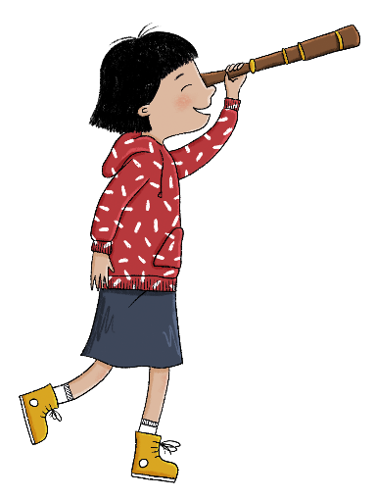
In this lesson, we will contrast the city of Rome and its landmarks to landmarks in your own locality.
Lesson 6: Lesson statement
Copyright © ArkCurriculum+ 2022

Slide 23
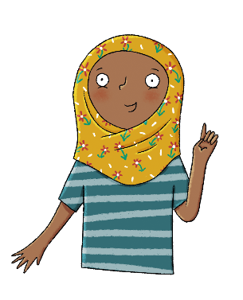
What is it like to live in Rome?
Key knowledge
Rome is the capital city of Italy.
The city was founded over 2000 years ago.
Rome has a Mediterranean climate.
The Vatican City is inside Rome.
There are many interesting landmarks in Rome, including the Colosseum and St Peter’s Square.
Key vocabulary
climate
founded
Mediterranean
population
Lesson 6: Key knowledge
Copyright © ArkCurriculum+ 2022
Notes:
Share the specific session knowledge and vocabulary.

Slide 24
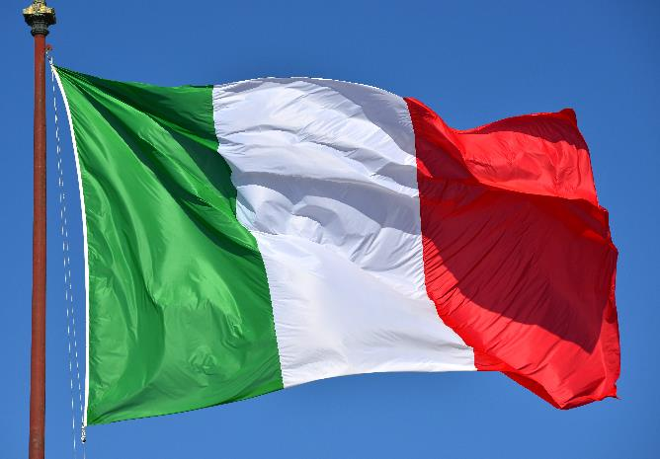
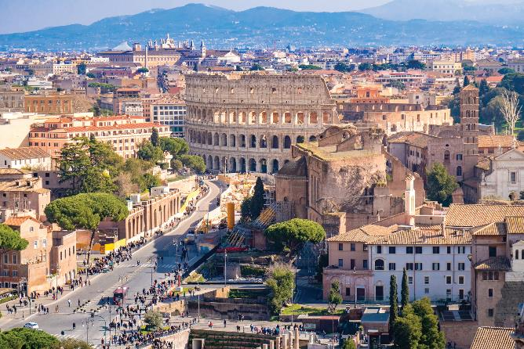
GOOGLE EARTH STUDIO - FLYING OVER ROME 3D 4K
Where is Rome?
Rome is the capital city of Italy, and it was founded in 753 BC during the ancient Roman Empire. It was built on the Tiber River in the centre west of Italy and is close to the sea. The population of Rome is 2.8 million.
Rome has a Mediterranean climate—hot, dry summers and mild, humid winters. Sometimes, temperatures can reach 40°C in July and August!
Lesson 6: Read
Copyright © ArkCurriculum+ 2022
Notes:
Read ‘Where is Rome?’. Pupils should already know that Rome is the capital city of Italy. Take some time to compare the different images of the city and discuss what it might be like to live in Rome.

Slide 25
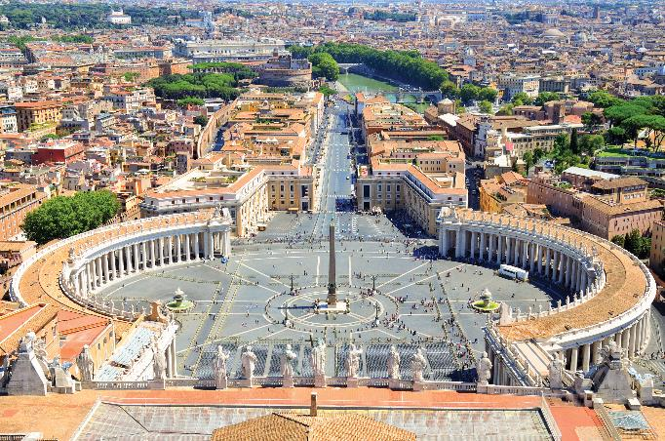
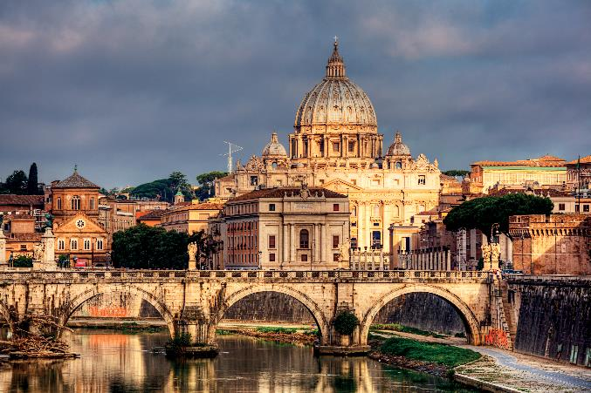
Where is Rome?
Inside Rome is the Vatican City, which is the home of the Pope and the centre of the Roman Catholic Church.
It became an independent country in 1929 and is the only example across the whole world of a country inside a city. Vatican City has a population of 825.
Lesson 6: Read
Copyright © ArkCurriculum+ 2022

Slide 26
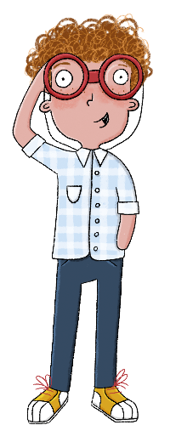
Answer these questions about Rome in your book.
Which country is Rome in?
Rome is in...
Which country is inside Rome?
The country inside Rome is ...
Lesson 6: Retrieve
Copyright © ArkCurriculum+ 2022

Slide 27
Stick the photos in your book then answer these questions about Rome.
Lesson 6: Retrieve
Look at the photos of Rome.
Do you think Rome is new or old? Why?
Answer under your picture.
Write three landmarks that you can see in the photos of Rome.
I can see...
Copyright © ArkCurriculum+ 2022

Slide 28
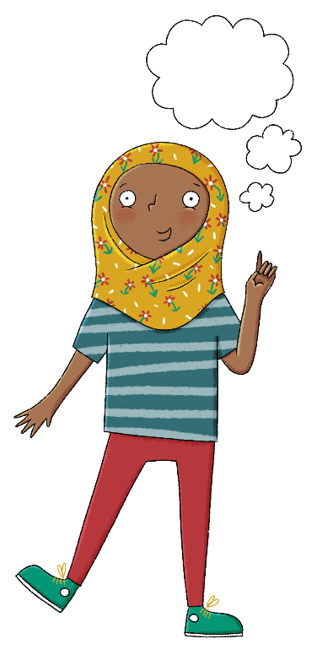
Would you prefer to live in Rome or where you live now? Explain why.
Lesson 6: Write
Copyright © ArkCurriculum+ 2022
Notes:
Pupils respond to the question: ‘Would you prefer to live in Rome or where you live now?’ Pupils should explain their thoughts. As with other lessons in this unit, pupils could engage with a wider class discussion or debate prior to completing this written task.

Slide 29
Exit question
What is it like to live in Rome?
List three points to summarise what you have learned.
Lesson 6: Learning review
Can you tell your partner an answer to the lesson question?
Copyright © ArkCurriculum+ 2022
Notes:
Talk partners tell each other an answer to the lesson question, and write three key points to summarise what they have learnt. Add further review questions if you wish to. Pupils might write an independent response into their knowledge record.

Slide 30
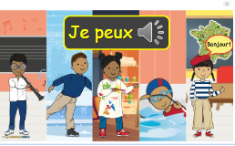
Lundi 31 Mars
TBAT: consolidate language covered in unit.
Home (languageangels.com)
Unit – I am able to
Lesson 6

Slide 31
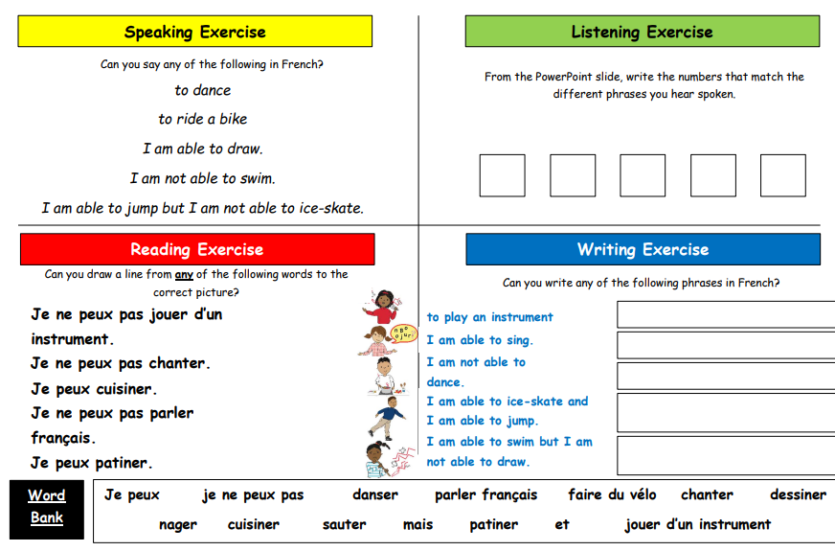
Home (languageangels.com)
Lundi 31 Mars
TBAT: consolidate language covered in unit

