Slide 1
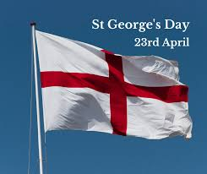
Wednesday 23rd April 2025 Morning challenge
St George's Day
St George’s Day is celebrated on April 23rd every year. It is a special day in England. St George is known as the patron saint of England. A patron saint is someone chosen to protect and guide a place or group of people.
A long time ago, people told stories about St George. One of the most famous stories is about him fighting a dragon. In the story, the dragon was scaring people in a village. St George was very brave and fought the dragon to save the village. Even though it is just a legend, many people remember him for his bravery and kindness.
On St George’s Day, some people wear a red rose or fly the flag of England, which has a red cross on a white background. Some towns and schools also have parades, plays, or special events to remember St George.
When is St George's Day celebrated?
What did St George do in the famous story?
What do some people do to celebrate St George’s Day?
What do people remember St. George for? (apart from killing the dragon)

Slide 2
Wednesday 23rd April 2025 Word work

Slide 3
Wednesday 23rd April 2025 Word work

Slide 4
Wednesday 23rd April 2025 Word work
Every fronted adverbial word, phrase or clause needs to be followed by a comma to separate it from the main clause of the sentence.
Where should the comma go in this fronted adverbial sentence?
Write the word that comes before the comma on your whiteboard.
Slowly and carefully they released the juvenile badger back into the wild.

Slide 5
Wednesday 23rd April 2025 Word work
Where should the comma go in this fronted adverbial sentence?
Write the word that comes before the comma on your whiteboard.
On Tuesday Class 12 are visiting The Imperial War Museum.

Slide 6
Wednesday 23rd April 2025 Word work
Where should the comma go in this fronted adverbial sentence?
Write the word that comes before the comma on your whiteboard.
Without a doubt Billy was going to finish the race in first place.

Slide 7
Wednesday 23rd April 2025 Word work
Where should the comma go in this fronted adverbial sentence?
Write the word that comes before the comma on your whiteboard.
Out in the field the horse and her new foal galloped.

Slide 8
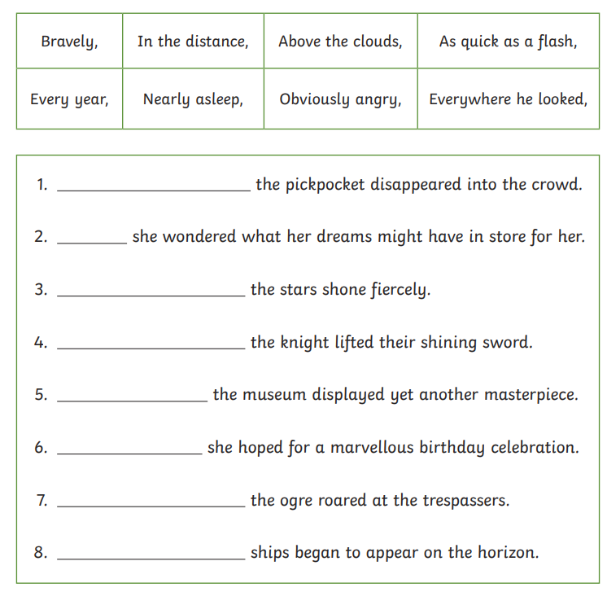
Wednesday 23rd April 2025 Word work
Can you complete each sentence with the fronted adverbial that best fits it?
Don’t forget the comma!

Slide 9
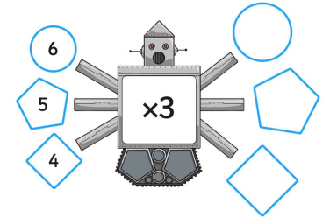
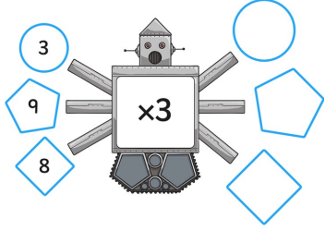
23.04.25 Times tables
3 Times Table Song (Green Green Grass by George Ezra)
Harry Potter maths
Around the world
Dice
Hit the button
Counting stick

Slide 10
23.04.25
TBAT: add and subtract mentally
3 in 3
4/10 + 3/10 =
What is half of 68?
Kangaroos have 2 legs and zebras have 4 legs. A zookeeper counts 22 legs altogether. How many kangaroos and zebras could there be?

Slide 11
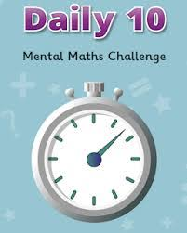
23.04.25
Daily 10 - Mental Maths Challenge - Topmarks
3x, 4x and 8x

Slide 12
23.04.25
TBAT: add and subtract mentally
How would you work out these questions mentally?
7 + 6 =
9 + 5 =
16 – 7 =
14 – 6 =

Slide 13
23.04.25
TBAT: add and subtract mentally
What is the correct answer to each question?

Slide 14
23.04.25
TBAT: add and subtract mentally
On whiteboards
Work out the following questions.
477 + 8 =
396 + 7 =
512 – 5 =
684 – 6 =

Slide 15
23.04.25
TBAT: add and subtract mentally
Sam has 348 beads, he gets given 9 more blue ones from his friend Ben. How many beads does he have now?
Laura has 472 stickers, she gives 7 of the animal ones to Lucy. How many does she have left?
True or false
276 + 9 > 284 - 7

Slide 16
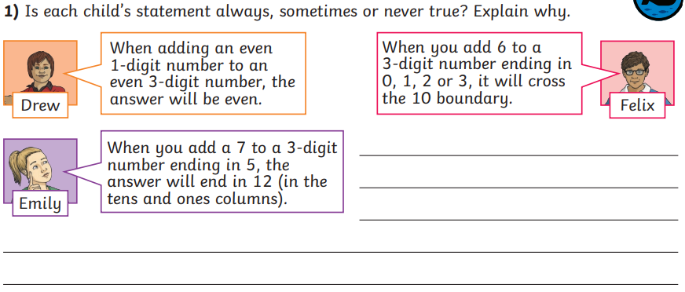
23.04.25
TBAT: add and subtract mentally
Independent
326 + 5 =
479 + 6 =
503 + 9 =
423 – 8 =
575 – 7 =
891 – 9 =
RP – Mrs Porter has 344 pencils in a box, she removes the 8 pencils that are broken. How many are left?
Challenge

Slide 17
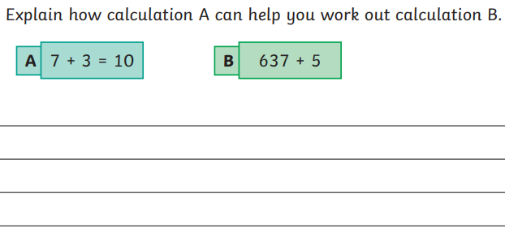
23.04.25
TBAT: add and subtract mentally
Mastery
Mastery with GD

Slide 18
Wednesday 23rd April 2025 Spellings TBAT: use the suffix –ation.
What is a suffix?​ ​ What do you notice about
the following ​words?​
What is the root word in each
of these words? ​ information​ adoration​ sensation​ preparation​ admiration
Write your spelling words, using joined writing, in your literacy books.
Challenge
Write each of the words in a full sentence.

Slide 19
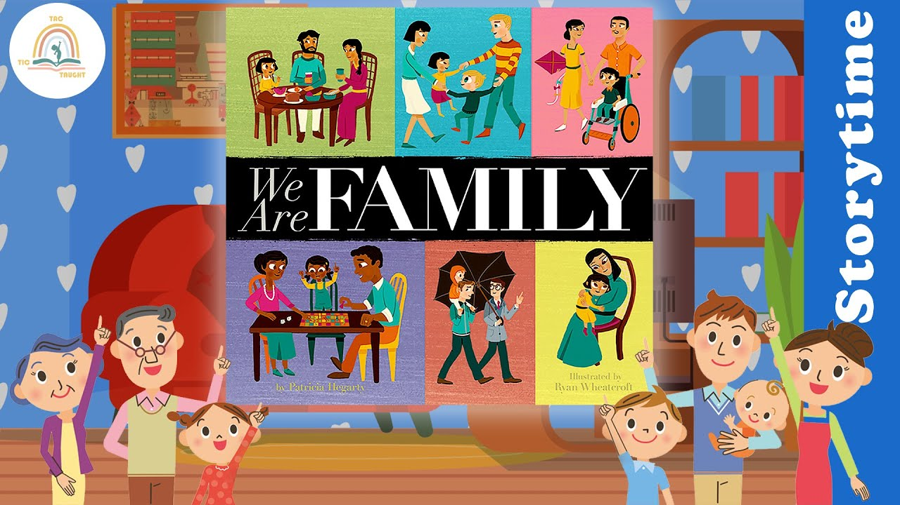
Wednesday 23rd April 2025 TBAT: write sentences including a conjunction.
Talk partners
What does the word family mean to you?
Are all families the same?
Who is part of your family?
WE ARE FAMILY | Patricia Hegarty | Read aloud 💜 #storyoftheweek

Slide 20
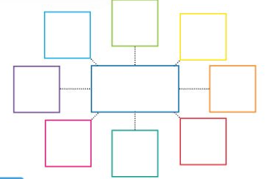
Wednesday 23rd April 2025 TBAT: write sentences including a conjunction.
Create a mind map about your family.
What words and phrases would you use to describe them?
Loving
annoying
loud
My Family
funny
Long
walks
Play
games
Teacher model

Slide 21
Wednesday 23rd April 2025 TBAT: write sentences including a conjunction.
Take a word or phrase from your mind map and write it in a full sentence, including a conjunction.
For example, loving.
My mum is loving as she always kisses me goodbye before school.
Our family is loving because we care for each other.

Slide 22
Wednesday 23rd April 2025 Q - Who is Allah and what is the Qur’an?
This half-term in RE we are going to learn about Muslim beliefs in Allah, from Islamic (Muslim) art.
This is the name of Allah in Arabic.
You will see this a lot in mosques.
Writing in this beautiful way is called calligraphy.
Have a go at copying the Arabic word for Allah in your book.

Slide 23
Wednesday 23rd April 2025 Q - Who is Allah and what is the Qur’an?
Who is Allah?
Allah is the name that Muslims give to God. They believe there is only one God and that Allah is all-powerful.
Allah ….
has always existed.
knows everything that can be known.
can do anything.
has no shape or form
Talk partners
Why might it be difficult to draw a picture of Allah?

Slide 24
Wednesday 23rd April 2025 Q - Who is Allah and what is the Qur’an?
We are going to look at some different Qur’ans.
What adjectives would you use to describe them?

Slide 25
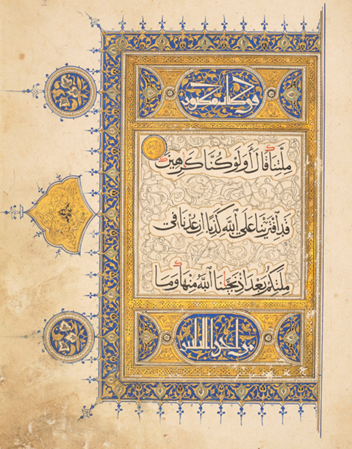
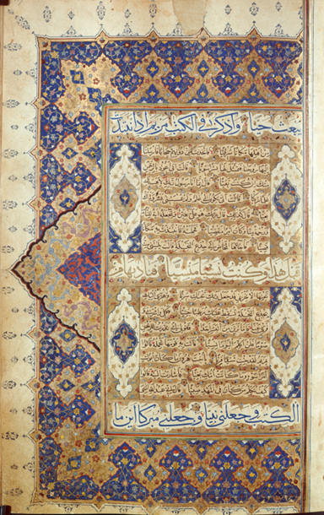
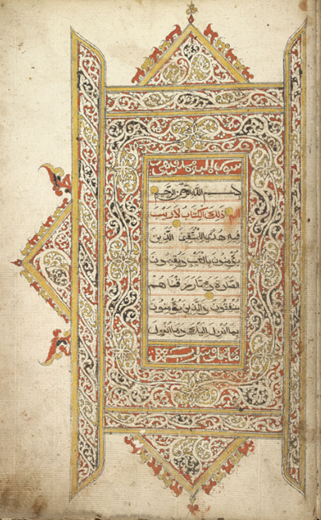
Why might a Muslim want to make their Qur’an look as beautiful as possible?

Slide 26
Wednesday 23rd April 2025 Q - Who is Allah and what is the Qur’an?
In your book, write down three reasons why an important Muslim might want a beautifully decorated Qur’an.

Slide 27
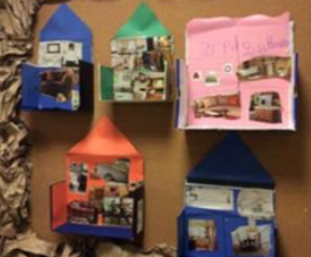
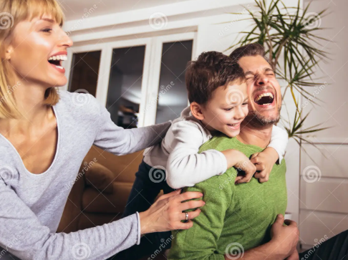
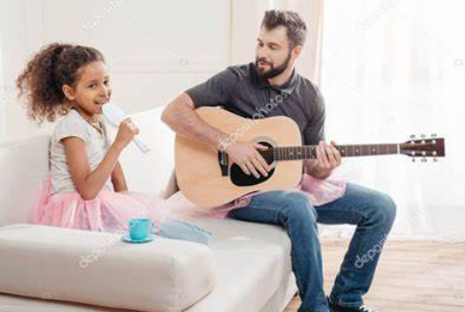
Wednesday 23rd April
TBAT: design a house
Make a Cereal Box Dolls House
My home is full of:
(Think what is your home full of and what would that look like – good and bad!!)
Example -
Laughter
Singing

