Slide 1
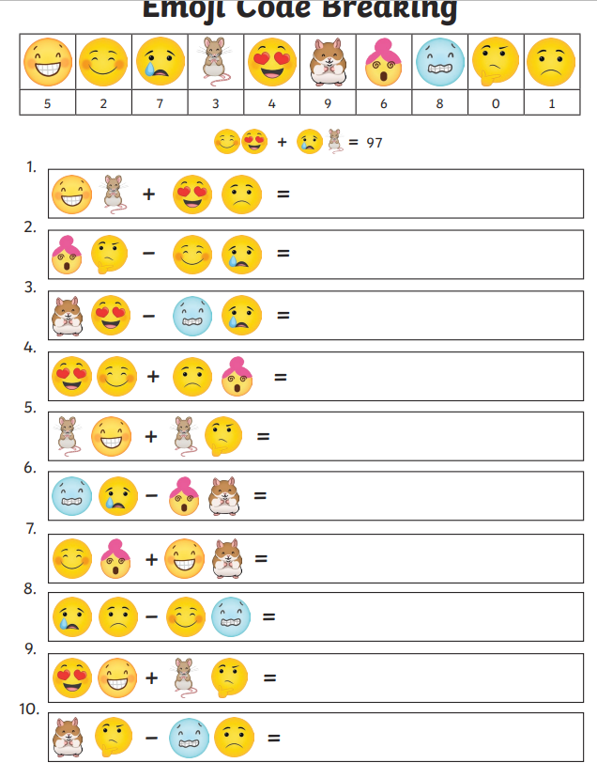
Thursday 3rd April 2025
Morning challenge
Assembly – 9.00 am

Slide 2
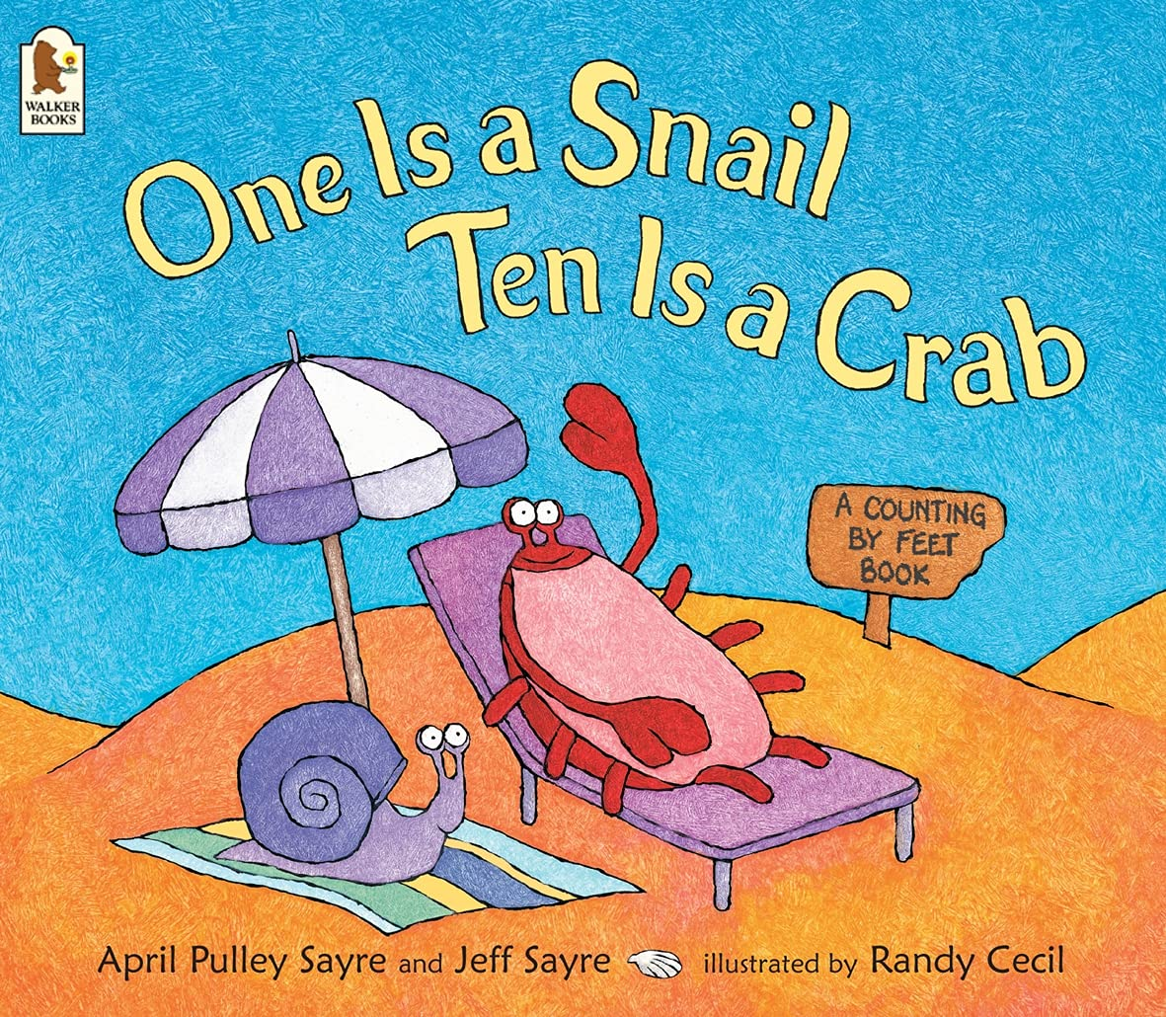
03.04.25 TBAT: use repeated addition and multiplication.
One is A Snail Ten is a Crab by April Pulley Sayre and Jeff Sayre - YouTube
Talk partners
What characters did we meet in the book?
What did we learn about these characters?

Slide 3
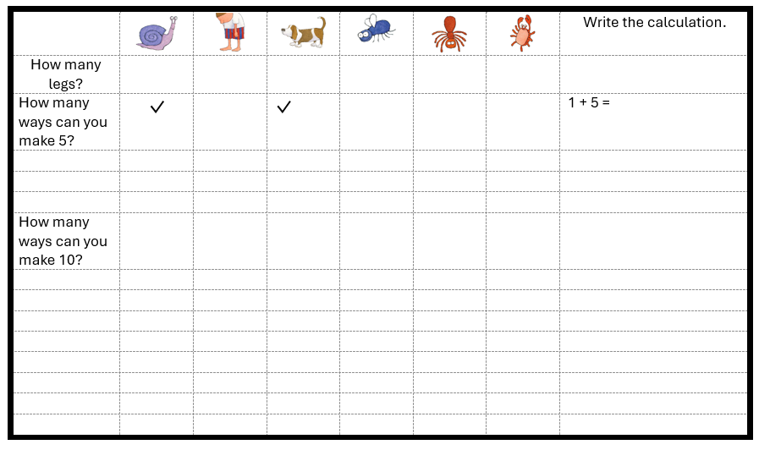
03.04.25 TBAT: use repeated addition and multiplication.
You are going to look at different ways to make 5 and then 10 by using addition.
Tick the boxes of the creatures needed and then show the calculation in the last column.

Slide 4
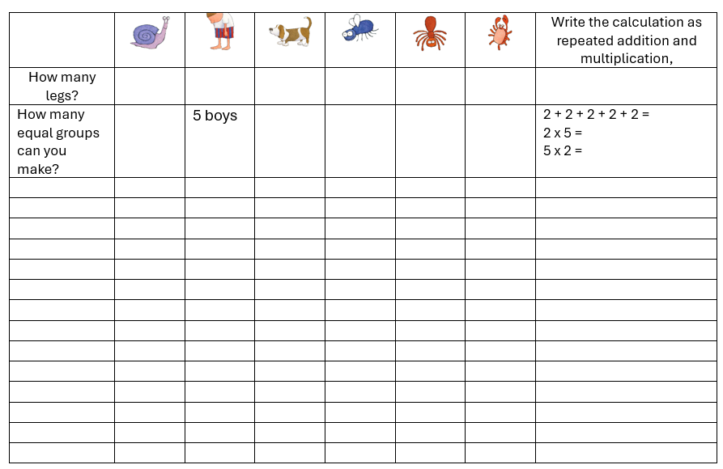
03.04.25 TBAT: use repeated addition and multiplication.
We are now going to explore equal groups, repeated addition and multiplication calculations using the characters from the story.
For example: There are 5 boys with 2 feet.
5 equal groups of 2 make 10.
2 + 2 + 2 + 2 + 2 = 10
2 × 5 = 10
5 × 2 = 10
What other ways can you make equal groups?

Slide 5
03.04.25 TBAT: use repeated addition and multiplication.
Challenge – you can only use each character from the story once!
What is the largest number you can make using only the odd number of feet?
What is the largest number you can make using only the even number of feet?
What is the smallest number you can make using only the odd number of feet?
What is the smallest number you can make using only the even number of feet?
Mastery
A family of 5 are walking their 3 dogs on the beach when they see 4 crabs run past. Each crab is carrying a snail and each snail has a fly on its back.
How many feet are there altogether.
Show your calculation
Greater depth – How many ways can you make 100 feet? Show me!

Slide 6
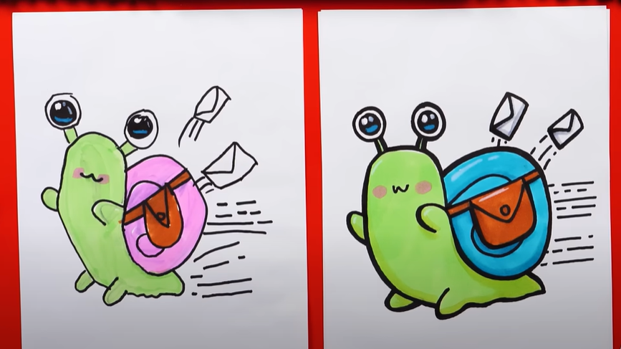
Thursday 3rd April
ART
How To Draw Snail Mail

Slide 7
Thursday 3rd April
Science Assessment

Slide 8
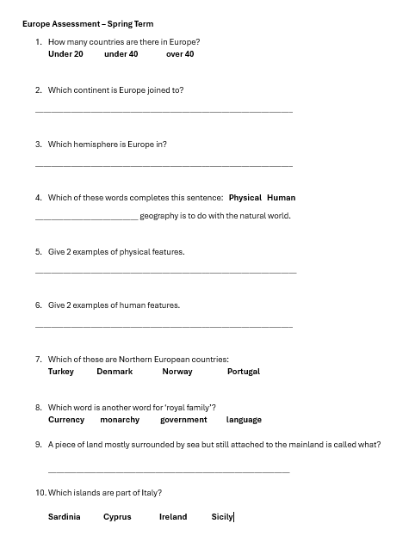
Thursday 3rd April
Geography Assessment

Slide 9
2pm

