Slide 1
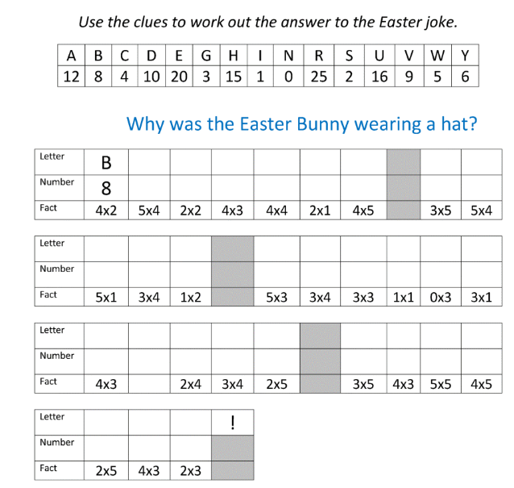
Wednesday 2nd April 2025
Morning challenge

Slide 2
Wednesday 2nd April 2025 Wordwork
Choose a preposition to complete these sentences.
The cat is _____ the mat.
The ball is ____ the fence.
I like to go running _________.

Slide 3
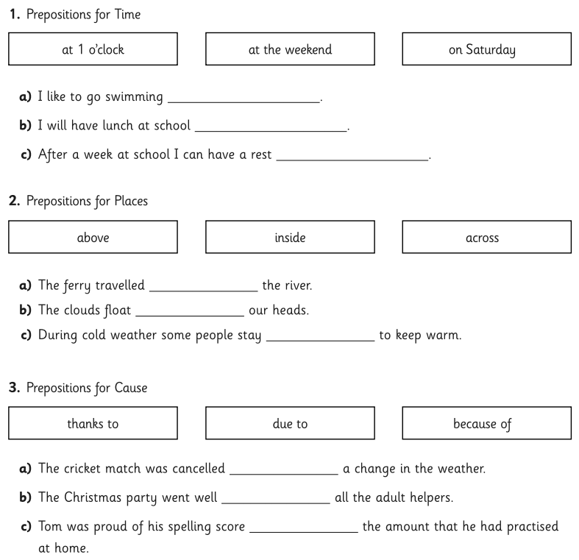
Wednesday 2nd April Wordwork
Ch -
Write your own sentence using the preposition:
at the weekend

Slide 4
02.04.25
Times table practice
Times table Bingo!
8 | 24 | 56
40 | 32 | 88
8 Times Table Song | Skip Counting by 8 Multiplication Song
Split your whiteboard into 6 sections.
In each section, write an answer from the 8-x table (up to 12 x 8)
I will call out a 4-x table calculation. If you have the answer on your board, cross it off.
For example, " 5 x 8" is 40 – so I would cross it off my board.

Slide 5
02.04.25
TBAT: multiply a 3-digit number by a 1-digit number
3 in 3
45 x 8 =
2. Double 352 =
3. 7/6 - 3/6 =
Challenge
I buy 2 bracelets that cost £1.25 each. I pay with a £20 note. How much change will I receive?

Slide 6
02.04.25
Daily 10 - Mental Maths Challenge - Topmarks

Slide 7
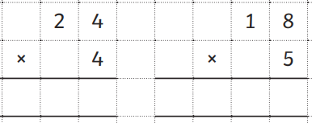
02.04.25
TBAT: multiply a 3-digit number by a 1-digit number
Whiteboard recap

Slide 8
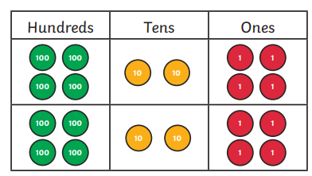
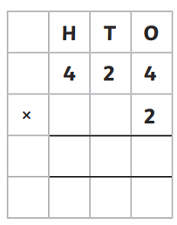
02.04.25
TBAT: multiply a 3-digit number by a 1-digit number
Complete the calculation shown on the place value chart.

Slide 9
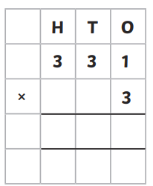
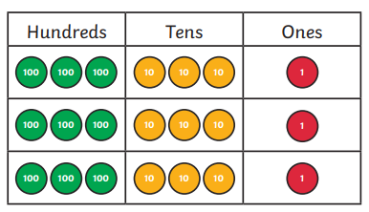
02.04.25
TBAT: multiply a 3-digit number by a 1-digit number
Complete the calculation shown on the place value chart.

Slide 10
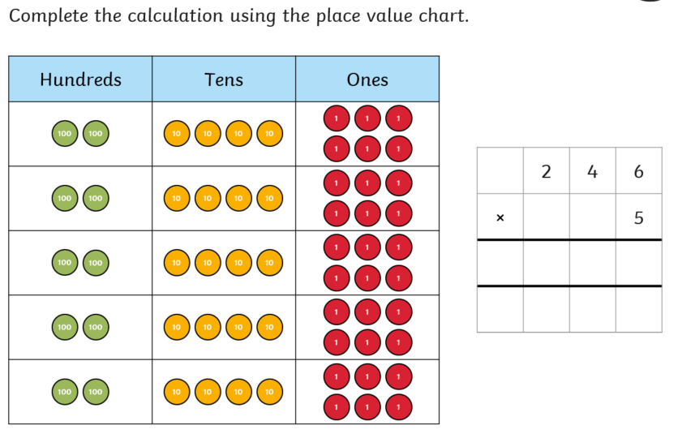
02.04.25
TBAT: multiply a 3-digit number by a 1-digit number
We will now look at multiplying a 3-digits number by 1-digit numbers. The same rules apply as before.

Slide 11
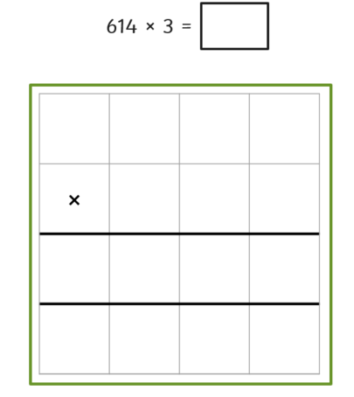
02.04.25
TBAT: multiply a 3-digit number by a 1-digit number
328 x 3 =
Class whiteboard work

Slide 12
02.04.25
TBAT: multiply a 3-digit number by a 1-digit number
229 x 4 =
Independent whiteboard work

Slide 13
02.04.25
TBAT: multiply a 3-digit number by a 1-digit number
Blue Green
2
4
4
2
3
4
3
4

Slide 14
02.04.25
TBAT: multiply a 3-digit number by a 1-digit number
Independent
247 x 3 =
229 x 4 =
346 x 3 =
429 x 2 =
RP
There are 4 shows on at the theatre, each sitting 345 people. How many tickets have they sold?

Slide 15
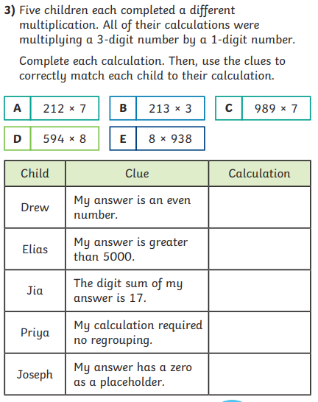
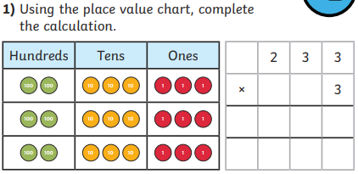
02.04.25
TBAT: multiply a 3-digit number by a 1-digit number
Challenge Mastery Greater depth

Slide 16
Wednesday 2nd April Spelling
Spelling thief
The spelling thief has taken some of the letters from our spelling words! Can you work out which letters are missing?
Write the correct spelling in your book.
libr_ry
bo_nda_y
p_imar_
_rdin_ _y
_ebr_a_y

Slide 17
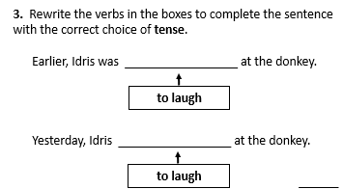
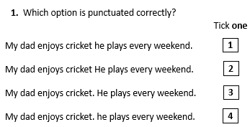
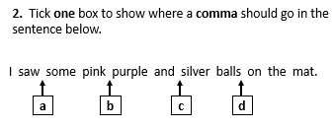
Wednesday 2nd April
TBAT: write a recount.
3 in 3
Rewrite the answer to question one using a conjunction to join the two sentences together.

Slide 18
Wednesday 2nd April
TBAT: write a recount.
List the features that are needed in a recount.
Give an example of when we may write a recount. Why? Which scientific words may we use in our recount?

Slide 19
Wednesday 2nd April
TBAT: write a recount. Partner talk: Look at your plan from yesterday. Start thinking about how you are going to spilt your writing into paragraphs.

Slide 20
Wednesday 2nd April
TBAT: write a recount. We are going to write in chronological order.
Which sequential words could we use?

Slide 21
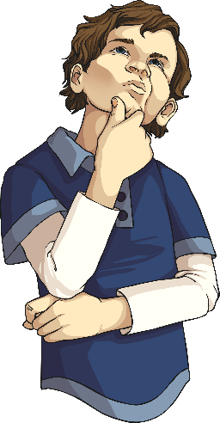
Sequential Words
Here are a few examples:
Finally
Later
Meanwhile
Next
Firstly
Then
Eventually
What others can you think of?

Slide 22
Main body
Write in chronological order.
Use sequential words.
Write in paragraphs.
Use detailed and technical vocabulary.
Write about what happened during the activity.

Slide 23
Wednesday 2nd April
TBAT: write a recount. We are going to start to write our recount. Let's think about our steps to success:
We need paragraphs that include all of our writing tools to impress.
Can you think of the order you are going to write your paragraphs in?

Slide 24
Wednesday 2nd April
TBAT: Write the beginning to my recount
Example
I was able to complete the __________ investigation in which we were trying to discover ________________ . This investigation we predicted that _________________ . In this recount you will learn about how we carried out the investigation and the results that we found.

Slide 25
W.A.G.O.L.L
Our Science Experiment
Last week, our class completed a science experiment to test which materials and objects were magnetic. Some of the objects that we tested were split pins, a sharpener, pom poms, a rubber and pipe cleaner. I was feeling ecstatic that we were able to complete an experiment!
Firstly, we were put into groups of five. We gathered our equipment that was needed for the experiment. As a group, we discussed who would complete each part of the experiment. Then, I got to test the pom pom with a magnet. We were disappointed to see that it was not magnetic. _________ tested the split pin and we were thrilled to see that it was attracted to the magnet!
Finally, we discussed our results to see which materials each of the objects were made from.
Include adverbials of manner in your writing.

Slide 26
Wednesday 2nd April 2025 Q - What is baptism and why does it happen in a stadium?
Blue /Green
Discuss what you can remember about how paintings in the National gallery can tell us about Christianity.
Green partner first, then blue partner – 1 minute.
Vocabulary to use:
Gold, halo, blue paint, angels, ivory.

Slide 27
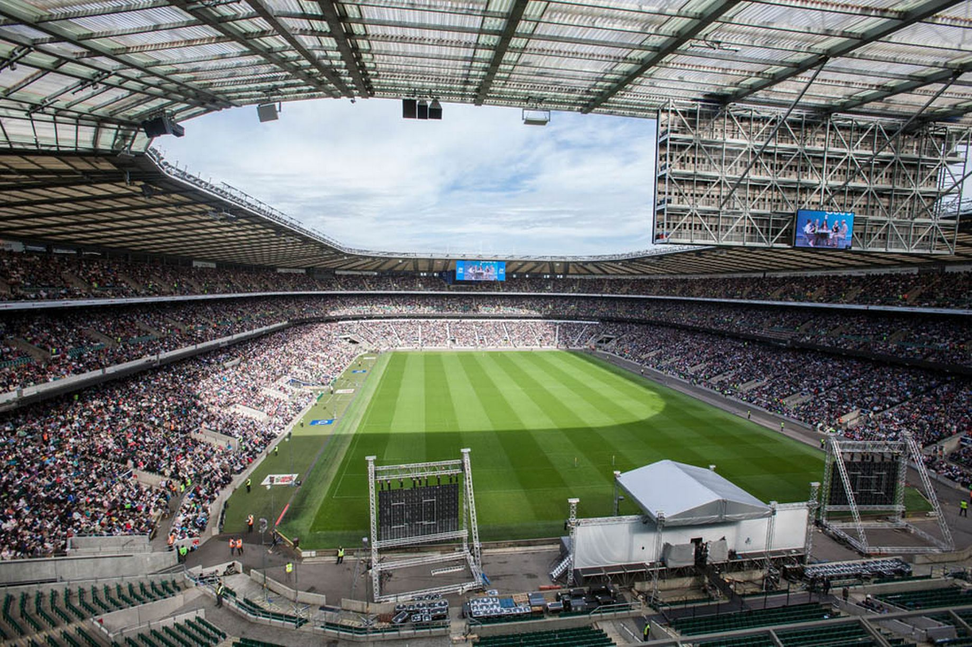
What do you think is about to happen in this stadium?
It’s actually a mass baptism at Twickenham Stadium in South West London

Slide 28
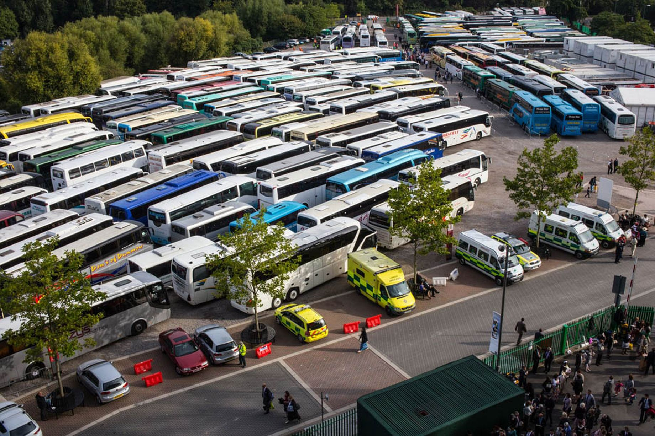
People come from all over the UK to take part in this Christian service.

Slide 29
Baptism is when someone is blessed with holy water.
It welcomes them into the Christian church.
When someone converts to Christianity they will be baptised as an adult.

Slide 30
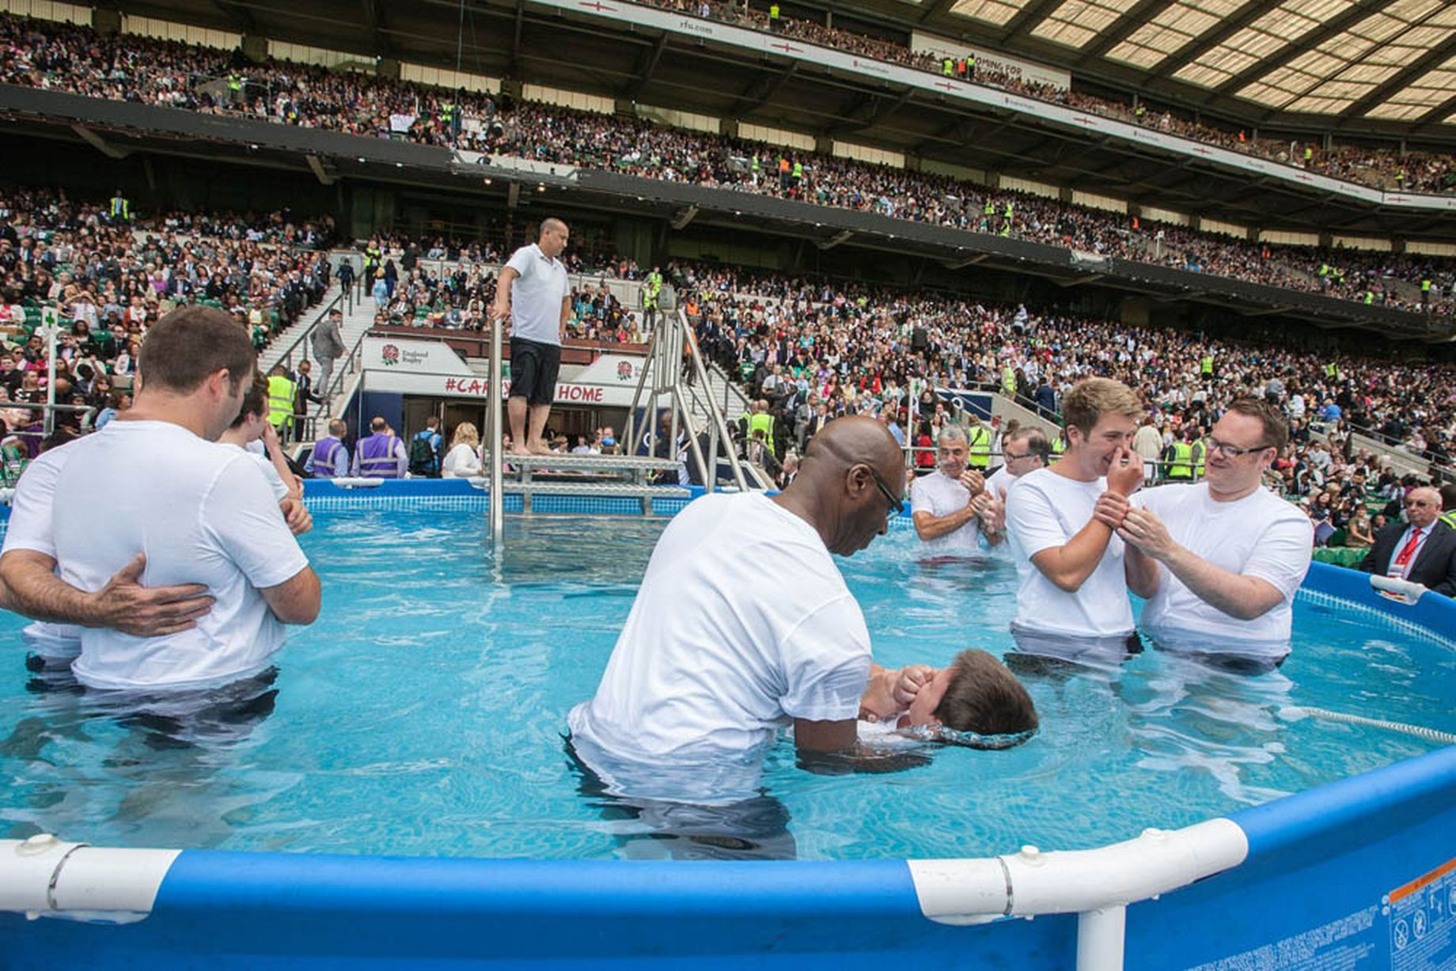
The idea here is for as many people as possible to be present to witness you being baptised.
Why might it be good or not good to be baptised in such a way?

Slide 31
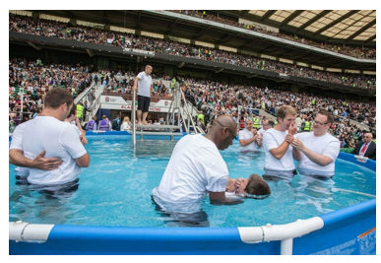
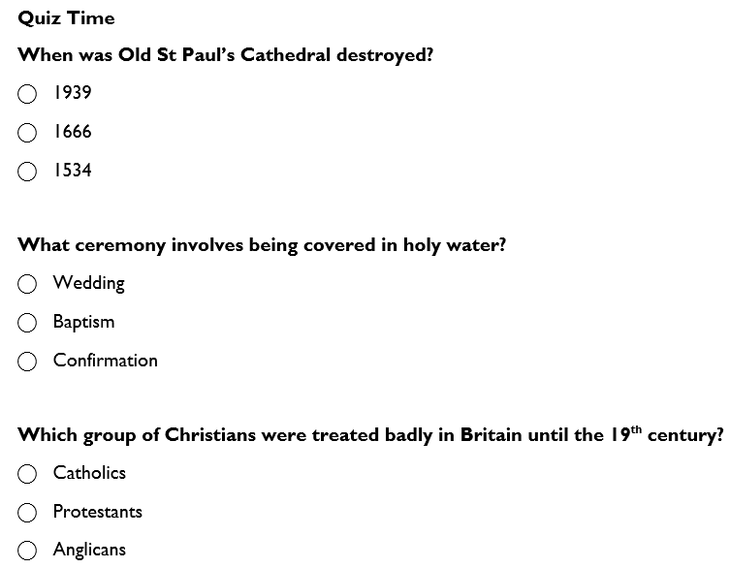
Stick this picture in your book.
Write an explanation of why might it be good or not good to be baptised in such a way?

Slide 32
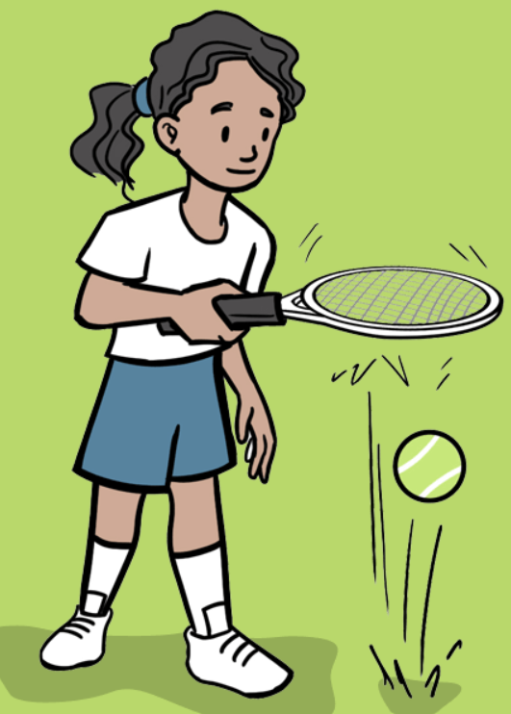
Wednesday 2nd April
PE – tennis
TBAT: involve all team members to work towards a shared goal.
This half term in P.E will be tennis and OAA (outdoor adventurous activities)
- Changing for PE - Rules and expectations moving to PE - Move to the downstairs hall or outside
Get Set 4 PE - Lesson Plan -3 for Year 3 OAA

Slide 33
Wednesday 2nd April 2025
Science

Slide 34
Wednesday 2nd April 2025​
Q – Are all magnets the same strength?
3 in 3
Magnetic materials are special because they can be attracted to magnets. Some metals, like iron, nickel, and cobalt, are magnetic. This means if you hold a magnet near them, they will stick to it!
Not all metals are magnetic. For example, gold and silver do not stick to magnets. Many things around us are made from magnetic materials, like fridge doors, paper clips, and some tools.
Questions:
Name two metals that are magnetic.
What happens when you bring a magnet near a paper clip?
Is gold a magnetic material? Why or why not?

