Slide 1
Tuesday 1st April 2025
Morning challenge
April Fool's Day
How many words can you make using these letter? You can only use each of the letters once!

Slide 2
Tuesday 1st April 2025
Word work
**Whiteboards**

Slide 3
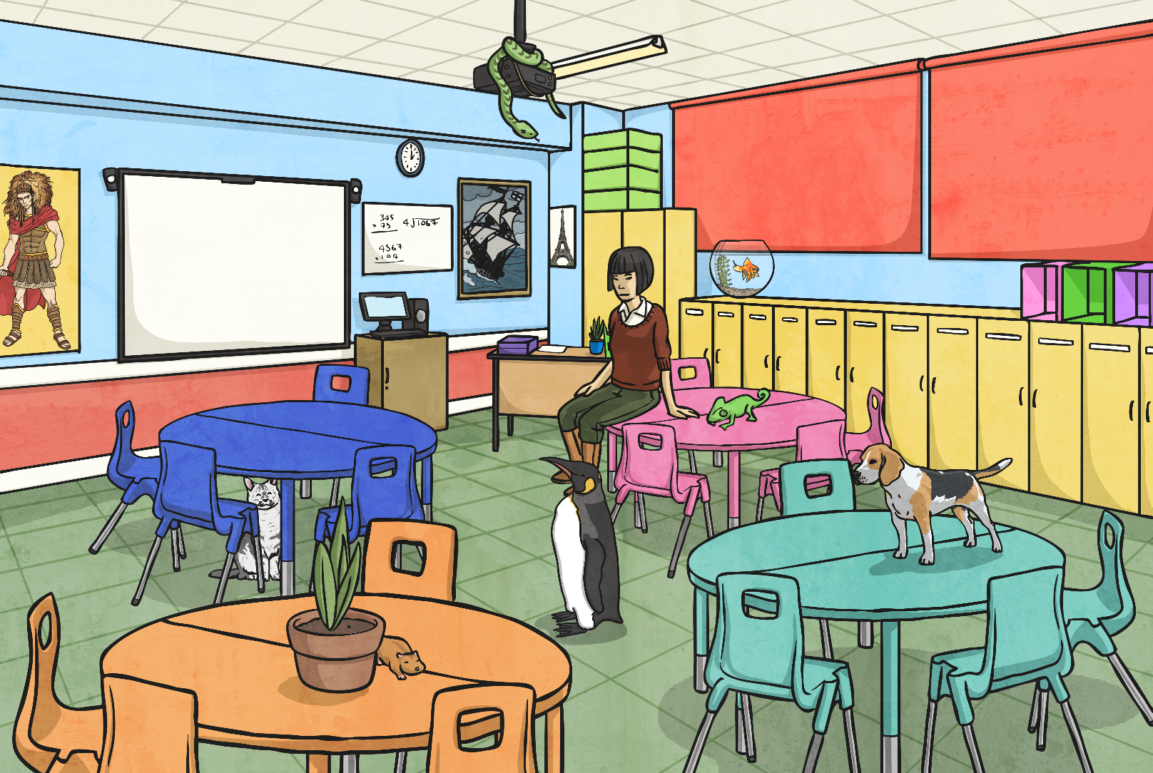
The Pets Have Escaped!
The pets have escaped from the local pet shop! Look at the following
picture and describe where each of the animals are hiding.

Slide 4
The Pets Have Escaped!
Share your animal sentences with the rest of the class.
You have been using prepositions to describe where the animals are.
Prepositions are words / phrases used to describe a place, time or cause.
With your talk partner, repeat the activity you have just done using some of the following place prepositions.

Slide 5
The Pets Have Escaped!
Repeat the activity you have just done using some of the
following place prepositions.
beside
beneath
under
in
on
through
behind

Slide 6
The Pets Have Escaped!
Prepositions are words / phrases used to describe a place, time or cause.
The dog is on the table.
The iguana is next to the teacher.
These prepositions tell us about the place of the animals.

Slide 7
The Pets Have Escaped!
Prepositions can also tell us about time.
At 6 o’clock the dog was on the floor.
During the lesson, the cat was under the table.
Other prepositions tell us about how something is caused by something else.
Due to the barking, she put her hands over her ears.

Slide 8
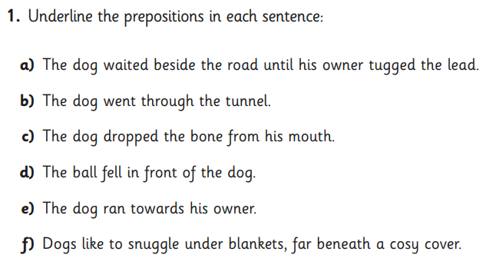
Tuesday 1st April 2025
Word work

Slide 9
01.04.25
Times tables
8 Times Table Song | Skip Counting by 8 Multiplication Song - YouTube

Slide 10
01.04.25
TBAT: multiply a 2-digit by a 1-digit number.
3 in 3
5/7 + 1/7 =
56 divided by 8 =
864 – 387 =
Challenge
Complete the missing numbers.
600, ____, ____, 450, 400, ____

Slide 11
01.04.25
Daily 10 - Mental Maths Challenge - Topmarks

Slide 12
01.04.25
TBAT: multiply a 2-digit by a 1-digit number.
Recap – work out this calculation using the column method we learned yesterday.
Talk partners
What do you remember about column multiplication?
23 x 3 =

Slide 13
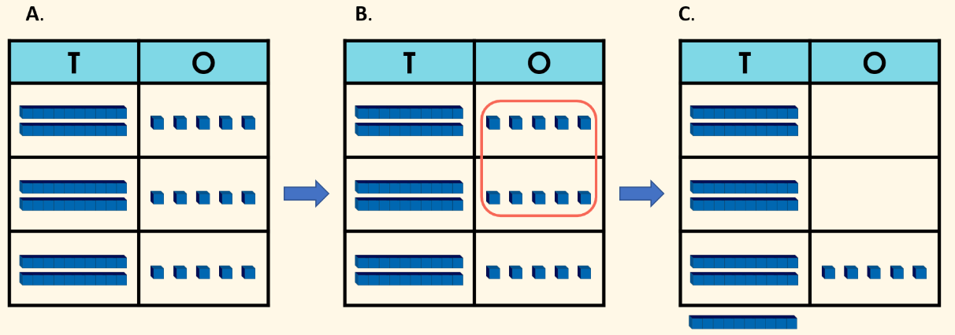
01.04.25
TBAT: multiply a 2-digit by a 1-digit number.
Here are representations to help us work out the answer to 25 x 3.

Slide 14
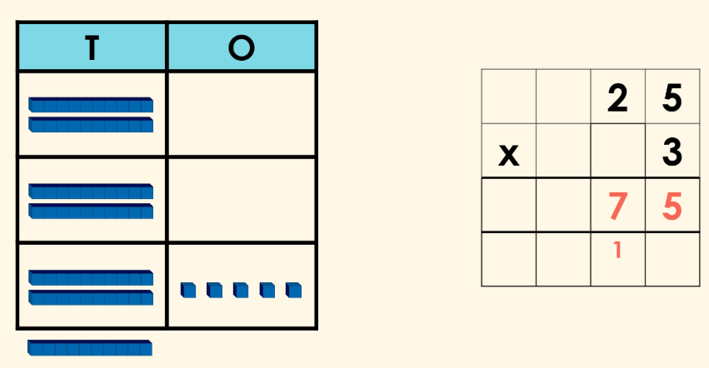
01.04.25
TBAT: multiply a 2-digit by a 1-digit number.
When we multiplied the ones column, we made another 10.
This 10 needs to be placed into the correct column.

Slide 15
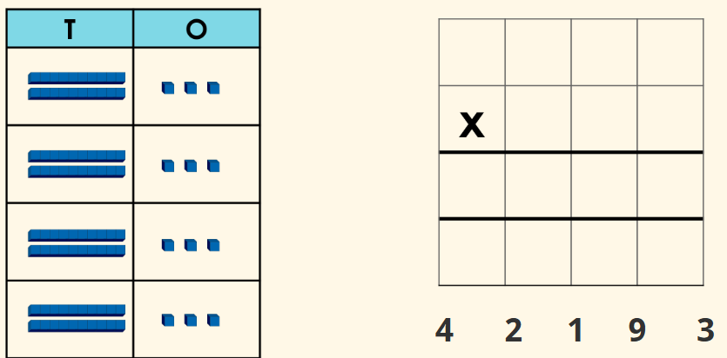
01.04.25
TBAT: multiply a 2-digit by a 1-digit number.
Classwork - whiteboard
Now work out these calculations on your whiteboard.
26 x 3 =
34 x 3 =

Slide 16
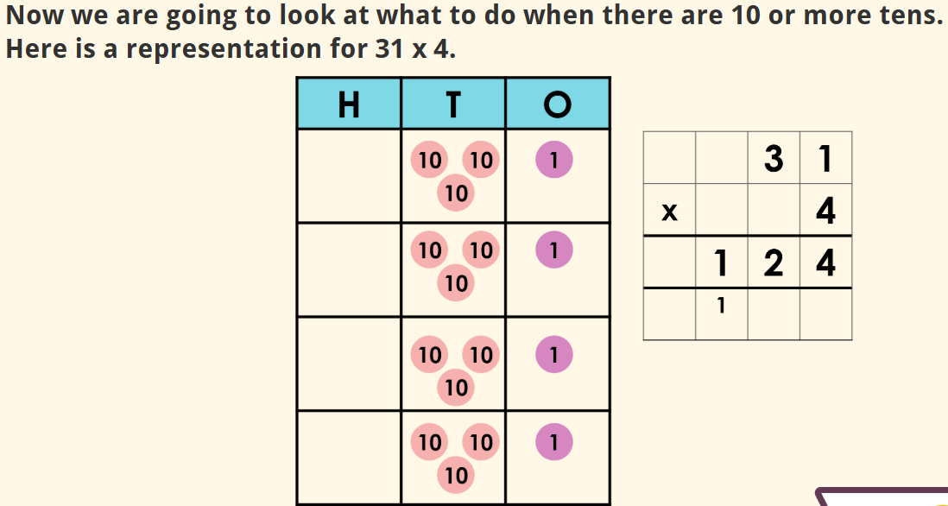
01.04.25
TBAT: multiply a 2-digit by a 1-digit number.
12 x 10 = 120.
We have made another 100 so we need to add this to the correct column.

Slide 17
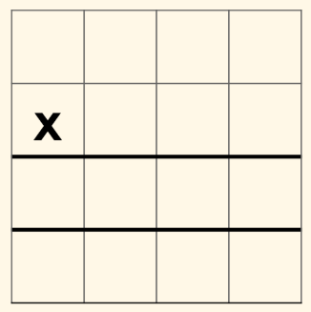
01.04.25
TBAT: multiply a 2-digit by a 1-digit number.
Blue Green
5
2
6
3
4
3

Slide 18
01.04.25
TBAT: multiply a 2-digit by a 1-digit number.
Independent – set your calculation out using the column method.
64 x 4 =
48 x 5 =
38 x 3 =
52 x 8 =
73 x 4 =
RP
Pencils come in boxes of 45. How many pencil will there be in 8 boxes?

Slide 19
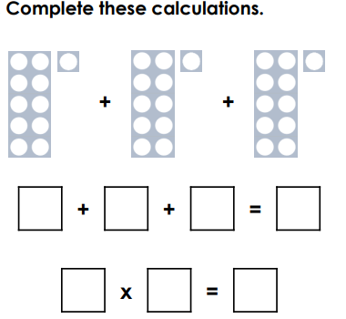
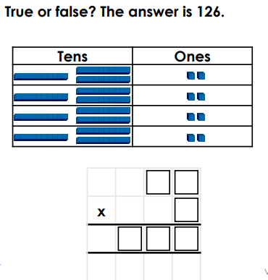
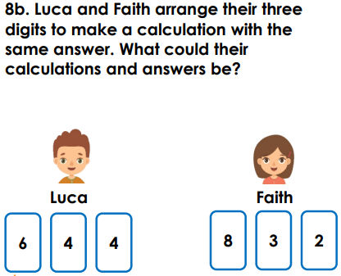
01.04.25
TBAT: multiply a 2-digit by a 1-digit number.
Challenge Mastery Greater depth

Slide 20
Tuesday 1st April
Spelling
**Whiteboards**

Slide 21
All of your spelling words for this week focus on words ending in –ary.
For example:
library
Say the word aloud. Write the letters ary on your friend’s back.
Can you hear the three distinct sounds that the letters in the letter string ary make?

Slide 22
Let’s find out more about what these letters mean.
-ary is from Latin and means
belonging to or connected with
For example, look how the word ‘library’ has been created:
libr
+
ary
meaning book
+
connected to
=
relating to or connected to books

Slide 23
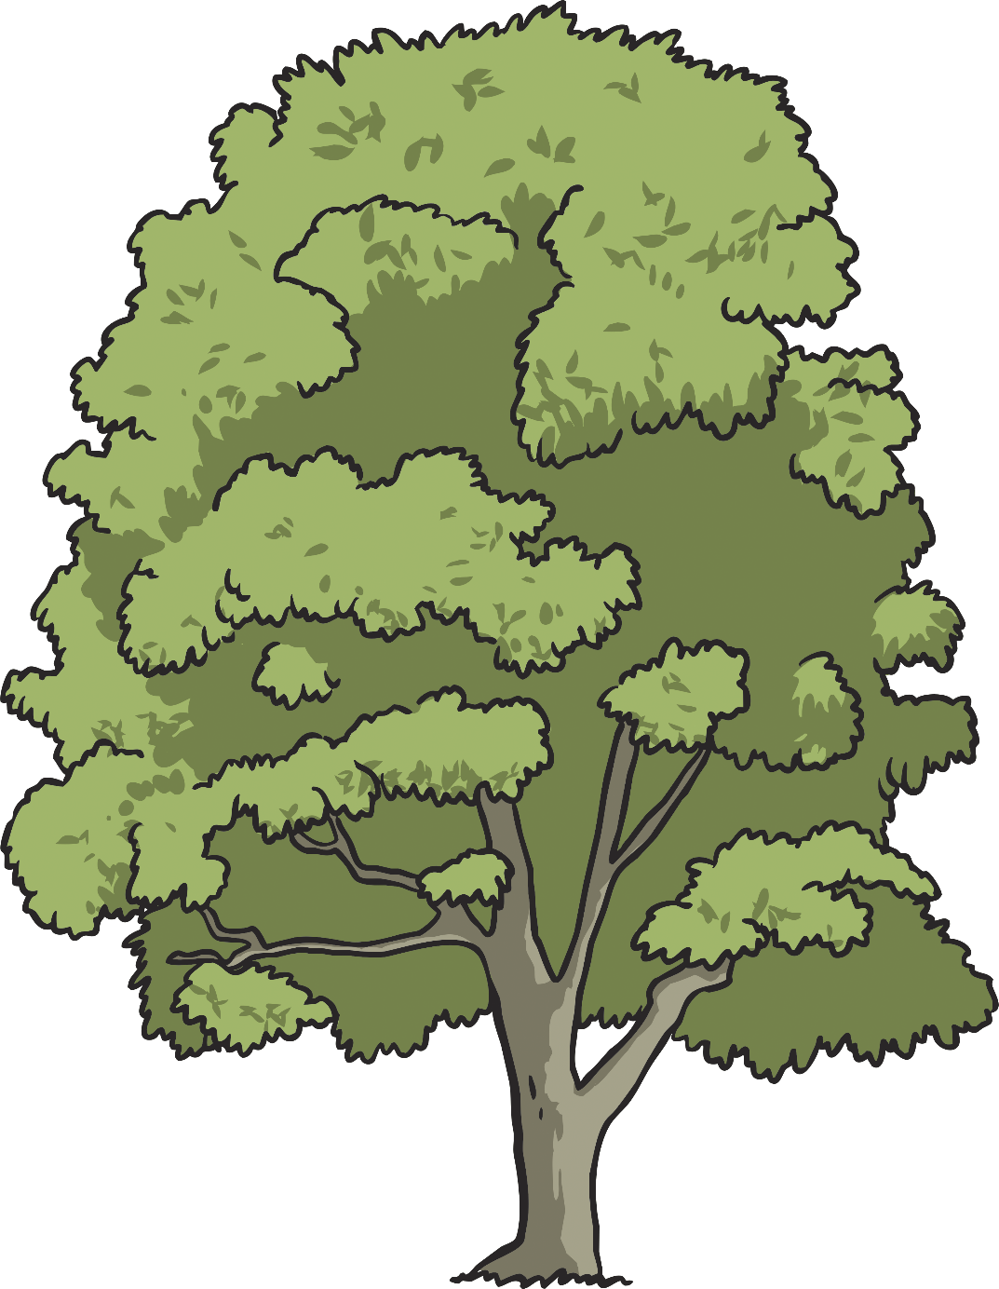
summary
library
Can you and your partner use a dictionary to find a definition for each of these words? Write the words and their meaning down in alphabetical order.
necessary
ordinary
boundary
salary
secondary
primary
February
dictionary
-ary

Slide 24
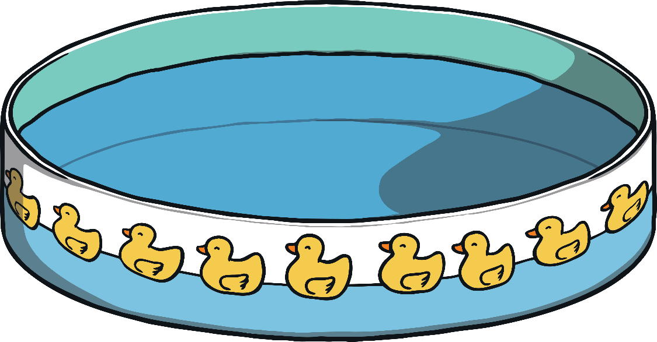
Select the correct ducks to spell out the word that appears when you click 'Show spelling'.
incorrect letter
_ _ _ _ _ _ _
Show spelling
l
i
b
r
a
r
y
Hide spelling
y
r
a
l
library
e
w
b
i

Slide 25
Select the correct ducks to spell out the word that appears when you click 'Show spelling'.
incorrect letter
_ _ _ _ _ _ _ _
Show spelling
F
e
b
r
u
a
r
y
Hide spelling
f
w
y
e
r
February
b
a
u

Slide 26
Select the correct ducks to spell out the word that appears when you click 'Show spelling'.
incorrect letter
_ _ _ _ _ _ _ _ _ _
Show spelling
d
i
c
t
i
o
n
a
r
y
Hide spelling
h
c
a
r
d
y
o
dictionary
n
t
s
i

Slide 27
Select the correct ducks to spell out the word that appears when you click 'Show spelling'.
incorrect letter
_ _ _ _ _ _ _ _
Show spelling
b
o
u
n
d
a
r
y
Hide spelling
e
u
a
r
b
y
d
boundary
i
n
w
o

Slide 28
Select the correct ducks to spell out the word that appears when you click 'Show spelling'.
incorrect letter
_ _ _ _ _ _
Show spelling
s
a
l
a
r
y
Hide spelling
y
a
r
l
salary
o
e
a
s
Notes:
Change the orange bar at the bottom to match the background to hide the fairground employee ☺

Slide 29
Select the correct ducks to spell out the word that appears when you click 'Show spelling'.
incorrect letter
_ _ _ _ _ _ _
Show spelling
s
u
m
m
a
r
y
Hide spelling
e
m
r
y
s
n
a
summary
i
m
o
u

Slide 30
Select the correct ducks to spell out the word that appears when you click 'Show spelling'.
incorrect letter
_ _ _ _ _ _ _
Show spelling
p
r
i
m
a
r
y
Hide spelling
y
m
a
p
e
primary
w
i
r

Slide 31
Select the correct ducks to spell out the word that appears when you click 'Show spelling'.
incorrect letter
_ _ _ _ _ _ _ _ _
Show spelling
s
e
c
o
n
d
a
r
y
Hide spelling
n
c
i
r
s
y
d
secondary
a
o
z
e

Slide 32
Select the correct ducks to spell out the word that appears when you click 'Show spelling'.
incorrect letter
_ _ _ _ _ _ _ _
Show spelling
o
r
d
i
n
a
r
y
Hide spelling
e
n
a
r
o
y
d
ordinary
i
i
w
r

Slide 33
Select the correct ducks to spell out the word that appears when you click 'Show spelling'.
incorrect letter
_ _ _ _ _ _ _ _ _
Show spelling
n
e
c
e
s
s
a
r
y
Hide spelling
s
c
i
r
n
y
s
necessary
a
e
z
e

Slide 34
Tuesday 1st April
TBAT: Plan a recount of our Science investigation
Talk partners We are going to plan to write a recount
What is a recount? When might a recount be from?

Slide 35
Tuesday 1st April
TBAT: Plan a recount of our Science investigation What does a recount tell us? What tense would you write a recount in and why? What other features of writing can we use to extend our piece?

Slide 36
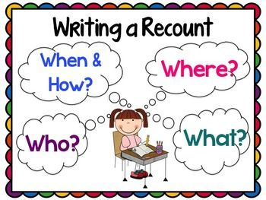
Tuesday 1st April
TBAT: Plan a recount of our Science investigation
Class Talk What do I include in my recount?

Slide 37
Introduction
Who did the activity?
Where did it all take place?
What did they do?
When did this happen?
Why was the activity carried out?

Slide 38
Write some bullet points on what you may include in your introduction.
Tuesday 1st April
TBAT: Plan a recount of our Science investigation

Slide 39
Main body
Write in chronological order.
Use sequential words.
Write in paragraphs.
Use detailed and technical vocabulary.
Write about what happened during the activity.

Slide 40
Write some bullet points on what you may include in your main body.
Tuesday 1st April
TBAT: Plan a recount of our Science investigation

Slide 41
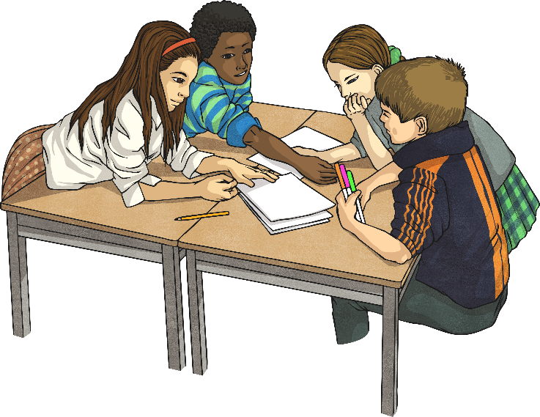
Concluding Paragraph
What would you recommend to others?
How would you describe the general atmosphere of the event?
Write about the highlights of the event.
What have you learnt?

Slide 42
Write some bullet points on what you may include in your conclusion.
Tuesday 1st April
TBAT: Plan a recount of our Science investigation

Slide 43
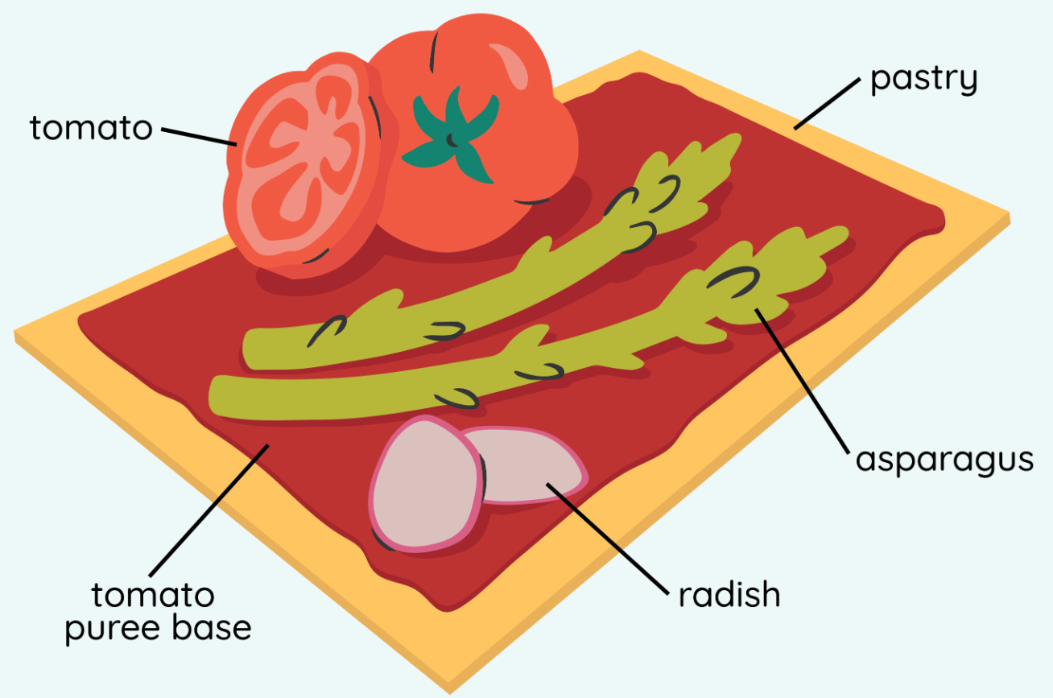
Tuesday 1st April 2025
D.T afternoon

