Slide 1
Tuesday 1st April 2025
1/4/25

Slide 2
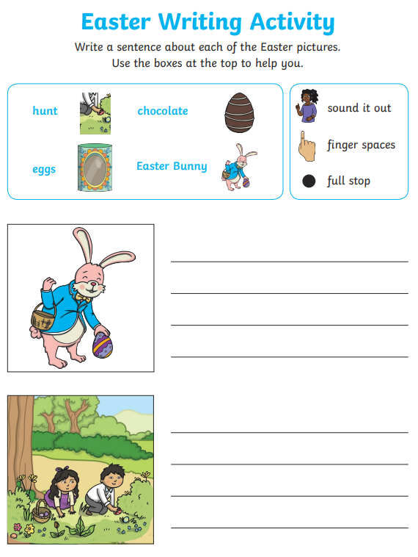
Morning Challenges:
Name writing

Slide 3
Pixl spelling test

Slide 4
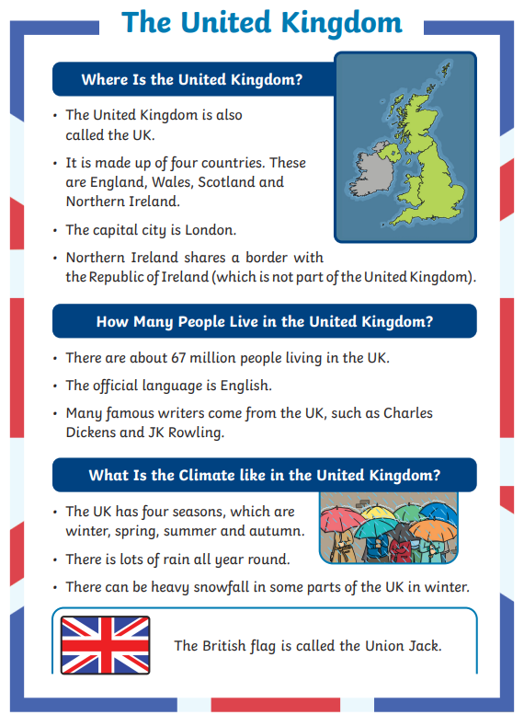
TBAT: Write a fact file 3 in 3
What are the features of a fact file?
Which feature is missing from this one?
What information do the pictures in this fact file give you?

Slide 5
Blue/ green
and but or

Slide 6
Today, we will write our own fact file about trees.
The title and sub-headings have been filled in for you.
What could we tell the reader in our introduction?

Slide 7
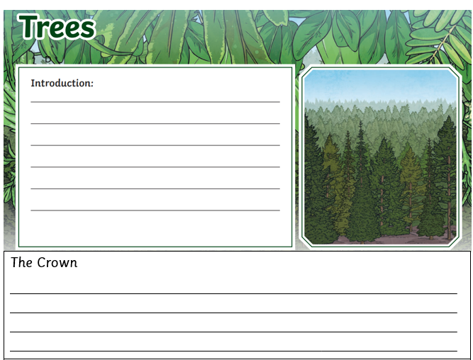
Write two sentences saying what trees are and what they are made up of.

Slide 8
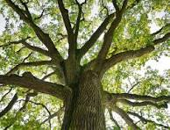
Now, we need to write some sentences about the Crown. What is the crown? What could you write about it? Use adjectives to describe.

Slide 9
Challenge: Create a fact box containing one or two interesting facts. Did you know… ?’

Slide 10
Lastly, for today, we need to describe the leaves. What do they look like? Are there different types? What do they do?

Slide 11
Challenge: Create a fact box containing one or two interesting facts. Did you know… ?’

Slide 12
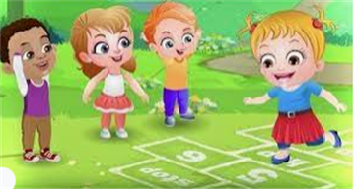
Break

Slide 13
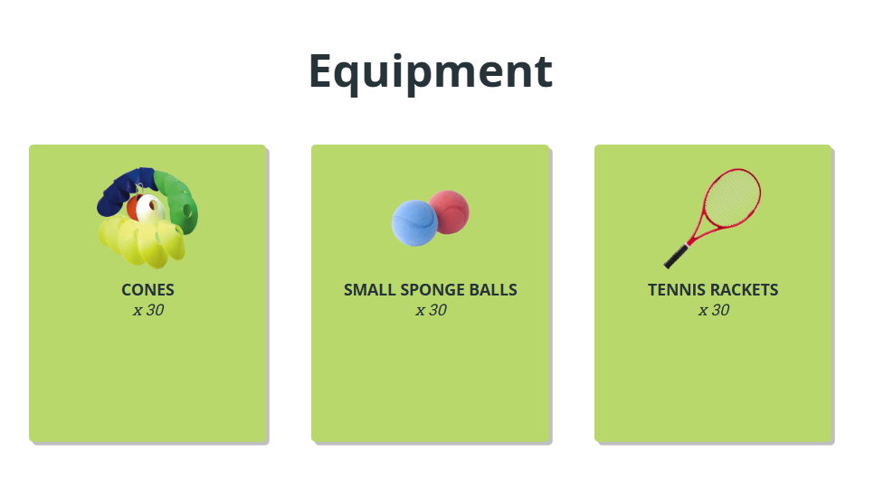
TBAT: develop hitting over a net.
Tuesday 1st April 2025

Slide 14
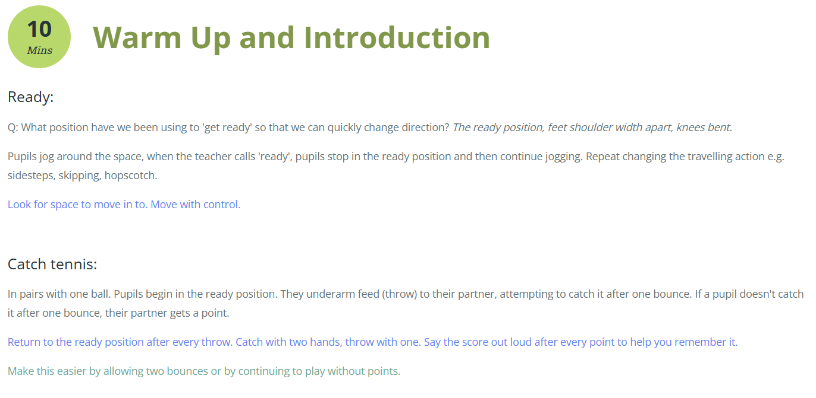
TBAT: develop hitting over a net.
Tuesday 1st April 2025

Slide 15
TBAT: develop hitting over a net.
Tuesday 1st April 2025

Slide 16
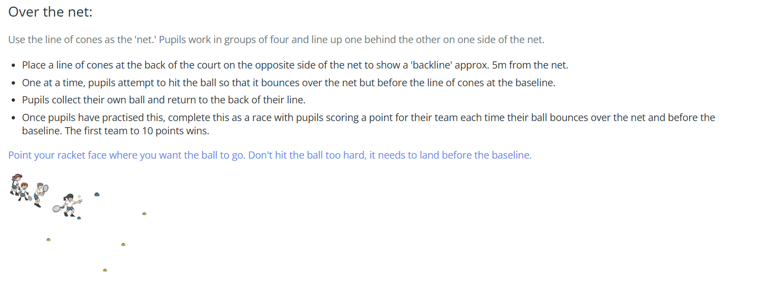
TBAT: develop hitting over a net.
Tuesday 1st April 2025

Slide 17
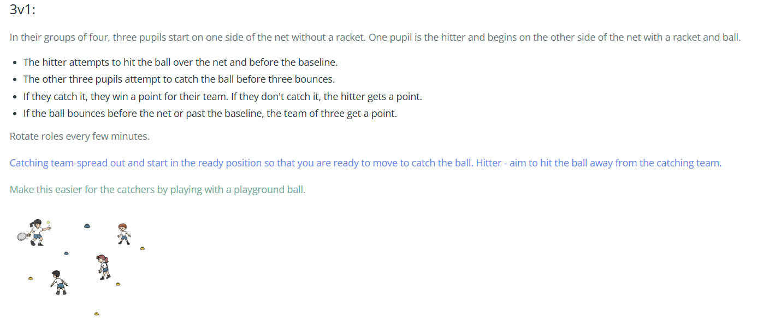
TBAT: develop hitting over a net.
Tuesday 1st April 2025

Slide 18
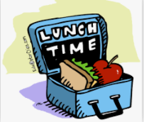
Lunch

Slide 19
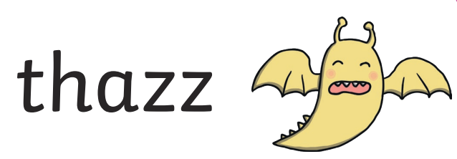
Today's Alien language is.......

Slide 20
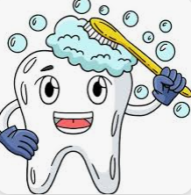
Toothbrushing

Slide 21
TBAT: find half of a quantity
Tuesday 1st April 2025

Slide 22
TBAT: find half of a quantity
Tuesday 1st April 2025

Slide 23
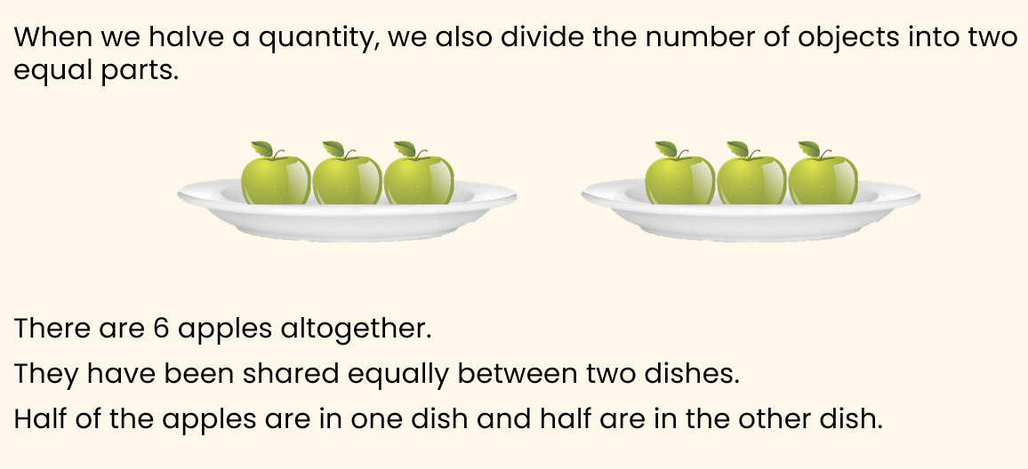
TBAT: find half of a quantity
Tuesday 1st April 2025

Slide 24
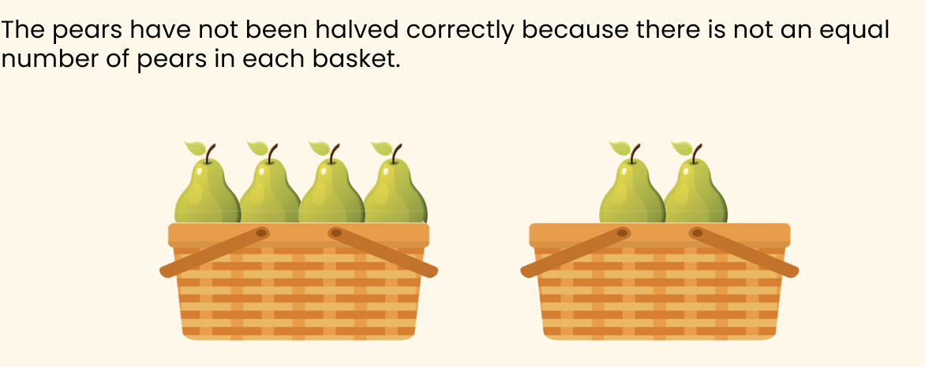
TBAT: find half of a quantity
Tuesday 1st April 2025

Slide 25
TBAT: find half of a quantity
Tuesday 1st April 2025

Slide 26
TBAT: find half of a quantity
Tuesday 1st April 2025

Slide 27
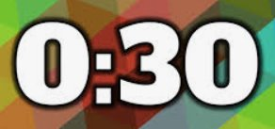
TBAT: find half of a quantity
Tuesday 1st April 2025
Blue/ Green
I think Matt is correct/ incorrect because …...................
I think Josh is correct/ incorrect because …...................

Slide 28
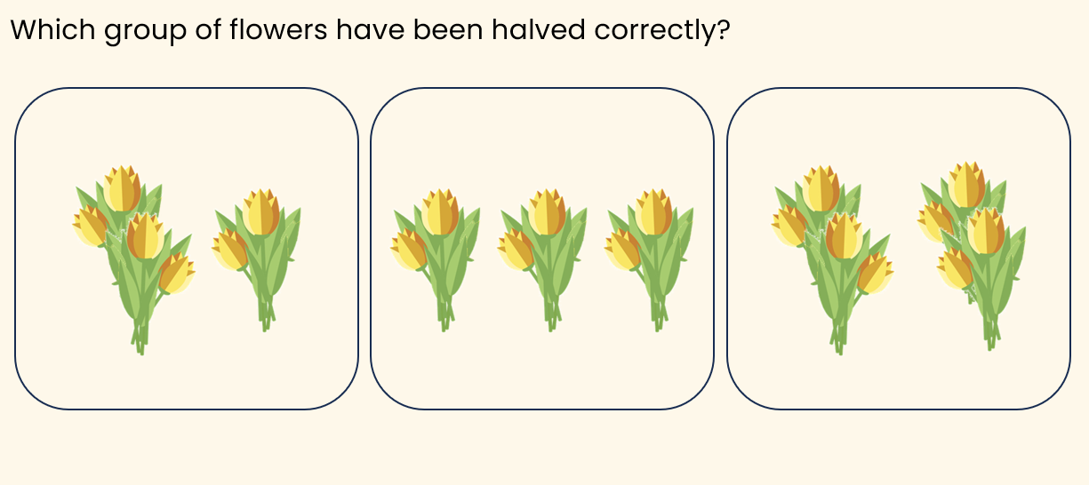
TBAT: find half of a quantity
Tuesday 1st April 2025

Slide 29
TBAT: find half of a quantity
Tuesday 1st April 2025

Slide 30
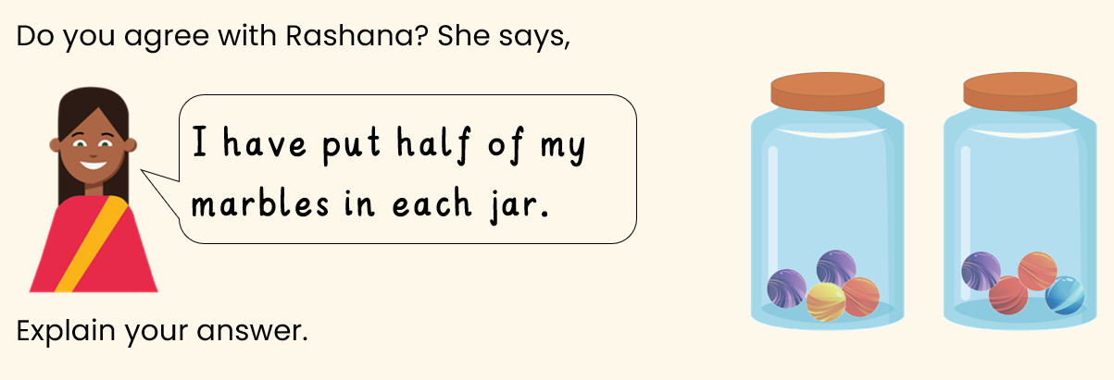
TBAT: find half of a quantity
Tuesday 1st April 2025

Slide 31
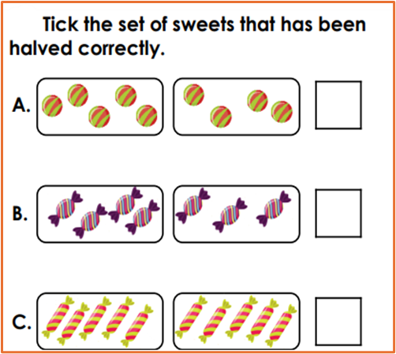
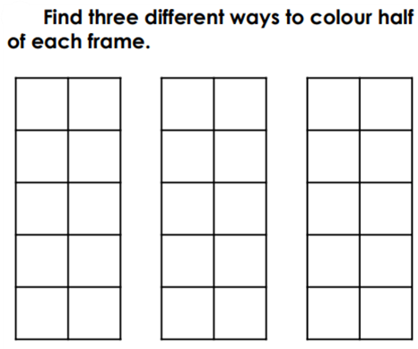
TBAT: find half of a quantity
Tuesday 1st April 2025
Independent:
RP:

Slide 32
TBAT: find half of a quantity
Tuesday 1st April 2025
Challenge:
Mastery:
Mastery with greater depth:

Slide 33
TBAT: Identify changes in pitch and respond with movement.
Key vocabulary:
Pitch: how high or low the sound is.
2 in 2
What is a ‘beat’?
What does ‘tempo’ mean?

Slide 34
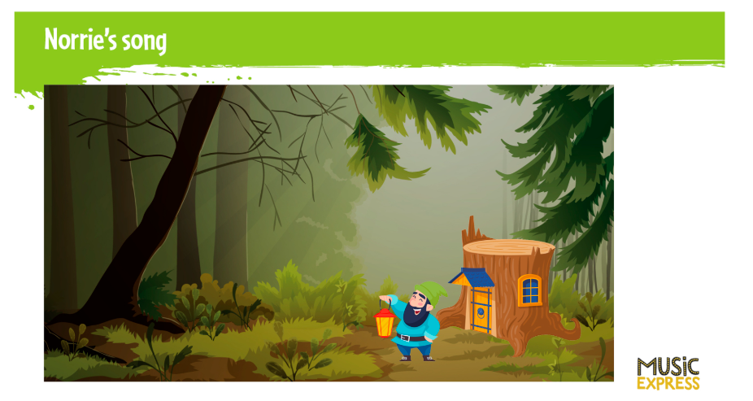
What is a gnome?
Are they real?
Can you think of any stories about gnomes?

Slide 35
What does the song tell us about Norrie?

Slide 36
This is Norrie’s special tune. How does the style of music help to describe him?

Slide 37
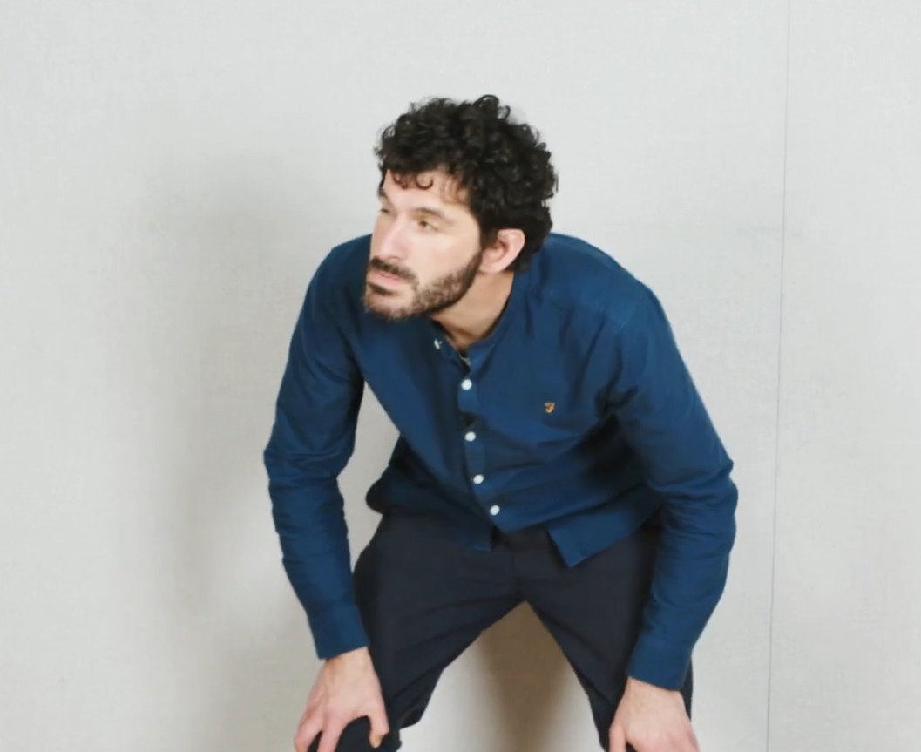
Learn the song and add movements that reflect the pitch of the song.

Slide 38
Add instruments!
Keep the beat

