Slide 1
Wednesday 2nd April 2025
2/4/25

Slide 2
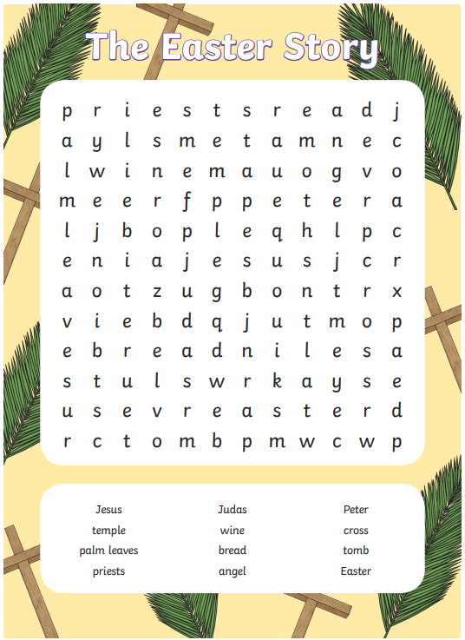
Morning Challenges:
Name writing

Slide 3
Phonics
Pixl spelling test

Slide 4
TBAT: write a fact file
3 in 3
Which words are spelled correctly?
thay their peopel freind there me my by of throogh

Slide 5
Blue/green
Improve the sentence by extending it with ‘and’, ‘but’ or ‘or’.
Plants are living things.
Leaves are green.

Slide 6
Today, we will finish our fact files and edit them. What could we write about the tree’s trunk?
Remember: Use ‘and’, ‘but’ and ‘or’.

Slide 7
Use ‘or’ in this section to explain the different types of seeds.
Remember: Use ‘and’, ‘but’ and ‘or’.

Slide 8
Challenge: Create a fact box containing one or two interesting facts. Did you know… ?’

Slide 9
When finished:
Check for full stops and capital letters.
Read through your work to check it makes sense’
Add any extra detail if you have empty lines.
Check spellings are correct.
If someone else on your table is finished, swap books and read each others. Give any feedback.

Slide 10
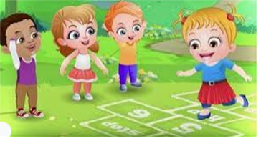
Break

Slide 11
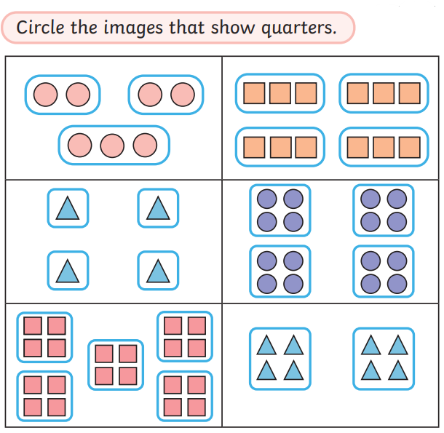
TBAT: consolidate quartering a quantity.
Wednesday 2nd April 2025
3 in 3
Challenge:
Explain how you know they have been quartered.

Slide 12
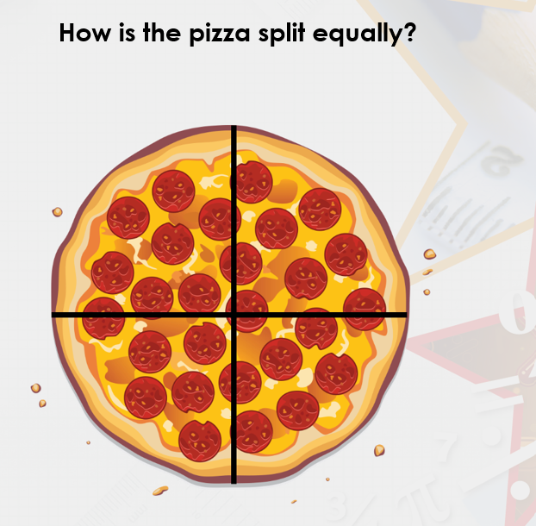
TBAT: consolidate quartering a quantity.
Wednesday 2nd April 2025

Slide 13
TBAT: consolidate quartering a quantity.
Wednesday 2nd April 2025
What happens when you quarter something?

Slide 14
TBAT: consolidate quartering a quantity.
Wednesday 2nd April 2025

Slide 15
TBAT: consolidate quartering a quantity.
Wednesday 2nd April 2025

Slide 16
TBAT: consolidate quartering a quantity.
Wednesday 2nd April 2025

Slide 17
TBAT: consolidate quartering a quantity.
Wednesday 2nd April 2025

Slide 18
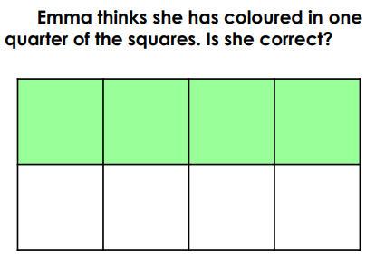
TBAT: consolidate quartering a quantity.
Wednesday 2nd April 2025
Blue/ Green
Emma is correct/ incorrect because.....................
James is correct/ incorrect because.....................

Slide 19
TBAT: consolidate quartering a quantity.
Wednesday 2nd April 2025

Slide 20
TBAT: consolidate quartering a quantity.
Wednesday 2nd April 2025

Slide 21
TBAT: consolidate quartering a quantity.
Wednesday 2nd April 2025

Slide 22
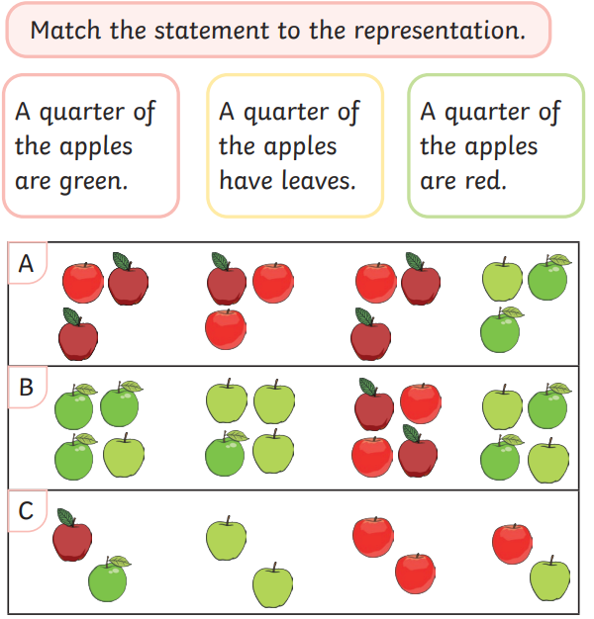
TBAT: consolidate quartering a quantity.
Wednesday 2nd April 2025
Independent:
RP:

Slide 23
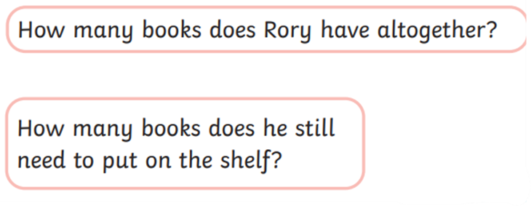
TBAT: consolidate quartering a quantity.
Wednesday 2nd April 2025
Challenge:
Mastery:
Mastery with greater depth:

Slide 24
Lunch

Slide 25
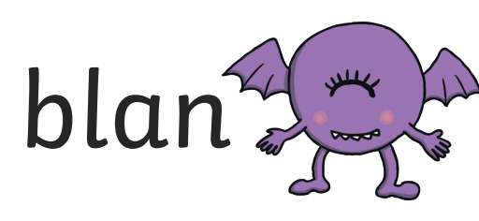
Today's Alien language is.......

Slide 26
Toothbrushing

Slide 27
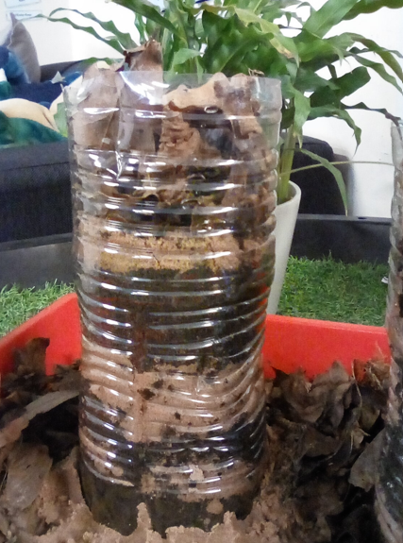
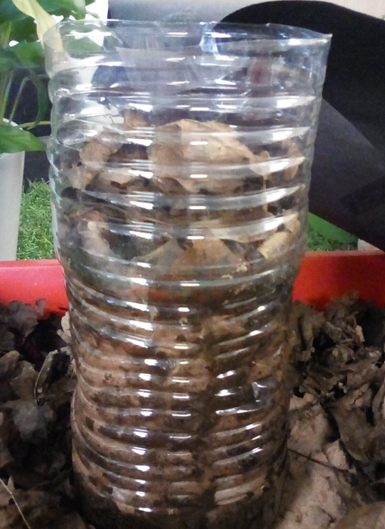
Let's look at our wormery.
Wednesday 2nd April 2025

Slide 28
Do you notice any differences?
Wednesday 2nd April 2025

Slide 29
Are there any differences between the leaves?
Wednesday 2nd April 2025

Slide 30
Are there any differences between the layers?
Wednesday 2nd April 2025

Slide 31
Do you notice any differences?
Wednesday 2nd April 2025

Slide 32
Lesson 6: Routes TBAT: find more than one solution to a problem.
Year 1 – Moving a robot
Notes:
Last updated 29-10-21
Resources are updated regularly — the latest version is available at: ncce.io/tcc.
This resource is licensed under the Open Government Licence, version 3. For more information on this licence, see ncce.io/ogl.

Slide 33
Blue/ green What turn will the robot make if you press these buttons? Half, quarter, full?
Use ‘because’ in your answer

Slide 34
Which way?
Introduction
Star
Cross
Sun
There is often more than one way to get somewhere. Today you will be looking for different routes and trying them out.

Slide 35
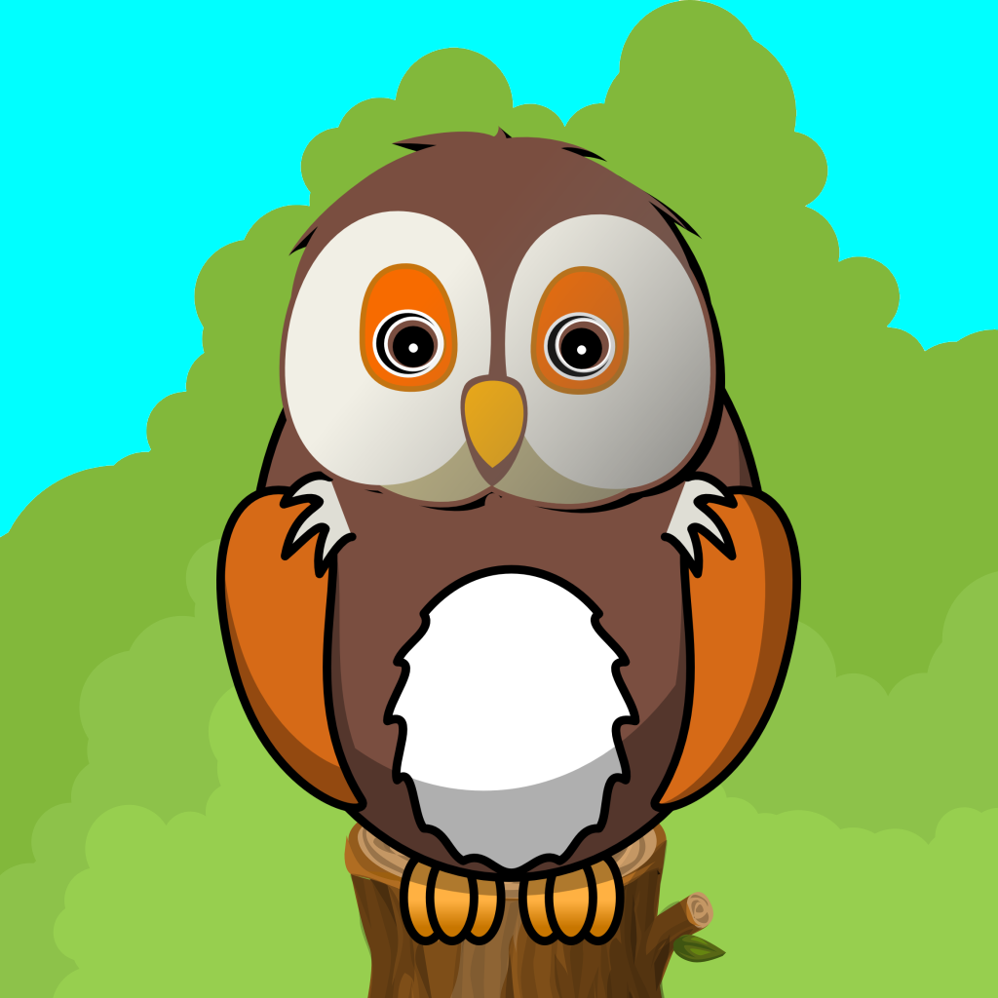
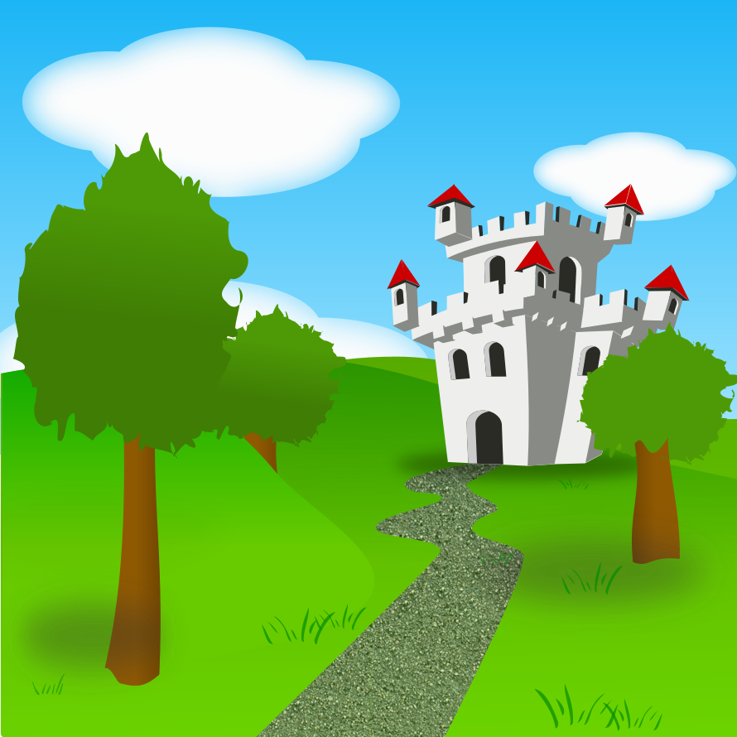
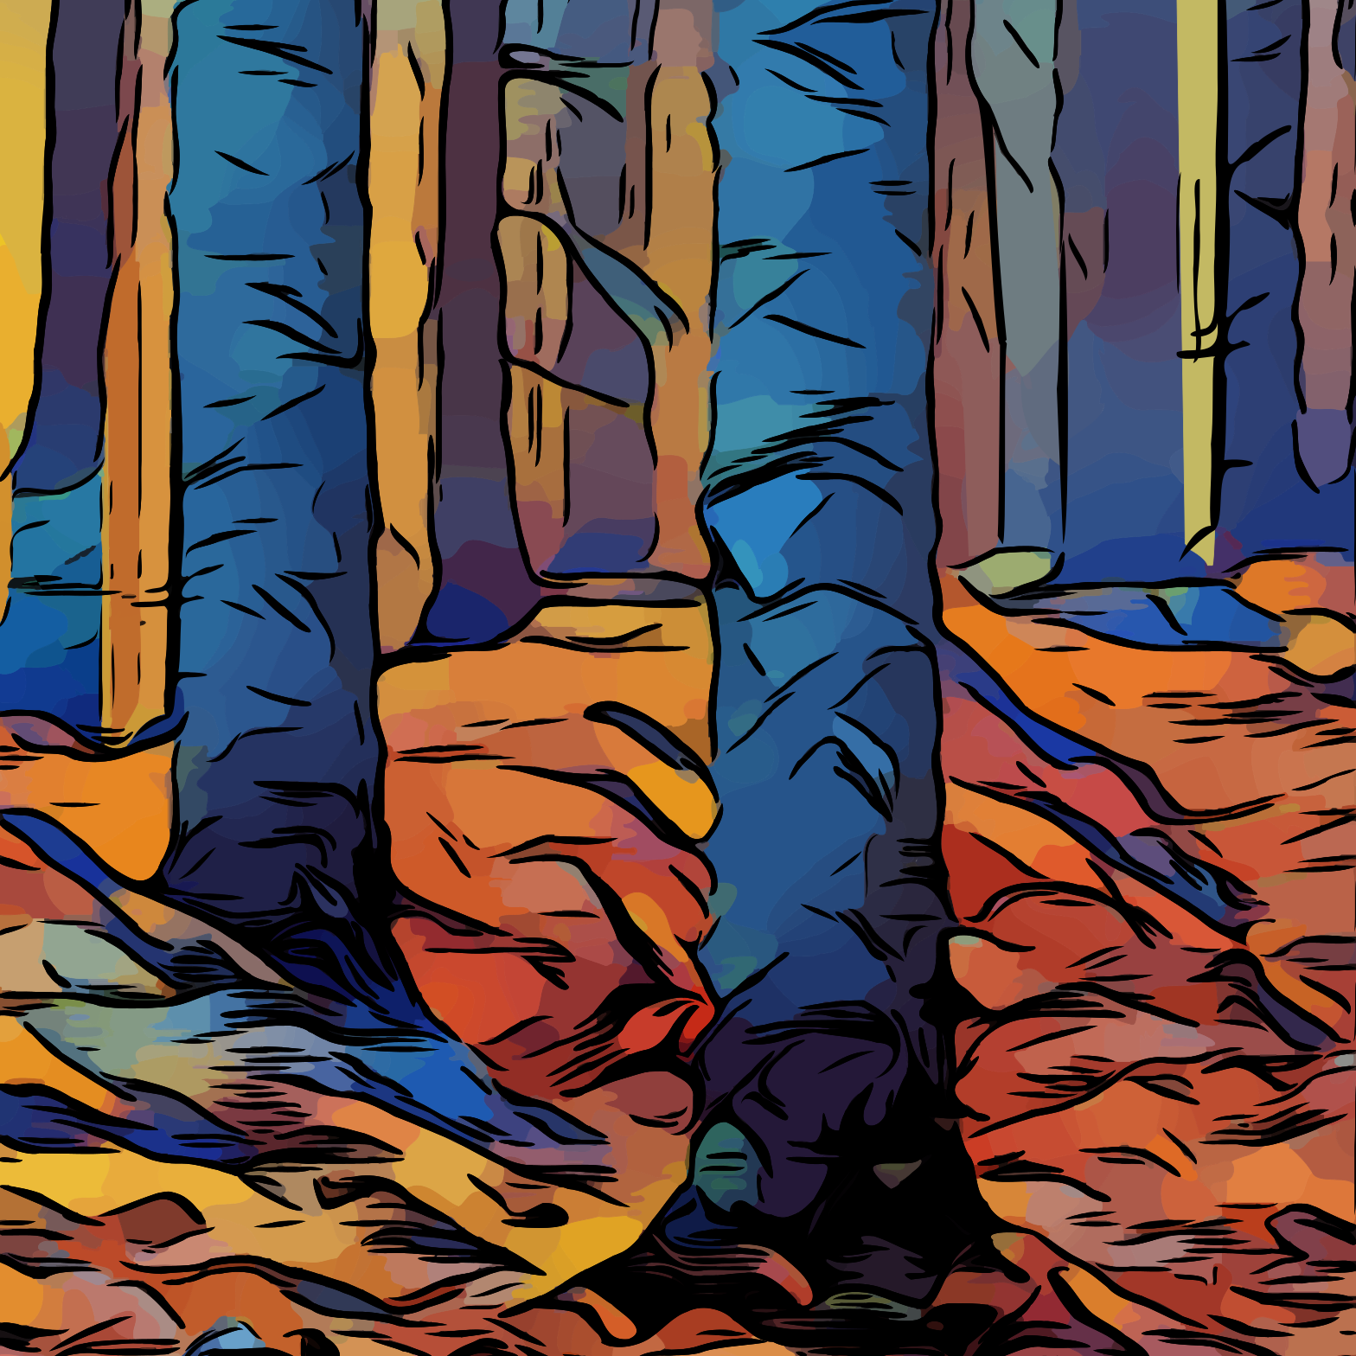
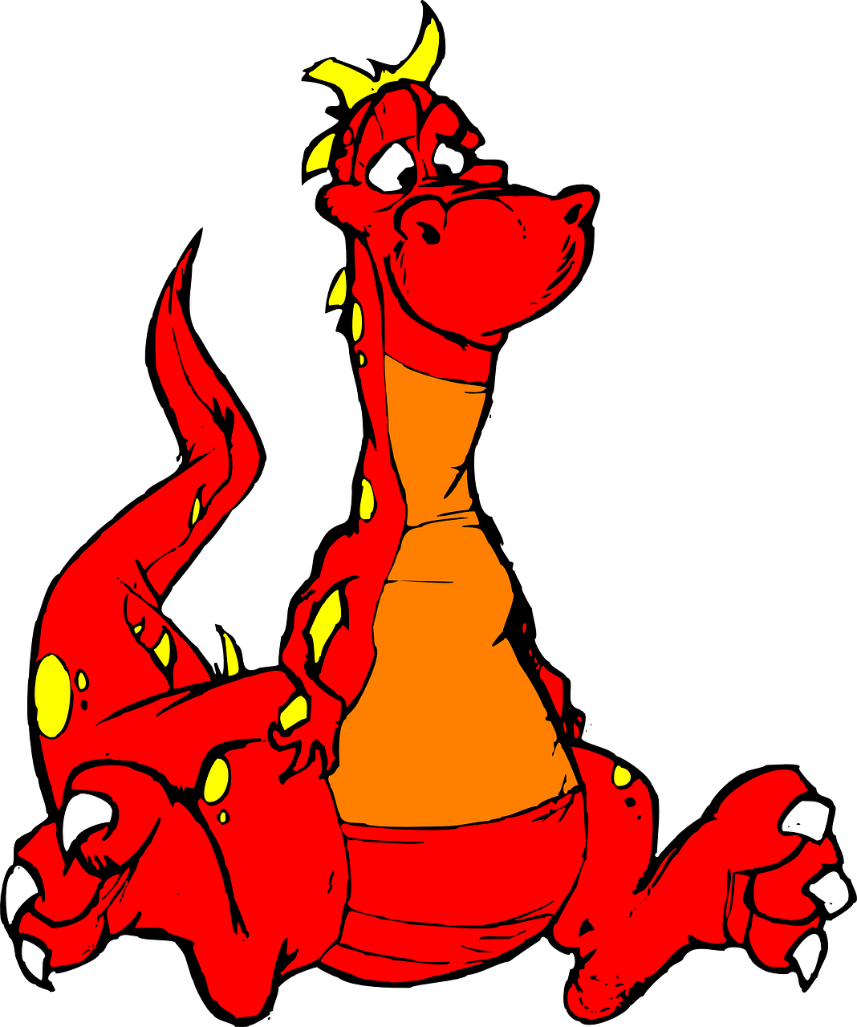
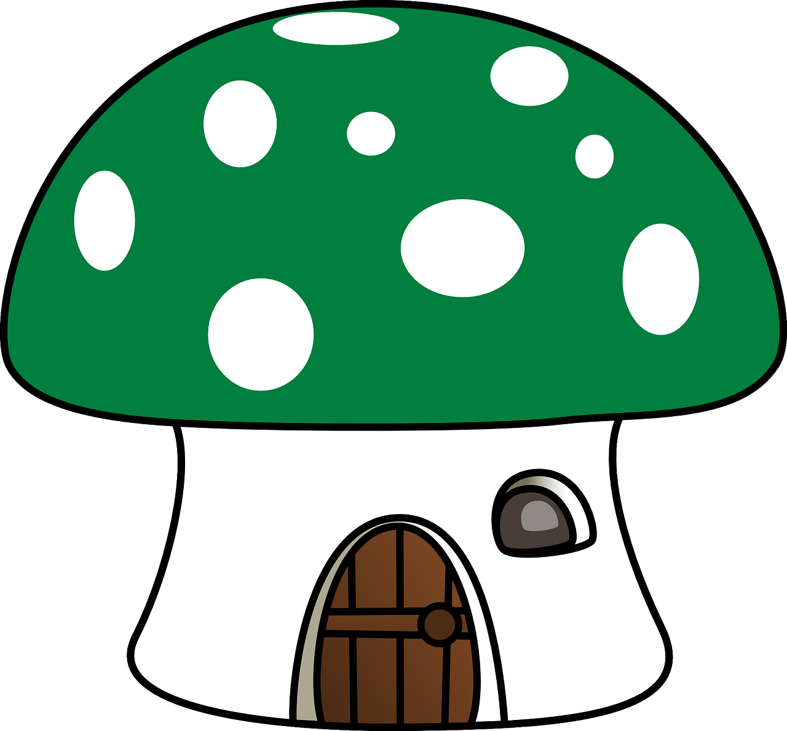
Going this way and that way
Activity 1
Use the cards to pick start and end places.
Notes:
Image sources:
https://pixabay.com/illustrations/wizard-magic-magician-mystery-1454385
https://pixabay.com/vectors/dragon-mythical-creature-310237
https://pixabay.com/vectors/castle-fort-fortress-land-146417
https://pixabay.com/vectors/the-background-background-design-352165
https://pixabay.com/vectors/mushroom-fly-agarnic-house-green-307468
https://pixabay.com/vectors/woods-trees-abstract-scene-forest-3988713
https://pixabay.com/vectors/tree-trunk-nature-environment-576144
https://pixabay.com/illustrations/greenery-bush-garden-shrub-leaves-3778767
https://pixabay.com/vectors/bird-owl-animal-cute-nature-157249

Slide 36
Draw your routes
Activity 1
Start:
End:
Draw two or three different routes between the start and end places.
Notes:
Image sources:
https://pixabay.com/illustrations/wizard-magic-magician-mystery-1454385
https://pixabay.com/vectors/dragon-mythical-creature-310237
https://pixabay.com/vectors/castle-fort-fortress-land-146417
https://pixabay.com/vectors/the-background-background-design-352165
https://pixabay.com/vectors/mushroom-fly-agarnic-house-green-307468
https://pixabay.com/vectors/woods-trees-abstract-scene-forest-3988713
https://pixabay.com/vectors/tree-trunk-nature-environment-576144
https://pixabay.com/illustrations/greenery-bush-garden-shrub-leaves-3778767
https://pixabay.com/vectors/bird-owl-animal-cute-nature-157249

Slide 37
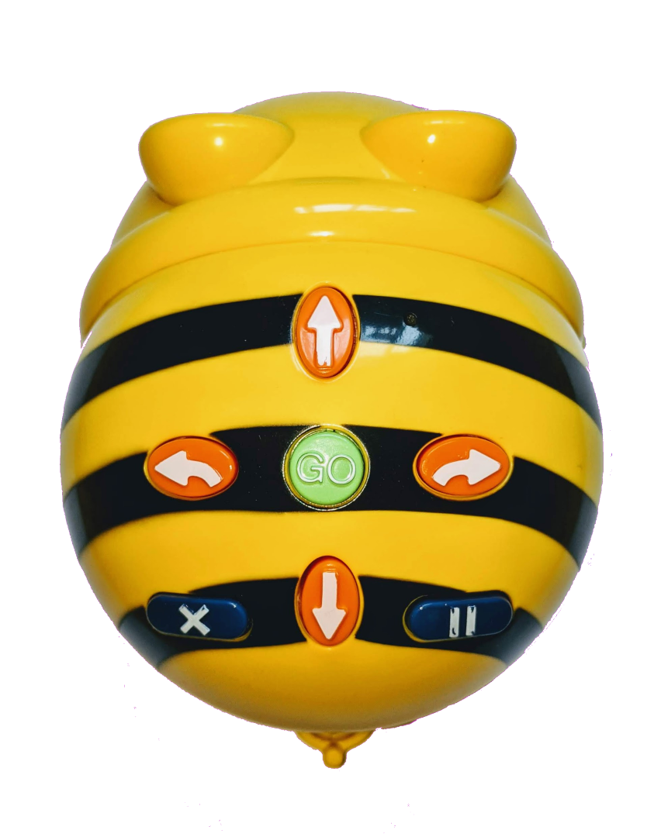
Create your algorithms
Activity 2
Start: End:
Before you begin planning, place your robot on the mat.
Notes:
Image sources:
https://pixabay.com/illustrations/wizard-magic-magician-mystery-1454385
https://pixabay.com/vectors/dragon-mythical-creature-310237
https://pixabay.com/vectors/castle-fort-fortress-land-146417
https://pixabay.com/vectors/the-background-background-design-352165
https://pixabay.com/vectors/mushroom-fly-agarnic-house-green-307468
https://pixabay.com/vectors/woods-trees-abstract-scene-forest-3988713
https://pixabay.com/vectors/tree-trunk-nature-environment-576144
https://pixabay.com/illustrations/greenery-bush-garden-shrub-leaves-3778767
https://pixabay.com/vectors/bird-owl-animal-cute-nature-157249

Slide 38
Create your algorithms
Activity 2
Start: End:
Decide which way it will look at the start of your program.
Notes:
Image sources:
https://pixabay.com/illustrations/wizard-magic-magician-mystery-1454385
https://pixabay.com/vectors/dragon-mythical-creature-310237
https://pixabay.com/vectors/castle-fort-fortress-land-146417
https://pixabay.com/vectors/the-background-background-design-352165
https://pixabay.com/vectors/mushroom-fly-agarnic-house-green-307468
https://pixabay.com/vectors/woods-trees-abstract-scene-forest-3988713
https://pixabay.com/vectors/tree-trunk-nature-environment-576144
https://pixabay.com/illustrations/greenery-bush-garden-shrub-leaves-3778767
https://pixabay.com/vectors/bird-owl-animal-cute-nature-157249

Slide 39
Create your algorithms
Activity 2
Try your algorithms out as programs on the robot. Debug your program if you need to.
Right turn
Forwards
Left turn
Forwards
Forwards
Forwards
Right turn
Forwards
Right turn
Forwards
Notes:
Image sources:
https://pixabay.com/illustrations/wizard-magic-magician-mystery-1454385
https://pixabay.com/vectors/dragon-mythical-creature-310237
https://pixabay.com/vectors/castle-fort-fortress-land-146417
https://pixabay.com/vectors/the-background-background-design-352165
https://pixabay.com/vectors/mushroom-fly-agarnic-house-green-307468
https://pixabay.com/vectors/woods-trees-abstract-scene-forest-3988713
https://pixabay.com/vectors/tree-trunk-nature-environment-576144
https://pixabay.com/illustrations/greenery-bush-garden-shrub-leaves-3778767
https://pixabay.com/vectors/bird-owl-animal-cute-nature-157249

Slide 40
Even more routes
Activity 3
Start: Then: End:
This time, choose three cards.
The robot needs to visit them in the order you picked them.
Your routes may go back over themselves.
Notes:
Image sources:
https://pixabay.com/illustrations/wizard-magic-magician-mystery-1454385
https://pixabay.com/vectors/dragon-mythical-creature-310237
https://pixabay.com/vectors/castle-fort-fortress-land-146417
https://pixabay.com/vectors/the-background-background-design-352165
https://pixabay.com/vectors/mushroom-fly-agarnic-house-green-307468
https://pixabay.com/vectors/woods-trees-abstract-scene-forest-3988713
https://pixabay.com/vectors/tree-trunk-nature-environment-576144
https://pixabay.com/illustrations/greenery-bush-garden-shrub-leaves-3778767
https://pixabay.com/vectors/bird-owl-animal-cute-nature-157249

Slide 41
Final challenge
Plenary
Start the robot on the woods, facing the owl.
Get the robot to the mushroom using only these commands:
Left turn
Forwards
Notes:
Image sources:
https://pixabay.com/illustrations/wizard-magic-magician-mystery-1454385
https://pixabay.com/vectors/dragon-mythical-creature-310237
https://pixabay.com/vectors/castle-fort-fortress-land-146417
https://pixabay.com/vectors/the-background-background-design-352165
https://pixabay.com/vectors/mushroom-fly-agarnic-house-green-307468
https://pixabay.com/vectors/woods-trees-abstract-scene-forest-3988713
https://pixabay.com/vectors/tree-trunk-nature-environment-576144
https://pixabay.com/illustrations/greenery-bush-garden-shrub-leaves-3778767
https://pixabay.com/vectors/bird-owl-animal-cute-nature-157249

