Slide 1
Wednesday 23rd April
24/4/25

Slide 2
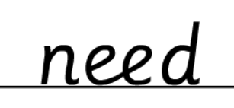
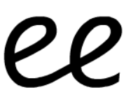
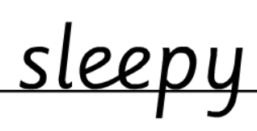
Morning Challenges:
Name writing

Slide 3
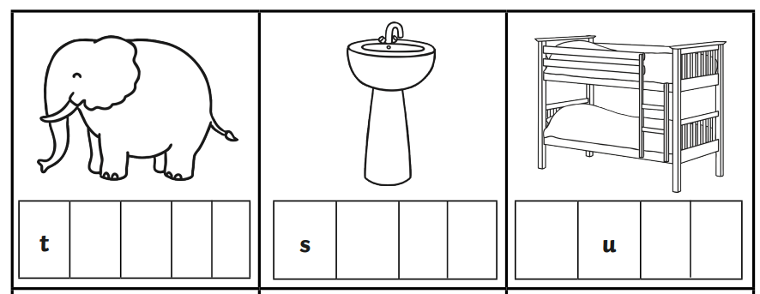
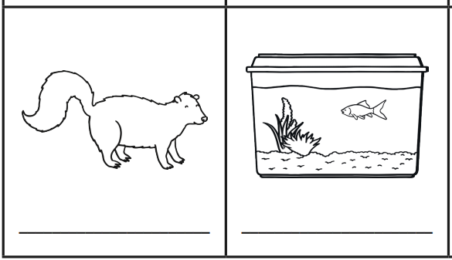
Early Morning Work
Challenge:
Think of more ‘nk’ words and write them.

Slide 4
TBAT: read and write words which include the /th/ and /ng/ digraphs.
Wednesday 23rd April 2025
Speedy sounds
Digital Flashcards - Teach Your Monster to Read

Slide 5
TBAT: read and write words which include the /th/ and /ng/ digraphs.
Wednesday 23rd April 2025

Slide 6
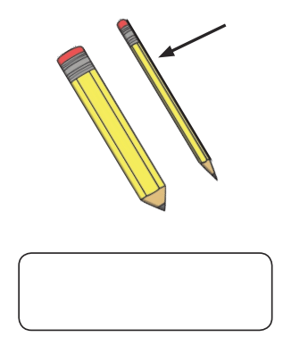
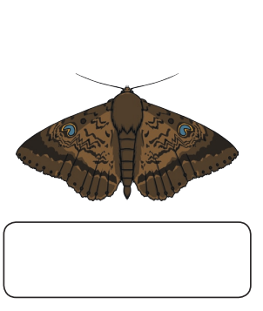
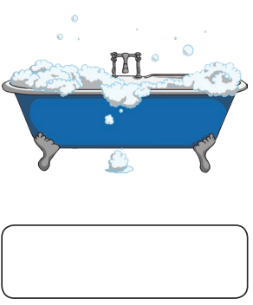
TBAT: read and write words which include the /th/ and /ng/ digraphs.
Wednesday 23rd April 2025
Label the /th/ pictures

Slide 7
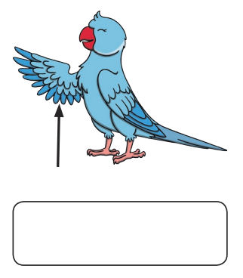
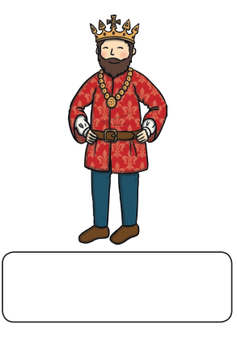
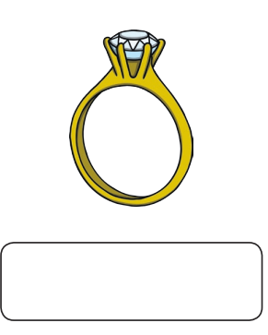
TBAT: read and write words which include the /th/ and /ng/ digraphs.
Wednesday 23rd April 2025
Label the /ng/ pictures

Slide 8
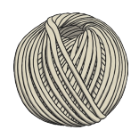
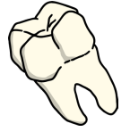
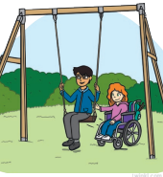
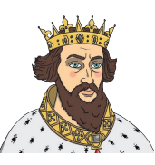
TBAT: read and write words which include the /th/ and /ng/ digraphs.
Wednesday 23rd April 2025
th | ng

Slide 9
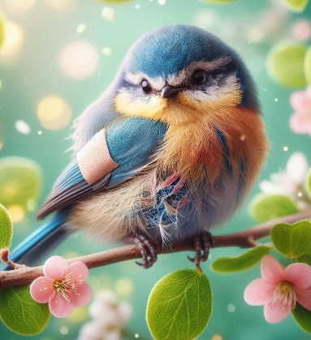
TBAT: read and write words which include the /th/ and /ng/ digraphs.
Wednesday 23rd April 2025
Underline the /th/ and /ng/ graphemes in the sentence.
The bird hurt its wing on a thorn.

Slide 10
TBAT: read and write words which include the /th/ and /ng/ digraphs.
Wednesday 23rd April 2025
…......................................................................
…......................................................................
….......................................................................
…........................................................................

Slide 11
TBAT: recognise and use questions.
Wednesday 23rd April 2025
What is a question?
When and why do we ask questions?

Slide 12
TBAT: recognise and use questions.
Wednesday 23rd April 2025
A question is a sentence you use to ask for information or to seek an answer.
They often start with words like "who", "what", "where", "when", "why", or "how".
Questions always end with a question mark (?).

Slide 13
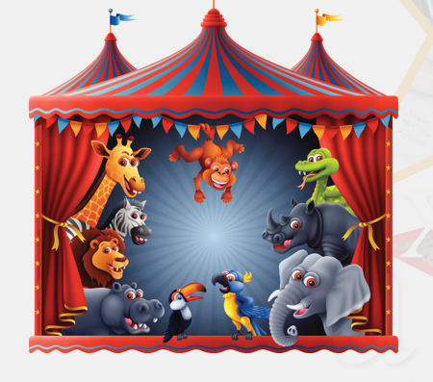
TBAT: recognise and use questions.
Wednesday 23rd April 2025
3 in 3:
Think of 3 questions that could be answered from this picture.

Slide 14
TBAT: recognise and use questions.
Wednesday 23rd April 2025
Blue/ Green- Does the question make sense? What might be wrong?
Who can I go to the beach?
Where is it time to go to get breakfast?
Challenge: What word should be used instead?

Slide 15
TBAT: recognise and use questions.
Wednesday 23rd April 2025

Slide 16
TBAT: recognise and use questions.
Wednesday 23rd April 2025

Slide 17
TBAT: recognise and use questions.
Wednesday 23rd April 2025

Slide 18
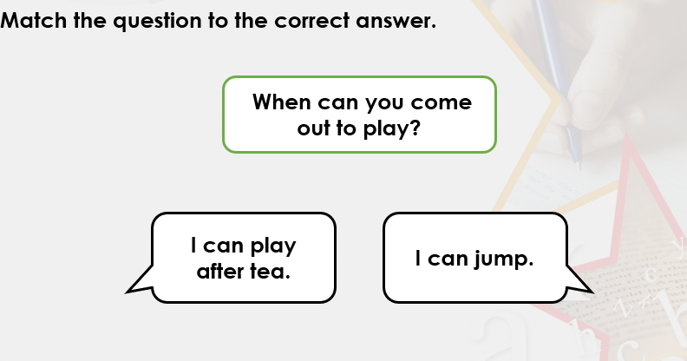
TBAT: recognise and use questions.
Wednesday 23rd April 2025

Slide 19
TBAT: recognise and use questions.
Wednesday 23rd April 2025

Slide 20
TBAT: recognise and use questions.
Wednesday 23rd April 2025

Slide 21
TBAT: recognise and use questions.
Wednesday 23rd April 2025

Slide 22
TBAT: recognise and use questions.
Wednesday 23rd April 2025

Slide 23
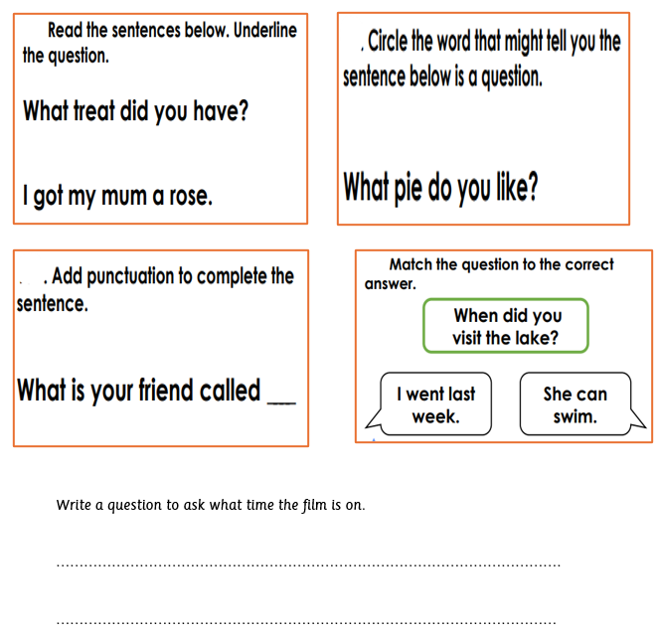
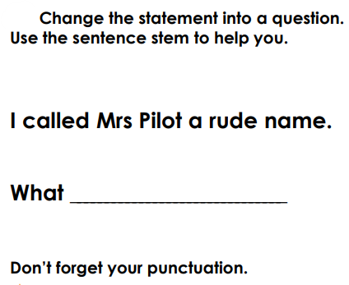
TBAT: recognise and use questions.
Wednesday 23rd April 2025
Independent:
Challenge:

Slide 24
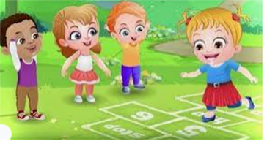
Break

Slide 25
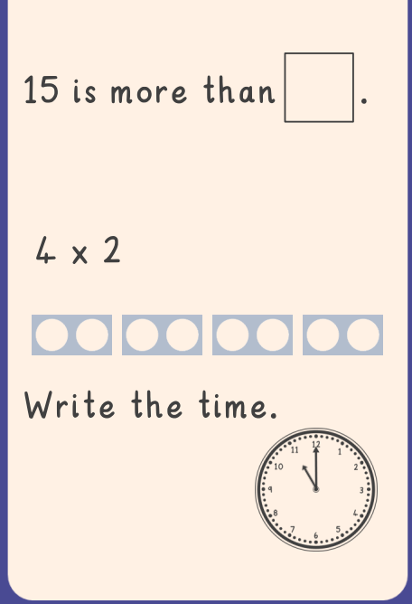
TBAT: represent numbers using Dienes on a place value chart
3 in 3
Count these in twos

Slide 26
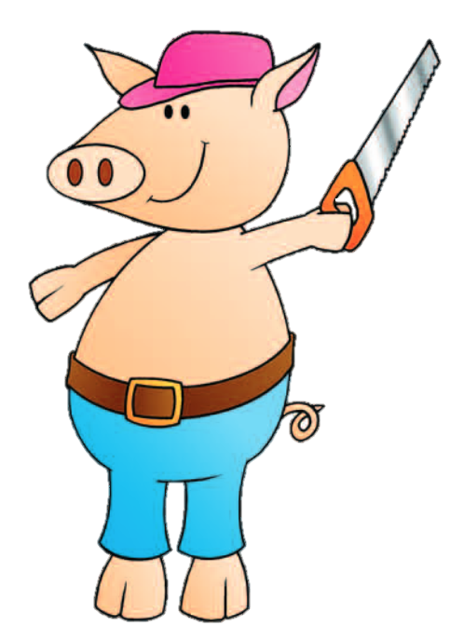
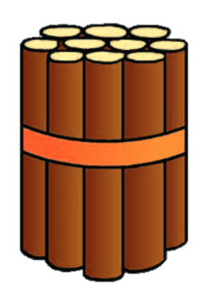
Blue/ Green Is the pig correct?
Challenge: draw the tens and ones in a part, part, whole model.
How do you know?
I have 33 sticks.
I have 62 sticks.
Notes:
Do Now: Addressing misconceptions
Show pupils the slide. Pupils read the pig’s statement and discuss whether he is correct. They use Dienes to support their reasoning (e.g. by making a concrete representation to match the picture and demonstrating that this is different to a concrete representation of 62).
What mistake do you think the pig has made?

Slide 27
TBAT: represent numbers using Dienes on a place value chart
tens
groups of ten
ones
place value
Dienes
Notes:
New Learning: Developing understanding of place value
This builds on pupils’ learning from Unit 8, where they began to use place value charts to record numbers to 50 and recognise how this connects to the number of groups of ten and number of ones.
Give pupils a context for counting groups of ten and ones: bricks are sold in packs of ten. Get pupils to repeat the following sentence structures:
Ten bricks make one pack. Ten ones make one ten.
The pig on the slide has seven packs of ten and five loose bricks.
How many bricks does the pig have? How do you know?
Seven tens and five ones make 75.
Connect this to a ‘pictorial’ place value chart which has packs of ten bricks and one loose brick as the headings, as well as a standard ‘tens’ and ‘ones’ place value chart.
Can you explain how the numeral in the place value chart connects to the pig’s bricks? What does the digit 7 represent? What does the digit 5 represent?
Repeat with another example in a different context, to check for understanding (pears are sold in bags of ten). Ensure pupils understand that it doesn’t matter what the object is; if we group in tens, we write the numeral in the same way.

Slide 28
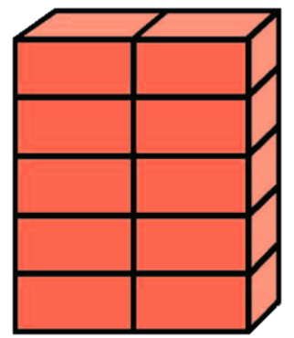
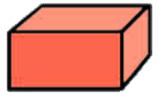
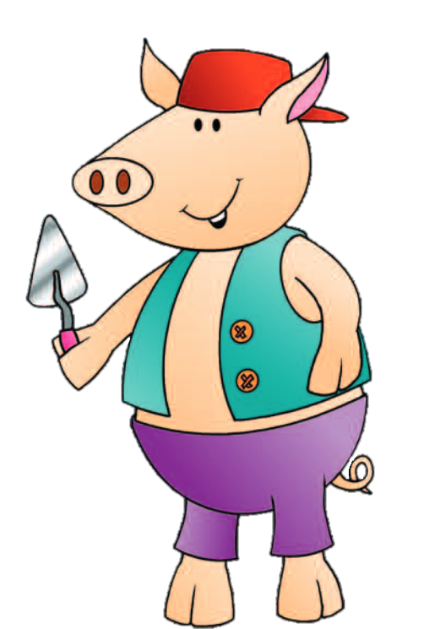
Ten bricks make one pack
Ten ones make one ten.
7 | 5
ten
pack
ten
pack
ten
pack
ten
pack
ten
pack
ten
pack
ten
pack
ten
pack
Tens | Ones
7 | 5
Seven tens and five ones is ____.
Notes:
New Learning: Developing understanding of place value
This builds on pupils’ learning from Unit 8, where they began to use place value charts to record numbers to 50 and recognise how this connects to the number of groups of ten and number of ones.
Give pupils a context for counting groups of ten and ones: bricks are sold in packs of ten. Get pupils to repeat the following sentence structures:
Ten bricks make one pack. Ten ones make one ten.
The pig on the slide has seven packs of ten and five loose bricks.
How many bricks does the pig have? How do you know?
Seven tens and five ones make 75.
Connect this to a ‘pictorial’ place value chart which has packs of ten bricks and one loose brick as the headings, as well as a standard ‘tens’ and ‘ones’ place value chart.
Can you explain how the numeral in the place value chart connects to the pig’s bricks? What does the digit 7 represent? What does the digit 5 represent?
Repeat with another example in a different context, to check for understanding (pears are sold in bags of ten). Ensure pupils understand that it doesn’t matter what the object is; if we group in tens, we write the numeral in the same way.

Slide 29
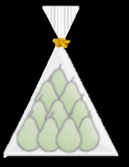
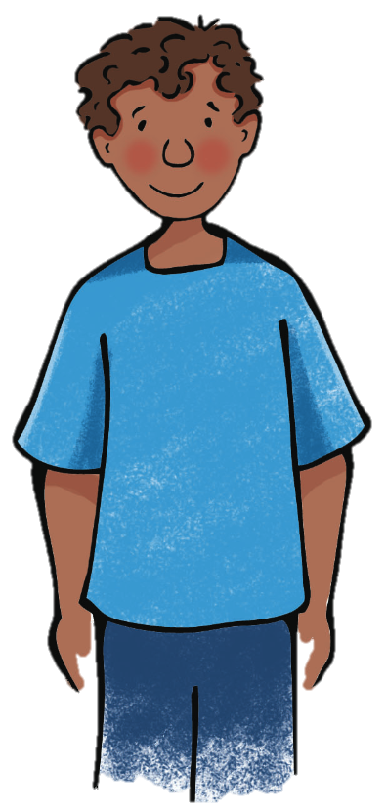
Mr Johnson sells pears in bags of ten
How many pears has Kadir bought?
How do you know?
5 | 9
Tens | Ones
5 | 9
Notes:
New Learning: Developing understanding of place value
This builds on pupils’ learning from Unit 8, where they began to use place value charts to record numbers to 50 and recognise how this connects to the number of groups of ten and number of ones.
Give pupils a context for counting groups of ten and ones: bricks are sold in packs of ten. Get pupils to repeat the following sentence structures:
Ten bricks make one pack. Ten ones make one ten.
The pig on the slide has seven packs of ten and five loose bricks.
How many bricks does the pig have? How do you know?
Seven tens and five ones make 75.
Connect this to a ‘pictorial’ place value chart which has packs of ten bricks and one loose brick as the headings, as well as a standard ‘tens’ and ‘ones’ place value chart.
Can you explain how the numeral in the place value chart connects to the pig’s bricks? What does the digit 7 represent? What does the digit 5 represent?
Repeat with another example in a different context, to check for understanding (pears are sold in bags of ten). Ensure pupils understand that it doesn’t matter what the object is; if we group in tens, we write the numeral in the same way.

Slide 30
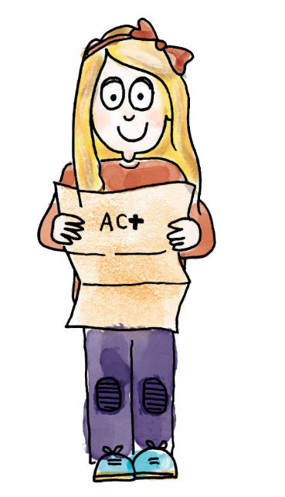
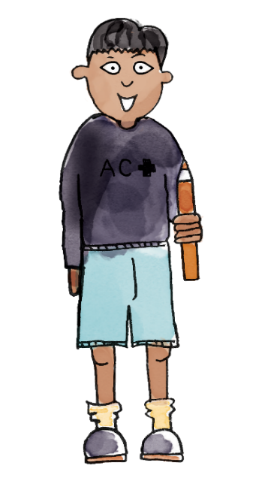
There are ten sticks in each bundle. There are seven bundles. Seven tens and two ones make 72.
The digit 7 represents the groups of ten. The digit 2 represents the two loose sticks. There are 72 sticks altogether.
7 | 2
Tens | Ones
7 | 2
tens ones place value groups of ten Dienes
Notes:
Talk Task: Understanding multiple representations of place value
Pupils have the Task Sheet. They discuss what they can see and how the different representations are connected. For example:
There are ten sticks in each bundle. There are seven bundles. Seven tens and two ones make 72.
The digit 7 represents the groups of ten. The digit 2 represents the two loose sticks. There are 72 sticks altogether.
Pupils could also comment on the similarities and differences between the numbers.

Slide 31
Representing 2-digit numbers
7 | 5
ten
pack
ten
pack
ten
pack
ten
pack
ten
pack
Tens | Ones
7 | 5
ten
pack
ten
pack
ten
pack
Tens | Ones
Notes:
Develop Learning: Representing numbers using Dienes on a place value chart
Return to the first example from the New Learning: the pig with 75 bricks.
How could we represent the pig’s bricks using Dienes? How many tens-blocks will I need? How many ones?
Place the Dienes in the corresponding columns on the last place value chart on the slide.
How do we write this number as a numeral in a place value chart?
Point out the numeral 75 as the digits 7 and 5 in the first two place value charts.
What does the digit 7 represent? What about the digit 5?
What is the same and what is different between the different representations of the number 75 on the board?

Slide 32
Representing 2-digit numbers Your turn!
ten
pack
ten
pack
ten
pack
ten
pack
Tens | Ones
ten
pack
ten
pack
Tens | Ones
Challenge:
Draw this as a part, part, whole model.
Notes:
Develop Learning: Representing numbers using Dienes on a place value chart
Return to the first example from the New Learning: the pig with 75 bricks.
How could we represent the pig’s bricks using Dienes? How many tens-blocks will I need? How many ones?
Place the Dienes in the corresponding columns on the last place value chart on the slide.
How do we write this number as a numeral in a place value chart?
Point out the numeral 75 as the digits 7 and 5 in the first two place value charts.
What does the digit 7 represent? What about the digit 5?
What is the same and what is different between the different representations of the number 75 on the board?

Slide 33
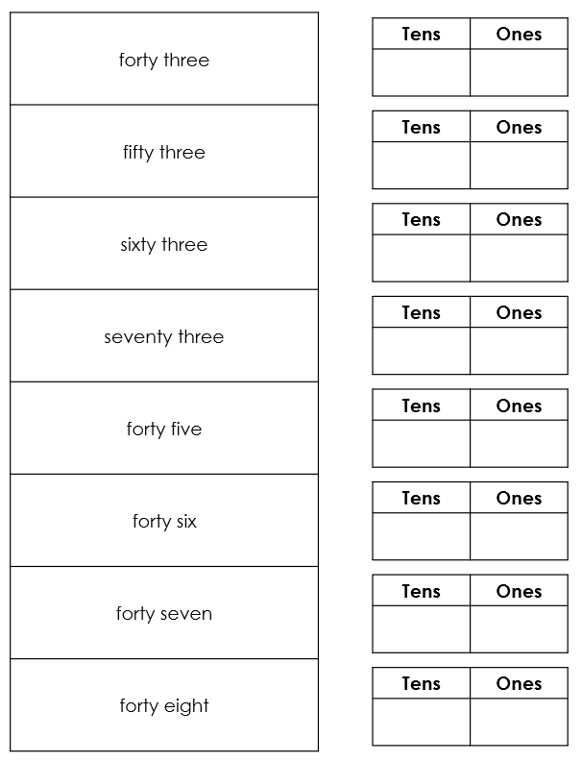
To represent numbers using Dienes on a place value chart
Make each number using Dienes on a place value chart.
Then record it as a numeral in the place value chart on the sheet.
Tens | Ones
Notes:
Independent Task: Writing numbers using understanding of place value
Pupils have the Task Sheet, Dienes and a large place value chart. They read each number in words, make a representation of it on the place value chart using Dienes and then record it as a numeral in the place value chart on the sheet.
Possible adaptations:
Give pupils picture cards with images of Dienes to match to the numbers in words. They could also copy the picture using Dienes blocks.
Ask pupils to identify what’s the same and what’s different between the numbers in the task, e.g. that the first four examples all have three ones.

Slide 34
RP:

Slide 35
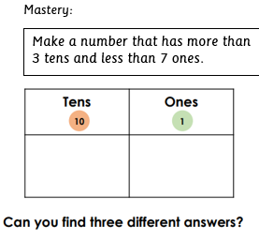
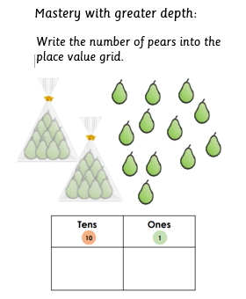

Slide 36
Which of these shows 68?
Notes:
Plenary: Explaining and justifying
Show pupils the six Dienes representations on the slide.
Which representations show the number 68?
Have you found all of them?
There are four images that show 68 - the purpose is for pupils to recognise that 68 can be grouped in different ways, e.g. five groups of ten and 18 ones.

Slide 37
Lunch

Slide 38
Today's Alien language is.......

Slide 39
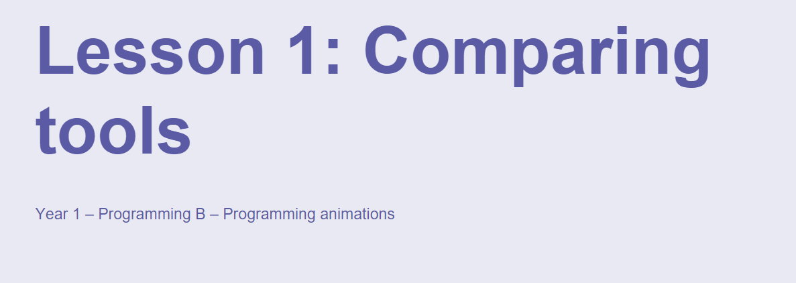
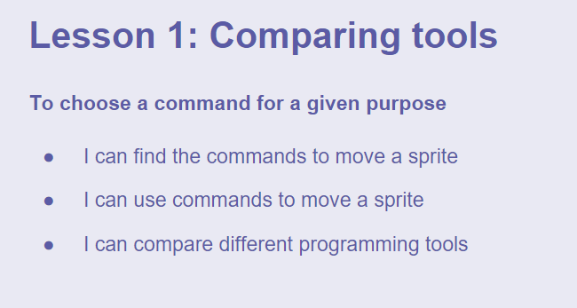
TBAT: choose a command for a given purpose.
Wednesday 17th April 2024

Slide 40
TBAT: choose a command for a given purpose.
Wednesday 17th April 2024
This half term we will be using a programme called 'Scratch'.
We are going to be moving 'Scratch' around the screen.

Slide 41
TBAT: choose a command for a given purpose.
Wednesday 17th April 2024
Blue/Green-
What vocabulary will be used to guide Scratch round the screen?
Hint: Think of vocabulary we have used when working with the Beebots.

Slide 42
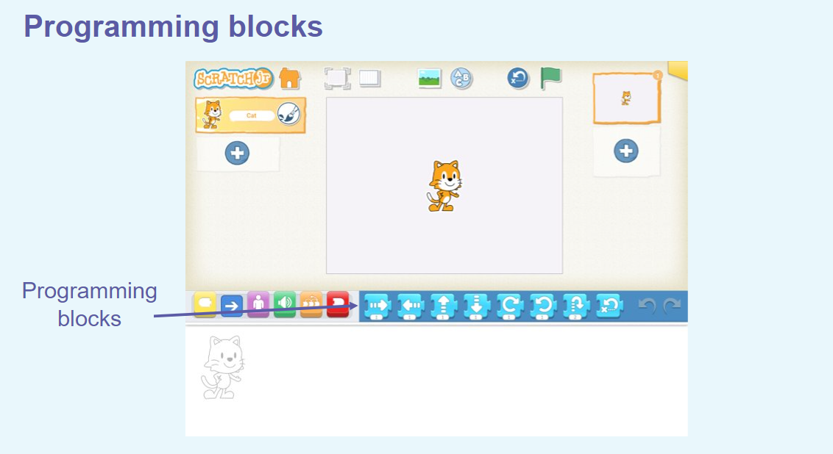
TBAT: choose a command for a given purpose.
Wednesday 17th April 2024

Slide 43
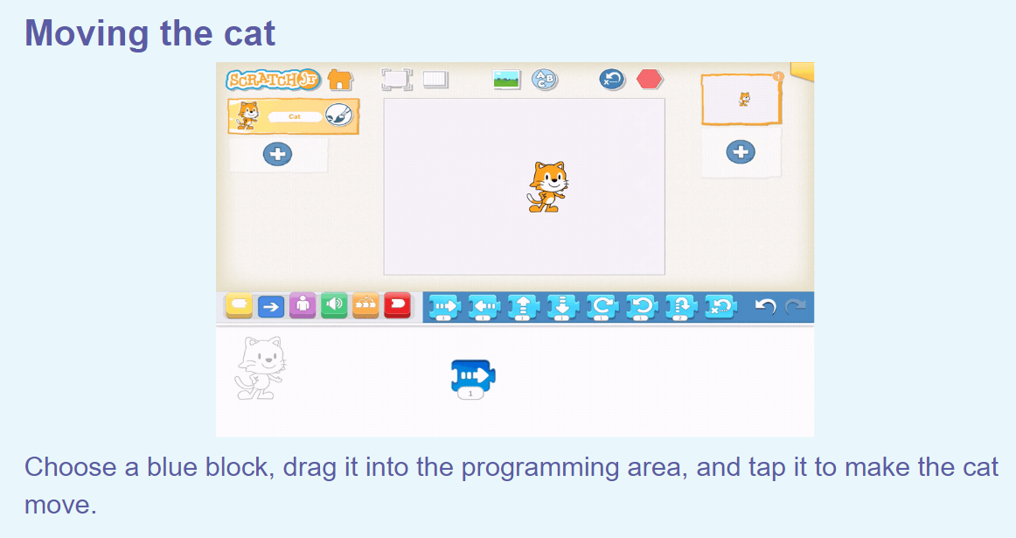
TBAT: choose a command for a given purpose.
Wednesday 17th April 2024

Slide 44
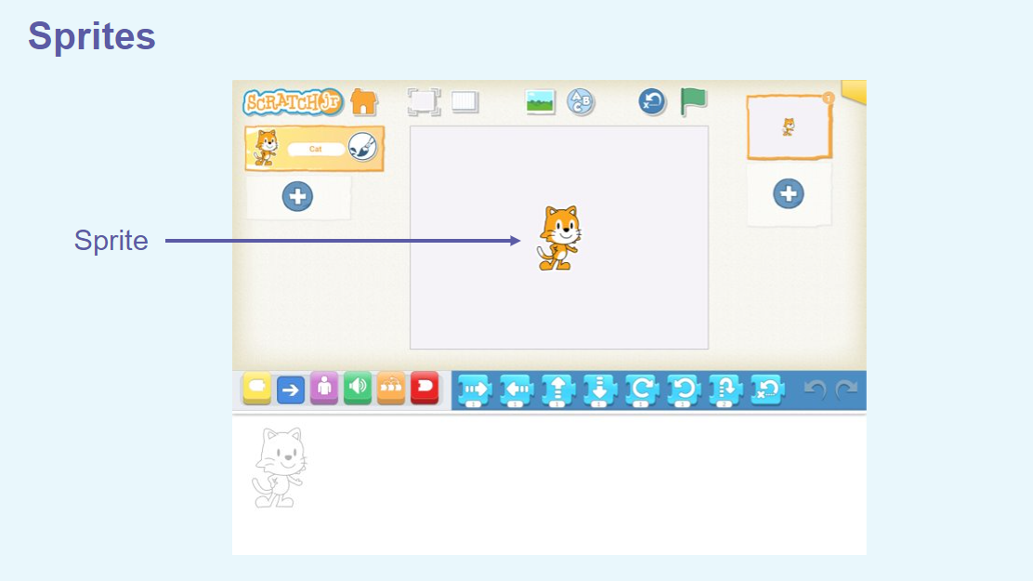
TBAT: choose a command for a given purpose.
Wednesday 17th April 2024

Slide 45
TBAT: choose a command for a given purpose.
Wednesday 17th April 2024

Slide 46
TBAT: choose a command for a given purpose.
Wednesday 17th April 2024

Slide 47
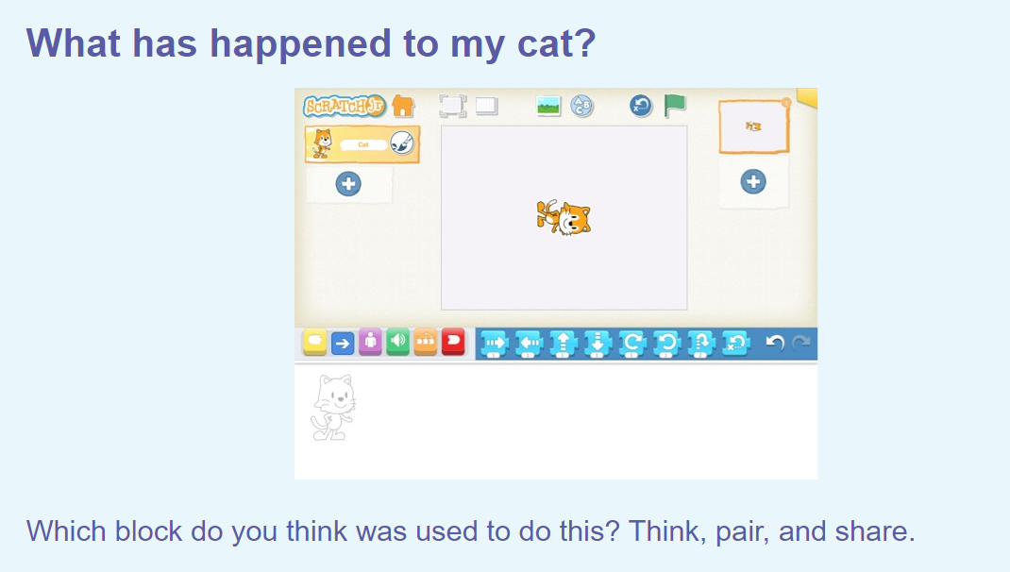
TBAT: choose a command for a given purpose.
Wednesday 17th April 2024
Talk Partners:
Which block do you think has been used to move the cat?

Slide 48
Art – TBAT: Create a family portrait.
Blue / Green
Think about your family. What is great about them?
What do you love about them?
Tell your partner about your family.
I love my family because…
When I think about my family, I feel…
Blue first!

Slide 49
Today, we are going to create a family portrait.
What is a portrait?

Slide 50
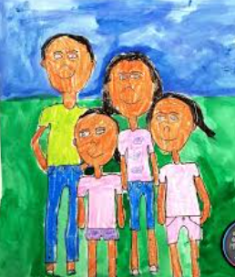
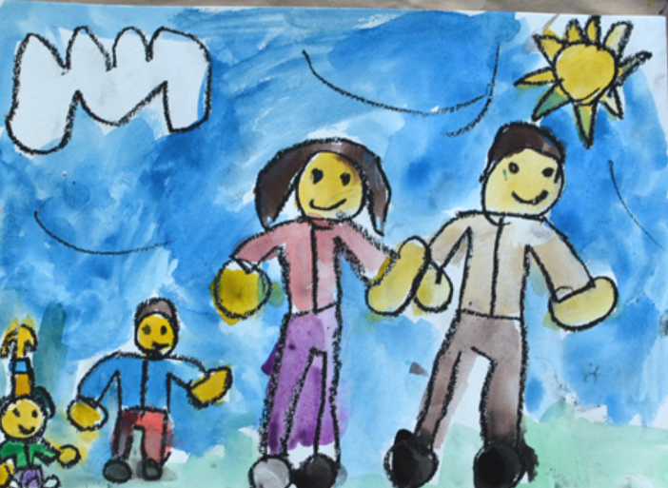
A portrait is an artistic representation, such as a painting, drawing, photograph, or sculpture, of a person or group of people.
So a family portrait is an artist’s picture of a family.

Slide 51
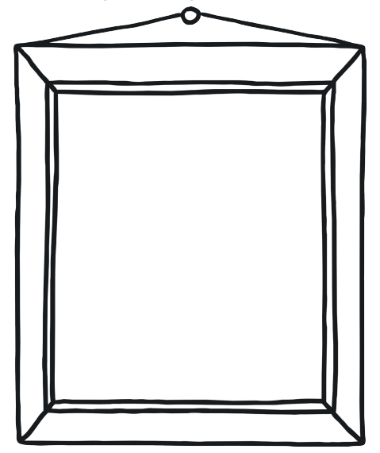
Think about how your portrait will look. Where will your family members be standing?
What will they be wearing?
What will be in the background?

Slide 52
First, choose your frame.
Then, draw your family members.
Colour them in.
Decorate the frame in the colours that remind you of your family.
Take your time and do your best.

