Slide 1
Tuesday 22nd April 2025 22/4/25

Slide 2
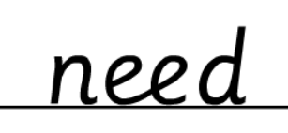
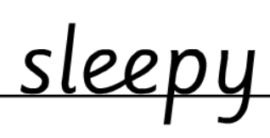
Morning Challenges:
Name writing

Slide 3
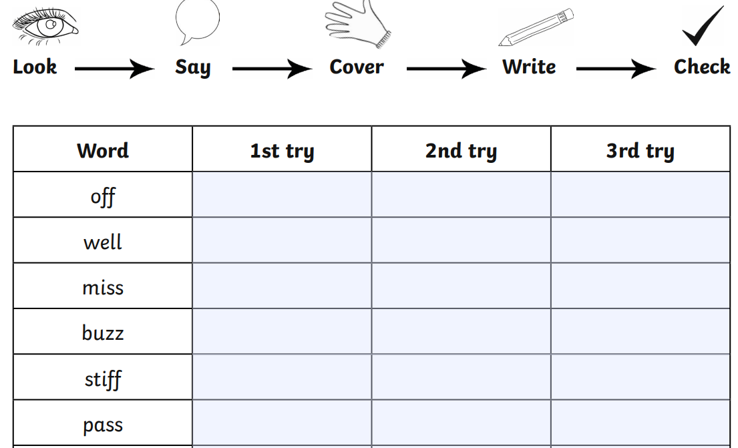
Early Morning Work
Write the word – They all end in a double consonant!

Slide 4
TBAT: read and write words which include the /ch/ and /sh/ digraphs.
Tuesday 22nd April 2025
Speedy sounds
Digital Flashcards - Teach Your Monster to Read

Slide 5
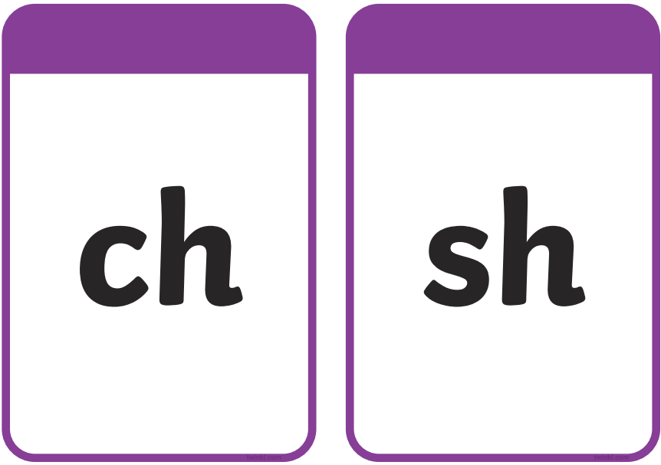
TBAT: read and write words which include the /ch/ and /sh/ digraphs.
Tuesday 22nd April 2025

Slide 6
TBAT: read and write words which include the /ch/ and /sh/ digraphs.
Tuesday 22nd April 2025
Do these words contain a /ch/ sound?
short
bunch
chair
dark
church

Slide 7
TBAT: read and write words which include the /ch/ and /sh/ digraphs.
Tuesday 22nd April 2025
Do these words contain a /sh/ sound?
dish
brick
thorn
shape
shark

Slide 8
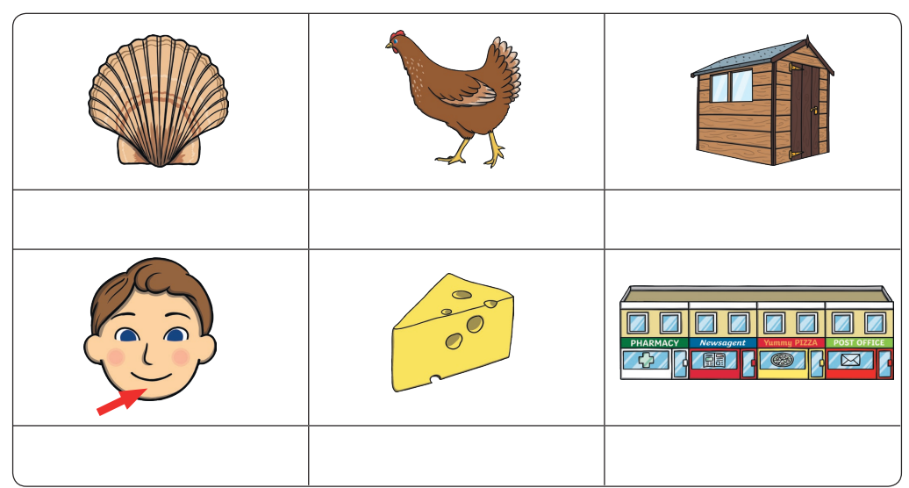
TBAT: read and write words which include the /ch/ and /sh/ digraphs.
Tuesday 22nd April 2025
Label the pictures: Use red to write the /sh/ words and blue to write the /ch/ words.

Slide 9
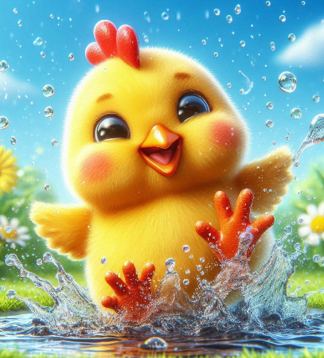
TBAT: read and write words which include the /ch/ and /sh/ digraphs.
Tuesday 22nd April 2025
Underline the /ch/ and /sh/ graphemes in the sentence.
The chicken splashed in the puddle.

Slide 10
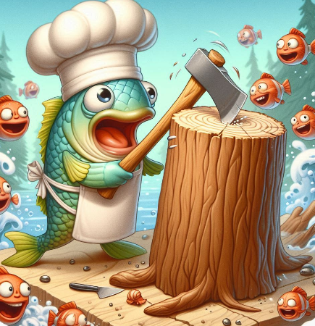
TBAT: read and write words which include the /ch/ and /sh/ digraphs.
Tuesday 22nd April 2025
…......................................................................
…......................................................................
….......................................................................
…........................................................................

Slide 11
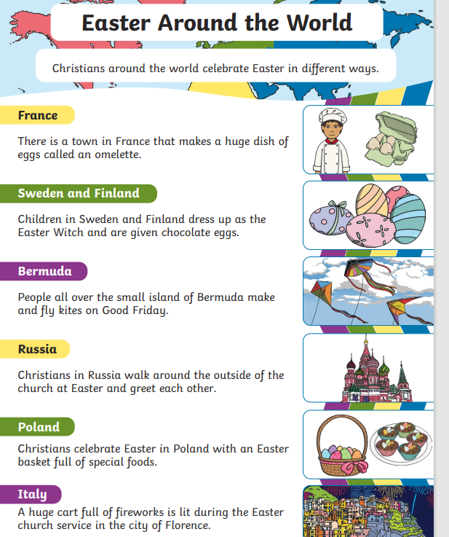
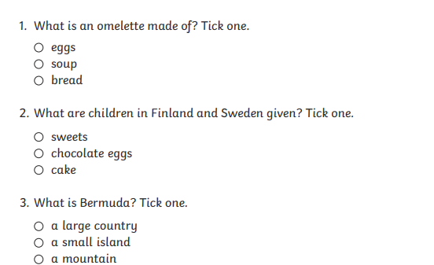
TBAT: answer questions about a text.
Tuesday 22nd April 2025
3 in 3

Slide 12
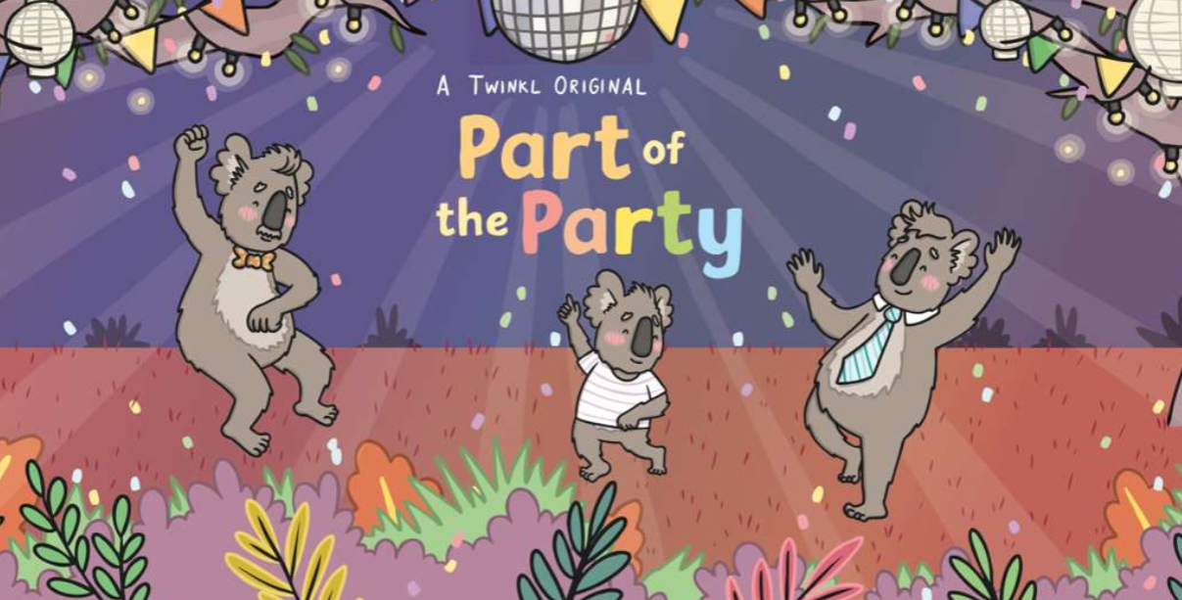
TBAT: answer questions about a text.
Tuesday 22nd April 2025
Blue/ Green- Use 'because' to explain your answer.
Who do you think the main characters are in the story?
What do you think might happen in the story?
I think the main characters are............ because.............
I think …....... will happen because.............

Slide 13
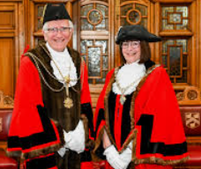
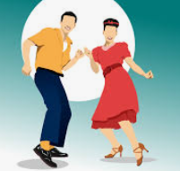
TBAT: answer questions about a text.
Tuesday 22nd April 2025
Words you will come across in the text:
mayor: the head of a city or town.
boogie: to dance energetically
confused: you don't understand things well.

Slide 14
TBAT: answer questions about a text.
Tuesday 22nd April 2025

Slide 15
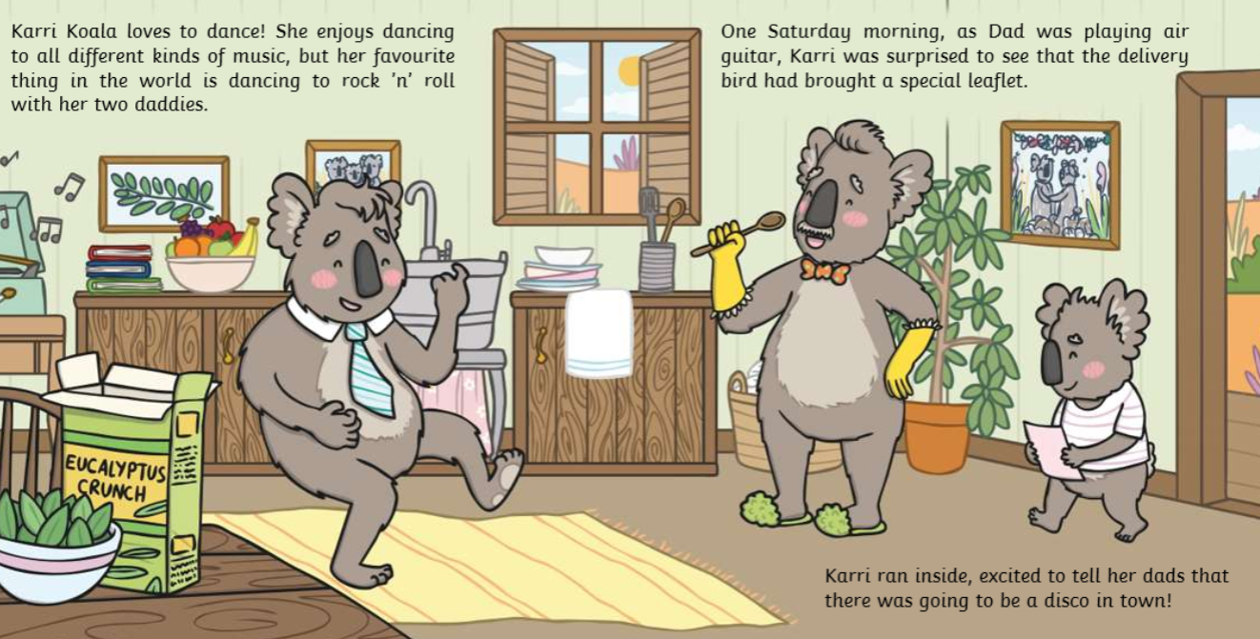
TBAT: answer questions about a text.
Tuesday 22nd April 2025

Slide 16
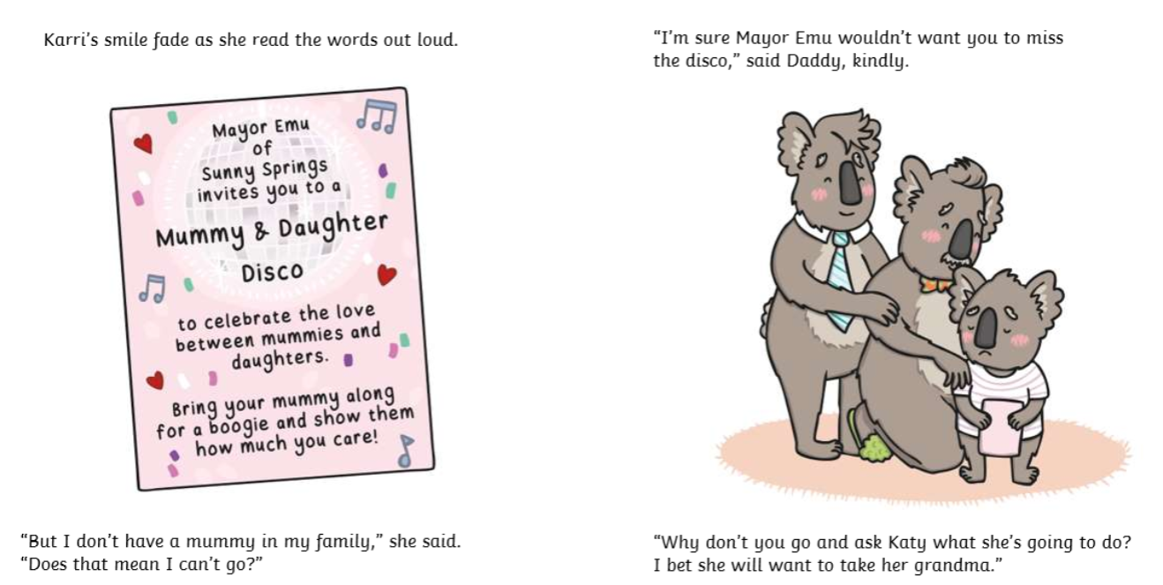
TBAT: answer questions about a text.
Tuesday 22nd April 2025

Slide 17
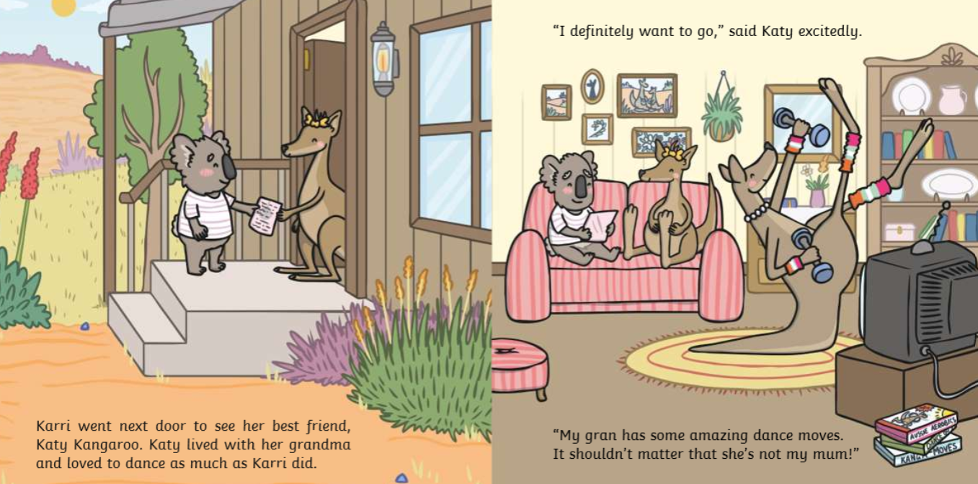
TBAT: answer questions about a text.
Tuesday 22nd April 2025

Slide 18
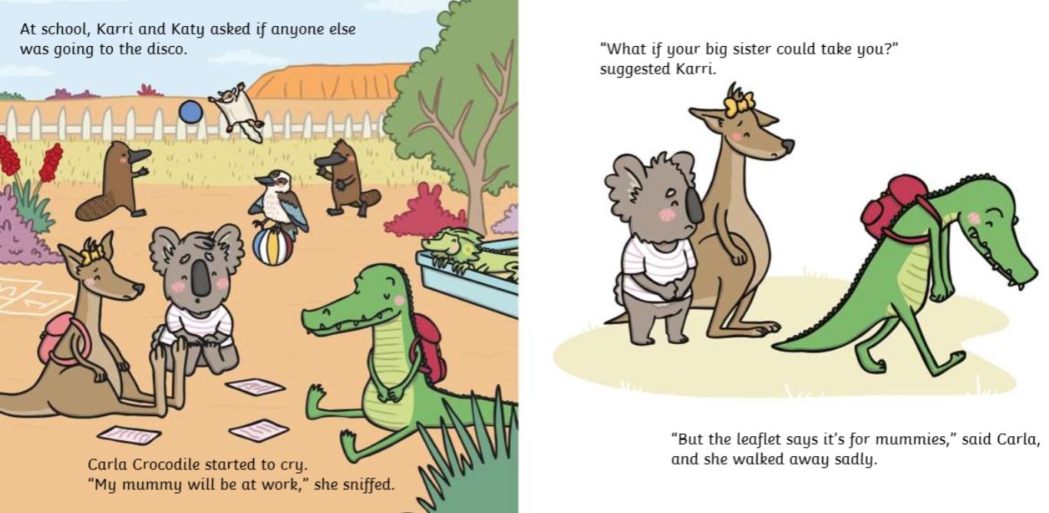
TBAT: answer questions about a text.
Tuesday 22nd April 2025

Slide 19
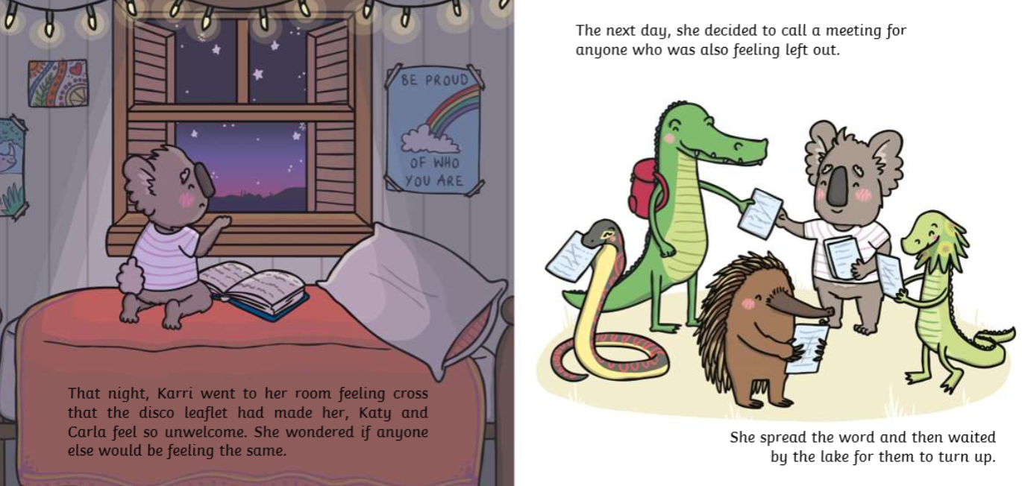
TBAT: answer questions about a text.
Tuesday 22nd April 2025

Slide 20
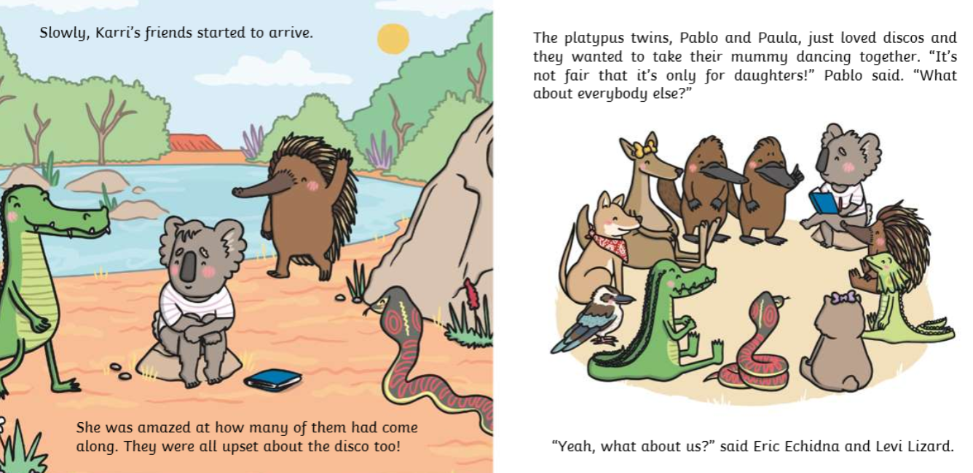
TBAT: answer questions about a text.
Tuesday 22nd April 2025

Slide 21
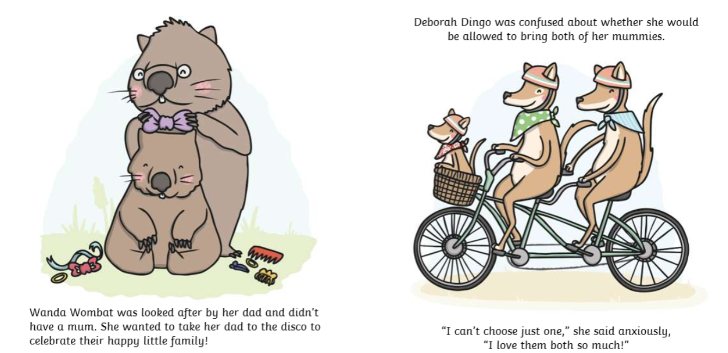
TBAT: answer questions about a text.
Tuesday 22nd April 2025

Slide 22
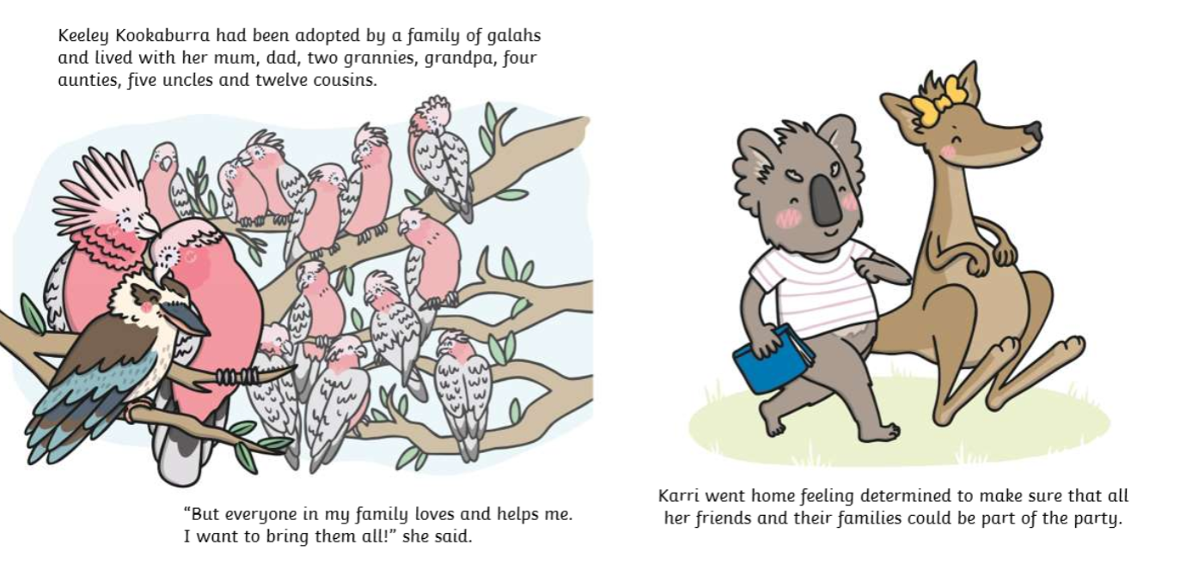
TBAT: answer questions about a text.
Tuesday 22nd April 2025

Slide 23
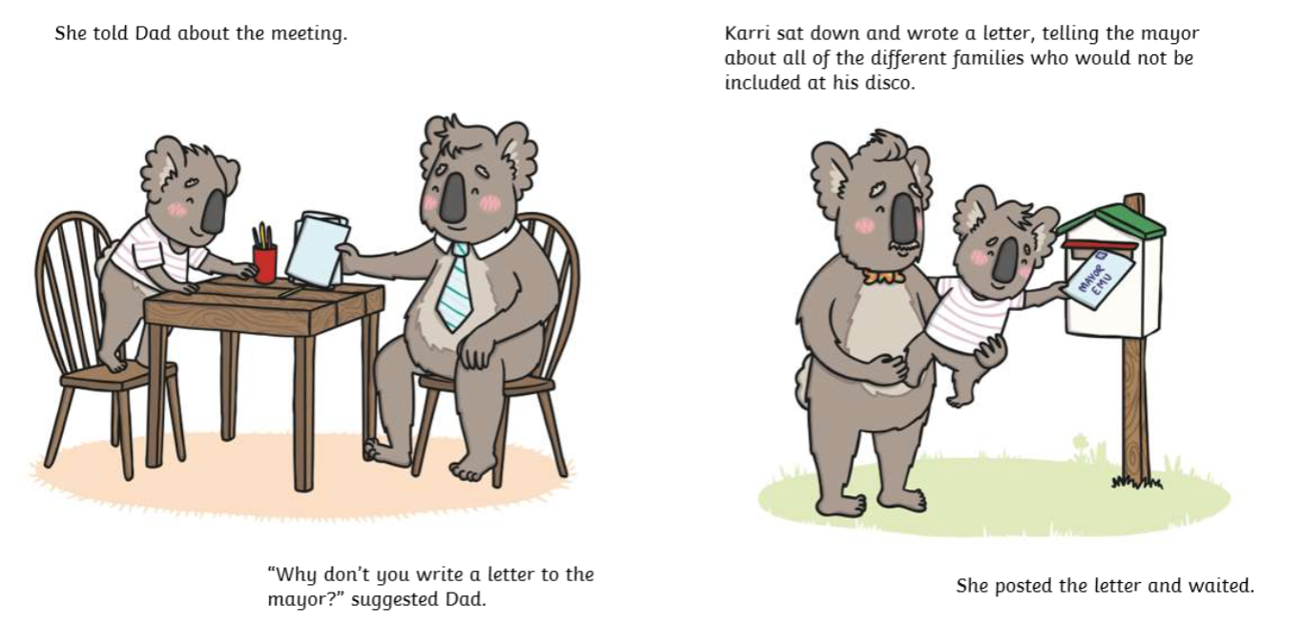
TBAT: answer questions about a text.
Tuesday 22nd April 2025

Slide 24
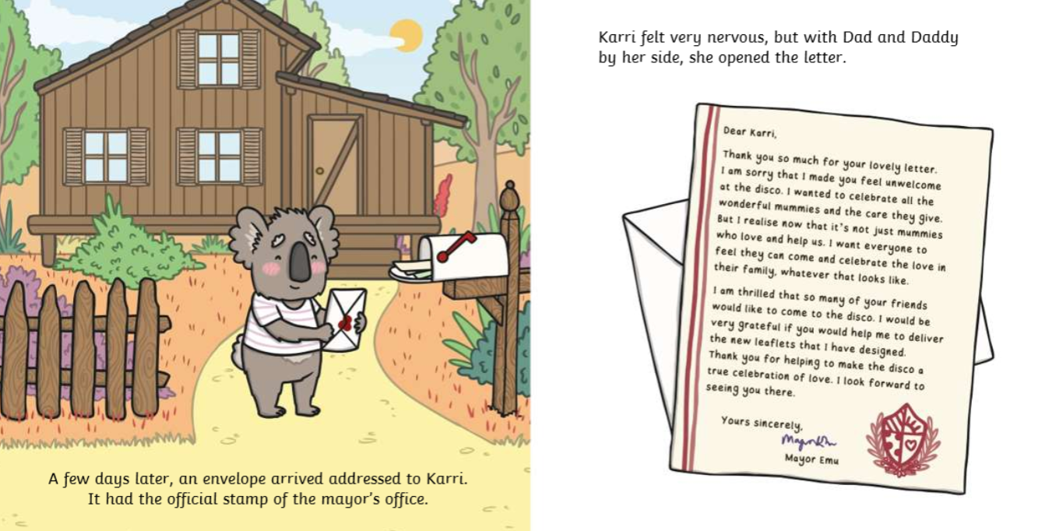
TBAT: answer questions about a text.
Tuesday 22nd April 2025

Slide 25
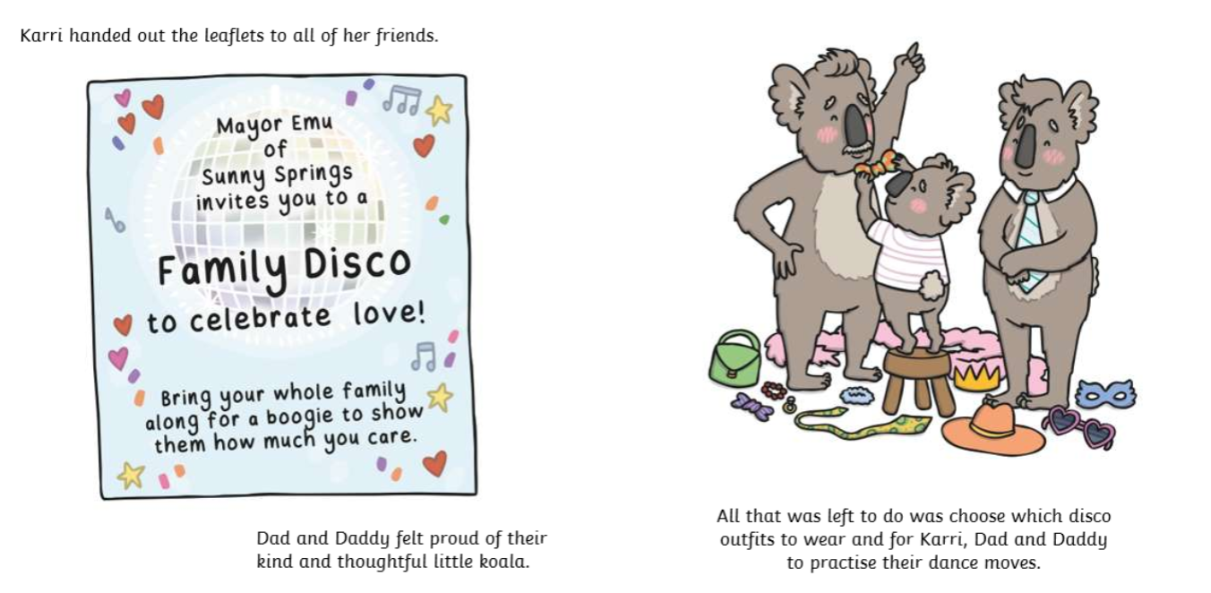
TBAT: answer questions about a text.
Tuesday 22nd April 2025

Slide 26
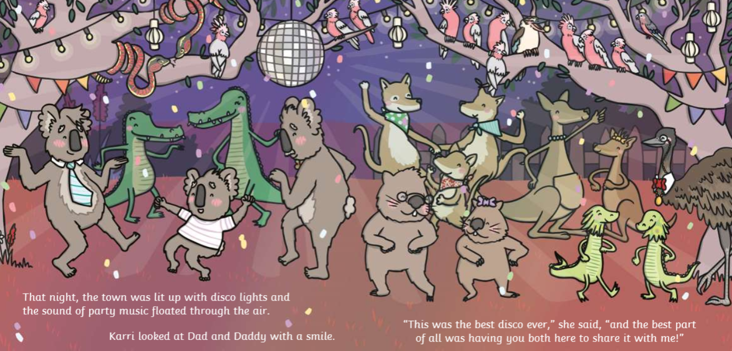
TBAT: answer questions about a text.
Tuesday 22nd April 2025

Slide 27
TBAT: answer questions about a text.
Tuesday 22nd April 2025
What is Kari's favourite thing to do in the world?
Playing the drums
Dancing with her daddies
Reading a book under a tree.

Slide 28
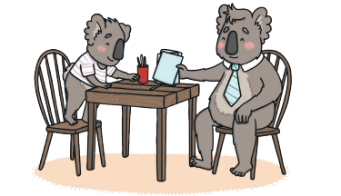
TBAT: answer questions about a text.
Tuesday 22nd April 2025
Who does Karri's Dad tell her to write a letter to?
The king
The prime minister
The mayor

Slide 29
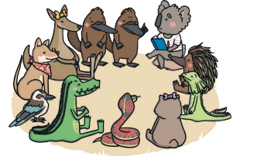
TBAT: answer questions about a text.
Tuesday 22nd April 2025
Where does Karri wait for her friend after she has called a meeting?
The lake
In the woods
In a cave

Slide 30
TBAT: answer questions about a text.
Tuesday 22nd April 2025
What do you think the main message of this story is?

Slide 31
Assembly

Slide 32
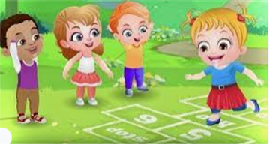
Break

Slide 33
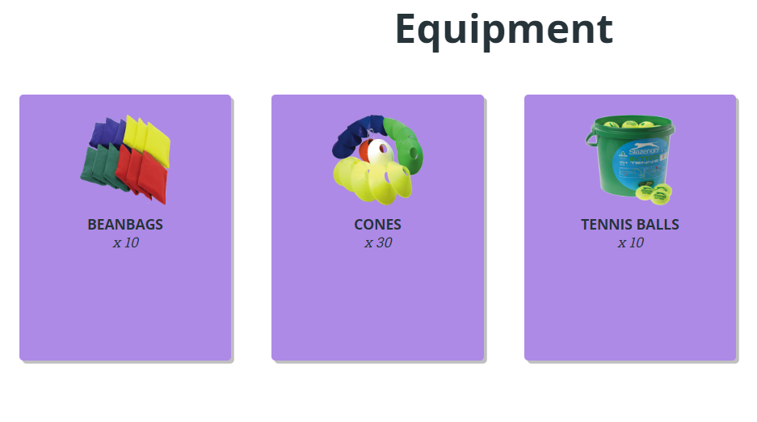
TBAT – develop underarm throwing and catching
2 in 2
What 2 parts of the body do we use to throw/catch a ball?
Name 2 sports that we throw or catch a ball

Slide 34
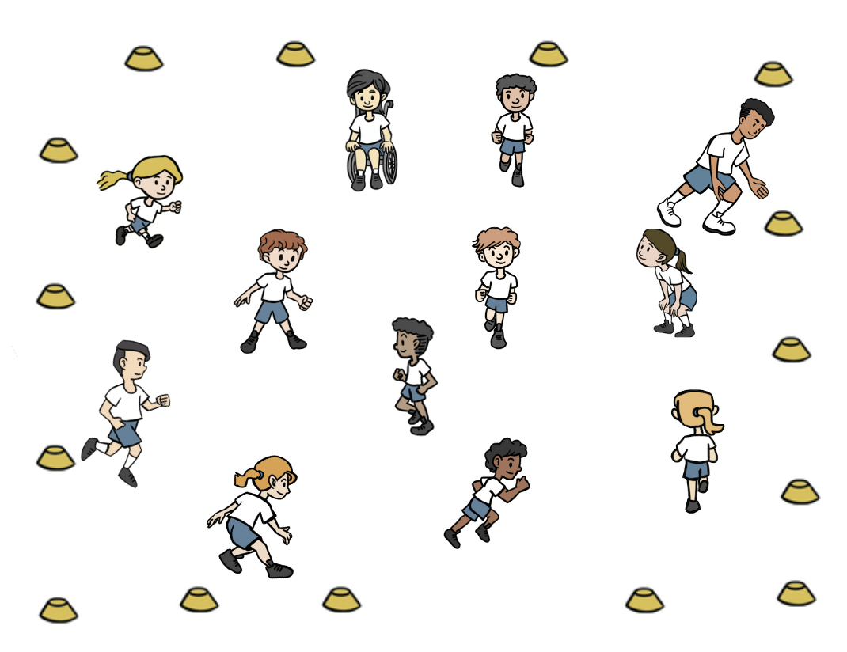
TBAT – develop underarm throwing and catching
Warm-up
Everyone has a cone that they place around the outside of the teaching space.
Jog around inside the cones.
When a number is called pupils run to touch that number of cones before continuing to travel again.

Slide 35
TBAT – develop underarm throwing and catching
Skill development
Throwing
Get into groups of 3 – have a bean bag each
With a straight arm swing the bean bag backwards and then forwards letting go. Take turns.
Step with the opposite foot to throwing hand. Finish with your hand pointing at your target.
Catching
Throw and catch whilst counting in tens out loud. How many tens can they get to? Repeat.
Call your partner's name if they are not looking at you. Track the beanbag by watching it and moving your feet if needed.

Slide 36
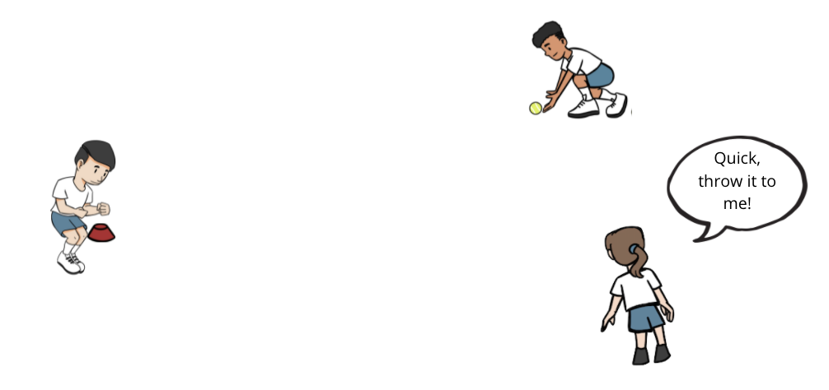
TBAT – develop underarm throwing and catching
Skill development
One of you is the batter with the ball by a cone.
The other two pupils are the fielders.
The batter throws the ball out in to the space and then starts to jump side to side over their cone, scoring one point for every jump.
The fielders collect the ball as quickly as possible and complete ten passes before shouting ‘stop’.
Communicate with your teammate to decide who will collect the ball. Move towards the ball as soon as it is thrown and as quickly as possible. Make sure your teammate is looking at you before you throw.

Slide 37
Plenary
My job as a batter is to score points
If I want the ball to go to my partner, I finish with my hand pointing at the sky.
To do an underarm throw, I use two hands.
When I throw, I step forward with the opposite foot to my throwing hand.

Slide 38
Lunch

Slide 39
Today's Alien language is.......

Slide 40
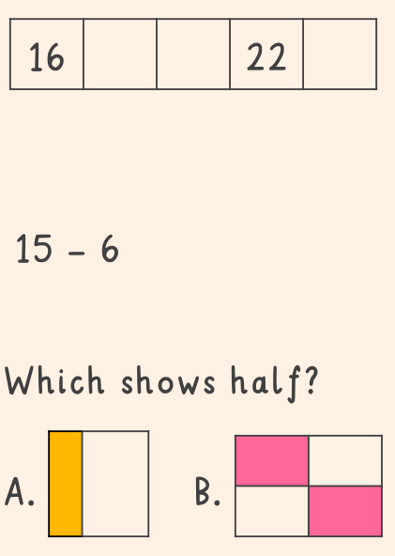
3 in 3
TBAT: count groups of ten and then count on in ones to identify 2-digit numbers

Slide 41
Practice counting in tens
TBAT: count groups of ten and then count on in ones to identify 2-digit numbers
Notes:
Do Now: Making groups of ten
In pairs or small groups, give pupils a large set of interlocking cubes. Ensure the quantity is a multiple of ten, e.g. 50 cubes. They make groups of ten and count the groups of ten.
I have made five groups of ten. Ten, twenty, thirty, forty, fifty.

Slide 42
TBAT: count groups of ten and then count on in ones to identify 2-digit numbers
ten
sixty
groups of ten
twenty
seventy
count on
thirty
eighty
tens
forty
ninety
ones
fifty
one hundred

Slide 43
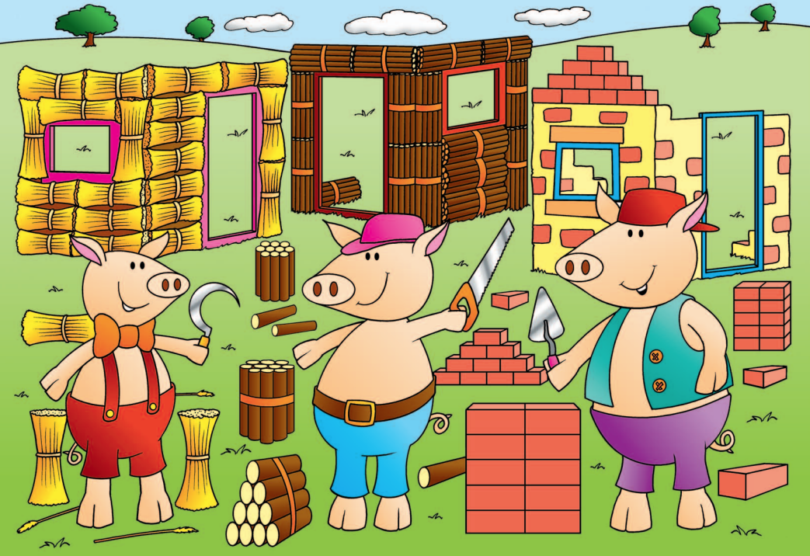
Where's the maths in that?
Blue/ green
Take turns to say what maths you can see within the picture.
Notes:
New Learning: Introducing numbers to 100
Show pupils the Big Picture (The Three Little Pigs) and ask what maths they can see. Explain that this unit is about counting and recognising numbers greater than 50. Explain that the three little pigs will have needed lots of straw, sticks and bricks to build their houses.
Then show the picture on the next slide of the pig with many ungrouped bricks. Ask pupils if they can tell you how many there are. Don’t give them too long for this but establish that it is difficult to keep track of counting such a large number.
Use the next slide to show the same bricks organised into groups of ten. Ask pupils to count in tens with a partner to find the total.
How do you know how many bricks there are?
Which representation is easier to count? Why?
Now use Dienes tens-blocks and have pupils identify different multiples of ten, talking about how many groups of ten there are and how many this is in total. (The next slide supports this.)
There are five groups of ten. That’s fifty. Five groups of ten and one more group of ten is six groups of ten. Six groups of ten are equal to 60.
You might also connect this to a number line representation by organising the Dienes horizontally along a number line.

Slide 44
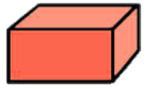
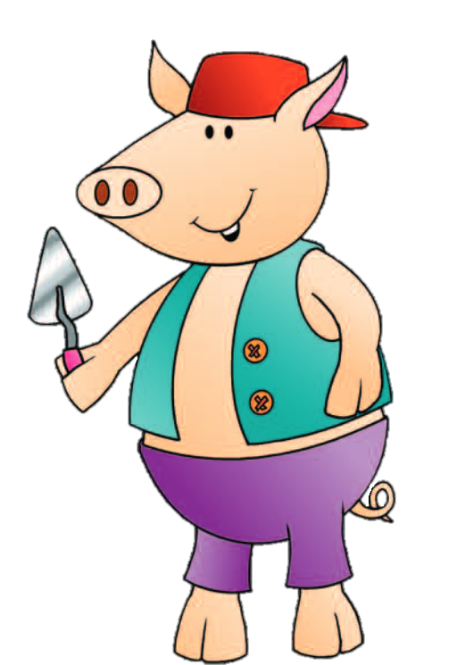
I bought all these bricks to build my house.
Can you tell me how many there are?
Notes:
New Learning: Introducing numbers to 100
Show pupils the Big Picture (The Three Little Pigs) and ask what maths they can see. Explain that this unit is about counting and recognising numbers greater than 50. Explain that the three little pigs will have needed lots of straw, sticks and bricks to build their houses.
Then show the picture on the next slide of the pig with many ungrouped bricks. Ask pupils if they can tell you how many there are. Don’t give them too long for this but establish that it is difficult to keep track of counting such a large number.
Use the next slide to show the same bricks organised into groups of ten. Ask pupils to count in tens with a partner to find the total.
How do you know how many bricks there are?
Which representation is easier to count? Why?
Now use Dienes tens-blocks and have pupils identify different multiples of ten, talking about how many groups of ten there are and how many this is in total. (The next slide supports this.)
There are five groups of ten. That’s fifty. Five groups of ten and one more group of ten is six groups of ten. Six groups of ten are equal to 60.
You might also connect this to a number line representation by organising the Dienes horizontally along a number line.

Slide 45
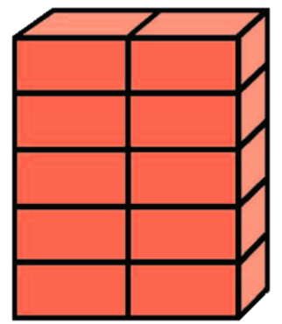
I've tidied all the bricks! There are ten in each pile. Count them with a partner.
Is it easier to count them now? Why?
Notes:
New Learning: Introducing numbers to 100
Show pupils the Big Picture (The Three Little Pigs) and ask what maths they can see. Explain that this unit is about counting and recognising numbers greater than 50. Explain that the three little pigs will have needed lots of straw, sticks and bricks to build their houses.
Then show the picture on the next slide of the pig with many ungrouped bricks. Ask pupils if they can tell you how many there are. Don’t give them too long for this but establish that it is difficult to keep track of counting such a large number.
Use the next slide to show the same bricks organised into groups of ten. Ask pupils to count in tens with a partner to find the total.
How do you know how many bricks there are?
Which representation is easier to count? Why?
Now use Dienes tens-blocks and have pupils identify different multiples of ten, talking about how many groups of ten there are and how many this is in total. (The next slide supports this.)
There are five groups of ten. That’s fifty. Five groups of ten and one more group of ten is six groups of ten. Six groups of ten are equal to 60.
You might also connect this to a number line representation by organising the Dienes horizontally along a number line.

Slide 46
ten 10 | twenty 20 | thirty 30 | forty 40 | fifty 50
sixty 60 | seventy 70 | eighty 80 | ninety 90 | one hundred 100
Notes:
New Learning: Introducing numbers to 100
Show pupils the Big Picture (The Three Little Pigs) and ask what maths they can see. Explain that this unit is about counting and recognising numbers greater than 50. Explain that the three little pigs will have needed lots of straw, sticks and bricks to build their houses.
Then show the picture on the next slide of the pig with many ungrouped bricks. Ask pupils if they can tell you how many there are. Don’t give them too long for this but establish that it is difficult to keep track of counting such a large number.
Use the next slide to show the same bricks organised into groups of ten. Ask pupils to count in tens with a partner to find the total.
How do you know how many bricks there are?
Which representation is easier to count? Why?
Now use Dienes tens-blocks and have pupils identify different multiples of ten, talking about how many groups of ten there are and how many this is in total. (The next slide supports this.)
There are five groups of ten. That’s fifty. Five groups of ten and one more group of ten is six groups of ten. Six groups of ten are equal to 60.
You might also connect this to a number line representation by organising the Dienes horizontally along a number line.

Slide 47
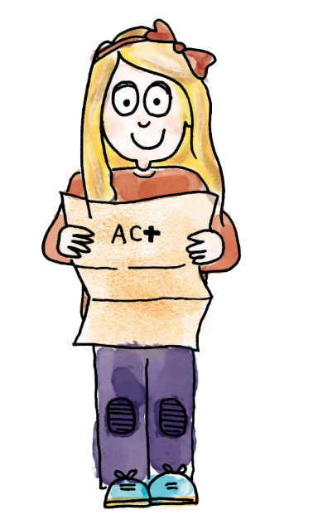
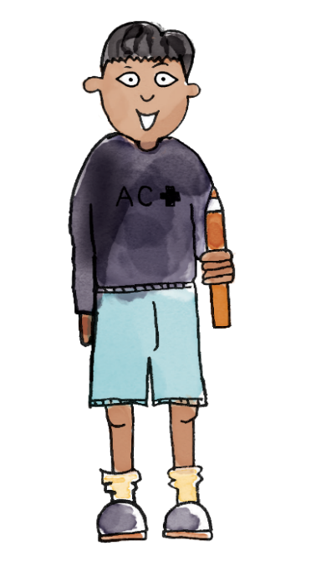
Here are some groups of ten.
One, two, three, four, five, six.
There are six groups of ten.
Ten, twenty, thirty, forty, fifty, sixty.
Six groups of ten are equal to 60.
groups of ten count on tens ones ten twenty thirty forty fifty sixty seventy eighty ninety one hundred
Notes:
Talk Task: Counting groups of ten
Pupils have objects pre-grouped into tens (e.g. interlocking cubes, lollipop sticks or straws). If possible, give different pairs of children different objects and draw attention to this to support their understanding of multiple representations, e.g. that 20 straws has the same value as 20 interlocking cubes. Dienes tens-blocks can also be used as another representation.
Pupil A gives Pupil B a number of groups of ten. Pupil B counts how many groups of ten there are (e.g. ‘There are seven groups of ten’). Pupil A counts in tens to identify the total number of ones (e.g. counting in tens to seventy). Pupils swap roles.

Slide 48
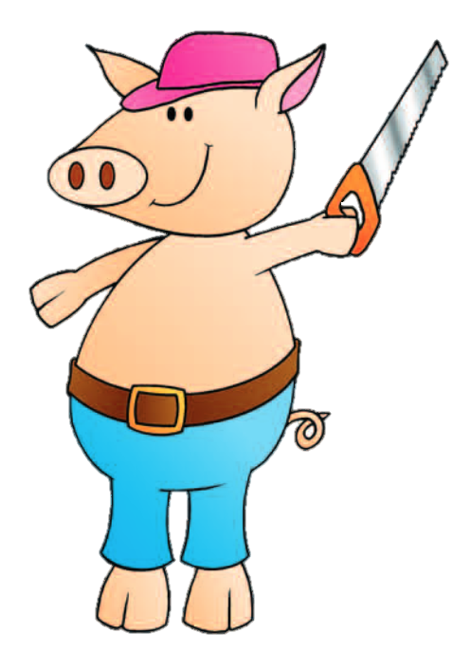
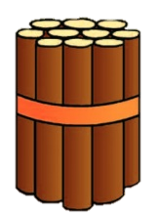
Blue / Green
Challenge: count in twos instead of ones.
How many bricks do I have?
What is the best way to count them?
How many sticks do I have?
What is the best way to count them?
I would count them like this because…
Notes:
Develop Learning: Counting in tens and on in ones to identify 2-digit numbers
Now move on to identifying any number within 100 by counting groups of ten first and then counting on in ones. Use the images of the pigs with their bricks and sticks as a stimulus. Have pupils make their own representations of the same numbers using Dienes.
Ten, twenty, thirty, forty, fifty, sixty, seventy. I’ve counted all the groups of ten. Now I need to count on in ones: 71, 72, 73, 74. The pig has 74 bricks.
Draw attention to the fact that the image on the slide and the Dienes representation have the same value but a different appearance. You might also use this part of the lesson to connect the Dienes to a number line representation, as in the New Learning.

Slide 49
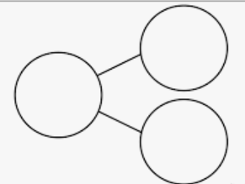
On white boards
Count them up and write the number you count.
Challenge:
Draw a part, part, whole model for each.

Slide 50
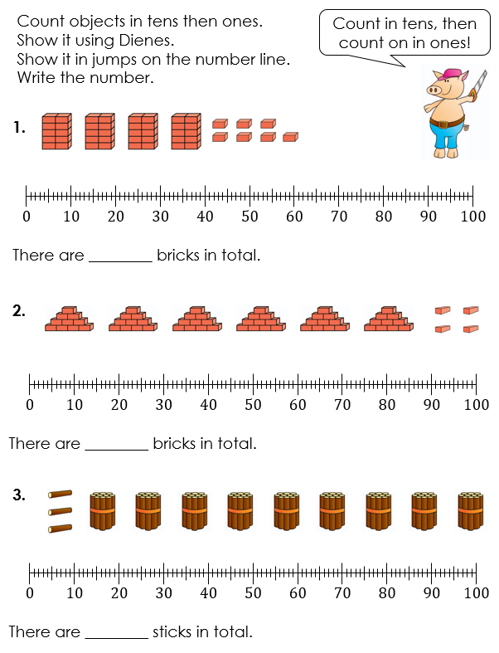
To count groups of ten and then count on in ones to identify 2-digit numbers
Notes:
Independent Task: Counting in tens then on in ones to identify 2-digit numbers
Pupils have Dienes tens-blocks and ones-blocks (nine tens and nine ones) and both pages of the Task Sheet. On the first page, pupils look at the pictorial representations and make each one using Dienes. They count in tens and on in ones to identify the total. They record this on a number line and in numerals. On the second page, pupils match written and pictorial representations and identify similarities and differences between the numbers.
Possible adaptations:
Adapt the first page of the Task Sheet to remove the number lines if you do not intend to teach this. Alternatively, you could model one of these on the Task Sheet.
Adapt the manipulatives/representations used, depending on pupil familiarity, either to scaffold or add challenge.

Slide 51
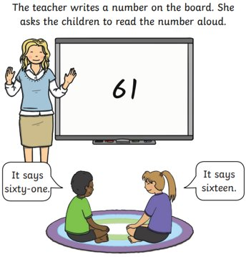
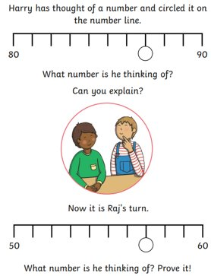
Challenge mastery

Slide 52
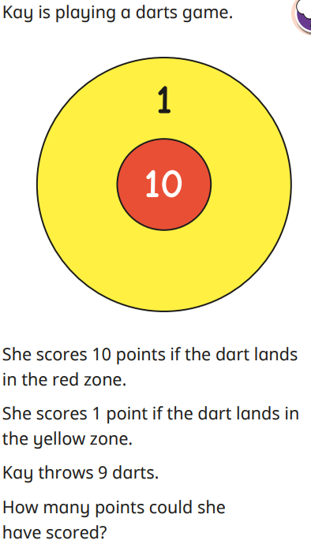
Mastery with Greater depth

Slide 53
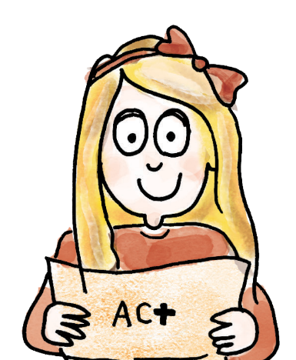
Play ‘Make 50’
Each pupil can say one, two or three consecutive numbers on their turn. The one who says 50 wins!
40, 41, 42.
43, 44.
45.
46, 47, 48.
49, 50. I win!
Notes:
Plenary: ‘Make 50’
Pupils take it in turns to say one, two or three consecutive numbers, starting at 40. The person to say 50 is the winner.
Is it better to start or let your partner start? Why?
You could adapt this for different number ranges, e.g. ‘make 80’.

Slide 54
Blue/ Green
TBAT: understand what is a pilgrimage.
Tuesday 22nd April 2025
Blue first, discuss with your partner, all of the information you remember from Autumn terms 'Introduction to Islam' unit.
mosque Allah worship fast

Slide 55
What is a pilgrimage?
TBAT: understand what is a pilgrimage.
Tuesday 22nd April 2025

Slide 56
TBAT: understand what is a pilgrimage.
Tuesday 22nd April 2025
A pilgrimage is a special religious journey that people make.

Slide 57
TBAT: understand what is a pilgrimage.
Tuesday 22nd April 2025
Lots of religions have pilgrimages.

Slide 58
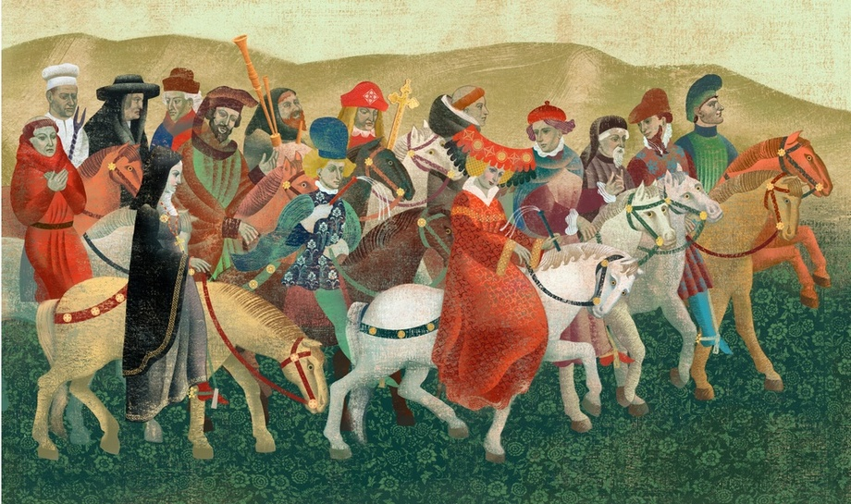
Christians in England have been travelling to a city called Canterbury to see the cathedral for hundreds of years

Slide 59
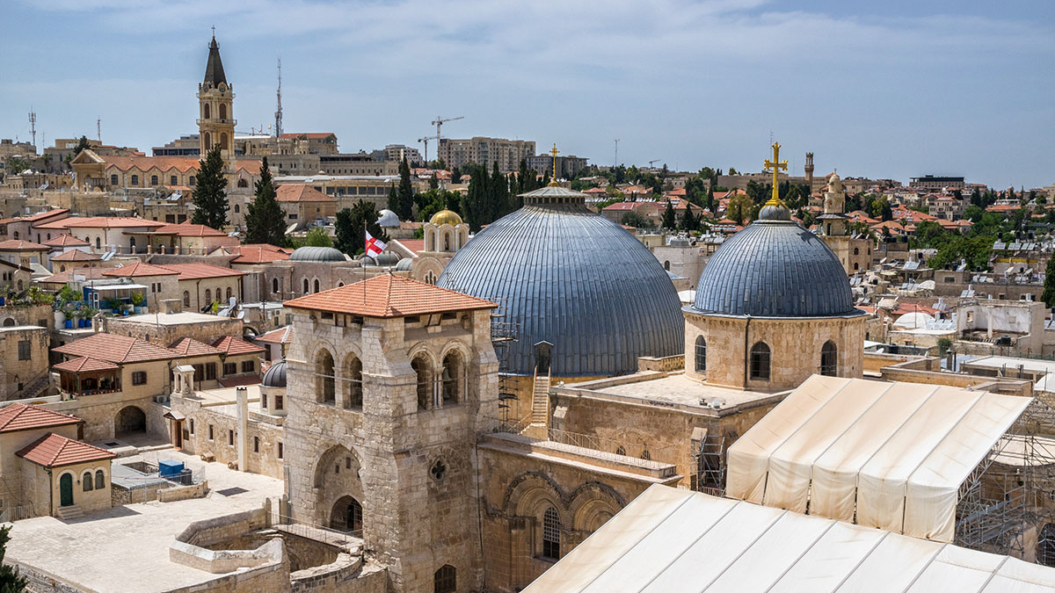
Jewish people travel from all across the world to visit the city of Jerusalem to pray and worship

Slide 60
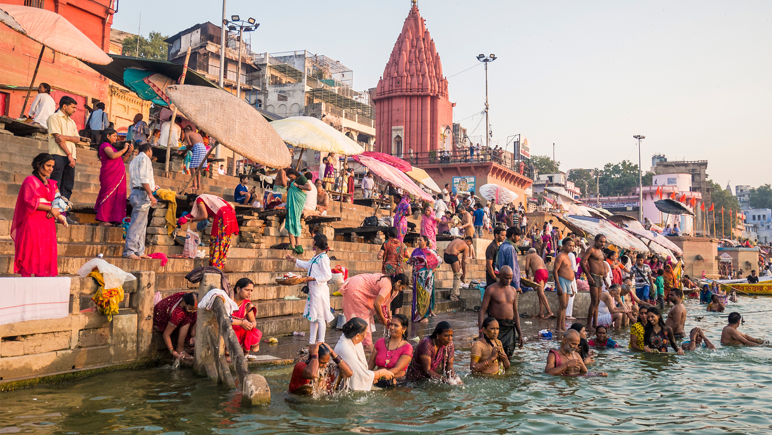
Hindu people travel for days and days to wash themselves in the River Ganges in India

Slide 61
TBAT: understand what is a pilgrimage.
Tuesday 22nd April 2025
But why?
It’s important for them to visit special, holy sites
It helps them feel closer to their god
It’s a tradition that people have been doing for hundreds of years

Slide 62
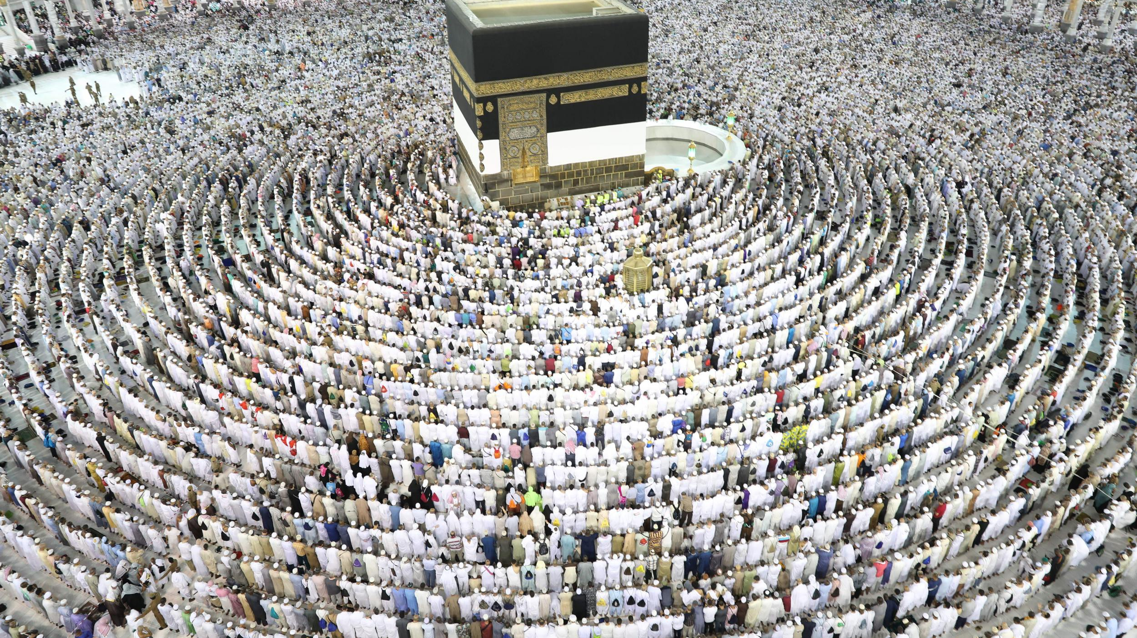
We are going to look at a pilgrimage that Muslim people make to a city called Mecca called the Hajj

