Slide 1
Thursday 3rd April 2025
3/4/25

Slide 2
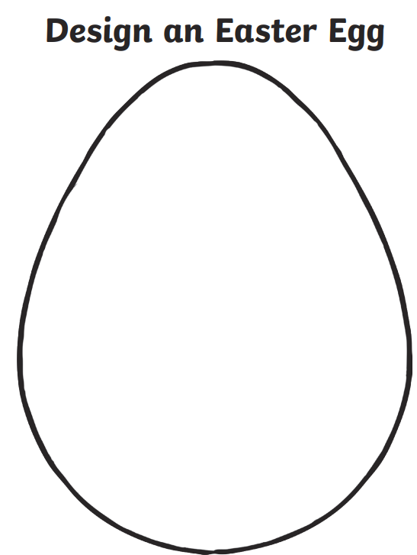
Morning Challenges:
Name writing

Slide 3
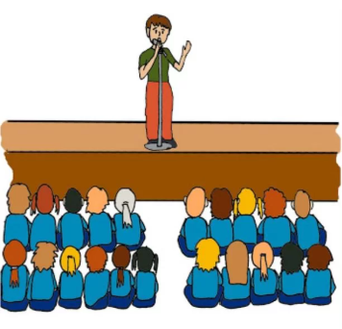
Assembly

Slide 4
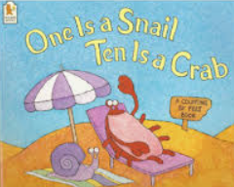
Maths Day
Thursday 3rd April 2025
One is A Snail Ten is a Crab by April Pulley Sayre and Jeff Sayre

Slide 5
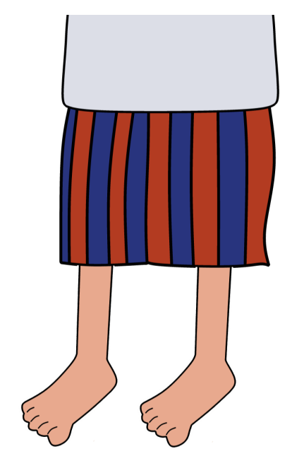
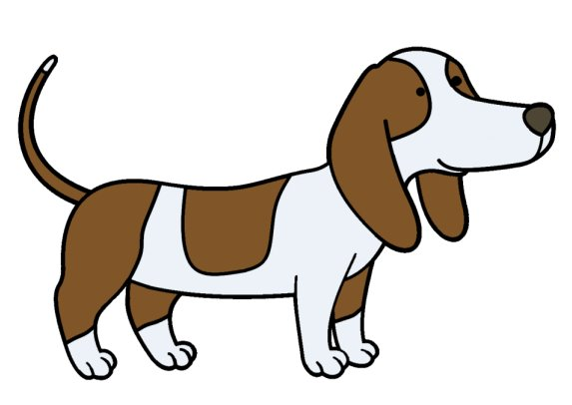
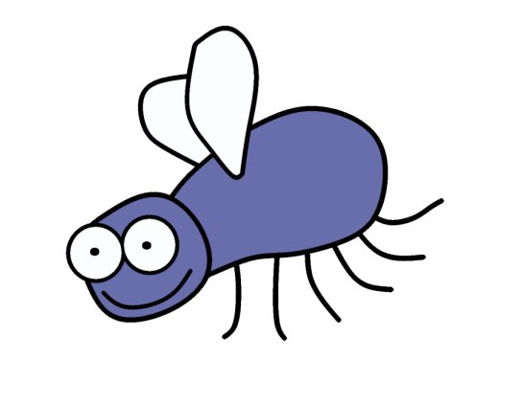
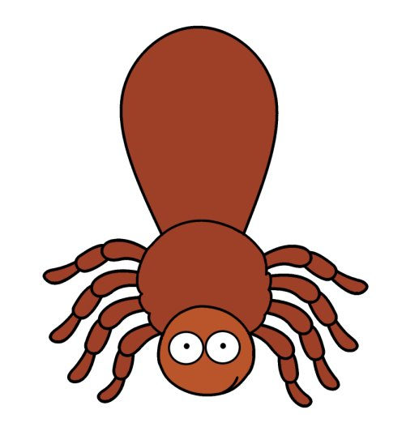
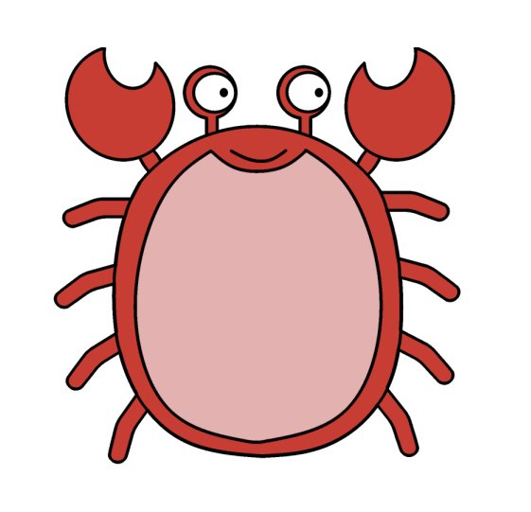
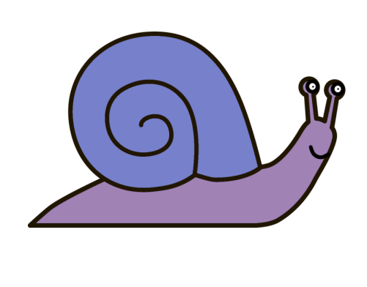
Maths Day
Thursday 3rd April 2025
The snail is 1
The person is 2
The dog is 4
The insect is 6
The spider is 8
The crab is 10

Slide 6
Maths Day
Thursday 3rd April 2025
+
=

Slide 7
Maths Day
Thursday 3rd April 2025
+
?
=

Slide 8
Maths Day
Thursday 3rd April 2025
+
+

Slide 9
Maths Day
Thursday 3rd April 2025
How many snails would you need to create ten?

Slide 10
Maths Day
Thursday 3rd April 2025
Can you think of any other ways of making ten?

Slide 11
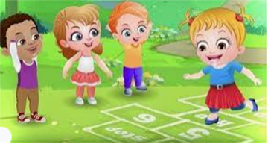
Break

Slide 12
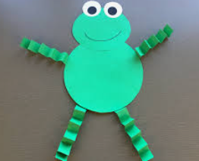
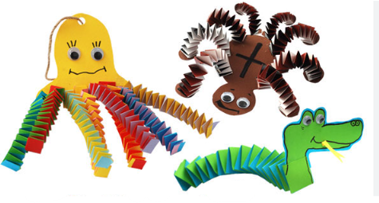
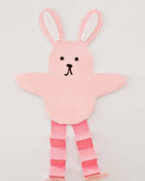
Animal leg craft

Slide 13
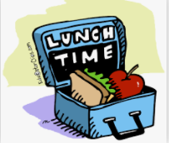
Lunch

Slide 14
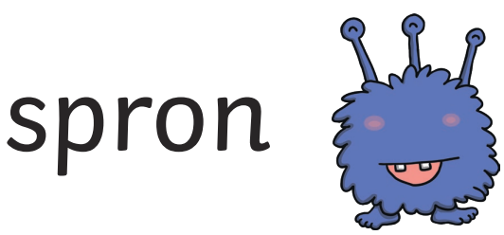
Today's Alien language is.......

Slide 15
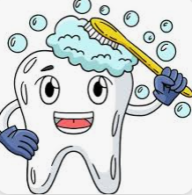
Toothbrushing

Slide 16
Assembly

