Slide 1
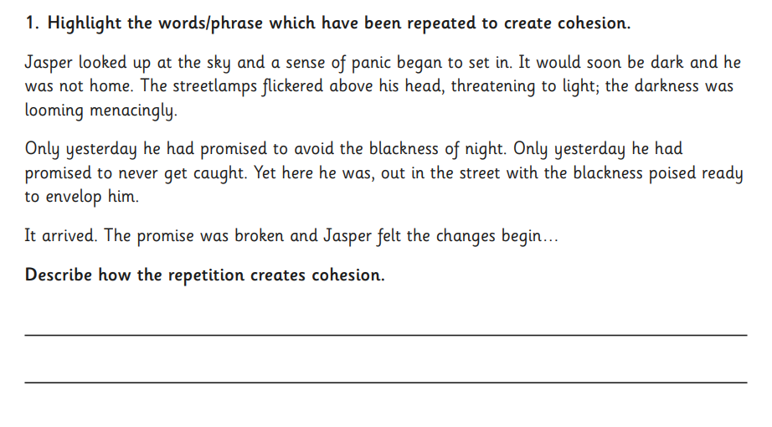
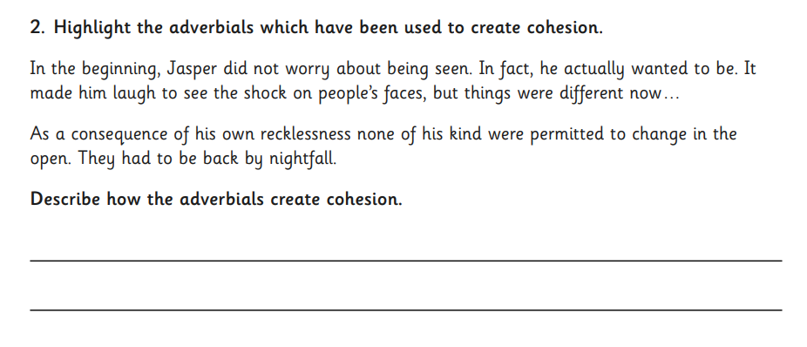
Morning challenge
Cohesion in writing

Slide 2
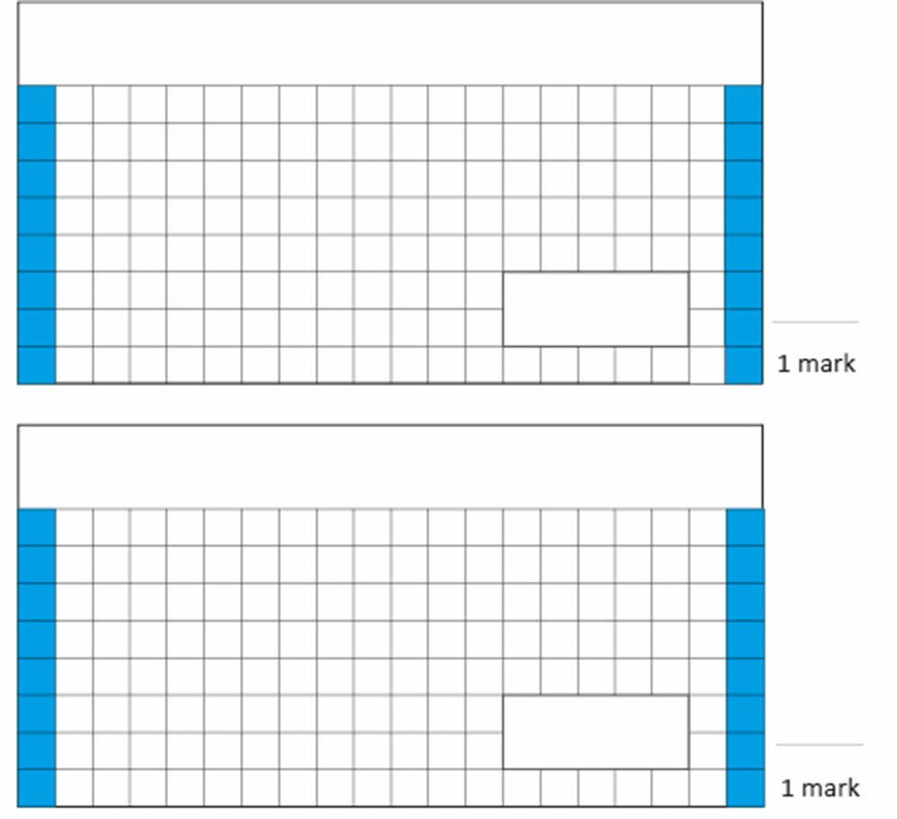
31.3.25
TBAT: order and compare decimals.
1 3/5 X 7 =
3. A curtain maker wants some material for a new order. Each curtain needs 175cm of material and he needs 4 curtains. The material costs £20 per metre. How much will he have to spend?
2. 1265 X 46 =
Challenge:
3/5 of 200 =

Slide 3
TBAT: order and compare decimals. x 7 tables
Daily 10 - Mental Maths Challenge - Topmarks

Slide 4
Talk Partners:

Slide 5
3.4 , 3.7, 4, 4.3 , ____, 4.6 , ____ 5.11 , 5.13, _____, 5.17, 5. 19
Challenge: - 4.59 , - 4.55, -4. 51 , _______

Slide 6
Talk partners: Which number is greater and how do you know?
Use a comparison symbol to compare the charts below.

Slide 7
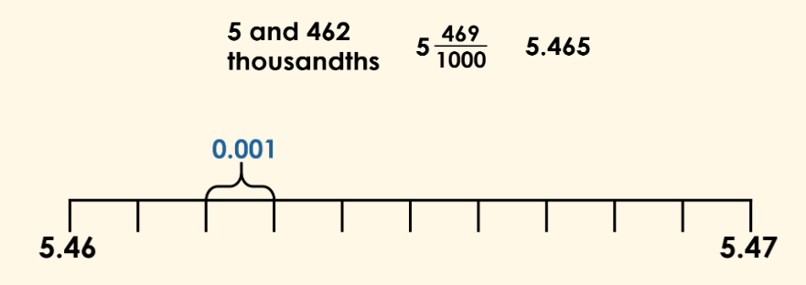
TBAT: order and compare decimals.
We can use a number line to help us order decimal numbers.
Whiteboard work:

Slide 8
TBAT: order and compare decimals.
We can order decimal numbers using our existing knowledge of place value.
We consider the digits in turn from the highest to lowest place value column.
Whiteboard work:

Slide 9
TBAT: order and compare decimals.
We can also order decimals with different numbers of decimal places.
Here we have numbers made up of 1, 2 and 3 decimal places.

Slide 10
TBAT: order and compare decimals.
Task: Use the number line to arrange the values.

Slide 11
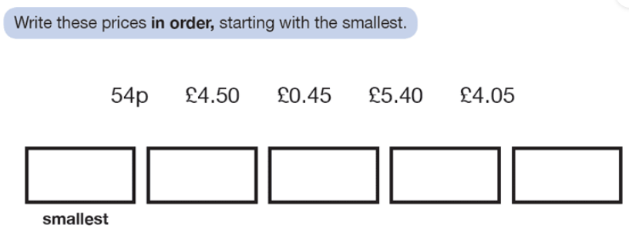
Independent- write the questions and answers in your books
Write these numbers in descending order:
0.92, 0.82, 0.4, 0.07, 0.01
Write these numbers in ascending order:
2) 5.3, 5.94, 5.19, 5.66, 5.04, 5.4, 5.52
Complete the missing numbers in the sequence:
3) 5.12, 5.22, _____, 5.42, _____
4) 2.62, 2.42, 2.22, _____, _____
Write < or > between each pair of lengths.
5) 4.5m 4, 050km
6) 3.2kg 2, 900g

Slide 12
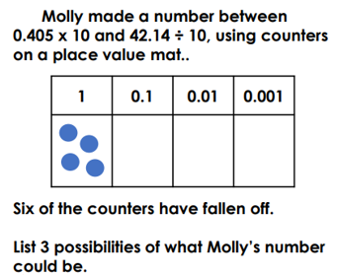
Challenge
Mastery

Slide 13
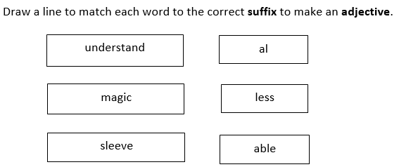
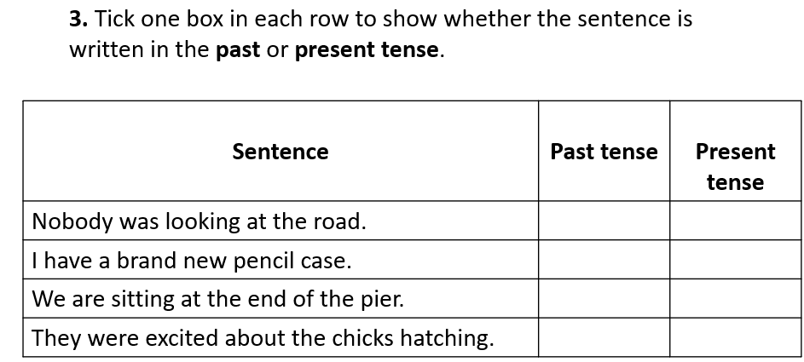
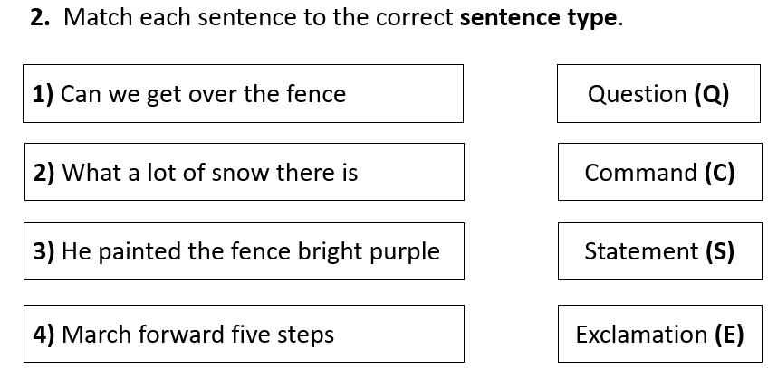
Monday 31st March TBAT- use persuasive techniques in writing.

Slide 14
Up-level the following paragraph: I am the best dad. I won't let ya down. I was asked to be a guest speaker at the local school. I am clearly trusted. I can help the children.

Slide 15
Read the opening paragraph that you wrote on Wednesday. You must have included one of the following: adverbial or parenthesis. Are there any informal words in your writing? Read your paragraph to your partner so your partner can identify any persuasive techniques.

Slide 16
Rewrite the first paragraph of your letter in best. P1- Wednesday Have you included? Adverbial (especially at the beginning of your paragraph.) Sentence 1 – why you should be chosen. Sentence 2- Elaborate, give an example of what you have done. Sentence 3- Why does this make you the best person for the role? Sentence 4 – Remind Dr Drax that you are the best person for the position.

Slide 17
P2 - preparation I like to help others. I am confident to take care of this team. Talk partners: Would I be able to use a semi-colon to combine these sentences? Explain your reasoning. Challenge: What conjunctive adverb could I use?

Slide 18
Remove a word and replace it with a semi-colon. Blue I am a committed father and I am confident that I will be able to lead the children on their journey. Green I am confident in my ability to be a good leader and I know that I am the best person for this role.

Slide 19
Class Work: Paragraph 2: Identify a range of punctuation that has been used and discuss the impact.

Slide 20
Paragraph 2 What reason is Liam giving about why he should be the chosen 'Dad' to accompany the children? Find an example of a persuasive technique that has been used and be ready to share it with your partner.

Slide 21
Using your plan, you will be writing P2 (persuasive point number 1). You need to convince Dr Drax that this experience makes you the best 'Dad' to accompany the children on the trip. Remember you are desperate to go, this whole idea was yours.
I find time to share expertise and interests with my daughter.

Slide 22
P2- (previous slides) Have you included? Adverbial (especially at the beginning of your paragraph. Sentence 1 – why you should be chosen. Sentence 2- Elaborate, give an example of what you have done. Sentence 3- Why does this make you the best person for the role? Sentence 4 – Remind Dr Drax that you are the best person for the position.

Slide 23
Lesson 5: Comparing data visually
Objectives
To explain that computer programs can be used to compare data visually
I can select an appropriate chart to visually compare data
I can refine a chart by selecting a particular filter
I can explain the benefits of using a computer to create charts

Slide 24
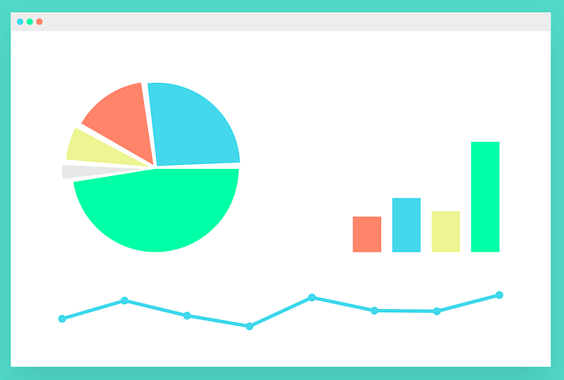
Talk partners: Why do we use charts?
Introduction
Notes:
Charts: https://pixabay.com/vectors/gui-interface-internet-program-2311261/

Slide 25
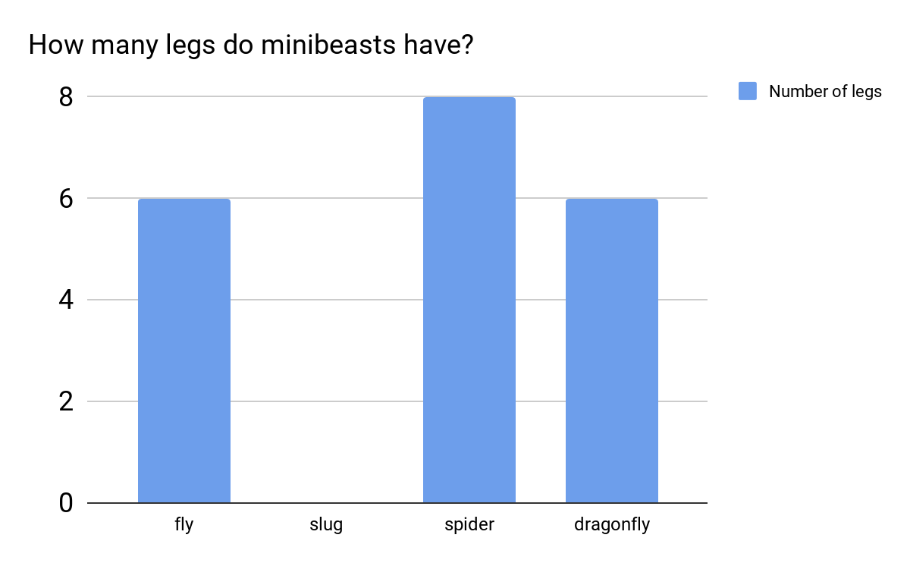
Talk partners: Why do we use charts?
Introduction
What does this chart tell us?
Notes:
Screenshot: https://www.j2e.com/data/examples/minibeasts

Slide 26
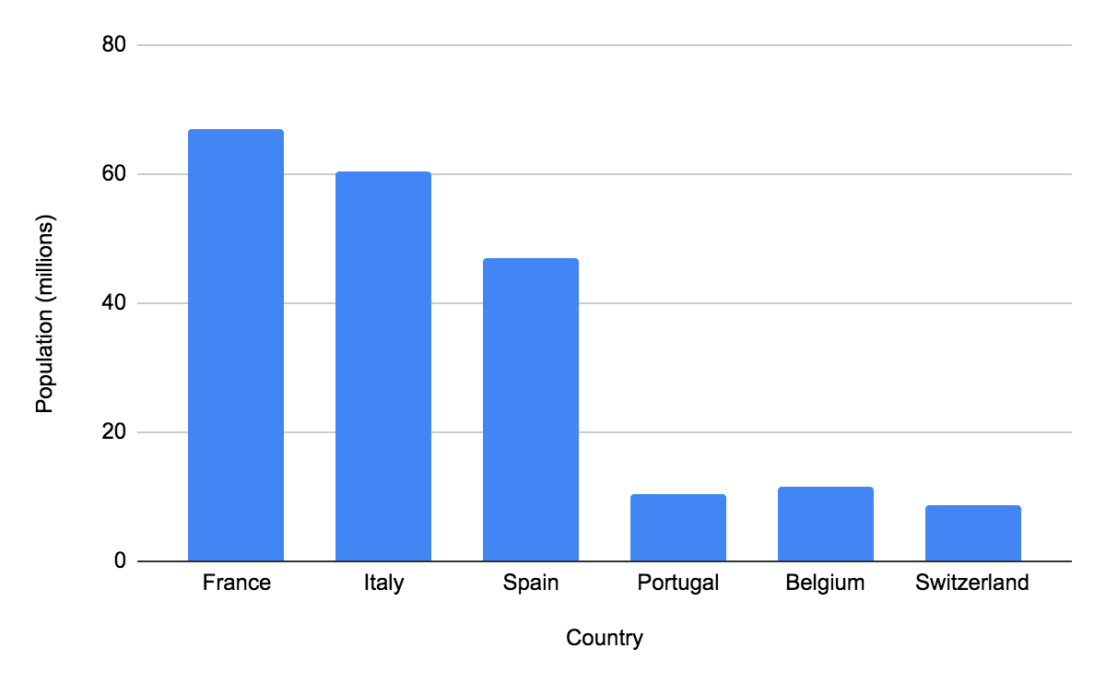
What does this chart tell us?
Activity 1
What title could it have?
Notes:
Screenshot: https://www.j2e.com/data/examples/countries

Slide 27
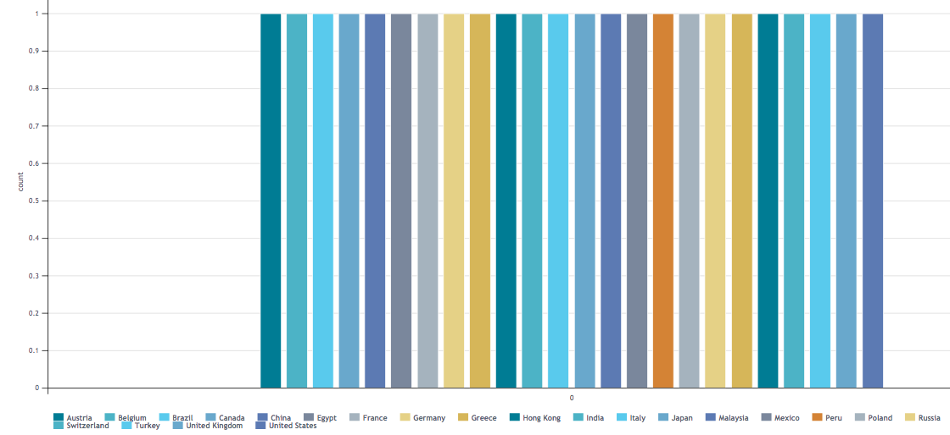
What does this chart tell us?
Activity 1
Notes:
Screenshot: https://www.j2e.com/data/examples/countries

Slide 28
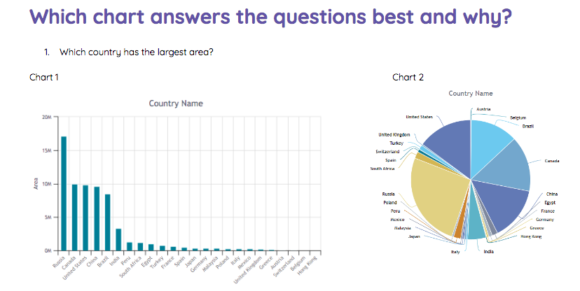
Which chart answers the question best?
Activity 1
With a partner, look at the pairs of charts on your sheet and decide which one answers the question best, and why.
Notes:
Screenshot: https://www.j2e.com/data/examples/countries

Slide 29
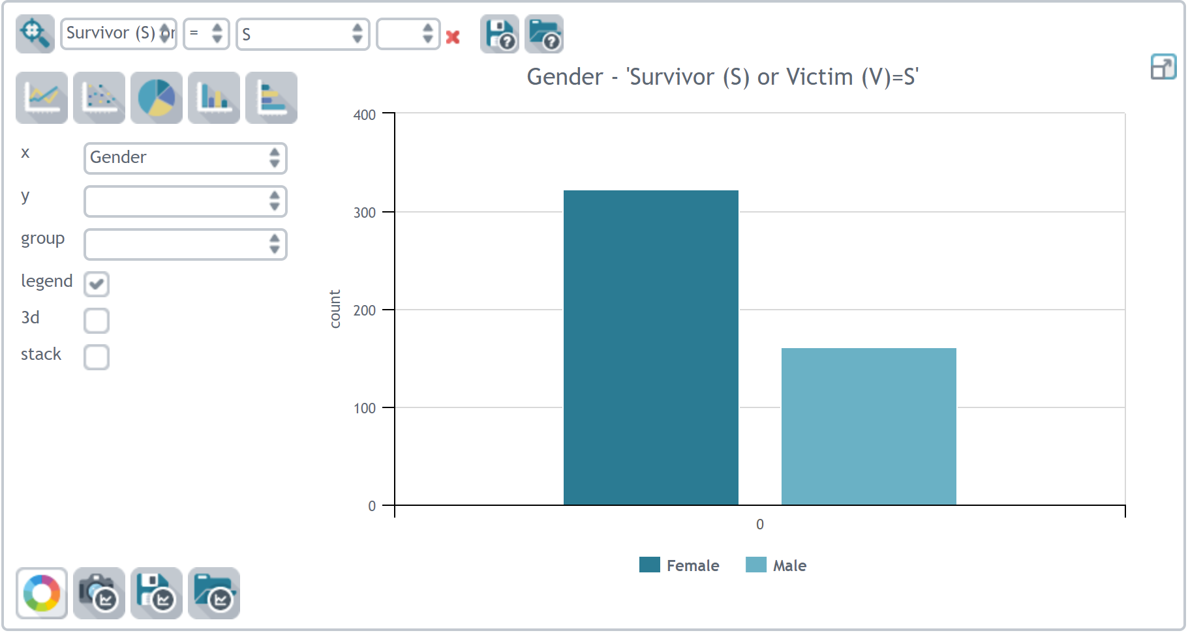
Talk partners: What questions could this chart answer? Record class answers on flip chart.
Activity 1
Notes:
As a class, look at the chart on the slide. Ask the pupils to look at the chart with a partner, and suggest the question they think the chart might be trying to answer. List some suggestions from pupils on the board and discuss them as a group.
Note: There could be more than one correct answer, e.g. ‘How many survivors were male?’ or ‘How many survivors were female?’
Screenshot: https://www.j2e.com/data/examples/Titanic+Passenger+List

Slide 30
Creating charts to answer questions. Let's find different chart types.
Activity 2
Use the video or a live demonstration to find the chart tab, and use it to create a chart using filters to define the x and y axes.
Talk partners:
If we change the x axis to gender, what effect is this having on the chart produced?
Notes:
Use the video or a live demonstration to find the chart tab, and use it to create a chart using filters to define the x and y axes. Outline where to find the different chart types. Carry out a search (e.g. ‘class = first’) to produce a bar chart. Change the x axis, e.g. choose ‘gender’. Ask pupils what effect this is having on the chart produced.
Video: https://www.j2e.com/data/examples/Titanic+Passenger+List

Slide 31
Creating charts to answer questions ncce.io/dat5-5-a2-r
Activity 2
Use the chart tool to answer the questions on your sheet.
Think carefully about the following:
Which chart type have you chosen?
Which fields did you choose for the x axes?
Did you need to search the data to reduce the data in your graph?
Creating charts to answer questions
Use the chart tool in the ‘Titanic’ database to create charts to answer the following questions and complete below:
Were there more males or females on board the Titanic?
Answer
Chart type used
x axes
Search (if needed)
2. In which city did least people board the Titanic?
Answer

Slide 32
Using a computer to produce charts
Plenary
Think about the charts created in this lesson. With a partner, discuss:How did you decide on which chart type to use?
Answer on the bottom of your worksheets:
If you had been creating these charts on paper, how would this process have been different?

Slide 33
Get Set 4 PE - Lesson Plan -2 for Year 5 OAA ksmith@ohacademy.co.uk Herman2025

