Slide 1
Tuesday 25th February 2025
25/2/25

Slide 2
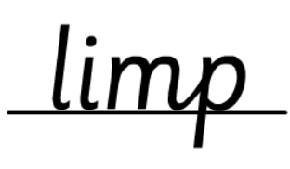
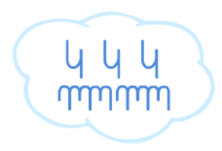
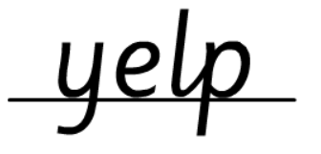
Morning Challenges:
Name writing

Slide 3
Revisit and review
Today's Grapheme
ur

Slide 4
Recap:
d ir ur ea oe ow ey ui

Slide 5
Revisit and review
What are the digraphs?
bruise
monkey
first
spread
beach
goes
Segment these
words and read them
Blend and say words

Slide 6
Focus words
w-or-k
w-or-l-d
w-or-s-e
Sounds out these
words and read them

Slide 7
Focus words
work
world
worse
Sounds out these
words and read them

Slide 8
Focus words
word
worse
world
worm
worth
Read, sound talk and blend
And again... FASTER!

Slide 9
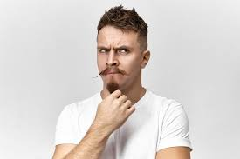
Revisit and review
their
oh
tricky words
once
Read the tricky words

Slide 10
Now let's read this sentence!​
What digraphs can you see?
What tricky words can you see?

Slide 11
Let's spell!
How many sounds? Write it.
tricky words
word world once
Listen to the sentence, say it, write it and read it!
Challenge
Extend the sentence using 'and'

Slide 12
TBAT: make inferences from a text.
Tuesday 25th February 2025
Blue/ Green – Green first
Use the word ‘because’ in your answer
Who do you think Jasper is? Why?
What do you think Jasper is going to do in this story?

Slide 13
TBAT: make inferences from a text.
Tuesday 25th February 2025
Today we are going to read Jasper's Beanstalk by Nick Butterworth and Mick Inkpen.
We will need to use inference skills to work out what is happening in the story.

Slide 14
Inference:
Find clues in the text and pictures to find out what the author means.

Slide 15
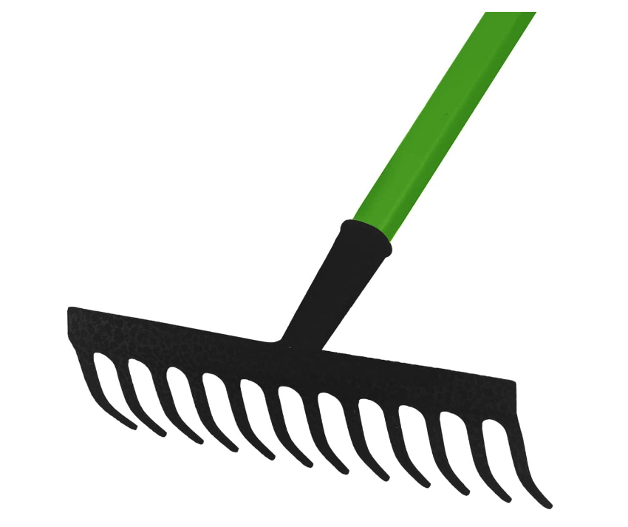
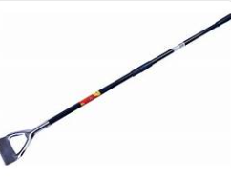
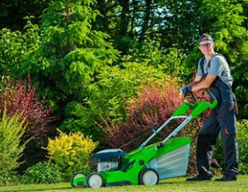
TBAT: make inferences from a text.
Tuesday 25th February 2025
Words you will come across in the text:
raked: to pull something in with a garden object.
hoed: use a hoe to dig (earth) or thin out or dig up (plants).
mowed: to cut with a lawn mower.

Slide 16
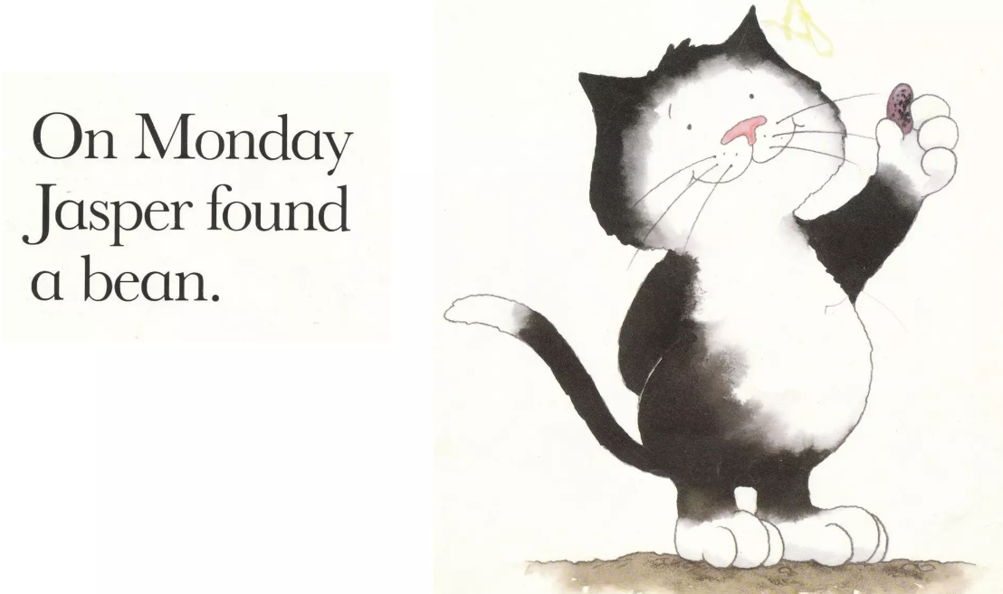
TBAT: make inferences from a text.
Tuesday 25th February 2025
Blue/ Green
How do you think Jasper is feeling here?
Why do you think that?
Do you agree? Why?

Slide 17
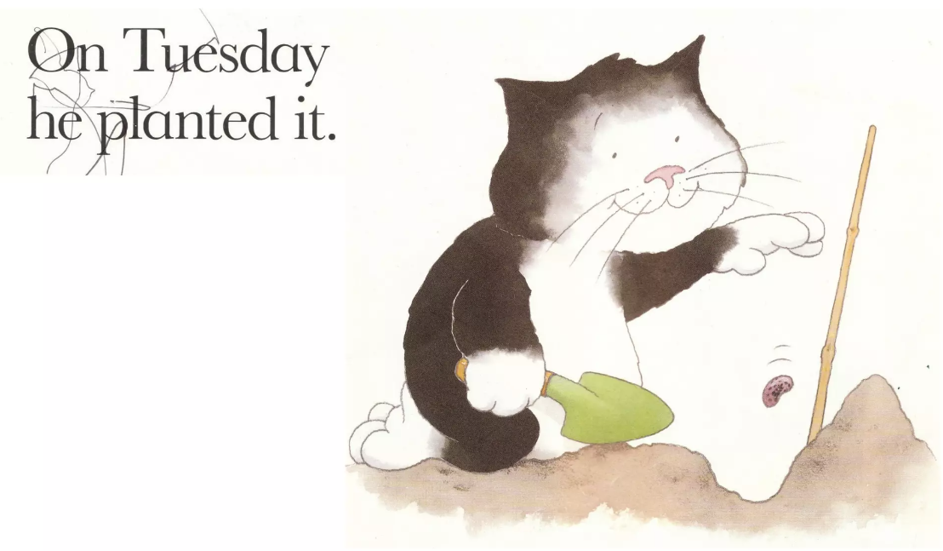
TBAT: make inferences from a text.
Tuesday 25th February 2025

Slide 18
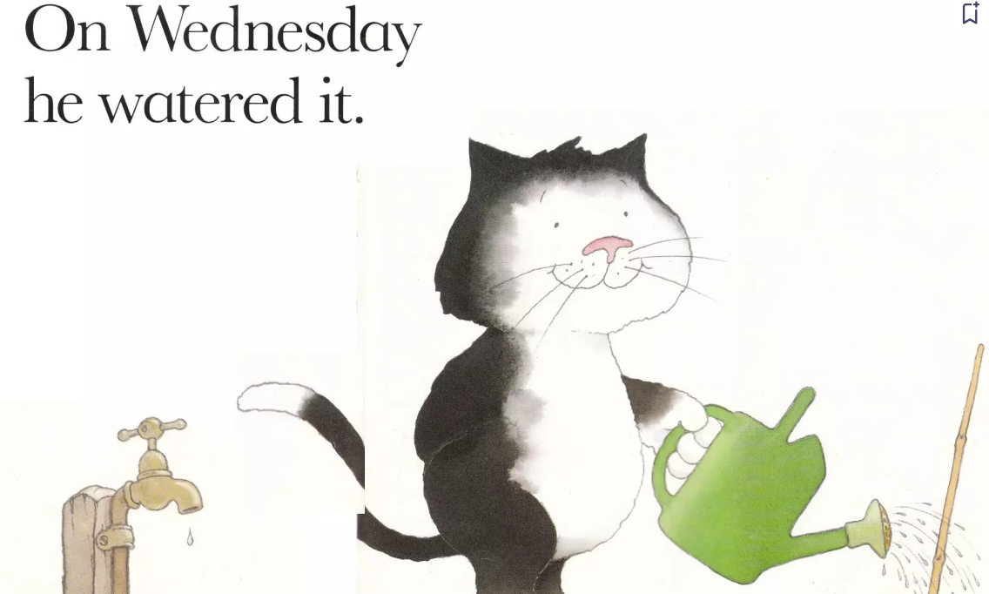
TBAT: make inferences from a text.
Tuesday 25th February 2025

Slide 19
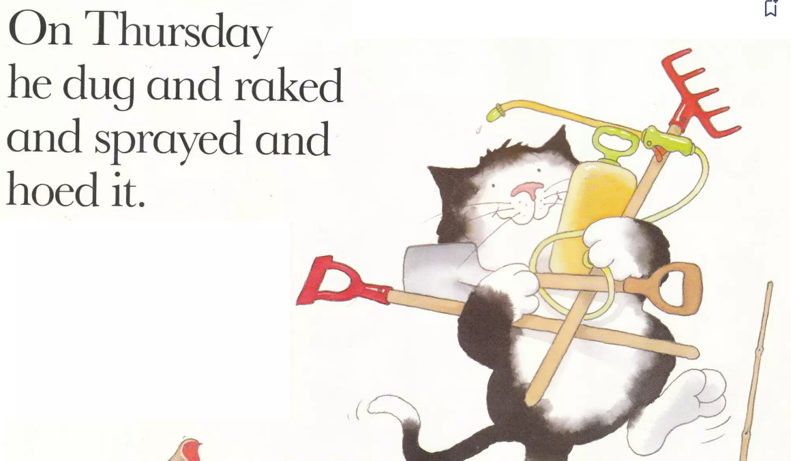
TBAT: make inferences from a text.
Tuesday 25th February 2025

Slide 20
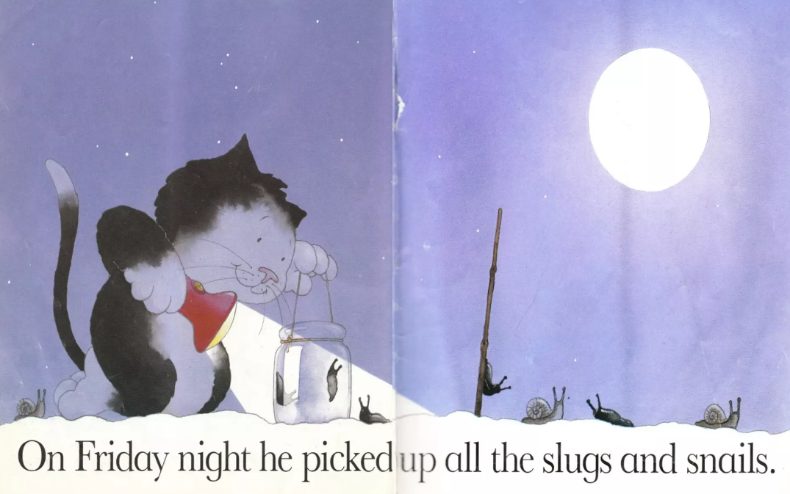
TBAT: make inferences from a text.
Tuesday 25th February 2025

Slide 21
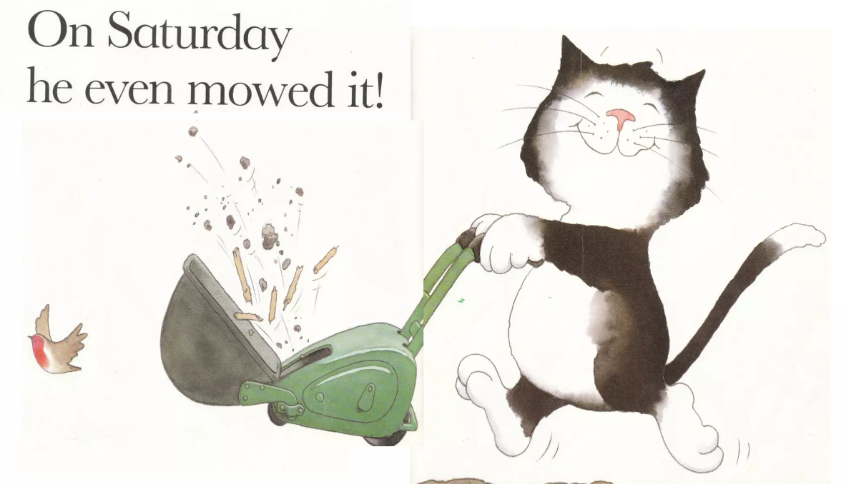
TBAT: make inferences from a text.
Tuesday 25th February 2025

Slide 22
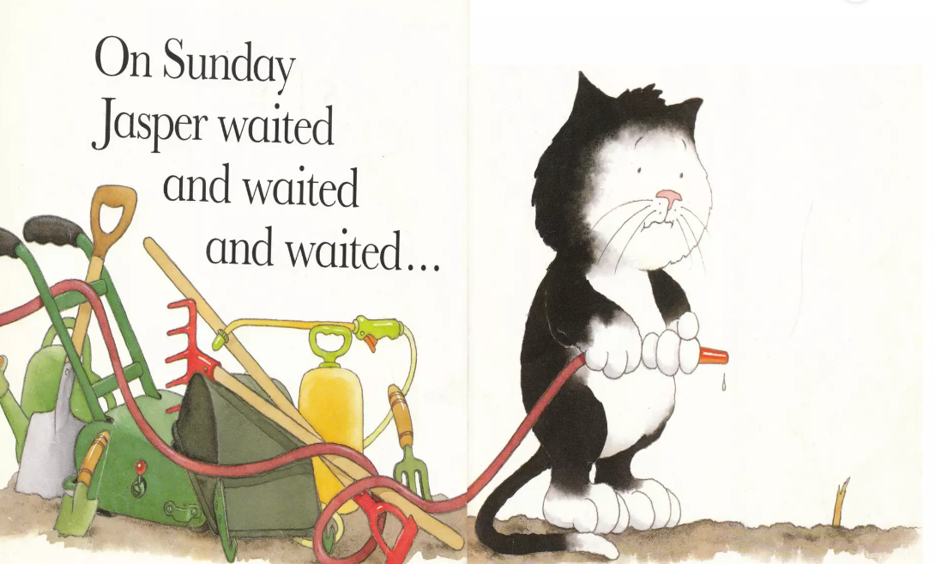
TBAT: make inferences from a text.
Tuesday 25th February 2025
Blue/ Green
Can you explain why Jasper looks so sad here?
Do you agree? Why?

Slide 23
TBAT: make inferences from a text.
Tuesday 25th February 2025

Slide 24
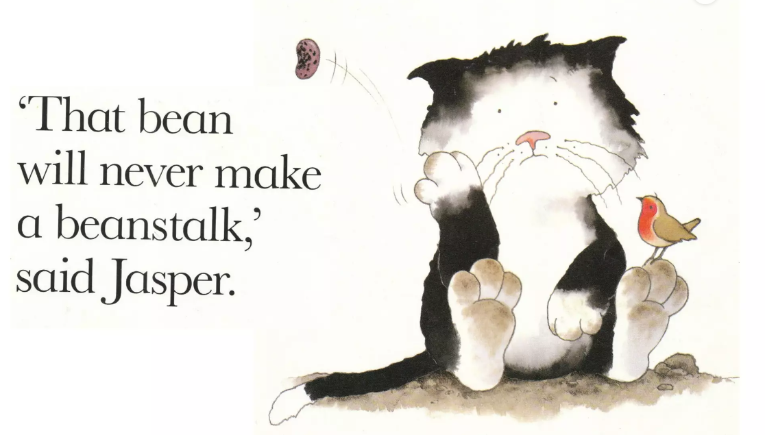
TBAT: make inferences from a text.
Tuesday 25th February 2025

Slide 25
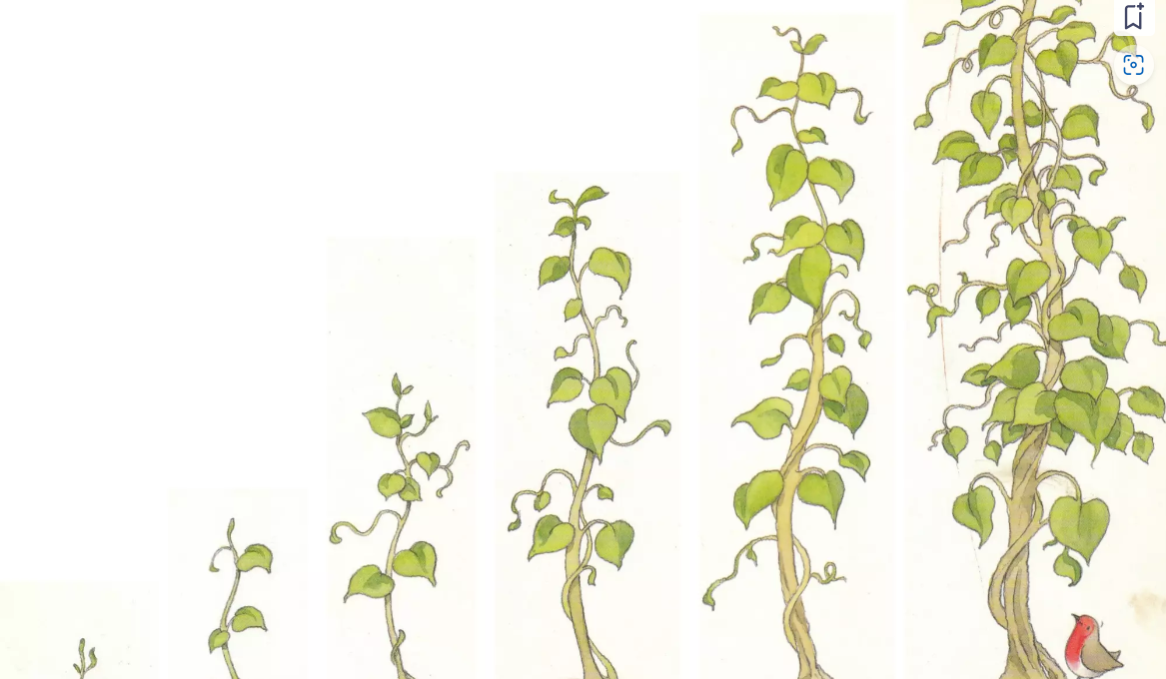
TBAT: make inferences from a text.
Tuesday 25th February 2025
How do you think Jasper would feel if he saw this?
Why do you think that?
Think for a moment, then I will choose someone to feed back

Slide 26
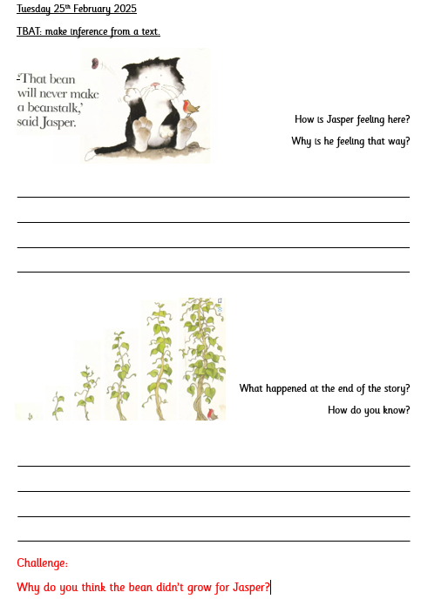

Slide 27
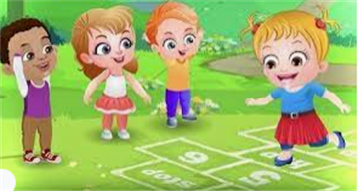
Break

Slide 28
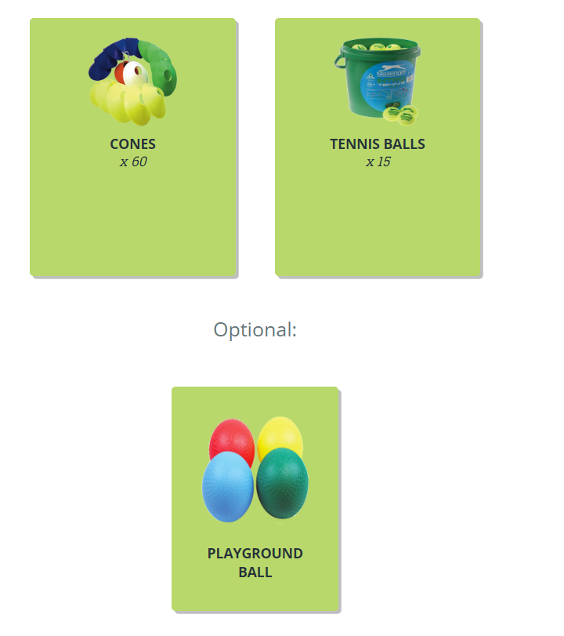
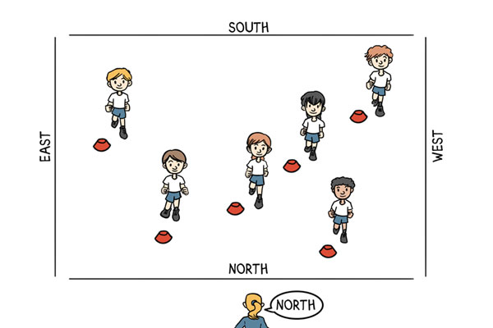
Warm up
TBAT – defend space using the ready position
2 in 2
Why do we warm up our bodies?
Do you know any 'net games'?
Face the front, turn your hips to run backwards but face forwards!
Feet together, legs straight.
Feet one in front of the other.
Feet apart, knees bent (the ready position).
Q: Which starting position was the quickest to react from? Why do you think this was?
Q: How does your body feel now you have started to move?

Slide 29
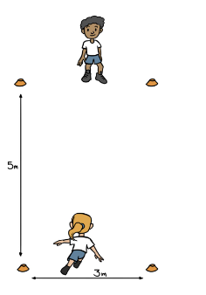
TBAT – defend space using the ready position
Mirror Me!
Pair work
Stand opposite each other create a goal with 2 cones.
1 child is the leader the other is a copier – DECIDE WHO!
The leader counts down from three and touches one of the cones and the partner mirrors it.
Both stand in the middle (starting position) and both count down and touch a cone – did they touch the same cone?
CHALLENGE
Make a wider goal – now can you reach your cone first?

Slide 30
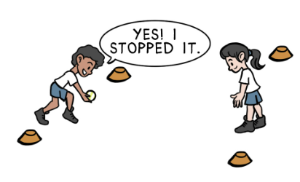
TBAT – defend space using the ready position
Roller ball!
Stand opposite your partner with your cones.
One person moves from the ready position to save the ball
Every time you score you get a point!
CHALLENGE​
Make a wider goal – now can you reach your cone first?

Slide 31
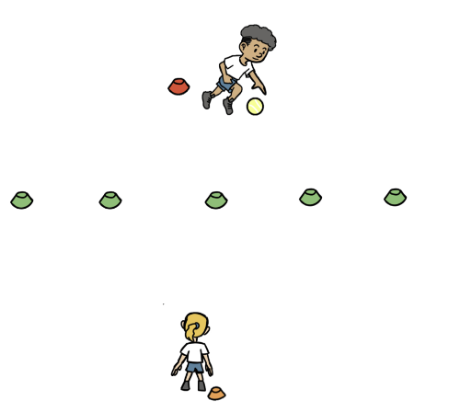
TBAT – defend space using the ready position
Catch Tennis!
Place a line of cones across the middle of the hall.
Place your cone either side of the middle cones
Count to 3 and throw the ball over the 'net' to your partner! IT MUST NOT BOUNCE MORE THAN ONCE!
Why is it important to go back to your own cone?

Slide 32
TBAT – defend space using the ready position
Plenary
Why is the ready position important?
What happens if you do not use the ready position?
How did you make it harder for your partner in the 'catch tennis' game?
What did your partner say to you today to encourage or be kind to you?
How did it make you feel?

Slide 33
Lunch

Slide 34
Today's Alien language is.......

Slide 35
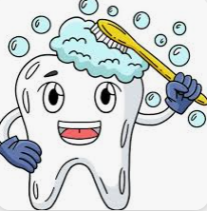
Toothbrushing

Slide 36
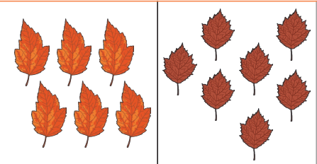
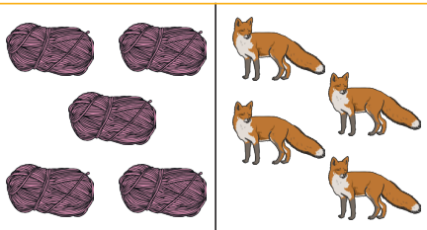
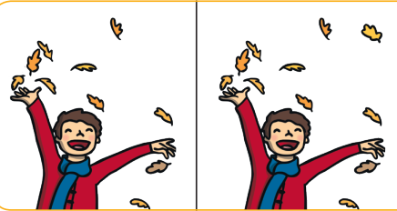
TBAT: To compare two sets using the language ‘more’, ‘fewer’ and ‘difference’
3 in 3
Which one has more? Which one has fewer?

Slide 37
To compare two sets using the language ‘more’, ‘fewer’ and ‘difference’
fewer
compare
difference
more

Slide 38
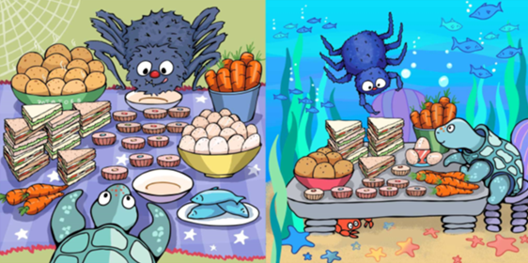
Comparing two sets using more and fewer
Let's count and compare food at the feasts!
Notes:
New Learning: Comparing two sets using more and fewer
Pupils have previously compared numbers using concrete representations and on number lines. In this New Learning, use the Big Picture to form statements using more and fewer, always in pairs. Count different items at the two feasts and get pupils to make a concrete representation to compare the amounts (one partner could be Anansi and the other, Turtle).

Slide 39
Comparing two sets using more and fewer
There are 12 cakes at Anansi’s feast.
There are 8 cakes at Turtle’s feast.
There are more cakes at Anansi’s feast.
There are fewer cakes at Turtle’s feast.
Notes:
New Learning: Comparing two sets using more and fewer
Use the following sentence structures to compare: There are $12$ cakes at Anansi’s feast. There are $8$ cakes at Turtle’s feast. There are more cakes at Anansi’s feast. There are fewer cakes at Turtle’s feast.’

Slide 40
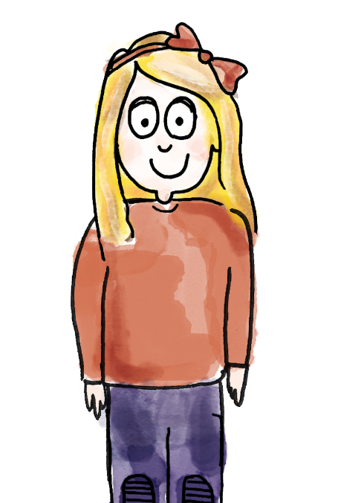
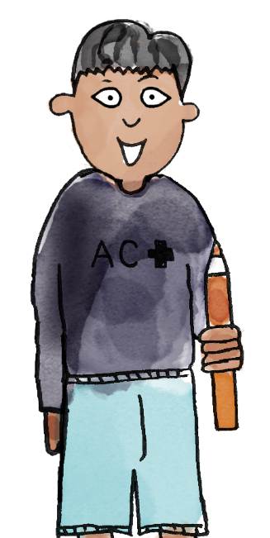
Using more and fewer accurately
I choose the potatoes at Anansi’s feast. There are 14 potatoes.
I choose the sandwiches at Anansi’s feast. There are 12 sandwiches.
There are more potatoes than sandwiches at
Anansi’s feast.
There are fewer sandwiches than potatoes at Anansi’s feast.
compare more fewer difference
Notes:
Talk Task: Using more and fewer accurately
Pupils have a copy of the Big Picture between them and a manipulative to represent the quantities (e.g. interlocking cubes or a bead string each). Each pupil chooses an item in the feast and represents it using concrete manipulatives. The pupil who has more makes a ‘more’ statement. The pupil who has fewer makes a ‘fewer’ statement. Pupils repeat with different items.

Slide 41
How many more cakes does Anansi have than Turtle?
Notes:
Develop Learning: Quantifying the difference
Have some pupils share their work from the Talk Task.
Return to the Big Picture and compare the cakes at each feast again, making a concrete representation of each.
How many more cakes does Anansi have than Turtle?
Give pupils a chance to discuss, and listen to their ideas. Some pupils might say Anansi has $12$ more because they have $12$ in total.

Slide 42
How many more cakes does Anansi have than Turtle?
DYNAMIC REPRESENTATION
Build up your own representation, ‘live’ in the lesson
This image is for teacher planning only
Anansi
Turtle
different
same
Notes:
Develop Learning: Quantifying the difference
Draw attention to the difference between the two numbers by lining up cubes in one-to-one correspondence. They have eight which are the same, and Anansi has four extras, which are different. Practise the sentences: ‘Anansi has four more cakes than Turtle. Turtle has four fewer cakes than Anansi. There is a difference of four between the number of cakes they have.’
Repeat with other examples, e.g. the fish (three for Anansi, zero for Turtle), the carrots (nine for Anansi, $11$ for Turtle), each time making the numbers using manipulatives and using the sentence structures.

Slide 43
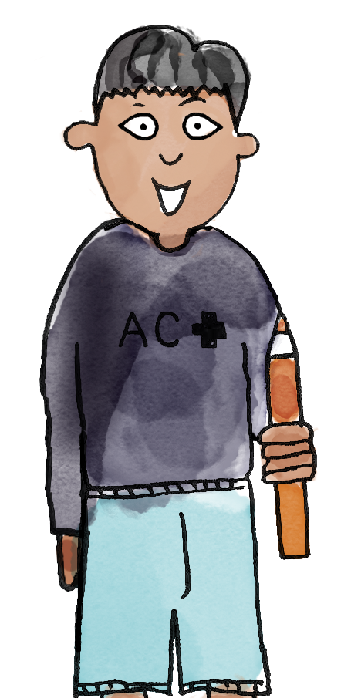
To compare two sets using the language ‘more’, ‘fewer’ and ‘difference’
Anansi’s feast has nine carrots.
Turtle’s feast has 11 carrots.
There are two cubes sticking out. Anansi’s feast has two fewer carrots than Turtle’s.
Turtle’s feast has two more carrots than Anansi’s.
There is a difference of two between the number of carrots.
Notes:
Independent Task: Using the word difference
Pupils return to their copy of the Big Picture. They represent items using concrete manipulatives lined up in one-to-one correspondence, as in the Talk Task, and this time they quantify the difference by counting how many more, how many fewer and the difference, using the sentence structures from the Develop Learning. The focus is on pupils using the new language accurately.
Possible adaptations:
Some pupils might be given a narrower task with more clearly defined questions. E.g. you could create some prompt images based on the Big Picture, and pupils make a matching concrete representation to talk about.
You could challenge pupils to find two items in the feast with a difference of three/four etc.

Slide 44
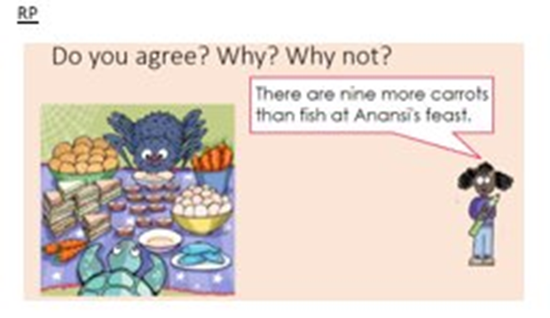
To compare two sets using the language ‘more’, ‘fewer’ and ‘difference’
Reasoning problem:
Challenge:
Notes:
Independent Task: Using the word difference
Pupils return to their copy of the Big Picture. They represent items using concrete manipulatives lined up in one-to-one correspondence, as in the Talk Task, and this time they quantify the difference by counting how many more, how many fewer and the difference, using the sentence structures from the Develop Learning. The focus is on pupils using the new language accurately.
Possible adaptations:
Some pupils might be given a narrower task with more clearly defined questions. E.g. you could create some prompt images based on the Big Picture, and pupils make a matching concrete representation to talk about.
You could challenge pupils to find two items in the feast with a difference of three/four etc.

Slide 45
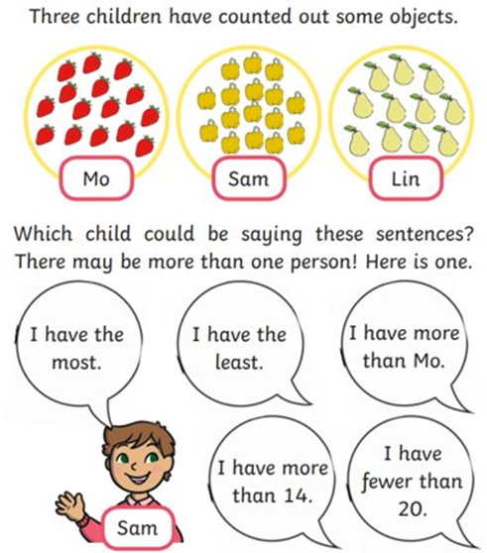
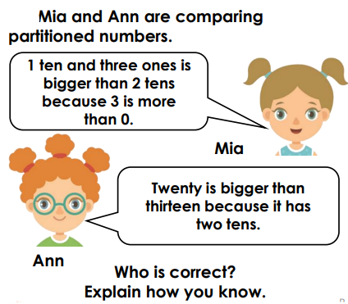
To compare two sets using the language ‘more’, ‘fewer’ and ‘difference’
Mastery:
Mastery with greater depth:
Notes:
Independent Task: Using the word difference
Pupils return to their copy of the Big Picture. They represent items using concrete manipulatives lined up in one-to-one correspondence, as in the Talk Task, and this time they quantify the difference by counting how many more, how many fewer and the difference, using the sentence structures from the Develop Learning. The focus is on pupils using the new language accurately.
Possible adaptations:
Some pupils might be given a narrower task with more clearly defined questions. E.g. you could create some prompt images based on the Big Picture, and pupils make a matching concrete representation to talk about.
You could challenge pupils to find two items in the feast with a difference of three/four etc.

Slide 46
Who was Jesus?
Lesson 7

Slide 47
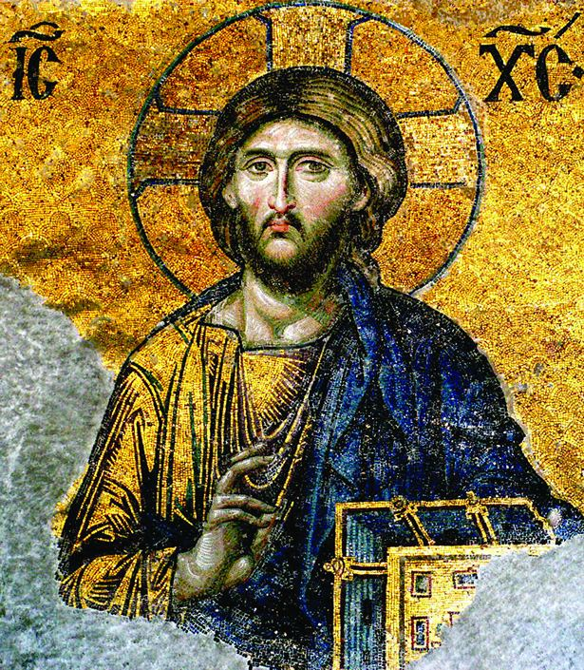
Last lesson we saw that Christians believe in one God.
One of the big differences between Christianity and other religions is that Christians believe God had a son.
This was a man called Jesus Christ who lived 2,000 years ago.

Slide 48
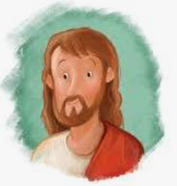
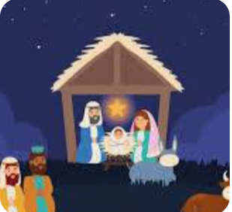
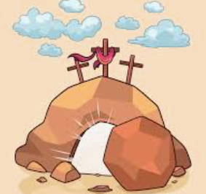
Blue/ Green
What do you already know about Jesus?
What stories do you know that he is part of?

Slide 49
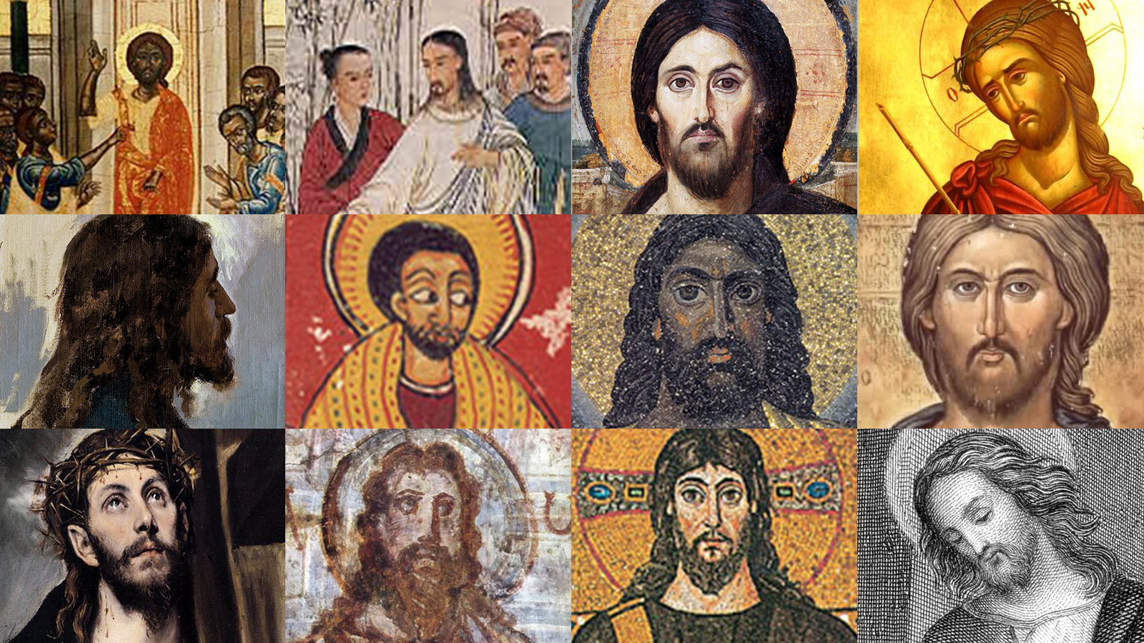
Just like with God there’s no real way to be sure about what Jesus looked like
often he is painted to look like the people the artist is familiar with

Slide 50
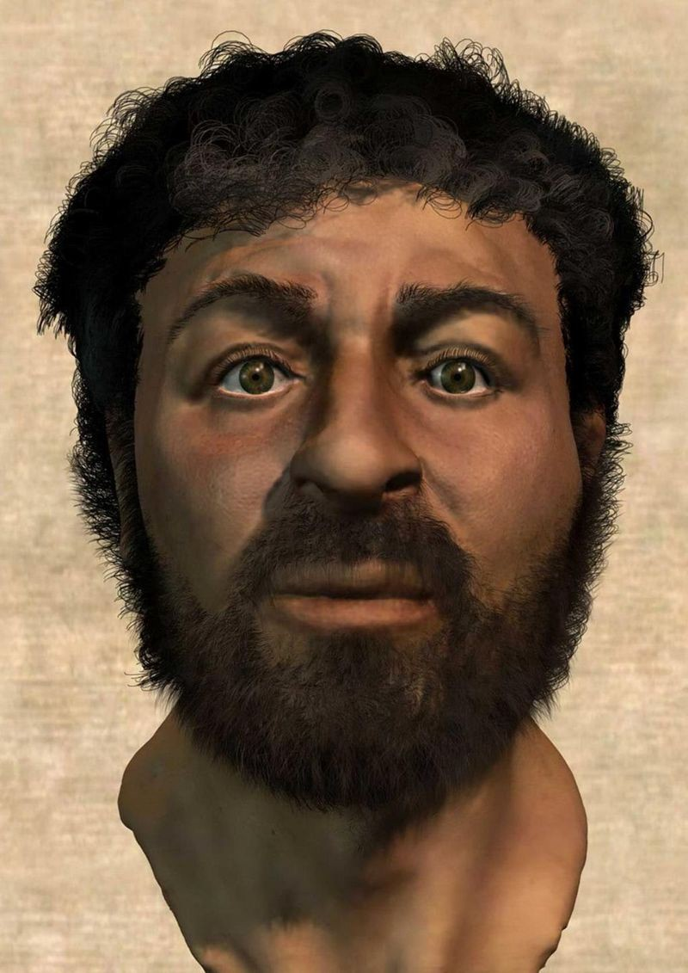
Most people agree that a man called Jesus did exist.
Christians, however, have faith that he was the Son of God. He was able to do impossible things.

Slide 51
Those impossible things are called miracles.
We will look at them more later in school but let’s learn about one today so we can see why Christians need faith to believe Jesus was special.

Slide 52
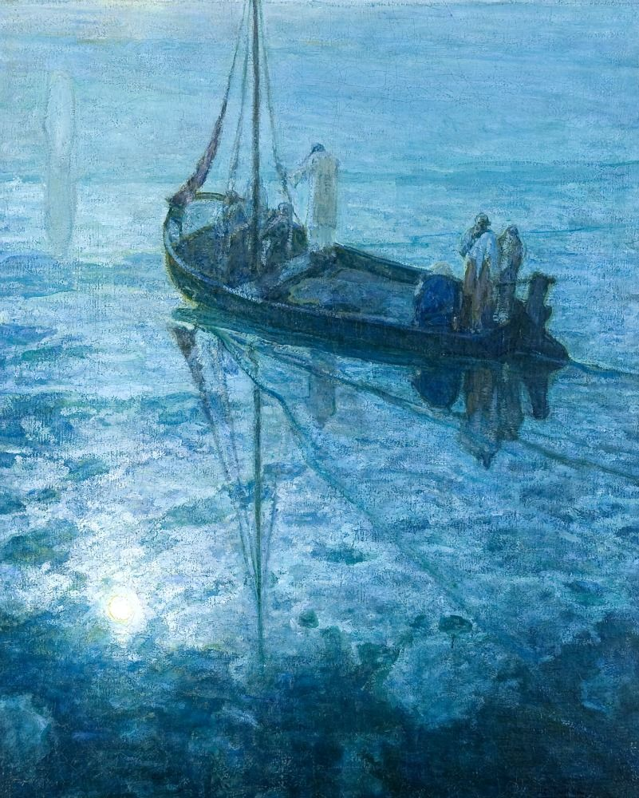
This story takes place 2,000 years ago on the edge of a lake called the Sea of Galilee.
Jesus had been teaching people by the lake and he sent his followers, called the disciples, out in a boat to cross the lake. Suddenly, a huge storm came down on them, it rained hard and waves lashed up against the side of the boat.
Out of the mist the disciples could see a figure coming towards them on the water. They thought it was a ghost or a spirit and were afraid!

Slide 53
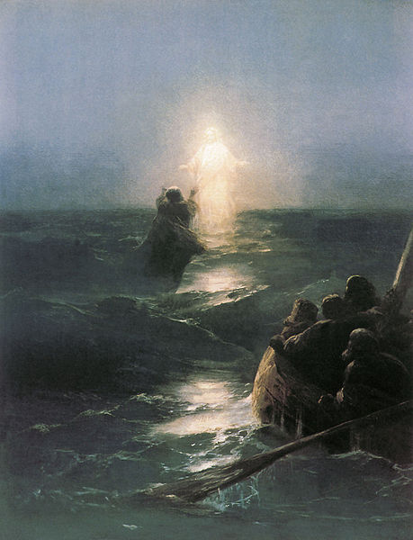
Jesus had walked on water across the lake to rescue them from the storm.
Jesus said, ‘be not afraid, it is I, Jesus’
Peter answered him and said, “Jesus, if it is you let me come to you on the water”
So Peter nervously put a foot into the water and found he could walk on its surface! He was amazed but also scared of what was happening.
Suddenly, he began to sink below the waves and begged Jesus to save him.

Slide 54
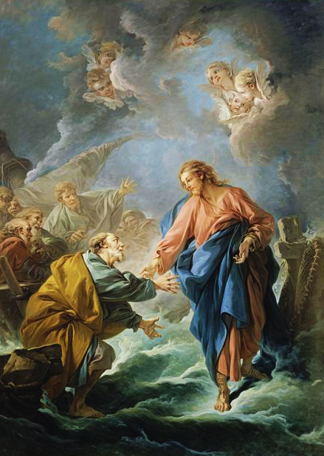
Jesus put out his hand and pulled Peter up to stand on the surface of the water again.
“Oh you of little faith, why did you doubt me?”, Jesus said.
When Jesus and Peter returned to the ship the disciples were amazed by what had happened. They had witnessed a miracle! The storm calmed and they were able to head safely to shore.

Slide 55
Jesus Walks on Water | Stories of the Bible
Why do you think Peter began to sink in the story?
It was because he had lost faith in Jesus.
He no longer believed Jesus had given him the power to walk on water.
Christians believe that having faith in God and Jesus is very, very important.

Slide 56
Christians have faith that God exists even if they can’t see or touch God.
Christians have faith that Jesus was the Son of God who could perform miracles even if they seem impossible.

Slide 57
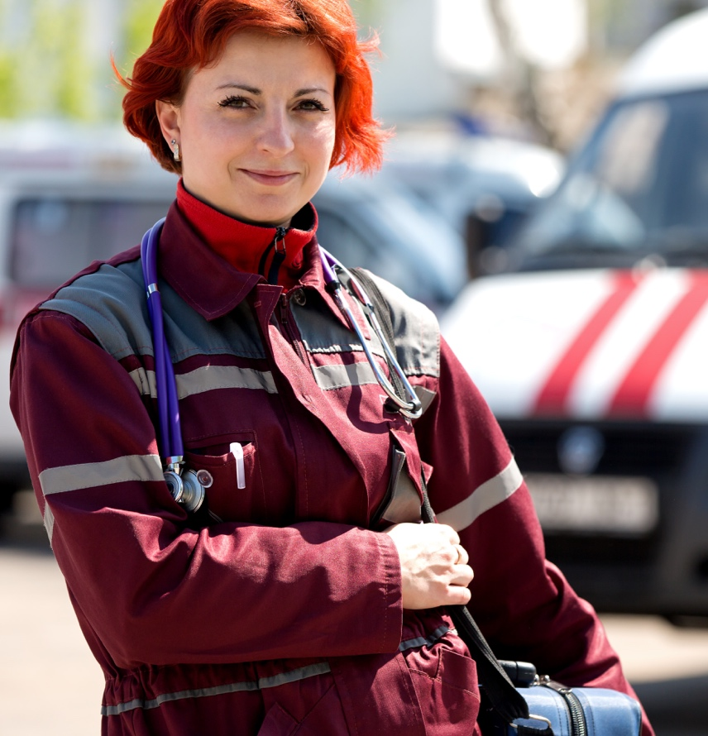
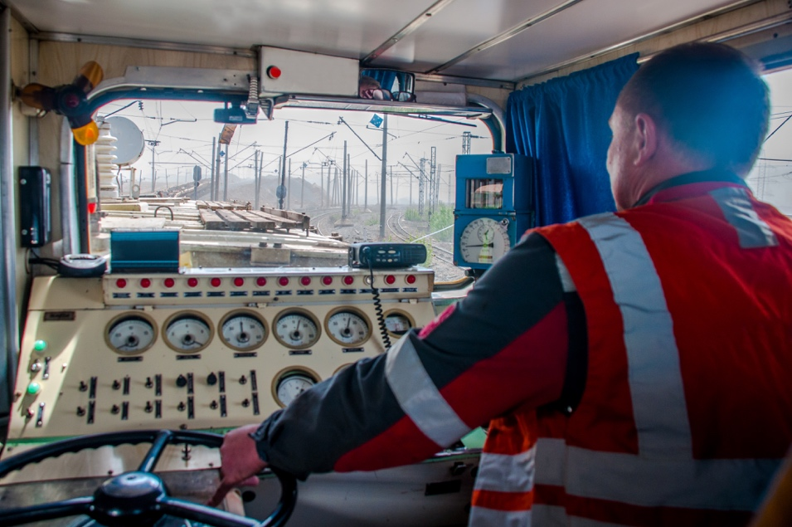
Today’s big question
Where do adults get their money?
Notes:
Encourage pupils to think of as many ideas as they can; they call these out and you can see how many you can write down as they go! Deduce that some people work and some, who are ill and cannot work due to being ill, or for other reasons, get benefits and social help. Others may be students or may work as volunteers (explain that this is unpaid work, normally for a good cause/charity).

Slide 58
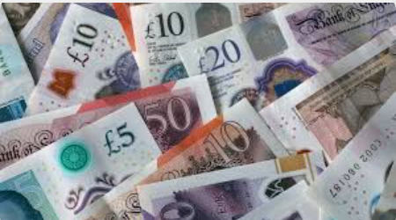
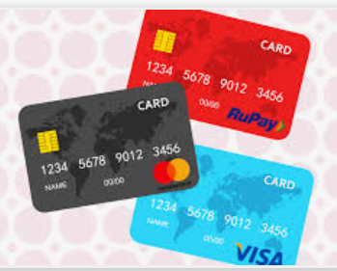
Blue/ Green
Where do you think money comes from?
Can you think of different ways to get money?

Slide 59
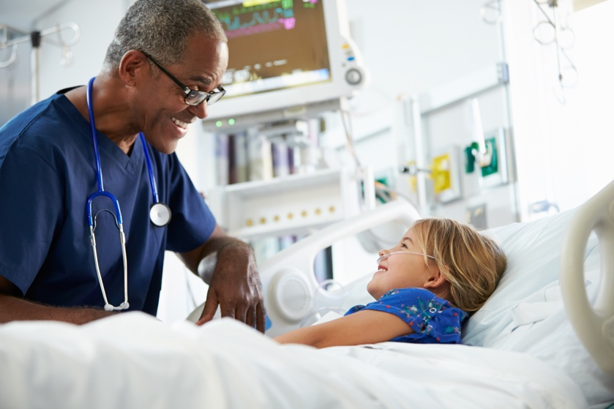
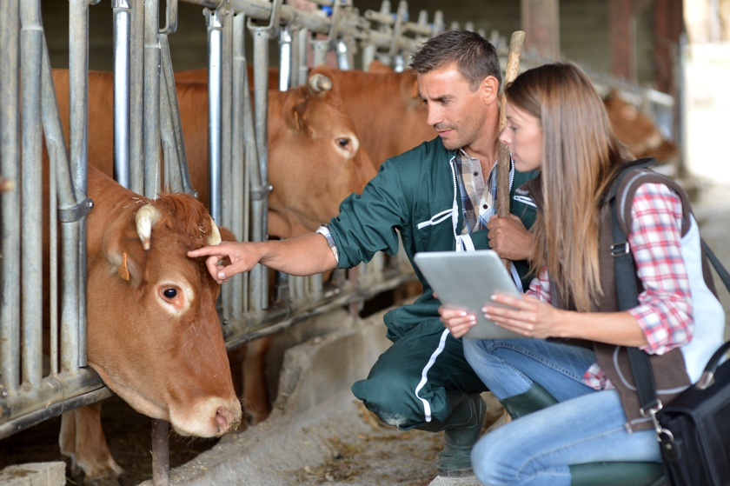
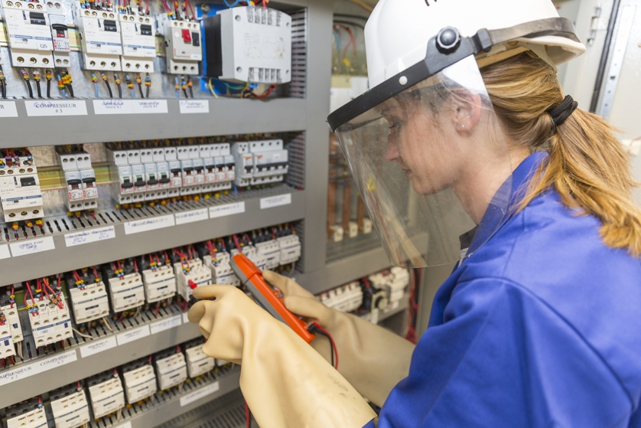
Jobs
What jobs do your grown ups have?
Notes:
This slide should be used as a stimulus for ideas about different jobs. Before you send the pupils off to talk together, spend a little time looking at and discussing the images and the different jobs. Why are they wearing these clothes? What might they do all day? Do they work inside or outside? Do they travel? What skills might they need?

Slide 60
Other ways people get money to live
What about people who are ill, or have to look after children, or are studying?
Working is the best way to make money but sometimes this isn’t possible.
The Government can help people who are unable to work or who only earn a little bit by supporting them with some money.
They do this through benefits, credits, pensions, loans or grants.
Notes:
These can be given to people who only earn a small amount of money or don’t earn anything, and so need help.
Examples include: Working Tax Credit – helps low income families; State Pension – helps older people who have retired; Sick Pay – people who are ill; Student Loans – the Government lends money to people who want to study; Jobseekers Allowance – those people who are looking for work or only work a few hours each week (16 hours); Housing Benefit – helps people pay rent; Disability Allowances – people of all ages who need help because of a disability.

Slide 61
What have we learnt?
Today’s big question:
Where do adults get their money?
Notes:
Pupils should now have a much clearer idea about the reality of how people get their money.
Remind pupils that they have learned that some jobs are paid (some more than others) and some are voluntary, while other people have to rely on social support. Use this big question to evaluate their understanding and, if necessary, spend time clarifying any misconceptions or answering any questions.

