Slide 1
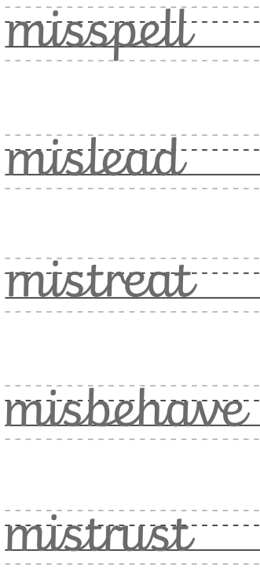
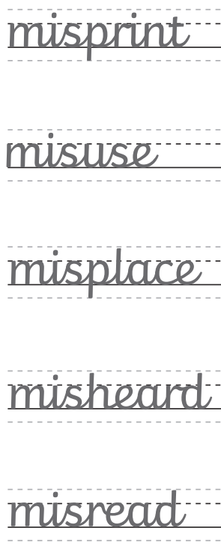
Monday 3rd February 2025 - Spellings
Copy the spelling words into your challenge books, think carefully about your handwriting.
Ch – put each word into a correctly punctuated sentence.

Slide 2
03.02.25 - Arithmetic paper
9.15am - 10.00am
Recap – whiteboards
23 + 10 =
476 + 282 =
539 – 50 =
____ = 299 + 871
36 ÷ 3 =
45 x 4 =
1/3 of 15 =
2/4 of 24 =
4/9 + 2/9 =

Slide 3
Monday 3rd February 2025 TBAT: retrieve information from a text.
3 in 3
Troy sat on the wall outside the corner shop. Inside, his friends were enjoying the thrill of choosing their sweets. Having only three pence to his name, he knew that there would be nothing that he could afford, so there was no point in even looking. He reached into his pocket and pulled out his feeble collection of coins. Why did they even bother making them if they couldn’t be used to buy anything? He rubbed his thumb over the two pence piece, as if cleaning it up would somehow increase its value. But then something happened that made him rub his own eyes instead.
1. What was Troy sitting on?
2. What were Troy’s friends doing?
3. How much money did Troy have?

Slide 4
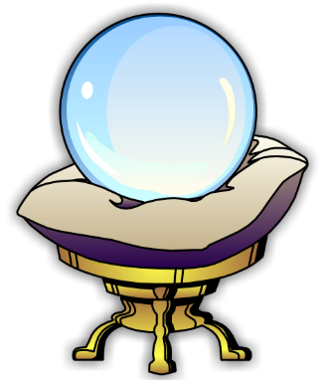
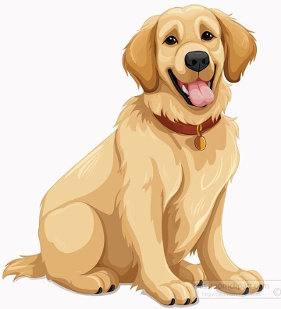
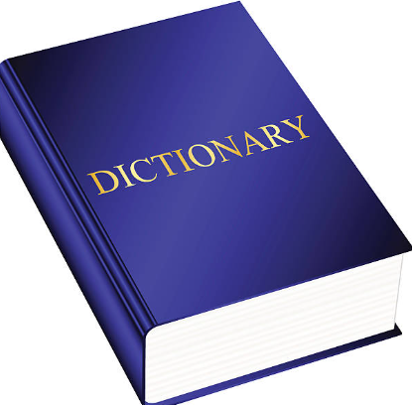
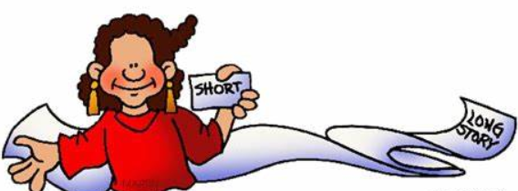
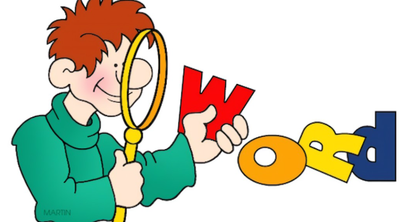
Monday 3rd February TBAT: retrieve information from a text.
Predict
Retrieve
Vocabulary
Infer
Summarise
Explain content
Words in context
Compare

Slide 5
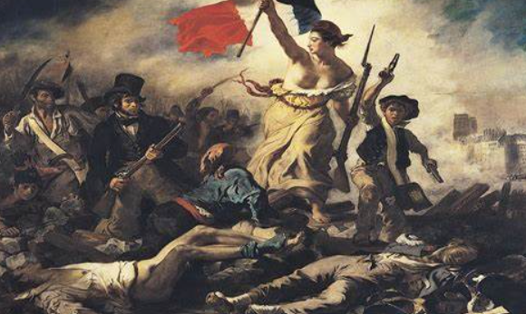
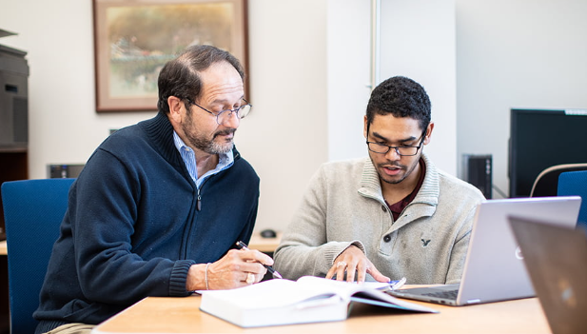
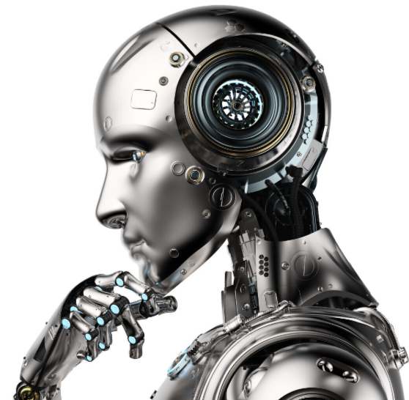
Monday 3rd February TBAT: retrieve information from a text.
Words you will find in the text:
Revolt – to take action against people in power.
Advisors – someone who provides support.
Banished – forced to leave somewhere/to get
rid of something.
Artificial – made by people.

Slide 6
Monday 3rd February TBAT: retrieve information from a text.
Multiple choice questions
What did the advisors start to do?
Talk about the King Spread rumors about the dark
2. Who was afraid of the dark?
The boy The advisors
3. It is usual for children to be afraid of the dark.
True False

Slide 7
Monday 3rd February TBAT: retrieve information from a text.
Retrieval questions
Why was the little boy so special?
2. When he became King, what was the little boy going to do?
3. How long was it until the King told his advisors about his plan?
4. List one of the rumours the advisors started to spread.
5. What was installed above the Palace?
Explain whether you think people in the town think the King may have made a mistake. Use evidence from the text to support your answer.

Slide 8
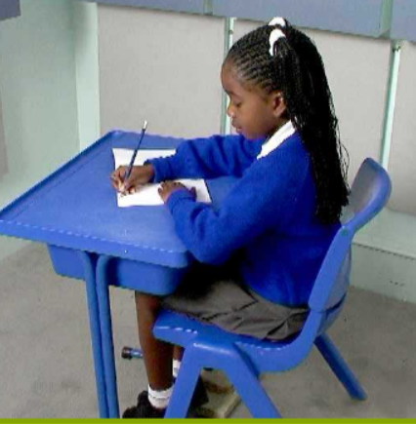
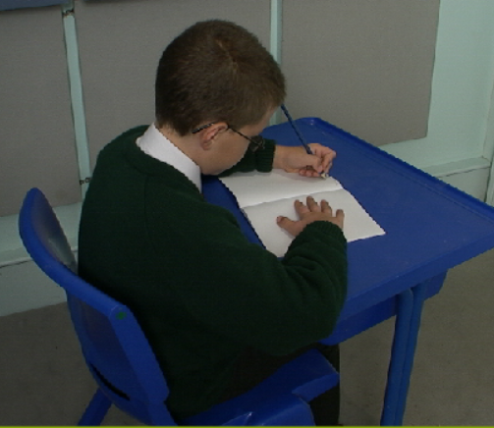
Monday 3rd February 2025
Handwriting
Warm up – fine warm up – interlinking fingers
Posture – are you sitting reading to write?
Right-handed posture
Left-handed posture

Slide 9
Monday 3rd February 2025
Handwriting - Unit 2
Practice joins:
Unit 2– First – parallel ascenders – high frequency words
Then - practice writing the words – beautiful, finish and school.

Slide 10
Monday 3rd February 2025
Q – What are tropical and equatorial climate zones like?
3 in 3
Tropical climate zones are warm and have lots of sunshine all year long. They are found near the equator, where the Earth is closest to the sun. In these areas, there are usually two seasons: a wet season with lots of rain and a dry season with less rain. Tropical climates are home to rainforests, where animals like monkeys, parrots, and tigers live. The temperature in these places stays warm, and plants grow really fast because of the heat and rain.
What two seasons are found in tropical climate zones?
Name two animals that lives in the tropical rainforest.
Where are tropical climate zones found on Earth?

Slide 11
Monday 3rd February 2025
Q – What are tropical and equatorial climate zones like?
​
Blue - ​Which climate zone is the United Kingdom in?
Mediterranean polar subpolar temperate
Green – Which climate zone has two seasons?
Mediterranean temperate
Challenge - Which words complete the sentence?
closer to further away from
Mediterranean climate zones are.... the Equator than temperate climate zones.

Slide 12
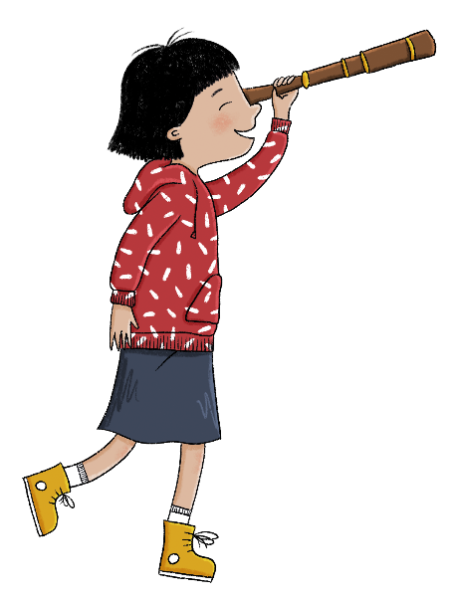
In this lesson, we will compare tropical and equatorial climate zones. We will also learn to analyse photographs and charts to identify a tropical or an equatorial climate’s conditions.
Lesson 5: Lesson statement
Copyright © ArkCurriculum+ 2022

Slide 13
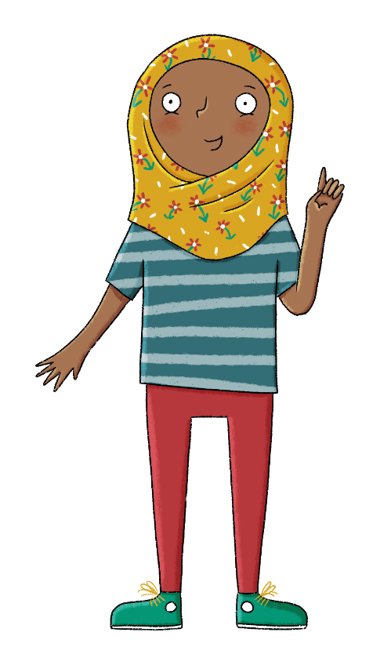
The key term in this lesson is tropical climate zone. A tropical climate zone has a rainy summer season and a very hot and very dry winter season.
Lesson 5: Key term
Copyright © ArkCurriculum+ 2022

Slide 14
What are tropical and equatorial climate zones like?
Key knowledge
Tropical climate zones are located either side of the equatorial climate zones.
Tropical climate zones have two very different seasons: a rainy season and a dry season.
Equatorial climate zones are found along the Equator.
Equatorial climate zones are hot and humid all year round.
Key vocabulary
equatorial
climate zone
rainfall
season
temperature
Lesson 5: Key knowledge
Copyright © ArkCurriculum+ 2022
Notes:
Share the specific session knowledge and vocabulary.

Slide 15
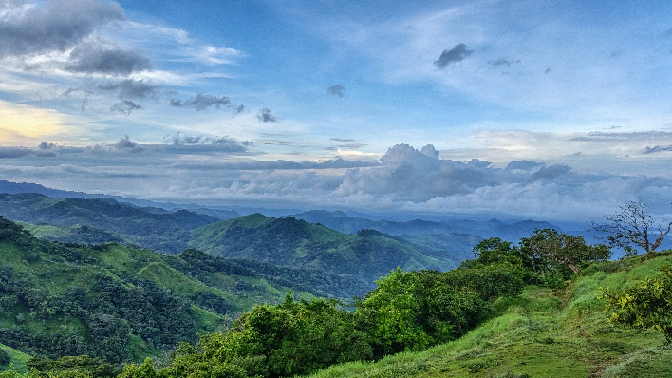
What is the climate like in a tropical climate zone?
The tropical climate zones are mostly found between the Tropic of Cancer and the Tropic of Capricorn, but not along the Equator.
They are either side of the equatorial climate zones.
Places in the tropical climate zones have two very different seasons: a rainy season and a dry season.
The rainy season (the summer) is hot and wet. The dry season (the winter) is very hot and very dry.
Tropical rainforest regions of the world - 4th level Geography - Video - BBC Bitesize
Lesson 5: Read
Copyright © ArkCurriculum+ 2022
Notes:
Read ‘What is the climate like in a tropical climate zone and in an equatorial climate zone?’. Discuss the clues in the pictures which show the pupils which climate zone it is.

Slide 16
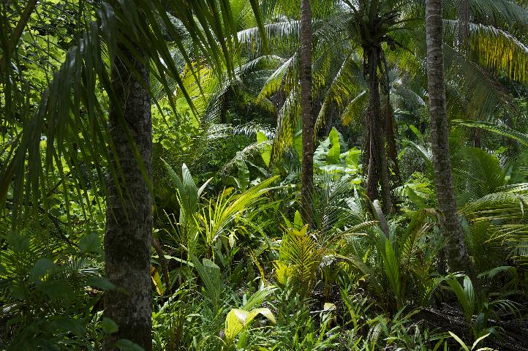
What is the climate like in an equatorial climate zone?
The equatorial climate zones are found along the Equator. The Sun’s heat is the most intense here, and so places in equatorial climate zones are hot all year round. There is also heavy rainfall throughout the year and the air nearly always feels humid.
All of the tropical rainforests are in equatorial climate zones (even though they sound like they should be in the tropical climate zones).
Lesson 5: Read
Copyright © ArkCurriculum+ 2022

Slide 17
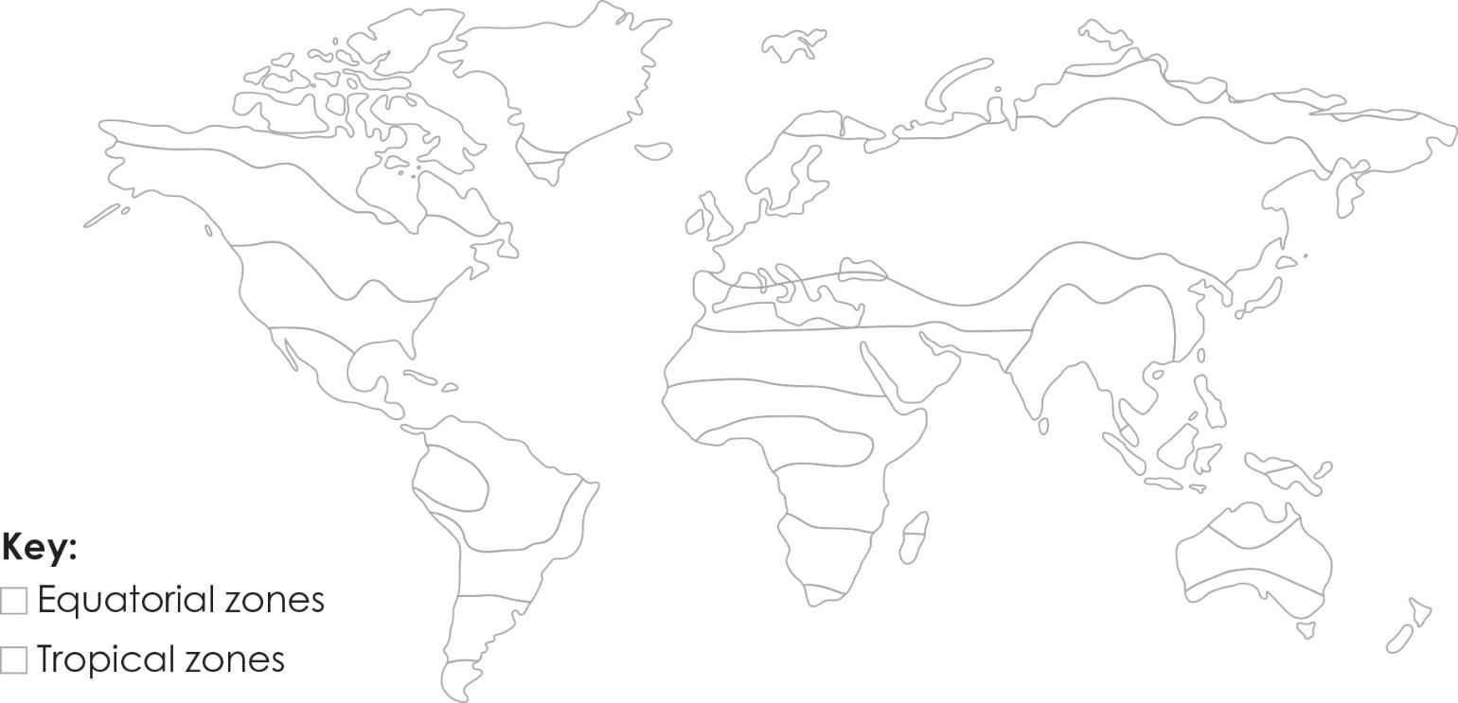
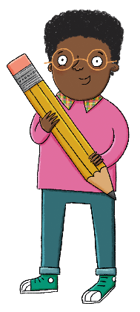
Find the equatorial and tropical zones in an atlas
Colour the equatorial zones on the map red.
Colour the tropical zones on the map orange.
Lesson 5: Investigate
Copyright © ArkCurriculum+ 2022
Notes:
Hand out atlases to the class and ask them to find a map of the whole world. Can they see the equatorial and tropical zones on the map? Ask pupils to colour the map in their workbooks—they colour the equatorial zones red, and the tropical zones orange.

Slide 18
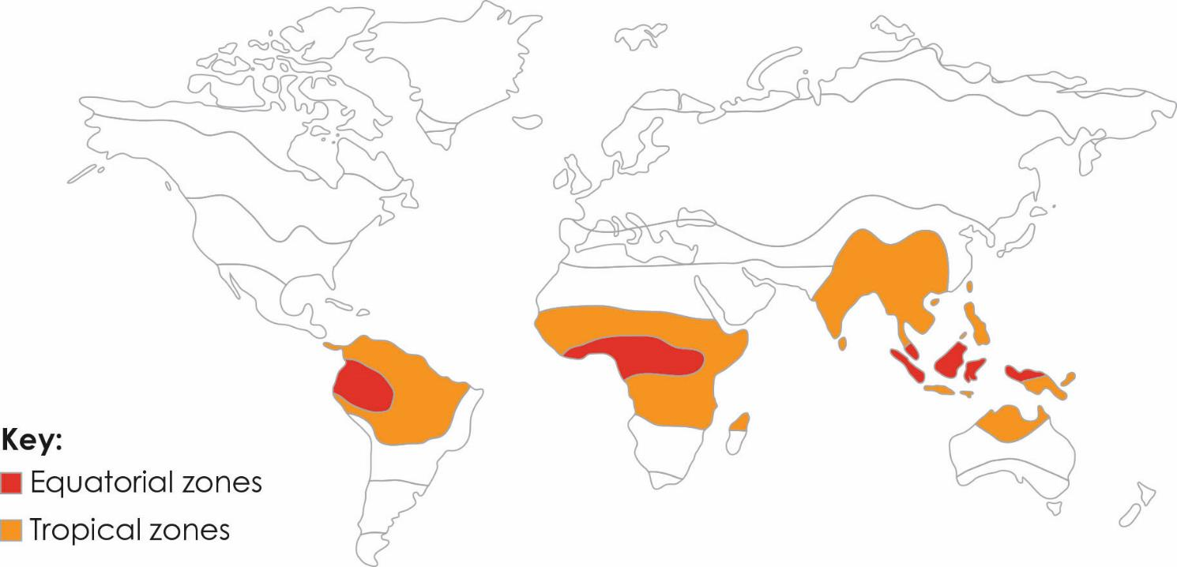
Find the equatorial and tropical zones in an atlas
Lesson 5: Investigate
Copyright © ArkCurriculum+ 2022

Slide 19
Fact file
Look at the following slides to help you complete your fact files.
Write down the information carefully.

Slide 20
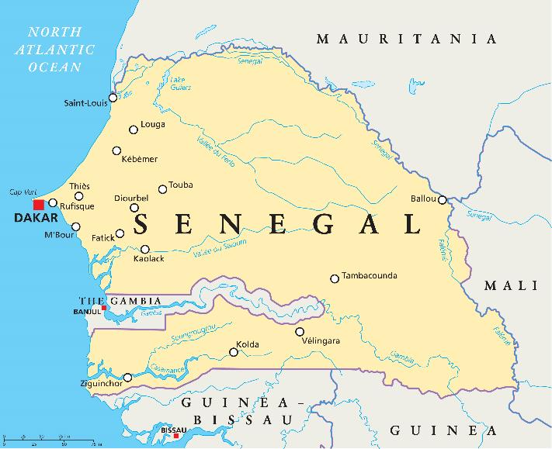
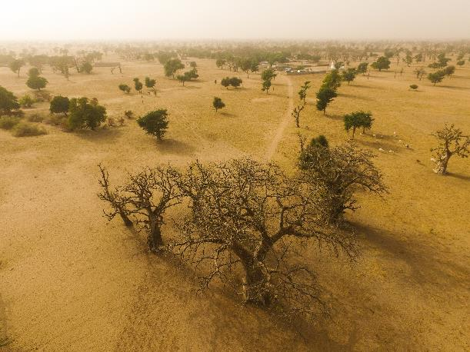
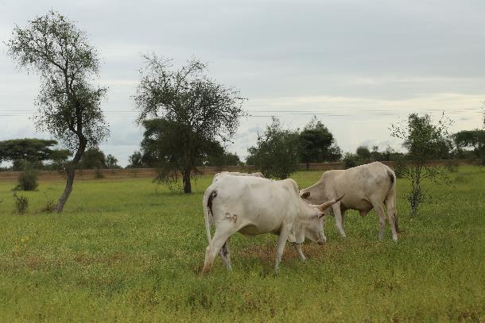
Fact file 1: Senegal
Dry season
Lesson 5: Read
Senegal’s dry season lasts from January until the summer months, when the wet season begins. Temperatures range between 20 and 30 degrees Celsius all year round.
Wet season
Copyright © ArkCurriculum+ 2022
Notes:
Ask pupils to read the two Fact files, which are about two climate zones. Explain that the titles have been missed off, so they don’t say which climate zone is covered by each Fact file. Can pupils work out which climate zones are depicted?

Slide 21
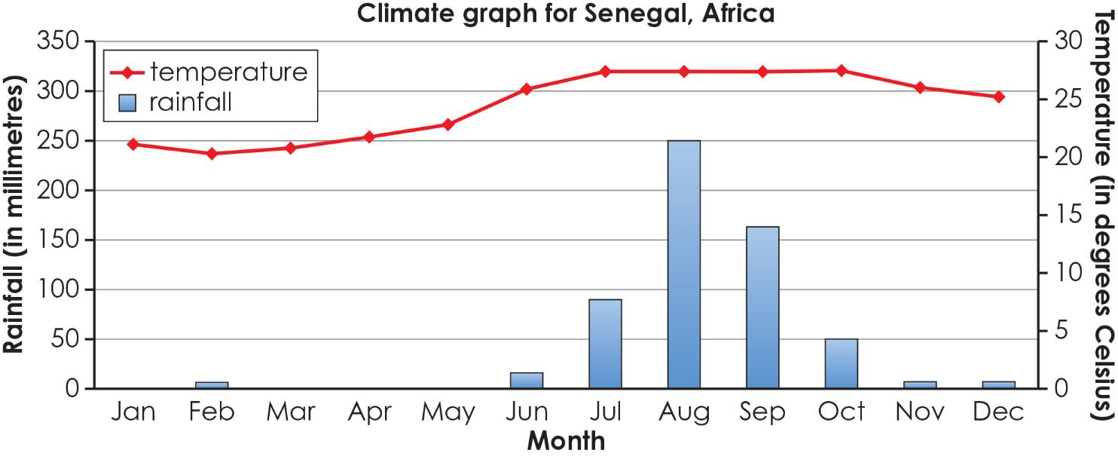
Fact file 1: Senegal
Fact file 1: Senegal
Lesson 5: Read
Copyright © ArkCurriculum+ 2022

Slide 22
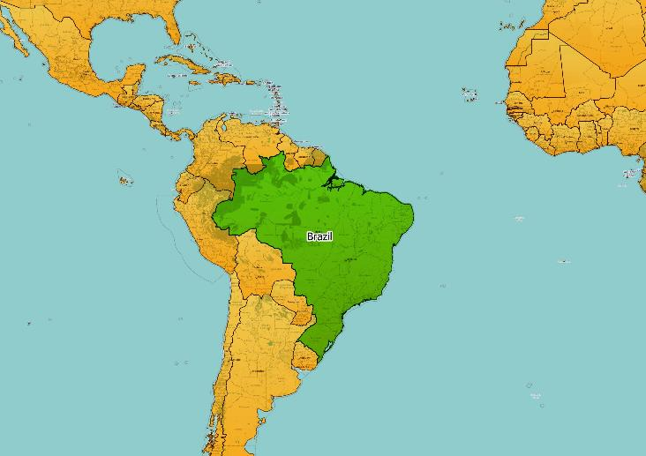
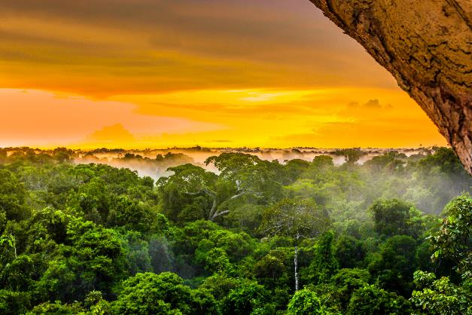
Fact file 2: Amazon rainforest, Brazil
Lesson 5: Read
The Amazon rainforest in Brazil has heavy rainfall all year round, which peaks at the beginning of the year. Temperatures vary from around 26 to 27.5 degrees Celsius.
Copyright © ArkCurriculum+ 2022

Slide 23
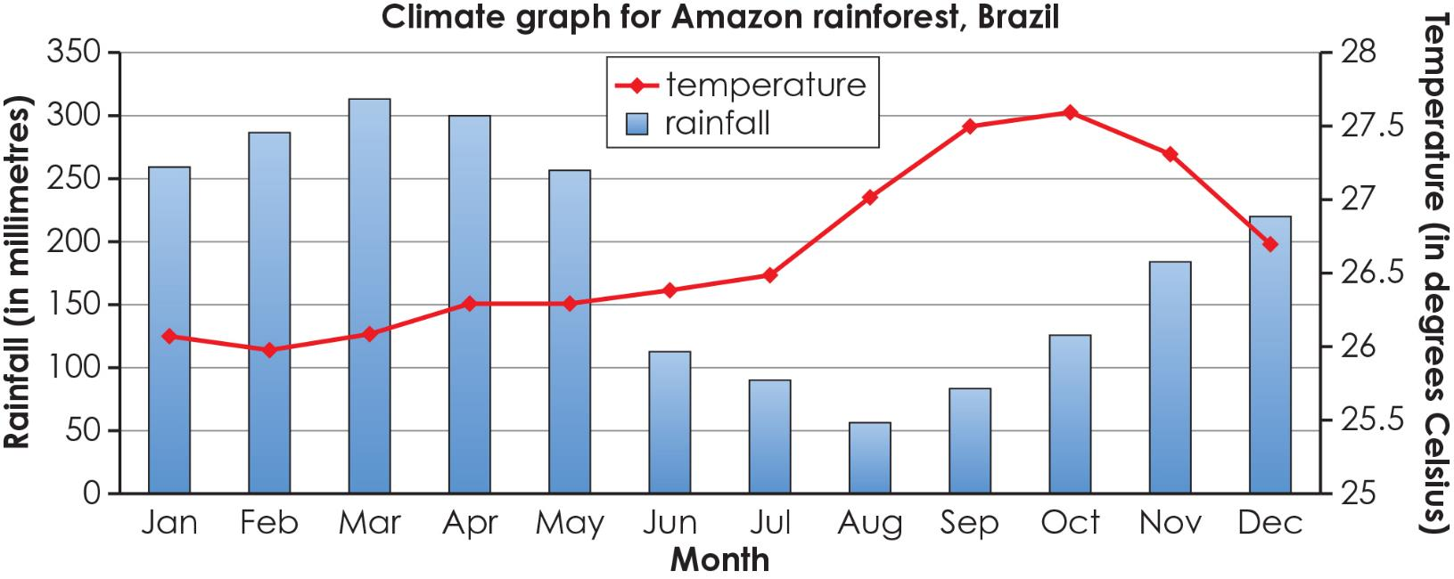
Fact file 2: Amazon rainforest, Brazil
Fact file 2: Amazon rainforest, Brazil
Lesson 5: Read
Copyright © ArkCurriculum+ 2022

Slide 24
Questions on the Fact files
Underneath your fact file:
Write one thing that is similar about the two climate zones described in the two fact files.
Write one thing that is different about the two climate zones described in the fact files.
Lesson 5: Retrieval
Copyright © ArkCurriculum+ 2022

Slide 25
Questions on the Fact files
Exit questions
What seasons are found in a tropical climate zone?
Where are equatorial climate zones found?
Lesson 5: Retrieval
Copyright © ArkCurriculum+ 2022

Slide 26
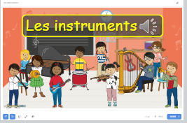
lundi 3 février
TBAT: use a verb for ‘to play’
Home (languageangels.com)

Slide 27
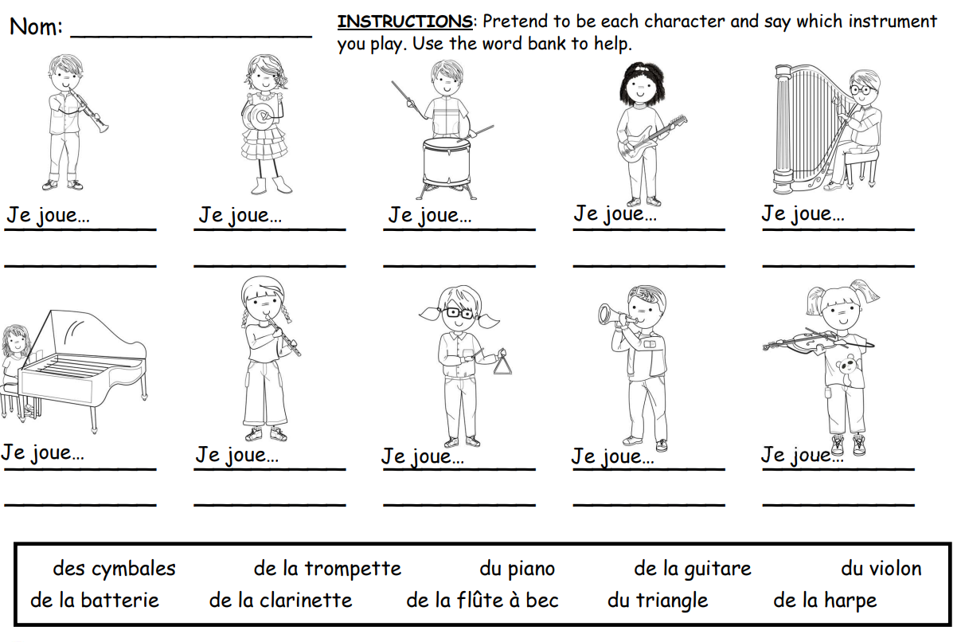
lundi 3 février
TBAT: use a verb for ‘to play’
Home (languageangels.com)

