Slide 1
Wednesday 5th February 2025
Mental health workshop
8.45am - 9.15am

Slide 2
Emotional regulation and coping strategies.
Know yourself, grow yourself

Slide 3
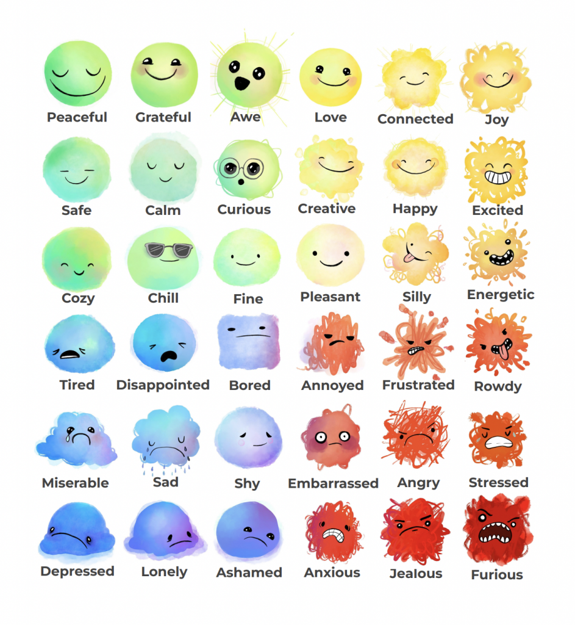
How many emotions can you think of?
You have 30 seconds to brainstorm – GO!

Slide 4
Some emotions will make us feel comfortable and other emotions may make us feel uncomfortable. We sometimes need ways to manage our emotions and know when we are feeling an uncomfortable emotion.

Slide 5
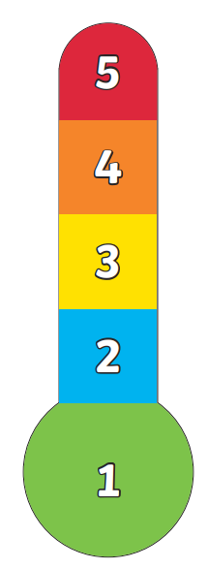
Activity
You are going to make an emotions thermometer to help you manage your emotions.
Colour in each section of your thermometer and add the appropriate emotion.

Slide 6
Calming strategies
Here are some ways that could help you cope with uncomfortable emotions.
Remember to talk to a trusted adult about your feelings as they may be able to help you.

Slide 7
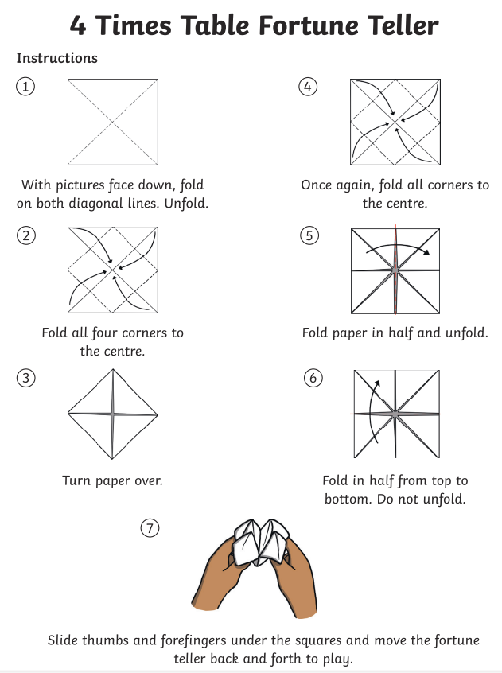
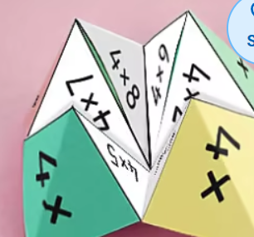
05.02.25
Times table practice
4 Times Table Song (Cover of I’m Still Standing by Taron Egerton)
Counting
Harry Potter Maths
Round the World
Hit the button
Roll the dice
Counting stick

Slide 8
05.02.25
TBAT: place 3-digit numbers on a number line.
Daily 10 - Mental Maths Challenge - Topmarks

Slide 9
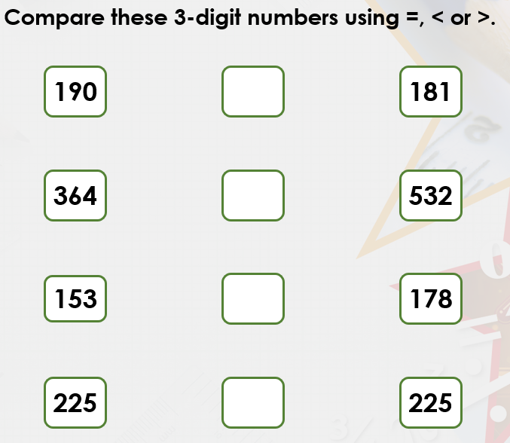
05.02.25
TBAT: place 3-digit numbers on a number line.

Slide 10
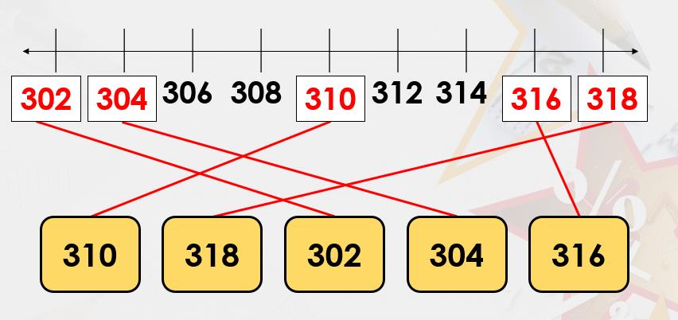
05.02.25
TBAT: place 3-digit numbers on a number line

Slide 11
05.02.25
TBAT: place 3-digit numbers on a number line
LET'S PRACTISE COUNTING IN 100'S UP TO 1,000.
How do we work out the increments for each number line?

Slide 12
05.02.25
TBAT: place 3-digit numbers on a number line
The start point is ____.
The end point is ____.
There are______ intervals on the number line.
Each interval is worth ____.
The number line is counting in steps of _____.

Slide 13
05.02.25
TBAT: place 3-digit numbers on a number line
Blue
Green

Slide 14
05.02.25
TBAT: place 3-digit numbers on a number line
Independent

Slide 15
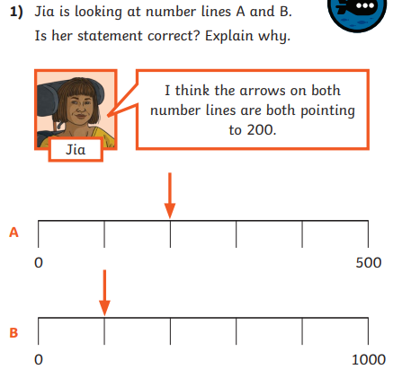
05.02.25
TBAT: place 3-digit numbers on a number line
Challenge
Mastery

Slide 16
Wednesday 5th February
Spelling
What is a prefix?
What does a prefix do?
How many different prefixes can you think of?

Slide 17
This week, we are going to look at adding a particular prefix to lots of different root words.
Can you remember what a prefix is?
A prefix is a letter or group of letters added at the beginning of a root word that creates a new word with a different meaning.
We are going to concentrate on adding the prefix…
mis-

Slide 18
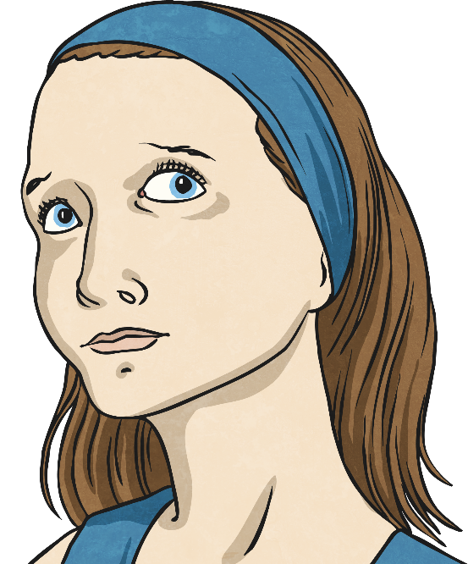
How does adding mis- affect the meaning of a root word?
Discuss how adding the mis- prefix changes the meaning of these root words…
mis
mis
lead
print
use
mis
The mis- prefix gives these root words a negative meaning.
‘Mis-’ means wrong.

Slide 19
Let’s play ‘Ten Strikes and You’re Out!’ Click on the letters that you think are missing to try to make the contracted word in the sentence. Every time you guess a letter incorrectly, press the ‘Uh-oh’ button to make a pin disappear! Can you guess all of the missing letters before you strike out?
Uh-Oh!
_ _ _ _ a _
a
b
c
d
e
f
g
h
i
j
k
l
m
n
o
p
q
r
s
t
u
v
w
x
y
z

Slide 20
To suspect that someone is not being honest or truthful.
_ _ _ _ _ _ _ _
s
t
Uh-Oh
a
b
c
d
e
f
g
h
i
j
k
l
m
n
o
p
q
r
s
t
u
v
w
x
y
z

Slide 21
To be naughty or disobedient.
_ _ _ _ _ _ _ _ _
e
Uh-Oh
a
b
c
d
e
f
g
h
i
j
k
l
m
n
o
p
q
r
s
t
u
v
w
x
y
z

Slide 22
To put something down somewhere and lose it.
_ _ _ _ _ _ _ _
Uh-Oh
a
b
c
d
e
f
g
h
i
j
k
l
m
n
o
p
q
r
s
t
u
v
w
x
y
z

Slide 23
To behave cruelly or nastily towards a person or animal.
_ _ _ _ _ _ _ _
t
Uh-Oh
a
b
c
d
e
f
g
h
i
j
k
l
m
n
o
p
q
r
s
t
u
v
w
x
y
z

Slide 24
To have not listened to something correctly.
_ _ _ _ _ _ _ _
Uh-Oh
a
b
c
d
e
f
g
h
i
j
k
l
m
n
o
p
q
r
s
t
u
v
w
x
y
z

Slide 25
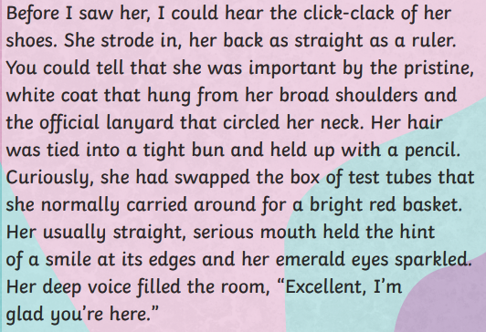
Wednesday 5th February
TBAT: plan a character description.
3 in 3
Find a word you could replace with 'walked'.
How was the character's hair held up?
Find a fronted adverbial that has been used in the text.

Slide 26
Wednesday 5th February
TBAT: plan a character description.
What does the King look like?
What personality does the King have? Use three words to describe him.
How many synonyms can you think of for the word greedy?

Slide 27
Wednesday 5th February
TBAT: plan a character description.

Slide 28
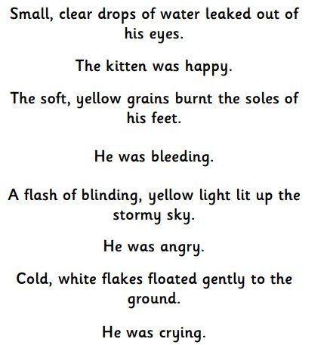
Wednesday 5th February
TBAT: plan a character description.
Look at the sentences. Which
sentences show but do not tell
the reader about the character?
Which sentences sound the best?

Slide 29
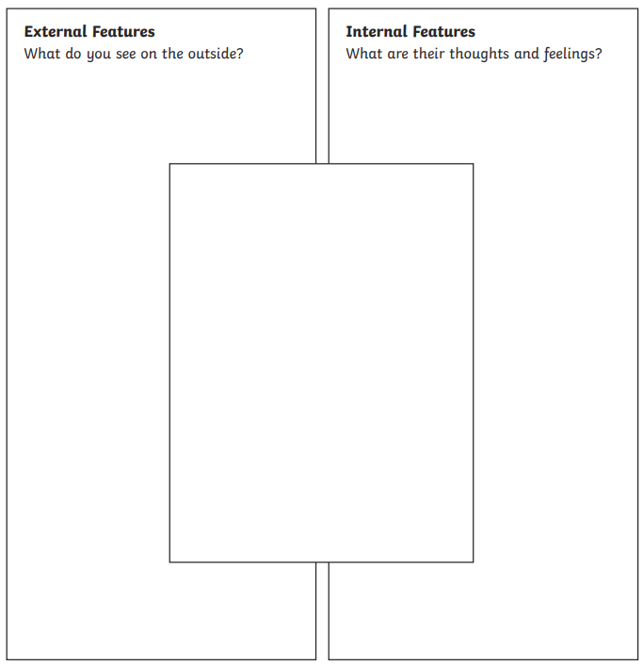
Wednesday 5th February
TBAT: plan a character description.
Fill in the character plan thinking about the ambitious vocabulary we discussed in yesterday's lesson.
Challenge
Think of 3 different ways to state how the King looks.

Slide 30
Wednesday 5th February 2025
TBAT: recap knowledge learned so far.
Blue – What is baptism?
Green – What is holy communion?
Challenge – What makes somebody a Christian?

Slide 31
Wednesday 29th January 2025
TBAT: recap knowledge learned so far.
Quiz Time
What is the name of the ceremony where Christians are sprinkled with holy water?
⃝ Communion
⃝ Baptism
⃝ Marriage
What does the bread represent in communion?
⃝ The blood of Christ
⃝ The Cross
⃝ The body of Christ
What is the bowl used in baptism called?
⃝ Font
⃝ Type
⃝ Folley

Slide 32
Wednesday 5th February 2025
TBAT: recap knowledge learned so far.
Key knowledge: The church is a place where very important ceremonies in Christians’ lives take place. Baptism and communion are both highly significant to Christians and the church allows these to be shared with others.
You will be writing a short paragraph that answers these questions:
What is baptism? Where does it take place?
What is communion? What does the bread and wine represent? Where does it take place?
Why are these ceremonies important for Christians?

Slide 33
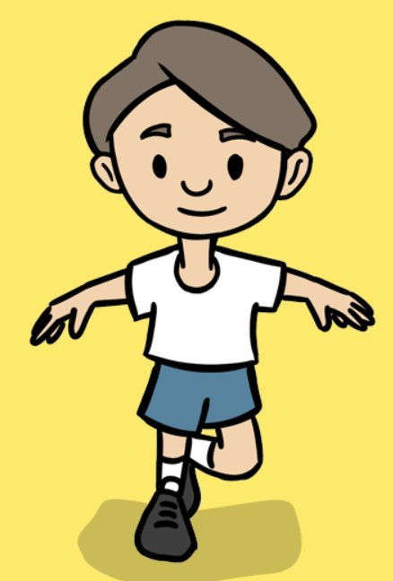
Wednesday 5th February 2025
PE – fundamentals
TBAT: understand how the body moves differently at different speeds.
This half term in P.E will be dance and fundamentals
- Changing for PE - Rules and expectations moving to PE - Move to the downstairs hall or outside
Get Set 4 PE - Lesson Plan -2 for Year 3 Fundamentals Y3/4

Slide 34
Wednesday 5th February 2025 TBAT: change the appearance of my project
Learning objectives
I can build a sequence of commands
I can decide the actions for each sprite in a program
I can make design choices for my artwork

Slide 35
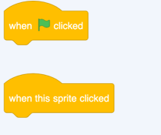
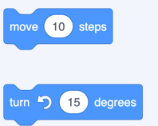
Wednesday 5th February 2025 TBAT: change the appearance of my project.
Blue – What will the event tabs do?
Green – What will the motion tabs do?
Challenge – What happens when you combine the different blocks together?

Slide 36
What have you learnt so far?
Introduction
Motion
Sounds
Events

Slide 37
You have combined blocks to make sequences...
Activity 1
...of motion
and of sounds

Slide 38
Sequences with movement and sound
Activity 1
What is different about this sequence?
What will happen when this sequence is run?
Think, pair, share
cat
Now try it out — were you right?

Slide 39
Change the appearance of your sprite
Activity 2

Slide 40
Animate with costumes
Activity 2
You can use a very simple code sequence to animate the appearance of sprites:
Try it
Which sprite has the most costumes?

Slide 41
Add a backdrop to your stage
Activity 2

Slide 42
Challenge:
Create code for your drum to make a noise and change appearance
Activity 2

Slide 43
Create a project based on your design
Activity 3
Sprite 1 name and event: Drum, when clicked What sounds will it make? Two different drum beats How will it move or change? Change the costume each time the drum beats | Sprite 2 name and event: Saxophone, when S key pressed What sounds will it make? Play notes C, D, and G in that order How will it move or change? Move 10 steps with each note | Sprite 3 name and event: Guitar, when clicked What sounds will it make? Play notes G, B, and D together How will it move or change? Change to costume b
Stage: Which backdrops will you use in your project? The backdrop will switch between the concert and the spotlight backdrops, when the B key is pressed.

Slide 44
Assessment
How confident are you? (1–3)
I can build a sequence of commands
I can decide the actions for each sprite in a program
I can make design choices for my artwork
3 – Very confident
2 – Unsure
1 – Not confident
Notes:
Image source: https://pixabay.com/vectors/thumb-up-hand-like-confirm-go-top-307176

Slide 45
Wednesday 5th February 2025
TBAT: experiment with colour.
What are the primary colours?
How many colours can you make with the primary colours?

Slide 46
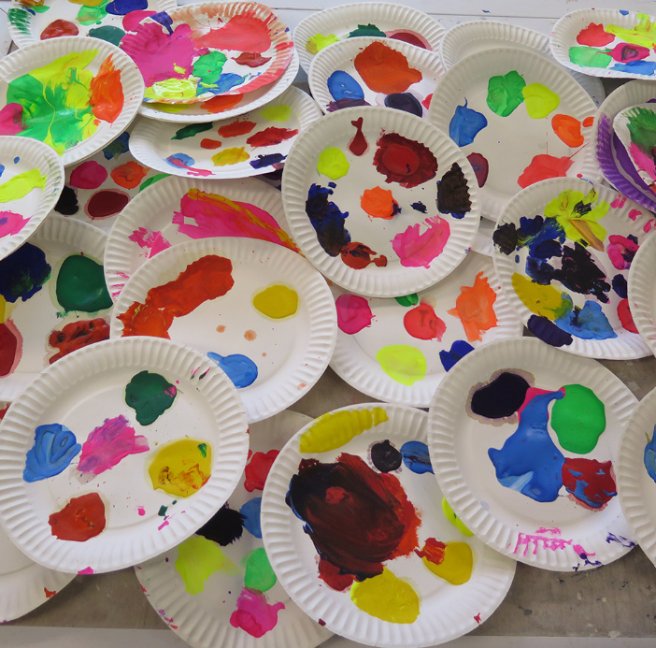
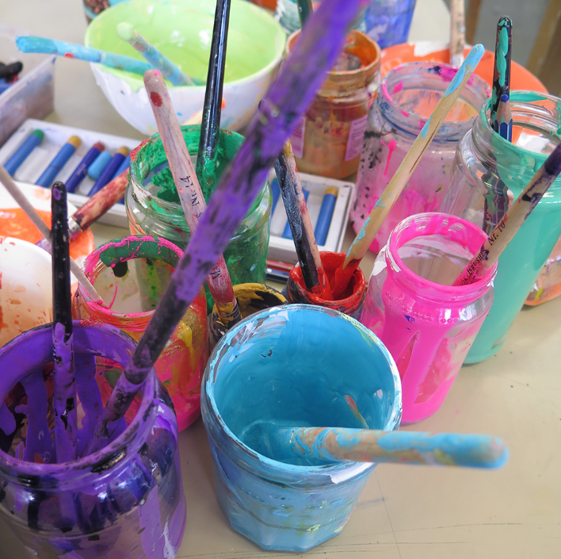
Wednesday 5th February 2025
TBAT: experiment with colour.
First, use paints to explore colour mixing, taking inspiration from the historical shades in the painting, but with a fresh and modern approach. Favourite shades to be painted on A5 paper and pinned up.

