Slide 1
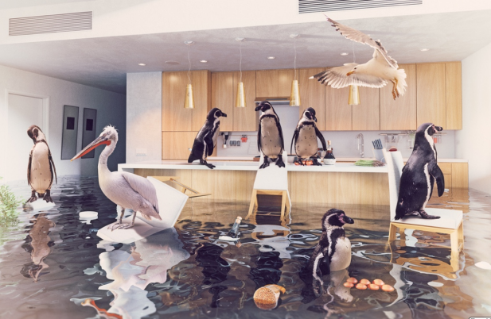
Tuesday 4th February 2025
Morning challenge
Infer
How did the birds get there
What caused the flood?
Whose house is this?
What is in the floating bottle
What is submerged under the water?
What do you think will happen next?

Slide 2
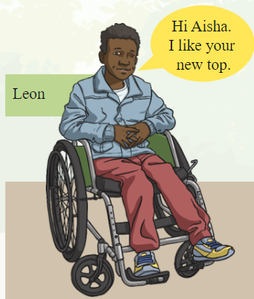
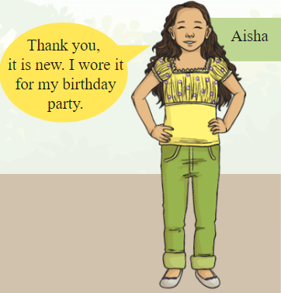
Tuesday 4th February 2025 Word work
With your partner, read out Leon and Aisha's conversation.
What if a text has no speech bubbles?
How can we turn this speech into a text?

Slide 3
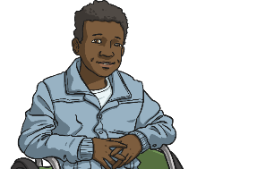
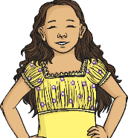
Hello, Hello, Hello!
‘Hi Aisha. I like your new top,’ said Leon.
‘Thank you, it is new. I wore it for my birthday party,’ replied Aisha.
This direct speech uses inverted commas.
‘Hi Aisha. I like your new top,’ said Leon.
They look like commas floating in the air!
Inverted commas mark the beginning and end of direct speech.

Slide 4
Hello, Hello, Hello!
Can you spot the difference?
“Hi Aisha,” said Leon.
‘Hi Aisha,’ said Leon.
Inverted commas can be used as “ double or ‘ single.
You can use either, but it is important to choose either double or single and stick with them.
Don’t switch between them during your writing.
Notice where a comma appears in these sentences.
‘Hi Aisha,’ said Leon.
The comma appears before the last inverted comma.

Slide 5
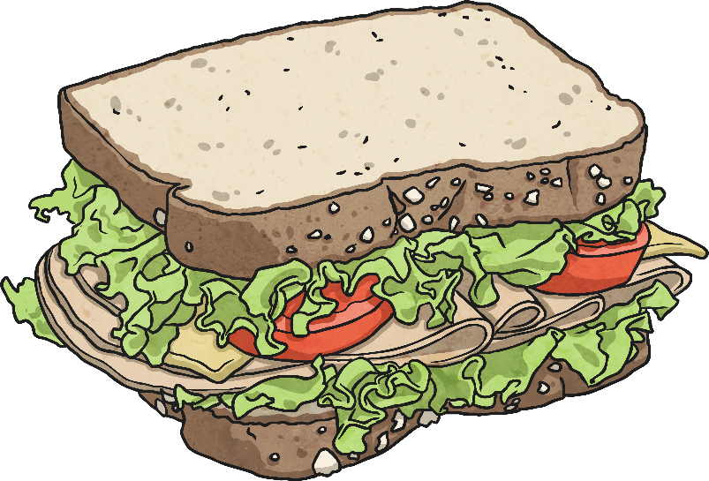
Hello, Hello, Hello!
As a class, punctuate this sentence.
Remember that direct speech needs the inverted commas and a relevant punctuation mark.
I would like a sandwich commented Ben.
‘
’
,
Choose the correct punctuation for the sentence above.

Slide 6
Hello, Hello, Hello!
On whiteboards, try these with you partner.
Remember that direct speech needs the inverted commas and a relevant punctuation mark.
I enjoy playing at the park murmured Ameera.
The sun is out and the sky is blue replied Jay.
My friends make me smile explained Beatrice.
I love Fridays commented Reuben.

Slide 7
Hello, Hello, Hello!
Answers
‘I enjoy playing at the park,’ murmured Ameera.
‘The sun is out and the sky is blue,’ replied Jay.
‘My friends make me smile,’ explained Beatrice.
‘I love Fridays,’ commented Reuben.

Slide 8
04.02.25
Reading paper – Part 1 – 10.00am - 10:30am

Slide 9
04.02.25
Reading paper – Part 2 – 10.45am - 11.15am

Slide 10
04.02.25
4 Times Table Song (Cover of I’m Still Standing by Taron Egerton)
Times table spalt!
2 children, 1 calculation.
Who will splat the answer first?
Times table practice
4
24
48
32
12
20
36
28
44
30
40
16

Slide 11
04.02.25
Daily 10 - Mental Maths Challenge - Topmarks

Slide 12
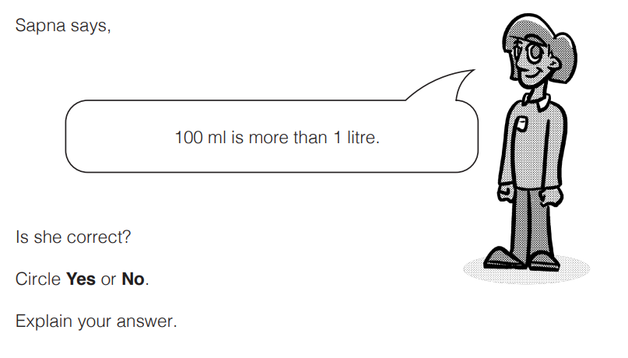
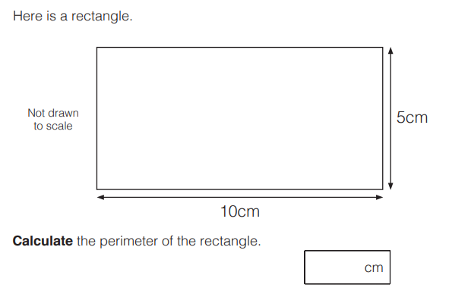
04.02.25

Slide 13
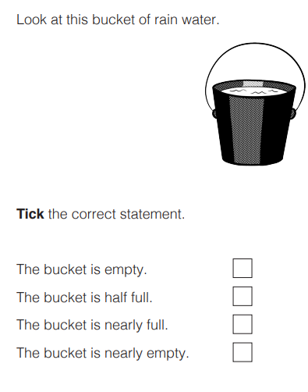
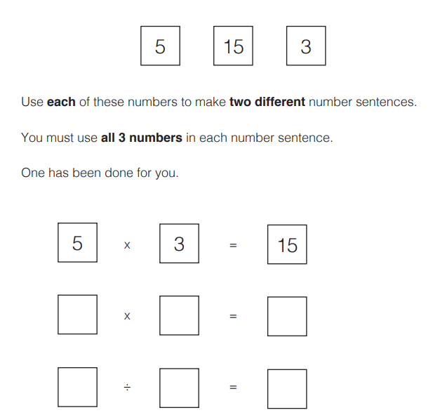
04.02.25

Slide 14
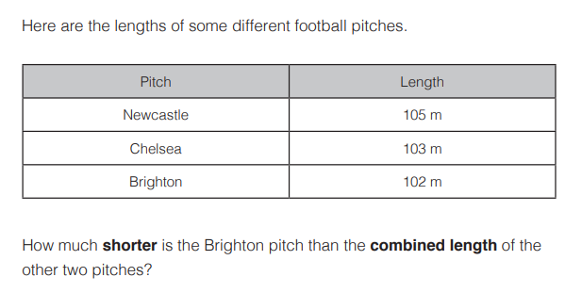
04.02.25

Slide 15
04.02.25 -
Vocabulary

Slide 16
Tuesday 4th February2025
TBAT: Understand pitch through melody and develop a song.
The Collins Hub Educator > Library
Sounds – Lesson 1 - Stamping tubes

Slide 17
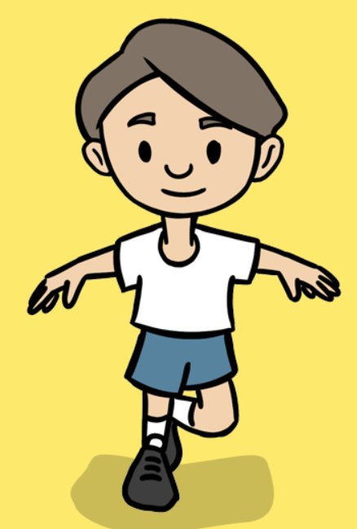
Tuesday 4th February 2025
PE – fundamentals
TBAT: develop balance and apply it to other fundamental movement skills.
This half term in P.E will be dance and fundamentals
- Changing for PE - Rules and expectations moving to PE - Move to the downstairs hall or outside
Get Set 4 PE - Lesson Plan -1 for Year 3 Fundamentals Y3/4

Slide 18
Tuesday 4th February 2025 TBAT: change the appearance of my project
Learning objectives
I can build a sequence of commands
I can decide the actions for each sprite in a program
I can make design choices for my artwork

Slide 19
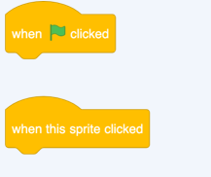
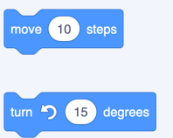
Tuesday 4th February 2025 TBAT: change the appearance of my project.
Blue – What will the event tabs do?
Green – What will the motion tabs do?
Challenge – What happens when you combine the different blocks together?

Slide 20
What have you learnt so far?
Introduction
Motion
Sounds
Events

Slide 21
You have combined blocks to make sequences...
Activity 1
...of motion
and of sounds

Slide 22
Sequences with movement and sound
Activity 1
What is different about this sequence?
What will happen when this sequence is run?
Think, pair, share
cat
Now try it out — were you right?

Slide 23
Change the appearance of your sprite
Activity 2

Slide 24
Animate with costumes
Activity 2
You can use a very simple code sequence to animate the appearance of sprites:
Try it
Which sprite has the most costumes?

Slide 25
Add a backdrop to your stage
Activity 2

Slide 26
Challenge:
Create code for your drum to make a noise and change appearance
Activity 2

Slide 27
Create a project based on your design
Activity 3
Sprite 1 name and event: Drum, when clicked What sounds will it make? Two different drum beats How will it move or change? Change the costume each time the drum beats | Sprite 2 name and event: Saxophone, when S key pressed What sounds will it make? Play notes C, D, and G in that order How will it move or change? Move 10 steps with each note | Sprite 3 name and event: Guitar, when clicked What sounds will it make? Play notes G, B, and D together How will it move or change? Change to costume b
Stage: Which backdrops will you use in your project? The backdrop will switch between the concert and the spotlight backdrops, when the B key is pressed.

Slide 28
Assessment
How confident are you? (1–3)
I can build a sequence of commands
I can decide the actions for each sprite in a program
I can make design choices for my artwork
3 – Very confident
2 – Unsure
1 – Not confident
Notes:
Image source: https://pixabay.com/vectors/thumb-up-hand-like-confirm-go-top-307176

Slide 29
Tuesday 4th February
TBAT: experiment with colour
What are the primary colours?
How many colours can you make with the primary colours?

Slide 30
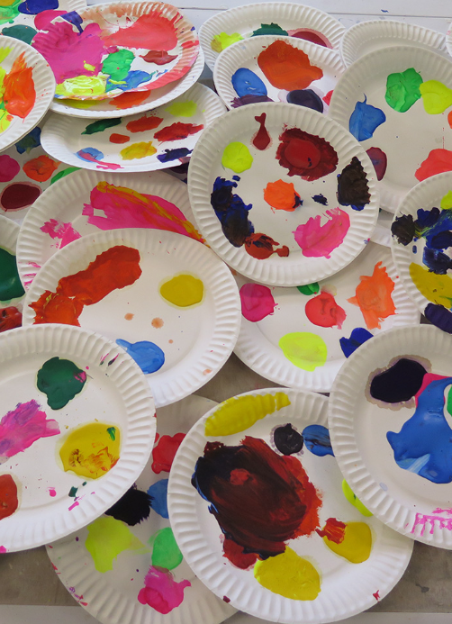
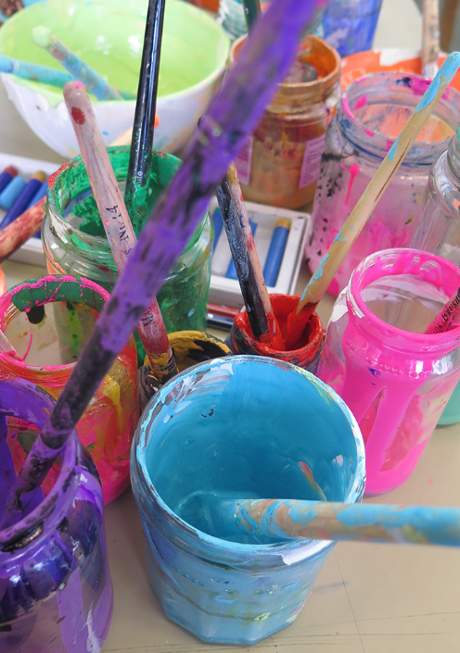
Tuesday 4th February
TBAT: experiment with colour
First, use paints to explore colour mixing, taking inspiration from the historical shades in the painting, but with a fresh and modern approach. Favourite shades to be painted on A5 paper and pinned up.

