Slide 1
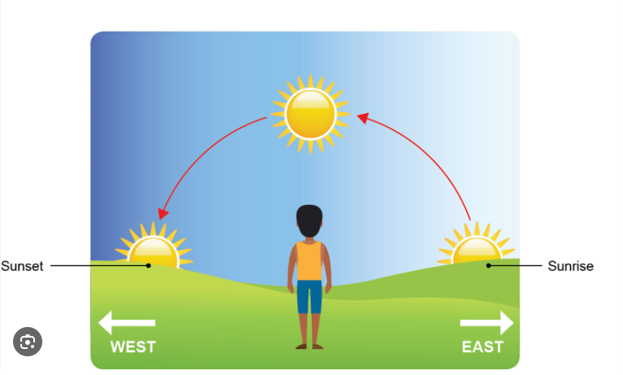
Friday 7th February
Morning challenge: Science – complete the results table:
Look at your results table. What have you found out? What does this tell you about what happens to the sun? In your answer include vocabulary: Rotate east to west axis
Time | Length of shadow (m)
9am | 4.15m
10am | 2.71m
11am | 2.1m
12pm | 1.91m
1pm | 2.68m
2pm | 2.68m
3pm | 3.49m

Slide 2
Spelling (Give example sentences)
altar
2. alter
3. ascent
4. assent
5. bridal
6. Bridle
7. cereal
8. serial
9. compliment
10. complement

Slide 3
TBAT- solve problems involving money.
Challenge:
4 - __1__ =
5 2
5, 004 – 300 =
25.67 + 245 =
Place these numbers in descending order:
5.6 5.66 5.06 6.5 6.05

Slide 4
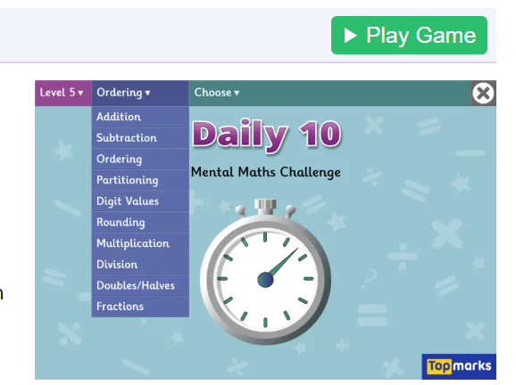
Daily 10 - Mental Maths Challenge - Topmarks x8

Slide 5
Whiteboard work: Recap of prior learning How many hours are in a day? How many days are in a week? How many months are in a year? How many minutes are in one hour? How many pence are in £1?

Slide 6
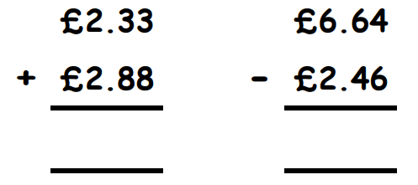
Why has column method been used? Blue Green
Challenge: What other method could be used to solve these problems?

Slide 7
Two children needed new school shoes. One pair was £14.99 and another were £21.45. What is the total cost of the shoes?
Talk partners: How would we solve this problem?
R- read the problem.
N- note/underline the key information.
C- decide on the calculation.
A- answer the problem.

Slide 8
Two children needed new school shoes. One pair was £14.99 and another were £21.45. How much change would you get from £30?
Talk partners: How would we solve this problem?
R- read the problem.
N- note/underline the key information.
C- decide on the calculation.
A- answer the problem.

Slide 9
A sandwich cost £2.45. A drink cost £1.89. How much change would I get from £5 if I bought one of each?
Whiteboard work:
R- read the problem.
N- note/underline the key information.
C- decide on the calculation.
A- answer the problem.

Slide 10
A loaf of bread cost £2.90. I bought a loaf of bread and two identical cupcakes. The total was £5.10. How much was one cupcake?
Talk partners: How would we solve this problem?
Task: Complete the calculation on your whiteboard.
R- read the problem.
N- note/underline the key information.
C- decide on the calculation.
A- answer the problem.

Slide 11
The same coat has a different price in two shops. In shop A it costs £34.28. In shop B it costs £29.88 How much more does the coat cost in shop B, than shop A?
Whiteboard work:
R- read the problem.
N- note/underline the key information.
C- decide on the calculation.
A- answer the problem.

Slide 12
In books:
Mia goes to the shop and buys two bags of sweets that cost £1.75 each.
Mia says that she should get £2.50 change from £5, is this correct?
A packet of crisps cost £1.19. If I were to buy two packs, how much change would I get from £3?
Challenge: An adult's bus ticket cost £1.80 and a child's is half this price. How much change would there be from £5 if one child and one adult boarded?

Slide 13
Independent:
Charlotte has £15 to spend on rides at the fun fair. Her favourite ride (the rhythm rider) costs £4.45 per ride so she goes on it twice. How much does she spend? How much change will she have?
2) Popcorn costs £2.89. A bag of sweets cost £1.65. A drink costs £1.80.
Could she buy all three items using her leftover money?
3) Entry to the museum was £6.00 a child and £12.50 an adult. If a family of 2 adults and 3 children visited the museum, how much would it cost?
4) If a family of 1 adult and 4 children went to the museum and paid with three £10 notes, how much change would they get?

Slide 14
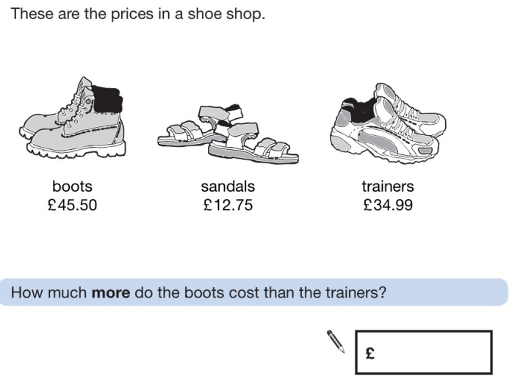
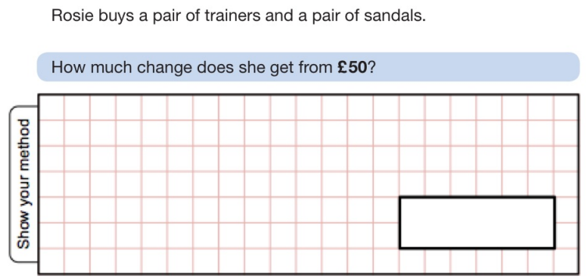

Slide 15
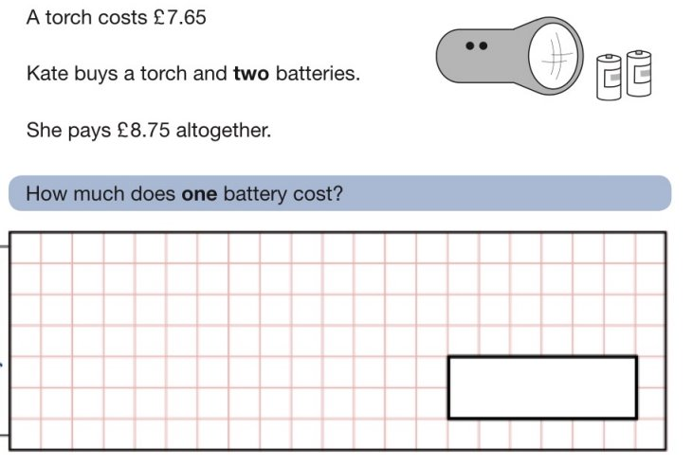
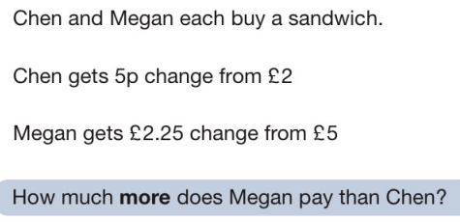
Challenge:
Mastery:

Slide 16
Friday 7th February TBAT: Convey character's emotions.
3 in 3 Ethan lounged in the leather armchair, a scowl etched deep into his face. He flicked through channels on the enormous TV, each click louder than the last. His mother stood nearby, her smile faltering as she held up a neatly wrapped gift. “It’s the latest one,” she offered hopefully. Ethan barely glanced at it. “Took you long enough,” he muttered, tossing the remote onto the floor with a thud. His father cleared his throat. “We thought you’d be excited.” Ethan rolled his eyes. “Whatever,” he drawled, already scrolling through his phone, ignoring the strained looks on their faces.
What can you infer about Ethan from this text? Give evidence to support your answer.
2. How are Ethan's parents feeling? How do you know?
3. Find and copy a phrase which shows that Ethan's family could be wealthy.

Slide 17
Friday 7th February TBAT: Convey character's emotions.
What does the phrase "show not tell" mean in writing? Can you give an example. How can you convey how a character is feeling? What features in writing can you use? Which description is more interesting? Why? a) John was crying because he was angry. b) As he fought back the tears in his eyes, John clenched his hands into fists and began to tremble in frustration.

Slide 18
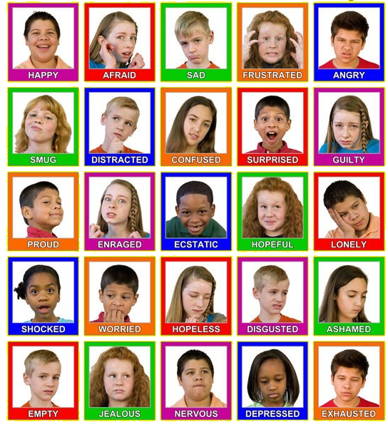
How do the emotions affect the face of these children?

Slide 19
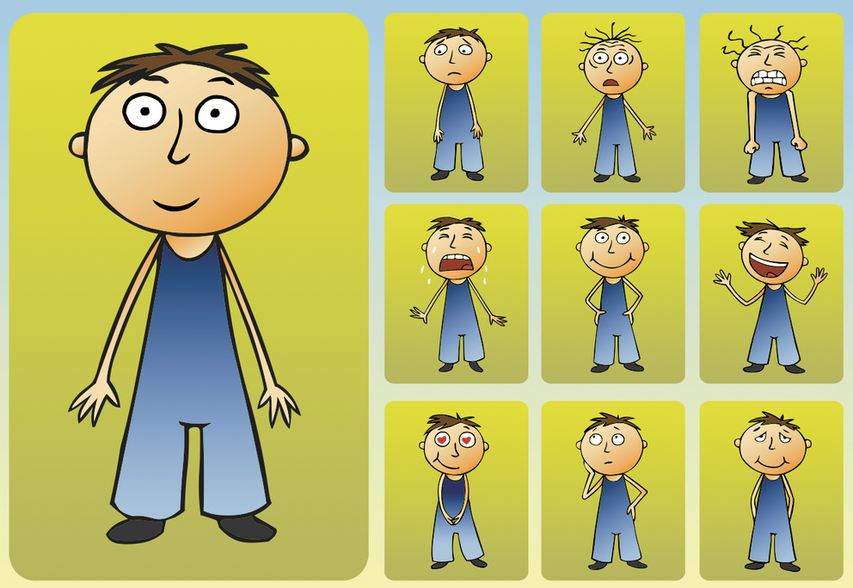
How do these emotions affect body language?

Slide 20
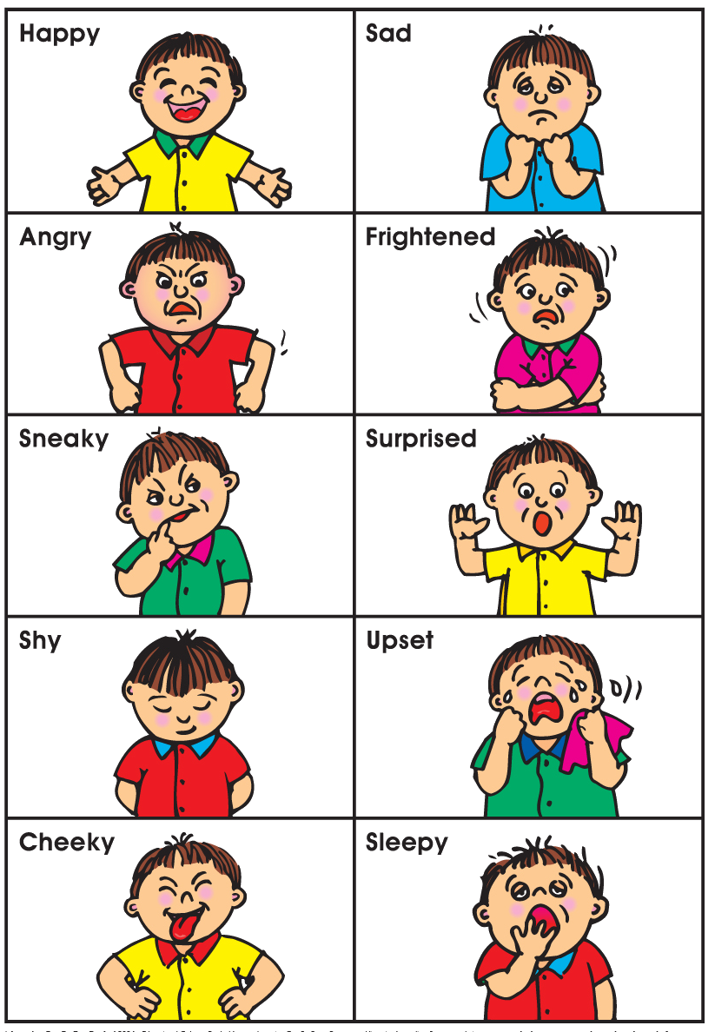
Our bodies change when we are displaying different emotions – our actions change?

Slide 22
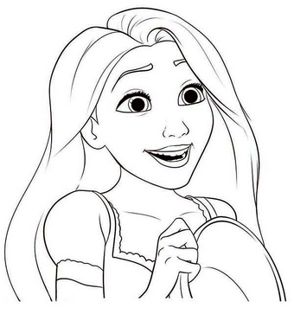
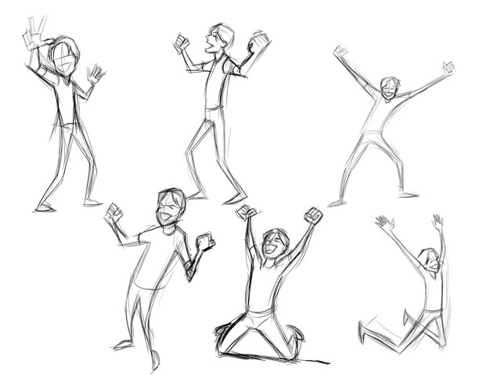
Excited for what’s to come
talkative,
pacing around,
rubbing hands,
eyes darting around,
big smiles,
hugging,
shaking hands,
punching someone on the arm,
giggles,
victory dance,
staring into the distance,
group feeling of joy.
When might our main character show excitement? Look at your plan? Which paragraph? Add a sentence to the introduction to show your character is excited about the competition.
*If there is no room in your box, write it in your literacy book and show that it is for box 1: Box 1: Ellie began pacing around her bedroom; her eyes darting around excitedly as she began to think about her competition entry.

Slide 23
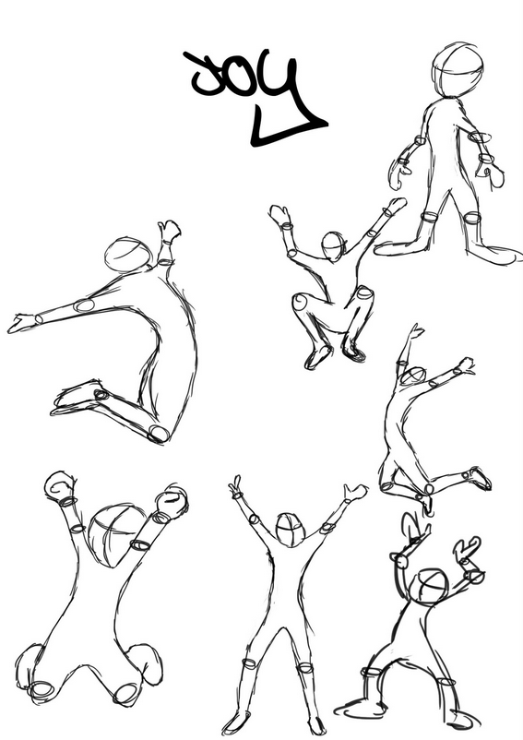
Amused
smiling,
eyes wide,
head up,
walking quickly,
friendly,
talkative,
using arms a lot,
throwing head back,
cupping the cheeks,
holding ribs,
holding hand up to stay stop,
covering the mouth,
trying to keep a straight face,
bouncing on toes,
breathlessness,
tapping with fingers.

Slide 24
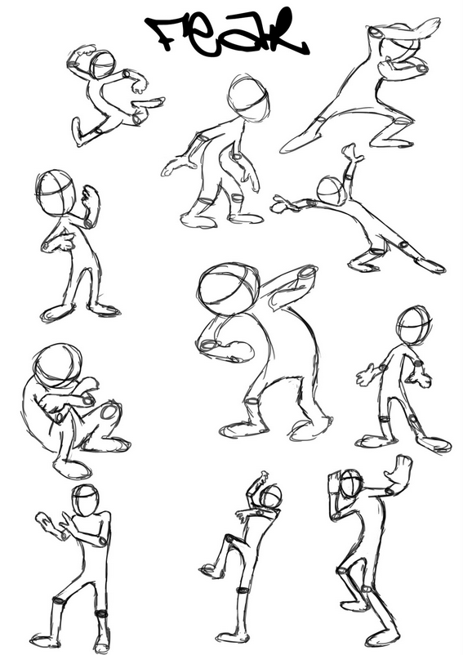
Fear
dry mouth,
biting lip,
wanting to run,
gasping for air,
cold sweat,
talking non stop,
dizziness,
shivery skin,
flinching at noises,
shaking,
shrill voice,
stuttering voice.
crouching
tip-toeing
hands up

Slide 25
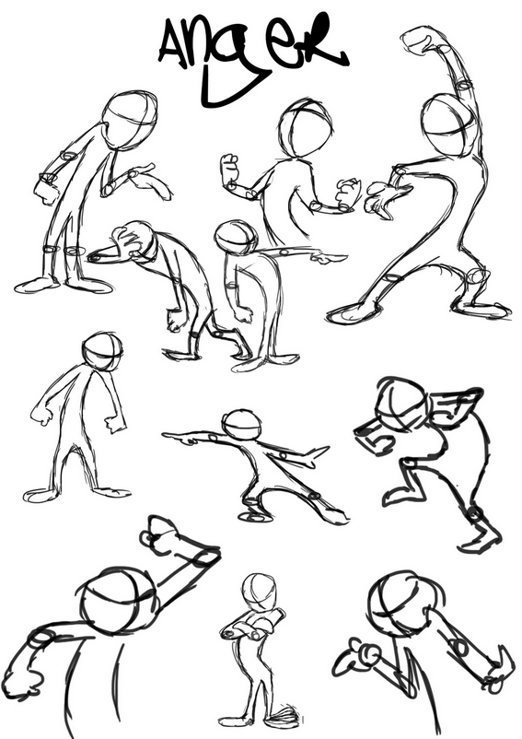
Anger
breathing deeply,
picking fights,
sarcasm,
pounding fists,
prodding finger,
deeper louder voice,
shoulders and head forward,
eyes wide and glaring,
hands forward in fists,
red face.
When might our main character show anger? Look at your plan? Which paragraph? Add a sentence to the box which announces the unworthy winner to show your character is angry.

Slide 26
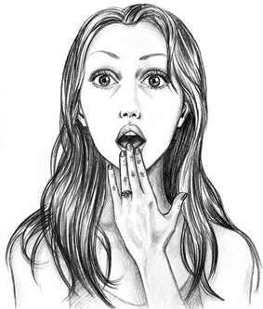
Shock
yelp or light scream,
stiffening posture,
sudden coldness,
eyes wide and water,
head darting left and right
hand against chest,
hand against throat,
shaky soft voice,
grabbing someone’s arm for comfort,
heavy feeling in the stomach,
tingling skin,
asking who, what, why questions.
When might our main character show that they are shocked? Look at your plan? Which paragraph? Add a sentence to one of the boxes to show your character is shocked about the competition.

Slide 27
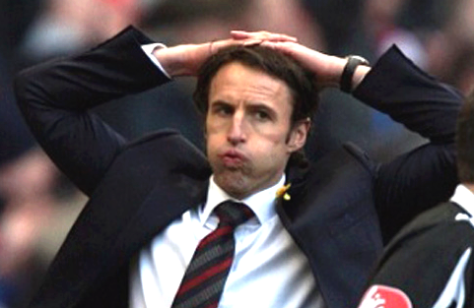
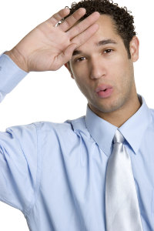
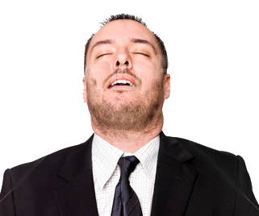
Relief
smiling
wide grinning eyes
eyes closed
hand holding brow
blowing air out of mouth
holding hair with both hands
mouth open, hands wide
shaking head, disbelief
laughter
When might our main character feel relieved? Look at your plan? Which paragraph? Add a sentence to one of your winner announcement boxes to show your character is relieved.

Slide 28
A good writer shows emotions through ‘actions’ rather than using the emotional word.
Emotion | Actions
Amused | Smiling, eyes wide, head up, walking quickly, friendly, talkative, using arms a lot, throwing head back, cupping the cheeks, holding ribs, holding hand up to stay stop, covering the mouth, trying to keep a straight face, bouncing on toes, breathlessness, tapping with fingers.
Fear | Dry mouth, biting lip, wanting to run, gasping for air, cold sweat, talking non stop, dizziness, shivery skin, flinching at noises, shaking, shrill voice, stuttering voice.
Anger | Breathing deeply, picking fights, sarcasm, pounding fists, deeper louder voice, shoulders and head forward, eyes wide and glaring, hands forward in fists, red face.
Shock or Surprise | Yelp, stiffening posture, sudden coldness, eyes water, hand against chest, hand against throat, shaky soft voice, grabbing someone for comfort, heavy feeling in the stomach, tingling skin, asking who, what, why questions.
Curiosity | Straining to see, ears and head pointing to hear, shushing others to be quiet, wide eyes, slower breaths, lips parted slightly, gasp of wonder, small smile, soft voice
Excited for what’s to come | Talkative, pacing around, rubbing hands, eyes darting around, big smiles, hugging, shaking hands, punching someone in fun on the arm, giggles, victory dance, group feeling of joy.
Embarrassment | Looking down, can’t look at others eyes, hiding face with long hair, walking quickly away, grasping things against chest, gritting teeth, keep swallowing, stammering, panicked thoughts, shoulders slumped, glancing around anxiously for an exit.
Sadness | Downcast eyes, slow walk, feeling sick, crying, not wanting to talk, jerky breathing, shoulders slumped, rubbing face, avoiding others eyes.
Task: Write your final paragraph to show and not tell that your character is feeling nervous about the final announcement. Ch: Can you include a semi colon?

Slide 29
Friday 7th February Q- What does the Bible say about making the right decisions?

Slide 30
Mind map ideas about what the Bible says about making the right decisions.

Slide 31
Before we go any further let’s remind ourselves of a few things about the Bible.
For Christians, the Bible is their holy text – they believe that it was written by human beings over many centuries but that those humans were inspired by God.
They also believe that it contains the story of Jesus who was the son of God, and very importantly, the words he spoke and the messages he taught.

Slide 32
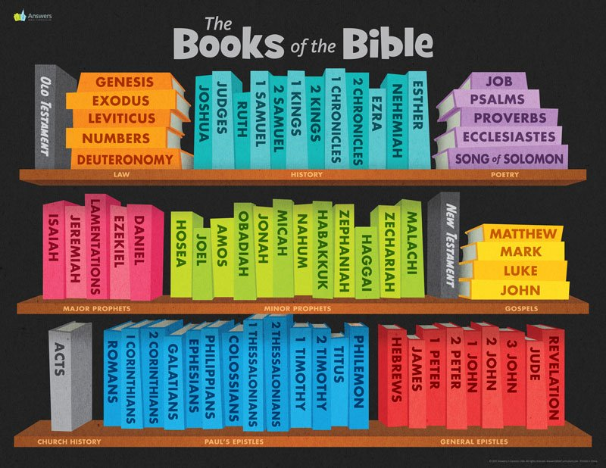
Even though you might think of the Bible as a single book it is actually made up of dozens of individual books.
They were written by many different authors in many different places across the course of hundreds of years.
Some are books of poetry, some historical, some tell the story of Jesus, some are letters or records of wise sayings.
For example,
Genesis is all about creation.
Psalms is a collection of songs and poems.
Acts tells the story of the early church.

Slide 33
A lot of these books contradict each other.
That means they don’t agree with one another.
Let’s look at an example a Christian might use to help them make a moral decision

Slide 34
Write what you think the quote is saying.
“If a serious injury results, then you must require a life for a life— eye for eye, tooth for tooth, hand for hand, foot for foot, burn for burn, wound for wound, and stripe for stripe.”
Exodus 21:23-25
Can you work out what this quote is trying to say? It’s in a section of the Bible giving advice for solving arguments and making laws.
It’s saying that if someone kills someone they ought to be killed themselves.
If someone wounds someone they should be wounded.
This is a very simple idea of justice, of balancing the scales.
Do you agree with it?

Slide 35
If you forgive others the wrongs they have done to you, your Father in heaven will also forgive you. But if you do not forgive others, then your Father will not forgive the wrongs you have done.”
Matthew 6:14-15
Can you work out what this quote is trying to say? It’s words spoken by Jesus when asked about the importance of forgiveness and loving others.
It’s saying that if someone hurts you or does you wrong you should forgive them otherwise, if you don’t you won’t be forgiven in turn.
This is a very different idea of justice – it’s about creating a more peaceful world where God is the judge.
Do you agree with it?

Slide 36
“If a serious injury results, then you must require a life for a life— eye for eye, tooth for tooth, hand for hand, foot for foot, burn for burn, wound for wound, and stripe for stripe.”
Exodus 21:23-25
If you forgive others the wrongs they have done to you, your Father in heaven will also forgive you. But if you do not forgive others, then your Father will not forgive the wrongs you have done.”
Matthew 6:14-15
The fact is that, as Aquinas argues, Christians have to use their reason (their thinking power) to work out what the message of the Bible is. They can’t just rely on reading it and getting all the answers.
We’ve only looked at one example but there are hundreds of these problems that arise for Christians.

