Slide 1
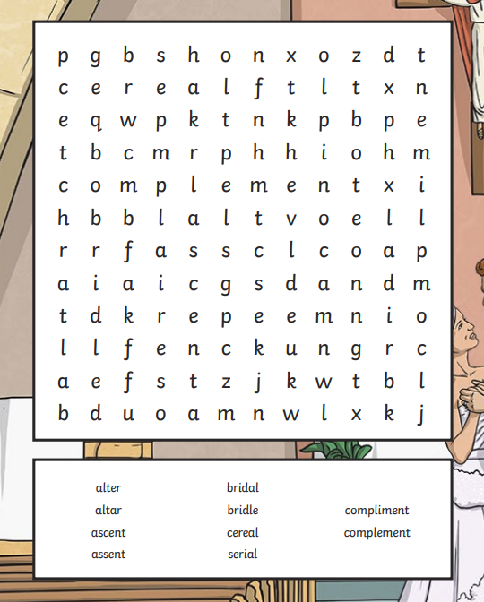
Thursday 6th February Morning challenge - complete Science - up to results table. - complete spelling sheet

Slide 2
Thursday 6th February Word work: TBAT: Upskill my vocabulary Read through your plan in your literacy books. Circle 5 words which you could up skill. Share these words with your partner.

Slide 3
Thursday 6th February Word work: TBAT: Upskill my vocabulary Read through your plan in your literacy books. Circle 5 words which you could up skill. Share these words with your partner.

Slide 4
Thursday 6th February Word work: TBAT: Upskill my vocabulary Can your partner think of a better word for your circled word? Use a thesaurus to upskill your word. Can you upskill the sentence which your word is in? Fronted adverbial subordinate clause relative clause

Slide 5
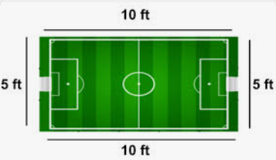
06.02.25 TBAT- solve addition and subtraction problems. 3 in 3 1) Perimeter: Area: 2) 0.87 + 12.7 = 3) 60% = ______ = 0. ___
Challenge:
1/3 + ¾ =

Slide 6
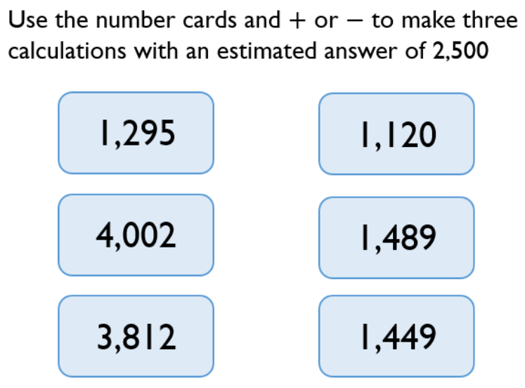
Paired work:

Slide 7
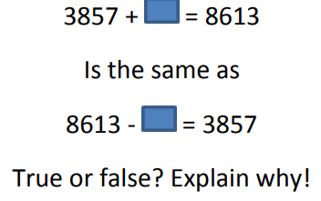
Talk partners:

Slide 8
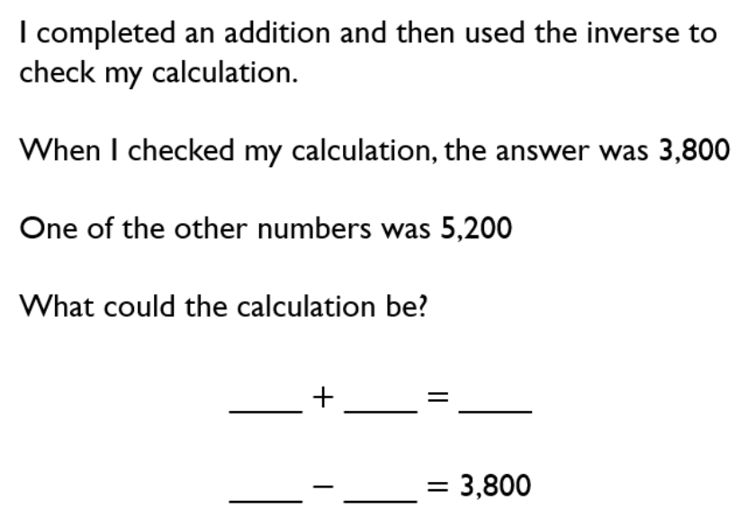

Slide 9
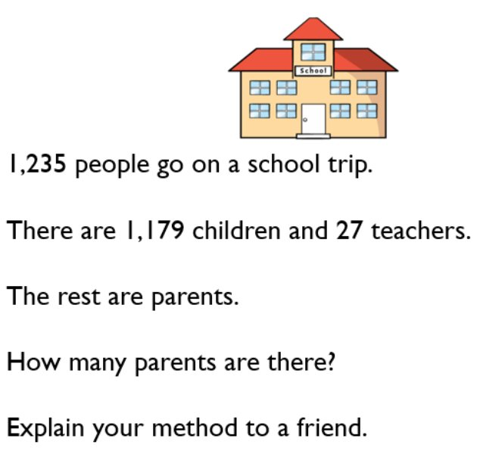
Paired work:
R- read the problem.
N- note/underline the key information.
C- decide on the calculation.
A- answer the problem.

Slide 11
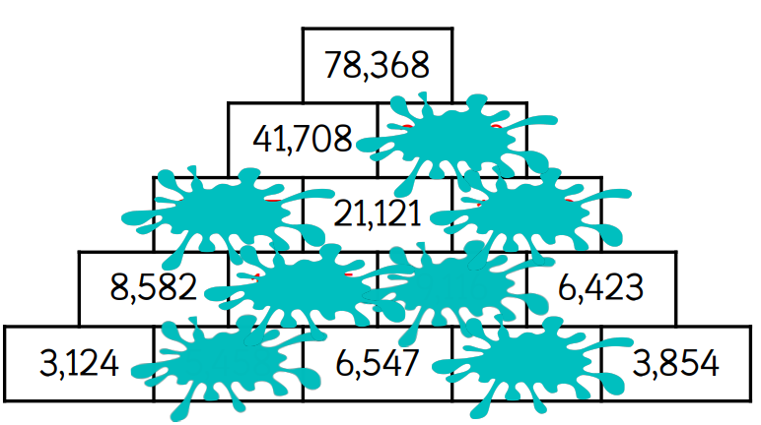
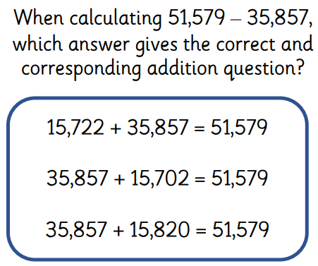
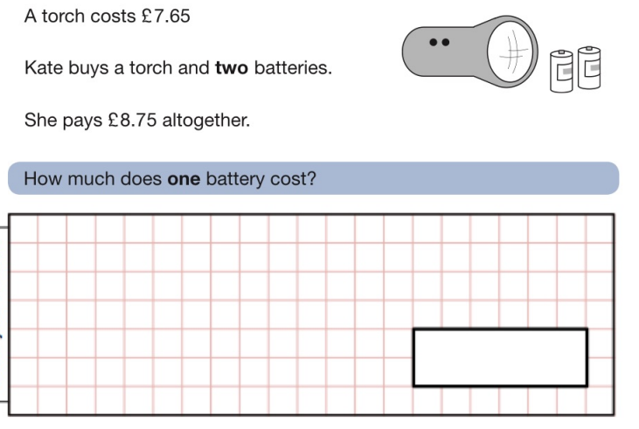
Independent:

Slide 12
Challenge:
Mastery:
Sam has £26 more than Tom and Amy has £17.10 which is £11.05 less than Tom. How much do they have altogether?

Slide 13
Thursday 6th February TBAT: plan a narrative 3 in 3 Leo’s heart thumped wildly, each beat louder than the last, as he sat frozen on the edge of the sofa. The news anchor’s voice filled the room, sharp with suspense. "And now," she declared dramatically, "the announcement you’ve all been waiting for — the final winner of the LEGO Junior Master Inventor competition." Leo’s breath came in shallow gasps, nerves twisting in his stomach. Was his creation imaginative enough? Had his futuristic city design impressed the judges? He wiped his sweaty palms on his jeans, trying to steady himself. The air was thick with anticipation when suddenly, his phone vibrated against his leg. His pulse quickened as he stared at the glowing screen. Slowly, he lifted it, eyes widening as he read the first few words... 1. Find and copy a word which means reporter. 2. "He wiped his sweaty palms on his jeans, trying to steady himself." How is Leo feeling in this sentence? 3. How has the author left the reader wanting to read on?

Slide 14
Thursday 6th February TBAT: plan a narrative Talk partners: Summarise your plan to your partner. What happens in your story? Who are your characters? What are your character's traits? How will your story end?

Slide 15
Literacy Planning for paragraph 6
Ellie’s heart thumped loudly in her chest as she waited for the final announcement. “Only one spot remains,” the reporter teased, “and the judges have made their decision.” Ellie swallowed hard. Could it be her? She had poured her heart into her submission. Her palms grew sweaty as she stared at her phone, willing it to buzz. Suddenly, it vibrated in her hand. A notification popped up on the screen. Ellie’s breath caught in her throat as she read the first few words— What do you like about this paragraph? What features have been used?

Slide 16
Task: Write your main characters final thoughts on the competition – there is one space left. How is your main character feeling physically? Sick? Can you uplevel this word?
How is your main character feeling emotionally? Hopeful, anxious? Can you uplevel these words?

Slide 17
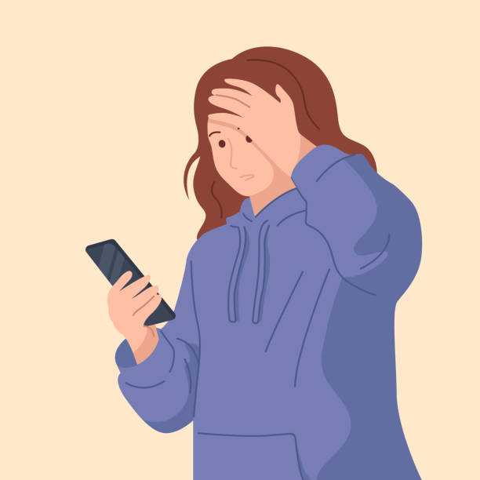
Task: Write your main characters final thoughts on the competition – there is one space left. (Box 6)
P6 include: -Figurative language to show main character's physical feelings. -an announcement/tweet from Lego to say the final spot remains -rhetorical question -description of how the character is feeling.

Slide 18
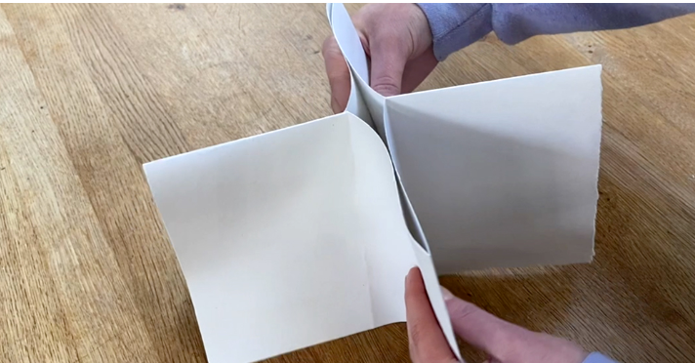
Thursday 6th February ART TBAT- begin to create a visual poetry zine
We're going to make a zine over the next few lessons based on a poem.
What is a zine?
A zine is a self-published, non-commercial print-work that is typically produced in small, limited batches. Zines are created and bound in many DIY ways, but traditionally editions are easily reproduced. Zines may also be sewn, taped, glued—or even exist in unbound and other non-folio formats. The main rule is that there are no rules!
People who create zines are likely to be more motivated by self-expression and artistic passion than they are by profit: zines are usually inexpensive and sometimes distributed for free.

Slide 19
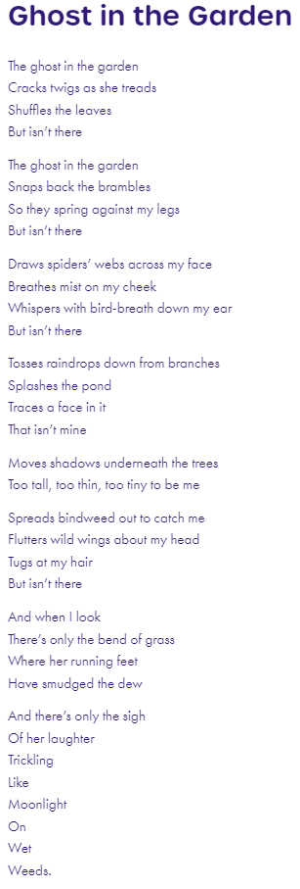
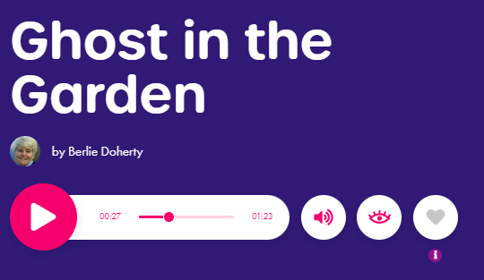
TBAT: create a visual poetry zine.
Ghost in the Garden - Children's Poetry Archive
Make sure to recite it out loud many times to get a real feel for the sound of the words and the senses/images that they evoke.

Slide 20
TBAT: create a visual poetry zine.
Making a Simple Folded Sketchbook (accessart.org.uk)
Making a small “booklet” sketchbook out of a single piece of paper is a handy trick to have up your sleeve! These versatile sketchbooks can be made in a variety of sizes and used for drawing exercises, specific projects or even to accompany pupils on school trips.

Slide 21
TBAT: create a visual poetry zine.
Today we will create the page backgrounds…
The next step is to create backgrounds – using paint. The monotype drawings you make will be made over the page backgrounds.
With the sense and imagery evoked by the poetry in your head, start to mix colours that you might like to use as background colour. This is an opportunity for you to explore how you can mix a variety of hues and tints so that the colours you use are quite subtle.
Remember colour mixing basics – which primary colours make which secondary colours etc. A good tip to pass on is that generally you will need far less blue or red when mixing with yellow – a tiny bit of blue will help turn yellow green, and a tiny bit of red will help turn yellow orange. You can always add more after.
Don’t mix too much of any one colour – and keep tweaking colours already mixed by adding a small amount of extra colour. As you work, keep going back to the poem. What kinds of colours does the language evoke to you?
Try to avoid making backgrounds too dark as the monotype drawings won’t show up.

Slide 22
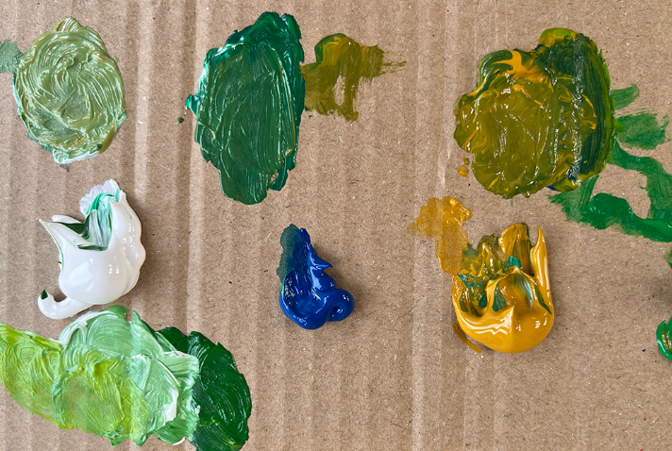
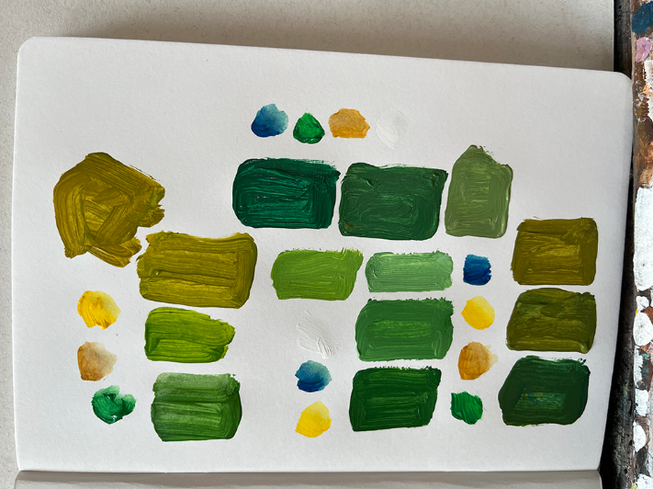
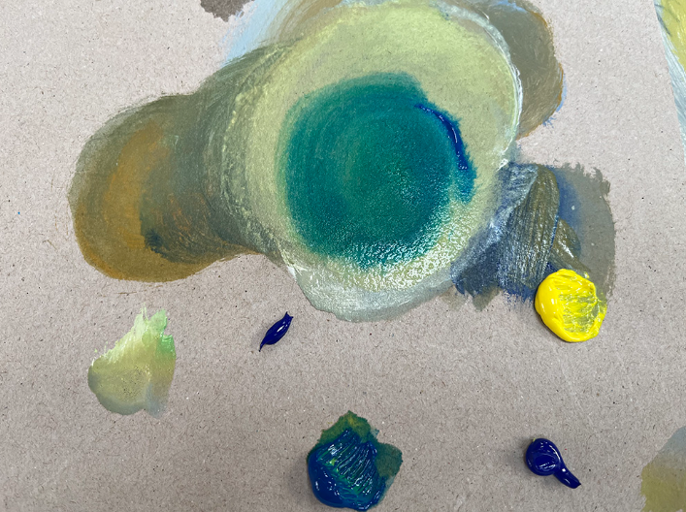
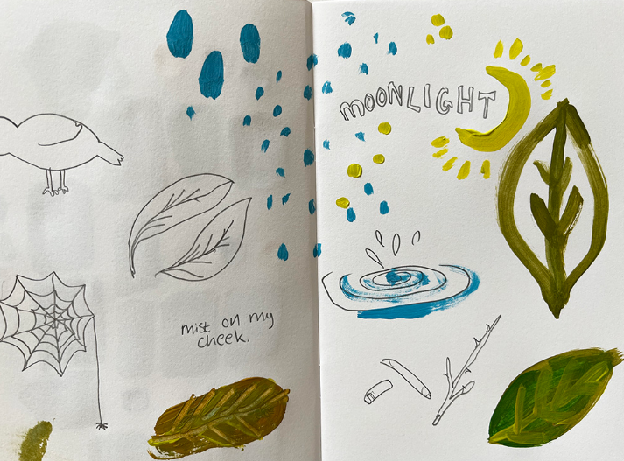
TBAT: create a visual poetry zine.
Test the colours in sketchbooks so you have a record of your colour palette, but don’t work so slowly that your colours dry before you have painted the backgrounds.

Slide 23
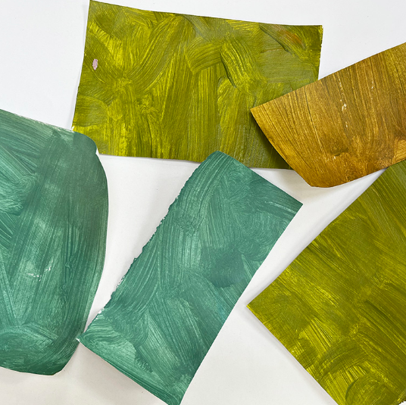
TBAT: create a visual poetry zine.
Paint small sheets of paper with the paint, so over one session you build up a collection of painted sheets. At this stage you are covering the entire sheet with one colour – you are going to use these painted sheets to collage with.

Slide 24
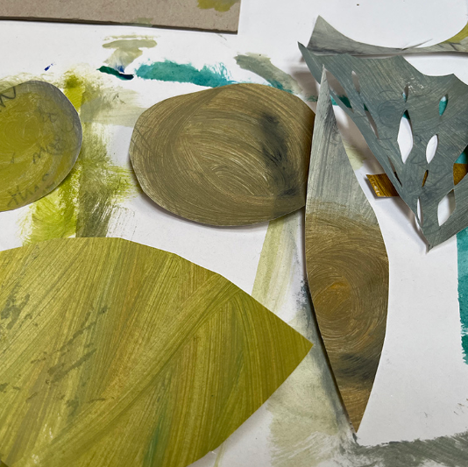
TBAT: create a visual poetry zine.
Once the rectangles are dry, use scissors to cut out some shapes.
Don’t draw the shapes first, instead just cut into the coloured paper. In terms of the shapes you cut, again listen to the poem and let the content of the poem guide the imagery.
In this case – Ghost in the Garden made us think of leaf shapes, grass shapes, cobwebs etc.

Slide 25
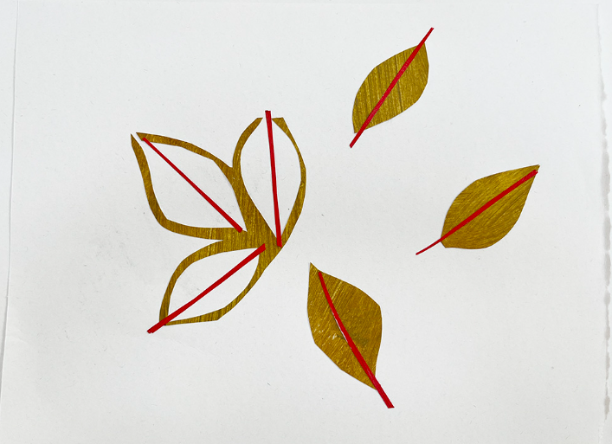
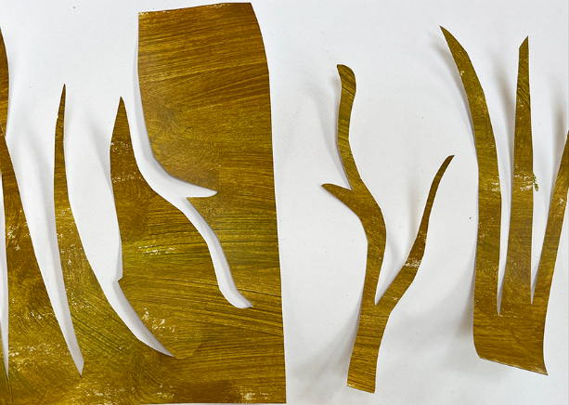
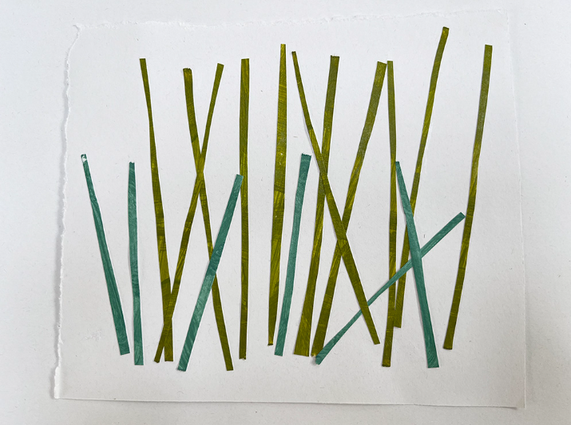
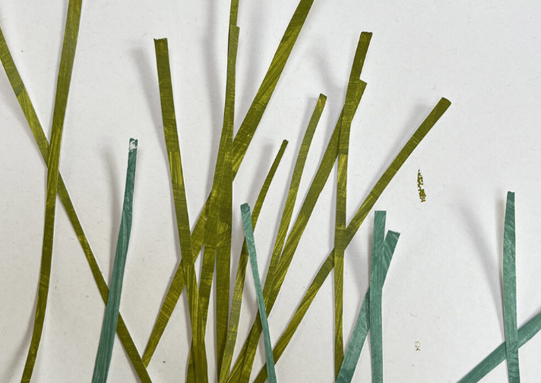
TBAT: create a visual poetry zine.
Experiment with how you would like to use the shapes to collage backgrounds on the pages of the blank zine. Play around with the pieces of painted paper before you finally stick them down.

