Slide 1
Exit Questions: Mountains are most often formed by the ____________ of _________ _______. To be classed as a mountain, it needs to measure ______________ or above. Which mountain range is the highest?

Slide 2
Word work
Whiteboard work

Slide 3
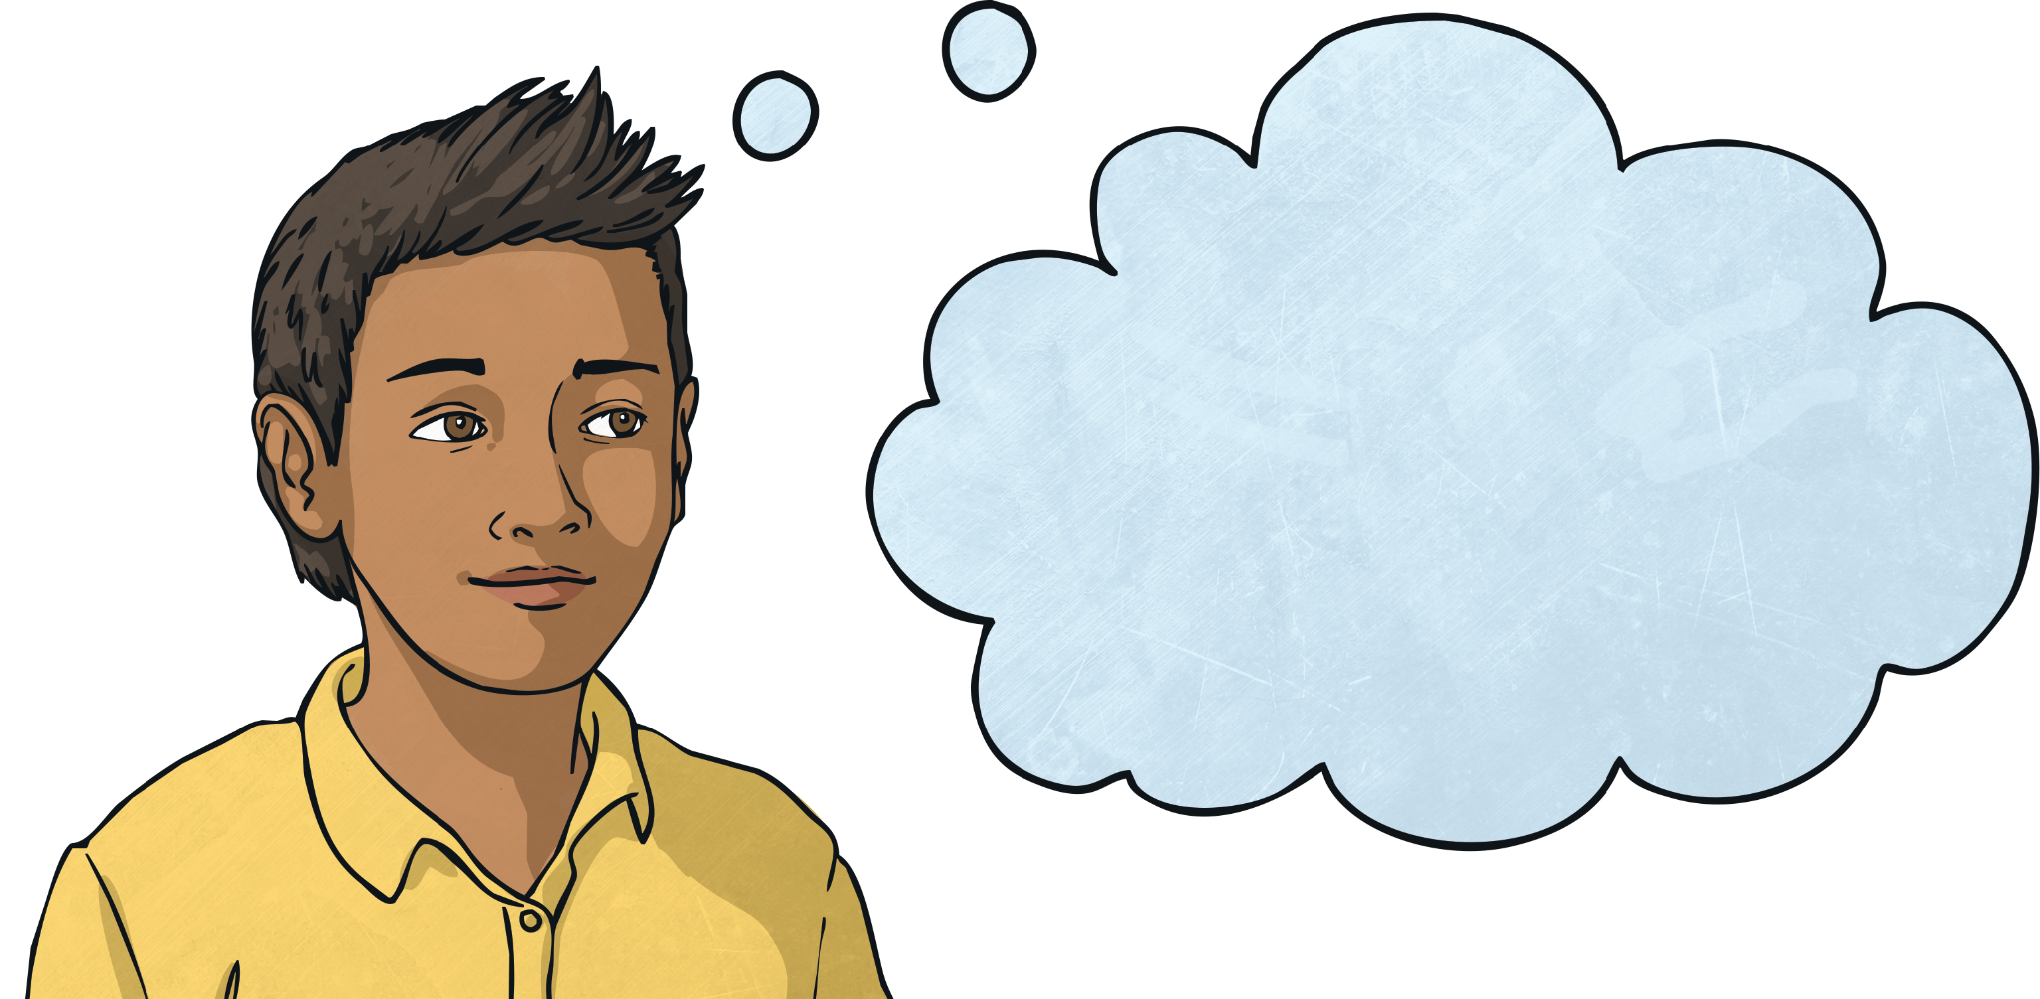
Homophones and Near Homophones
This week we are going to look at some more tricky homophones and near homophones.
Can you remember what homophones are?
Homophones (or near homophones) are words that sound the same but have different spellings and meanings.

Slide 4
Homophones and Near Homophones
Can you join the words with their homophone or near homophone?
alter
complement
ascent
bridle
bridal
assent
cereal
altar
compliment
serial

Slide 5
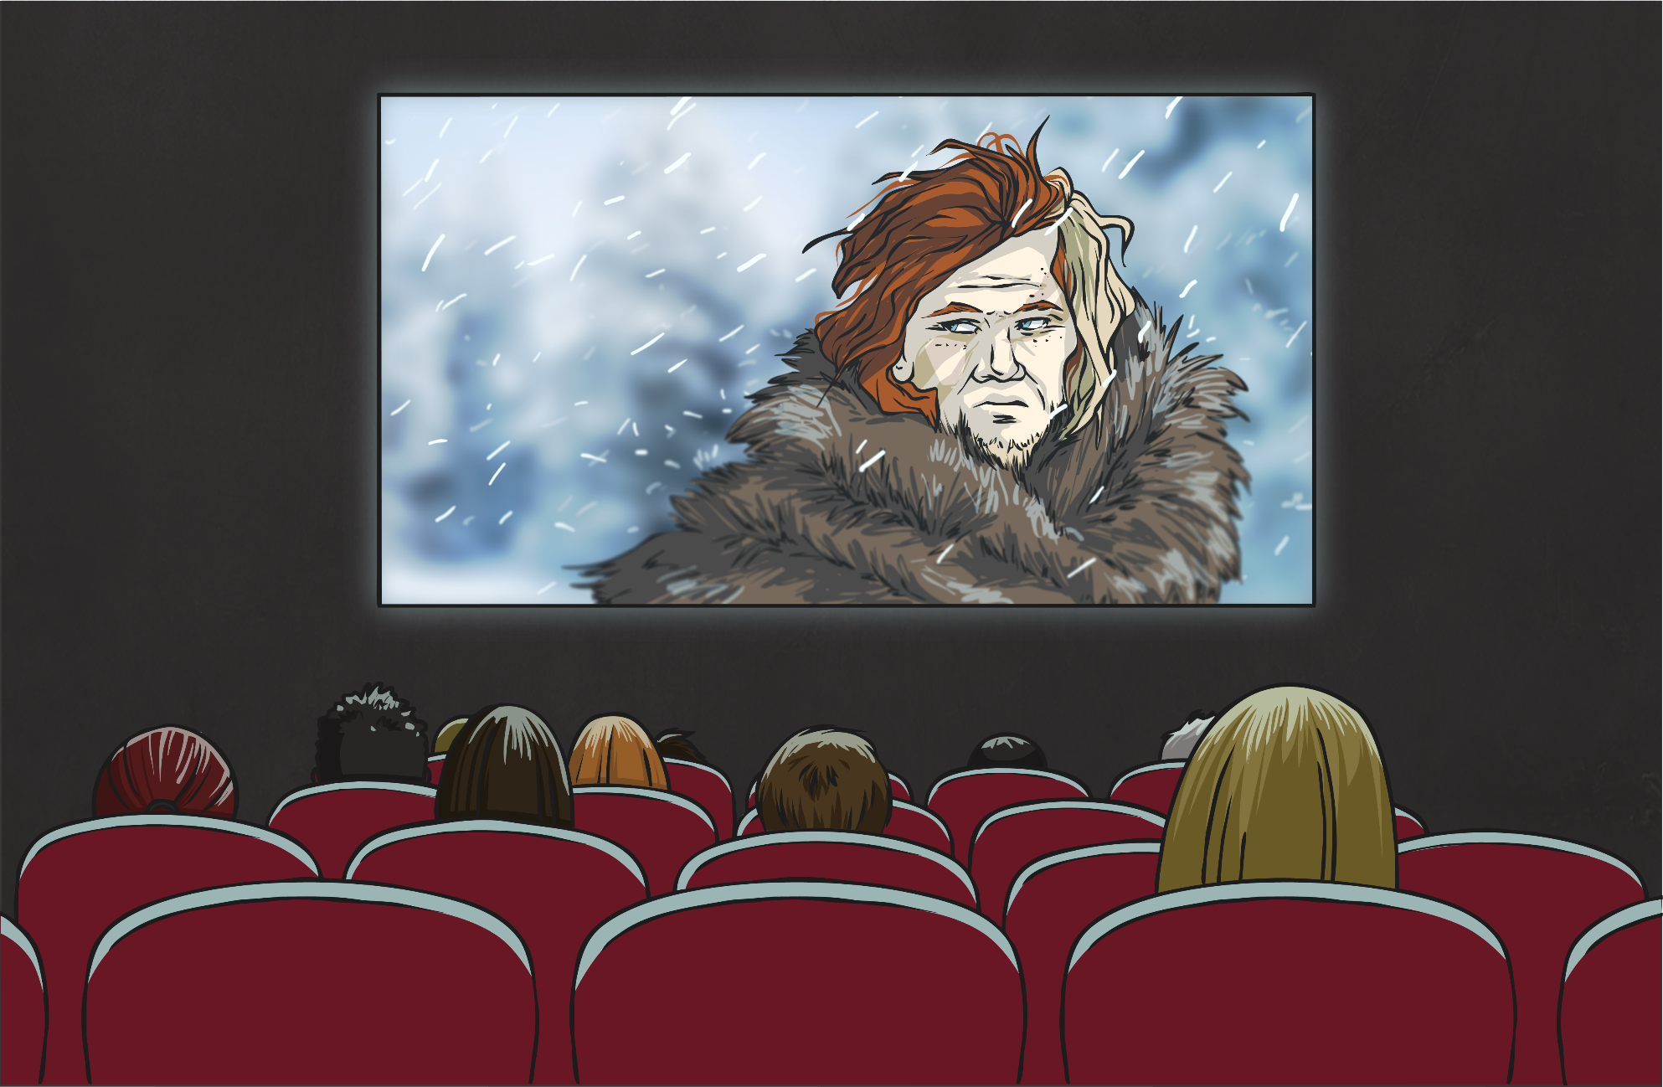
Can you spot the pair of homophones in this sentence?
It was the best film he had ever seen; the battle scene was phenomenal!
It was the best film he had ever seen; the battle scene was phenomenal!

Slide 6
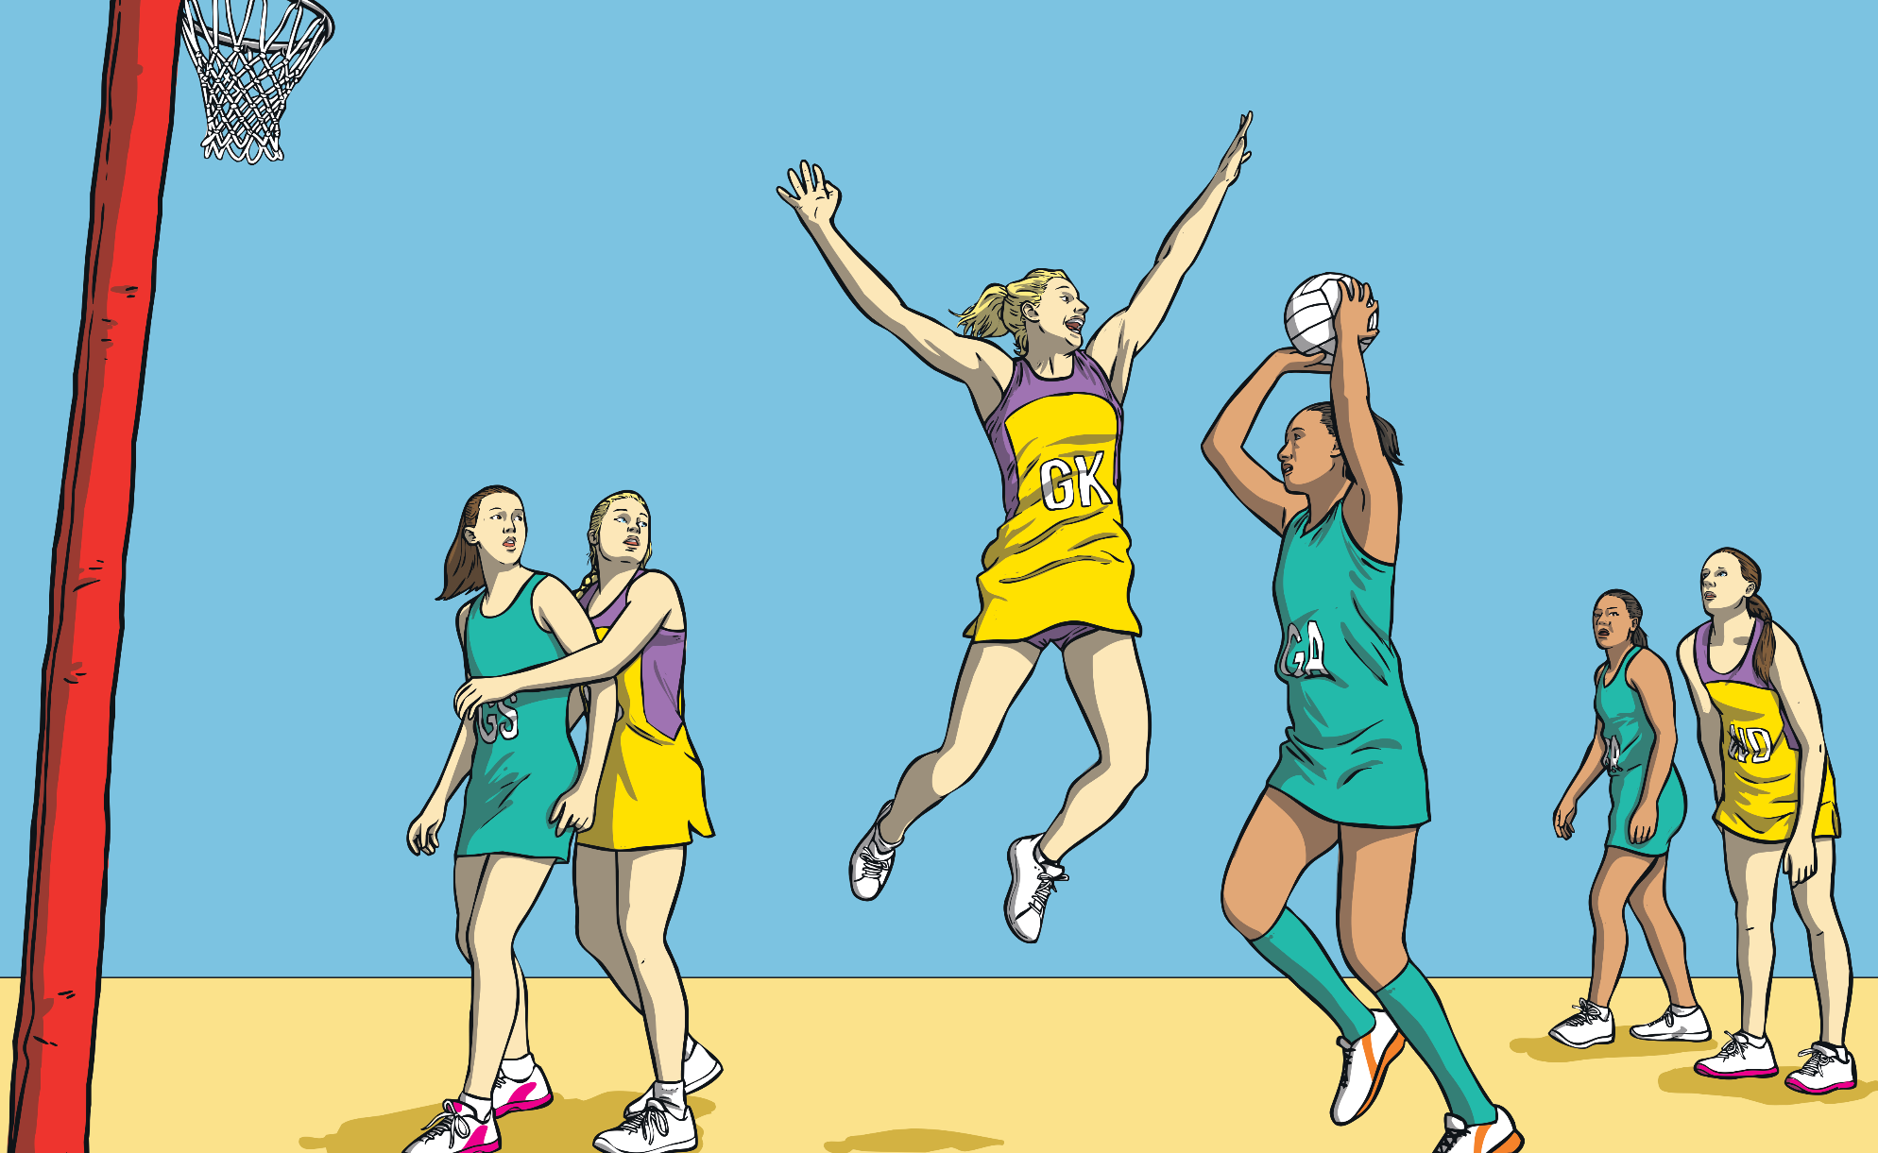
Can you spot the pair of homophones in this sentence?
Abbie flew through the air to try and block the ball before her opponent threw it into the net!
Abbie flew through the air to try and block the ball before her opponent threw it into the net!

Slide 7
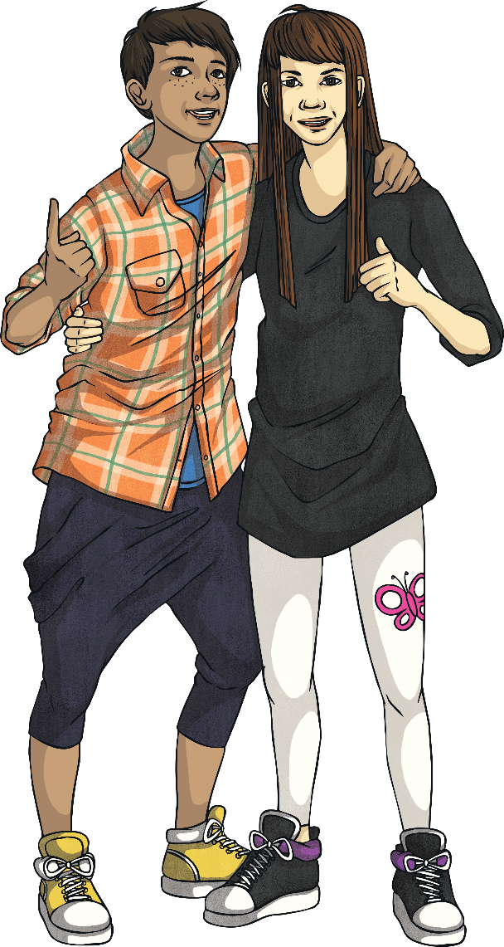
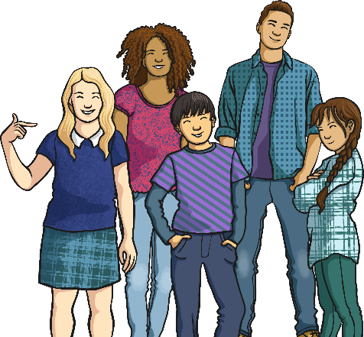
To work out your new spelling words, which are all pairs of homophones or near homophones, I am going to give you pairs of definitions.
You will need to work with a partner to figure both words out. Think hard because some of these are very tricky!
Definition 1:
A plural possessive pronoun.
Definition 2:
A unit of time equal to sixty minutes.
our
hour

Slide 8
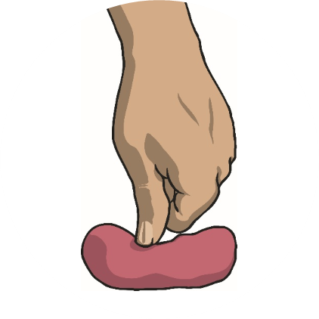
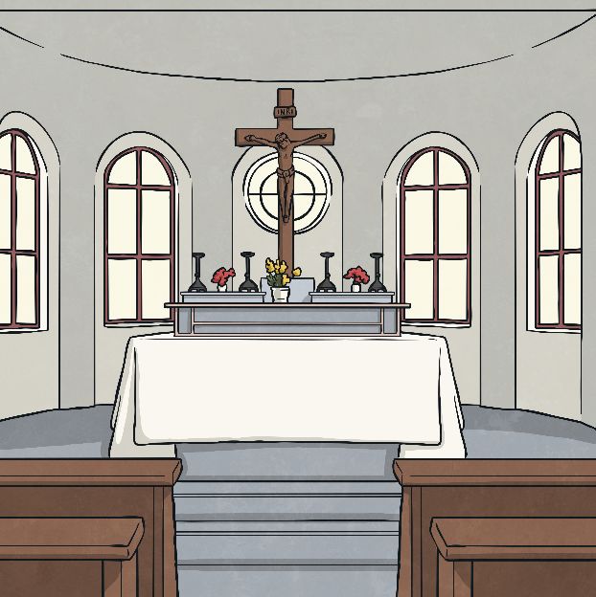
Write down the pair of homophones for these definitions. Use a dictionary if you need to.
Definition 1
Definition 2
To change something.
A table in a Christian church.
alter
altar

Slide 9
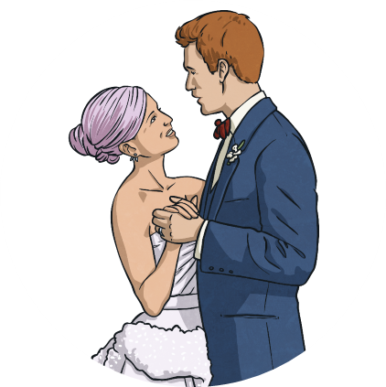
Write down the pair of homophones for these definitions. Use a dictionary if you need to.
Definition 1
Definition 2
An adjective concerning a wedding or a bride.
The headgear used on a horse.
bridal
bridle

Slide 10
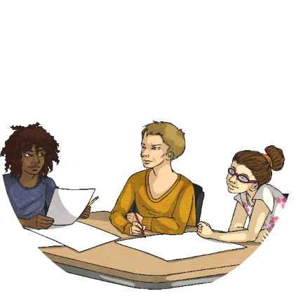
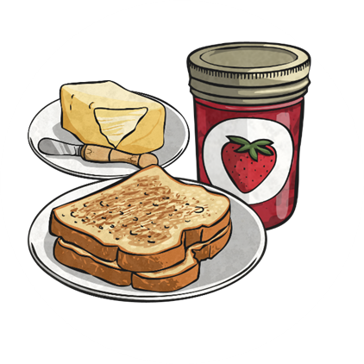
Write down the pair of homophones for these definitions. Use a dictionary if you need to.
Definition 1
Definition 2
To give someone praise.
A perfect accompaniment or accessory.
You did really well!
compliment
complement

Slide 11
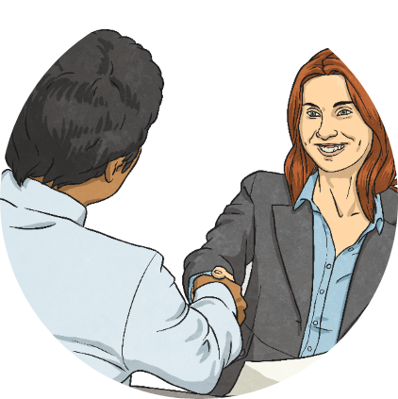
Write down the pair of homophones for these definitions. Use a dictionary if you need to.
Definition 1
Definition 2
To express approval or agreement.
A climb to the top of a mountain or hill.
assent
ascent

Slide 12
Spelling Bee
Using homophones/near homophones from this week and last week.

Slide 13
5.2.25 TBAT- select an appropriate method for subtraction.

Slide 14
Whiteboard work:
Talk partners:
What method should be used to solve this problem?
4, 538 – 3, 001 =

Slide 15
In books:Mental methods
2, 910 – 999=
12, 839 – 10, 019=
4, 368 – 999=
25, 633 – 10, 003=
Challenge: 65, 290 - ? = 12, 999

Slide 16
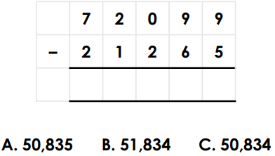
Whiteboard work: written method

Slide 17
In books:Mental methods
67, 293 – 6, 384=
84, 276 – 44, 827=
Challenge: There was £350 in the bank. I spent 20% of it, how much is left?

Slide 18
Whiteboard work:

Slide 19
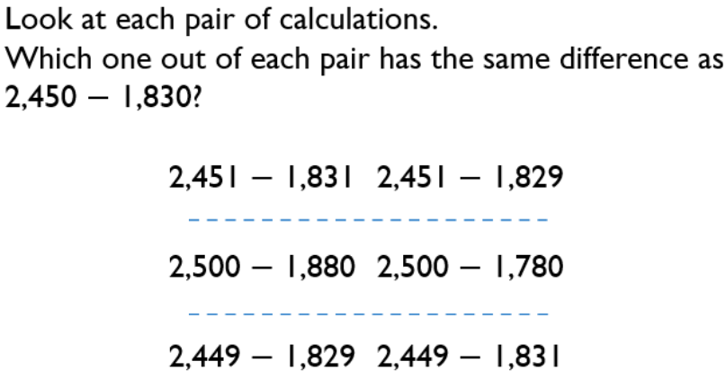
Blue
Green

Slide 20
Independent:
RP:
8000 – 4321 = 4321
Why is this calculation incorrect? Where did the student go wrong?
2) True or false? Explain your answer.
A) 12999 – 6999 = 13000 – 7000
B) 16732 – 13421 = 16733 – 13422
75, 369 – 35, 826 =
2) 64, 329 – 32, 876 =
3) 45, 378 – 19, 999 =
4) 62.75 - 11.03 =

Slide 21
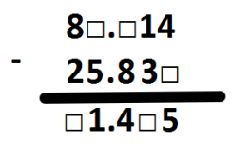
Challenge:
Tom is struggling with the calculation 5000 – 3321.
Can you give a step-by-step explanation about how to do this calculation?
Make sure to clearly explain how to exchange and use diagrams to help explain it!
Mastery:
Make up a subtraction problem with missing boxes for me to work out! Both numbers should contain at least 2 decimal places. See example below.

Slide 22
Wednesday 5th February TBAT- plan a narrative. 3 in 3 The camera panned across the cosy living room, the shelves brimming with colourful LEGO models towering like miniature cities. The cameraman moved carefully, capturing every detail before focusing on the wide-eyed child seated proudly in the centre. The news reporter beamed at the camera, microphone in hand. "We’re here live at the home of our final LEGO competition winner, the brilliant young inventor who wowed the judges with their stunning design for a futuristic floating city!" she announced with excitement. Turning toward the child, she added, "Meet twelve-year-old Leo, a creative genius with a heart full of imagination. Leo, how does it feel to win this incredible opportunity?" The camera zoomed in on Leo's bright smile as they grinned nervously but proudly. "It’s amazing," they said, their voice full of wonder. "I just can’t believe it!" 1. Find and copy a word which means to follow. 2. What is the camera capturing? 3. How does Leo feel about winning?

Slide 23
P1- Competition announcement. X 2 questions and bullet points P3, P4 and P5 Winner announcements P2- Last Tuesday's lesson 3- First announcement . Yesterday's lesson P6 – Main character's final thoughts (tomorrow)

Slide 24
P4- Second announcement -Presenter introduce the character: "Welcome to the home of Felix Gold, a ten –year old boy from the little village of Croston." -What can the camera see? Describe the room they're in, or where they are sat. Eg, Giana could barely see the child due to the monstrous sofas he was sinking into. Whilst his parents pondered to his every need, he sat eyes glued to the screen almost as if no reporters were there at all. -Presenter ask the winner how they feel. "So how does it feel to be our youngest winner yet?"

Slide 25
-Winner respond with how they feel.​ Silence filled the air, before the reporter repeated the question for the fourth time. "Yes...yes, can you not see I'm a bit busy here. I built it, so what! I think I've actually done better to be honest." ​
Your main character's comment ​ Without hesitation Giana had her head in hand and one thought was going through her mind: don't take the ticket then.

Slide 27
Talk partners: How is this announcement different to the others?

Slide 28
5- Write the third announcement on your planning sheet.

Slide 30
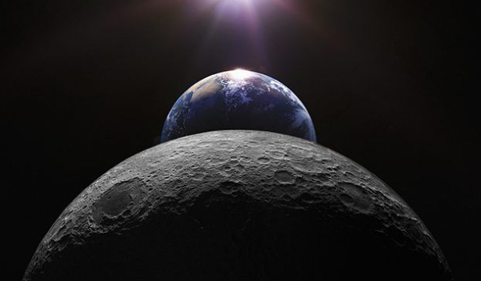
Science 05/02/24
Q: How do we get Day and Night?
3 in 3
What do we call it when the Moon appears to be getting bigger?
What do we call it when the Moon appears to be getting smaller?
T/F We see more of the moon in a New Moon than in a Full Moon.

Slide 31
Green: How long does it take the Moon to orbit the Earth?
Blue: What is the Latin word for the Moon?
Explain the journey of the moon, the earth and the sun.

Slide 32
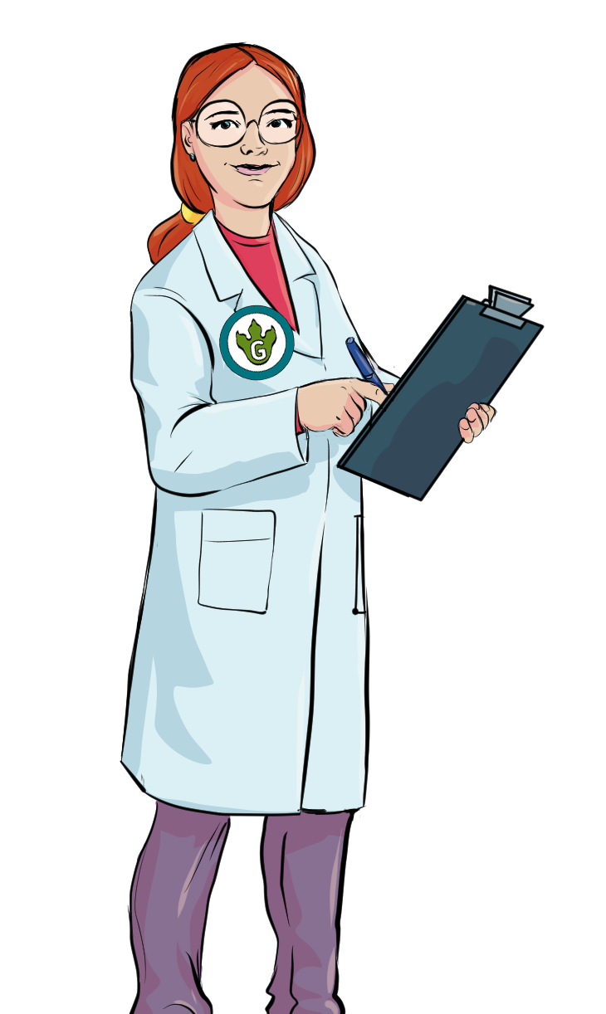
Reflection Time…
1
What have you learnt so far in our
Earth and Space topic?
Share your thoughts with your partner before we discuss them as a class.

Slide 33
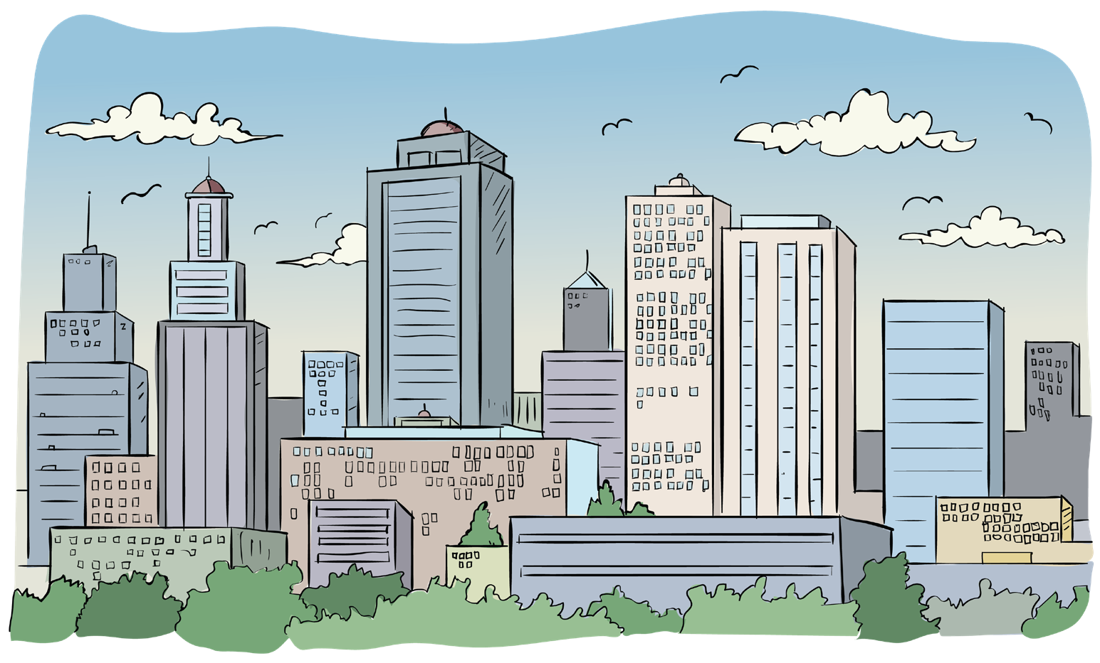
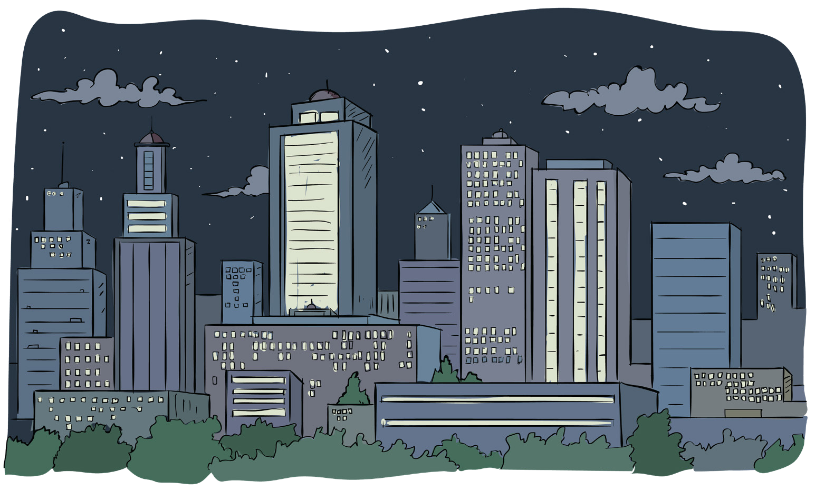
Day and Night
2
How do we know it is daytime?
How do we know it is night-time?
How do we have day and night?

Slide 34
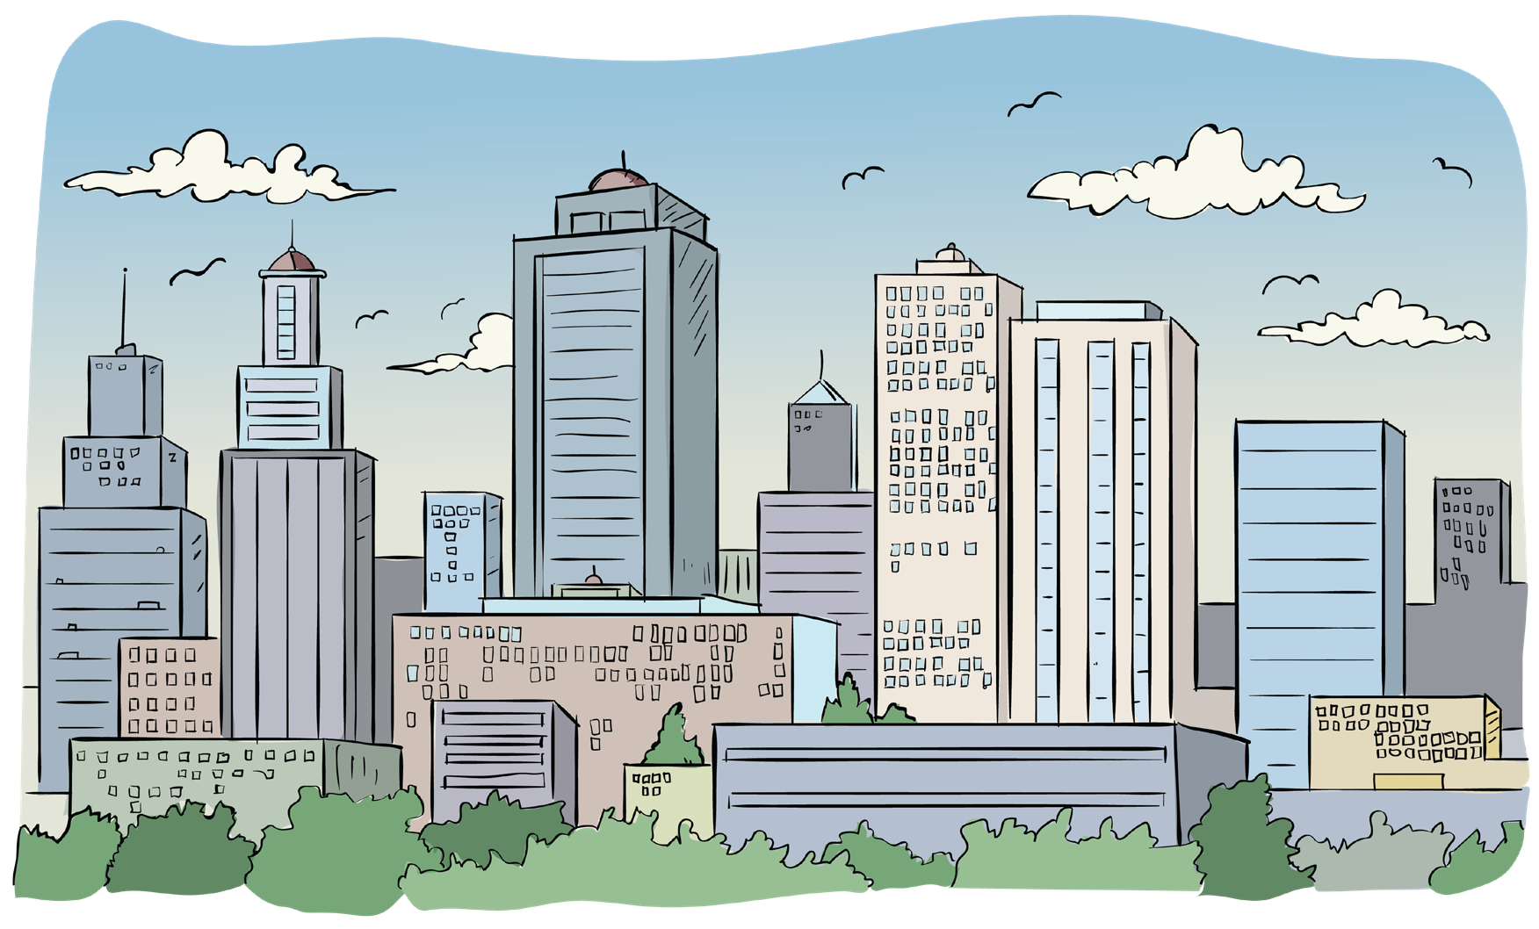
Day and Night
3

Slide 35
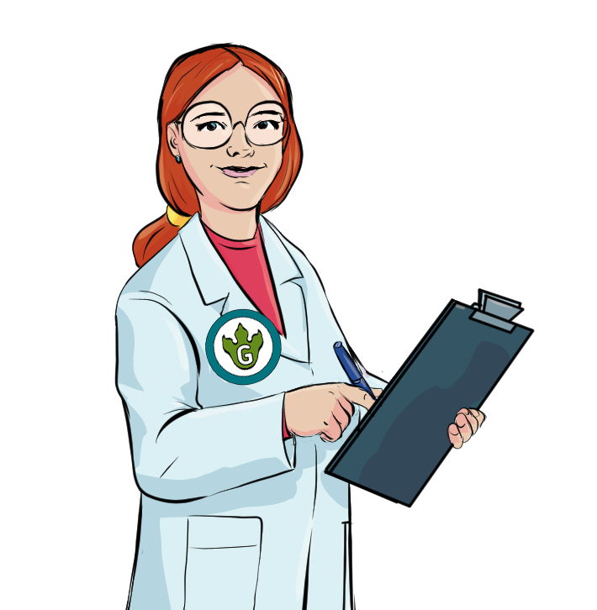
Day and Night
4
The Earth is constantly spinning on its axis.
It takes 24 hours for the Earth to completely spin.
When the UK is facing the Sun, it is daytime. When the UK is facing away from the Sun, it is night-time.
Does the whole world have day and night at the same time?
Day and night - BBC Bitesize

Slide 36
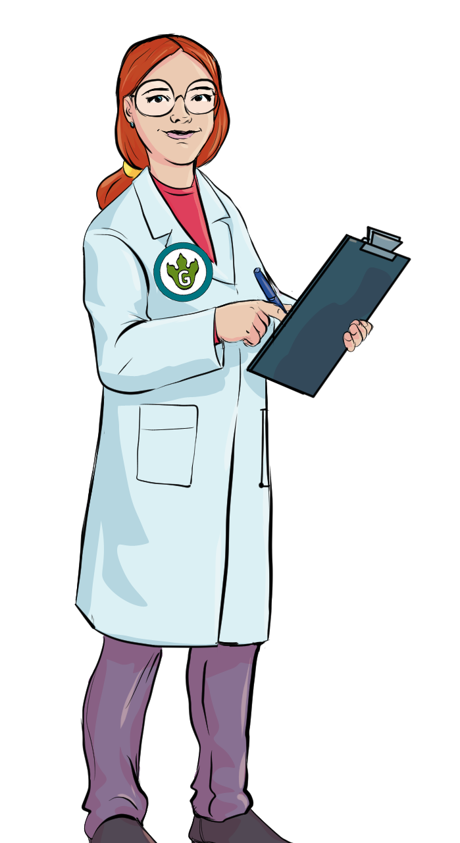
Thinking time!
5
Does the whole world have day and night at the same time?

Slide 37
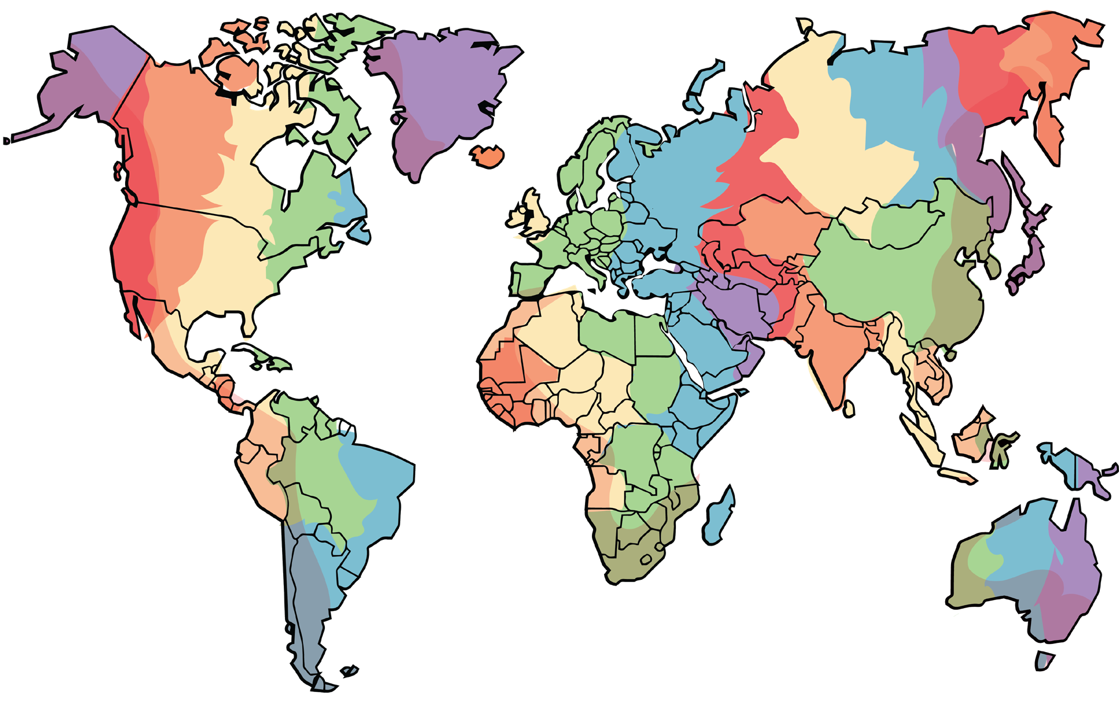
Time Zones
6
We have learnt that some countries may have their daytime whilst others have their night-time.
That means that all the countries cannot have the same time. For example, if it is 12 noon here (lunchtime), it cannot be 12 noon for every country, as some will be in darkness at that time. When you go on holiday, you might go to a different country with a different time zone.
This map shows the differences in times across the world.

Slide 38
Independent Activity
7
You will now plan an investigation to see what happens to the Sun during the day. The best way to do this is to look at our shadows.
You will be working in groups to plan and carry out your investigation. You will have to plan what you need to do throughout the day (e.g. when/how often will you look at the shadows?).
How can we see what happens to the
Sun using our shadows?
Do you think our shadow will change during the day?
When do you think our shadow will be the shortest?
When do you think it will be the longest?
Hint!
You could use a member of your group to create a shadow, or
you could create a shadow clock using cardboard.

Slide 39
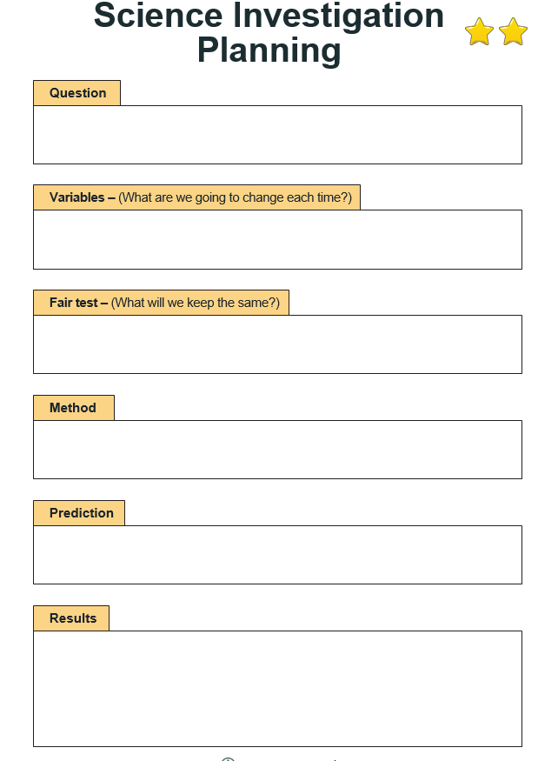
How Can We Use a Model to Figure Out What Caused the Stick's Shadow Pattern? (youtube.com) Take class outside to set this experiment up – use a ball as the sun to explain what is happening. *Estimate the lengths of the shadows to give us our data. Record results in a table https://www.youtube.com/watch?v=_MFM8PFio6k

Slide 40
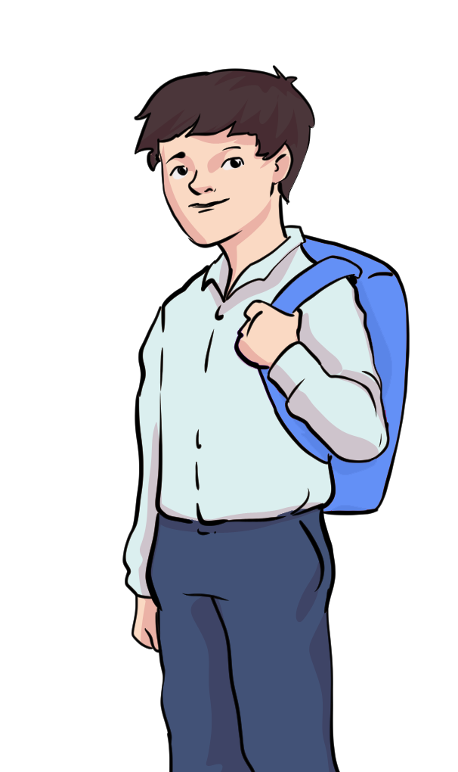
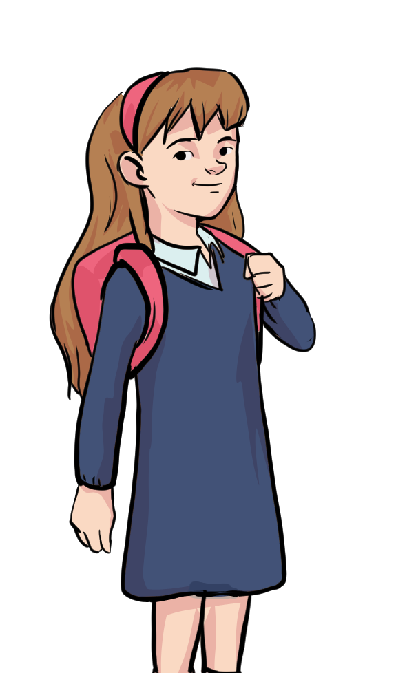
What did we find out?
8
Find yourself a partner who wasn’t in your investigation group.
Explain to them what your group found out about the Sun using scientific vocabulary.

Slide 41
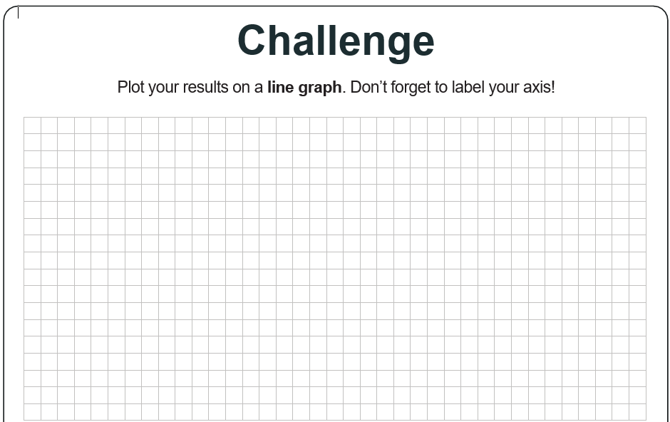

Slide 42
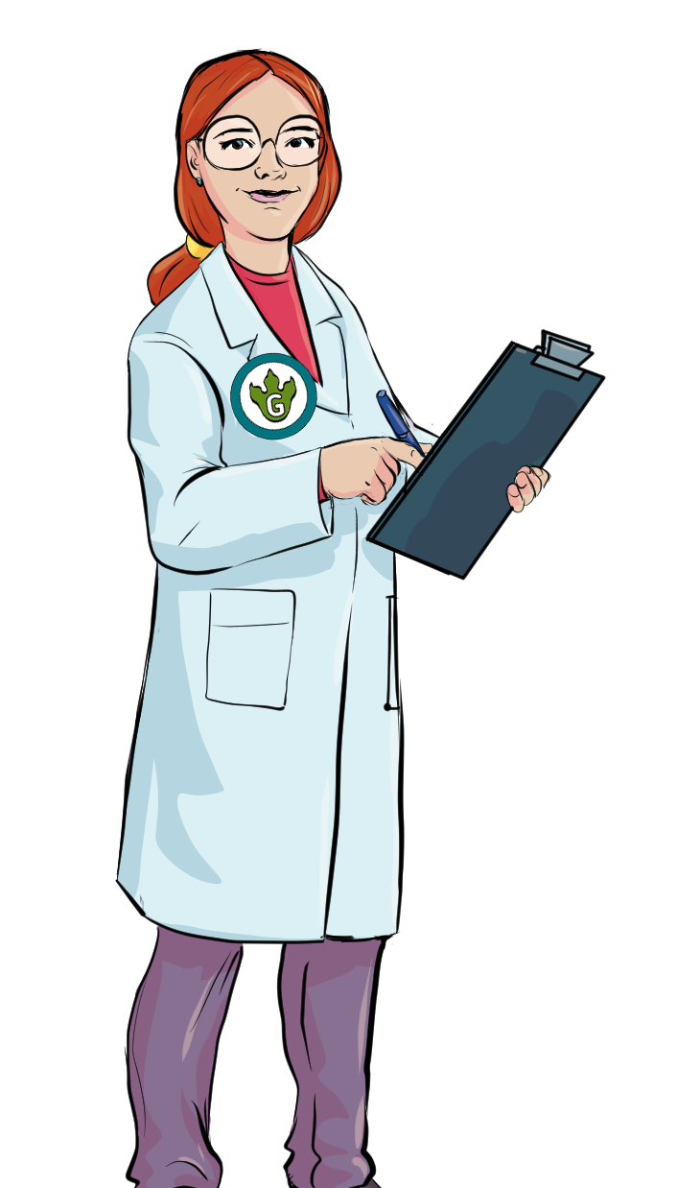
Exit Question
9
Does the Sun move across the sky?
Discuss with your partner.

Slide 43
Exit Question
10
Does the Sun move across the sky?
NO!
The Earth rotates, making it seem like the Sun is moving, BUT it is the Earth rotating that makes the Sun ‘move’ across the sky.

Slide 44
PSHE Café Know yourself, grow yourself

Slide 45
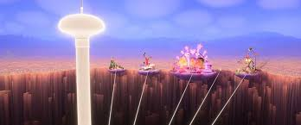
PSHE Café Inside Out Islands of Personality

Slide 46
Safer internet Day – February 11th - The theme this year is: 'Too good to be true? Protecting yourself and others from scams online' - We want to share this leaflet with you to help keep your children safe online.

