Slide 2
Spelling test: 1. forty
2. scorch
3. absorb
4. decorate
5. afford
6. enormous
7. category
8. tornado
9. according
10. opportunity

Slide 3
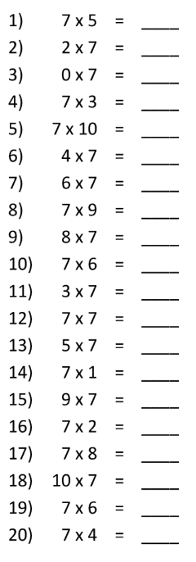
7 x tables

Slide 4
TBAT- identify lines of symmetry.
673 + 502 =
576 x 22 =
6257 divided by 3 =
Challenge:
2/3 + ½ =

Slide 5
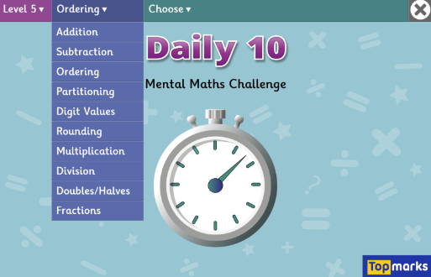
TBAT- identify lines of symmetry. x7 tables.
Daily 10 - Mental Maths Challenge - Topmarks

Slide 6
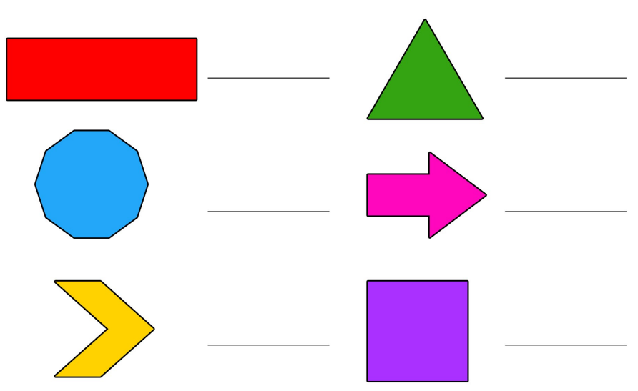
Write the name of your shape and identify if it is regular or irregular. Blue Green

Slide 7
A 2D shape is symmetrical if a line can be drawn through it and either side is a reflection of the other. You would call this the line of symmetry.

Slide 8
Talk partners: There is also a horizontal line of symmetry in this shape. True or false?

Slide 9
Lines of symmetry - Maths - Learning with BBC Bitesize

Slide 10
A 2D ______ is symmetrical if a line can be drawn through it and either side is a ________ of the other. You would call this the line of __________.
symmetry
reflection
shape
drawn

Slide 11
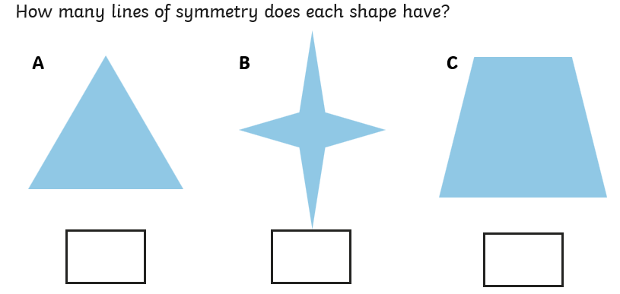
Whiteboard work:

Slide 12
Whiteboard work:

Slide 13
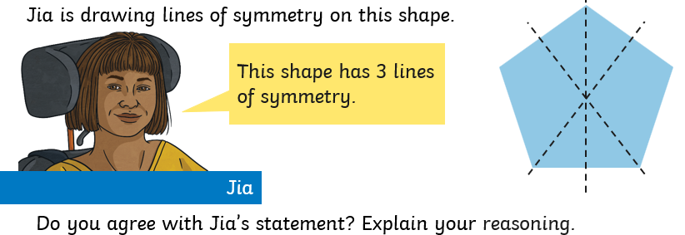
Talk partners:

Slide 14
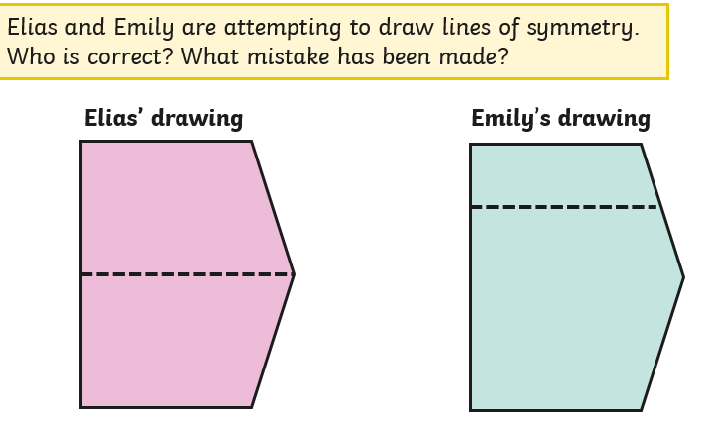
Talk partners:

Slide 15
Draw the lines of symmetry on the shapes.
Green Blue
Challenge: What does a line of symmetry mean?

Slide 16
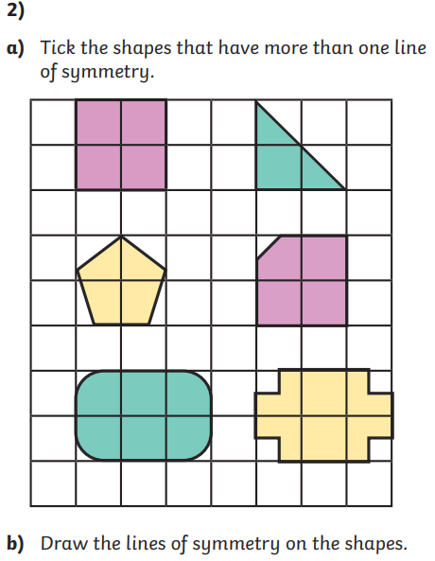
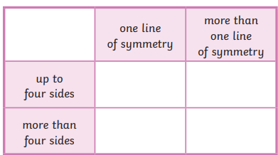
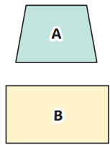
Independent:

Slide 17
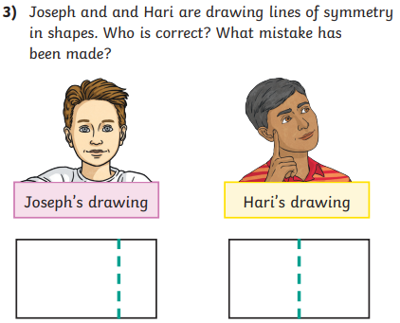
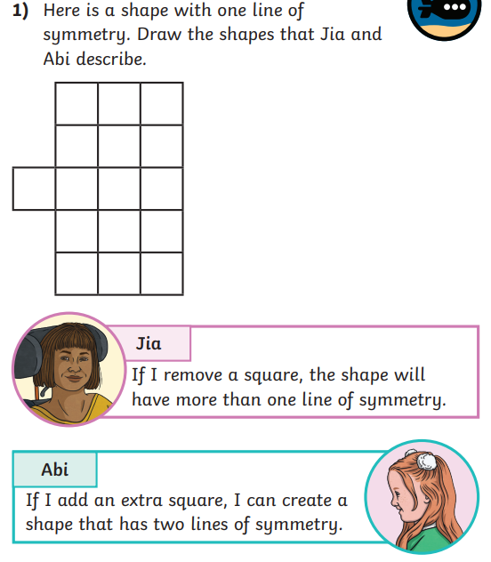
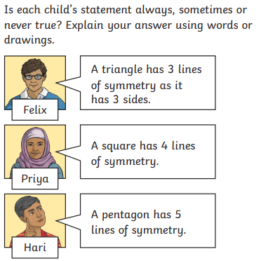
Challenge:
Mastery:

Slide 18
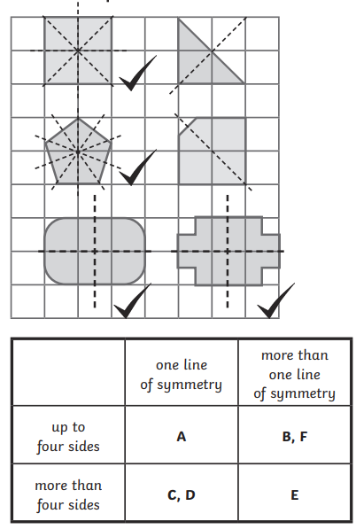
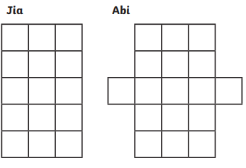
Challenge:

Slide 19
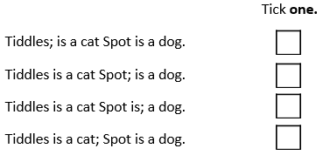
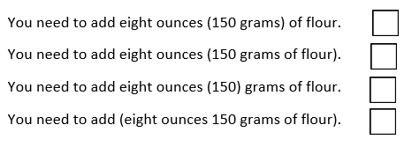
VENTURERS Friday 28th February TBAT- write to inform.

Slide 20
Expand the sentence below. Blue Children will go swimming. Green An activity is abseiling.

Slide 21
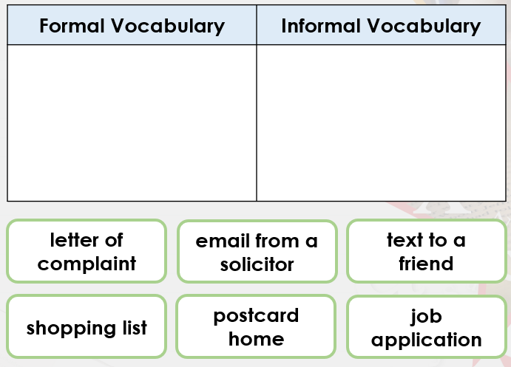

Slide 22
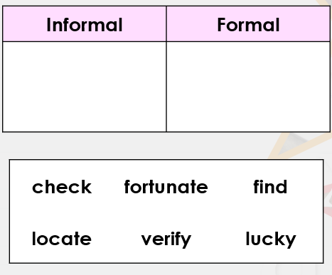

Slide 23
Replace the underlined words with more formal choices. I need an appointment with you concerning your kid, but I’m only free from 5.30pm.

Slide 25
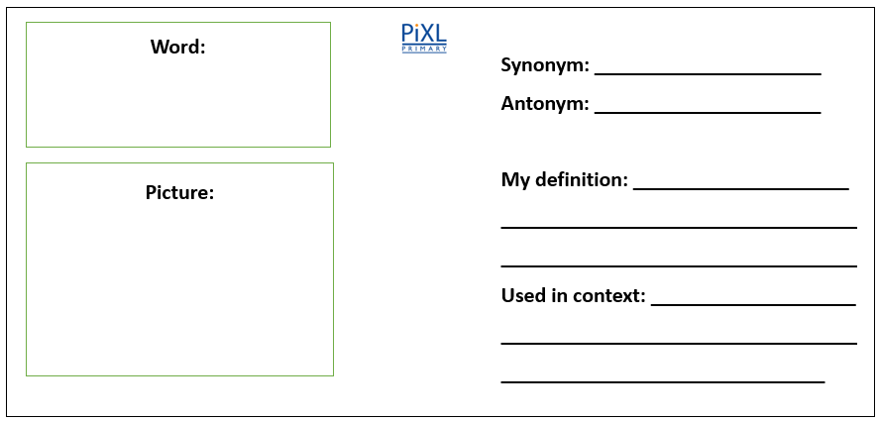
Is the itinerary sufficient evidence? The word is sufficient

Slide 26
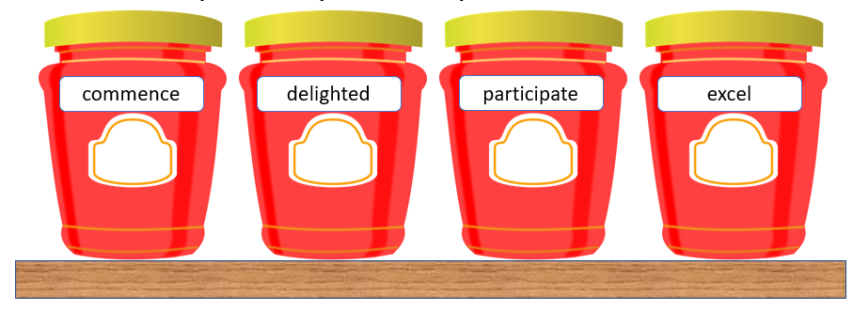
The Swap Shop: Write a sentence containing one of these words. Convince your partner that you should be able to take that word because you have written a detailed sentence. As a row select the most effective sentence and the adult will choose the row with the most creative sentence to steal the word.
Challenge: What word with a similar meaning will you swap with me?

Slide 27
VOYAGERS Friday 28th February TBAT- write to inform.

Slide 28
VOYAGERS Friday 28th February TBAT- write to inform. Tell your partner three activities Liam will do on day one at the activity centre. Tell your partner what Liam will do in "down time" at the activity centre. Orally rehearse a sentence for your itinerary including a fronted adverbial and parethesis.

Slide 29
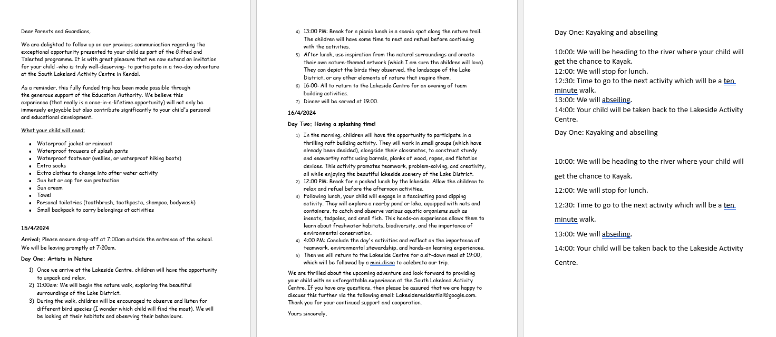
Read modelled text together:

Slide 30
Class Work: Which activity would you be looking forward to the most and why? Use evidence from the text to support your answer.

Slide 31
16/4/2024
Day Two: Having a splashing time!
In the morning, children will have the opportunity to participate in a thrilling raft building activity. They will work in small groups (which have already been decided), alongside their classmates, to construct sturdy and seaworthy rafts using barrels, planks of wood, ropes, and flotation devices. This activity promotes teamwork, problem-solving, and creativity, all while enjoying the beautiful lakeside scenery of the Lake District.
12:00 PM: Break for a packed lunch by the lakeside. Allow the children to relax and refuel before the afternoon activities.
Following lunch, your child will engage in a fascinating pond dipping activity. They will explore a nearby pond or lake, equipped with nets and containers, to catch and observe various aquatic organisms such as insects, tadpoles, and small fish. This hands-on experience allows them to learn about freshwater habitats, biodiversity, and the importance of environmental conservation.
4:00 PM: Conclude the day's activities and reflect on the importance of teamwork, environmental stewardship, and hands-on learning experiences.
Then we will return to the Lakeside Centre for a sit-down meal at 19:00, which will be followed by a mini-disco to celebrate our trip.
Find formal word choices and write the informal alternative.

Slide 32
On your planning sheet, write the itinerary for day two. 16/04/2024 Day Two: ___________________

