Slide 1
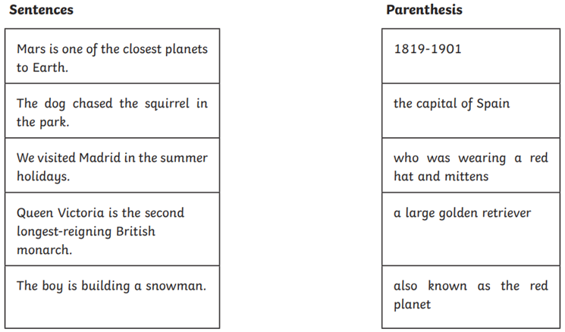
Morning Challenge: Use a ruler to connect the sentence and parenthesis. Write the sentence in your books using dashes or brackets.
If assembly is at 10am, Maths 9-10am and Lit after break. If assembly is after break, Maths 9-10am; Lit 10-10.30 and continue after break

Slide 2
TBAT- identify and draw perpendicular lines.
45.8 + 111 =
7206 divided by 100 =
Challenge:
76 % = 0. = ____

Slide 3
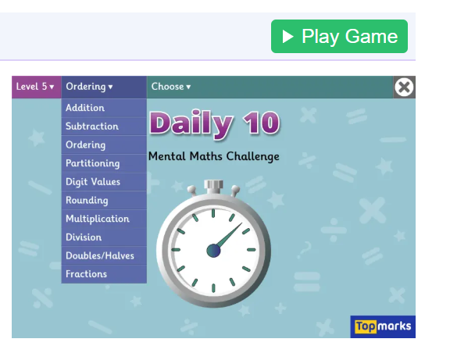
Daily 10 x7
Daily 10 - Mental Maths Challenge - Topmarks

Slide 4
Blue
Green
Challenge: List two properties of a rectangle.

Slide 5
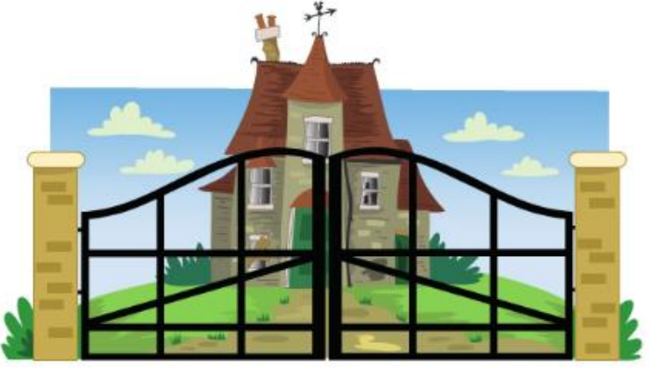
Identify the parallel and perpendicular lines on the gates.

Slide 6
Talk partners:

Slide 7
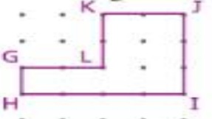
How many right angles are in this shape? How many perpendicular lines are there in this shape?

Slide 8
Class work: KJ is perpendicular to ______

Slide 9
Whiteboard work: HG is perpendicular to ______
Challenge: write a sentence . _______ is perpendicular to ________

Slide 10
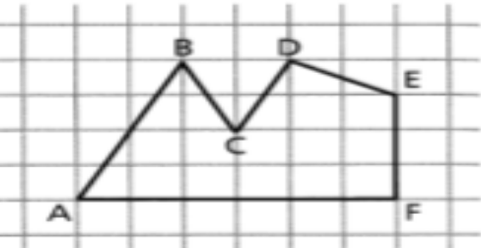
Talk partners: Which statement is correct? How do you know?
AB is perpendicular to BC.
AF is perpendicular to AB.
EF are perpendicular to FA.

Slide 11
Independent: Identify the perpendicular lines.

Slide 12
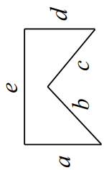
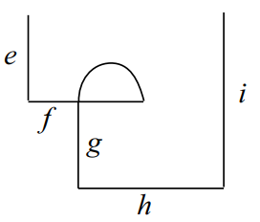
Draw two lines to complete each rectangle below.
True or false?
AE is perpendicular to ED
CD is perpendicular to CB
Challenge:
Write mathematical sentences to support this diagram.
___is perpendicular to ____

Slide 13
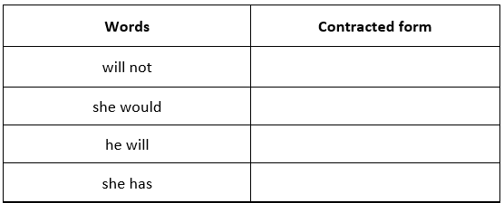
TBAT- use bullet points in my writing. 2 in 2

Slide 14
Liam has arrived home and his parents have asked him to go sit down as they need to talk to him. Independent thinking: 1) How is Liam feeling at this point? 2) Why do you think this? Now share with your partner, do you have the same thoughts?

Slide 15
His parents have received the itinerary and they don't believe it. Blue- You are the parents. What would you be asking Liam to get further clarification? Green- You are Liam. Think about how you need to respond.
Character in role: Green- you are Liam

Slide 16
His parents have received the itinerary and they are satisfied. Blue- You are Liam. What would you now be saying to your parents? Green- You are the parents. How would you respond?
Character in role: Blue- You are Liam

Slide 17
Back-to-back mobile phone In pairs, the children sit back-to-back and enact a scenario where they are on the phone to each other.
You are having a conversation about what you will need to pack for your adventure to visit Dr.Drax.
2 minute discussion
Then record down all of your ideas
Feedback and create a class list

Slide 18
Back-to-back mobile phone In pairs, the children sit back-to-back and enact a scenario where they are on the phone to each other.
You are having a conversation about what you would need to bring to the Lake District to take part in your activities if you were actually going.
2 minute discussion
Then record down all of your ideas
Identify the objects that work for both
Which objects must we forget about so that Mum and Dad don't get suspicious?

Slide 19
What your child will need:
Waterproof jacket or raincoat
Waterproof trousers of splash pants
Waterproof footwear (wellies, or waterproof hiking boots)
Extra socks
Extra clothes to change into after water activity
Sun hat or cap for sun protection
Sun cream
Towel
Personal toiletries (toothbrush, toothpaste, shampoo, bodywash)
Small backpack to carry belongings at activities

Slide 20
Task: Write a set of bullet points for what the child needs to pack.
Subheading
Bullet points
Brackets for extra information

Slide 21
15/4/2024
Arrival: Please ensure drop-off at 7:00am outside the entrance of the school. We will be leaving promptly at 7:20am.
Day One: Artists in Nature
Once we arrive at the Lakeside Centre, children will have the opportunity to unpack and relax.
11:00am: We will begin the nature walk, exploring the beautiful surroundings of the Lake District.
During the walk, children will be encouraged to observe and listen for different bird species (I wonder which child will find the most). We will be looking at their habitats and observing their behaviours.
13:00 PM: Break for a picnic lunch in a scenic spot along the nature trail. The children will have some time to rest and refuel before continuing with the activities.
After lunch, use inspiration from the natural surroundings and create their own nature-themed artwork (which I am sure the children will love). They can depict the birds they observed, the landscape of the Lake District, or any other elements of nature that inspire them.
16:00: All to return to the Lakeside Centre for an evening of team building activities.
Dinner will be served at 19:00.
What are the two activities on day one?
Why do you think I chose the sub-heading that I did?

Slide 22
16/4/2024
Day Two: Having a splashing time!
In the morning, children will have the opportunity to participate in a thrilling raft building activity. They will work in small groups (which have already been decided), alongside their classmates, to construct sturdy and seaworthy rafts using barrels, planks of wood, ropes, and flotation devices. This activity promotes teamwork, problem-solving, and creativity, all while enjoying the beautiful lakeside scenery of the Lake District.
12:00 PM: Break for a packed lunch by the lakeside. Allow the children to relax and refuel before the afternoon activities.
Following lunch, your child will engage in a fascinating pond dipping activity. They will explore a nearby pond or lake, equipped with nets and containers, to catch and observe various aquatic organisms such as insects, tadpoles, and small fish. This hands-on experience allows them to learn about freshwater habitats, biodiversity, and the importance of environmental conservation.
4:00 PM: Conclude the day's activities and reflect on the importance of teamwork, environmental stewardship, and hands-on learning experiences.
Then we will return to the Lakeside Centre for a sit-down meal at 19:00, which will be followed by a mini-disco to celebrate our trip.
What are the two activities on day two? Sub-heading?

Slide 23
Thinking about the two activities for day one, what is your subheading going to be?

Slide 24
Day One: Kayaking and abseiling 10:00: We will be heading to the river where your child will get the chance to Kayak. 12:00: We will stop for lunch. 12:30: Time to go to the next activity which will be a ten minute walk. 13:00: We will abseiling. 14:00: Your child will be taken back to the Lakeside Activity Centre.
Talk partners: What are your thoughts on this itinerary?

Slide 25
Task: In groups, up-level the itinerary and be ready to feedback a couple of the changes that you have made.
Day One: Kayaking and abseiling ​ ​ 10:00: We will be heading to the river where your child will get the chance to Kayak. ​ 12:00: We will stop for lunch. ​ 12:30: Time to go to the next activity which will be a ten minute walk. ​ 13:00: We will abseiling. ​ 14:00: Your child will be taken back to the Lakeside Activity Centre. ​

Slide 26
Task: Write your itinerary for day one. 15/04/2024 Day One: _________________ Bullet points Be clear on what your activities are

Slide 27
DT TBAT: understand how ingredients are reared and processed. Vocabulary match: abattoir the meat from a mature cow
Beef a piece of land used to raise animals and grow crops for food
Farm a series of steps or actions taken to achieve a goal or result.
Ingredients a building where animals are killed and processed for meat
Process one part of a mixture.

Slide 28
What is spaghetti bolognese? What ingredients are needed for spaghetti bolognese?

Slide 29
Spaghetti bolognese | Design and Technolog... - VideoLink -What kind of beef is used in a Bolognese recipe?
-What flavours are discussed?
-What other ingredients did you see prepared?

Slide 30
Burly Beef: from farm to fork... - VideoLink -How long does the farmer raise the cattle for?
-How does the farmer look after the cows?
-Where do the cattle go to be turned into meat?

Slide 31
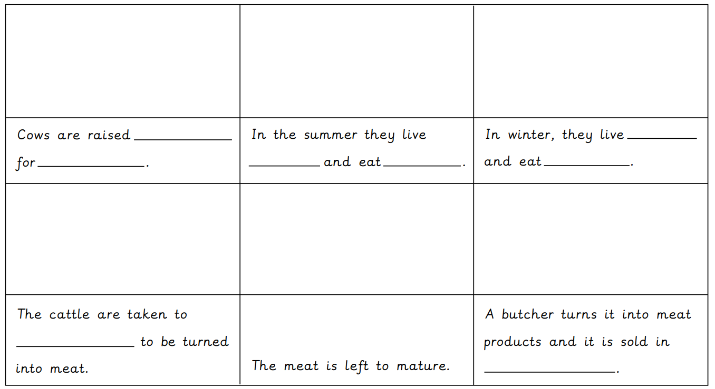
We are going to create a poster or storyboard which tells the audience how our meat goes "from farm to fork"...

Slide 33
