Slide 1
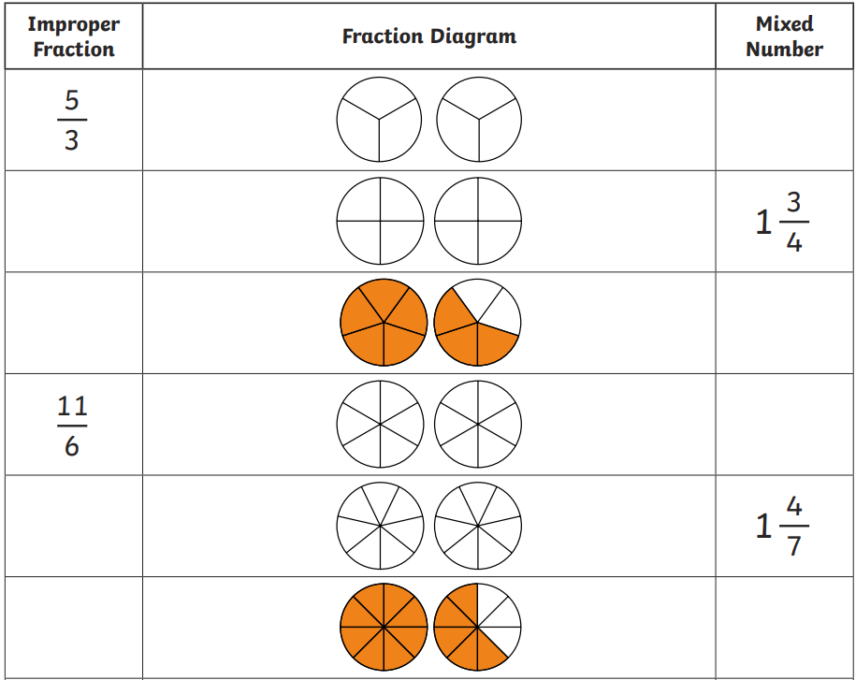

Slide 2
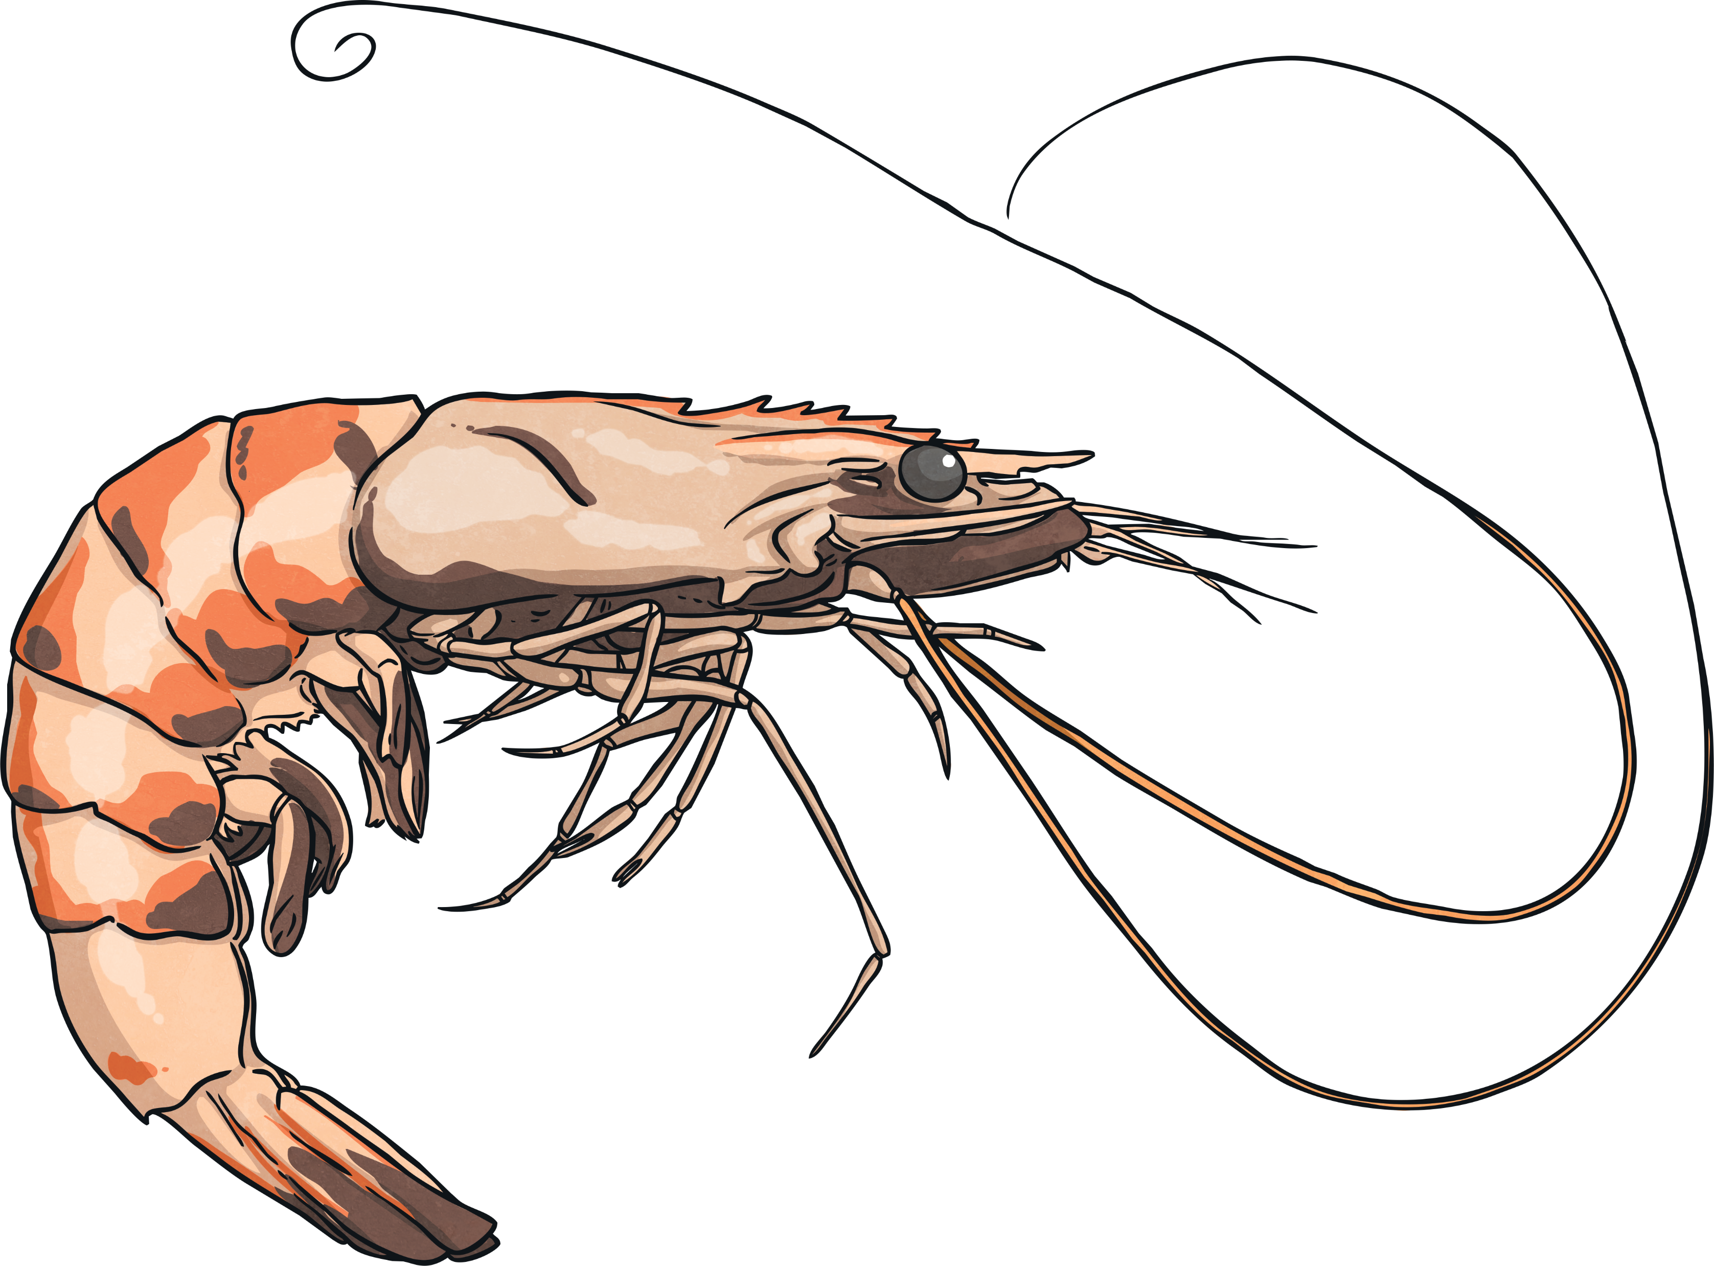
We are starting to look at words that have an /or/ sound within them. An /or/ sound can be made in variety of ways, including using ‘or’, ‘au’ and ‘aw’.
For example:
sport
sauce
prawn
This week, we are going to concentrate on trickier words containing /or/ spelt using ‘or’.

Slide 3
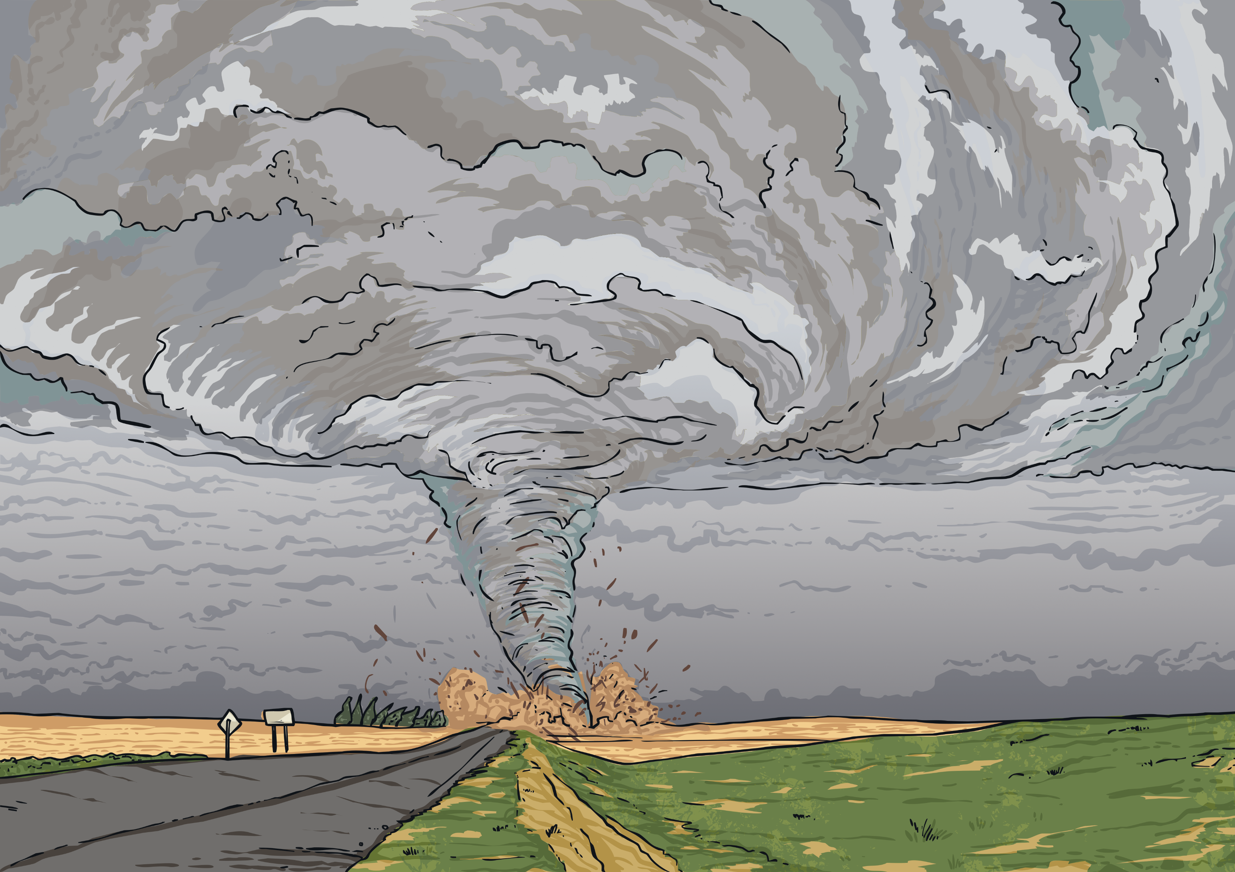
WHITE BOARD WORK
Can you work out the mystery ‘or’ word shown in this picture?
Click for clue
The __________ was so strong that Dorothy’s house flew through the air to the land of Oz.
1
2
3
4
5
6
7
8
9
Answer
tornado

Slide 4
Can you work out the mystery ‘or’ word shown in this picture?
I need a cloth to ________ the water that I have spilled.
Click for clue
1
2
3
4
5
6
absorb
Answer

Slide 5
Here are this week’s spellings to practise.
forty
scorch
absorb
decorate
afford
enormous
category
tornado
according
opportunity

Slide 6
Spelling Bee on whiteboards

Slide 7
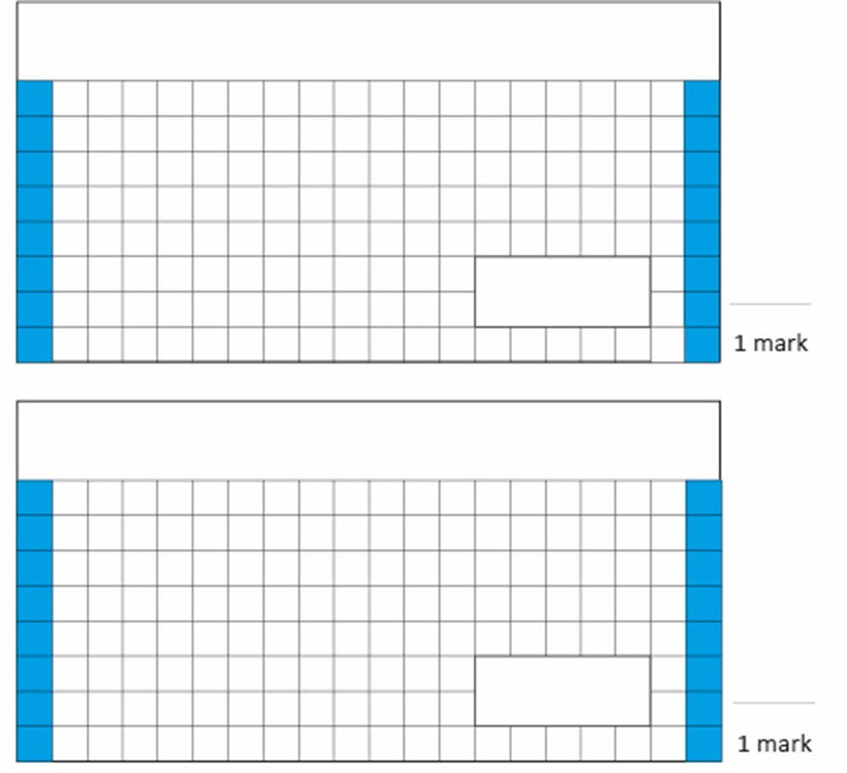
TBAT: revise terms obtuse, acute and reflex angles, perpendicular and parallel sides.
1. 25 X 15 =
3. Zoe is sorting out some weights in the classroom. She finds twenty-three weights each weighing ½ kg. What is the total mass of the weights?
2. 3 – 1.2 =
Challenge:
Write the decimal equivalent of these fractions.

Slide 8
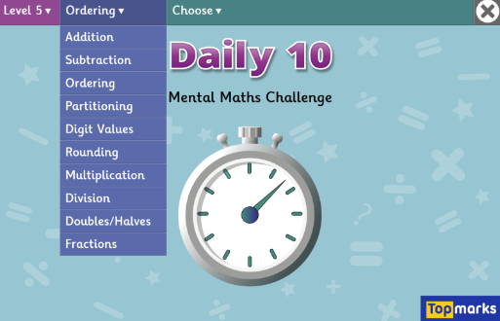
TBAT: revise terms obtuse, acute and reflex angles, perpendicular and parallel sides.
Daily 10 - Mental Maths Challenge - Topmarks

Slide 9
TBAT: revise terms obtuse, acute and reflex angles, perpendicular and parallel sides.
Talk partners:
identify all the shapes that have at least two right angles.

Slide 10
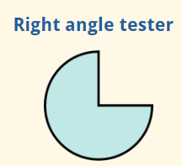
TBAT: revise terms obtuse, acute and reflex angles, perpendicular and parallel sides.
We have previously looked at the angles shown below.

Slide 11
TBAT: revise terms obtuse, acute and reflex angles, perpendicular and parallel sides.
We can continue to use a right angle tester to identify if an angle is acute or obtuse.

Slide 12
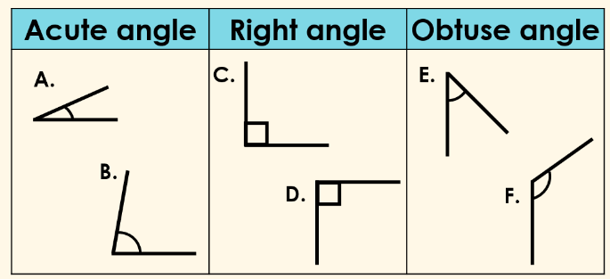
TBAT: revise terms obtuse, acute and reflex angles, perpendicular and parallel sides.
Paired activity:
Which angle has been incorrectly placed in the table below? Write the letter that is next to the angle.

Slide 13
TBAT: revise terms obtuse, acute and reflex angles, perpendicular and parallel sides.
The number of degrees in an angle can also tell us whether an angle is acute, obtuse or a right angle.

Slide 14
TBAT: revise terms obtuse, acute and reflex angles, perpendicular and parallel sides.
Whiteboard work:
The size of an angle helps us determine the type of angle it is.
Identify the type of angle for the measurements given.

Slide 15
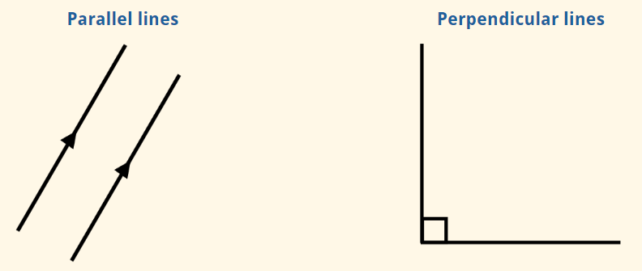
TBAT: revise terms obtuse, acute and reflex angles, perpendicular and parallel sides.
Parallel lines are lines that are always the same distance apart and never meet.
Perpendicular lines are two lines that meet at a right angle.

Slide 16
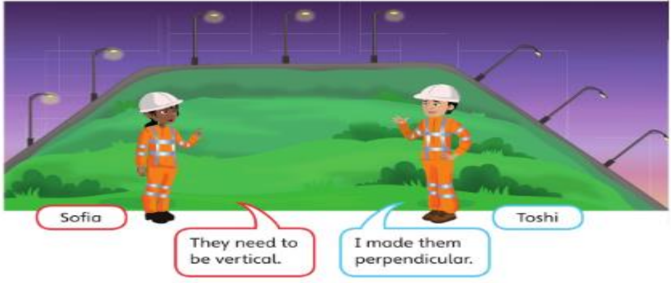

Slide 17
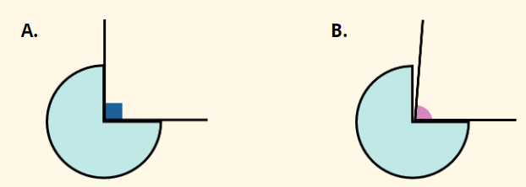
TBAT: revise terms obtuse, acute and reflex angles, perpendicular and parallel sides.
To identify perpendicular lines we can use a right angle tester.
Other examples of perpendicular lines are:

Slide 19
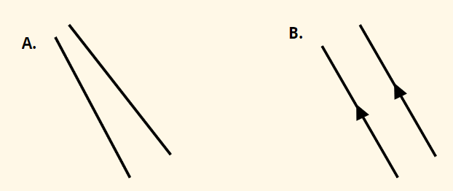
TBAT: revise terms obtuse, acute and reflex angles, perpendicular and parallel sides.
To identify a pair of parallel lines we must make sure the distance between the lines remains the same.

Slide 20
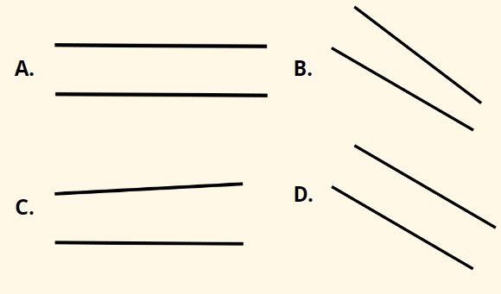
TBAT: revise terms obtuse, acute and reflex angles, perpendicular and parallel sides.
Whiteboard work:
Which of these are parallel lines?

Slide 21
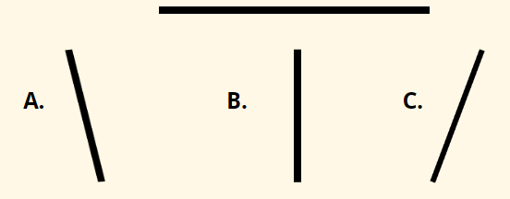
TBAT: revise terms obtuse, acute and reflex angles, perpendicular and parallel sides.
Which of these lines can be joined to the line below to create a pair of perpendicular lines?

Slide 22
Activity: How many parallel and perpendicular lines can you identify?

Slide 23
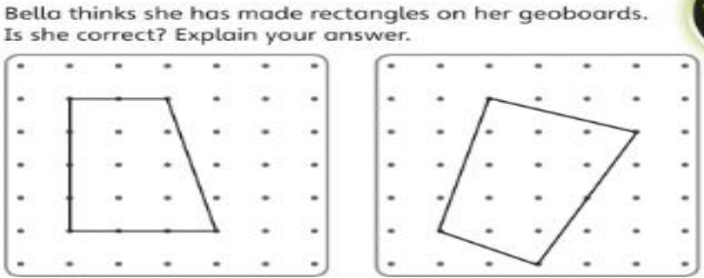
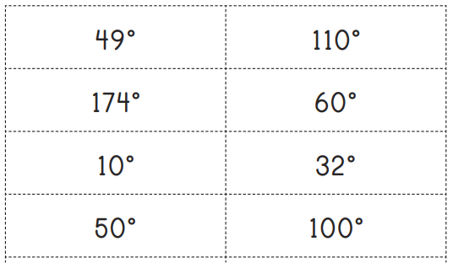
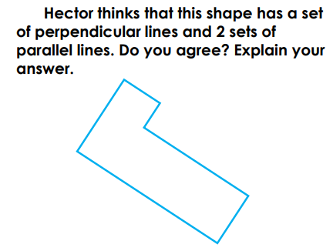
Sort these angles, based on their size, into acute or obtuse angles.
Which lines need arrows to share that they are parallel?

Slide 24
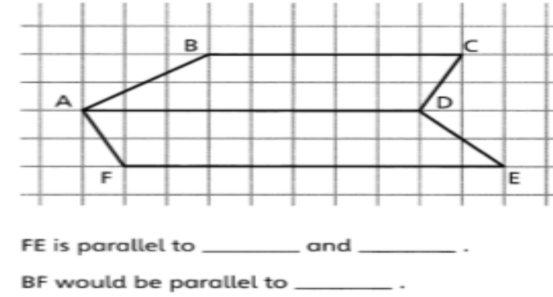
Challenge: Mastery: True or false? A horizontal line is always at right angles with a vertical line. All shapes with 2 pairs of parallel lines are rectangles. A pair of perpendicular lines must be horizontal and vertical.

Slide 26
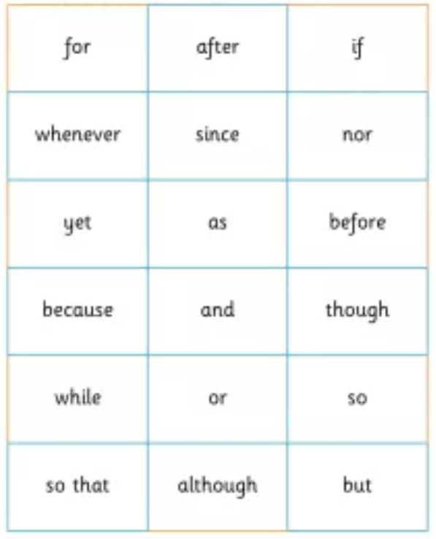
Wednesday 26th February TBAT- develop my understanding of cohesion.
Write the subordinating conjunctions.
2. Write the subordinating clause.
After she finished kicking Liam, she posed for a photograph.
3. Add a subordinating clause to the following sentence.
Florida was furious.

Slide 27
Blue Why are subheadings used in writing? Green Writing is organised into paragraphs. Why is this? Challenge: Explain what an itinerary is.

Slide 28
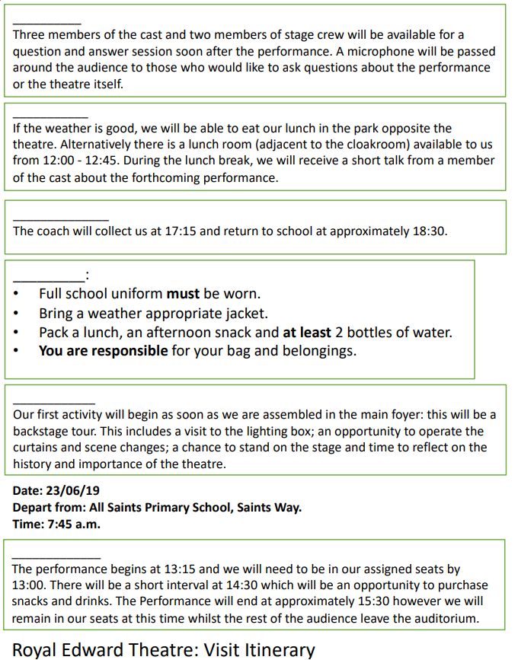
Partner Work: 1) Order the events in chronological order. 2) Once you are happy with the order, write a sub-heading for each of the paragraphs. Challenge: What types of words should be used in a sub-heading?

Slide 29
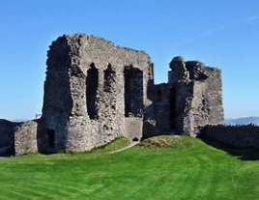
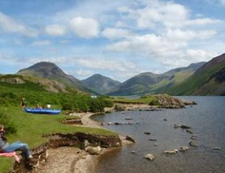
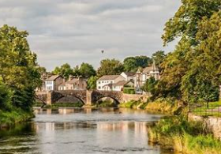
Talk partners: What activities may happen at the South Lakeland Activity Centre in Kendal. -Explore KendalWall - Kingswood and Kingswood Camps outdoor adventures Water Sport Activities | Mendip Activity Centre | Somerset

Slide 30
Cohesion-Organising information effectively: Put the following events into chronological order. 1) Once we arrive at the Lakeside Centre, children will have the opportunity to unpack and relax. 2) Then (at around midday) we will find a picturesque location to stop for lunch. 3) At 11:00am, we will complete the nature walk whilst also bird watching. 4) Following this, the children (who I am sure will be very excited by this) will observe the surroundings and complete a piece of artwork to remember the day. 5) We will meet at the main entrance of the school at 7:00am and be ready to depart by coach at 7:20am. 6) Day One: 15/4/2024 7) On day one of our fantastic trip, the children will be taking part in a nature walk and an art activity -which will be a surprise task on the day.
How could we improve the sub-heading?
Underline the relative clauses.

Slide 31
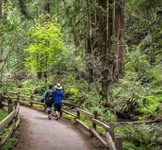
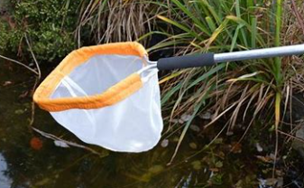
To prevent Liam's parents from contacting the school, resulting in them immediately discovering the lie, Liam instead promises them a more detailed itinerary. Say a sentence that tells the reader the four activities that they will complete over the two days. Steps to success: adverbial commas in a list parenthesis for extra information

Slide 32
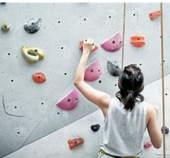
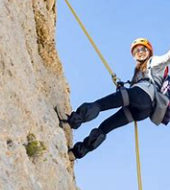
Write a sentence that tells the reader the four activities that they will complete over the two days. The two days will be full of excitement.... Two days of adventure is ahead for your child.... Over the course of the two days... Steps to success: adverbial commas in a list parenthesis for extra information

Slide 33
Give each activity a title: Adventurous Abseiling Climb on up!

Slide 34
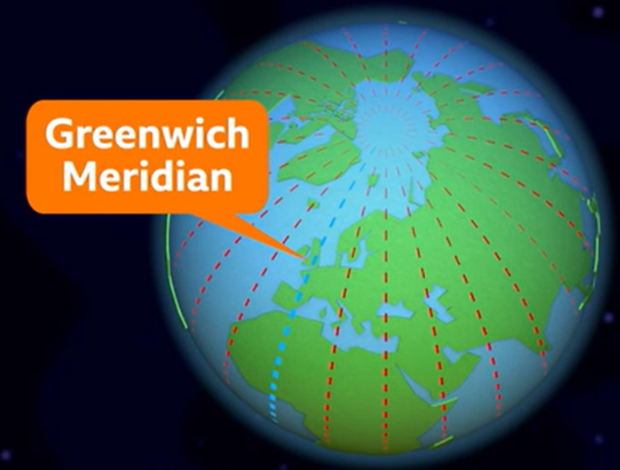
Wednesday 26th February 2024
Q : What are international time zones?
3 in 3
1.What do we call imaginary lines round the Earth?
2.How many time zones are there?
3.Where would you find the Prime Meridian?

Slide 35
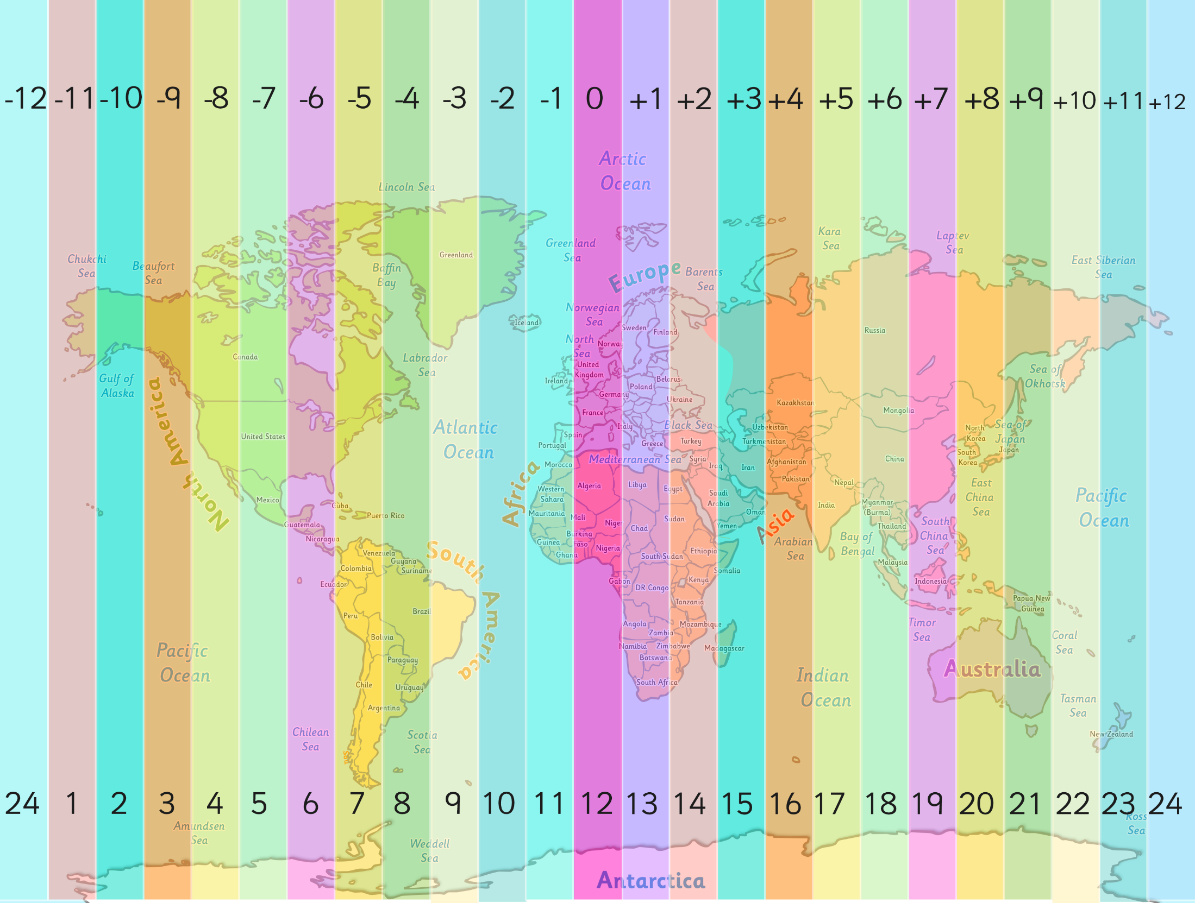

Slide 36
Night and Day
Discuss the following questions with your talk partner:
Does night and day occur at the same time everywhere on Earth?
Why does night and day occur? How do you know?
Why? Why not?

Slide 37
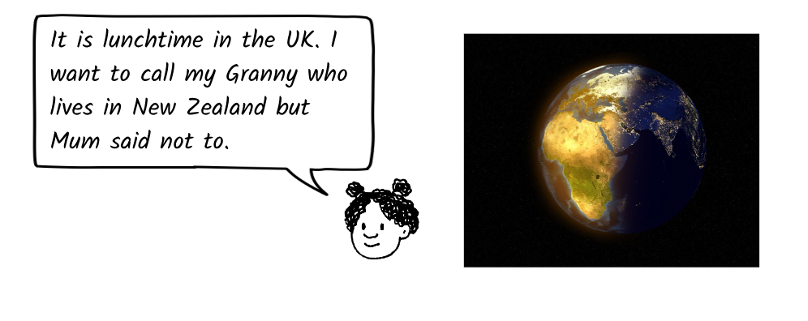
Explain why.

Slide 38
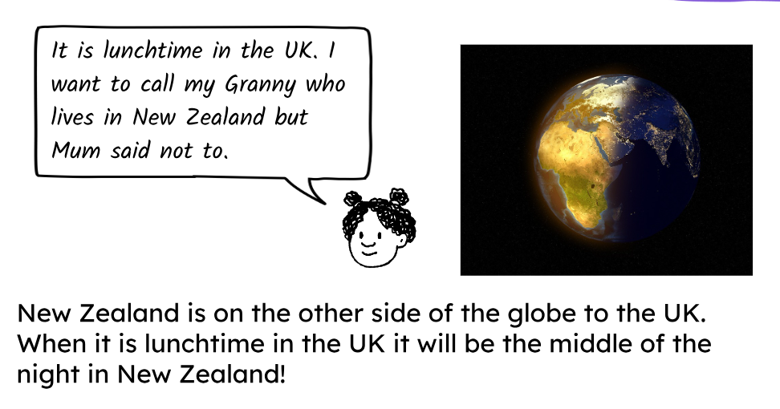
Explain why.

Slide 39
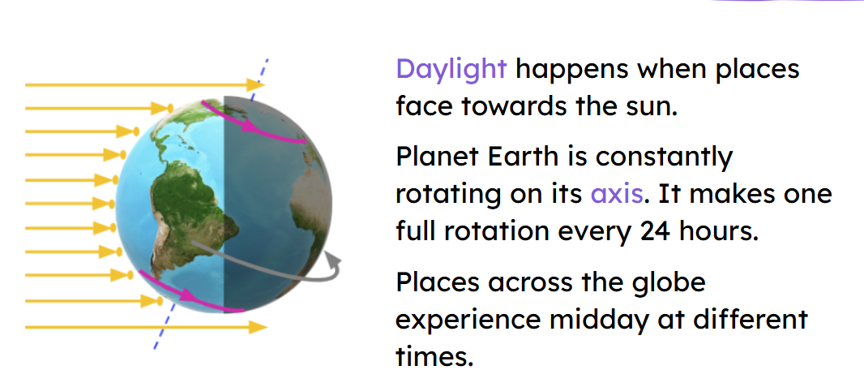

Slide 41
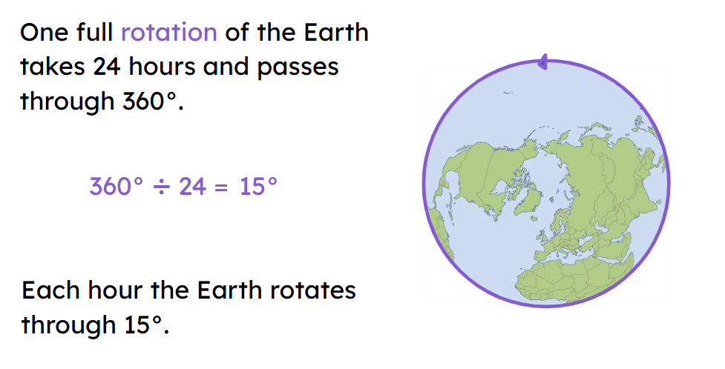

Slide 42
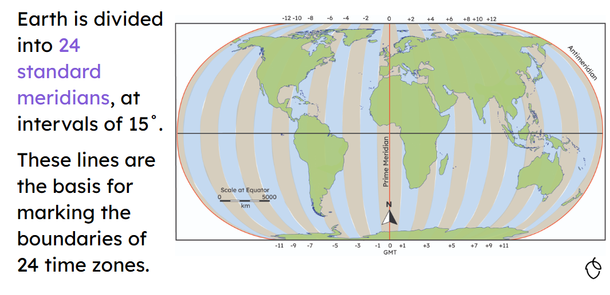

Slide 43
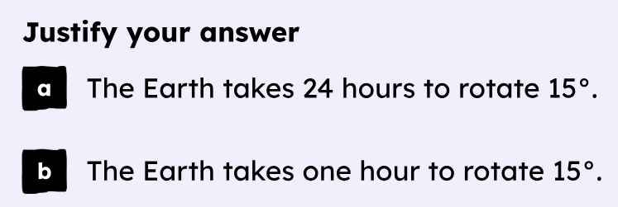

Slide 44
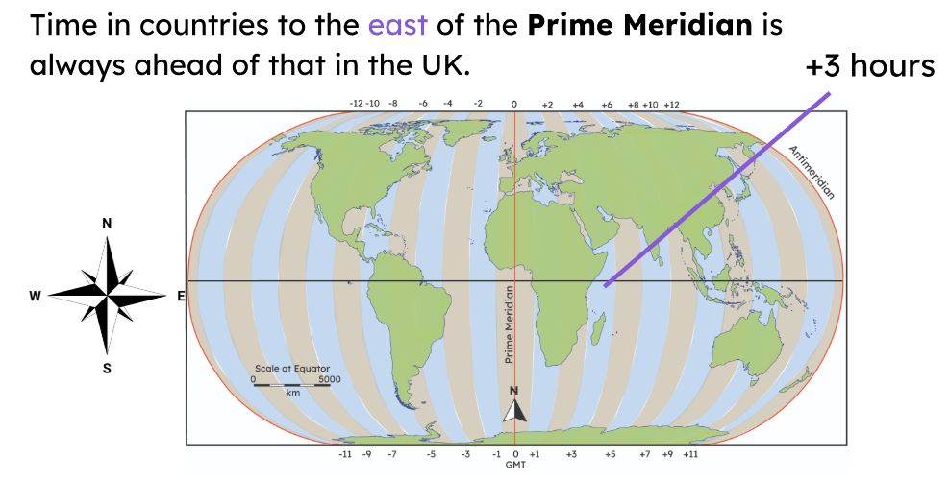

Slide 45
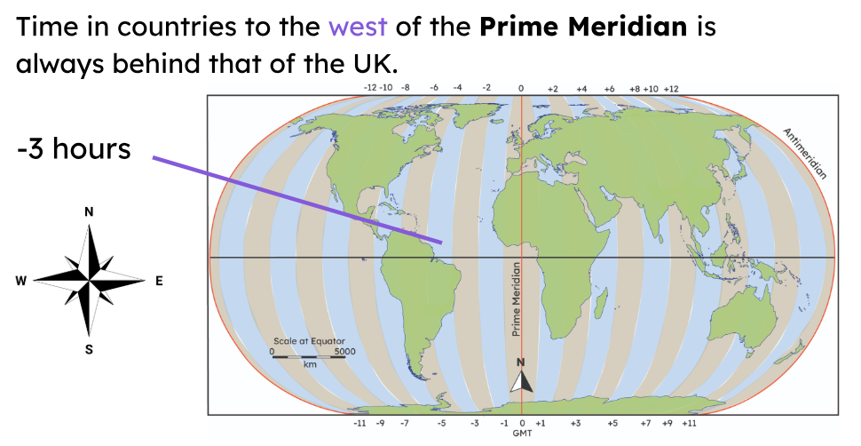

Slide 46
Night and Day Investigation
If it is midday in New Zealand, what time do you predict that it will be in the UK?
What are the different time zones? - BBC Bitesize

Slide 47
Checking Predictions
How can we check if our predictions are correct?
Where would we get the information from?
Where would we get the information from?

Slide 49
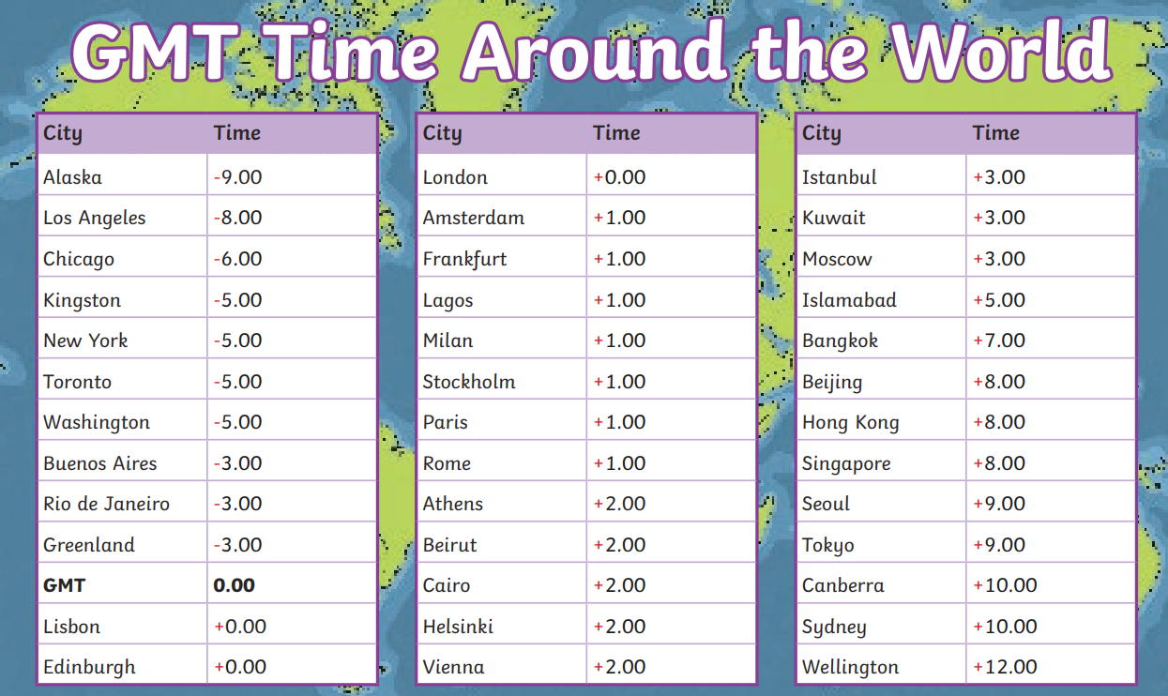
Independent: Choose three cities (you can use an Atlas to help you) and use the information below to say what time it would be in these countries when it is midday in England. 12pm England – 10pm Sydney Explain why different places around the world have different time zones. Vocabulary: Rotation Sun Axis

Slide 50
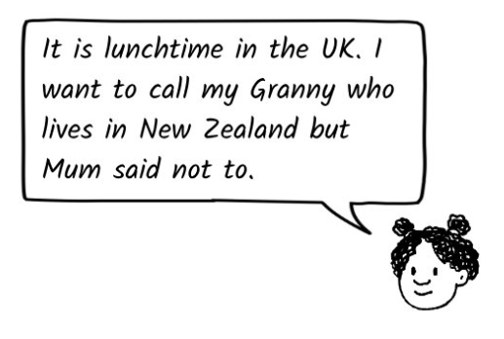
Challenge When would be the best time to call Granny in New Zealand? When would it suit both of you?

Slide 51
Exit question: What are international time zones? Explain why there isn’t just one time zone for everyone around the world.

