Slide 1
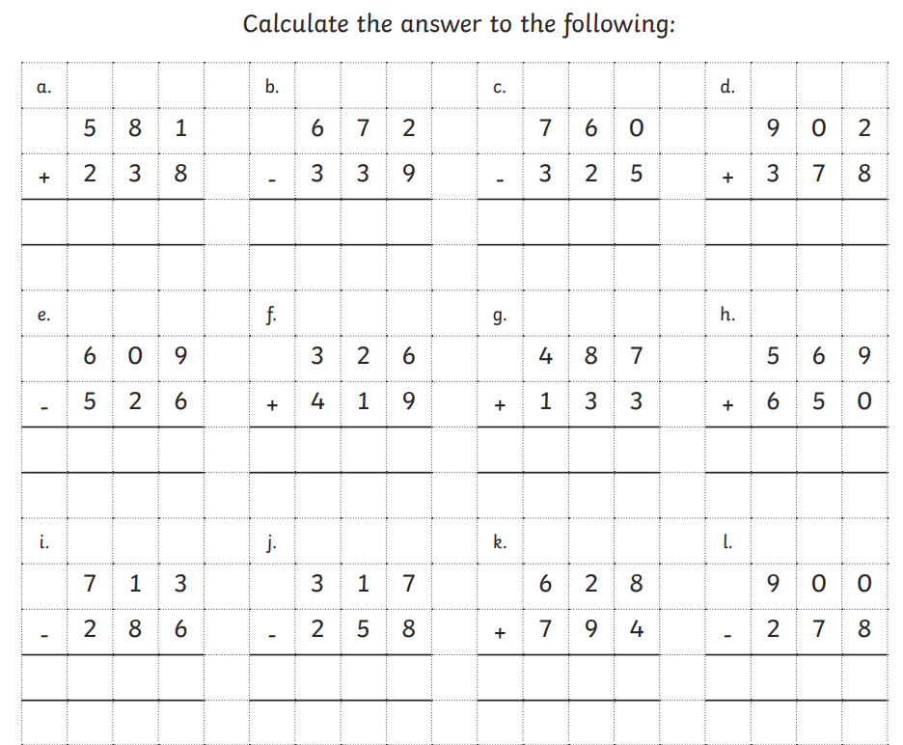
Friday 28th February 2025 - Morning challenge

Slide 2
Friday 28th February
Dictation
The brave knight baked bread with flour before going on his adventure.
The bear won the race by running very fast through the forest.
The fisherman’s son loved to sail on the deep blue sea.

Slide 3
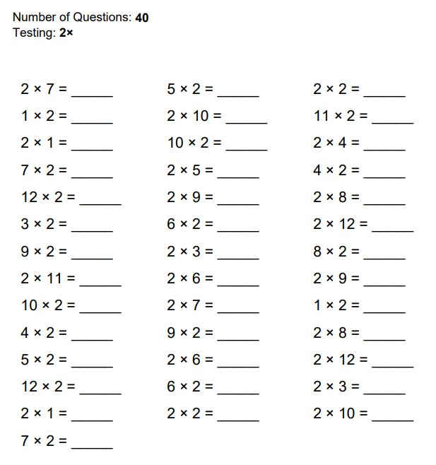
28.02.25
Times table practice

Slide 4
28.02.25
TBAT: recall multiplication facts for the 3-, 4- and 8-times table.
3 in 3
35 x 8
2/4 of 48
_________ = 32 ÷ 4
Challenge

Slide 5
28.02.25
TBAT: recall multiplication facts for the 3-, 4- and 8-times table.
Daily 10 - Mental Maths Challenge - Topmarks

Slide 6
28.02.25
TBAT: recall multiplication facts for the 3-, 4- and 8-times table.
Carousel of activities – 15 minutes per activity
Group 1 – Times table treasure hunt
Group 2 – Matching cards
Group 3 – loop cards

Slide 7
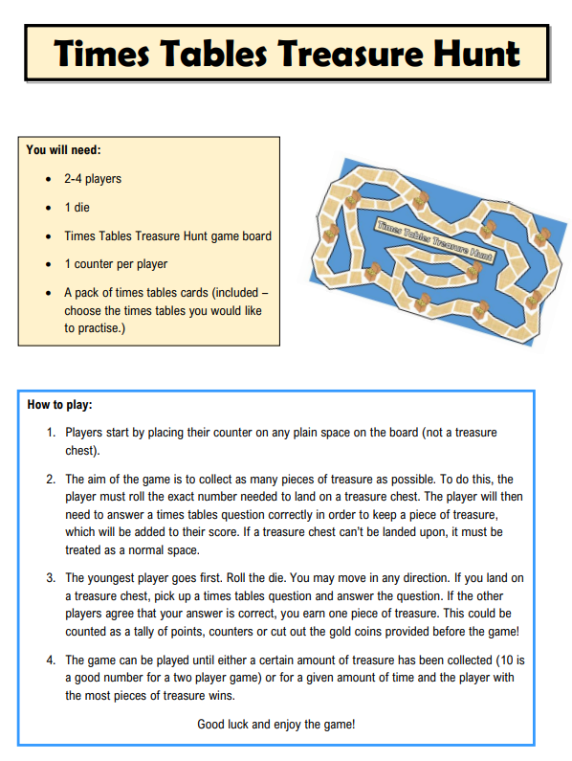
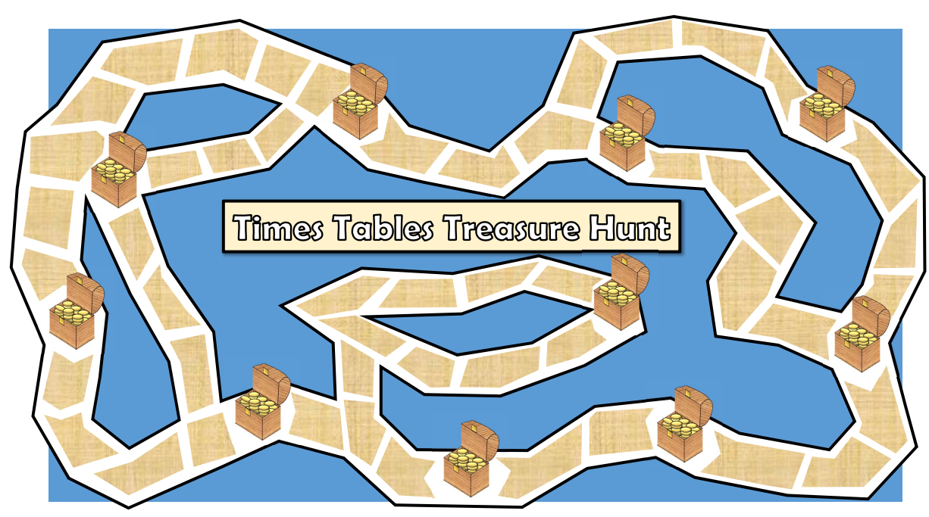
28.02.25
TBAT: recall multiplication facts for the 3-, 4- and 8-times table.

Slide 8
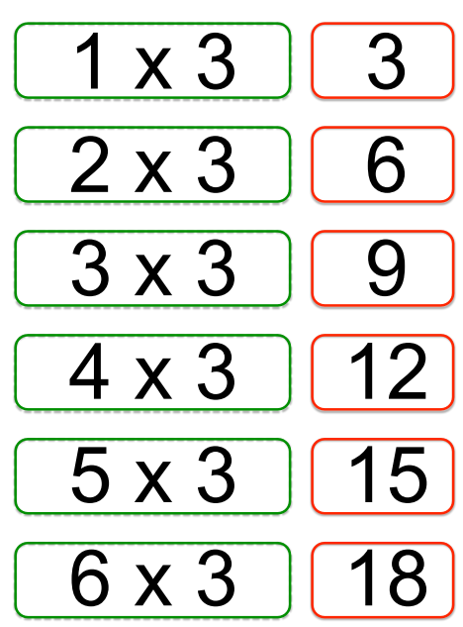
28.02.25
TBAT: recall multiplication facts for the 3-, 4- and 8-times table.
Times table match
You have 3 different sets of times table cards.
Turn them all over so you cannot see the writing. Start your timer and see how long it takes your group to match all of the calculations correctly!

Slide 9
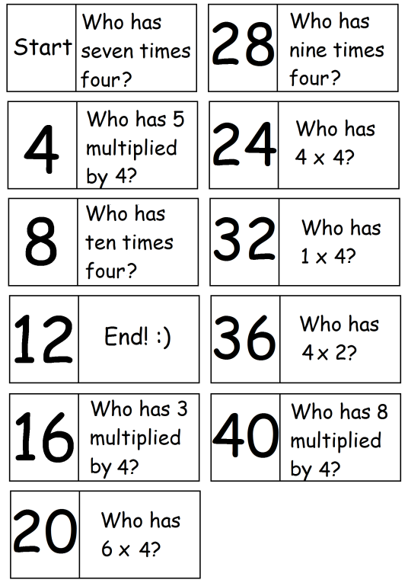
28.02.25
TBAT: recall multiplication facts for the 3-, 4- and 8-times table.
Times table loop cards
You have 3 different sets of times table loop cards.
Choose 1 times table set at a time.
Deal out the loop cards.
One person starts the game by reading out their card.
Once you have used your card, turn it over.

Slide 10
Friday 28th February 2025
TBAT: identify and begin to use inverted commas to punctuate direct speech 3 in 3 How much would you weigh if you lived on a different planet? Often when we talk about weight, we actually mean mass. After all, mass is what we really measure using kilos and grams. Weight is a force caused by the effect of gravity on a mass. Your mass would be the same whatever planet you were on because it is about you. On the moon, for example, your weight would be less because the effect of the moon’s gravity is much less than Earth’s. Stand on Jupiter, however, and your weight would rocket because its greater size means it has stronger gravity.
1.Where does the text say your weight be less than on Earth?
2. On which planet would your weight be greater?
3. Find and copy the word in the last sentence that means increase a lot.

Slide 11
Inverted commas

Slide 12
Inverted commas
Inverted commas are also known as speech marks and quotation marks. Inverted commas show what is being said.
Sometimes, they might look like a small 66 and 99.
“ ”
Sometimes, they might look like two small lines.

Slide 13
Inverted commas
Inverted commas go around the words the character says.
“It’s lovely to meet you,” smiled Riaz.
Words the character is saying
Riaz smiled, “It’s lovely to meet you.”
Words the character is saying

Slide 14
Inverted commas
Inverted commas are always placed before the first word of the speech and after the end punctuation of the speech.
“See you at the match!” yelled Leo and Amira.
First word of speech
End punctuation of the speech
Leo and Amira yelled, “See you at the match!”
First word of speech
End punctuation of the speech

Slide 15
Inverted commas
The reporting clause tells us who is speaking. It is never punctuated with inverted commas.
“I can’t find my pen,” grumbled Annie.
Reporting clause
Annie grumbled, “I can’t find my pen.”
Reporting clause

Slide 16
Inverted commas
The character’s sentence must use the correct end punctuation.
If the end of the character’s sentence is also the end of your sentence, this will usually be a full stop, question mark or exclamation mark.
Tomas grinned, “That’s great.”
. at the end of sentence
Tomas shouted, “Hurry up!”
! to add emphasis
Tomas asked, “Where is it?”
? as it is a question

Slide 17
Inverted commas
If the end of the character’s sentence is not the end of your sentence, you will need a comma, question mark or exclamation mark.
Your sentence will end with a full stop.
, at the end of Tomas’s sentence as it is not the end of your sentence
“That’s great,” grinned Tomas.
“Hurry up!” shouted Tomas.
! to add emphasis
“Where is it?” asked Tomas.
? as it is a question

Slide 18
Inverted commas
If the reporting clause is at the beginning, use a comma before you start the speech to allow the reader to pause and change their voice, if needed.
Miss Cook announced, “The book sale is after school.”
If the reporting clause is at the end, you will already have used a comma, exclamation mark or question mark at the end of the character’s sentence.
“The book sale is after school,” announced Miss Cook.

Slide 19
Practise
Why have inverted commas been used in the sentence below? Select one.
Mr Benton asked, “Where are you going?”
To show that it is a question.
To show that someone is speaking.
To show that there is a pause.
To mark the end of the sentence.

Slide 20
How did you do?
Why have inverted commas been used in the sentence below? Select one.
Mr Benton asked, “Where are you going?”
To show that it is a question.
To show that someone is speaking.
To show that there is a pause.
To mark the end of the sentence.

Slide 21
Practise
Which sentence uses inverted commas correctly? Select one.
“Please get your recorder,” requested the teacher.
“Please get your recorder, requested the teacher.”
Please get your recorder, “requested the teacher.”
Please get your recorder, “requested” the teacher.

Slide 22
How did you do?
Which sentence uses inverted commas correctly? Select one.
“Please get your recorder,” requested the teacher.
“Please get your recorder, requested the teacher.”
Please get your recorder, “requested the teacher.”
Please get your recorder, “requested” the teacher.

Slide 23
Practise
Which punctuation has been used to show that someone is speaking in the sentence below? Select one.
“We should wash the paintbrushes,” suggested Miko.
Full stop Capital letters
Commas Inverted commas

Slide 24
How did you do?
Which punctuation has been used to show that someone is speaking in the sentence below? Select one.
“We should wash the paintbrushes,” suggested Miko.
Full stop Capital letters
Commas Inverted commas

Slide 25
Practise
Tick two boxes to show where the inverted commas should be placed.
B
D
Leah and Milon shouted , Good luck Anya !
A
C
E

Slide 26
How did you do?
Tick two boxes to show where the inverted commas should be placed.
B
D
Leah and Milon shouted , Good luck Anya !
A

Slide 27
Reflection
Remember to use these tips to help you use inverted commas correctly.
Use inverted commas around what the character actually says.
Inverted commas are always placed before the first word of the speech and after the end punctuation of the speech.

