Slide 1


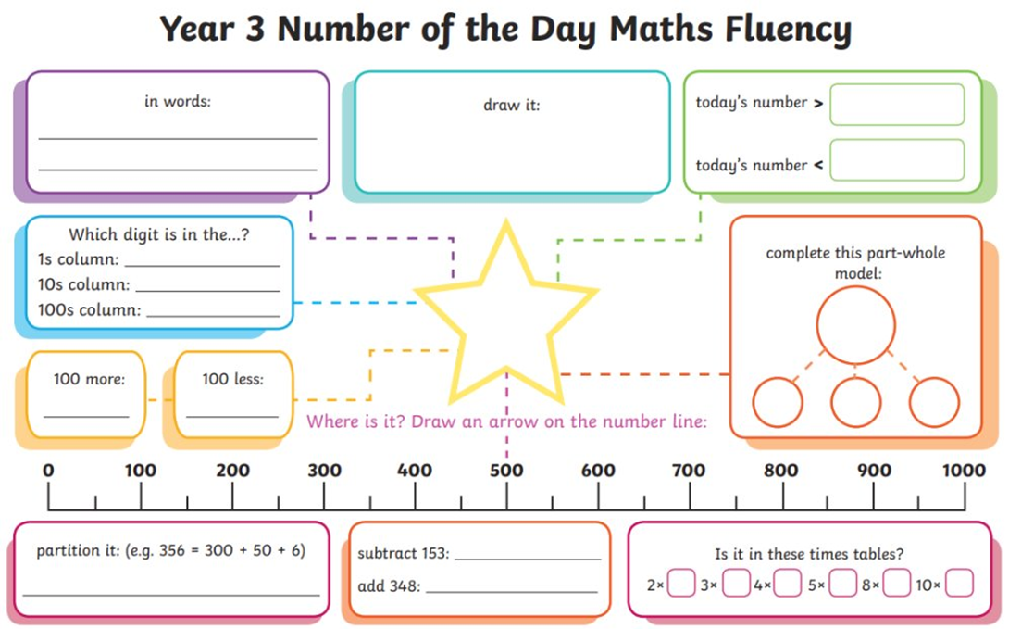
Thursday 27th February 2025
Morning challenge
718

Slide 2
Thursday 27th February 2025
Wordwork

Slide 3


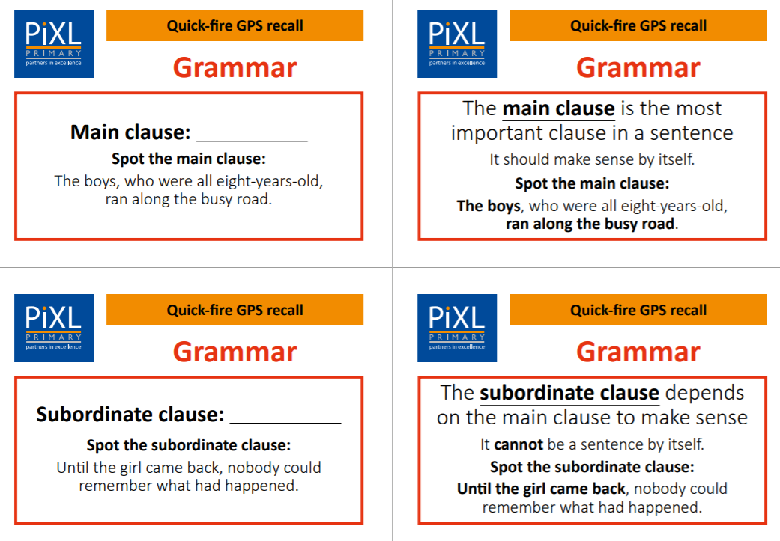
Main clauses

Slide 4
Tell me… Examples…
Tell me what a main clause is.
…a group of words containing a subject and a verb that makes sense by itself.
Examples of main clauses:
E.g. The children raced.
E.g. We danced around the room.
subject
verb
subject
verb

Slide 5
Subordinate clauses

Slide 6
Tell me… Examples…
Tell me what a subordinate clause is.
…a group of words containing a verb that depends on the main clause to make sense. They often begin with a subordinating conjunction.
Examples of subordinate clauses:
E.g. although we were late
E.g. whilst we remembered
subordinating conjunction
verb
subordinating conjunction
verb

Slide 7

Main clauses and subordinate clauses
A main clause makes sense by itself. A subordinate clause depends on the main clause to make sense.
We put on our coats
because it was cold.
main clause
subordinate clause
It was dark
even though it was only 4pm.
main clause
subordinate clause

Slide 8
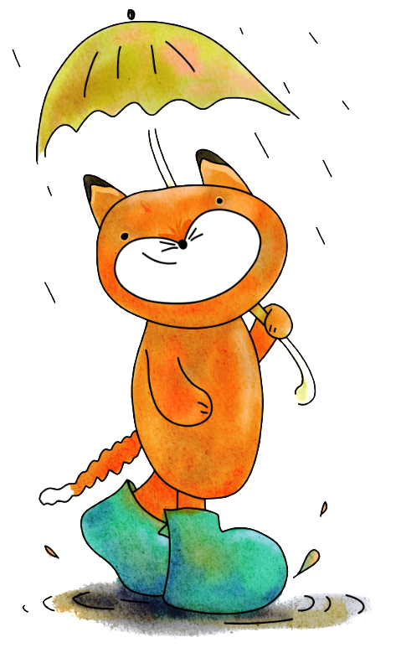
Main clauses and subordinate clauses
A main clause does not always come before the subordinate clause.
Everyone collected their artwork
before they went home.
main clause
subordinate clause
Whilst it was raining,
the children sheltered under a tree.
subordinate clause
main clause

Slide 9

Practise
Which of these are main clauses?
They grinned.
Almost every weekend.
Whenever it is cold.
Suzzana was at home.
Zaine rushed back home.
Remember: a main clause contains a subject and a verb. It must make sense on its own.

Slide 10

How did you do?
Which of these are main clauses?
They grinned.
Almost every weekend.
Whenever it is cold.
Suzzana was at home.
Zaine rushed back home.
Remember: a main clause contains a subject and a verb. It must make sense on its own.

Slide 11
Practise
Tick to show whether the underlined clause is a main clause or a subordinate clause.
Sentence | Main clause | Subordinate clause
The ride re-opened once the rain stopped.
After finishing our work, we ran out to play.
I liked the story because it was about wolves.
As we woke up late, we missed our train.
Remember: a main clause contains a subject and a verb. It must make sense on its own.

Slide 12
How did you do?
Tick to show whether the underlined clause is a main clause or a subordinate clause.
Sentence | Main clause | Subordinate clause
The ride re-opened once the rain stopped.
After finishing our work, we ran out to play.
I liked the story because it was about wolves.
As we woke up late, we missed our train.
Remember: a main clause contains a subject and a verb. It must make sense on its own.

Slide 13
Practise
Underline the main clause in each sentence below.
Stay out of the water if you see a jellyfish.
Although we were tired, we were determined to finish.
Everybody clapped when the actors bowed.
Remember: a main clause contains a subject and a verb. It must make sense on its own.

Slide 14
How did you do?
Underline the main clause in each sentence below.
Stay out of the water if you see a jellyfish.
Although we were tired, we were determined to finish.
Everybody clapped when the actors bowed.
Remember: a main clause contains a subject and a verb. It must make sense on its own.

Slide 15
Practise
Underline the subordinate clause in each sentence below.
While we waited for our turn, we played a clapping game.
We turned on the cooker because it was time for dinner.
If you want to be helpful, you could put away the paints.
Remember: a main clause contains a subject and a verb. It must make sense on its own.

Slide 16
How did you do?
Underline the subordinate clause in each sentence below.
While we waited for our turn, we played a clapping game.
We turned on the cooker because it was time for dinner.
If you want to be helpful, you could put away the paints.
Remember: a main clause contains a subject and a verb. It must make sense on its own.

Slide 17
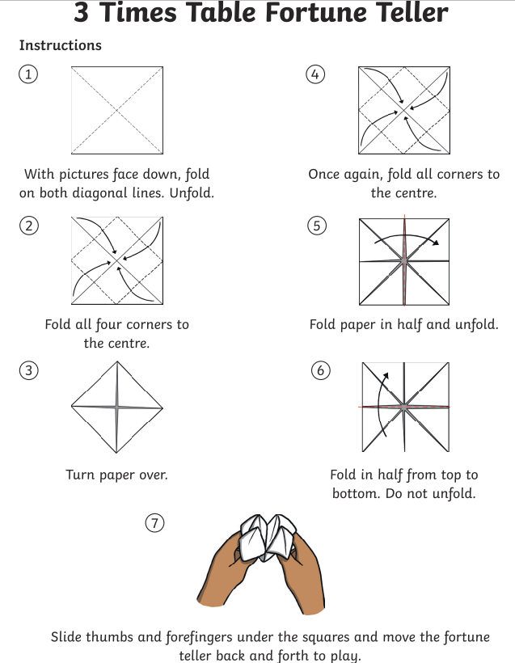
27.02.25
Times table practice
3 Times Table Song (Green Green Grass by George Ezra)
Counting
Harry Potter Maths
Round the World
Hit the button
Roll the dice
Counting stick

Slide 18

27.02.25
TBAT: solve fraction word problems.
3 in 3
52 x 8 =
2. Double 356 =
3. 2/5 of 55 =
Challenge
What is the perimeter of this shape?
Each side measures 4 cm.

Slide 19

27.02.25​
TBAT: solve fraction word problems.
Daily 10 - Mental Maths Challenge - Topmarks

Slide 20

Model Question 1

Slide 21
Stage 1 - Vocabulary
Paula has a banana loaf cake that she cuts into 6 pieces. Paula eats 1 piece and Tom eats 2 pieces. What fraction of the banana loaf cake have Paula and Tom eaten together?
Do you know what all of these words mean?

Slide 22

Stage 2 – Understanding vocabulary
Class work
Synonym: _____________________
Antonym: _____________________
My definition: ____________________
_________________________________
_________________________________
Used in context: ___________________
_________________________________
______________________________
Word:
piece
Picture:

Slide 23
Stage 3 – Number Free Zone
Paula has a banana loaf cake that she cuts into 6 pieces. Paula eats 1 piece and Tom eats 2 pieces. What fraction of the banana loaf cake have Paula and Tom eaten together?
1. Vocabulary - Write a definition for the following words:
a) fraction b) together
2. Retrieval – Who has eaten some banana loaf cake?
3. Inference – What is the question asking you to do? Summarise the problem.

Slide 24
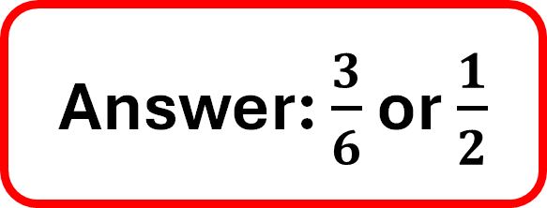
Stage 4 – Answer Free Zone
Shhh!
Paula has a banana loaf that she cuts into 6 equal pieces. Paula eats 1 piece and Tom eats 2 pieces. What fraction of the banana loaf have Paula and Tom eaten altogether?
Answer: $\frac{3}{6}$ or $\frac{1}{2}$

Slide 25
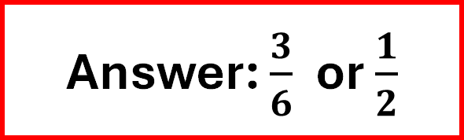
Thinking Talk
Paula has a banana loaf that she cuts into 6 equal pieces. Paula eats 1 piece and Tom eats 2 pieces. What fraction of the banana loaf have Paula and Tom eaten altogether?
Firstly, draw a bar to show the whole banana loaf.
Next, split it into 6 equal pieces.
Answer: $\frac{3}{6}$ or $\frac{1}{2}$

Slide 26
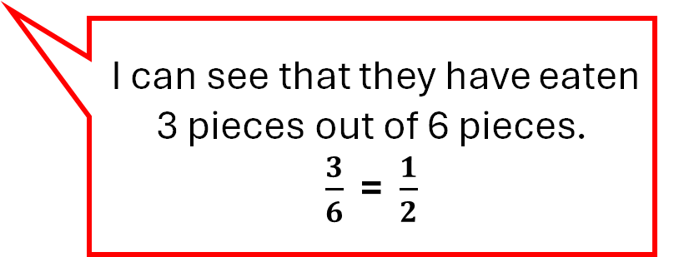
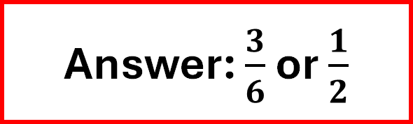
Thinking Talk
Paula has a banana loaf that she cuts into 6 equal pieces. Paula eats 1 piece and Tom eats 2 pieces. What fraction of the banana loaf have Paula and Tom eaten altogether?
Label the piece that Paula ate and the pieces that Tom ate.
P
T
T
I can see that they have eaten 3 pieces out of 6 pieces.
$\frac{3}{6}$ = $\frac{1}{2}$
Answer: $\frac{3}{6}$ or $\frac{1}{2}$

Slide 27
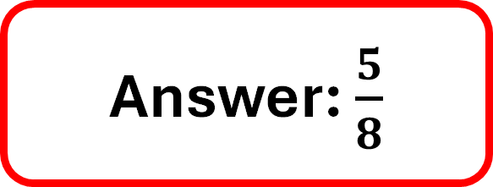
Stage 5 – Your Turn
Book work - Problem 1
Seb is designing a tile made up of 8 equal squares. He shades 2 squares purple and 3 squares green. What fraction of the tile is shaded altogether?
Answer: $\frac{5}{8}$

Slide 28
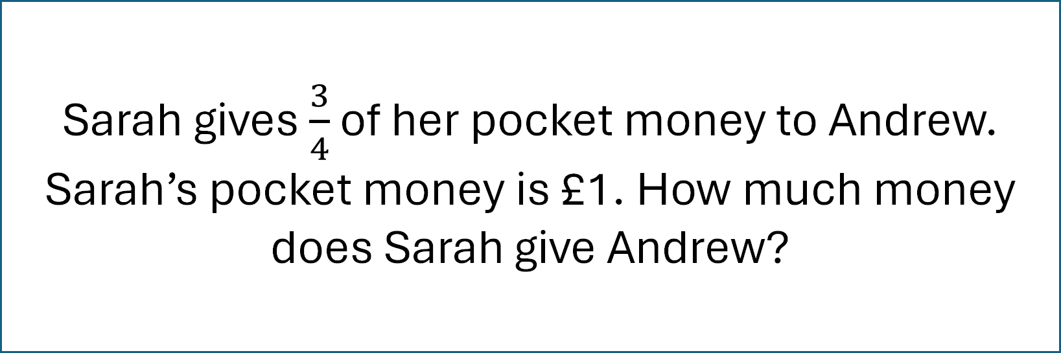
Stage 1 - Vocabulary
Sarah gives $\frac{3}{4}$ of her pocket money to Andrew. Sarah’s pocket money is £1. How much money does Sarah give Andrew?
Do you know what all of these words mean?

Slide 29
Stage 2 – Understanding vocabulary
Synonym: _____________________
Antonym: _____________________
My definition: ____________________
_________________________________
_________________________________
Used in context: ___________________
_________________________________
______________________________
Word:
give
Picture:

Slide 30
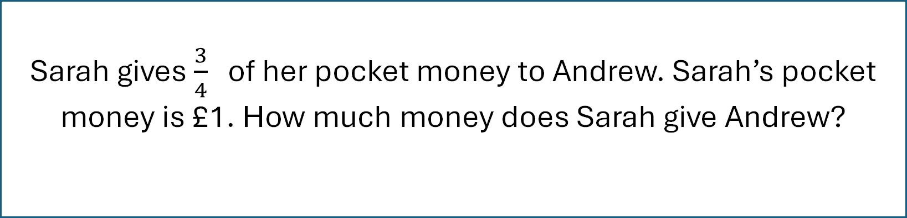
Stage 3 – Number Free Zone
Sarah gives $\frac{3}{4}$ of her pocket money to Andrew. Sarah’s pocket money is £1. How much money does Sarah give Andrew?
1. Vocabulary - What does how much tell you about the type of answer?
2. Retrieval – Where does Andrew get his money from?
3. Inference – What is the question asking you to do? Summarise the problem.

Slide 31
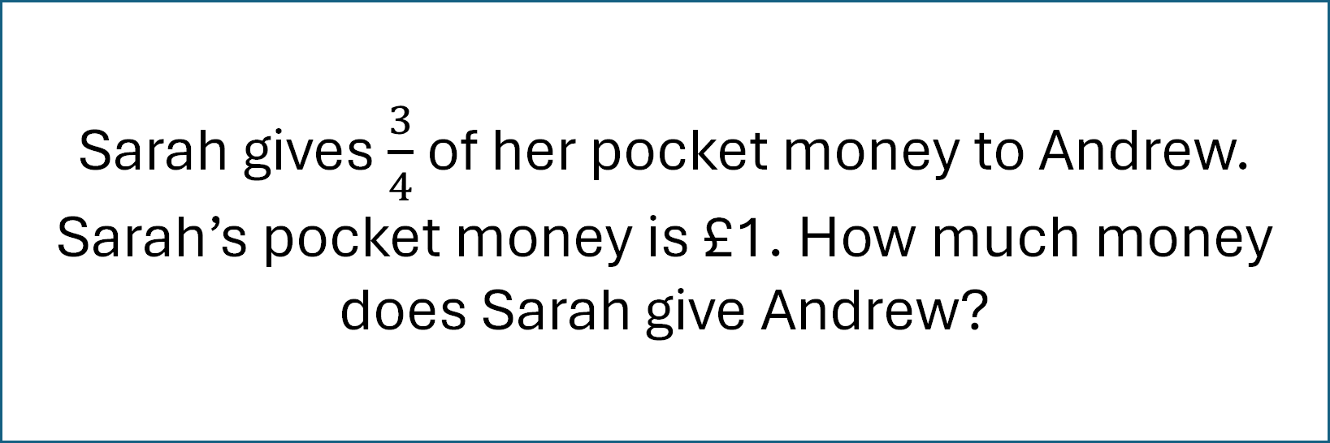
Stage 4 - Answer Free Zone
Shhh!
Sarah gives $\frac{3}{4}$of her pocket money to Andrew. Sarah’s pocket money is £1. How much money does Sarah give Andrew?
Answer: 75p

Slide 32
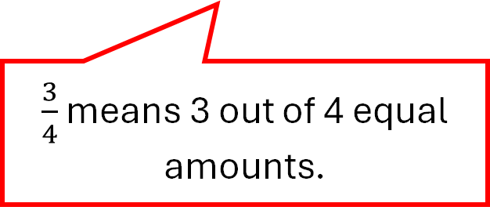
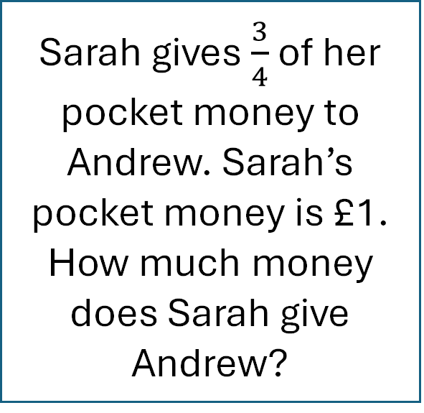
Thinking Talk
Sarah gives $\frac{3}{4}$ of her pocket money to Andrew. Sarah’s pocket money is £1. How much money does Sarah give Andrew?
Firstly, I need to convert pounds into pence so I can find a fraction of it.
$\frac{3}{4}$ means 3 out of 4 equal amounts.
There are 100p in £1.
100 ÷ 4 = 25
100p
Answer: 75p

Slide 33

Thinking Talk
Sarah gives $\frac{3}{4}$ of her pocket money to Andrew. Sarah’s pocket money is £1. How much money does Sarah give Andrew?
100 ÷ 4 = 25
100p
25
25
25
25
$\frac{3}{4}$ is 3 x 25 = 75p
Answer: 75p

Slide 34
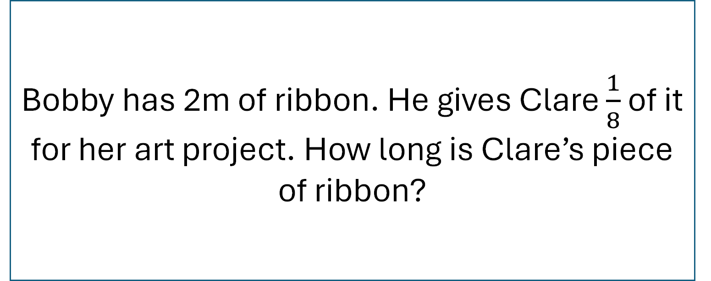
Stage 5 – Your Turn
Book work – Problem 2
Bobby has 2m of ribbon. He gives Clare $\frac{1}{8}$ of it for her art project. How long is Clare’s piece of ribbon?
Answer: 25cm

Slide 35
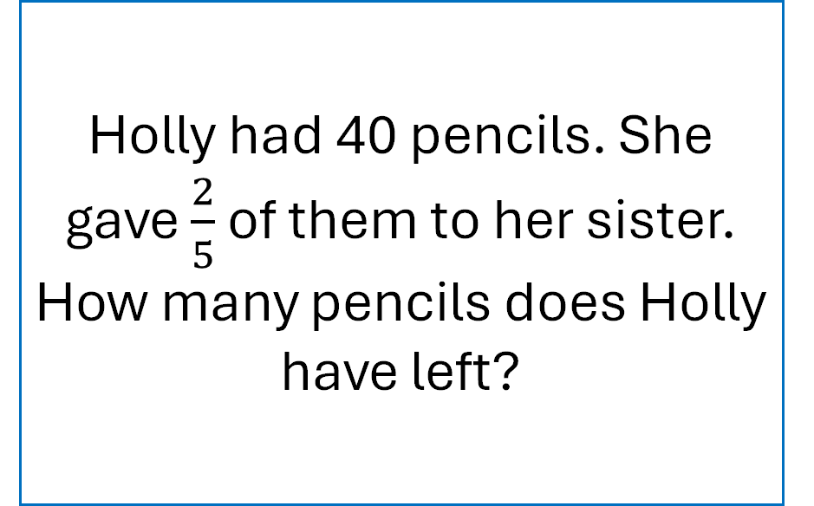
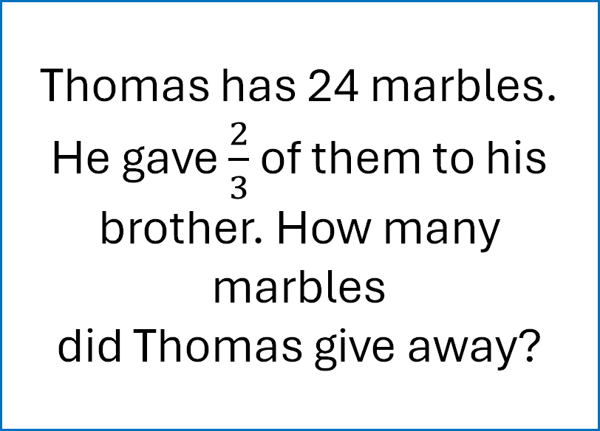
Your Turn
Problem 3
Problem 4
Thomas has 24 marbles. He gave $\frac{2}{3}$ of them to his brother. How many marbles
did Thomas give away?
Holly had 40 pencils. She gave $\frac{2}{5}$ of them to her sister. How many pencils does Holly have left?

Slide 36

10:45

Slide 37
Thursday 27th February 2025
Spelling
What is a homophone?
What is a homophone for not?
True or false – has the homophone been used correctly.
I ordered chicken and chips for my mane meal.

Slide 38
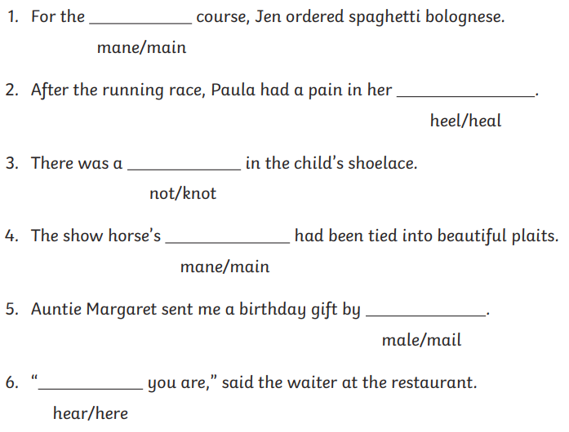
Thursday 27th February 2025
Spelling
Ch -
Write a silly sentence containing each word from a pair of homophones above.

Slide 39
Thursday 27th February
TBAT: begin sentences in a different way by using an adverb
3 in 3
How much would you weigh if you lived on a different planet? Often when we talk about weight, we actually mean mass. After all, mass is what we really measure using kilos and grams. Weight is a force caused by the effect of gravity on a mass. Your mass would be the same whatever planet you were on because it is about you. On the moon, for example, your weight would be less because the effect of the moon’s gravity is much less than Earth’s. Stand on Jupiter, however, and your weight would rocket because its greater size means it has stronger gravity.
What do we often mean when we say weight?
2. What do we measure mass in?
3. Find and copy the words that describe what weight really is.

Slide 40
Do you sometimes find it difficult to think of how to begin sentences? Look at this piece of writing. What do you notice?
Jane was excited because it was ‘Sports Day’. She always loved it. She hoped that her team would win. She was very good at running and usually won the sprint race. She also hoped that she would be captain this year. It was very sunny outside, so at least it wouldn’t be cancelled.
Jane was excited because it was ‘Sports Day’. She always loved it. She hoped that her team would win. She was very good at running and usually won the sprint race. She also hoped that she would be captain this year. It was very sunny outside, so at least it wouldn’t be cancelled.
The sentence beginnings are very repetitive and not very interesting.

Slide 41
How can we make sentence beginnings more interesting?
There are many ways to begin sentences. We are going to begin by looking at ADVERBIALS.
An ADVERB is a word which gives us more information about a VERB. An ADVERBIAL PHRASE is a group of words which give us more information about a verb.

Slide 42
ADVERBIALS are phrases or clauses that tell us more about the verb.
adverbials
HOW
WHEN
WHERE
WHY

Slide 43
Here is a simple sentence. Let’s look at how we could begin it in different ways.
Kate won the race.
HOW did she win it? If we use an adverb at the beginning of the sentence, we can give the reader more information AND create a more interesting sentence starter.
adverbials
HOW
WHEN
WHERE
WHY
Amazingly, Kate won the race.
Triumphantly, Kate won the race.
Your turn: write down your own version, using an ADVERB to give information about HOW Kate won the race.

Slide 44
Here is a simple sentence. Let’s look at how we could begin it in different ways.
Kate won the race.
WHEN did she win it? If we use an adverb at the beginning of the sentence, we can give the reader more information AND create a more interesting sentence starter.
adverbials
HOW
WHEN
WHERE
WHY
Yesterday, Kate won the race.
At last, Kate won the race.
Your turn: write down your own version, using an ADVERB to give information about WHEN Kate won the race.

Slide 45
Here is a simple sentence. Let’s look at how we could begin it in different ways.
Kate won the race.
WHERE did she win it? If we use an adverb at the beginning of the sentence, we can give the reader more information AND create a more interesting sentence starter.
adverbials
HOW
WHEN
WHERE
WHY
On the track, Kate won the race.
At the Olympic Games, Kate won the race.
Your turn: write down your own version, using an ADVERB to give information about WHERE Kate won the race.

Slide 46
Here is a simple sentence. Let’s look at how we could begin it in different ways.
Kate won the race.
WHY did she win it? If we use an adverb at the beginning of the sentence, we can give the reader more information AND create a more interesting sentence starter.
adverbials
HOW
WHEN
WHERE
WHY
Because she was the fastest, Kate won the race.
As she was so quick, Kate won the race.
Your turn: write down your own version, using an ADVERB to give information about WHY Kate won the race.

Slide 47
NOTICE - when we begin a sentence with an adverb (or an adverbial phrase), a COMMA is placed after the adverb.
Yesterday, Kate won the race.
Because she was the fastest, Kate won the race.
At the Olympic Games, Kate won the race.
Amazingly, Kate won the race.

Slide 48
Your turn: can you write four versions of this sentence to include each type of adverbial?
The robot walked across the floor.
HOW the verb was done
WHEN the verb was done
WHERE the verb was done
WHY the verb was done

Slide 49
Using an ADVERB to tell us how a character is feeling
If we choose ADVERBS carefully, we can give our reader more information about a character’s feelings in a story.
Tom opened the box.
Nervously, Tom opened the box.
Discussion
Compare the two sentences. How does the ADVERB at the beginning change how the reader feels?
By using the ADVERB ‘nervously’, the reader knows how the character is feeling. It also makes us wonder WHY he is nervous, so we read on.

Slide 50
Your turn: think of an ADVERB to go in front of each sentence which shows that the character is being careful. One has been done for you.
Tom opened the box.
Carefully, Tom opened the box.
Kia drew the triangle.
Cautiously, Kia drew the triangle.
Sapna cut up the carrot.
Slowly, Sapna cut up the carrot.

Slide 51
Your turn: think of an ADVERB to go in front of each sentence which shows that the character is excited.
Tom opened the box.
Excitedly, Tom opened the box.
Kia ran across the playground.
Eagerly, Kia ran across the playground.
Sapna dashed through the door.
Happily, Sapna dashed through the door.

Slide 52
Let’s return to the first paragraph which we looked at. How can we use ADVERBS to improve some of the sentence beginnings?
Jane was excited because it was ‘Sports Day’. She always loved it. She hoped that her team would win. She was very good at running and usually won the sprint race. She also hoped that she would be captain this year. It was very sunny outside so at least it wouldn’t be cancelled.
At breakfast, Jane was excited because it was ‘Sports Day’. She always loved it. Desperately, she hoped that her team would win. Because she trained hard, she was very good at running and usually won the sprint race. She also hoped that she would be captain this year. Luckily, it was very sunny outside so at least it wouldn’t be cancelled.
Discussion
How is the second version better? What extra information do we have?

Slide 53
Your turn: rewrite this paragraph to improve it by adding some ADVERBS or ADVERBIAL PHRASES at the beginning of some of the sentences.
Jack started to open the box. He wondered what was in it. He lifted the lid and looked inside. It was full of jewels. He picked some up to look at them. They shone in the sunlight.

Slide 54
So, when you are writing, try to look carefully at how you begin sentences. Remember, by using ADVERBS or ADVERBIAL PHRASES, our sentences are more interesting and give more information to the reader.
adverbials
HOW
WHEN
WHERE
WHY

Slide 55
Thursday 27th February
Q) What is a force?
Forces make things move. Whenever an object starts to move or moves faster, it is a force making this happen.
Forces can also make things stop moving or slow down.
But what is a force?
Forces are pushes and pulls.
These pushes or pulls will always change the motion of an object. They will either make it start to move or speed up, slow it down or even make it stop.
What makes something move faster?
What can forces also make an object do?
Forces are either a ________ or a _________

Slide 56

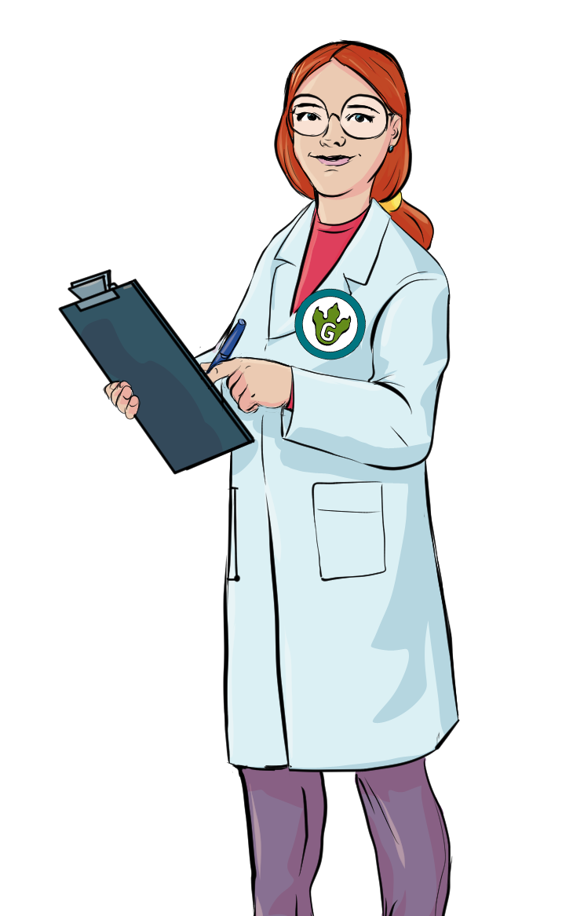


Thinking Time…
1
What do you already know about forces and magnets?
d Magnets
Forces an
Forces a
nd Magnets
You could think about:
- what forces are
- examples of forces
- what a magnet is
- what we use magnets for
www.grammarsaurus.co.uk

Slide 57

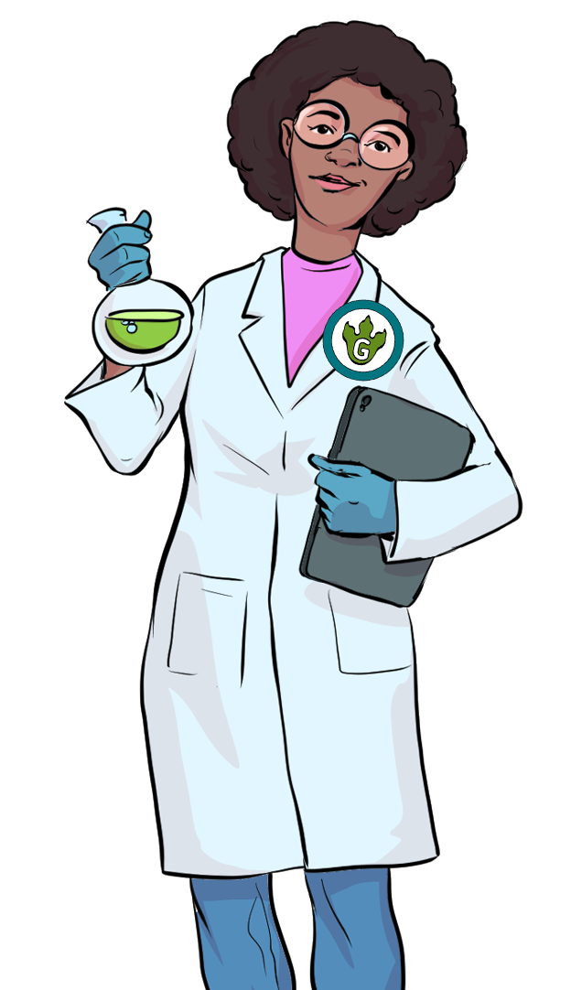
How can we make it move?
2
On your tables, you have a variety of different objects.
Your task is to investigate how we make them move. Write keywords on your whiteboard to explain.
Glue stick
Pens
Books
Rubber
www.grammarsaurus.co.uk

Slide 58



How can we make it move?
3
What did you have to do to make the different objects move?
Could you make the objects move in different ways?
Were any forces involved?
Discuss with your table before we discuss it as a class.
www.grammarsaurus.co.uk

Slide 59

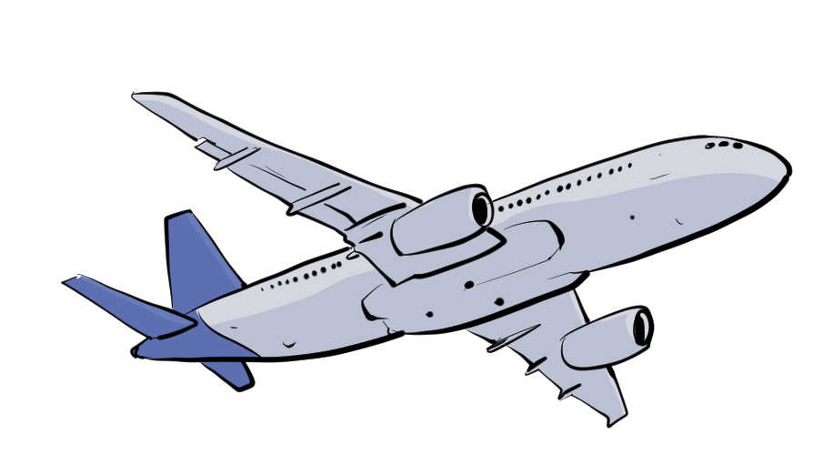
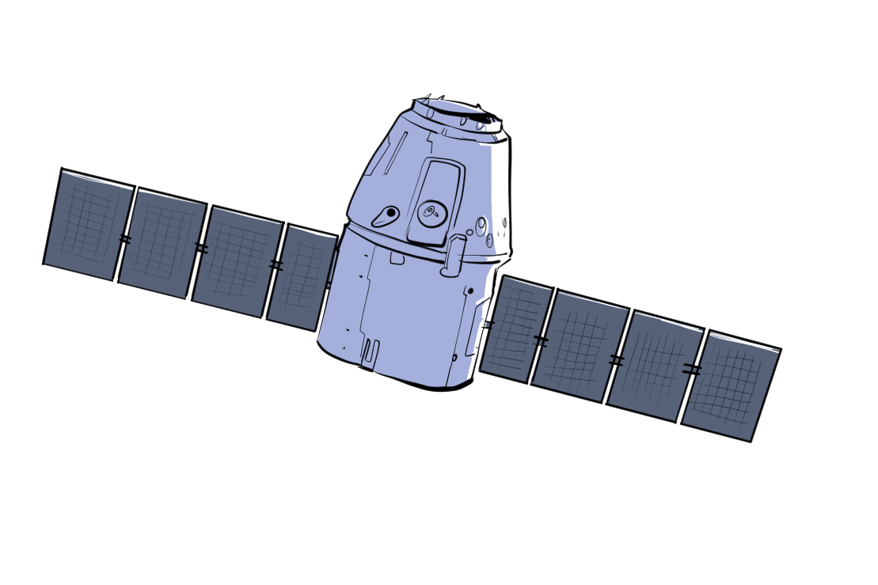
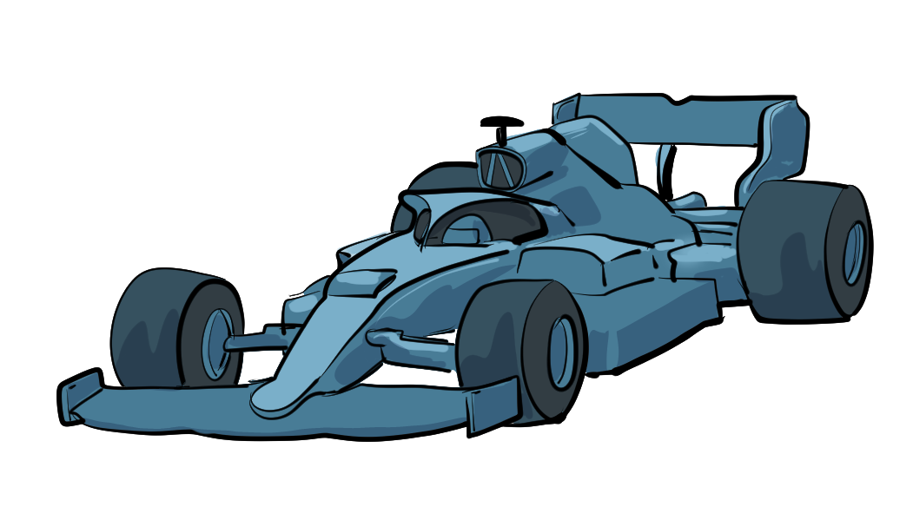

Force
4
We can't see forces, but they are an important part of our everyday lives.
Forces are acting on us all the time!
Forces act on us when we drive to school or fly on holiday.
Because human beings have a good knowledge of forces, we can build houses that don’t fall down and chairs that don’t collapse. It enables us to launch satellites into orbit that can beam television signals around the world and map the planet from space!
Simple forces are pushes and pulls.
www.grammarsaurus.co.uk

Slide 60

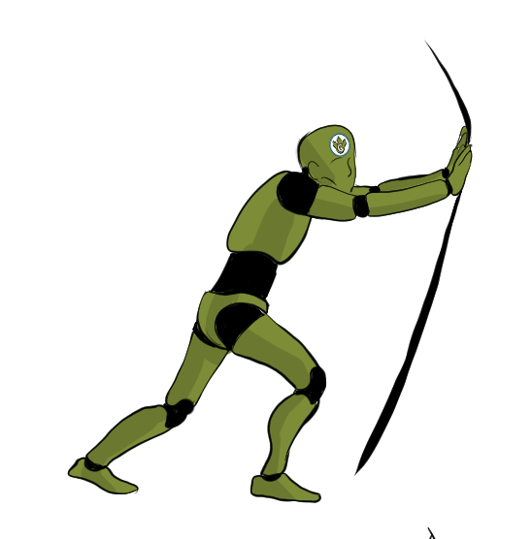
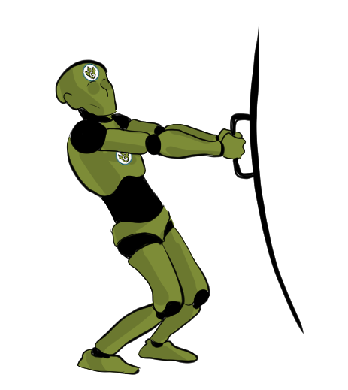


Simple Forces
5
We looked at simple forces like pushes and pulls.
We push and pull objects to do many different things. When we push or pull objects, we can move the object, change the shape of the object or make the object change direction.
Pushes and pulls require contact between two objects.
For example, to push a door, you must put your hand on it and push. There is contact between the door and your hand. However, some forces can work without any contact from a distance.
push
pull
Can you think of any examples?
www.grammarsaurus.co.uk

Slide 61

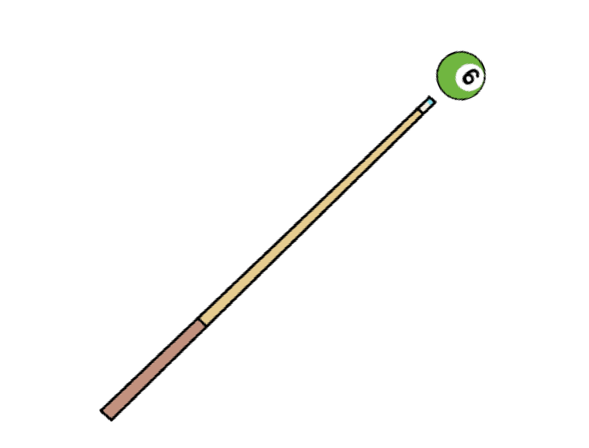
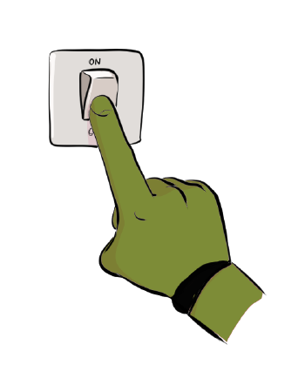
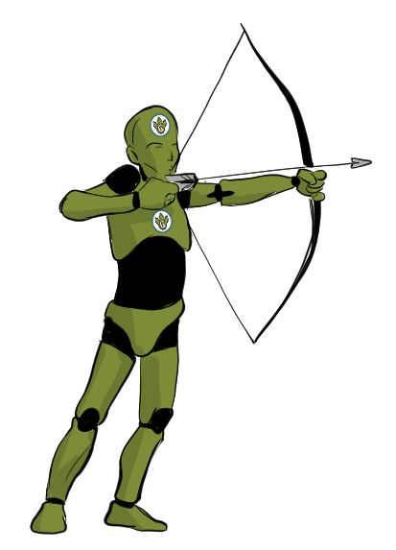
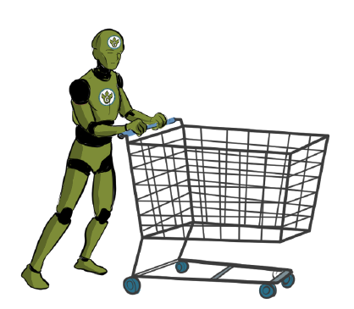
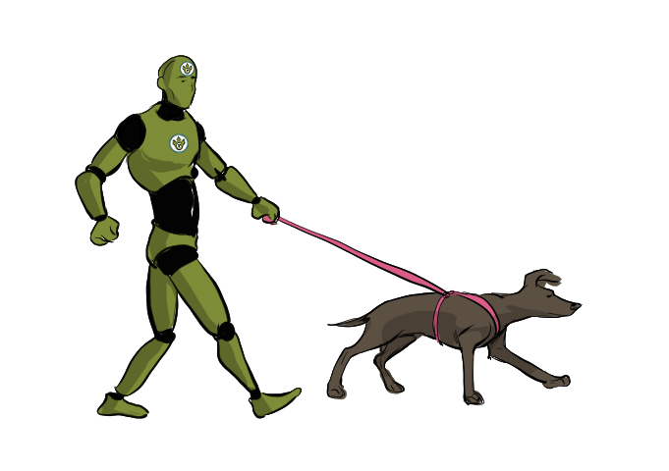
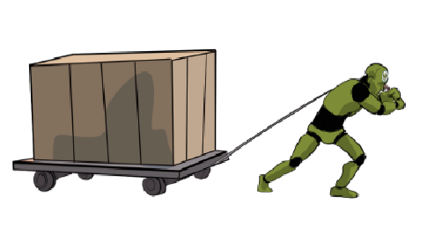

Partner Sorting Activity
6
With your partner, sort these actions into push or pull.
push | pull
www.grammarsaurus.co.uk

Slide 62


Independent Activity
8
You are now going to sort the different objects that we moved earlier and on the push and pull slide.
Think about how the objects moved and how much force you needed or think you would need to make them move.
www.grammarsaurus.co.uk

Slide 63
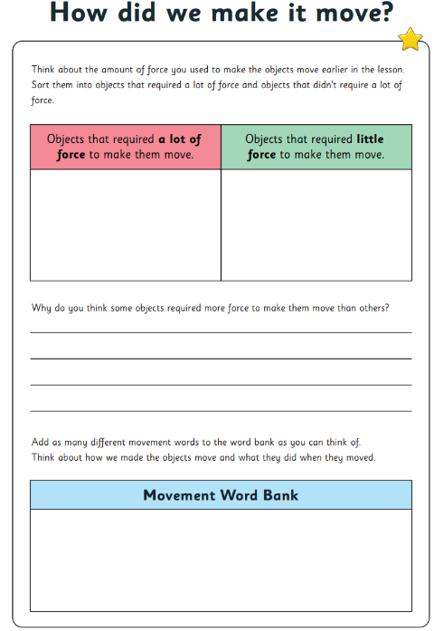
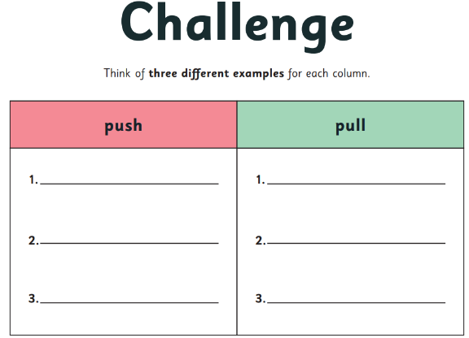
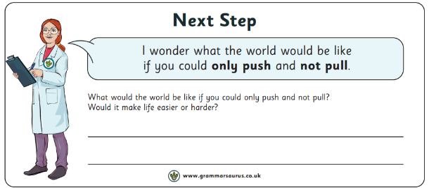

Slide 64
Thursday 27th February
PSHE
TBAT: understand that everyone's likes and dislikes are different
We are going to turn the left side of the classroom into the like side, we are going to turn the right side of the classroom into a dislike side.
I am going to read out some things, you have to pick whether you like or dislike these by picking a side of the classroom.
Items on next slide.

Slide 65
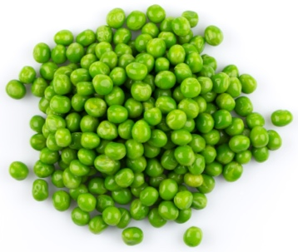
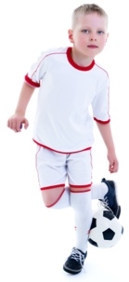
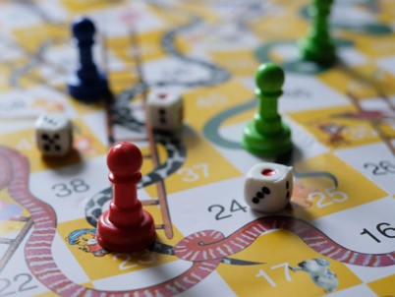
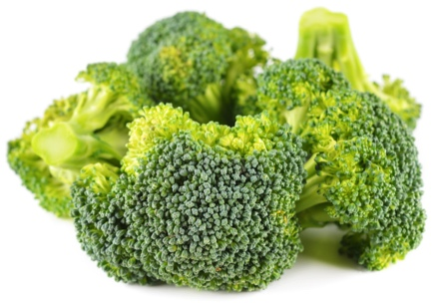
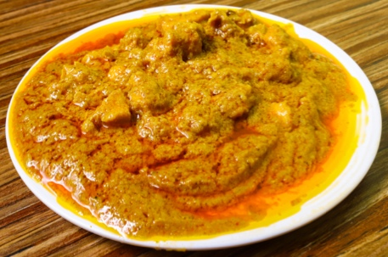
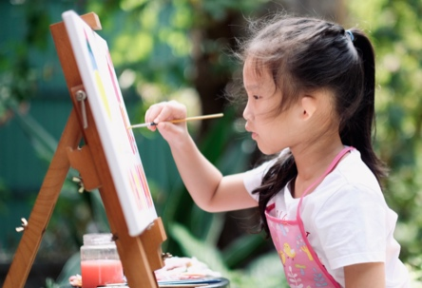
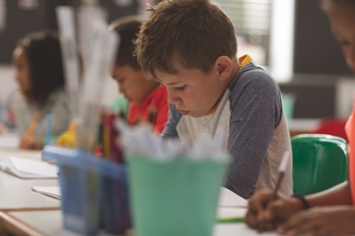
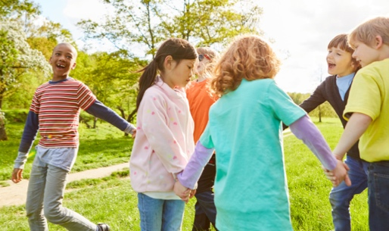
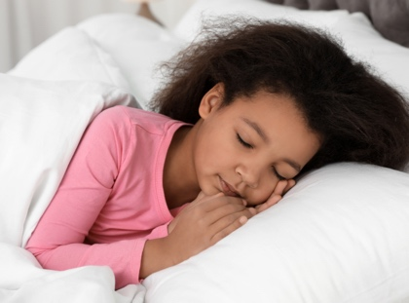
Like or dislike?
Peas
Football
Board games
Broccoli
Chicken curry
Painting
Spelling tests
Dancing
Sleep
Notes:
Ask pupils to stand in the middle of the room. Label one side of the room ‘Like’ and the other ‘Dislike’. Then read each of the items on the slide in turn and ask pupils to stand on the appropriate side of the room. Encourage them to really think about what they like/dislike, rather than just following their friends. Add extra ideas to the game to suit your class.

Slide 66
Your favourite things
Write or draw your favourite
Place
Food
Once you've done this write 5 words that either eating this food or being in this place makes you feel
Think of all the super adjectives and describing words you have in your vocabulary
Notes:
Encourage pupils to write or draw things which are personal to them, rather than conferring with peers or friends. The activity is designed to get them to think carefully about their own preferences. How do they feel when they think about their favourite things?

Slide 67
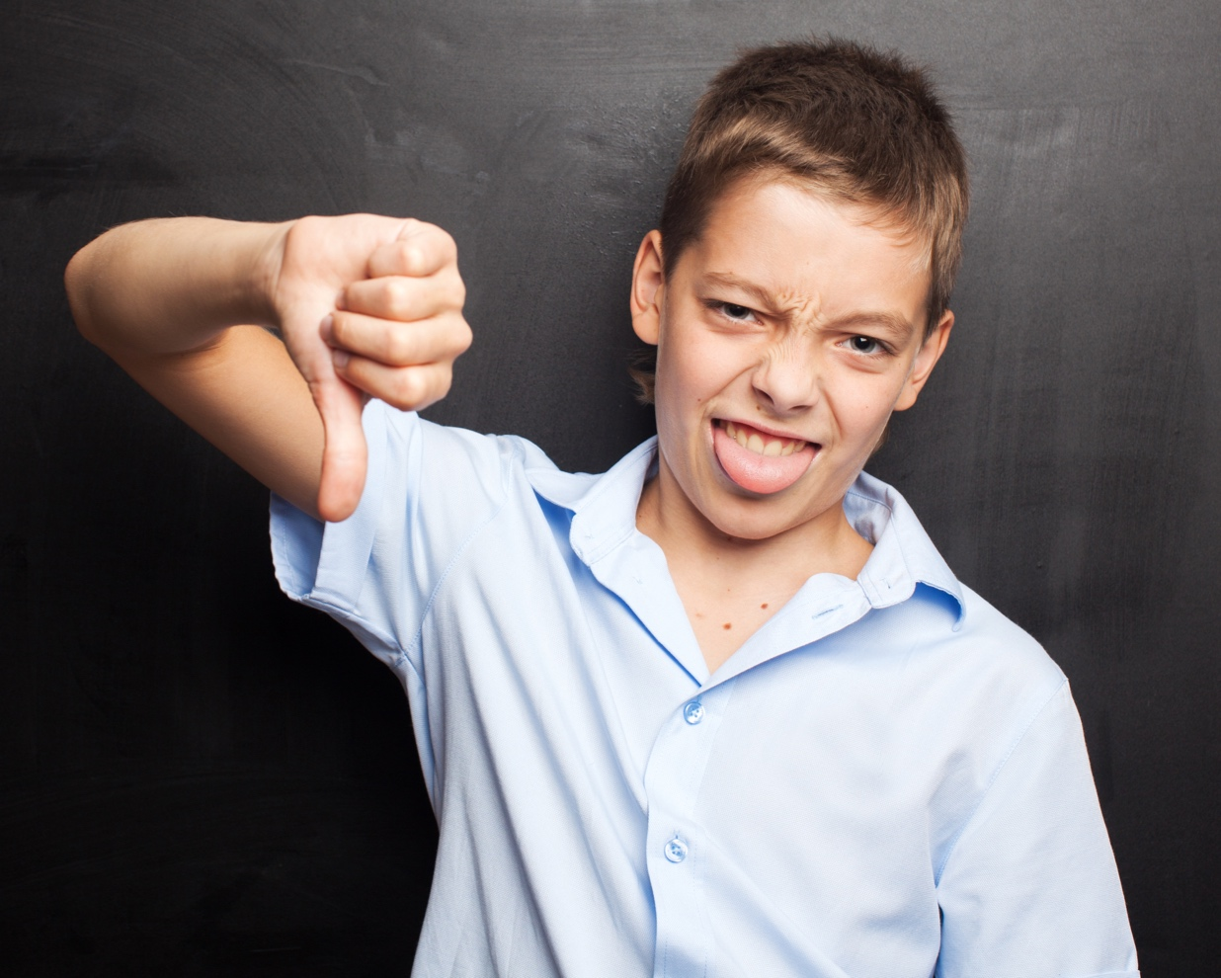
Your favourite things
Write or draw your favourite
Food
Sport
Once you've done this write 5 words that either eating this food or playing this sport makes you feel
Think of all the super adjectives and describing words you have in your vocabulary
Notes:
Encourage pupils to write or draw things which are personal to them, rather than conferring with peers or friends. The activity is designed to get them to think carefully about their own preferences. How do they feel when they think about their favourite things?

Slide 68
Things in common
Share some of the likes and dislikes in the classroom
Can someone give me an example of something they really like or dislike.
We can then see who agrees and who disagrees with your opinion.
Remember no one is right or wrong!
Notes:
Ask pupils to look at the work they have done and find peers within the class who have the same or similar likes or dislikes as them. They should form pairs or groups based on common likes or dislikes. Are they surprised at the things they have in common with others or are there some likes and dislikes which aren’t common?

