Slide 1
Check your answers
Walking through the forest near his home, Mark could smell the wonders of spring in the air with wild flowers starting to bloom and pine needles heavy with rain.

Slide 2
Structure
The structure of your sentence is extremely important and should always be remembered when writing.
A sentence should start with a capital letter and finish with a full stop.
The man walked his dog to the park.
capital letter
full stop

Slide 3
Structure
To make your writing flow, some of your sentences should contain conjunctions. Coordinating conjunctions join two main ideas together.
for, and, nor, but, or, yet, so
This afternoon I am going shopping and I am going to post some letters.
co-ordinating conjunction

Slide 4
Structure
To make your writing flow, some of your sentences should contain conjunctions. Subordinating conjunctions add new information to a main clause.
even though, because, when, after, although, if
Jeremy ran to the shops after hearing that there was a sale on.
subordinating conjunction

Slide 5
Your turn
Extend the sentences below using a conjunction.
for, and, nor, but, or, yet, so
even though, because, when, after, although, if
Emmanuel ran to the shops…
I heard something smash…
The cat climbed the tree…

Slide 6
Check your answers
Examples:
Emmanuel ran to the shops because he had run out of milk.
I heard something smash so I went downstairs to investigate.
The cat climbed the tree but was scared to climb down.

Slide 7
Stamina
Stamina is the ability to sustain prolonged physical or mental effort.
We often hear about athletes having stamina for their sport, especially long-distance runners who have to use their energy carefully in order to finish their race. A runner will practise running a lot before a race in order to have good stamina.

Slide 8
Stamina
Writing stamina is the ability to focus and write independently for extended periods of time without becoming distracted or giving up. Just like running, it requires practice. Over time, your stamina for writing will improve and you will be able to write more and more without stopping.

Slide 9
Body posture
Sitting with a good posture for writing will make you feel more stable and sturdy. It can also increase your attention and focus.

Slide 10
Your turn
Follow these instructions in order to achieve good posture for writing:
Sit at your desk with your feet firmly on the ground.
Your body should be fully facing your table.
Place your forearms on the table with your elbows level with, but not on top of, the table.
Keep your back straight. Incline your back forwards; avoid rounding your back (slouching).
Have a go at picking up a pencil and writing a few words down. It might feel strange at first!

Slide 11
Generating ideas
Generating ideas before writing is a great way to help you write for a longer period of time because it means you have plenty of things to write about. You could use bullet points to make a list or draw a mind map.

Slide 12
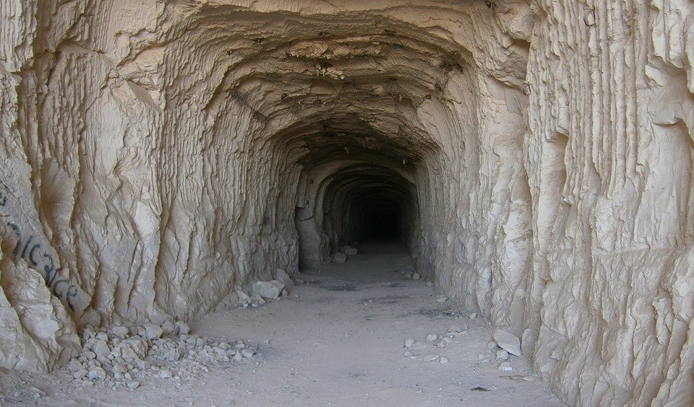
Visual prompts
Visual prompts such as pictures can be helpful as they can stimulate the creative part of your brain. Having a visual stimulus can help you to visualise something more easily, resulting in more ideas and, therefore, more things to write about.

Slide 13
Your turn
How could this picture of a cave be used to generate ideas for writing?

Slide 14
How did you do?
Examples:
A setting description about a dark, gloomy cave.
An adventure story where the hero saves someone who is trapped in a cave.
A mythical creature could live in this cave.

Slide 15
Targets
An empty page can seem daunting at first.
Give yourself a personal target to ensure you write for a sustained period of time. You can choose between writing for a certain amount of time or reaching a certain line on your page.
Ask your teacher for help if you’re not sure which target you should start with. Over time, increase your stamina by creating more challenging targets.

Slide 16
Your turn
At the moment, how much can you write without stopping or wanting to give up? Can you write a certain amount of sentences or for a certain amount of time?
With your teacher, agree on a target that you will strive to achieve in your writing lessons. How will your target increase from week to week?

