Slide 1
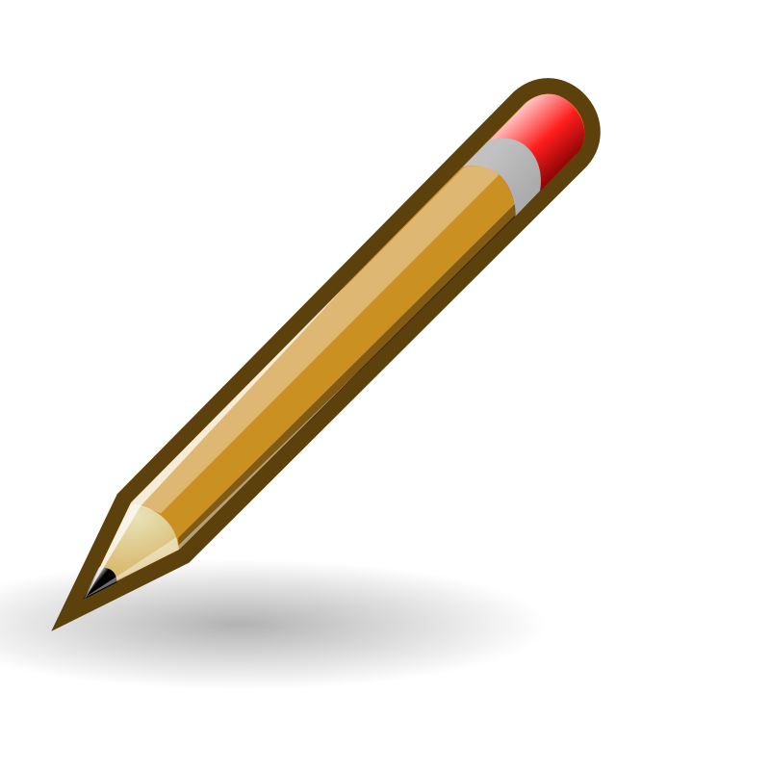
Mental methods
Choosing an appropriate strategy for division
We can solve this mentally using our division and multiplication facts
30 ÷ 5 = 6
6 x 2 = 12
$\frac{2}{5}$ of 30 =
We have solved this calculation mentally using some jottings to help us remember the steps. The jottings we could make are in green.

Slide 2
Complete these calculations in your book using the mental division method.
Independent – mental division.
60 ÷ 5 =
27 ÷ 3 =
1/5 of 45 =
2/3 of 30 =
3/8 of 72 =
Challenge
I share 56 sweets, from a bag of 100, with 8 friends. How many sweets do we get each?
How many sweets are left?

Slide 3
Wednesday 26th February
Spelling

Slide 4
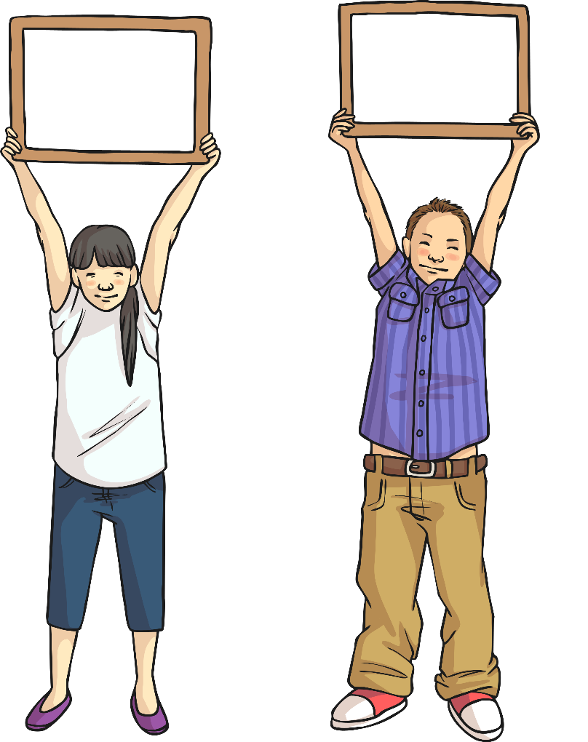
What is a Homophone?
What are homophones?
sea
see
The two words opposite are homophones:
Talk to your partner about what
you think a homophone might be.
Write this down on a whiteboard.
A homophone is…

Slide 5
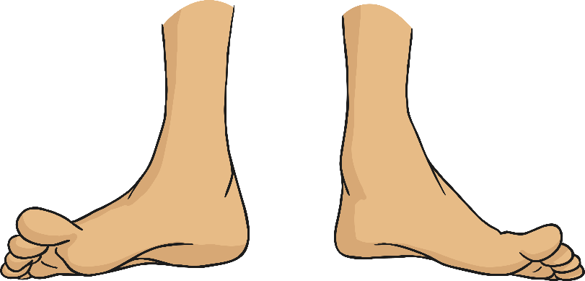
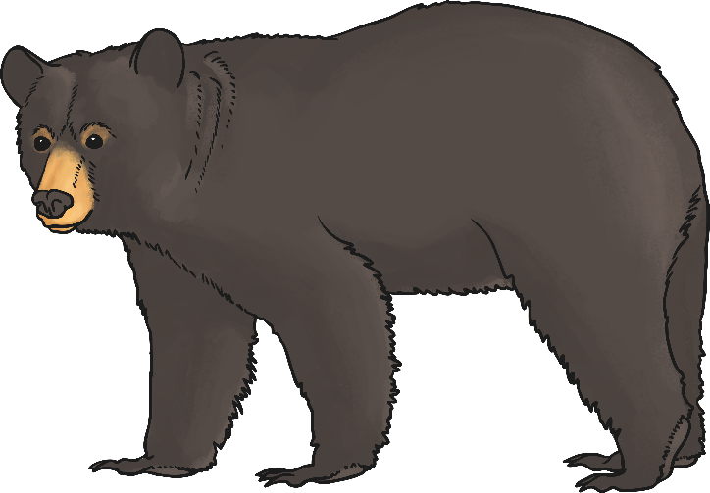
What is a Homophone?
A homophone is a word that sounds the same as another word, but its spelling or meaning is different.
bare
bear

Slide 6
What is a Homophone?
On the next few slides you will need to guess the homophone.
Using whiteboards, test yourself and your partner by choosing the correct homophone.
Good luck!

Slide 7
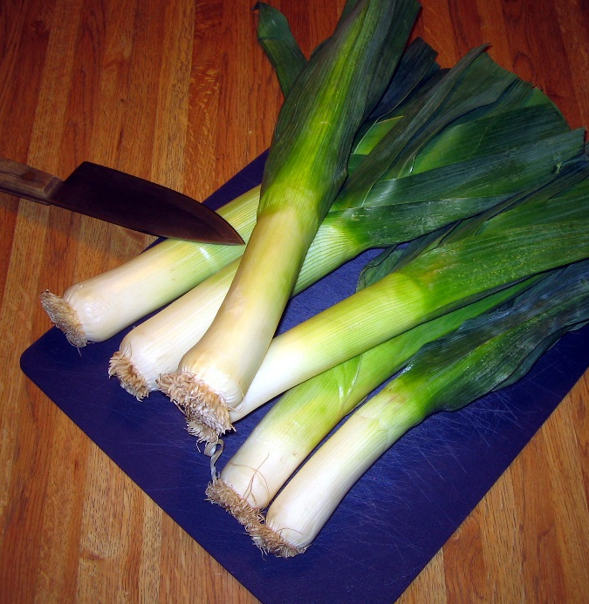
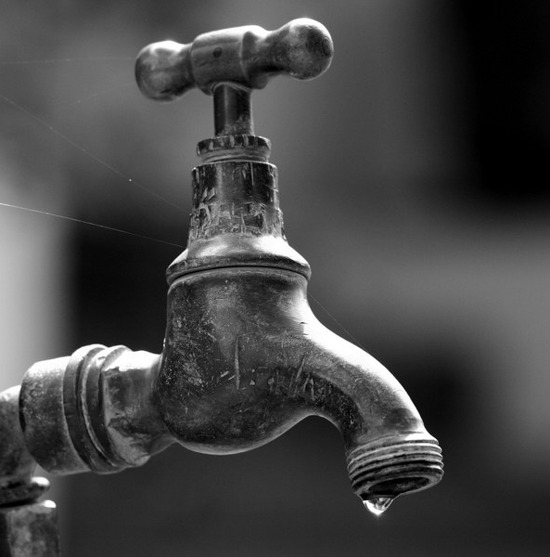
Guess the Homophone
I chopped up a ____ to put in my stew.
The outdoor tap has a ____.
leek
leak
Photos courtesy of karenandbrademerson and Peter Baker @flickr.com) - granted under creative commons licence - attribution

Slide 8
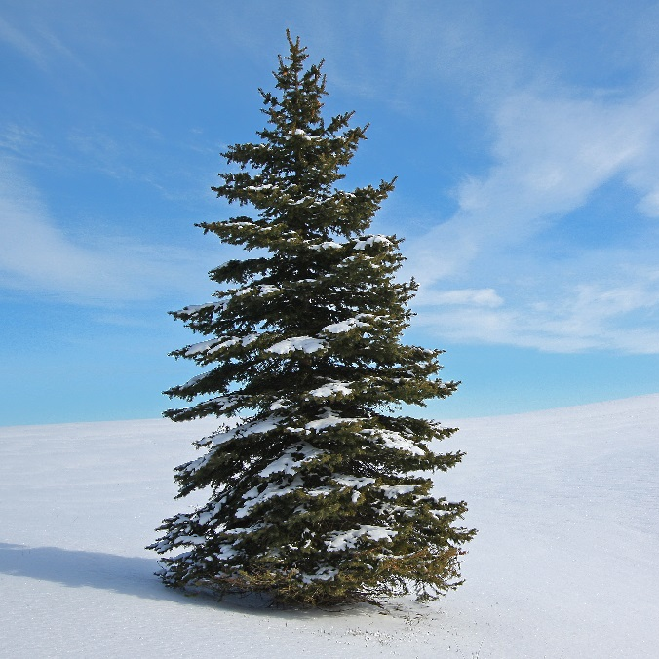
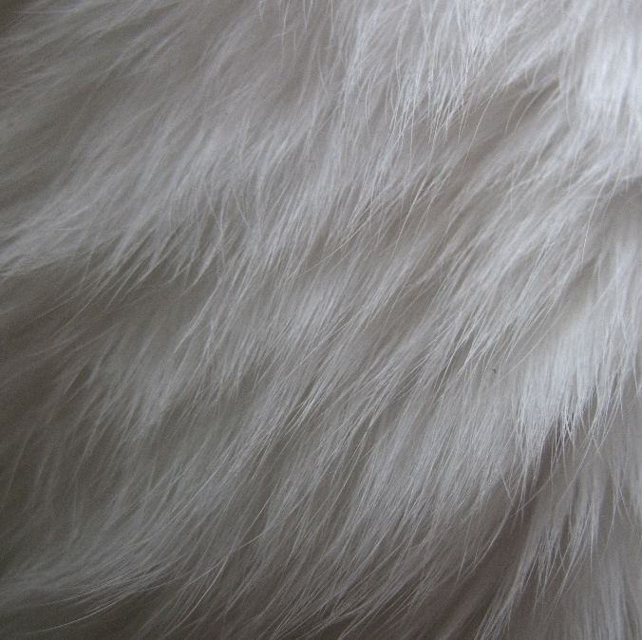
Guess the Homophone
The ___ tree was covered in snow.
My cat has very soft ___.
fir
fur
Photos courtesy of Allen McGregor and calebkimbrough @flickr.com) - granted under creative commons licence - attribution

Slide 9
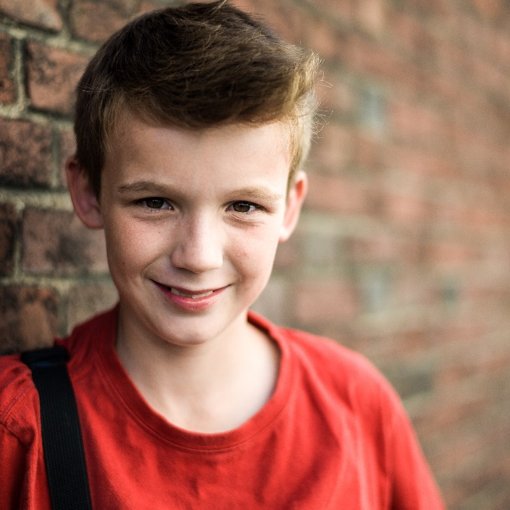
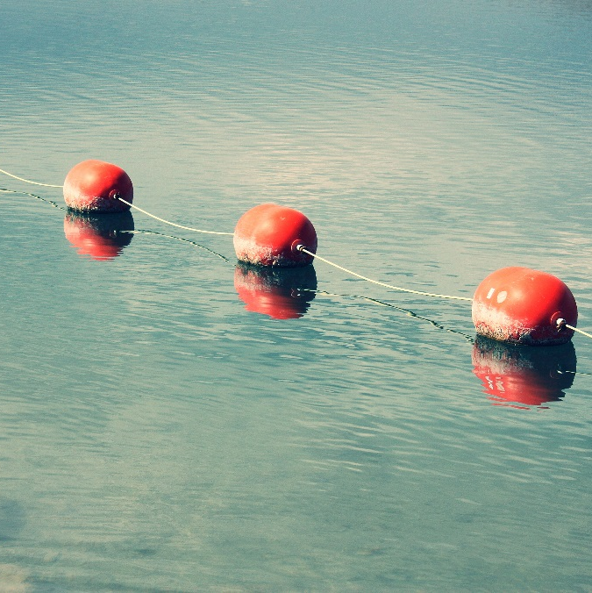
Guess the Homophone
The ___ was very happy.
The ____ bobbed around in the water.
boy
buoy
Photos courtesy of wolfB1958 and timlewisnm @flickr.com) - granted under creative commons licence - attribution

Slide 10
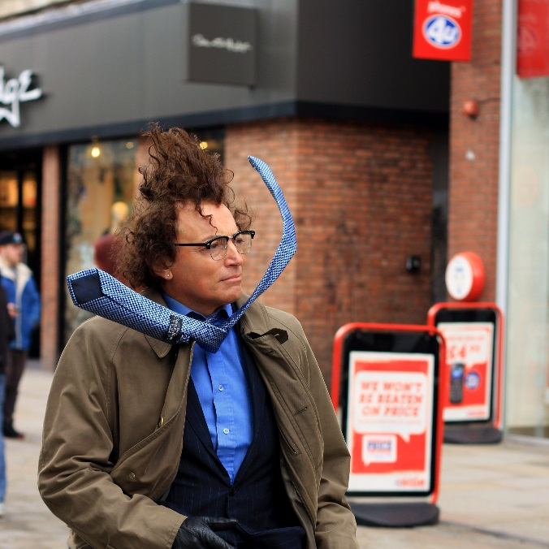
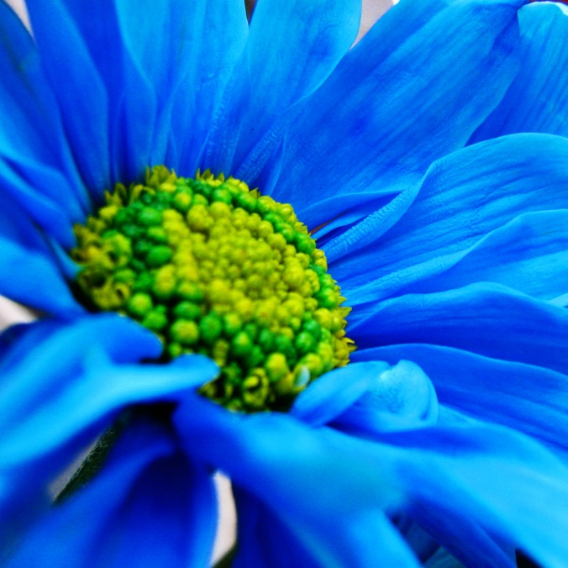
Guess the Homophone
The wind nearly ____ the man off his feet.
The colour of the flower is ____.
blew
blue
Photos courtesy of potzuyoko and Luz Adriana Villa A. @flickr.com) - granted under creative commons licence - attribution

Slide 11
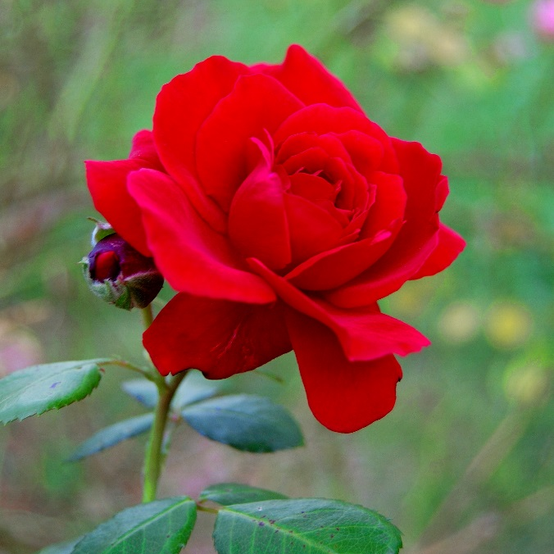
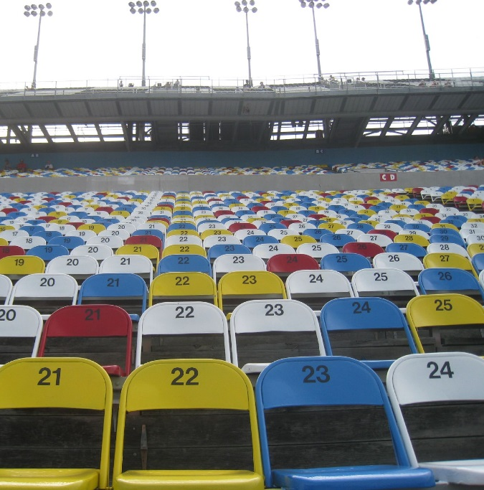
Guess the Homophone
He picked her a beautiful red _____.
The ____ of chairs were all set out for the match.
rose
rows
Photos courtesy of hbunny and sun dazed @flickr.com) - granted under creative commons licence - attribution

Slide 12
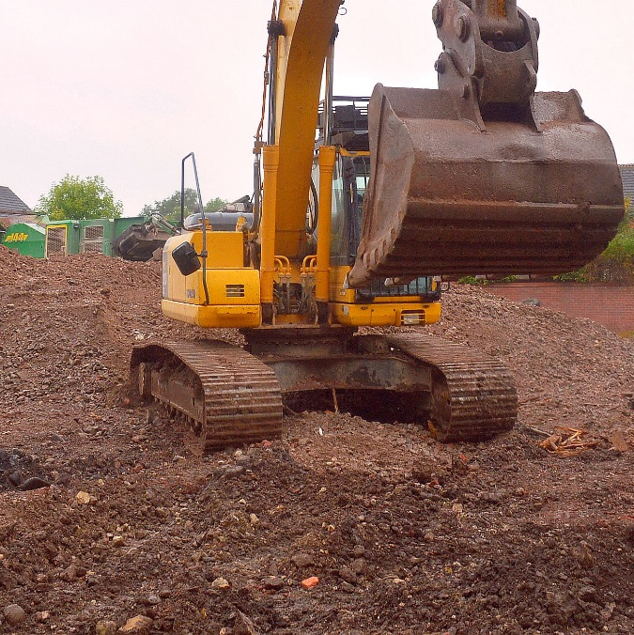
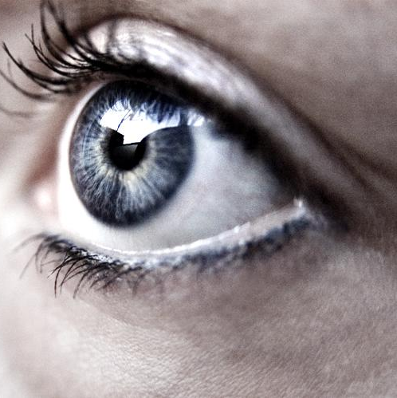
Guess the Homophone
You need to wear a hard hat on the building ____.
She looked around but no one was in _____.
site
sight
Photos courtesy of MICOLO J Thanx 4 675k+ views and helgabj@flickr.com) - granted under creative commons licence - attribution
Photos courtesy of MICOLO J Thanx 4 675k+ views and helgabj@flickr.com) - granted under creative commons licence - attribution

Slide 13
Wednesday 26th February 2025
TBAT: write with fluency and stamina
3 in 3
Troy sat on the wall outside the corner shop. Inside, his friends were enjoying the thrill of choosing their sweets. Having only three pence to his name, he knew that there would be nothing that he could afford, so there was no point in even looking. He reached into his pocket and pulled out his feeble collection of coins. Why did they even bother making them if they couldn’t be used to buy anything? He rubbed his thumb over the two pence piece, as if cleaning it up would somehow increase its value. But then something happened that made him rub his own eyes instead.
…pulled out his feeble collection of coins.
What does the word ‘feeble’ mean in this context? Tick one.
not enough sweet shiny too much
2. What did Troy used to rub his two pence coin?
3. What did Troy hope might happen when he rubbed the coin?

Slide 14
Fluency
Writing fluently refers to your ability to write with a natural flow and rhythm.
Writing fluency can be broken down into three skills: handwriting, spelling and structure.

Slide 15
Handwriting
To ensure your handwriting is legible (readable) for your audience you must follow some simple rules.
Letters need to be consistently formed.
Some letters are joined correctly (don’t join capital letters).
Spacing is appropriate to the size of the letters.

Slide 16
Spelling
Writing with few, if not any, spelling mistakes will make your writing more fluent because you will be able to focus on creating interesting sentences. It will also make your writing flow for the reader because they will not have to stop to figure out what a word says.
Always make sure you edit your work for any spelling mistakes.

Slide 17
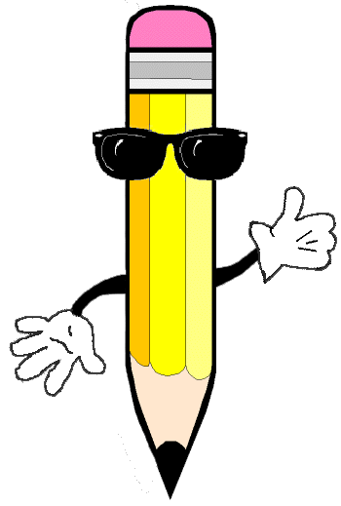
Your turn
Read the paragraph and correct the spelling mistakes.
Waking through the forest near his hom, Mark could smell the wonders of spring in the air wiv wild flowers starting to bloum and pine needles heavy with rayn.

