Slide 1
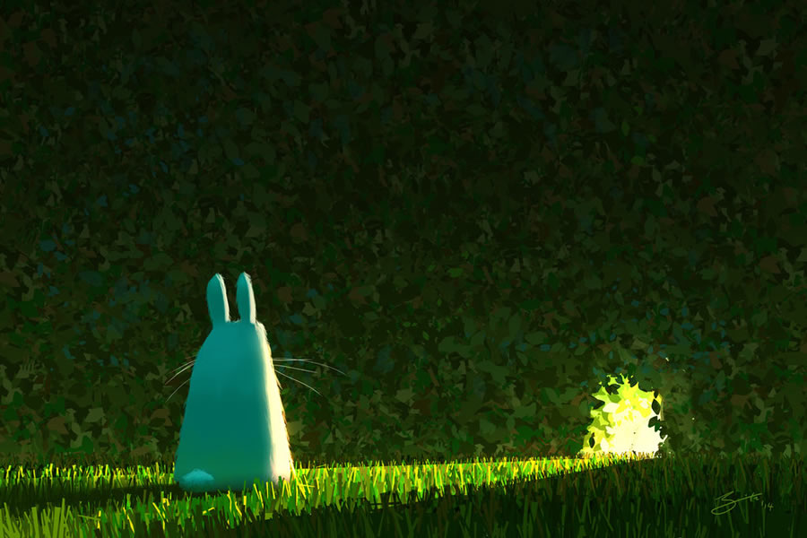
Tuesday 25th February 2025
Morning challenge
Predict
Where does the tunnel lead?
What is the source of the light?
Do you think the rabbit will go through?
Has it been through before?
How did it find out about the tunnel?
Would you go through it?
Write the start of the story.

Slide 2
Tuesday 25th February 2025
Word work

Slide 3
End punctuation

Slide 4
End punctuation

Slide 5
End punctuation

Slide 6
End punctuation
End punctuation must be used to mark the end of every sentence.
You will need to use a full stop, question mark or exclamation mark.
.
?
!

Slide 7
End punctuation
Full stops are usually used at the end of statement or command sentences.
.
I visited my aunt last night.
Go and put on your raincoat.
We should go to the library later because I need to borrow some new books.

Slide 8
End punctuation
A question mark must be used at the end of a question sentence.
?
Where are you going now?
Could you buy some more apples later?
I can ride my bike after I have cleaned my bedroom, can’t I?

Slide 9
End punctuation
An exclamation mark is used at the end of an exclamation sentence.
It can also be used at the end of a statement or command sentence to show that something is shocking/surprising or said with force.
!
What a fantastic time we had!
The floor is completely covered in slime!
Put all of your toys away now!

Slide 10
End punctuation
Sentences can contain the same words but require different end punctuation.
We can go to the park.
Statement
Can we go to the park?
Question
You have got a new bag.
Statement
Have you got a new bag?
Question
Remember: a question sentence must end with a question mark.

Slide 11
Practise
Match each sentence to the most likely end punctuation. Use each punctuation mark only once.
Stone Age people gathered fruits
.
What a long time ago these people lived
?
What tools did people in the Stone Age use
!
Remember: a question sentence must end with a question mark.

Slide 12
How did you do?
Match each sentence to the most likely end punctuation. Use each punctuation mark only once.
Stone Age people gathered fruits
.
What a long time ago these people lived
?
What tools did people in the Stone Age use
!
Remember: a question sentence must end with a question mark.

Slide 13
Practise
Which option must not end in a full stop?
That is an interesting question
Tie the string around the top of the container
Have you finished your work yet
Collect your trainers from the office
Remember: a question sentence must end with a question mark.

Slide 14
How did you do?
Which option must not end in a full stop?
That is an interesting question
Tie the string around the top of the container
Have you finished your work yet
Collect your trainers from the office
Remember: a question sentence must end with a question mark.

Slide 15
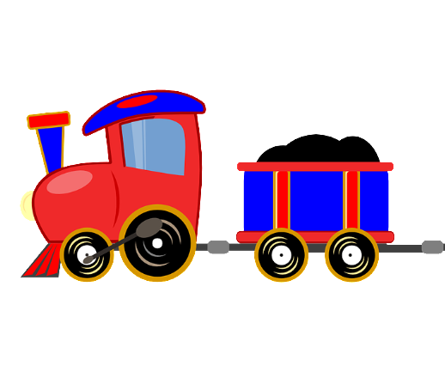
End punctuation
End punctuation helps the reader to pause in the correct places so that the sentences make sense.
E.g. My dad cleaned up Mia played with her toys
This could be confusing!
My dad cleaned up. Mia played with her toys.
This makes sense and is easy to read.

Slide 16
End punctuation
End punctuation can also indicate to the reader that they should change their expression, for example to show that a question is being asked or that something is shocking/exciting.
E.g. Did James fall over Ella said he was screaming
This could be confusing!
Did James fall over? Ella said he was screaming!
This makes sense and indicates to the reader that they should change their expression.

Slide 17
Practise
Which sentence is punctuated correctly?
The fox ran over the road. And into the woods.
We couldn’t carry all the bags. Because they were too heavy.
The shop was closed. Lots of people were waiting outside.
Most of the lights were broken. So it was difficult to see.

Slide 18
How did you do?
Which sentence is punctuated correctly?
The fox ran over the road. And into the woods.
We couldn’t carry all the bags. Because they were too heavy.
The shop was closed. Lots of people were waiting outside.
Most of the lights were broken. So it was difficult to see.

Slide 19
Practise
Insert the missing full stops so that the passage below is punctuated correctly.
The Romans built the first roads in
Britain Roman soldiers used
them to travel around

Slide 20
How did you do?
Insert the missing full stops so that the passage below is punctuated correctly.
The Romans built the first roads in
Britain. Roman soldiers used
them to travel around

Slide 21
Practise
Insert the missing full stop and question mark so that the passage below is punctuated correctly.
Would you like to come with us to
Ashford Park Jenny is planning
to bring her new football
Remember: a question sentence must end with a question mark.

Slide 22
How did you do?
Insert the missing full stop and question mark so that the passage below is punctuated correctly.
Would you like to come with us to
Ashford Park? Jenny is planning
to bring her new football.
Remember: a question sentence must end with a question mark.

Slide 23
25.02.25
Times tables
3 Times Table Song (Green Green Grass by George Ezra)
3 x table loop cards

Slide 24
25.02.25
TBAT: choose an appropriate strategy for addition and subtraction.
3 in 3
345 + 364 =
464 - 101 =
How many days in a year?
Challenge
I use 46cm of ribbon from a 1 metre roll. How much ribbon do I have left?

Slide 25
25.02.25
TBAT: choose an appropriate strategy for addition and subtraction.
Daily 10 - Mental Maths Challenge - Topmarks

Slide 26
Choosing an appropriate strategy
When solving calculations, we have a choice of strategies:
Mental methods
Mental methods with jottings (notes) to help us
Formal written methods
How do we decide which one to use?
We need to be able to do the calculation efficiently (quickly), especially in tests but, at the same time, make sure we are accurate.
Efficiency versus accuracy

Slide 27
Mental methods
Choosing an appropriate strategy for addition
We have to ADD 732 and 101.
732 + 101 =
Read the calculation. Look at the sign and be confident that you understand what you need to do.
We now need to decide how to solve this calculation using an appropriate strategy.

Slide 28
Mental methods
Choosing an appropriate strategy for addition
It is very important to look at a calculation and decide if we can do it mentally in our head or with some jottings. We should always consider this before using a written method.
732 + 101 =
We can solve this calculation mentally.
Talk partners - Discuss how this could be solved.

Slide 29
Mental methods
Choosing an appropriate strategy for addition
Say both numbers to your partner.
Hundreds | Tens | Ones
7 | 3 | 2
Hundreds | Tens | Ones
1 | 0 | 1
Both numbers are 3-digit numbers, but we can still solve this calculation mentally.
101 is very close to 100. Let’s add 100 to 732.
732 + 100 = 832
But we must not forget the extra one that we haven’t added yet.
832 + 1 = 833
Notes:
Children should use Base Ten apparatus and number lines if they are not confident with adding 10s and 100s to any 2 or 3-digit number.

Slide 30
Mental methods
Choosing an appropriate strategy for addition
We have to ADD 653 and 70.
653 + 70 =
Read the calculation. Look at the sign and be confident that you understand what you need to do.
We now need to decide how to solve this calculation using an appropriate strategy.

Slide 31
Mental methods
Choosing an appropriate strategy for addition
Discuss with your talk partner: why would we use a mental strategy for this calculation?
653 + 70 =
We can solve this calculation mentally.
Talk partners - Discuss how this could be solved.

Slide 32
Mental methods with jottings
Choosing an appropriate strategy for addition
Say both numbers to your partner.
Hundreds | Tens | Ones
6 | 5 | 3
Hundreds | Tens | Ones
 | 7 | 0
Look at the number 653. We need to add 70 or 7 tens to this number.
653 has 5 tens, so we need 5 more tens to make a hundred because 50 + 50 = 100.
70 has 7 tens, so let’s partition the number into 5 tens and 2 tens or 50 and 20.
Notes:
Children should use Base Ten apparatus and number lines if they are not confident with adding 10s to any 2 or 3-digit number.

Slide 33
Mental methods with jottings
Choosing an appropriate strategy for addition
Hundreds | Tens | Ones
6 | 5 | 3
Hundreds | Tens | Ones
 | 7 | 0
Let’s add the 5 tens or 50 to 653 first: 653 + 50 = 703
Don’t forget, we still need to add 2 tens or 20.
703 + 20 = 723
Note: we have still solved this calculation mentally but we could jot down some numbers so we do not have to remember all the steps. The jottings we could make are in green.
Notes:
Children should use Base Ten apparatus and number lines if they are not confident with adding 10s to any 2 or 3 digit number.

Slide 34
Complete these calculations in your book using the mental addition method.
Independent – mental addition
236 + 40 =
155 + 70 =
345 + 101 =
683 + 202 =
Challenge
I have 25 marbles and my friend has 40 marbles. How many more marbles do we need to make 100 marbles?

Slide 35
Written methods
Choosing an appropriate strategy for addition
Talk partners
Why would we use a written strategy for this calculation?
563 + 367 =
This calculation would be difficult to solve mentally without making a mistake. We could use a written method.

Slide 36
Written methods
Choosing an appropriate strategy for addition
We have to ADD 563 and 367.
563 + 367 =
Read the calculation. Look at the sign and be confident that you understand what you need to do.
We now need to decide how to solve this calculation using an appropriate strategy.

Slide 37
Written methods
Choosing an appropriate strategy for addition
This time let's put our numbers underneath each other in a HTU chart.
Hundreds | Tens | Ones
5 | 6 | 3
Hundreds | Tens | Ones
3 | 6 | 7
Let’s add the ones first: 7 + 3 = 10
Now, let’s add the 10s:
60 + 60 + 10 = 130
Our answer is 930
9
3
0
Now, let’s add the hundreds:
500 + 300 + 100 = 900
1
1
Notes:
Children should use Base Ten apparatus and an expanded method initially until they are confident with adding using the formal method.

Slide 38
Complete these calculations in your book using the written addition method.
Independent – written addition
236 +487 =
155 + 867 =
478 + 365 =
345 + 675 =
Challenge
I scored 354 points playing my game on Monday. On Tuesday, I scored 479 points. On Wednesday, I scored 234 points.
How many points did I score altogether?

Slide 39
Mental methods
Choosing an appropriate strategy for subtraction
We have to SUBTRACT 50 from 282.
282 - 50 =
Read the calculation. Look at the sign and be confident that you understand what you need to do.
We now need to decide how to solve this calculation using an appropriate strategy.

Slide 40
Mental methods
Choosing an appropriate strategy for subtraction
Say both numbers to your partner.
Hundreds | Tens | Ones
2 | 8 | 2
Hundreds | Tens | Ones
 | 5 | 0
282 has 8 tens or 80. 50 has 5 tens or 50. We can subtract 50 from 80.
80 – 50 = 30 so our answer is 232.
Look at the number line on the next slide if you need to.
Notes:
Children should use Base Ten apparatus and number lines initially if they are not confident with subtracting 10s from any 2 or 3 digit number.

Slide 41
Choosing an appropriate strategy for subtraction
Hundreds | Tens | Ones
2 | 8 | 2
Hundreds | Tens | Ones
 | 5 | 0
- 10
- 10
- 10
- 10
- 10
232
242
252
262
272
282
Notes:
Children should use Base Ten apparatus and number lines initially if they are not confident with subtracting 10s from any 2 or 3-digit number.

Slide 42
Mental methods
Choosing an appropriate strategy for subtraction
Talk partners
Why would we use a mental strategy for this calculation?
609 - 10 =
We can solve this calculation mentally. Discuss how this could be solved.

Slide 43
Mental methods
Choosing an appropriate strategy for subtraction
We have to SUBTRACT 10 from 609.
609 - 10 =
Read the calculation. Look at the sign and be confident that you understand what you need to do.
We now need to decide how to solve this calculation using an appropriate strategy.

Slide 44
Mental methods with jottings
Choosing an appropriate strategy for subtraction
Say both numbers to your partner.
Hundreds | Tens | Ones
6 | 0 | 9
Hundreds | Tens | Ones
 | 1 | 0
609 has 9 ones so we could subtract 9 from 609. 609 – 9 = 600.
But we need to subtract 10, not 9, so we must subtract another 1:
600 – 1 = 599
Look at the number line on the next slide if you need to.
Notes:
Children should use Base Ten apparatus and number lines if they are not confident with subtracting 10s and 100s to any 2 or 3-digit number.

Slide 45
Choosing an appropriate strategy for subtraction
Hundreds | Tens | Ones
6 | 0 | 9
Hundreds | Tens | Ones
 | 1 | 0
- 1
- 9
599
600
609
Notes:
Children should use Base Ten apparatus and number lines if they are not confident with subtracting 10s and 100s to any 2 or 3-digit number.

Slide 46
Complete these calculations in your book using the mental subtraction method.
Independent – mental subtraction
296 + 60 =
185 + 30 =
304 + 10 =
607 + 20 =
Challenge
I have 102 marbles. I give my friend 40 marbles. How many marbles do I have left?

Slide 47
Written methods
Choosing an appropriate strategy for subtraction
Talk partners
Why would we use a written strategy for this calculation?
573 - 238 =
We can solve this calculation using a written method. Discuss how this could be solved.

Slide 48
Written methods
Choosing an appropriate strategy for subtraction
We have to SUBTRACT 238 from 573.
573 - 238 =
Read the calculation. Look at the sign and be confident that you understand what you need to do.
We now need to decide how to solve this calculation using an appropriate strategy.
We could use a written method here to avoid making mistakes.

Slide 49
Written methods
Choosing an appropriate strategy for subtraction
Hundreds | Tens | Ones
5 | 7 | 3
Let’s subtract the ones first. It is hard to calculate 3 – 8 as we will end up with a negative number. We need to take a ten from 70.
6
1
Hundreds | Tens | Ones
2 | 3 | 8
13 – 8 = 5
Now subtract the tens: 60 – 30 = 30
Our answer is 335
3
3
5
Finally, subtract the hundreds: 500 - 200 = 300
Notes:
Children should use Base Ten apparatus and an expanded method initially until they are confident with subtracting using the formal method.

Slide 50
Complete these calculations in your book using the written subtraction method.
Independent – written subtraction
536 - 287 =
855 - 376 =
478 - 284 =
945 - 569 =
Challenge
I collected 246 Pokemon cards. I gave my friend 69 cards. How many cards do I have left?

Slide 51
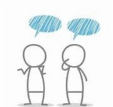
Reasoning – Talk partners
Jody says she would use a mental method to solve 202 – 198 but Tom says he would use a written method.
Who do you think is right?
Explain your answer.

Slide 52
Tuesday 25th February
Spelling

Slide 53
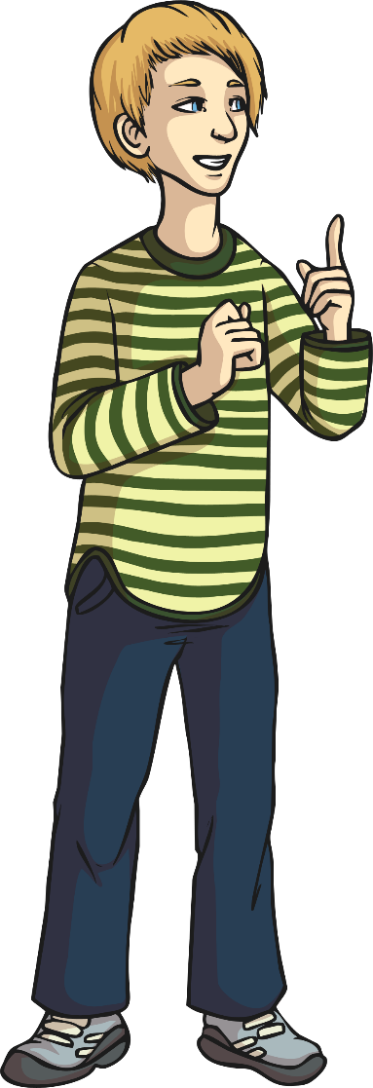
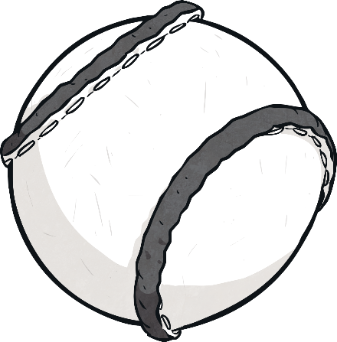
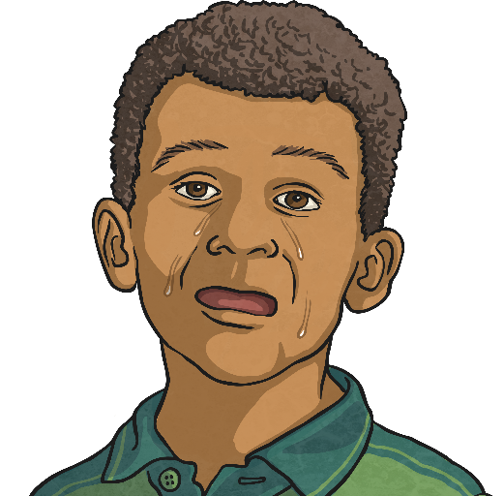
This week, we are going to look at pairs of homophone words. Can anyone remember what a homophone is?
Homophones are words that sound the same, but have different spellings and meanings. Can you spot the homophones illustrated in these two pictures?
ball
bawl

Slide 54
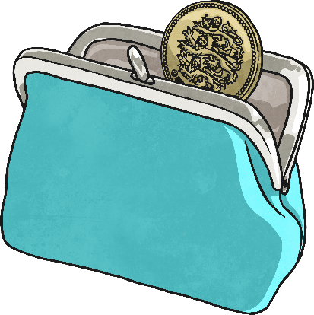
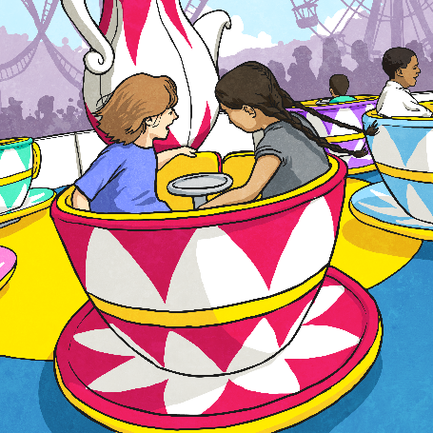
To work out your new spelling words, which are all pairs of homophones, I am going to give you some cryptic clues.
You will need to work with a partner to figure both words out!
For example a cryptic clue might be…
A small fee to enter the theme park
fare
fair

Slide 55
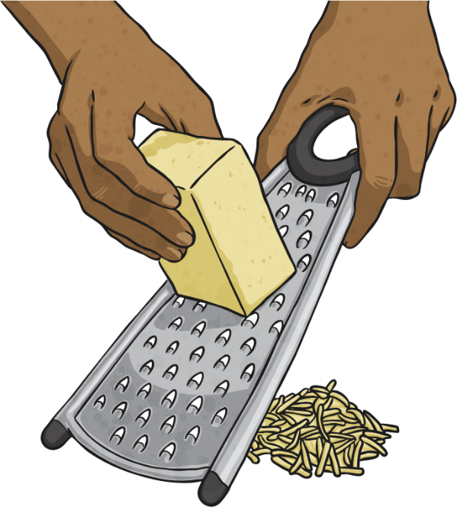
Write down the pair of homophones for…
Cryptic clue 1:
A fantastic way to separate cheese into small pieces.
great
grate

Slide 56
Write down the pair of homophones for…
Cryptic clue 2:
To let out a grunt because you’ve got taller.
groan
grown

Slide 57
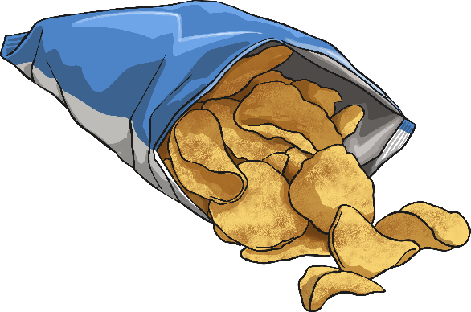
Write down the pair of homophones for…
Cryptic clue 3:
A very simple mode of air travel.
plain
plane

Slide 58
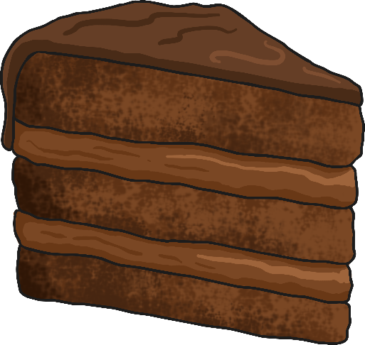
Write down the pair of homophones for…
Cryptic clue 4:
A section of time without war.
piece
peace

Slide 59
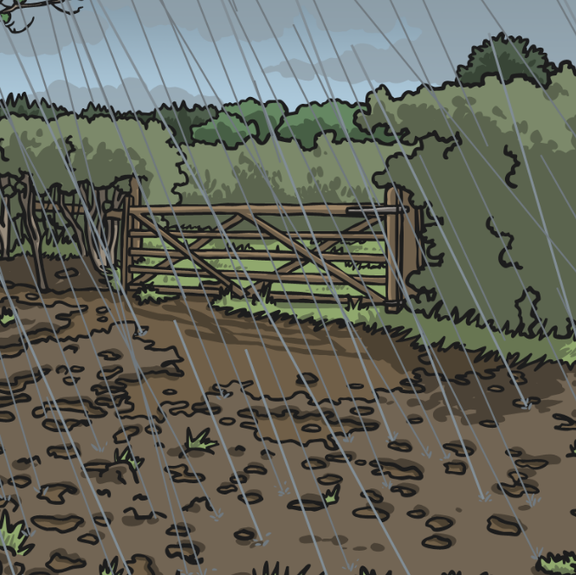
Write down the pair of homophones for…
Cryptic clue 5:
A nasty shower that drenches The Queen on her throne.
rain
reign

Slide 60
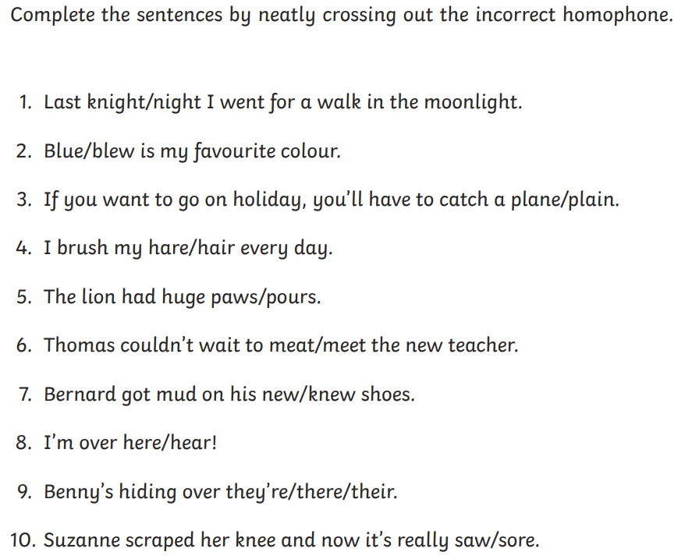
Tuesday 25th February​
Spelling
Ch -
Define what the words or and oar mean.

Slide 61
Tuesday 25th February
TBAT: make inferences about characters' actions in a story based upon evidence from the text.
Troy sat on the wall outside the corner shop. Inside, his friends were enjoying the thrill of choosing their sweets. Having only three pence to his name, he knew that there would be nothing that he could afford, so there was no point in even looking. He reached into his pocket and pulled out his feeble collection of coins. Why did they even bother making them if they couldn’t be used to buy anything? He rubbed his thumb over the two pence piece, as if cleaning it up would somehow increase its value. But then something happened that made him rub his own eyes instead.
What was Troy sitting on?
2. What were Troy’s friends doing?
3. How much money did Troy have?

Slide 62
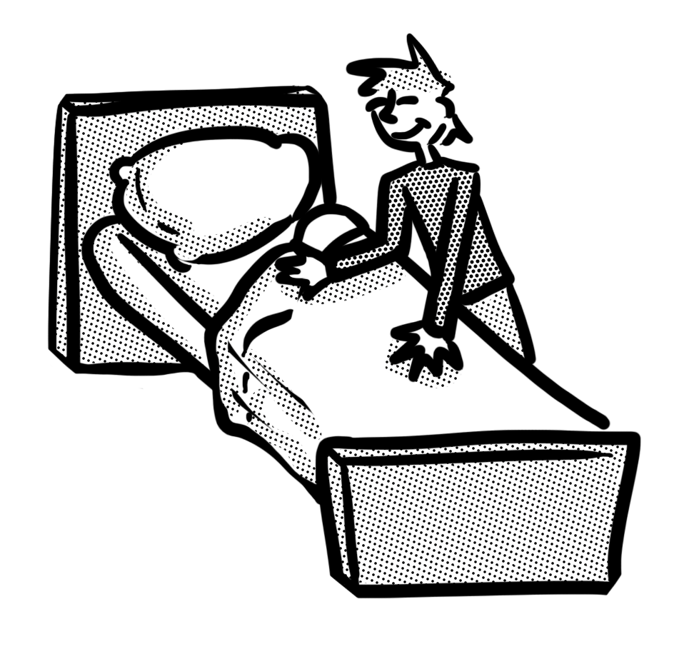
What is inference?
When people write or speak, they rarely tell you everything – and thank goodness. Think about these two sentences:
1. Zak went to bed.
2. Zak got up, walked out of the room and went upstairs.
He changed into his pyjamas, had a wash and cleaned his teeth.
Then, he walked into his bedroom and pulled back his covers. Finally, he slid into his bed and rested his head on his pillow before going to sleep.

Slide 63
What is inference?
Sentence 1 gets straight to the point. It tells you
what you really want to know and assumes that
you can work out the rest.
Sentence 2 might be accurate but you were probably
either bored or annoyed by all the detail.
Sentence 1 expects you to use inference – to fill in the gaps yourself. That means the speaker or writer can focus on the more interesting information.
Other ways of describing inference include:
joining the dots
reading between the lines.

Slide 64
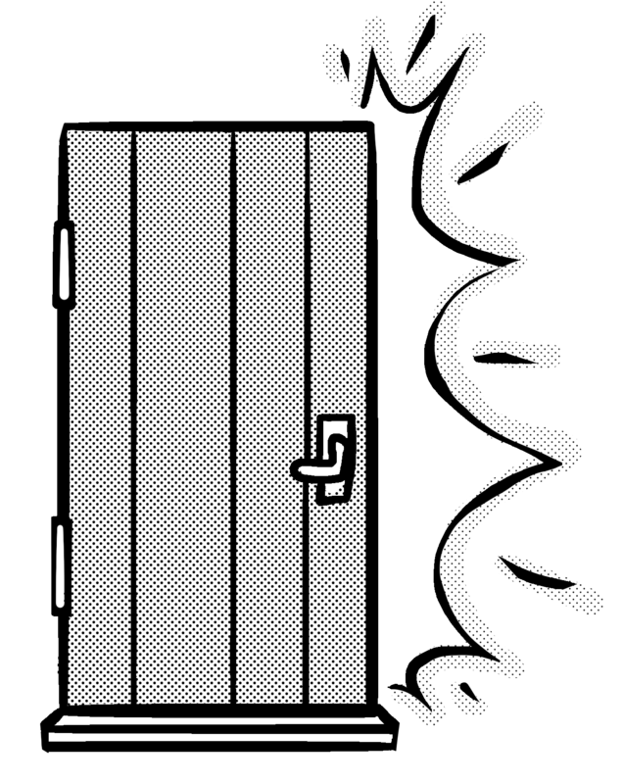
What is inference?
Often, a writer will let you infer the reasons for a character’s behaviour or feelings.
For example, if a character stomps out of the room and slams the door, the author does not need to explain that the character was upset or in a bad mood.

Slide 65
What is inference?
What can you infer about what has happened here?
Dr Jansen looked at the new x-ray and gasped. Then she looked at the old one, just to check. “I’ve got it!” she cried and ran out of the door.
“I’ve got it!” is what people often say when they have worked something out. As this character is a doctor and is looking at an x-ray, we might infer that she has worked out what is wrong with a patient and has run off to tell someone.

Slide 66
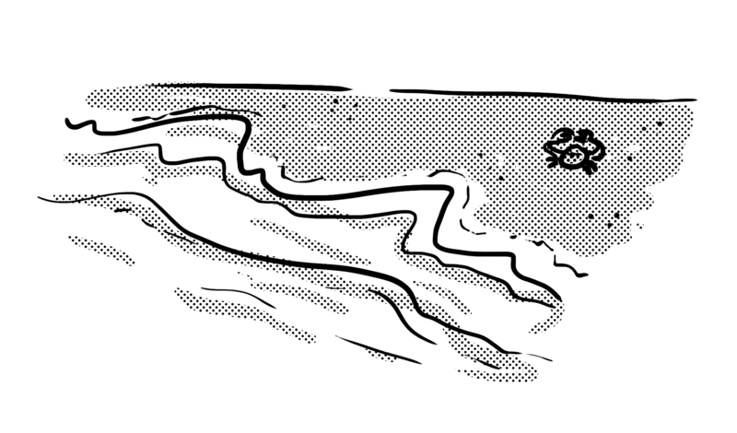
Your turn
Why did Danni scream and run? Click to check.
Danni took another careful step. The water was up to her ankles. Suddenly, an unusually big wave crashed over her. She screamed and ran for her towel, shivering.
Danni is clearly paddling in the sea. Her scream suggests that she was taken by surprise. By describing her as running for her towel and shivering, we can infer that the water was very cold.

Slide 67
Inferring feelings from behaviour
A character’s actions are often driven by what they are feeling. For example, how is the character feeling here?
When she got to the bus stop, she could see that her bus had already left. She kicked the lamp post, howled in pain and then sat down to rub her foot.
First she is feeling angry about missing her bus. That is why she kicked the lamp post. Then she was in pain, which is why she rubbed her foot.

Slide 68
Inferring feelings from behaviour
Infer the character’s feelings from the action.
He sniffed and rubbed his eyes.
He is feeling angry.
He shook his fist at them.
He is feeling tired.
He yawned and stretched.
He was feeling sad.

Slide 69
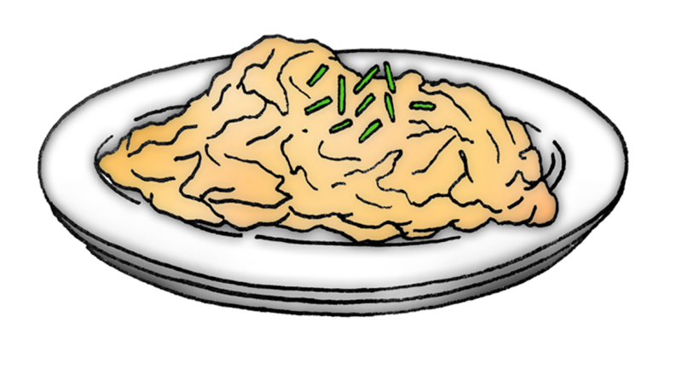
Inferring feelings from behaviour
After taking a couple of mouthfuls, a young child has pushed away the bowl of food he has been given. Which of the following can be reasonably inferred from this behaviour? Discuss how you know.
He is full and doesn’t want any more.
He is really enjoying his meal.
He has tried it and doesn’t like it.
He is so hungry he will eat anything.

Slide 70
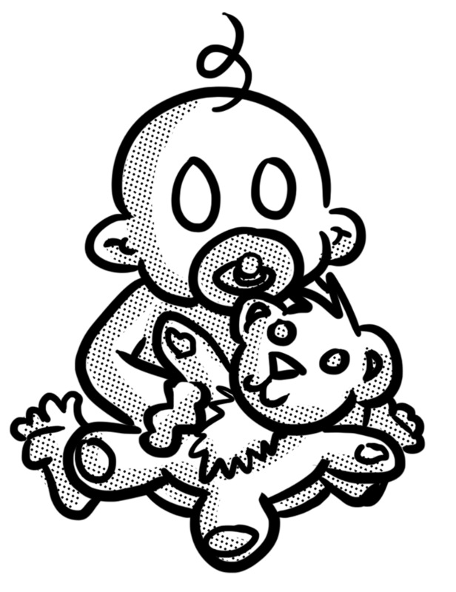
Your turn
Discuss with your group what you can infer from these actions.
After a couple of minutes of swiping through her phone, she burst out laughing.
After reading the letter, she slumped back on to the stairs and buried her head in her hands.
Dad picked up the baby, said, “Ugh!” and held his nose.

Slide 71
Your turn
Read the following text and then answer the questions below. Remember to give evidence from the text to support your ideas. See the next slide to check.
Kelsey just held the brightly wrapped present for a moment. A smile spread across her face. At last, she would have the thing she had always wanted. Not able to wait any longer, she ripped off the paper. For a second, she stared at box.
Then, she burst into tears and stomped out of the room.
1. How was Kelsey feeling before she unwrapped the present?
2. Why did she burst into tears?

Slide 72
How did you do?
Kelsey just held the brightly wrapped present for a moment. A smile spread across her face. At last, she would have the thing she had always wanted. Not able to wait any longer, she ripped off the paper. For a second she stared at box.
Then, she burst into tears and stomped out of the room.
1. How was Kelsey feeling before she unwrapped the present?
Her smile shows she was feeling happy and excited. She was certain she was going to get what she always wanted and was enjoying the moment.
2. Why did she burst into tears?
The tears and stomping suggest she was extremely sad and angry. We can infer that the present was not what she was hoping for so she was very disappointed.

Slide 73
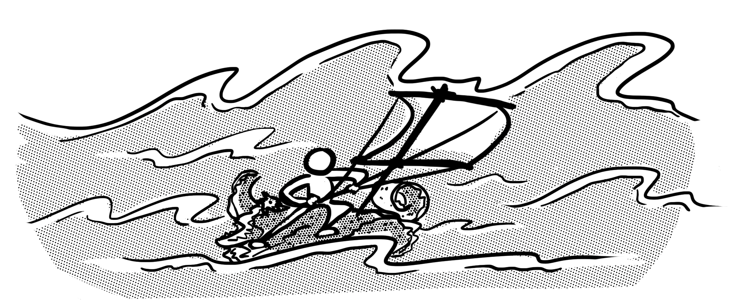
Have another go
Read the following text, then answer the questions below. Remember to give evidence from the text to support your ideas. See the next slide to check.
He was soaked to the skin. His teeth were chattering and his fingers would not stop shaking, making it very difficult for him to tie the ropes. If only he
hadn’t finished all his supplies so quickly. Even a ship’s biscuit or
two would help to calm the rumbling in his belly.
1. How was he feeling?
2. Why did he wish he hadn’t finished all his supplies?

Slide 74
How did you do?
He was soaked to the skin. His teeth were chattering and his fingers would not stop shaking, making it very difficult for him to tie the ropes. If only he
hadn’t finished all his supplies so quickly. Even a ship’s biscuit or
two would help to calm the rumbling in his belly.
1. How was he feeling?
He was cold, wet and hungry. We know because it says he was soaked to the skin and your fingers tend to shake when you are cold. Also, it says his belly was rumbling.
2. Why did he wish he hadn’t finished all his supplies?
He really wanted something to eat. We can tell he was very hungry because his tummy was rumbling but he didn’t even have a single biscuit left from the supplies he once had.

Slide 75
Tuesday 25th February 2025
TBAT: Understand pitch through melody and develop a song.
The Collins Hub Educator > Library
Communication – Lesson 1 - Emoticons

Slide 76
Tuesday 25th February 2025 Q – Which countries are in Europe?
Blue Green – How many countries can you name that are in the continent of Europe?
You have 1 minute to discuss.
Challenge – How many continents are there? Can you name them all?

Slide 77
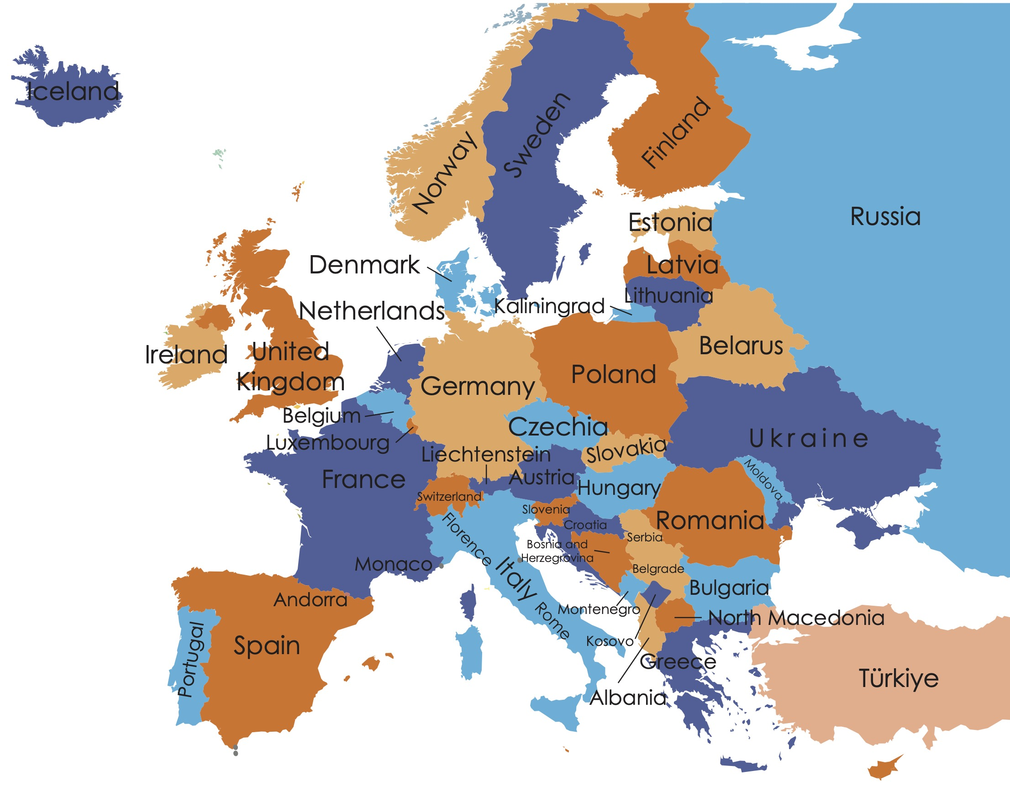
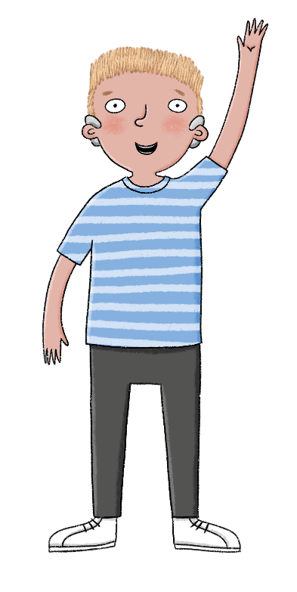
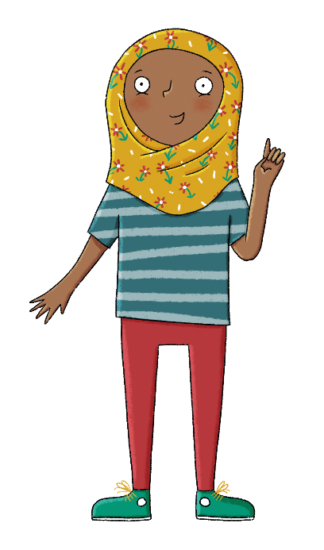
Talk partners
What do you know about Europe?
What would you like to find out?
Lesson 1: Existing knowledge
Copyright © ArkCurriculum+ 2022
Notes:
Gauge pupils’ knowledge of the continent of Europe and the countries that make up Europe.

Slide 78
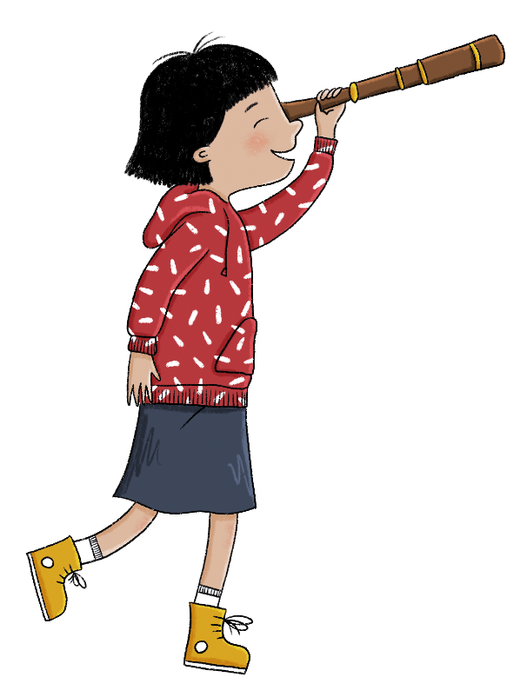
In this lesson, we will learn where Europe is in the world and use an atlas to find the countries in Europe.
Lesson 1: Lesson statement
Copyright © ArkCurriculum+ 2022

Slide 79
Which countries are in Europe?
Key knowledge
A continent is a large section of land that includes more than one country.
Europe is in the Northern hemisphere.
There are over 40 different countries in Europe.
Key vocabulary
continent
country
mainland
Northern hemisphere
transcontinental
Lesson 1: Key knowledge
Copyright © ArkCurriculum+ 2022
Notes:
Share enquiry question ‘Which countries are in Europe and what are they like?’, the Learning journey and specific lesson question, knowledge, and vocabulary.

Slide 80
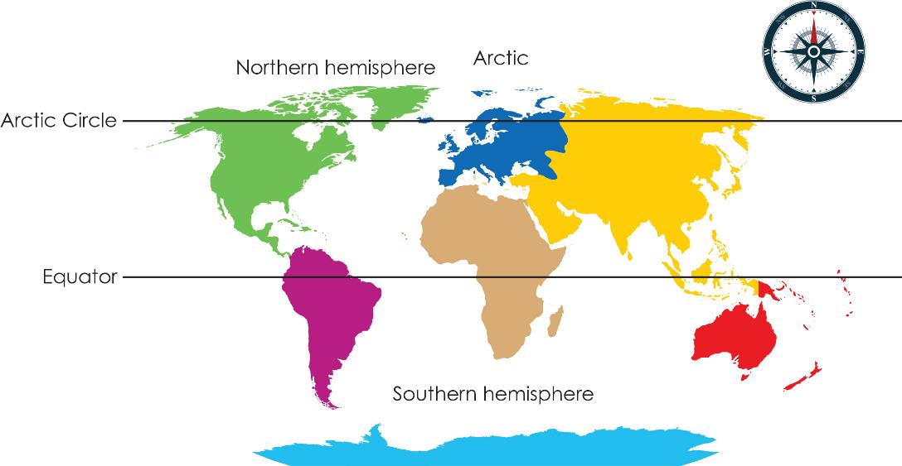
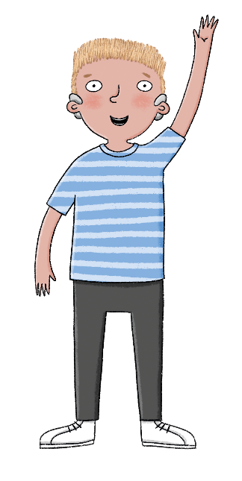
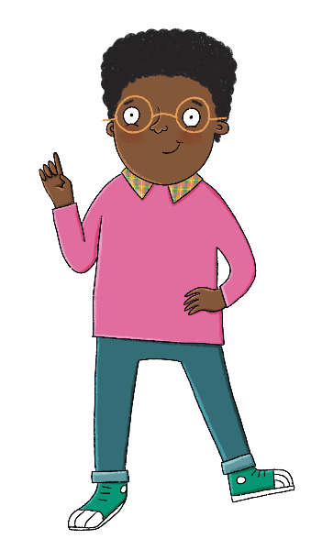
Can you circle the United Kingdom?
Do you remember the names and locations of the continents of the world?
Lesson 1: Talk task
Copyright © ArkCurriculum+ 2022
Notes:
In talk partners, pupils to discuss the names and locations of each of the continents of the world.

Slide 81
Where is Europe?
A continent is a large section of land that includes different countries.
Europe is a continent that is made up of a mainland and many different islands—including the United Kingdom.
Europe is in the Northern hemisphere, between the Equator and the Arctic Circle.
Lesson 1: Read
Copyright © ArkCurriculum+ 2022
Notes:
Read: ‘Where is Europe?’ Explain that Europe is a continent in the Northern hemisphere, and it is the continent that the United Kingdom is located in. Use the maps on the slides to ask pupils questions to check their understanding.

Slide 82
Where in the world is Europe?
Where is Europe?
Directly north of Europe is the Arctic Ocean, and if you travelled further North you would reach the Arctic.
Directly south of Europe is the Mediterranean Sea and the Black Sea. The continents that are South of Europe are Africa and parts of Asia.
To the east, Europe is joined to Asia and to the west, across the Atlantic Ocean, there is North America.
The smaller North Sea, Baltic Sea, and Black Sea also border parts of Europe.
Lesson 1: Read
Copyright © ArkCurriculum+ 2022

Slide 83
Where in the world is Europe?
Where is Europe?
The countries of Europe can be divided into regions based on the four point of a compass:
Northern Europe
Southern Europe
Eastern Europe
Western Europe
Lesson 1: Read
Copyright © ArkCurriculum+ 2022
Notes:
If needed, use the compass to revise compass points, and ask questions about the location in countries in terms of these compass points, again to check understanding.

Slide 84
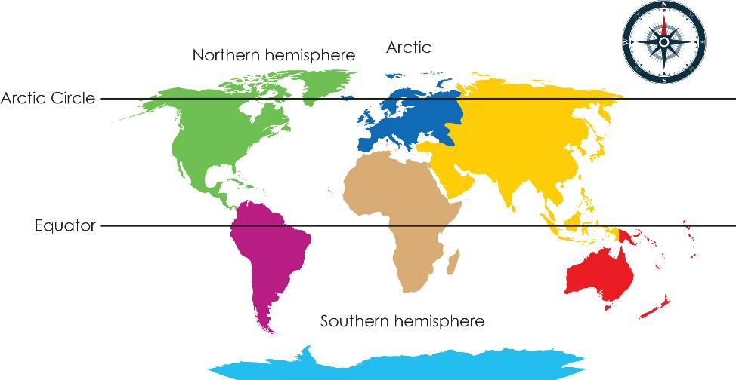
Use the information to answer these
Lesson 1: Label
Label these continents on the map.
Asia North America Africa Europe
Label these seas and oceans on the map.
Mediterranean Sea Baltic Sea Atlantic Ocean
Draw a circle around the United Kingdom.
Copyright © ArkCurriculum+ 2022
Notes:
Pupils write the names of the continents on the map in their workbooks. They also write the names of the seas and oceans. Pupils can use atlases or digital mapping tools to help with this. Ask them to circle the United Kingdom on the map in their workbooks. If possible, build on this by asking pupils to also identify each continent and the United Kingdom on a globe.

Slide 85
Use the information to answer these
Baltic Sea
Mediterranean Sea
Lesson 1: Label
North America
Europe
Asia
Atlantic
Ocean
Africa
Label these continents on the map.
Asia North America Africa Europe
Label these seas and oceans on the map.
Mediterranean Sea Baltic Sea Atlantic Ocean
Draw a circle around the United Kingdom.
Copyright © ArkCurriculum+ 2022

Slide 86
Which countries are in Europe?
There are over 40 different countries in Europe.
The number is not agreed because sometimes countries are counted as being in both Asia and Europe. Cyprus and Georgia are examples of countries like this.
Europe has four regions: Northern Europe, Western Europe, Southern Europe, and Eastern Europe.
Another reason that people disagree on the number of countries in Europe is because some countries have land in both Europe and Asia.
These countries are known as transcontinental countries, and examples are Russia and Türkiye.
Lesson 1: Read
Copyright © ArkCurriculum+ 2022
Notes:
Ask pupils to read the information detailing the number of countries in Europe, and ask them to explain in their own words why this number is disputed.

Slide 87
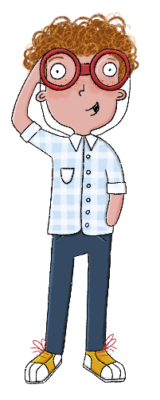
Find Europe in an atlas or on a map
Book work
How many countries are in Europe?
I have counted that there are .... in Europe.
What does ‘transcontinental’ mean?
Lesson 1: Retrieve
Copyright © ArkCurriculum+ 2022
Notes:
Pupils respond to the questions based on the text.

Slide 88
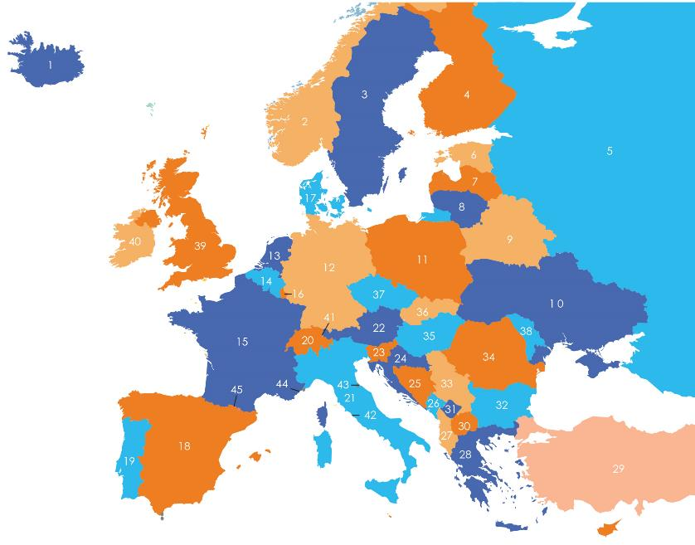
Use an atlas to complete the table of countries
1 | Iceland | 2 |  | 3 | Sweden
4 |  | 5 | Russia | 6
7 | Latvia | 8 |  | 9 | Belarus
10 |  | 11 | Poland | 12
13 | Netherlands | 14 |  | 15 | France
16 | Luxembourg | 17 | Denmark | 18
19 | Portugal | 20 |  | 21 | Italy
22 |  | 23 | Slovenia | 24
25 | Bosnia and Herzegovina | 26 |  | 27 | Albania
28 |  | 29 | Türkiye | 30
31 | Kosovo | 32 |  | 33 | Serbia
34 |  | 35 | Hungary | 36
37 | Czech Republic | 38 |  | 39 | UK
40 |  | 41 |  | 42
43 | San Marino | 44 |  | 45 | Andorra
Lesson 1: Investigate
Copyright © ArkCurriculum+ 2022
Notes:
Ask pupils to use an atlas (or online maps) to identify each of the numbered countries on the map within the workbook. Pupils should complete the table by writing the name of the country next to the correct number.

Slide 89
Use an atlas to complete the table of countries
1 | Iceland | 2 | Norway | 3 | Sweden
4 | Finland | 5 | Russia | 6 | Estonia
7 | Latvia | 8 | Lithuania | 9 | Belarus
10 | Ukraine | 11 | Poland | 12 | Germany
13 | Netherlands | 14 | Belgium | 15 | France
16 | Luxembourg | 17 | Denmark | 18 | Spain
19 | Portugal | 20 | Switzerland | 21 | Italy
22 | Austria | 23 | Slovenia | 24 | Croatia
25 | Bosnia and Herzegovina | 26 | Montenegro | 27 | Albania
Lesson 1: Investigate
Copyright © ArkCurriculum+ 2022

Slide 90
Use an atlas to complete the table of countries
28 | Greece | 29 | Türkiye | 30 | North Macedonia
31 | Kosovo | 32 | Bulgaria | 33 | Serbia
34 | Romania | 35 | Hungary | 36 | Slovakia
37 | Czech Republic | 38 | Moldova | 39 | UK
40 | Ireland | 41 | Liechtenstein | 42 | Vatican City
43 | San Marino | 44 | Monaco | 45 | Andorra
Lesson 1: Investigate
Copyright © ArkCurriculum+ 2022

Slide 91
Which countries are in Europe?
List three points to summarise what you have learnt.
Lesson 1: Learning review
Exit question
What are the four regions of Europe called?
Copyright © ArkCurriculum+ 2022
Notes:
Talk partners tell each other an answer to the lesson question, and write three key points to summarise what they have learnt. Add further review questions if you wish to. Pupils might write an independent response into their knowledge record.

Slide 92
Tuesday 25th February 2025
Computing
TBAT: explain how a sprite moves in an existing project
Blue – What is a scam? How do you know?
Green – Are people on an online game your friends?
Challenge – What would you do if a pop up came onto your screen telling you to click the link to claim your prize?

Slide 93
Tuesday 25th February 2025
Computing
TBAT: explain how a sprite moves in an existing project
Learning objectives
To explain how a sprite moves in an existing project
I can explain the relationship between an event and an action.
I can choose which keys to use for actions and explain my choices.
I can identify a way to improve a program.
Key vocabulary
motion
event
Sprite
algorithm
logic

Slide 94
Controlling movement
Introduction
Think of a computer game you have played recently. How do you control movement in the game?
Notes:
Arrow keys: https://pixabay.com/photos/arrow-keys-isolated-keyboard-keys-1925901/
Phone: https://pixabay.com/vectors/smartphone-android-os-samsung-153650/
Gamepad: https://pixabay.com/vectors/controller-gamepad-xbox-video-games-1827840/

Slide 95
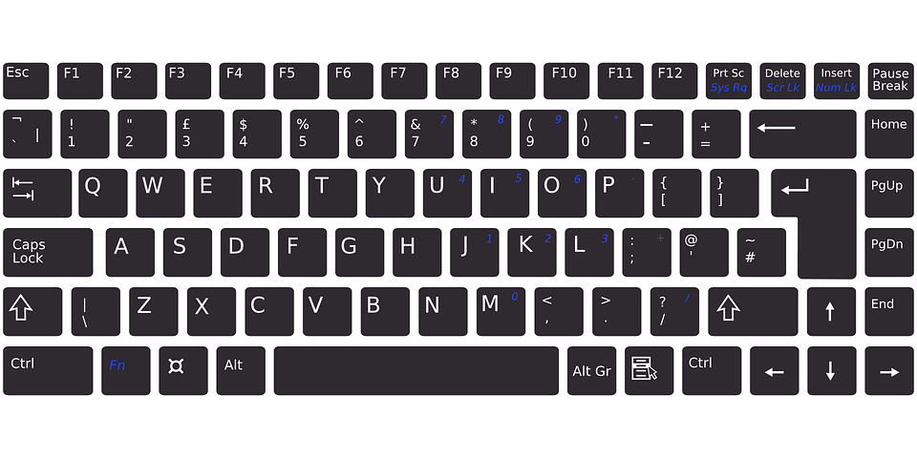
How does this sprite move?
Activity 1
Teacher link - Go to:
L1 - A1 remix on Scratch
The instructions for this project have not been completed. Use the mouse and the keyboard to explore how you can move Scratch the cat.
Notes:
Keyboard: https://pixabay.com/vectors/keyboard-electronic-computer-311803/
Mouse: https://pixabay.com/vectors/computer-mouse-computer-device-152249/

Slide 96
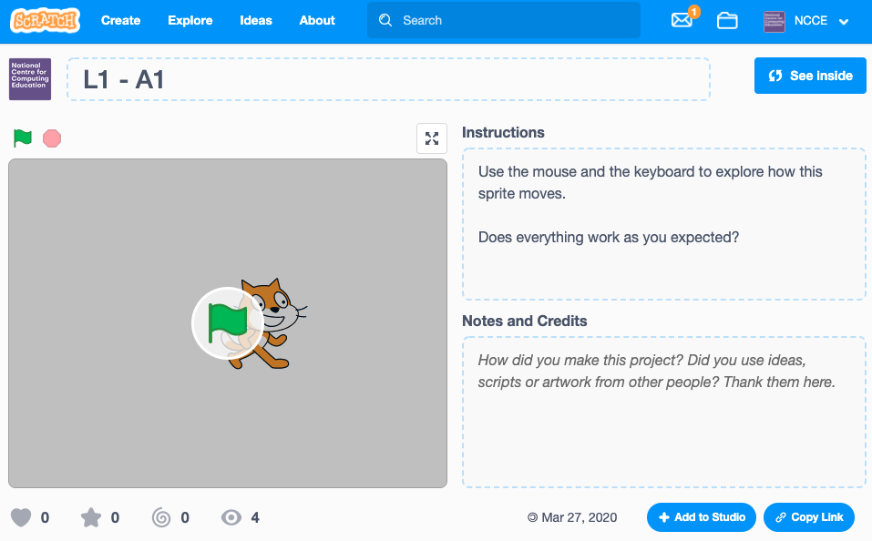
Click on See inside to edit the project
Activity 2
Notes:
Screenshots from https://scratch.mit.edu/

Slide 97
Can you complete the instructions?
Activity 1
Complete the instructions on your worksheet.
Does the project do everything you expected it to do?
Move right
Move left
Move up
Move down
Change costume
Turn clockwise
Turn anticlockwise

Slide 98
Change the controls and fix the errors
Activity 2
These are the blocks used. How would you change them to improve this program?
Notes:
Screenshots from https://scratch.mit.edu/

Slide 99
Design your changes
Activity 2
Design your changes and then code them!
Can you choose better ways to control the sprite?
Event | Press ‘R’ key
Movement | Rotate sprite clockwise

Slide 100
Add a second sprite and control its movement
Activity 3
Try controlling the movement of this sprite in a different way.
Here are some blocks you could use.
Share your project with a partner.
Notes:
Screenshots from https://scratch.mit.edu/

Slide 101
Tuesday 25th February
D.T
TBAT: explain why food comes from different places around the world.
Where does food come from?
How many food groups are there?
Can you explain why a balanced diet is important?

Slide 102
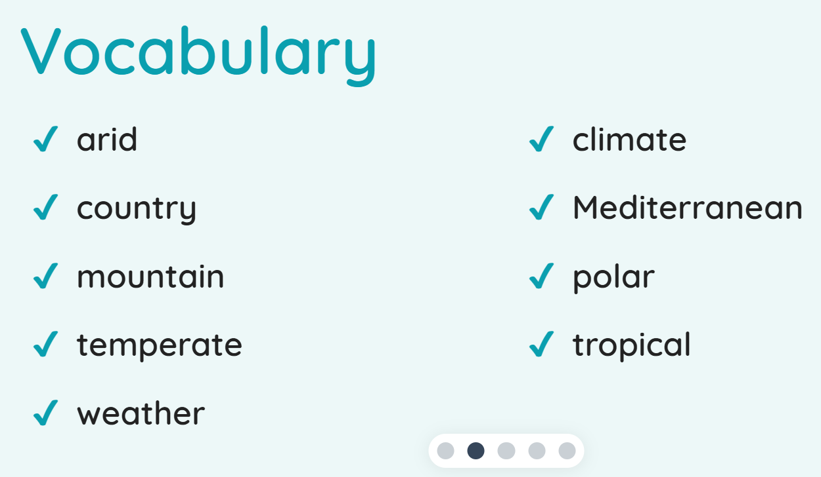

Slide 104
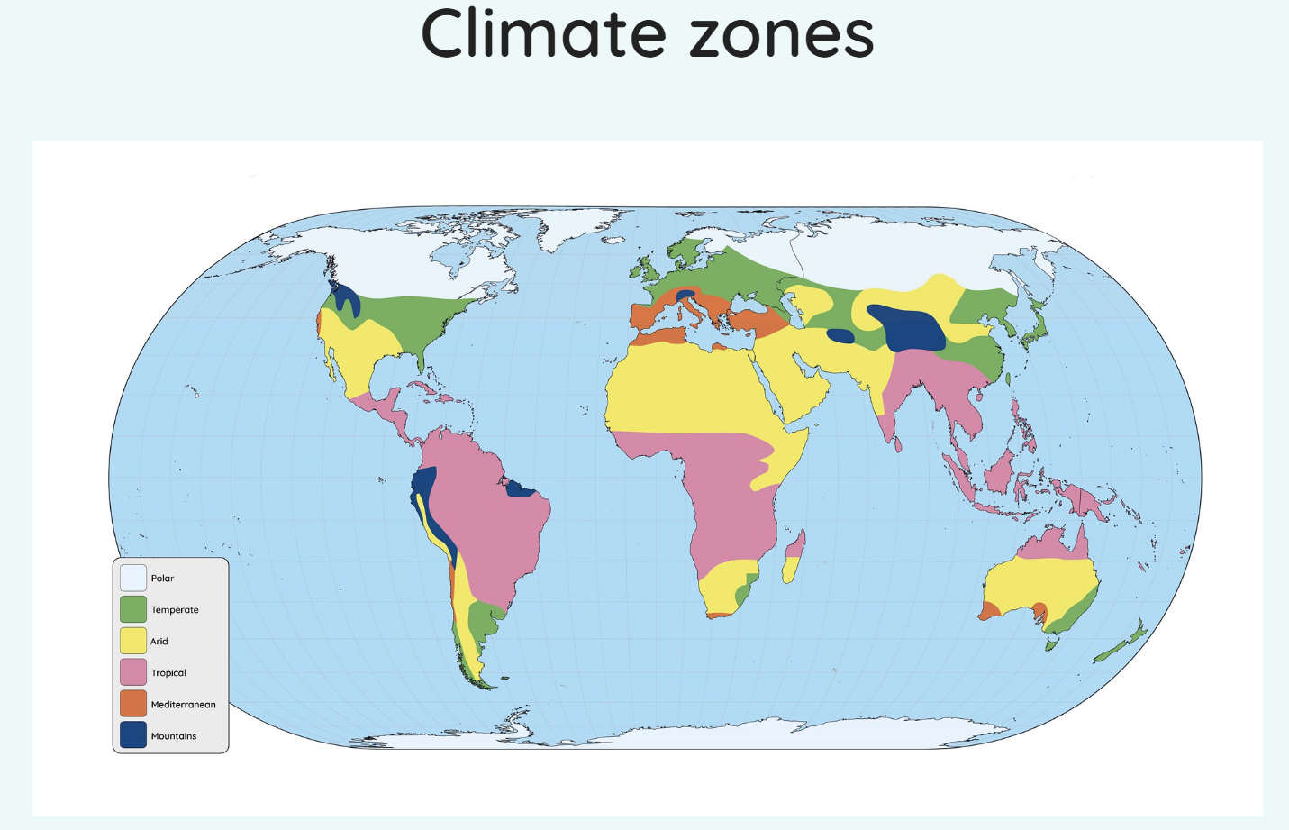

Slide 105
Different climates of the world mean that different countries can grow different foods.
The slide shows where certain fruits and vegetables traditionally grow but does not show the country names.

Slide 106
In pairs and with an atlas (one between two). Work with your partners to locate countries where the foods on the map are grown.
Eg. Tomatoes - China

Slide 107
1.Which country does the map show bananas coming from?
2. What climate zone is it in?
3. How did you work out the climate zone?

Slide 108
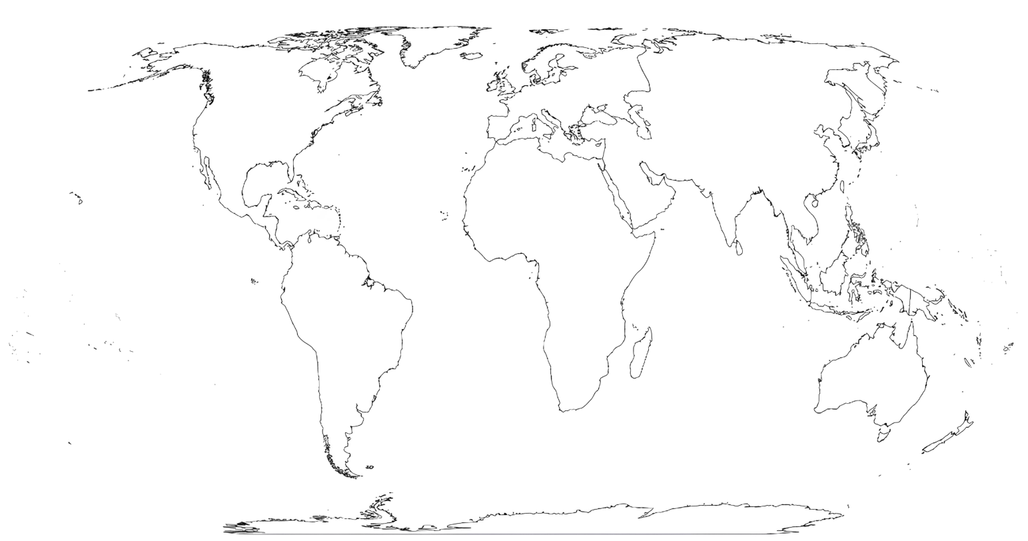
Using the first map and your atlas, label at least five foods with their country of origin and climate zone on the blank map of the world.

Slide 110
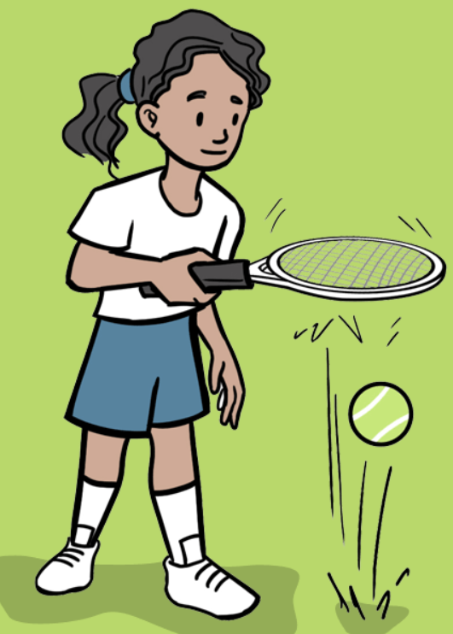
Tuesday 25th February 2025
PE – tennis
TBAT: develop racket and ball control.
This half term in P.E will be tennis and OAA (outdoor adventurous activities)
- Changing for PE - Rules and expectations moving to PE - Move to the downstairs hall or outside
Get Set 4 PE - Lesson Plan -1 for Year 3 Tennis

