Slide 1
Thursday 6th February 2025
Morning challenge
23 x 4 =
Half of 64 =
567 + 233 =
1/5 of 65 =
39 divided between 3
765 – 435 =
Double 37 =
4/8 + 3/8 =
Challenge
Write a word problem using one of these questions.

Slide 2
Reasoning maths paper
9.15 am – 10.00 am

Slide 3
Thursday 6th February
Wordwork 10.00 - 10.30
***Whiteboards***

Slide 4
Inverted Commas
There are two places where inverted commas are needed when writing direct speech:
“What’s the matter, Dina?” said Sid.
Inverted Commas
Inverted Commas
You need to open your inverted commas with a “ (66) before the first word which is
being spoken.
You need to close your inverted commas with a ” (99) after the last word which is being spoken.
Imagine that inverted commas are like hands;
They hold within them only the words which are being spoken.
“What’s the matter, Dina?” said Sid.
Back

Slide 5
Punctuation
There are two places where other forms of punctuation are needed when writing direct speech:
“What’s the matter, Dina?” said Sid.
You need to end the speaking with:
a comma
a question mark, if it is a question.
an exclamation mark, if it is an exclamation.
You will need to finish your sentence with a full stop after the reporting clause.
Examples of other punctuation in direct speech are:
“How exciting it is!” exclaimed Sarah.
“I don’t know what to do,” said Sayeed.
Back

Slide 6
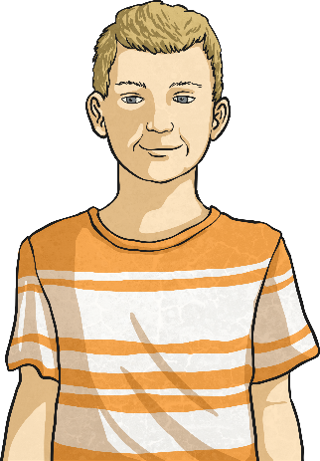
Reporting Clauses
After the speech itself, a reporting clause gives a little bit of information about who is speaking and how it was said.
“What’s the matter, Dina?” said Sid.
Reporting Clauses
In this case, Sid is speaking.
If Sid said it in a different way, you could change ‘said’ to...
“What’s the matter, Dina?” asked Sid.
“What’s the matter, Dina?” whispered Sid.
“What’s the matter, Dina?” uttered Sid.
“What’s the matter, Dina?” shouted Sid.
Back

Slide 7
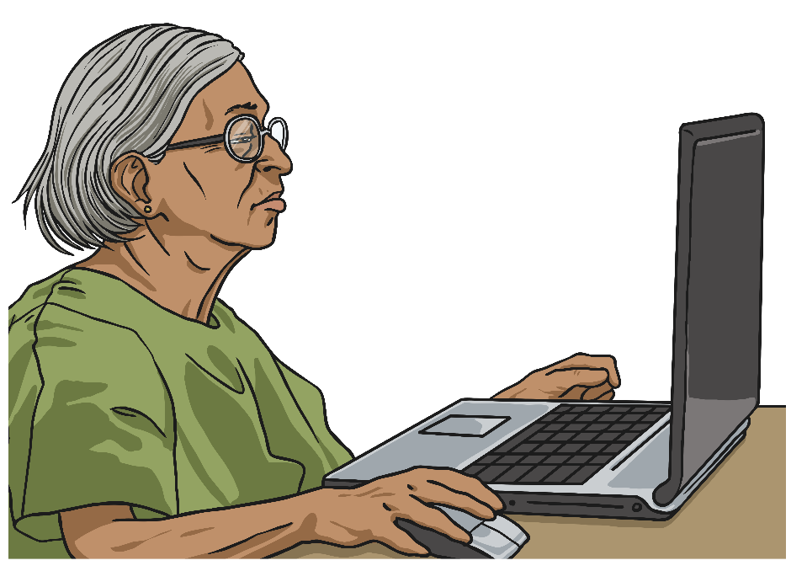
It’s Your Turn…
Here is a conversation between Aminah and her son, Sunil. Write the direct speech on a whiteboard using inverted commas and the correct punctuation.
Sunil, can you come and help me send an email?
Aminah

Slide 8
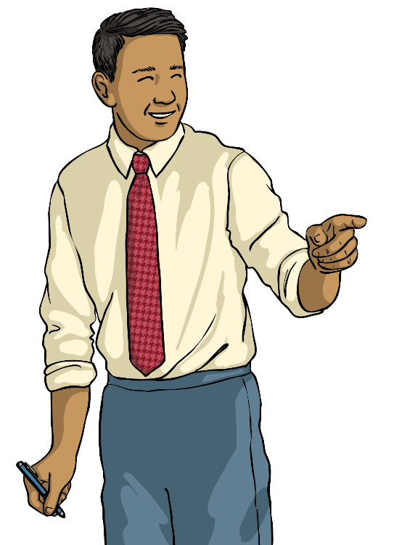
It’s Your Turn…
Here is a conversation between Mr. Miller and Max. Write the direct speech on a whiteboard using inverted commas and the correct punctuation.
Where more than one person is talking, remember to start new line for each new speaker.
Mr Miller
Please could you take those to Jessica’s classroom?
No problem, sir.
Max

Slide 9
It’s Your Turn…
Here is a conversation between three friends. Write the direct speech on a whiteboard using inverted commas and the correct punctuation. Remember: new speaker, new line!
What are your plans for tonight?
I don’t really have any.
Do you fancy going out for a meal?
Lisa
Janine
Alex

Slide 10
Example Answers
How did you do? Did you remember the inverted commas, punctuation and reporting clause?
“Sunil, can you come and help me send an email?” shouted Aminah.
“What are your plans for tonight?” asked Lisa.
“I don’t really have any,” replied Janine.
“Do you fancy going out for a meal?” said Alex.
“Please could you take those to Jessica’s classroom?” asked Mr Miller.
“No problem, sir,” replied Max.
It does not matter if you used said, asked, exclaimed or any other reporting verb – just don’t forget to mix it up a bit in your work. The same reporting verb too many times can get boring.

Slide 11
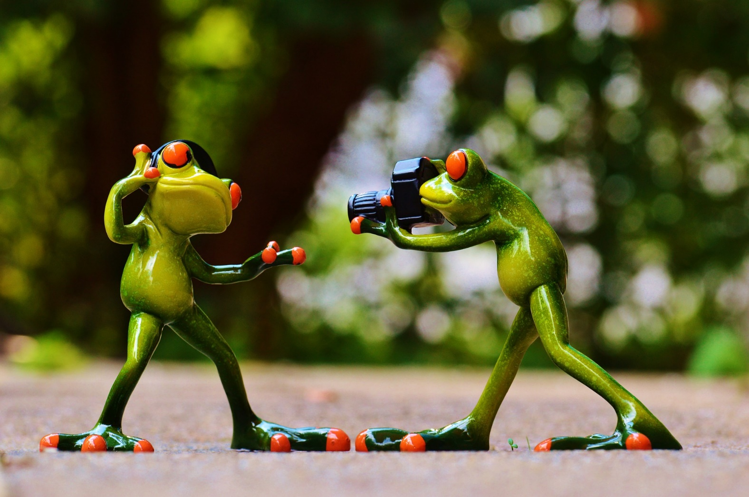
Froggy Freeze Frame
Write what each frog is saying using the correct speech punctuation...

Slide 12
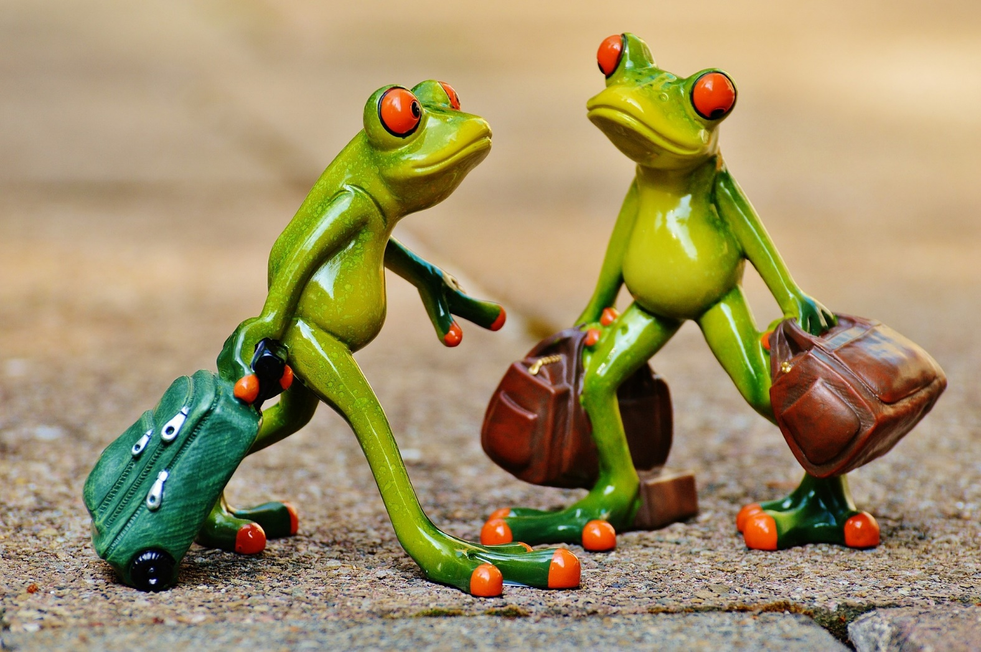
Froggy Freeze Frame
Write what each frog is saying using the correct speech punctuation...

Slide 14
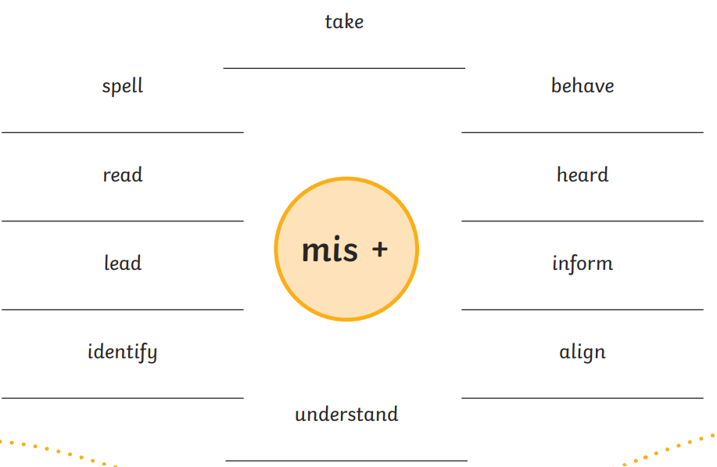
Thursday 6th February
Spelling
Write the words with the prefix 'mis'.
Ch -
Now choose 5 of the words. Write each word into a sentence.
Don't forget capital letters and full stops!

Slide 15
Thursday 6th February
TBAT: write a character description.
3 in 3
When you learn to swim, you are helping to continue a sport that humans have been doing for centuries. There are cave paintings in Egypt that show people swimming some ten thousand years ago. They appear to be doing the breaststroke although it might be the doggy paddle. Perhaps even more impressive is the fact that these pictures were found in an area of rocky desert. It could not have been easy to find enough water to drink, let alone bathe in. No wonder they thought it was such a special event that they decided to make a record of it.
1. In which country were the cave paintings found?
2. How old are the paintings thought to be?
3. Which two swimming strokes does the article suggest might be shown in the paintings?

Slide 16
Thursday 6th February
TBAT: write a character description.
What is a better word for 'little'?
What is a better word for 'selfish'?

Slide 17
Thursday 6th February
TBAT: write a character description.

Slide 18
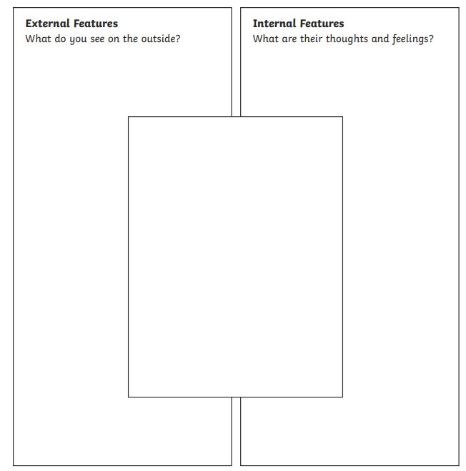
Thursday 6th February
TBAT: write a character description.
Using your plan, share your ideas with your partner on a sentence you could use to describe the King's appearance and a sentence to describe the King's personality.

Slide 19
Thursday 6th February
TBAT: write a character description.
W.A.G.O.L.L
King Oliver, the majestic ruler, stood regally with a crown that sparkles like twinkling stars placed over his thin, black hair. His wise eyes reveal a touch of sorrow as he scans around the room. Despite his outwardly confident leadership, he has a hidden fear of the dark, a fear that subtly shadows his character. This forces him to issue banning darkness in his kingdom, enforcing never-ending daylight. King Oliver selfishly only worries about himself and does not think about the citizens in his town.
Ch -
Include both the King's appearance and personality. Include expanded noun phrases.

Slide 21
Thursday 6th February
Q -How do mirrors work? 3 in 3
Mirrors are shiny and smooth objects that reflect light, helping us see our own reflection. When you stand in front of a mirror, it shows an exact copy of you, but everything is reversed. People use mirrors every day to check their appearance, while cars and bikes use them to see behind. Some mirrors, like funhouse mirrors, can make you look taller, shorter, or even wobbly. Mirrors can also be used in telescopes and cameras to help people see things far away.
What happens when you stand in front of a mirror?
Where might you find mirrors being used, besides in homes?
What makes funhouse mirrors different from regular mirrors?

Slide 22
Thursday 6th February
Q) How do mirrors work?
How do we see things?
How does light travel?
What is the difference between transparent and translucent?

Slide 23
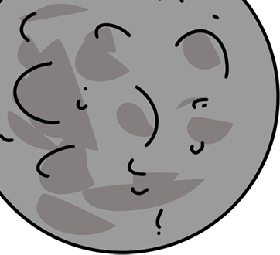
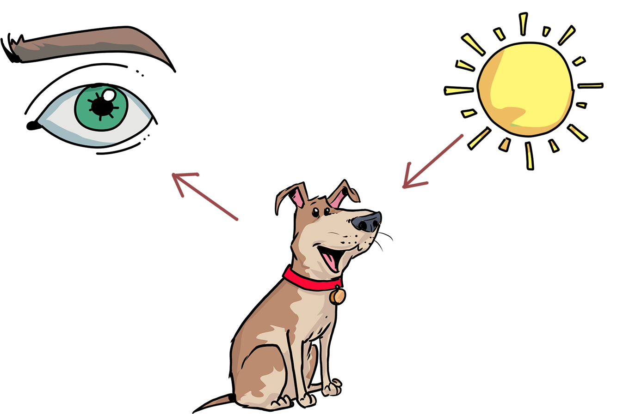
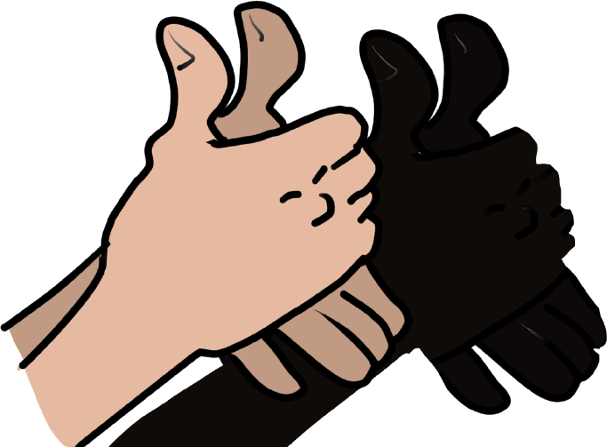
Light
1
We have learnt that we can see things because light is reflected. Some materials reflect light better than others. Light travels in straight lines.
Light travels from the Sun in a straight line.
When the light hits the dog, it is reflected and enters our eyes.
The Sun is a light source so it creates light.
When light hits an object, it is reflected (bounces off) and enters our eyes. This is how we see the object.
www.grammarsaurus.co.uk

Slide 24
Thinking Time...
3
Is a mirror opaque, translucent or transparent? Why?
Is a mirror an object that reflects light or is it a light source?
Talk to your partner before we discuss as a class.
www.grammarsaurus.co.uk

Slide 25
Thinking Time...
4
Is a mirror opaque, translucent or transparent? Why?
Opaque – it does not allow any light through it. It will make a shadow.
Is a mirror an object that reflects light or is it a light source?
It reflects light. It does not create its own light.
Talk to your partner before we discuss as a class.
www.grammarsaurus.co.uk

Slide 26
Mirrors
5
Mirrors are really good at reflecting light because they have a smooth surface, glass sheet
with a shiny metallic backing. Humans first made simple mirrors out of polished obsidian
(black, shiny rock) about 600 BC.
Then they produced more sophisticated mirrors out of polished metals, e.g. copper, bronze, silver, gold and lead. These mirrors were small because they were relatively heavy.
In the 14th century mirrors similar to those used today began to be made, but the glass was poor quality and adding the molten metal as backing often broke the glass.
Modern mirrors are made by silvering which is
spraying a thin layer of silver or aluminium to the back of a sheet of glass.
www.grammarsaurus.co.uk

Slide 27
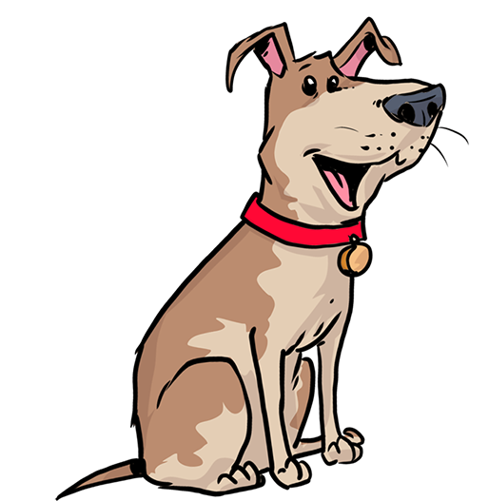
Types of Mirror
6
In a plane mirror the image is the same size as the object and the same way up. But it is inverted, (‘back-to-front’)
There are two types of curved mirror. A mirror that bulges outwards is called a convex mirror. Convex mirrors show things the right way up and are usually smaller.
Convex mirror
A mirror that bulges inwards is called a concave mirror. How you appear in a concave mirror depends on how close you
are to it. From close up you look bigger and the right way up.
Further away you look, smaller and upside down.
Concave mirror
www.grammarsaurus.co.uk

Slide 28
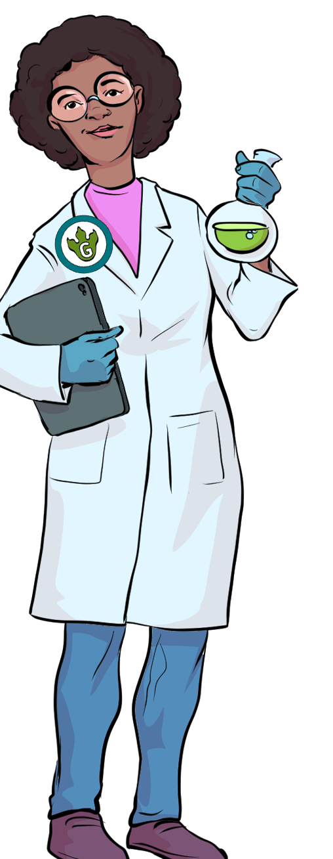
Partner Task 1
7
Write a word on a post-it note and stick it under your table and your partner needs to try and read the word.
Rules:
You can’t move your head lower than the table
You can only use mirrors to read the word
What was difficult about this task?
What could make it easier?
Challenge - if you have time, adapt the task and try again!
www.grammarsaurus.co.uk

Slide 29
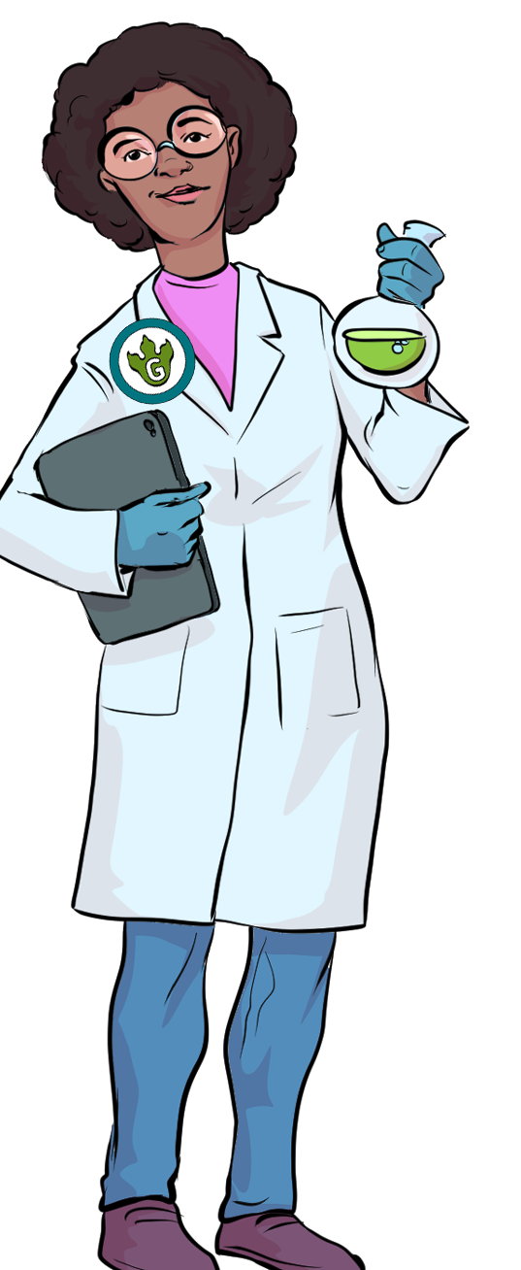
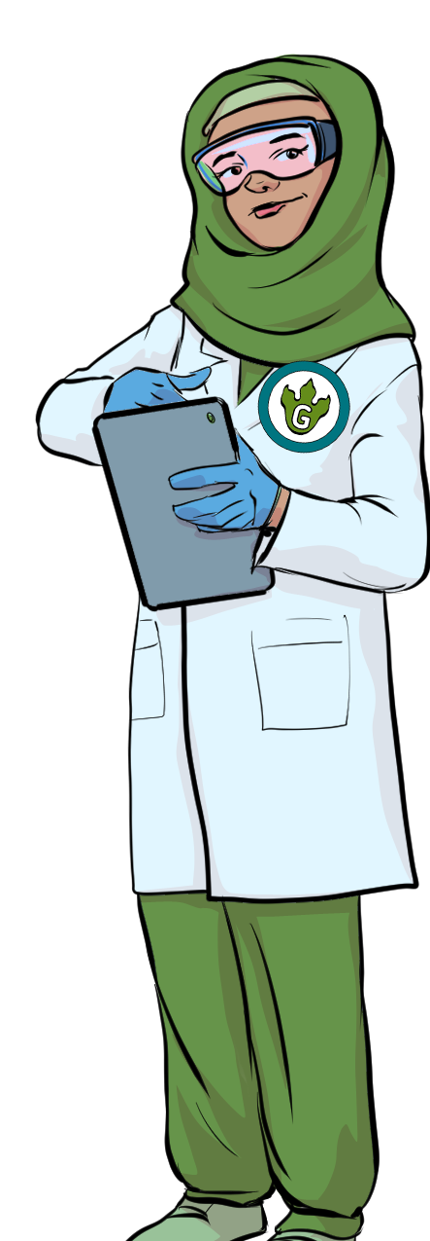
Activities
8
On your worksheets, you have a number of different activities to have a go at.
- They all require a mirror.
- Some of them require a partner.
www.grammarsaurus.co.uk

Slide 30
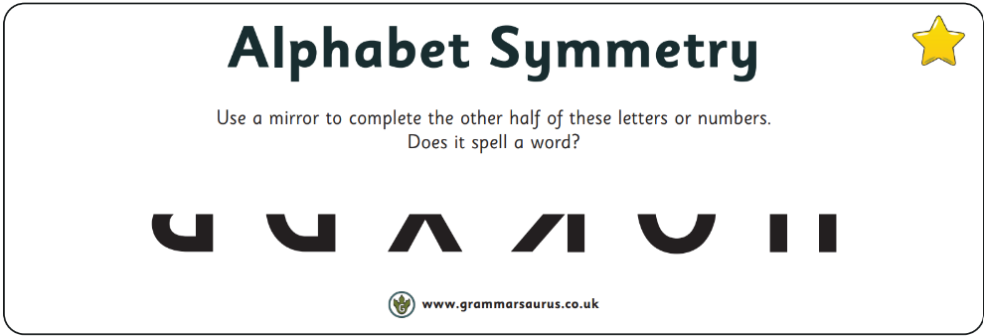
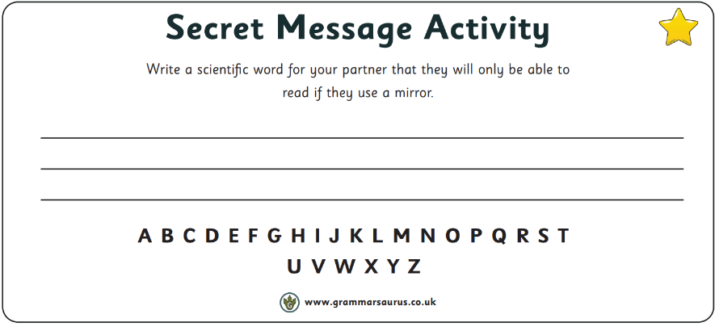
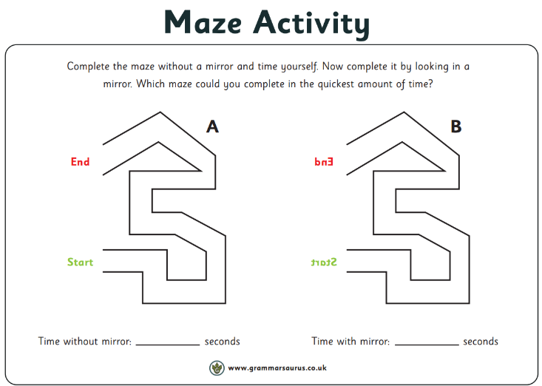

Slide 31
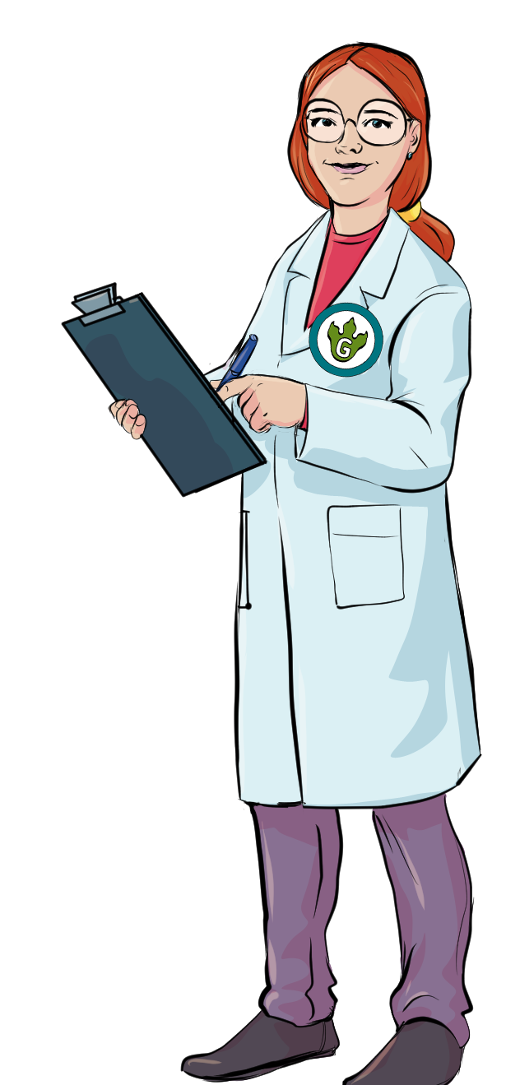
What did we find out?
9
Think about these questions and discuss with your partner before feeding back to the class.
What did you most enjoy about this lesson?
Tell me one thing you have learnt.
Did you find anything difficult?
www.grammarsaurus.co.uk

Slide 32
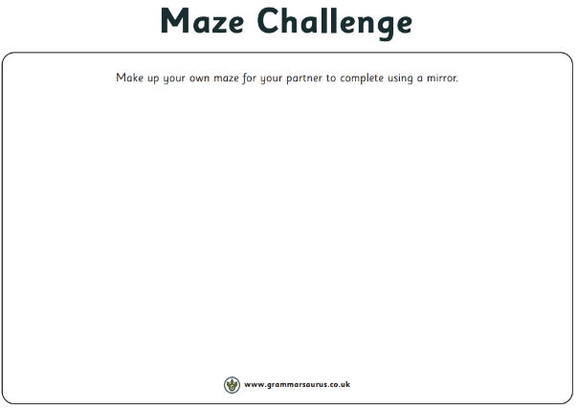

Slide 33
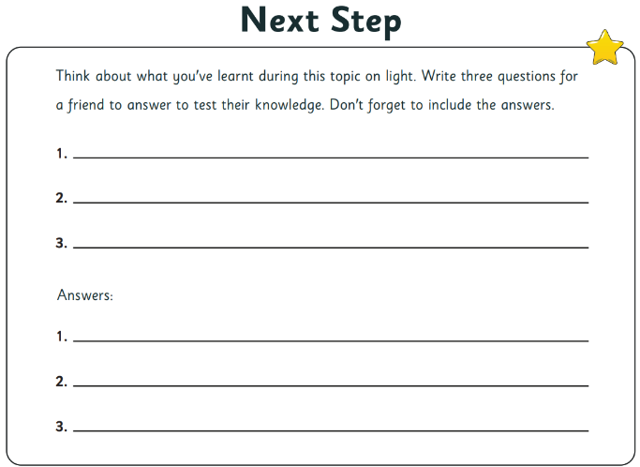

Slide 34
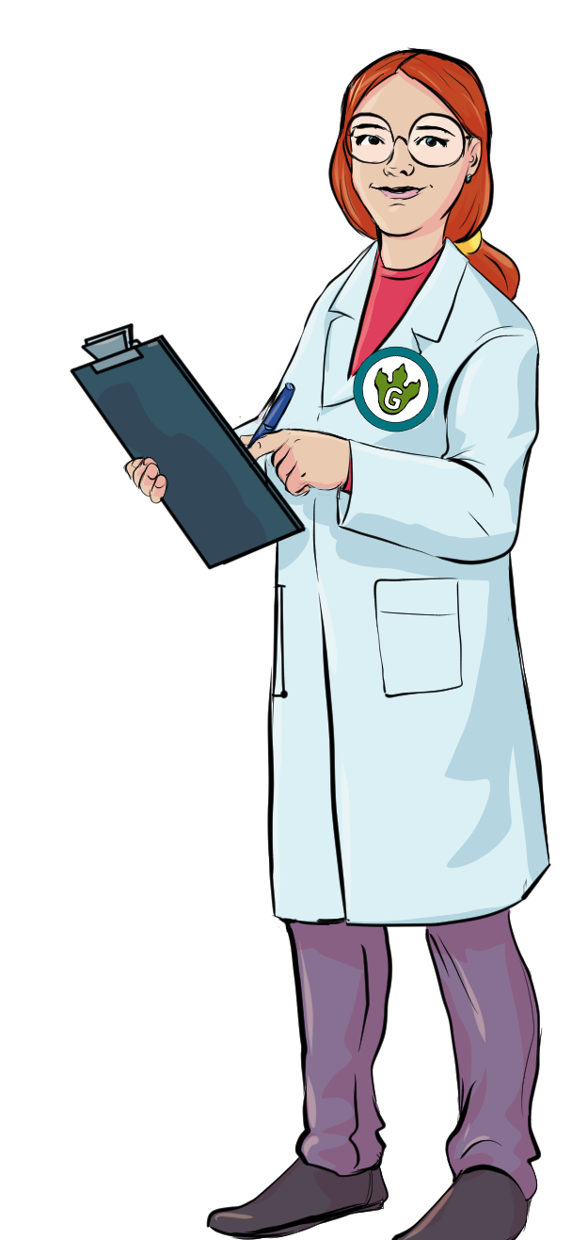
End of Topic
1 0
Now that we have completed our science topic on light, you can go back to the mind map you completed in the first lesson and add anything that you have learnt in a different colour.
www.grammarsaurus.co.uk

Slide 35
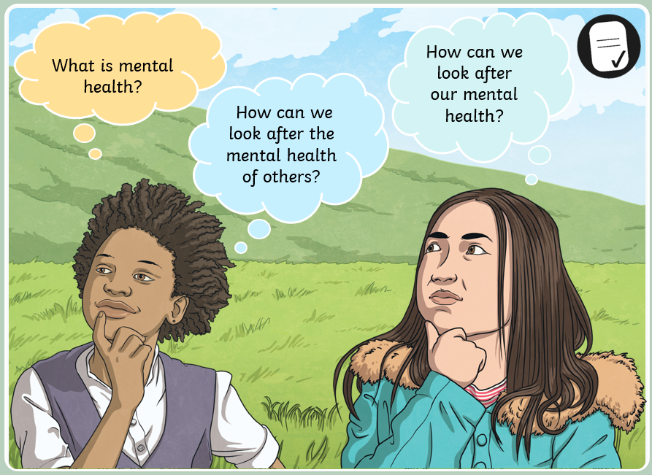
Thursday 6th February
Children's Mental Health Week

Slide 36
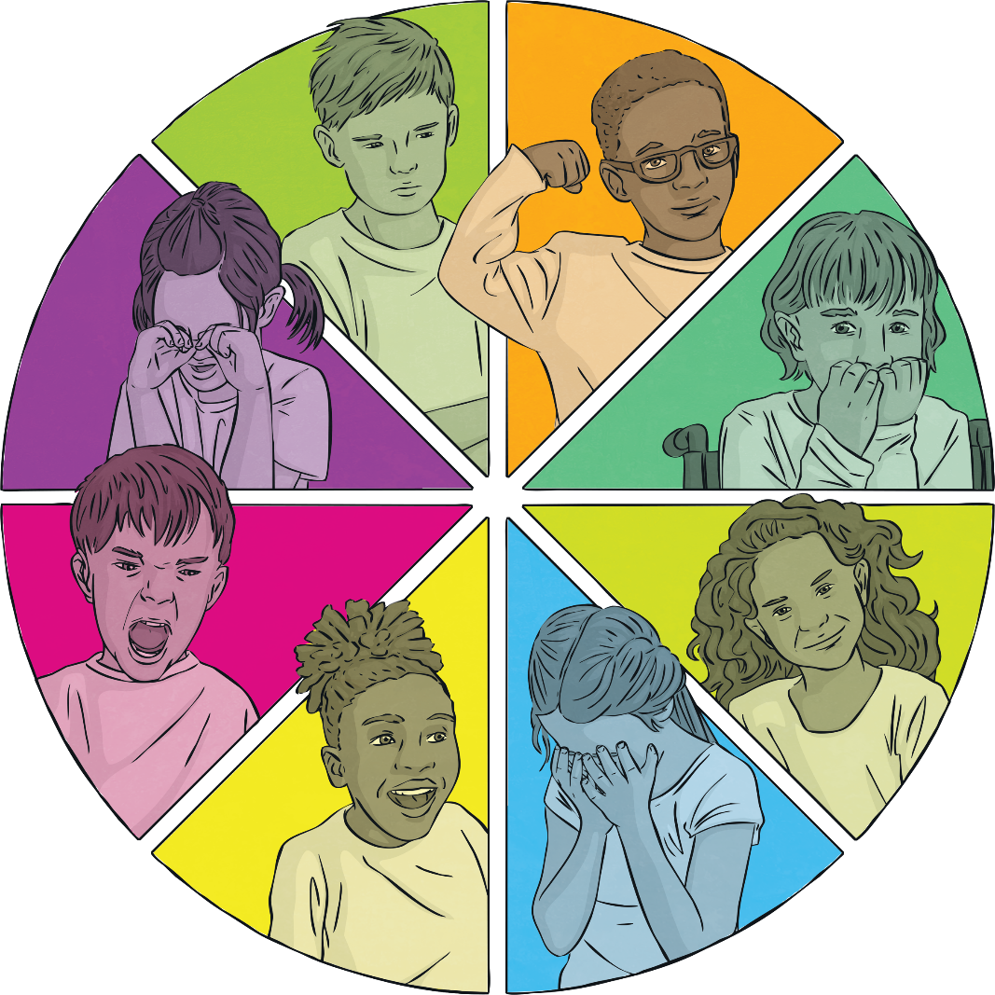
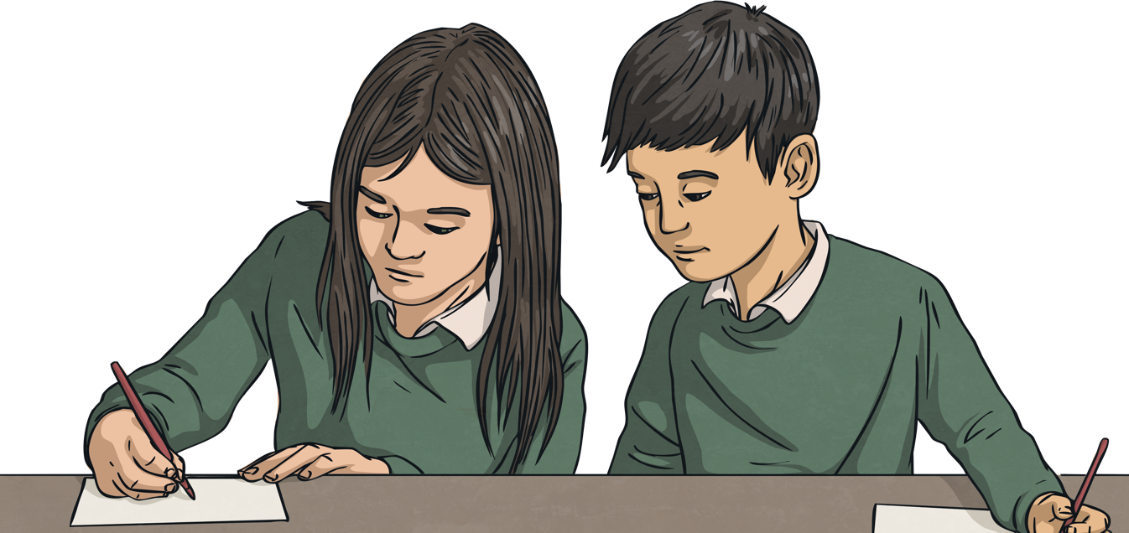
What Is Mental Health?
What does mental health mean?
Mental health is all about how we are feeling, the thoughts we are having and how this affects the choices we make and how we behave. It is also how able we are to cope with what is happening in our daily lives.
Talk to a partner and then share your thoughts with the class.

Slide 37
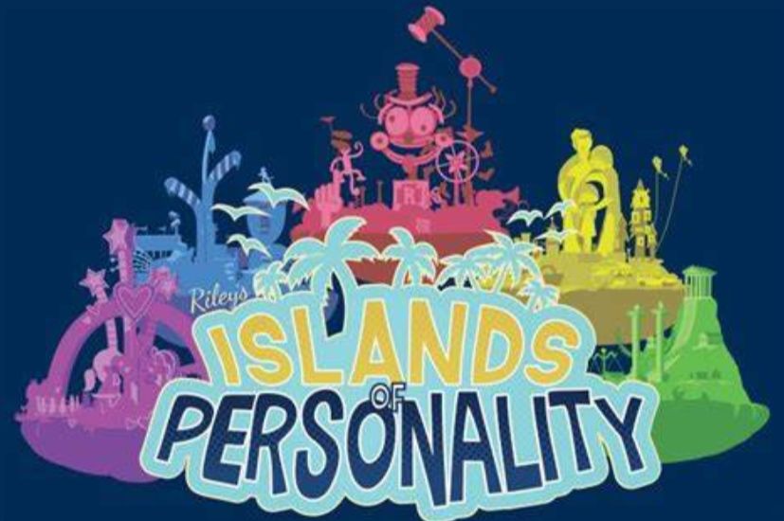
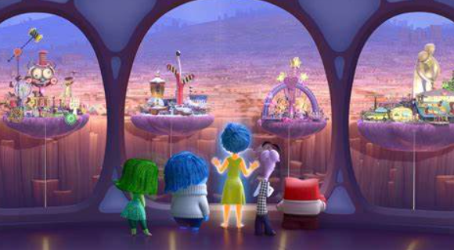
Thursday 6th February
Children's Mental Health Week
Just like Riley, we all hold different Islands of Personality in our brains. These islands are created from our past memories, emotions, life experiences and passions. Get into small groups or pairs and discuss what are your Islands of Personality?
Inside Out: Riley’s Islands

Slide 38
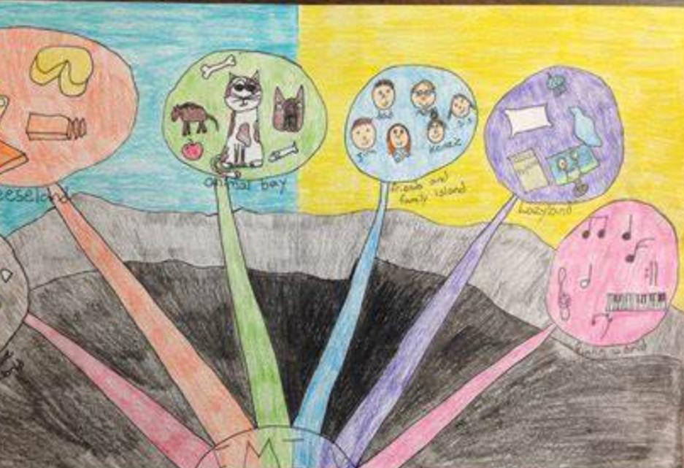
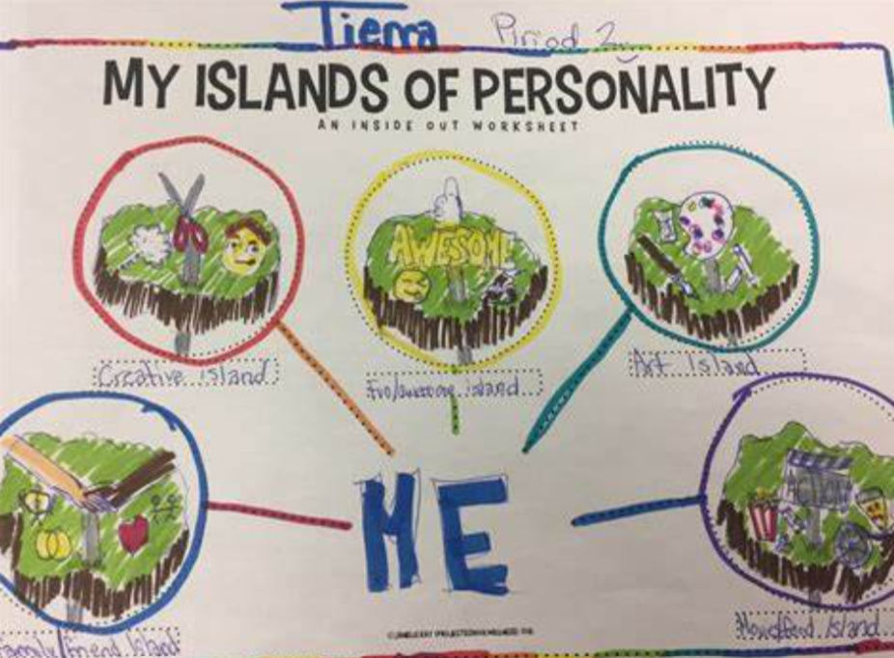
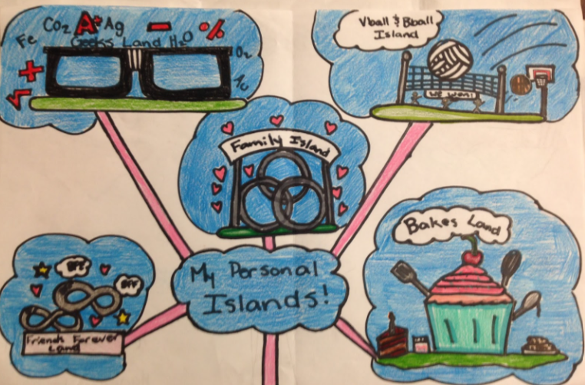
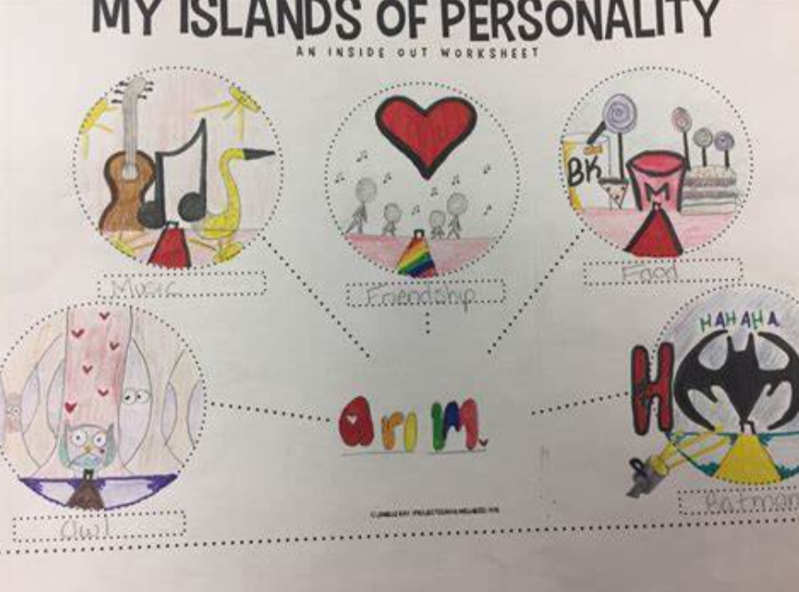
Thursday 6th February
Children's Mental Health Week

