Slide 1
Wednesday 5th February 2025
5/2/25

Slide 2
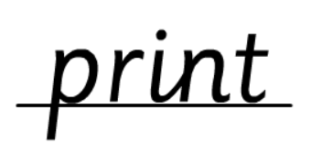
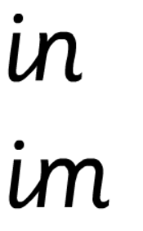
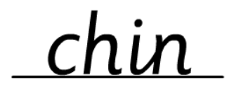
Morning Challenges:
Name writing

Slide 3
Phonics
Wednesday 5th Febuary 2025
5/2/25
Revisit and review
Lesson focus:
Read words with the /s/z phoneme

Slide 4
Recap
c se ce
s zz ss

Slide 5
Revisit and review
Wednesday 5th Febuary 2025
5/2/25
Today's Grapheme
ce/se

Slide 6
face
space
success
visit
fizzy
princess
tease
Revisit and review
Wednesday 5th Febuary 2025
5/2/25
Where in the word?

Slide 7
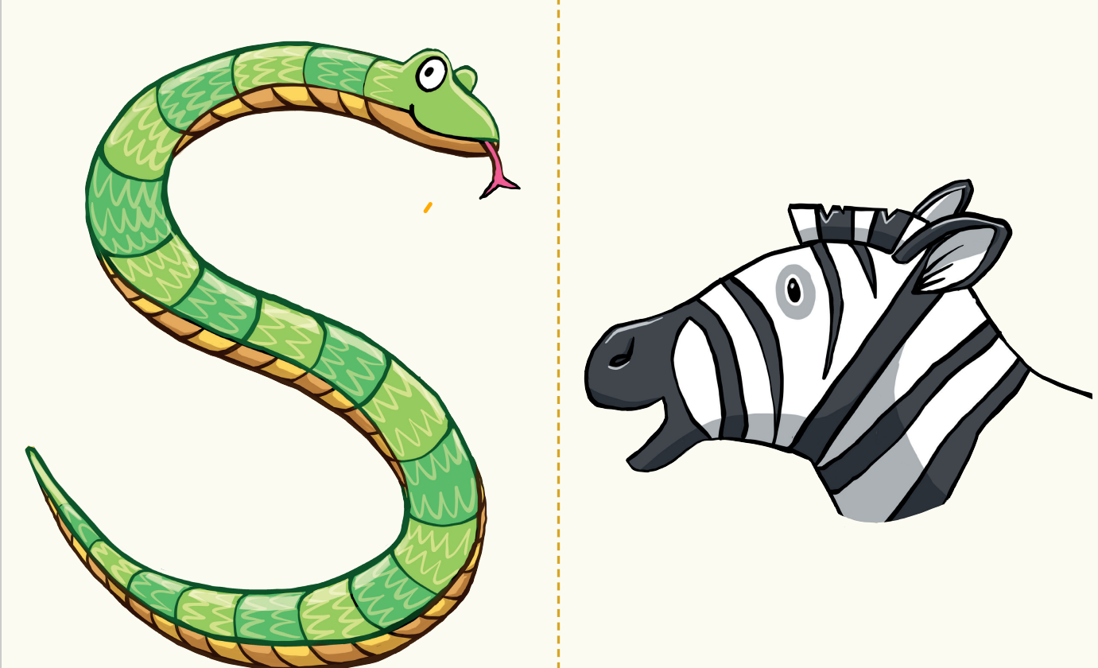
Teach and Practise
Sort the words
Wednesday 5th Febuary 2025
5/2/25
horse fence ice cosmic cheese puzzle noise

Slide 8
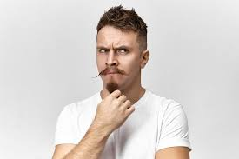
Revisit and review
Wednesday 5th Febuary 2025
5/2/25
Ms
school
Mrs
call
tricky words
Mr
different
Read the tricky words

Slide 9
Wednesday 5th Febuary 2025
5/2/25
Now let's read this sentence!​
What digraphs can you see?
What tricky words can you see?

Slide 10
Wednesday 5th Febuary 2025
5/2/25
Let's spell!
How many sounds? Write it.
tricky words
visit fizzy could
Listen to the sentence, say it, write it and read it!
Challenge
Extend the sentence using 'and'

Slide 11
TBAT: describe the characteristics of a superhero.
Wednesday 5th February 2025
3 in 3 Add the correct end punctuation to each sentence.
Pick up the boots
My friend Fred is playing at the park.
Sing louder

Slide 12
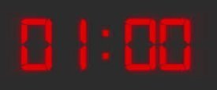
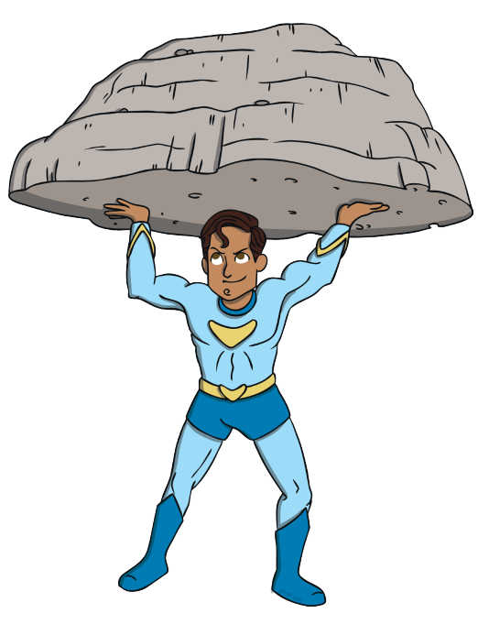
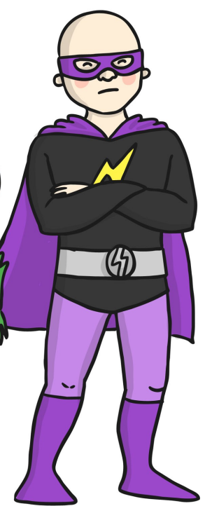
TBAT: describe the characteristics of a superhero.
Wednesday 5th February 2025
Blue/ Green
Blue, think of 3 words to describe the superhero.
Green, think of 3 words to describe the villain.
Then put them into a sentence to describe each character.
The superhero is........
The villian is........

Slide 13
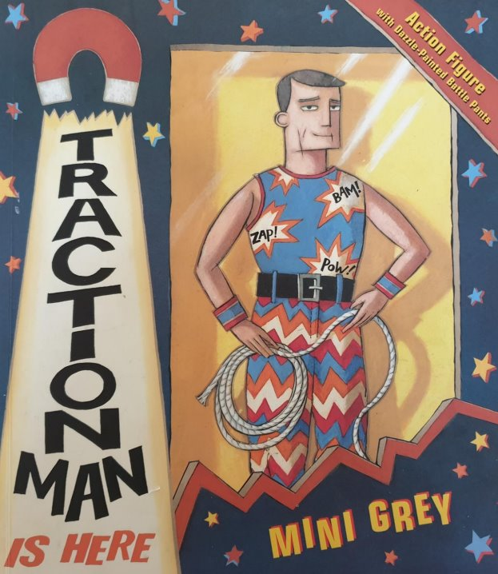
TBAT: describe the characteristics of a superhero.
Wednesday 5th February 2025
Today, we are going to think about what it takes to be a good superhero.
With your partner, stand like a superhero and discuss what is a good super hero needs to be.
Why do they need those characteristics?

Slide 14
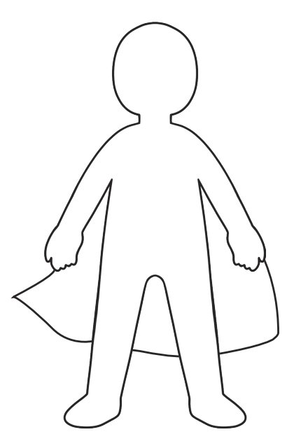
TBAT: describe the characteristics of a superhero.
Wednesday 5th February 2025

Slide 15
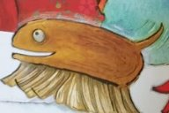
TBAT: describe the characteristics of a superhero.
Wednesday 5th February 2025
What does it take to be a good side kick?

Slide 16
TBAT: describe the characteristics of a superhero.
Wednesday 5th February 2025
Write some characteristics of a superhero around the character.
Challenge:
Write a short paragraph about your hero.

Slide 17
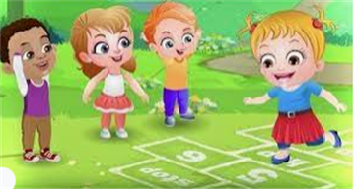
Break

Slide 18
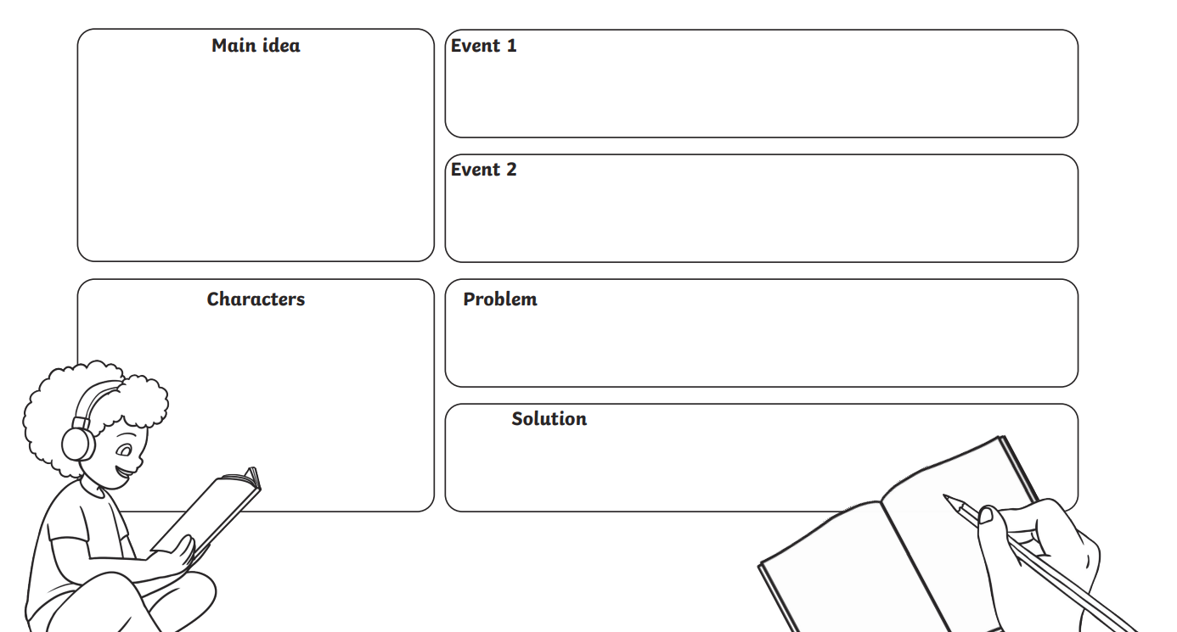
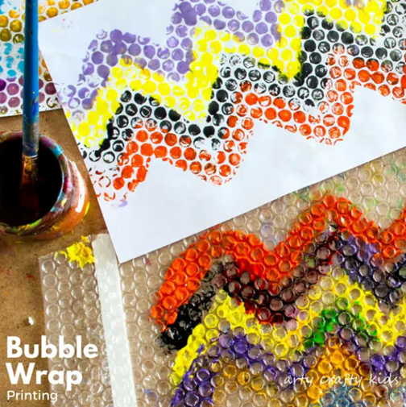
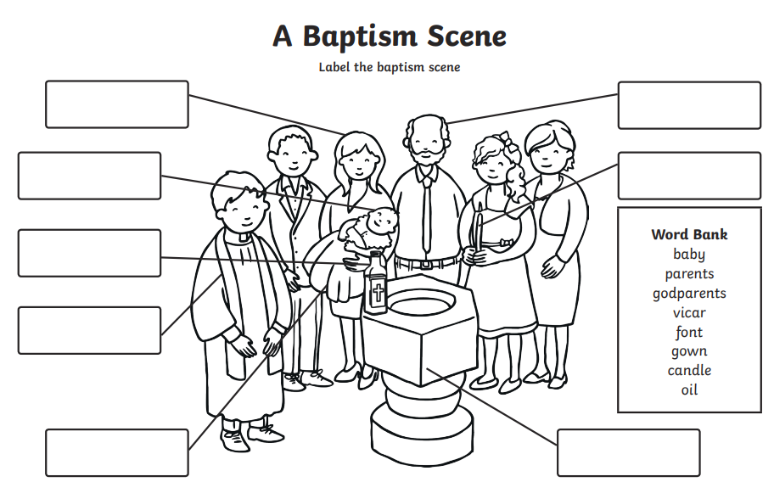
Independent Challenges:
Narrative Zone
Maths Zone
Order the numbers on the table from greatest to smallest.
Plan a superhero story.
Enquiry Zone
Creative Zone
Explore printing with bubble wrap

Slide 19
Lunch

Slide 20
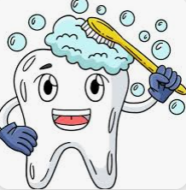
Toothbrushing

Slide 21
TBAT; explain what I need to do if something upsets me online.
Wednesday 5th February 2025
We will be joining a Safer Internet Day and Children's Mental Health Week challenge.
We will talk through a story and you need to think about how each part of the story would make you feel and what you might do about it.

Slide 22
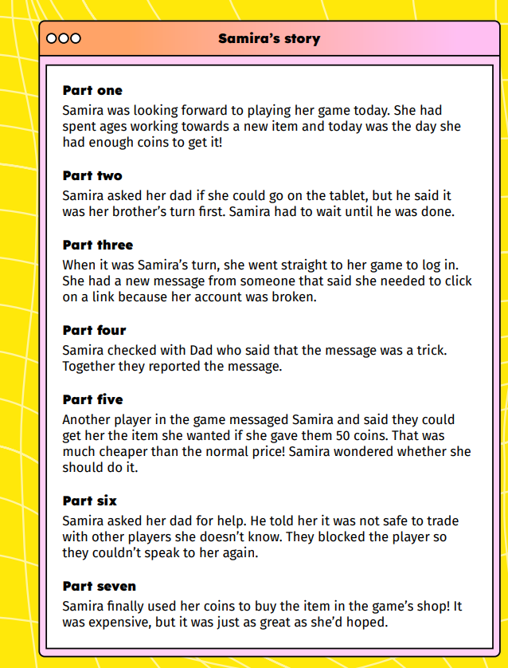
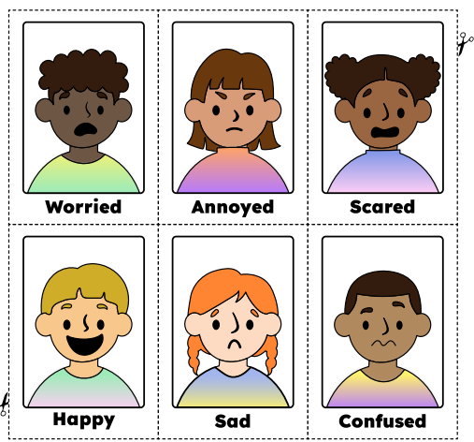
TBAT; explain what I need to do if something upsets me online.
Wednesday 5th February 2025

Slide 23
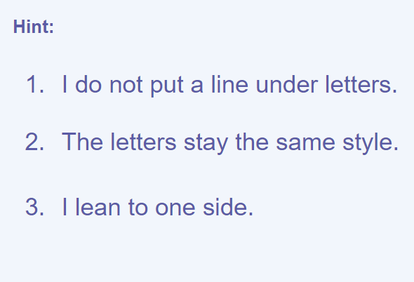
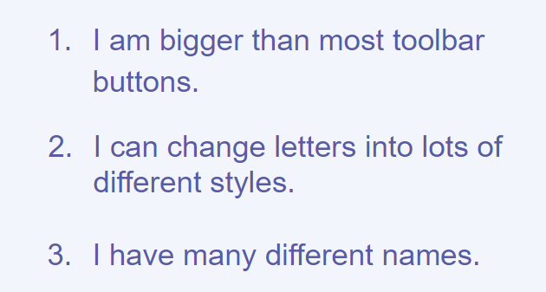
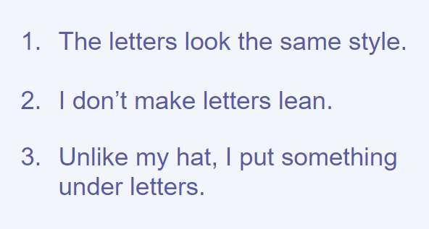
TBAT: explain what tool I used to change my text, and use undo to- remove changes.
Wednesday 5th February 2025
3 in 3- What am I?

Slide 24
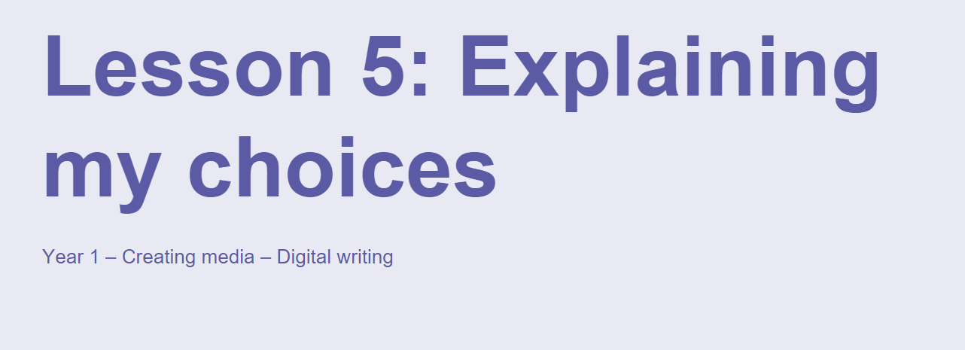
TBAT: explain what tool I used to change my text, and use undo to- remove changes.
Wednesday 5th February 2025

Slide 25
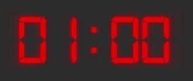
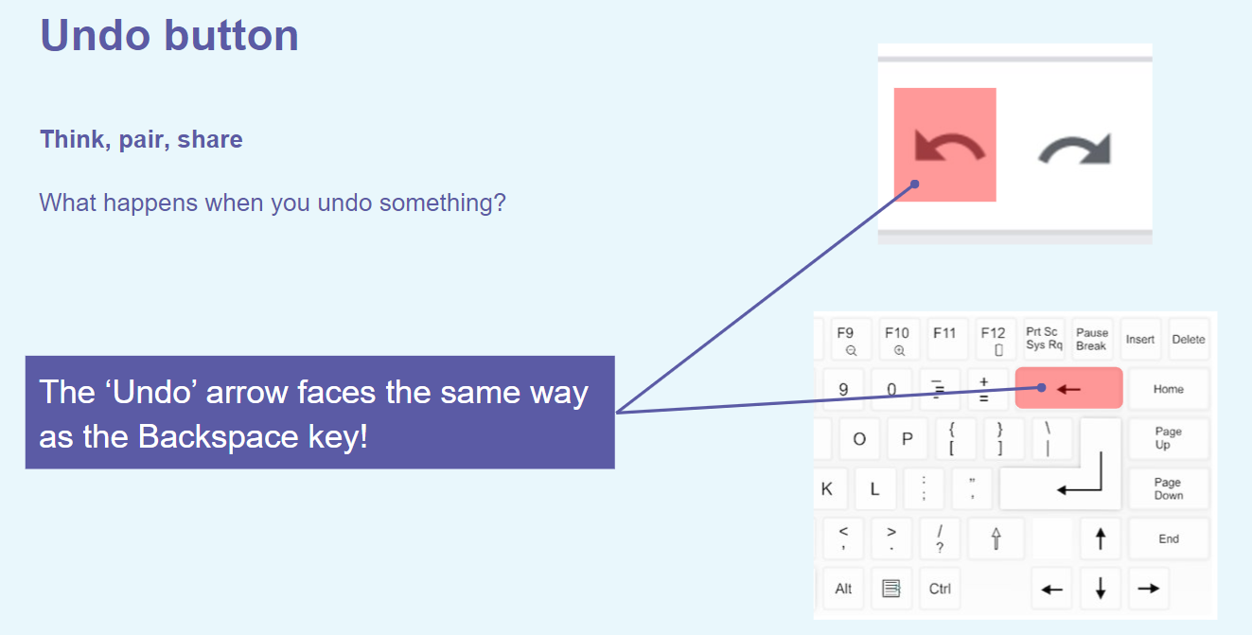
TBAT: explain what tool I used to change my text, and use undo to- remove changes.
Wednesday 5th February 2025
Blue/ Green
What other buttons would cause the same effect?

Slide 26
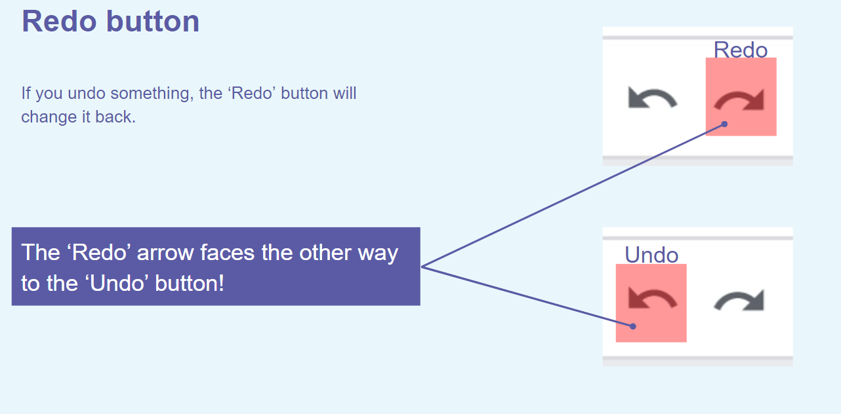
TBAT: explain what tool I used to change my text, and use undo to- remove changes.
Wednesday 5th February 2025

Slide 27
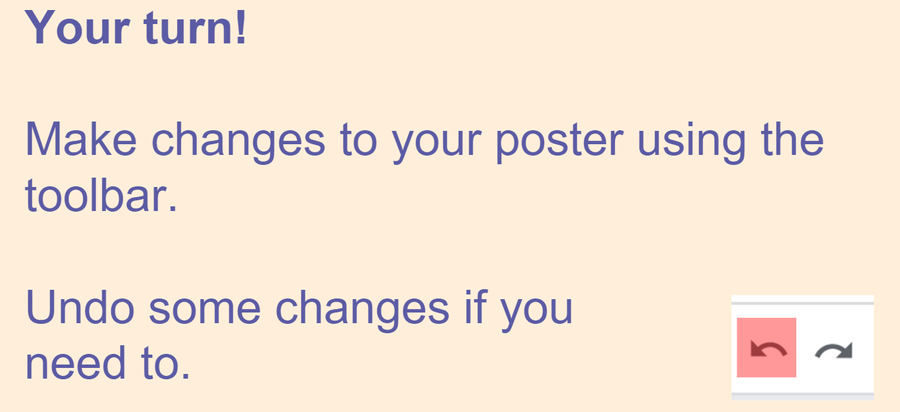
TBAT: explain what tool I used to change my text, and use undo to- remove changes.
Wednesday 5th February 2025

Slide 28
Independent Challenges:
Narrative Zone
Maths Zone
Order the numbers on the table from greatest to smallest.
Plan a superhero story.
Enquiry Zone
Creative Zone
Explore printing with bubble wrap

