Slide 1
Wednesday 26th February 2025
26/2/25

Slide 2
Morning Challenges:
Name writing

Slide 3
Recap:
oo or ey ce o-e o aw ay o

Slide 4
Phonics
Revisit and review
TBAT
Read words with the /ur/oo/air/or phonemes

Slide 5
Revisit and review
What are the digraphs?
worked
work
valley
dance
done
nothing
Segment these
words and read them
Blend and say words

Slide 6
Focus words
aw-f-u-l
p-l-ay-f-u-l
c-ou-ld
Sounds out these
words and read them

Slide 7
Focus words
awful
playful
could
Read these words on sight

Slide 8
Focus words
awful
playful
octopus
pudding
Read, sound talk and blend
And again... FASTER!

Slide 9
Revisit and review
their
oh
once
tricky words
Read the tricky words
our

Slide 10
Now let's read this sentence!​
What digraphs can you see?
What tricky words can you see?

Slide 11
Let's spell!
How many sounds? Write it.
tricky words
awful playful our
Listen to the sentence, say it, write it and read it!
Challenge
Extend the sentence using 'and'

Slide 12
Year 1 – Spring Block 1 – Conjunctions
TBAT: recognise and use ‘and’ in sentences.
© Classroom Secrets Limited 2018

Slide 13
3 in 3
Add the full stops in the correct places.
Jasper worked hard to grow his bean stalk but it did not grow He tried watering and mowing it He gave up too early The bean stalk grew after he left it

Slide 14
Introduction
Count the number of times the conjunction ‘and’ is used in the sentences below.
Jack and Annie are brother and sister.
I have a cat and two dogs.
I had fish and chips for my dinner.
My mum and I went to the shop and the park.
After school I go to my dad’s house.
How many are there altogether?
© Classroom Secrets Limited 2018

Slide 15
Varied Fluency 1
Underline the conjunction ‘and’ in the sentence below.
Let’s go out to the garden and play a game.
© Classroom Secrets Limited 2018

Slide 16
Varied Fluency 2
Tick the sentence which uses ‘and’ correctly.
Jack went to the birthday party and.
I found my and purse put it away in my bag.
Kim is a good friend and she is funny.
© Classroom Secrets Limited 2018

Slide 17
Varied Fluency 4
Circle the ‘and’ which is not needed in the sentence below.
They put the TV on and watched and a film.
© Classroom Secrets Limited 2018

Slide 18
Application 1
Match the sentences that should be joined by the conjunction ‘and’.
A. Polly packed her lunch. |  | 1. We spent it on books.
B. We had some pocket money. |  | 2. He had a great time.
C. Frank went on holiday. |  | 3. She put it in her bag.
© Classroom Secrets Limited 2018

Slide 19
Reasoning 1
Mr Hall shares a sentence with Year 1:
Fay says,
Is she correct?
Explain your reasoning.
I went to the beach swam in the sea.
The sentence is missing the conjunction ‘and’.
© Classroom Secrets Limited 2018

Slide 20
Application 2
Complete the sentence below by putting the words from the word bank in the correct order.
Greg fell ________________________________
_____________________________________ leg.
hurt | and | his | over
© Classroom Secrets Limited 2018

Slide 21
Varied Fluency 1
Join the two sentences together using ‘and’.
The frog is green.
He jumps around.
Challenge:
Can you use ‘and’ twice by thinking of some more information for the sentence?
© Classroom Secrets Limited 2018

Slide 22
Varied Fluency 2
Tick the correct box to show where ‘and’ should go in the sentence below.
We had cheese ham sandwiches.
© Classroom Secrets Limited 2018

Slide 23
Varied Fluency 3
Complete the sentence below.
My dog is sad and he_______________________.
© Classroom Secrets Limited 2018

Slide 24
Application 1
Use the words below to help you make a sentence using ‘and’.
They walked to school
on Tuesday
it was raining
it was cold
Challenge:
Can you use ‘and’ twice?
© Classroom Secrets Limited 2018

Slide 25
Application 2
Choose two sentences below and join them with ‘and’ to make one sentence.
He says goodbye.
He drinks his milk.
He goes home.
© Classroom Secrets Limited 2018

Slide 26
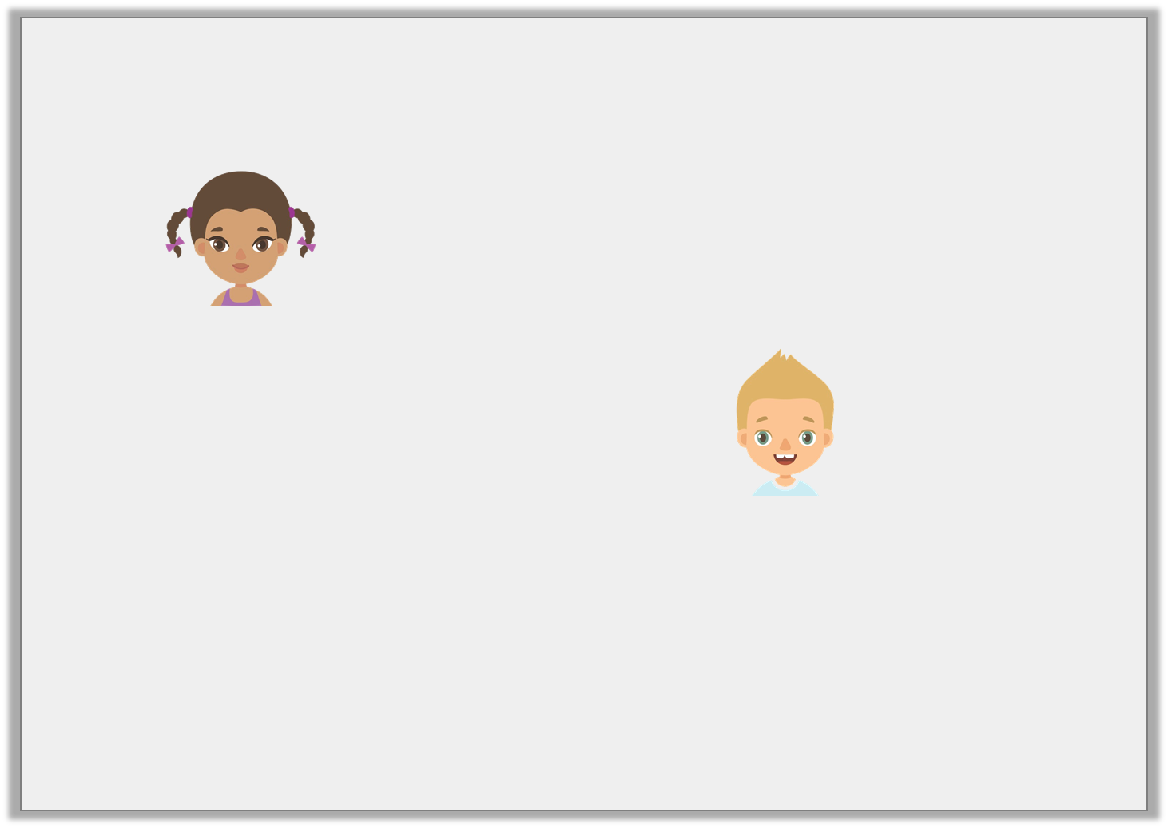
Reasoning 1
Lola and George write a sentence using ‘and’.
Who is correct? Explain why.
The boy was sad and he was crying.
Lola
And the boy was crying he was sad.
George
© Classroom Secrets Limited 2018

Slide 27
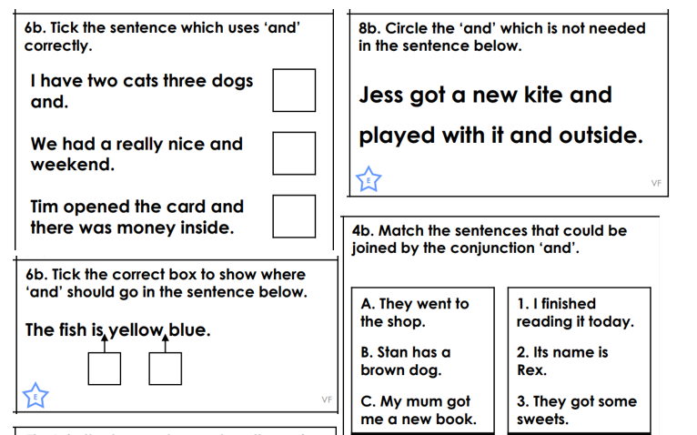
Independent

Slide 28
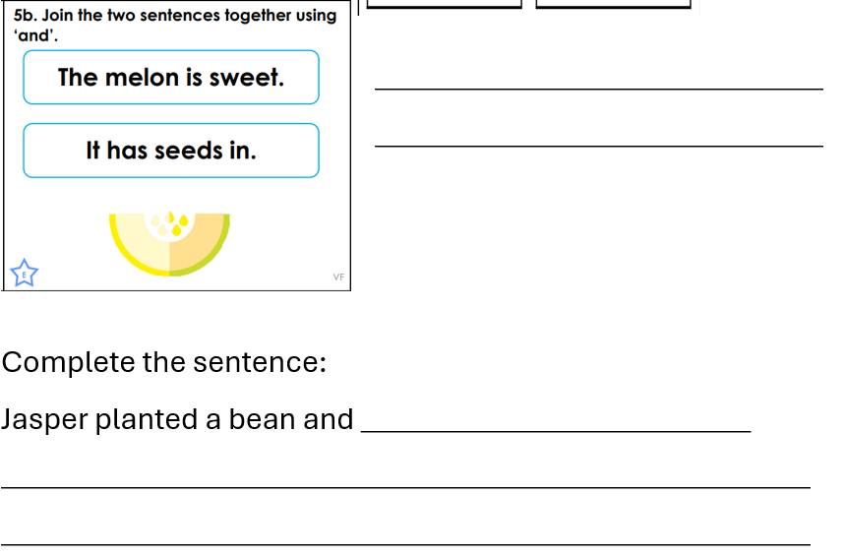

Slide 29
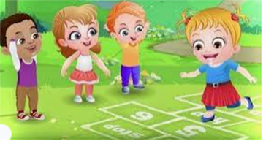
Break

Slide 30
Key Learning: To compare two sets and find the difference in a range of contexts
3 in 3

Slide 31
Key Learning: To compare two sets and find the difference in a range of contexts
fewer
compare
difference
more

Slide 32
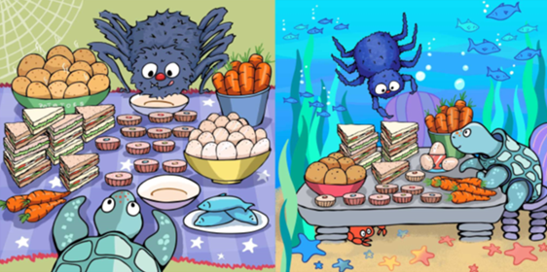
Comparing to find the difference
Let’s compare!
Notes:
New Learning: Comparing to find the difference
Note: The addition and subtraction equations we can write to express difference relationships are initially explored in Lessons $6$ and $7$. Lessons $1$ to $5$ focus on describing the relationships in words and with diagrams/concrete representations.
Show pupils the Big Picture again and recap learning from Lesson $1$, making concrete representations and using the language ‘more’, ‘fewer’ and ‘difference’.

Slide 33
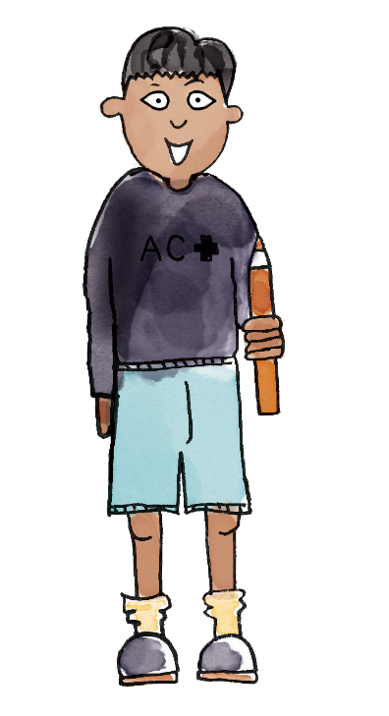
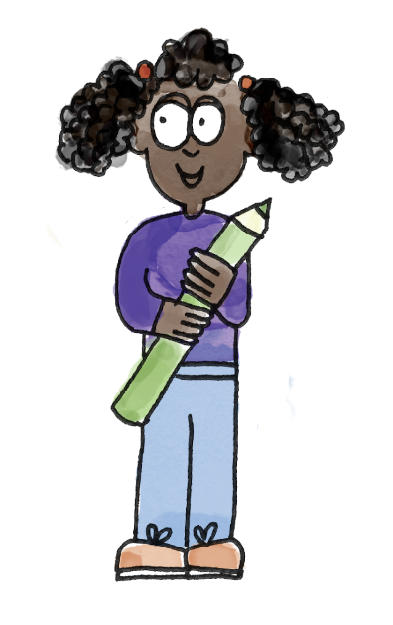
Comparing to find the difference
Gamal is 5 years old.
Danielle is 8 years old.
How could we represent their ages?
Gamal is 3 years younger than Danielle.
Danielle is 3 years older than Gamal.
The difference between their ages is 3 years.
Notes:
New Learning: Comparing to find the difference
Then choose some different contexts in which to quantify difference. For example:
using a weather block graph (from Maths Meetings) to compare windy/sunny days,
comparing ages (although this is more abstract as it is not a set of objects, represent the number of years using concrete manipulatives),
other measures if these have been introduced in Maths Meetings, e.g. comparing lengths using non-standard units such as cubes.

Slide 34
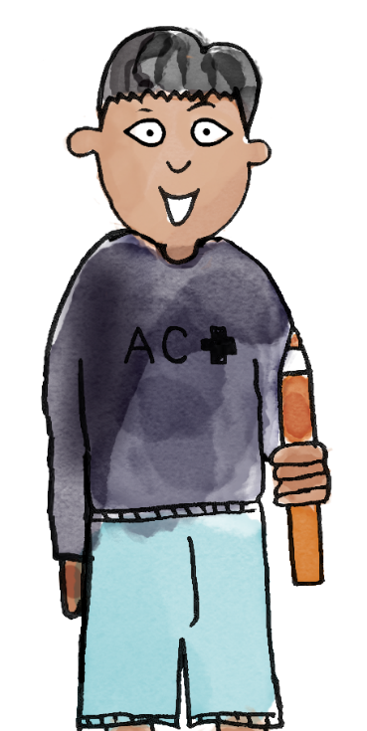
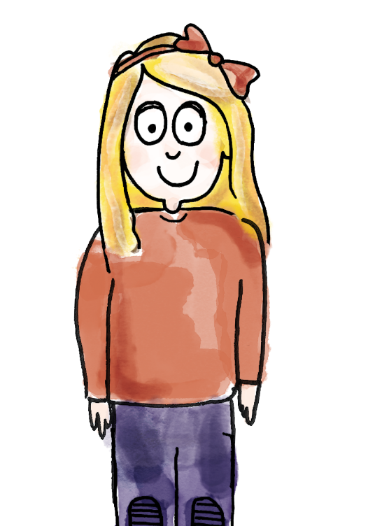
Using comparative language
I have 9 carrots.
I will represent that using nine cubes.
I have 5 carrots.
I will represent that using five cubes.
There are four cubes sticking out. I have four more carrots than you. You have four fewer carrots than me.
The difference between the number of carrots is four.
compare more fewer difference
Notes:
Talk Task: Using comparative language and the word ‘difference’ accurately
Pupils have a copy of the Talk Task sheet adapted to the context(s) you have chosen. They have interlocking cubes to represent the quantities. Pupil A uses cubes to represent one quantity and says what they have represented. Pupil B does the same with the other quantity. They line up their representations and compare the sets using ‘more’, ‘fewer’ and ‘difference’.

Slide 35
Are there more bananas or apples?
DYNAMIC REPRESENTATION
Build up your own representation, ‘live’ in the lesson
This image is for teacher planning only
Notes:
Develop Learning: Drawing pictorial representations to find the difference
Now move on to a question comparing two sets which are visually mixed together.
Are there more bananas or apples?
How could we draw a picture to compare them?
Give pupils a chance to discuss their ideas and make suggestions. Model rearranging the fruit into a row of bananas and a row of apples in one-to-one correspondence. Then model counting the set of apples and representing them by colouring a row of $11$ squares on some large squared paper. Repeat with a row of eight squares below to represent the bananas and compare.
What sentences can we make to describe the bananas and the apples?
Repeat with further examples.

Slide 36
Key Learning: To compare two sets and find the difference in a range of contexts
Identifying the difference
There are $_____$ more/ fewer butterflies than flowers.
There are $_____$ more/ fewer flowers than butterflies.
The difference between the number of flowers and butterflies is $_____$ .
Notes:
Independent Task: Drawing pictorial representations to identify difference
Pupils have a copy of the Task sheet. They count the number of items in each set, represent the sets pictorially in one-to-one correspondence (drawing lines to match the items) and complete the sentences.
Possible adaptations:
You could remove the written scaffold and require pupil to write their own sentences using more, fewer and difference.
Pupils could represent the two sets in each question using cubes first and then use this to create a drawing.

Slide 37
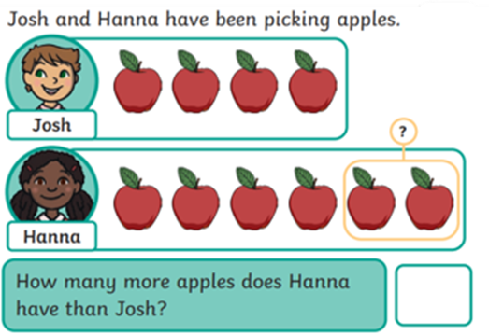
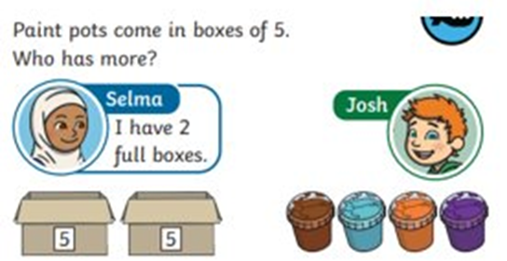
Key Learning: To compare two sets and find the difference in a range of contexts
Reasoning problem:
Challenge:
Notes:
Independent Task: Drawing pictorial representations to identify difference
Pupils have a copy of the Task sheet. They count the number of items in each set, represent the sets pictorially in one-to-one correspondence (drawing lines to match the items) and complete the sentences.
Possible adaptations:
You could remove the written scaffold and require pupil to write their own sentences using more, fewer and difference.
Pupils could represent the two sets in each question using cubes first and then use this to create a drawing.

Slide 38
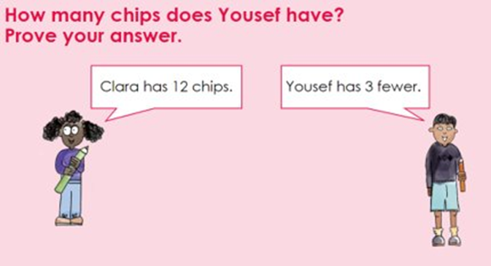
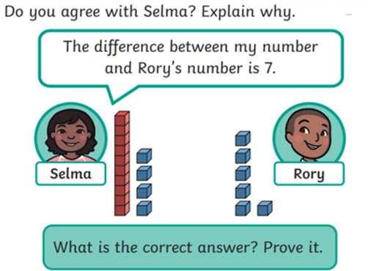
Key Learning: To compare two sets and find the difference in a range of contexts
Mastery:
Mastery with greater depth
Notes:
Independent Task: Drawing pictorial representations to identify difference
Pupils have a copy of the Task sheet. They count the number of items in each set, represent the sets pictorially in one-to-one correspondence (drawing lines to match the items) and complete the sentences.
Possible adaptations:
You could remove the written scaffold and require pupil to write their own sentences using more, fewer and difference.
Pupils could represent the two sets in each question using cubes first and then use this to create a drawing.

Slide 39
Lunch

Slide 40
Today's Alien language is.......

Slide 41
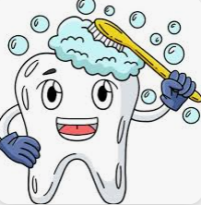
Toothbrushing

Slide 42
Lesson 1: Buttons
Year 1 – Moving a robot
TBAT: explain what a given command will do
Notes:
Last updated 29-10-21
Resources are updated regularly — the latest version is available at: ncce.io/tcc.
This resource is licensed under the Open Government Licence, version 3. For more information on this licence, see ncce.io/ogl.

Slide 43
Lesson 1: Buttons
Objectives
TBAT: explain what a given command will do
I can predict the outcome of a command on a device
I can match a command to an outcome
I can run a command on a device

Slide 44
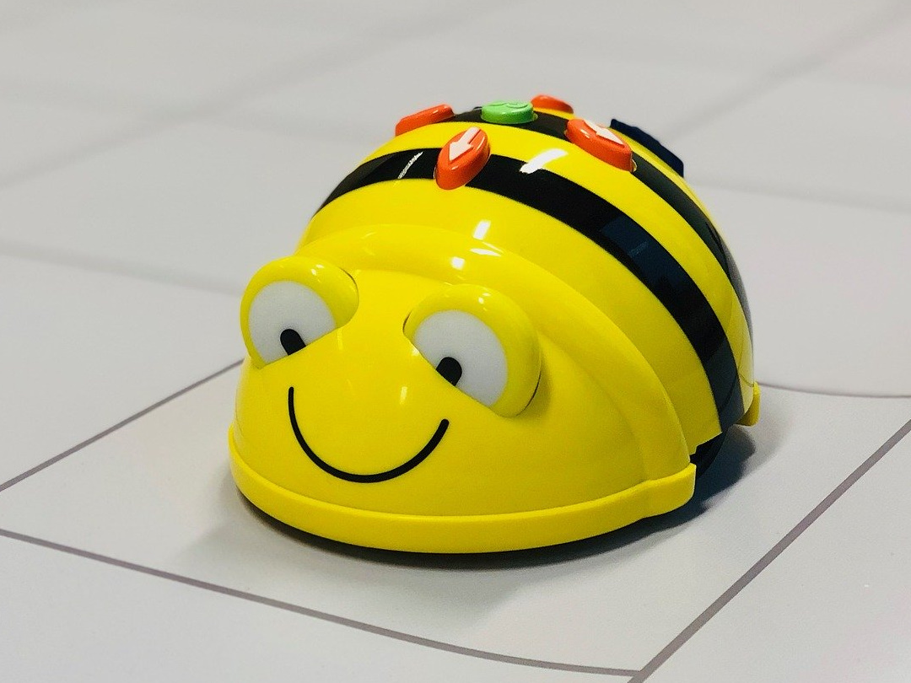
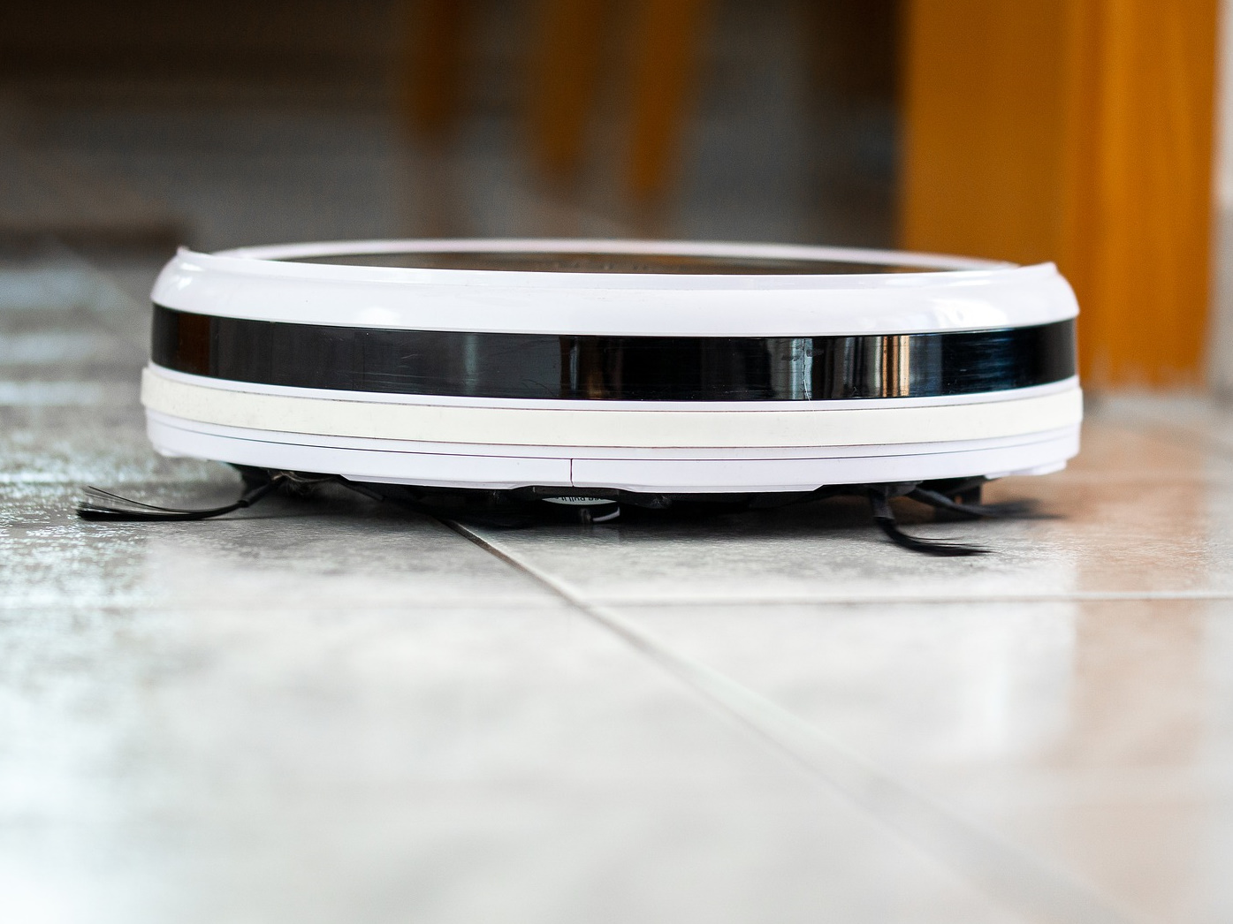
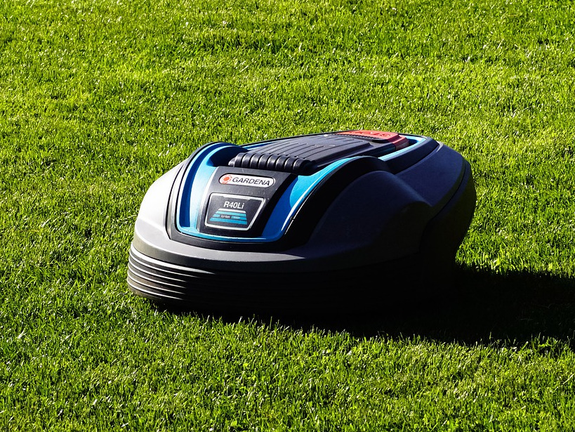
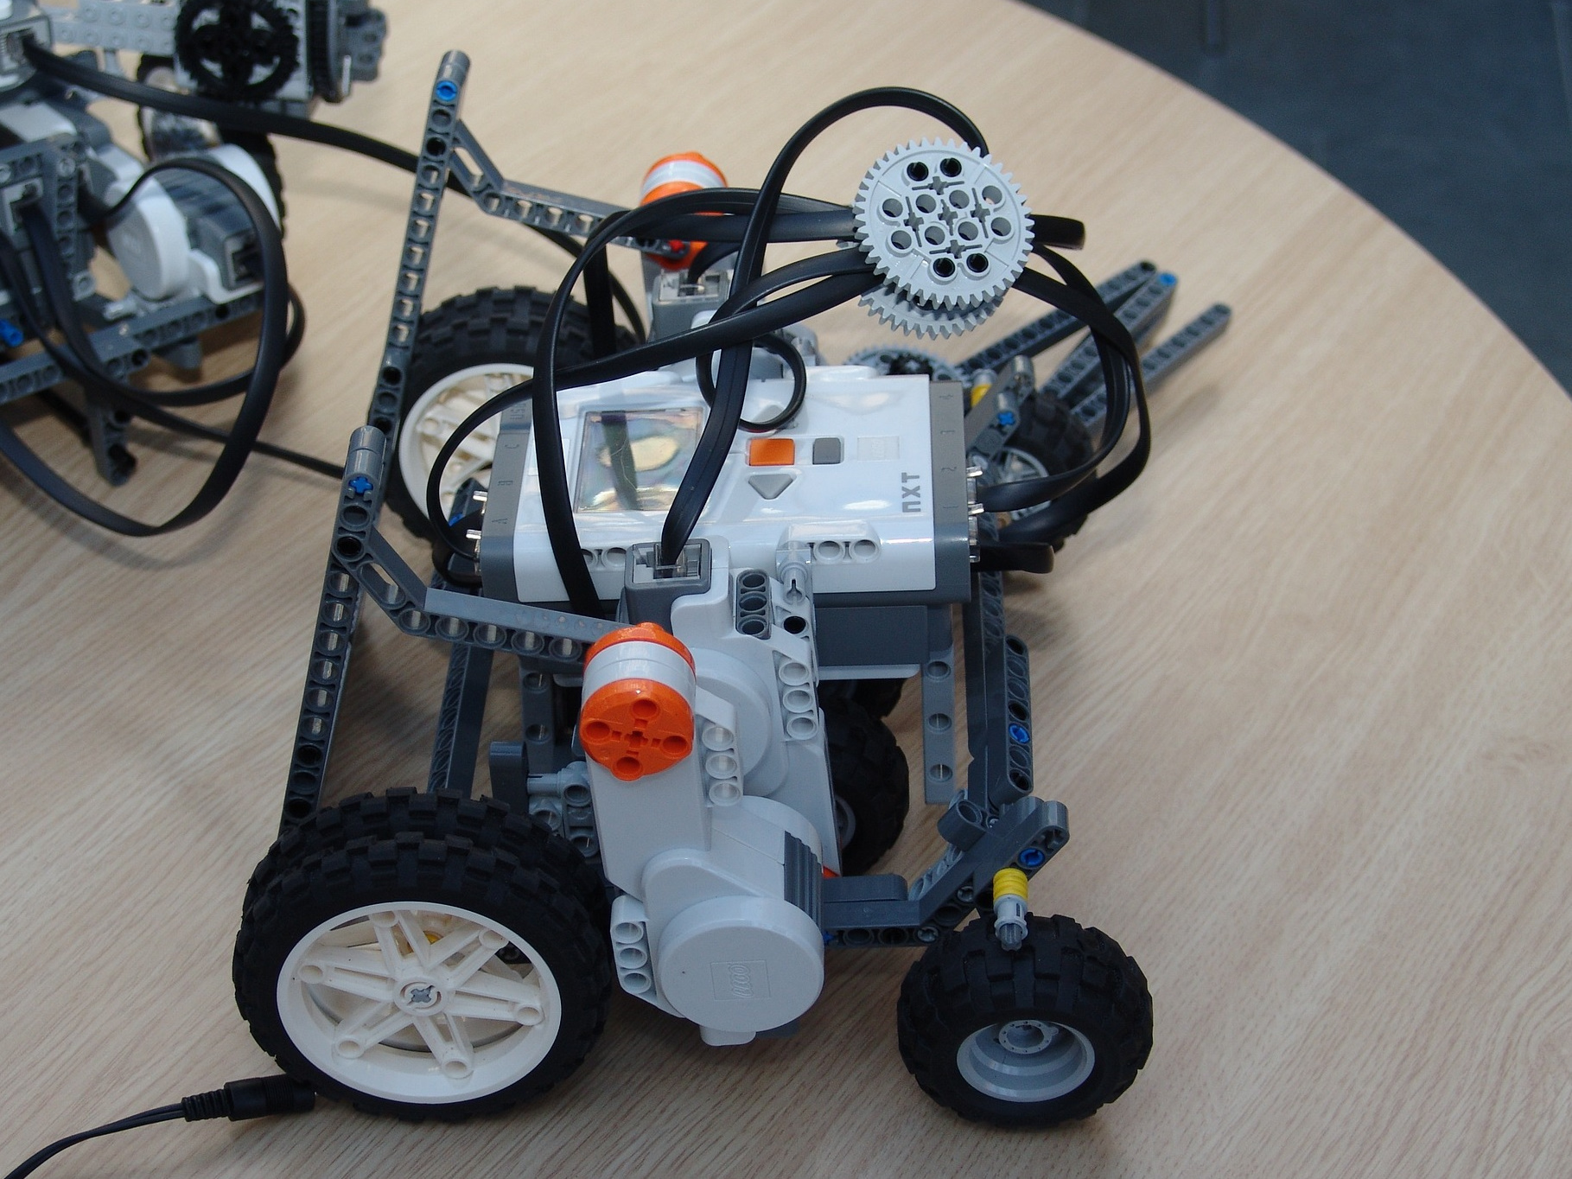
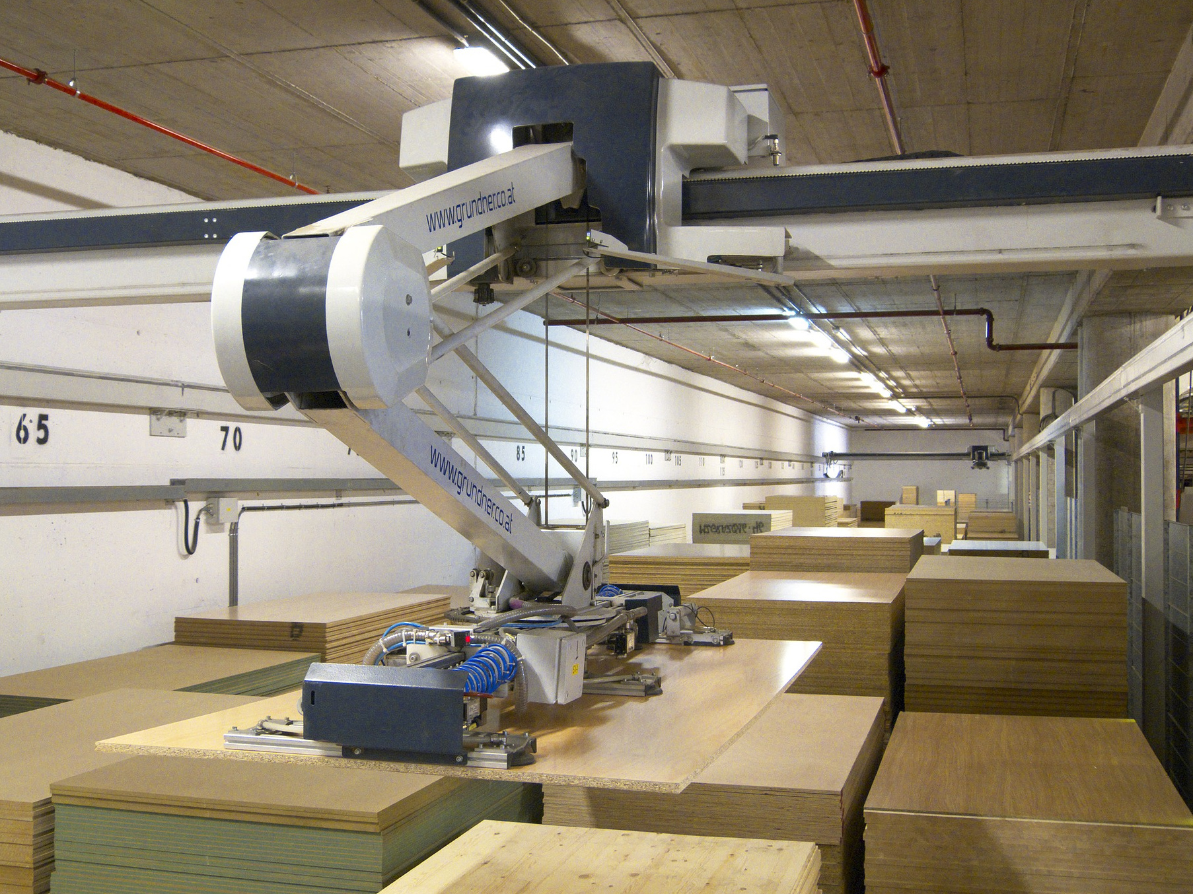
These are all robots
Introduction
TBAT: explain what a given command will do
What do we use robots for? Can you think of any robots you have used?
Notes:
https://pixabay.com/photos/lawn-mower-battery-mower-4502093/
https://pixabay.com/photos/mars-rover-robot-exhibit-space-2095270/
https://pixabay.com/photos/beebot-bee-robot-technology-4096410/
https://pixabay.com/photos/robot-warehouse-wood-2363400/
https://pixabay.com/photos/robot-technology-programming-675902/
https://pixabay.com/photos/vacuum-cleaner-robot-budget-4827253/

Slide 45
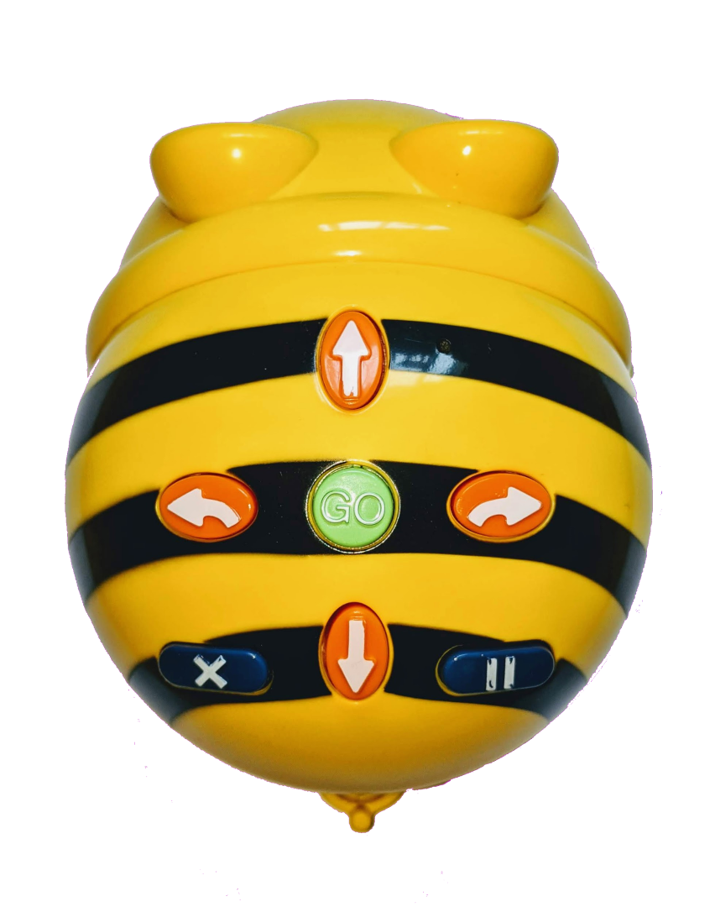
Your robots
Activity 1
TBAT: explain what a given command will do
Your robots have buttons on the top.
What do you think they do?
Notes:
https://pixabay.com/illustrations/search-to-find-internet-1013911/
Bee-bot: RPF image

Slide 46
Your robots
Activity 1
TBAT: explain what a given command will do
Before you press any buttons, talk to your partner about what you think they do.
Notes:
https://pixabay.com/illustrations/search-to-find-internet-1013911/
Bee-bot: RPF image

Slide 47
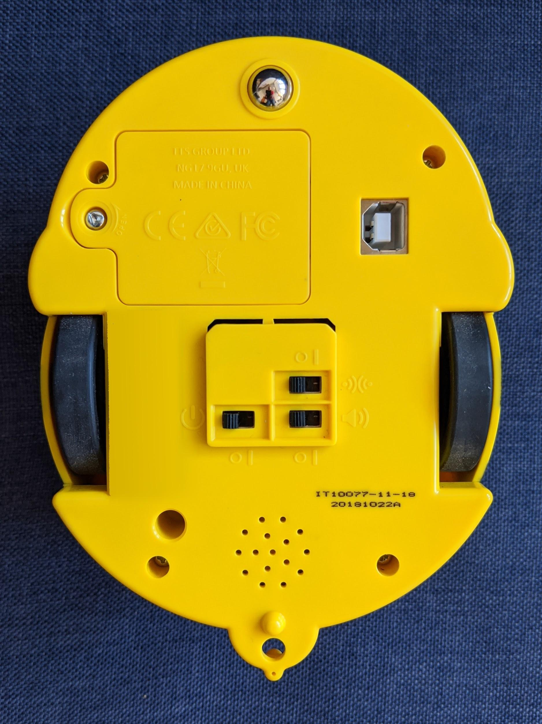
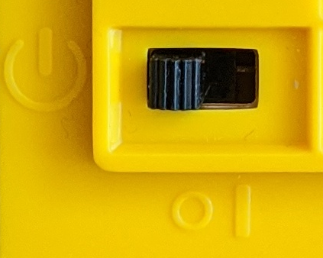
Try it out
Activity 1
TBAT: explain what a given command will do
You will need to switch the robot on. The switch is underneath.
Something lights up when you switch the robot on. Can you work out what it is?

Slide 48
Try it out
Activity 1
TBAT: explain what a given command will do
What does this button do?
It tells the robot to move forwards.
This is called a command.
Notes:
Bee-bot: RPF image

Slide 49
Try it out
TBAT: explain what a given command will do
Activity 1
Did this button do what you expected?
Did the buttons do what you expected them to?

Slide 50
Match them up
Activity 2
TBAT: explain what a given command will do
Your teacher is going to secretly press one button and then press Go.
After you see Bee-Bot move, place your finger on the button you think was used.
GO

Slide 51
Why are these two buttons very important?
Plenary
TBAT: explain what a given command will do
GO

Slide 52
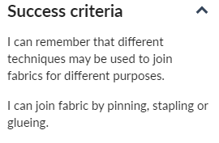
TBAT: join fabrics together using different methods.
Recap and recall:

Slide 53
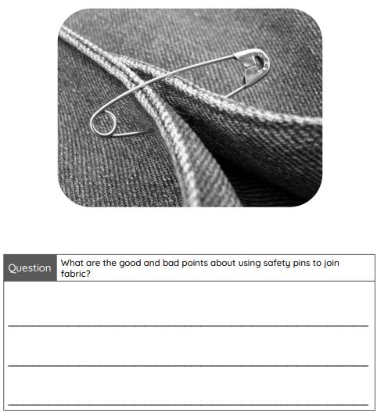
Who are the main characters in the story?
What do you know about the appearance of the main characters?
You are going to make a hand puppet of one of the characters and use it to retell the story.
Here are some examples of gloves, mittens and hand puppets for us to have a look at and discuss.
Today we will be joining fabrics together using different methods. One method is by using safety pins. Answer the question on your sheet about using safety pins. We will refer back to this later on in the unit.
Little Red Riding Hood - Gigglebox

Slide 54
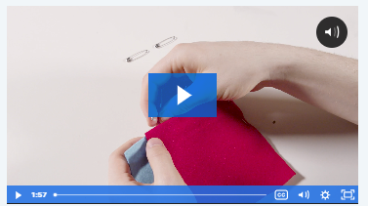
Technical knowledge
There are several ways of joining fabric together without sewing. Joining techniques are the different methods used to connect two pieces of material.
Today, we will look at three different joining techniques:
Pinning.
Stapling.
Glueing.
Use each joining technique safely and sensibly:
Safety pins have sharp points; watch where you place your fingers when opening and closing them or poking them through the material.
Keep hands out of the way of the lever when pressing on the stapler to avoid pinching your fingers, and keep the base of the stapler flat on the table.
Use glue spreaders and pots to limit the amount of glue the children can access and increase their ability to control where the glue is placed.
Lesson 1: Joining fabrics - Kapow Primary - pupil video
Make​
You will now try joining two pieces of fabric using each of the three joining techniques.

Slide 55
Plenary
Discuss the pros and cons of each method of joining fabric:
The gaps between pins.
The aesthetic appeal of pins.
The sharpness of pins or staples.
The speed of staples.
Discuss when you might use each different method:
Pinning might be used when you need something to be more secure/hold more weight but are not worried about having gaps (not suitable for holding tiny objects).
Glue is better for quickly adding small objects or sealing fabric together without gaps, but it will not be as strong as pins or staples and could come unstuck.
Questions
When is it best to use pins?
When is it best to use staples?
When is it best to use glue?
Which joining technique do you like best, and why?

Slide 56
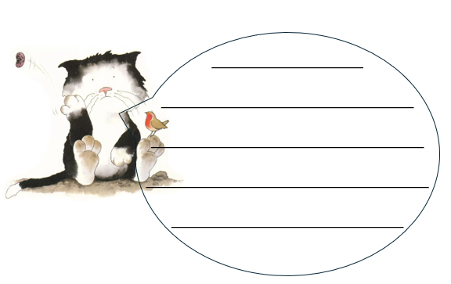
Independent Challenges:
Narrative Zone
Maths Zone
Fill in the speech bubbles, with something Jasper might say.
Enquiry Zone
Creative Zone
Experiment with the bee bots. Can you get them from A to B?

