Slide 1
Tuesday 4th February 2025
4/2/25

Slide 2
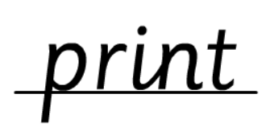
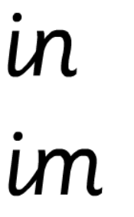
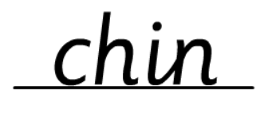
Morning Challenges:
Name writing

Slide 3
Phonics
Revisit and review
Tuesday 4th February 2025
4/2/25
TBAT
Read words with the /ee/ phoneme

Slide 4
Recap
ea e e-e ie
ey y ee

Slide 5
Revisit and review
Tuesday 4th February 2025
4/2/25
Today's Grapheme
ea/e/e-e
ie/ey/y/ee

Slide 6
happy
hairy
bodies
belief
monkey
honey
fever
secret
field
Where in the word?
Tuesday 4th February 2025
4/2/25
What are the digraphs?
Segment these
words and read them
Blend and say words

Slide 7
Best Bets
sheet
teeth
steep
treat
eating
each
these
least
Tuesday 4th February 2025
4/2/25
Sort the words under the correct grapheme

Slide 8
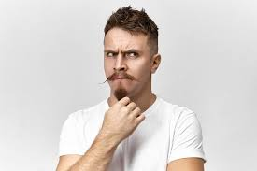
Revisit and review
where
would
Tuesday 4th February 2025
4/2/25
could
should
tricky words
whole
who
Read the tricky words
two

Slide 9
Tuesday 4th February 2025
4/2/25
Now let's read this sentence!​
What digraphs can you see?
What tricky words can you see?

Slide 10
Let's spell!
How many sounds? Write it.
Tuesday 4th February 2025
4/2/25
tricky words
happy secret want
Listen to the sentence, say it, write it and read it!
Challenge
Extend the sentence using 'and'

Slide 11
Year 1 Unit 8: Numbers to 50
TBAT: Compare and order numbers to 50

Slide 12
3 in3 Reading and writing numbers to 20
1
2
3
one
two
three
Notes:
Do Now: Reading and writing numbers to 20
On mini whiteboards, pupils write the numbers from zero to 20 in numerals and words. They could do this independently or use the printable resources ‘0–20 numerals and words’ as a prompt.

Slide 13
To compare and order numbers to 50
smaller
greater
greatest
smallest
less
order
least
ones
groups of ten

Slide 14
Represent these numbers on a place value chart
12
32
Which number has the greater value?
How do you know?
DYNAMIC REPRESENTATION
Build up your own representation, ‘live’ in the lesson
Notes:
New Learning: Representing and comparing two numbers
Pupils use interlocking cubes to represent the numbers 12 and 32 on a place value chart and discuss which has the greater value. Take feedback, listening particularly for whether pupils can explain that 32 has a greater value because it has three tens as opposed to one ten.
Share the pictorial representation on the next slide. Explain that when we compare 2-digit numbers we look at the ten first, because they have a greater value than the ones.
32 has more groups of ten than 12. It has three groups of ten and 12 has one group of ten. So 32 has a greater value than 12.
Ensure all pupils have a chance to repeat these key sentence structures.
Repeat for other pairs where the number of tens differ but the number of ones is the same.
Discuss an example where both numbers have the same number of tens, e.g. 29 and 25.
Which number has more groups of ten?
Neither of them. 29 and 25 both have two tens. They have an equal number of tens.
Discuss how in this case it is necessary to compare the ones.
29 has a greater number of ones. Nine is greater than five. So 29 has a greater value than 25.
Repeat for other pairs where the number of tens is the same and the number of ones differs.

Slide 15
Which number has the greater value? I know this because…
Blue/Green
12
Tens | Ones
32
Tens | Ones
12 has a smaller value than 32. It only has one ten.
32 has a greater value than 12. It has three tens.
Notes:
New Learning: Representing and comparing two numbers
Pupils use interlocking cubes to represent the numbers 12 and 32 on a place value chart and discuss which has the greater value. Take feedback, listening particularly for whether pupils can explain that 32 has a greater value because it has three tens as opposed to one ten.
Share the pictorial representation on the next slide. Explain that when we compare 2-digit numbers we look at the ten first, because they have a greater value than the ones.
32 has more groups of ten than 12. It has three groups of ten and 12 has one group of ten. So 32 has a greater value than 12.
Ensure all pupils have a chance to repeat these key sentence structures.
Repeat for other pairs where the number of tens differ but the number of ones is the same.
Discuss an example where both numbers have the same number of tens, e.g. 29 and 25.
Which number has more groups of ten?
Neither of them. 29 and 25 both have two tens. They have an equal number of tens.
Discuss how in this case it is necessary to compare the ones.
29 has a greater number of ones. Nine is greater than five. So 29 has a greater value than 25.
Repeat for other pairs where the number of tens is the same and the number of ones differs.

Slide 16
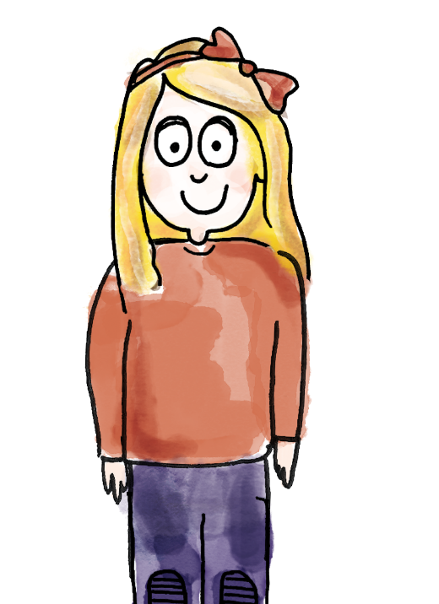
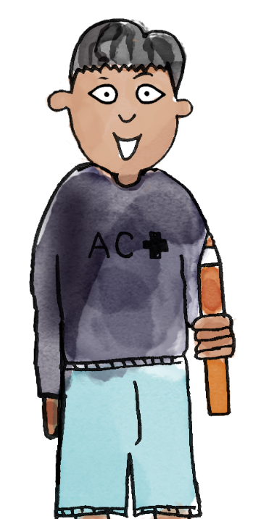
29
or
21
I have made 29.
It has two groups of ten and nine ones.
I have made 21.
It has two groups of ten and one one..
Tens | Ones
Tens | Ones
29 has a greater value than 21. They both have two groups of ten, but 29 has nine ones and 21 only has one one.
greater greatest smaller smallest less least order groups of ten ones
Notes:
Talk Task: Using comparative language
Pupils have concrete manipulatives of a type that can be grouped into tens and ones (not a fixed ten like Dienes), a large place value chart and the Task Sheet.
Pupil A represents the first number on their place value chart and says how many groups of ten and how many ones it has. Pupil B does the same for the second number. Pupil A says which number has a greater value and how they know. Pupils swap roles so that both have a chance to compare and explain.

Slide 17
Blue/ green What’s the same? What’s different?
32
23
Challenge:
Which is the greatest? How do you know?
DYNAMIC REPRESENTATION
Build up your own representation, ‘live’ in the lesson
Notes:
Develop Learning: Ordering a set of numbers
Show the numbers 32 and 23 and ask pupils what’s the same and what’s different. Invite pupils to make concrete representations on place value charts to compare the tens and ones.
Then show three numbers: 37, 34 and 27. Invite pupils to create each number using concrete manipulatives on place value charts. Support pupils to order the numbers from least to greatest value, using the concrete representations to support their reasoning. Remind pupils to begin by comparing the tens, and if the number of tens is the same, compare the ones. Ensure pupils are practising key sentence structures, e.g.
34 has a greater value than 27 because 34 has three groups of ten and 27 has two groups of ten.

Slide 18
Which number has the least value?
Which has the greatest value?
How do you know?
37
34
27
least
greatest
DYNAMIC REPRESENTATION
Build up your own representation, ‘live’ in the lesson
Notes:
Develop Learning: Ordering a set of numbers
Show the numbers 32 and 23 and ask pupils what’s the same and what’s different. Invite pupils to make concrete representations on place value charts to compare the tens and ones.
Then show three numbers: 37, 34 and 27. Invite pupils to create each number using concrete manipulatives on place value charts. Support pupils to order the numbers from least to greatest value, using the concrete representations to support their reasoning. Remind pupils to begin by comparing the tens, and if the number of tens is the same, compare the ones. Ensure pupils are practising key sentence structures, e.g.
34 has a greater value than 27 because 34 has three groups of ten and 27 has two groups of ten.

Slide 19
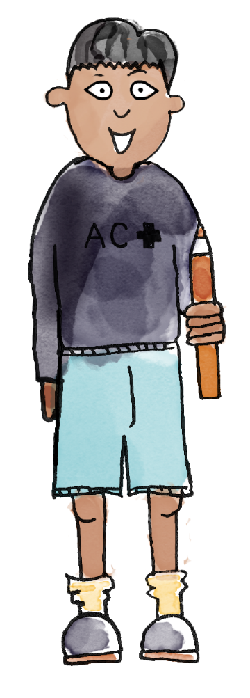
Do you agree with this child? Why/why not?
I think 16 is greater than 32 because it has six ones and 32 only has two ones.
Convince your partner that the child is correct/incorrect.
Notes:
Plenary: Addressing a misconception
Ask pupils to look at the statement: ‘I think 16 is greater than 32 because it has six ones and 32 only has two ones.’ Pupils discuss whether they agree or disagree, explaining their reasoning using manipulatives.

Slide 20
Compare the value of numbers using a number line
0
1
2
3
4
5
6
7
8
9
10
11
12
13
14
15
16
17
18
19
20
21
22
23
24
25
26
27
28
29
30
31
32
33
34
35
36
37
38
39
40
41
42
43
44
45
46
47
48
49
50
_____ has a greater value than _____.
_____ is further along the number line.
Notes:
New Learning: Identifying and comparing two numbers on the number line
This lesson builds on learning from Unit 4 Lesson 6, where pupils compared and ordered numbers up to 20 on a number line.
Show a 0–50 number line.
When we move to the right on the number line, what happens to the value of the numbers?
The numbers increase in value. Each number is one greater than the number next to it.
When we move to the left, what happens to the value of the numbers?
The numbers decrease in value. Each number is one less than the number next to it.
Explain that we can use this to compare the value of numbers.
Pick two numbers and circle them on the number line. Use this sentence structure:
48 has a greater value than 41. 48 is further along the number line.
Repeat for another pair, using the number line on the next slide and this sentence structure:
29 has a smaller value than 30. 29 is closer to zero on the number line.
Demonstrate the same comparison using two bead strings, holding them one on top of the other to see which has the greater value. The next slide can be used to support this.
(Note: when using bead strings, encourage pupils to move beads in blocks of ten and then ones to reinforce previous learning in this unit.)

Slide 21
Compare the value of numbers using a number line
0
1
2
3
4
5
6
7
8
9
10
11
12
13
14
15
16
17
18
19
20
21
22
23
24
25
26
27
28
29
30
31
32
33
34
35
36
37
38
39
40
41
42
43
44
45
46
47
48
49
50
_____ has a smaller value than _____.
_____ is closer to zero on the number line.
Notes:
New Learning: Identifying and comparing two numbers on the number line
This lesson builds on learning from Unit 4 Lesson 6, where pupils compared and ordered numbers up to 20 on a number line.
Show a 0–50 number line.
When we move to the right on the number line, what happens to the value of the numbers?
The numbers increase in value. Each number is one greater than the number next to it.
When we move to the left, what happens to the value of the numbers?
The numbers decrease in value. Each number is one less than the number next to it.
Explain that we can use this to compare the value of numbers.
Pick two numbers and circle them on the number line. Use this sentence structure:
48 has a greater value than 41. 48 is further along the number line.
Repeat for another pair, using the number line on the next slide and this sentence structure:
29 has a smaller value than 30. 29 is closer to zero on the number line.
Demonstrate the same comparison using two bead strings, holding them one on top of the other to see which has the greater value. The next slide can be used to support this.
(Note: when using bead strings, encourage pupils to move beads in blocks of ten and then ones to reinforce previous learning in this unit.)

Slide 22
Compare the value of numbers using bead strings
25
41
0
1
2
3
4
5
6
7
8
9
10
11
12
13
14
15
16
17
18
19
20
21
22
23
24
25
26
27
28
29
30
31
32
33
34
35
36
37
38
39
40
41
42
43
44
45
46
47
48
49
50
DYNAMIC REPRESENTATION
Build up your own representation, ‘live’ in the lesson
Notes:
New Learning: Identifying and comparing two numbers on the number line
This lesson builds on learning from Unit 4 Lesson 6, where pupils compared and ordered numbers up to 20 on a number line.
Show a 0–50 number line.
When we move to the right on the number line, what happens to the value of the numbers?
The numbers increase in value. Each number is one greater than the number next to it.
When we move to the left, what happens to the value of the numbers?
The numbers decrease in value. Each number is one less than the number next to it.
Explain that we can use this to compare the value of numbers.
Pick two numbers and circle them on the number line. Use this sentence structure:
48 has a greater value than 41. 48 is further along the number line.
Repeat for another pair, using the number line on the next slide and this sentence structure:
29 has a smaller value than 30. 29 is closer to zero on the number line.
Demonstrate the same comparison using two bead strings, holding them one on top of the other to see which has the greater value. The next slide can be used to support this.
(Note: when using bead strings, encourage pupils to move beads in blocks of ten and then ones to reinforce previous learning in this unit.)

Slide 23
0
1
2
3
4
5
6
7
8
9
10
11
12
13
14
15
16
17
18
19
20
21
22
23
24
25
26
27
28
29
30
31
32
33
34
35
36
37
38
39
40
41
42
43
44
45
46
47
48
49
50
I’ve circled 35 on the number line.
Now I’ll make 35 on my bead string: ten, twenty, thirty, 31, 32, 33, 34, 35.
The number 17 is here on the number line. And this is it on a bead string: ten, 11, 12, 13, 14, 15, 16, 17.
35 is greater than 17 because it is further away from zero on the number line.
17 is less than 35. It is further left on the number line.
greater than less than between value compare tens ones
Notes:
Talk Task: Using comparative language
Pupils have a copy of the Task Sheet between them and a bead string each.
Pupil A circles the first number on the number line and makes it on a bead string (moving blocks of ten first, then individual beads for the ones). Pupil B does the same for the second number. Pupil A says whether their number is greater or smaller and explains why. Pupil B does the same for their number.

Slide 24
On white boards, Show me a number that is greater than …
Blue:
Show your partner a number greater than 26.
How do you know it is greater than 26?
Green:
Show your partner a number less than 26.
How do you know it is less than 26?
DYNAMIC REPRESENTATION
Build up your own representation, ‘live’ in the lesson
Notes:
Develop Learning: Identifying relative positions of numbers on a number line
Pupils work in pairs, with a bead string each. Give them a number and ask them to show numbers greater and less than it. For example:
Pupil A/B, show your partner a number greater/less than 26. How do you know it is greater/less?
I made 29. I know it is greater than 26 because I made 26 and added three more beads.
I have made 18. I know it is less than 26 because it has one ten and 26 has two tens
Take feedback from a pair of pupils, marking their numbers on the number line on the next slide. Model the following sentence and have pupils repeat:
26 is between __ and __.
Repeat with other examples.

Slide 25
Numbers in between
0
1
2
3
4
5
6
7
8
9
10
11
12
13
14
15
16
17
18
19
20
21
22
23
24
25
26
27
28
29
30
31
32
33
34
35
36
37
38
39
40
41
42
43
44
45
46
47
48
49
50
26 is between _____ and _____.
How many different ways can you complete this sentence?
DYNAMIC REPRESENTATION
Build up your own representation, ‘live’ in the lesson
Notes:
Develop Learning: Identifying relative positions of numbers on a number line
Pupils work in pairs, with a bead string each. Give them a number and ask them to show numbers greater and less than it. For example:
Pupil A/B, show your partner a number greater/less than 26. How do you know it is greater/less?
I made 29. I know it is greater than 26 because I made 26 and added three more beads.
I have made 18. I know it is less than 26 because it has one ten and 26 has two tens
Take feedback from a pair of pupils, marking their numbers on the number line on the next slide. Model the following sentence and have pupils repeat:
26 is between __ and __.
Repeat with other examples.

Slide 26
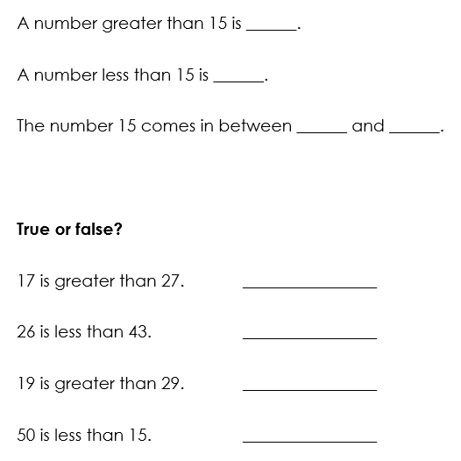
TBAT: compare and order numbers to 50
Represent each number on a place value chart.
Use this to compare the numbers using the star words.
Then write the numbers in order from least to greatest.
Notes:
Independent Task
Pupils have one copy of the Task Sheet between two. They also need a large place value chart and concrete manipulatives. They represent each number to compare and order and talk about how they know which number has the greatest/least value.
Possible adaptations:
The sets of numbers for pupils to order could be adapted, e.g. they could all have different tens values (8, 13 and 25).
Pupils could be provided with pictorial representations of the values, which they then ‘copy’ using manipulatives and then order.

Slide 27
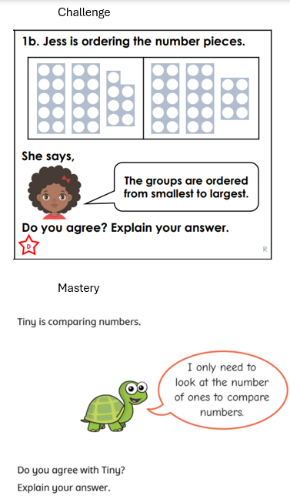
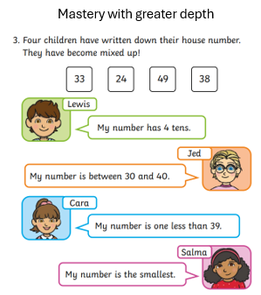

Slide 28
Guess my number
0
1
2
3
4
5
6
7
8
9
10
11
12
13
14
15
16
17
18
19
20
21
22
23
24
25
26
27
28
29
30
31
32
33
34
35
36
37
38
39
40
41
42
43
44
45
46
47
48
49
Notes:
Plenary: Guess my number
Play ‘guess my number’. Tell pupils you are thinking of a number and its value is greater than 20 but less than 40. Pupils must ask comparative questions (not just guess the number), e.g. Is it greater than 27? If the answer is yes, model crossing off all the numbers less than 27. If pupils do not offer questions using ‘between’, model this, e.g. Is it between 34 and 40?

Slide 29
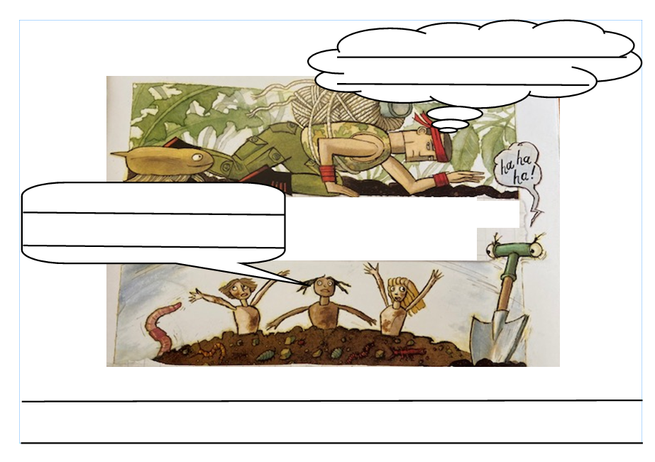
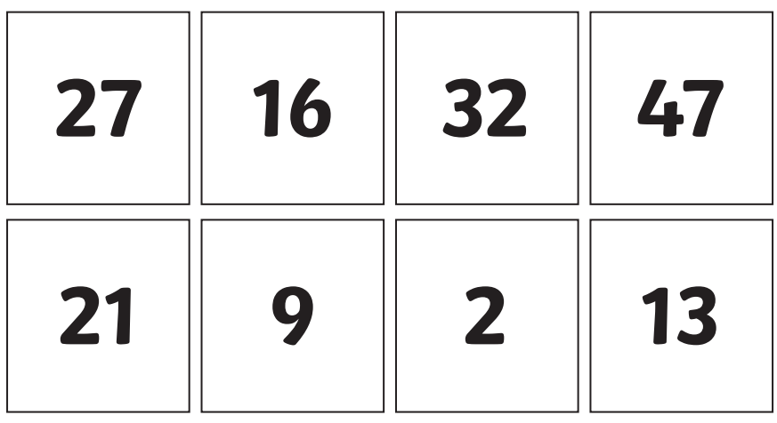
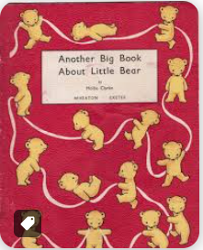
Independent Challenges:
Narrative Zone
Maths Zone
Add speech bubbles and commands to the images of Traction Man.
Cut out the numbers and order them from smallest to greatest
Enquiry Zone
Creative Zone
Design an 'emotion' charcter like the characters from Inside Out.
Explore the differences between the books published in 1961 and 2022.

Slide 30
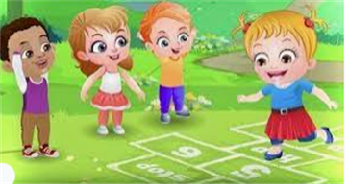
Break

Slide 31
PE- TBAT: Explore speeds and actions
Warm up – Sleeping toys
Move around the space. When the teacher shouts ‘sleeping toys!’ lie down and go to sleep. When the teacher shouts ‘rise and shine!’ Wake up again and move around.

Slide 32
Skill development – Exploring toy movements
Think of your own action.
Now, move like toys

Slide 33
Magical toy box
Choose three toys to put in your toy box. Practise your actions.
Add a pose at the beginning and end so that the audience knows when the dance has ended.
Perform your dance!

Slide 34
Lunch

Slide 35
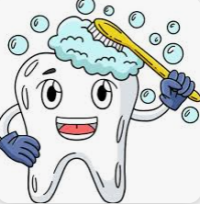
Toothbrushing

Slide 36
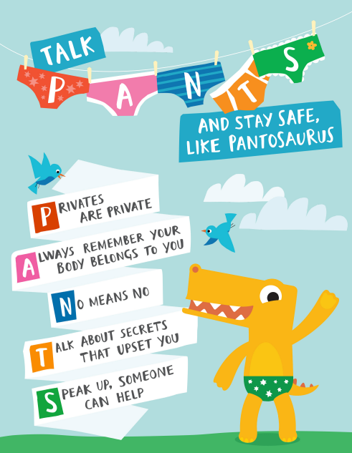
PSHE- TBAT: know how to keep our bodies safe.
The Pantosaurus Song! | #TalkPANTS | NSPCC - YouTube

Slide 37
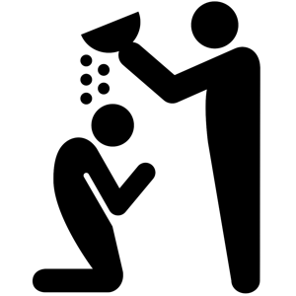
What is a baptism?
Tuesday 4th February 2025
Lesson 5

Slide 38
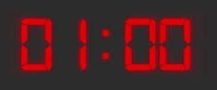
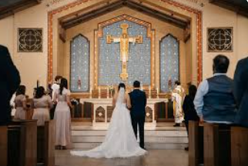
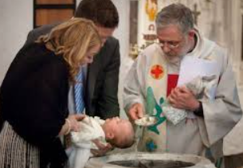
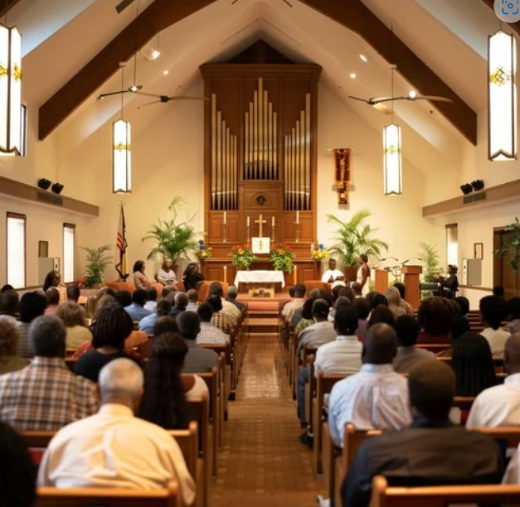
Key Question: What is a baptism?
Tuesday 4th February 2025
Blue/ Green
Green, tell your partner if you have ever been to a service like these in a church.
Blue, have you ever been to a service like these in a church.
Use a full sentence: I have been to church for..............

Slide 39
Key Question: What is a baptism?
Tuesday 4th February 2025
A special worship service that Christians have in a church is called a baptism.
Have you been to a baptism?
Do you know if you were baptised?

Slide 40
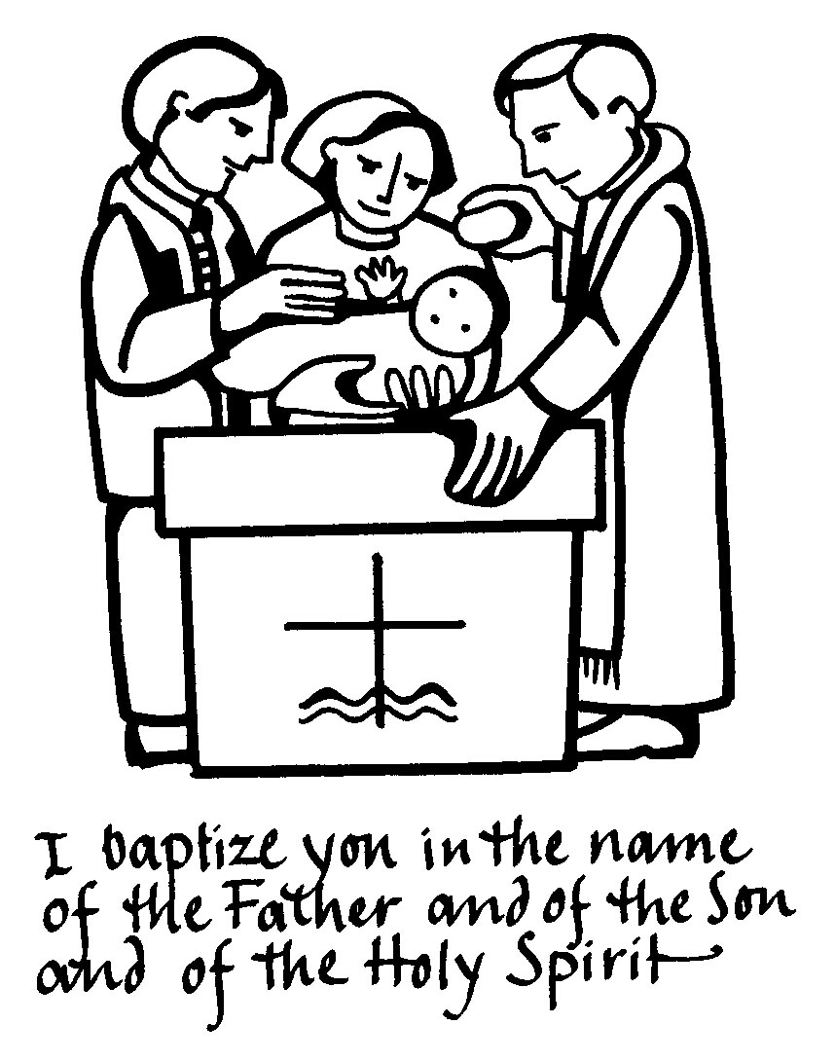
Key Question: What is a baptism?
A baptism is a ceremony where someone becomes a member of the Christian community.
A priest uses special, blessed water called holy water to wash away any bad things the person has done (sins) and welcome them into Christianity.
Sometimes when it is a baby being baptised it is called a christening.

Slide 41
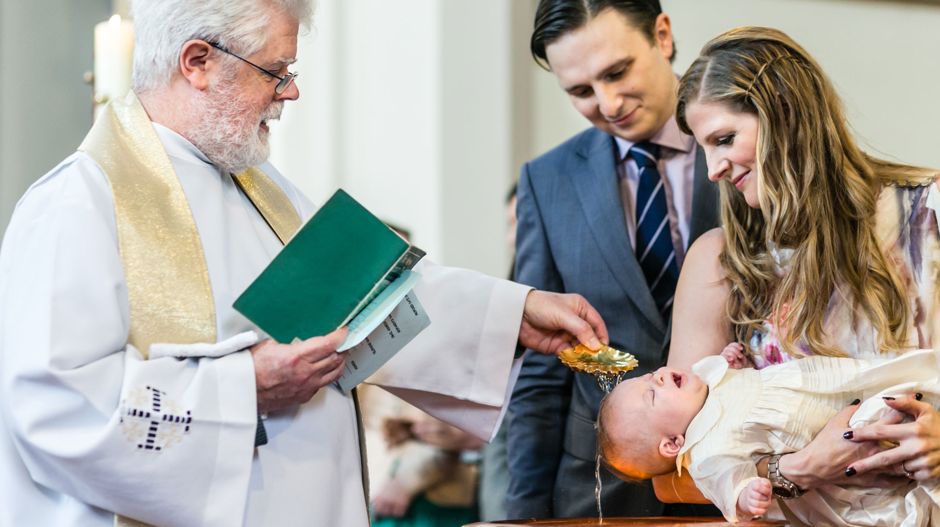
It can be done with babies

Slide 42
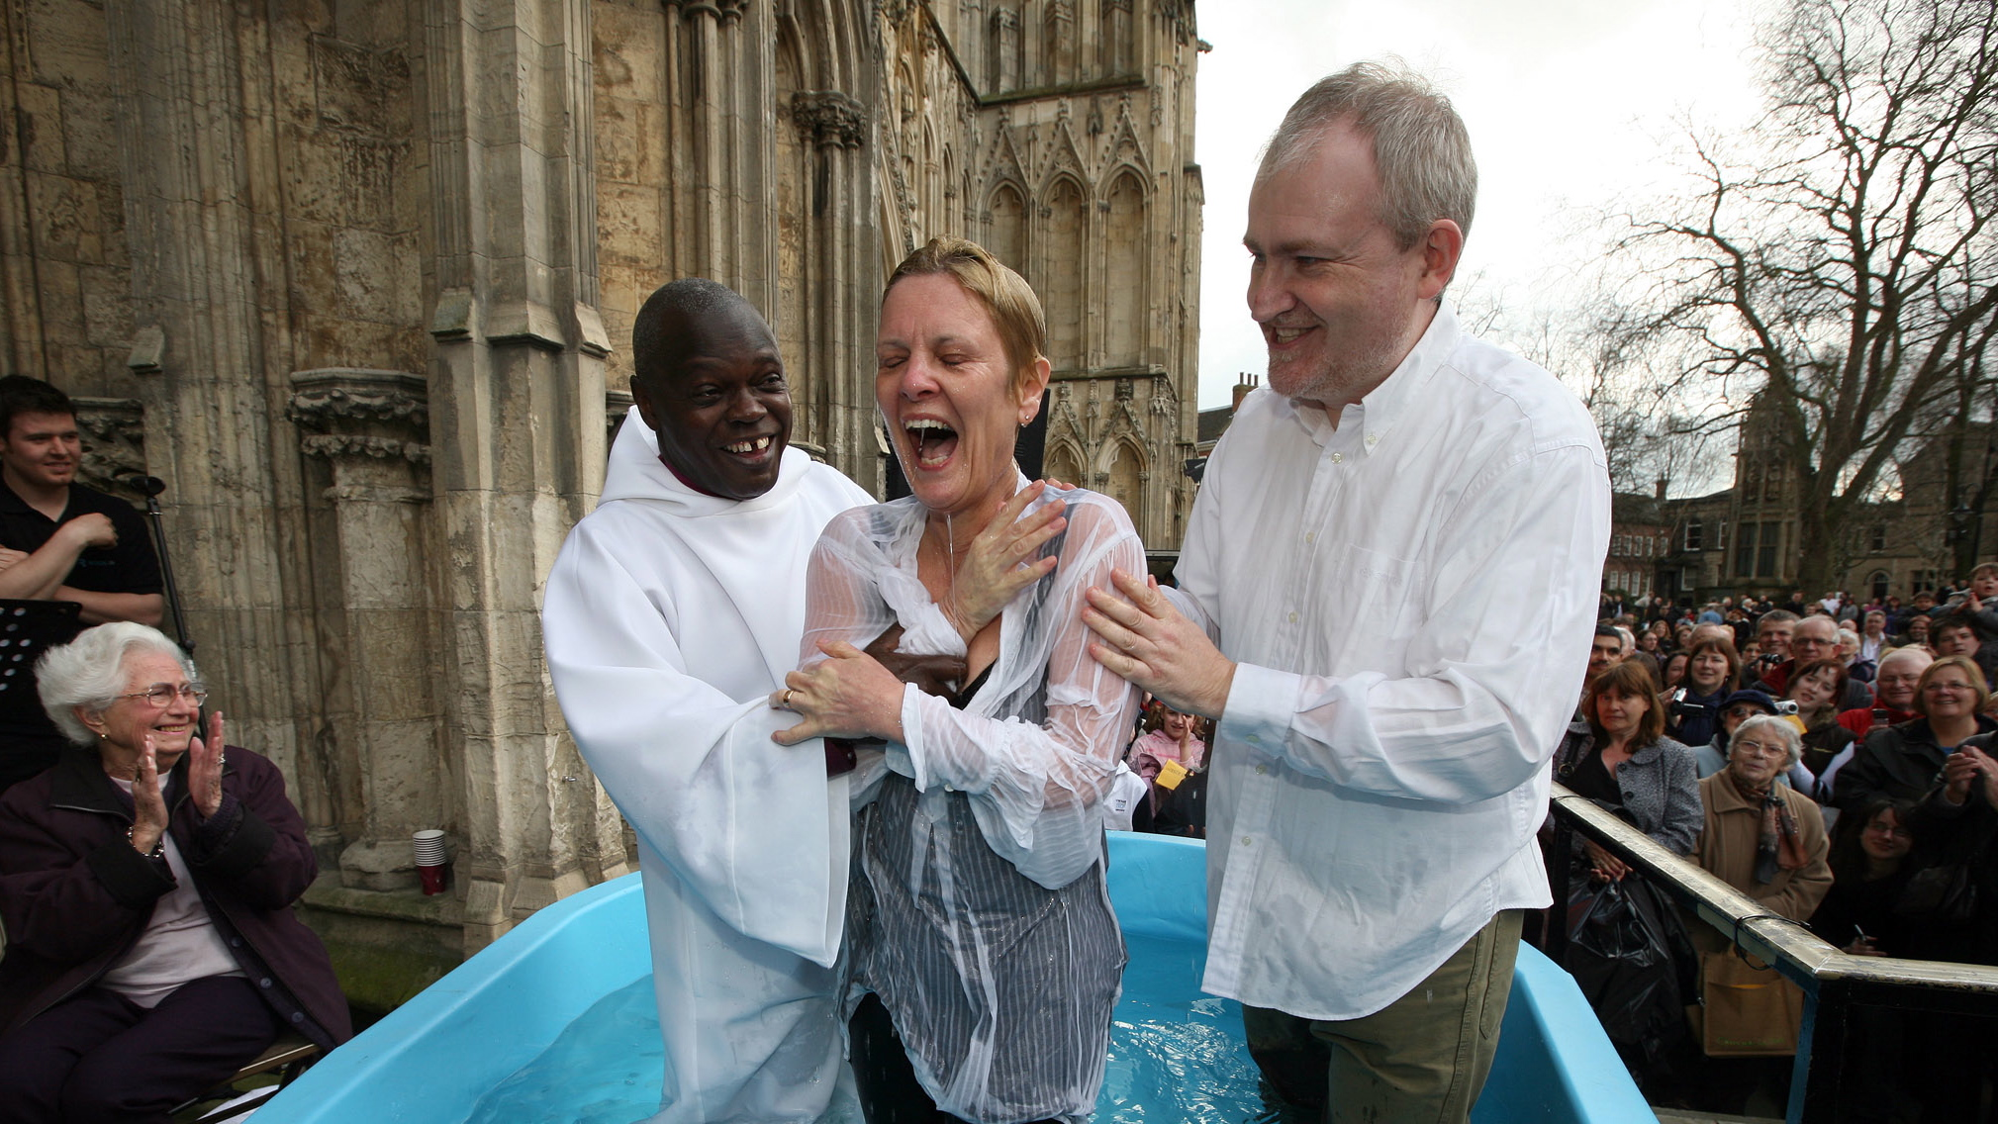
Or with adults!

Slide 43
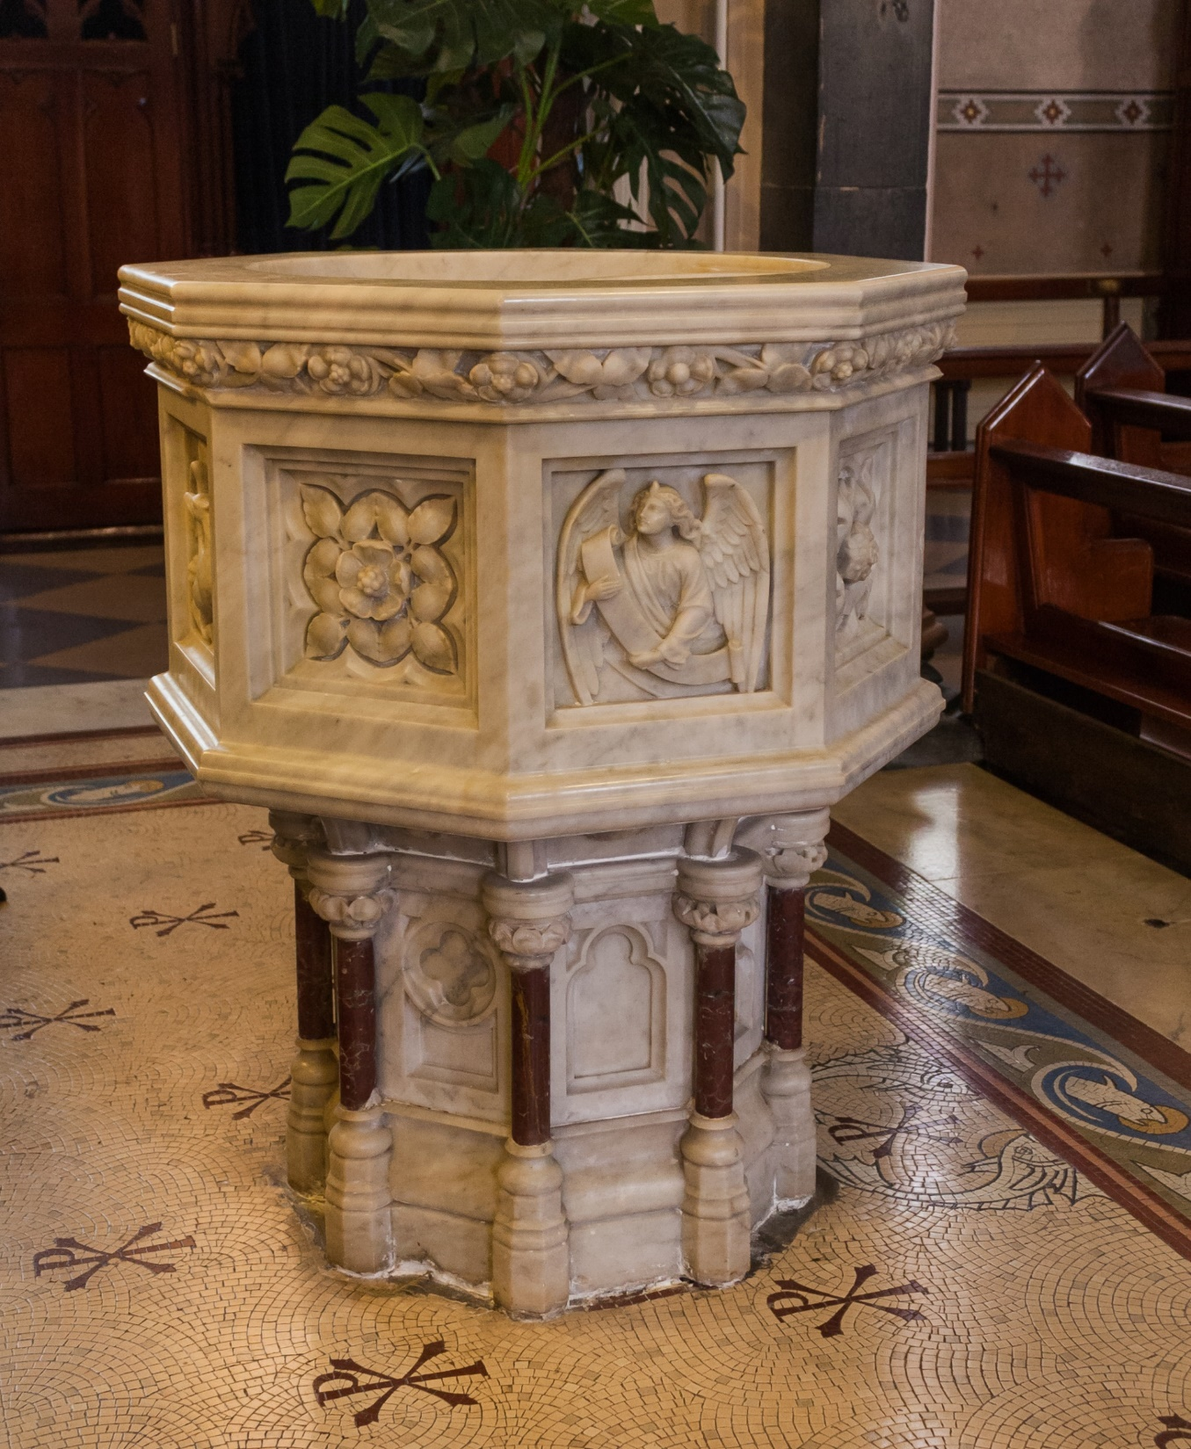
Key Question: What is a baptism?
The holy water is usually kept in this special bowl which is called a font.

Slide 44
Key Question: What is a baptism?
Tuesday 4th February 2025
Christians see baptism as a kind of holy bath. They say the holy water carries the special power of God and washes away all your previous sins (bad things).

Slide 45
Independent Challenges:
Narrative Zone
Maths Zone
Add speech bubbles and commands to the images of Traction Man.
Cut out the numbers and order them from smallest to greatest
Enquiry Zone
Creative Zone
Design an 'emotion' charcter like the characters from Inside Out.
Explore the differences between the books published in 1961 and 2022.

