Slide 1
Thursday 6th February 2025
6/2/25

Slide 2
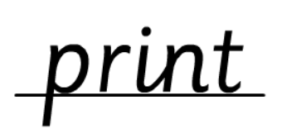
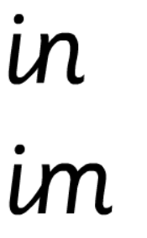
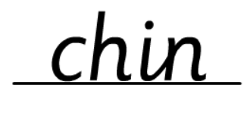
Morning Challenges:
Name writing
Year 1- Feedback | Next Steps

Slide 3
Phonics
Thursday 6th Febuary 2025
6/2/25
Revisit and review
Lesson focus:
Read words with the /s/z phoneme

Slide 4
Recap
Thursday 6th Febuary 2025​
6/2/25
c se ce
s zz ss

Slide 5
Revisit and review
Thursday 6th Febuary 2025
6/2/25
Today's Grapheme
ce/se

Slide 6
face
space
success
visit
fizzy
princess
tease
Revisit and review
Thursday 6th Febuary 2025
6/2/25
Where in the word?

Slide 7
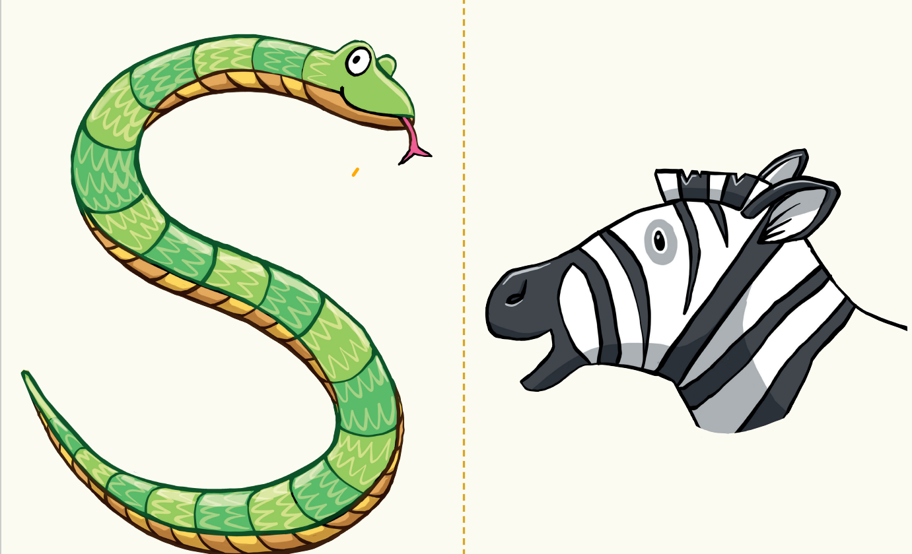
Teach and Practise
Sort the words
Thursday 6th Febuary 2025
6/2/25
horse fence ice cosmic cheese puzzle noise

Slide 8
Revisit and review
Thursday 6th Febuary 2025
6/2/25
Ms
school
Mrs
call
tricky words
Mr
different
Read the tricky words

Slide 9
Thursday 6th Febuary 2025
6/2/25
Now let's read this sentence!​
What digraphs can you see?
What tricky words can you see?

Slide 10
Thursday 6th Febuary 2025
6/2/25
Let's spell!
How many sounds? Write it.
tricky words
visit fizzy could
Listen to the sentence, say it, write it and read it!
Challenge
Extend the sentence using 'and'

Slide 11
Year 1 Unit 8: Numbers to 50
TBAT: practise and apply counting in twos and fives

Slide 12
Five tennis
Notes:
Do Now: Five tennis
Pupils practise counting in fives, in pairs. Pupil A says ‘five’, Pupil B ‘ten’ and so on until they reach 50. The other pupil begins next time.

Slide 13
TBAT: practise and apply counting in twos and fives
groups of five
groups of two

Slide 14
Blue/green How could we count these cubes? Think of two ways you could count them. Can you think of any other ways?
Notes:
New Learning: Counting a set of objects in twos
Pupils should be familiar with skip counting in twos. This lesson is an opportunity to build upon their familiarity with the ‘chanting’ aspect of this by linking it to concrete and pictorial representations.
Practise skip counting in twos from zero to 50 a few times. You could mark the pattern on a number line and ask pupils to describe the pattern, e.g. that each jump ‘skips’ one number. Show pupils the representation on the slide, showing cubes on ten-frames. Discuss how the cubes could be counted. Pupils might suggest counting individually, or counting the groups of ten and then the extra ones, counting groups of two, etc. You could try each of these options and discuss which is more efficient and how they all result in the same answer.
Explain that the ten-frames make it easy to count in twos. Model counting the cubes in twos, with pupils chanting along. Draw a ring around each horizontal group of two and then count together in twos to check the total.
Give pupils the ‘ten-frames’ and some cubes and ask them to make the representation on the next slide (two full ten-frames and four more). Count the total as a class together, touching two cubes at a time.
Repeat with an odd number of cubes, e.g. 17. Discuss how to count the ‘odd’ one.

Slide 15
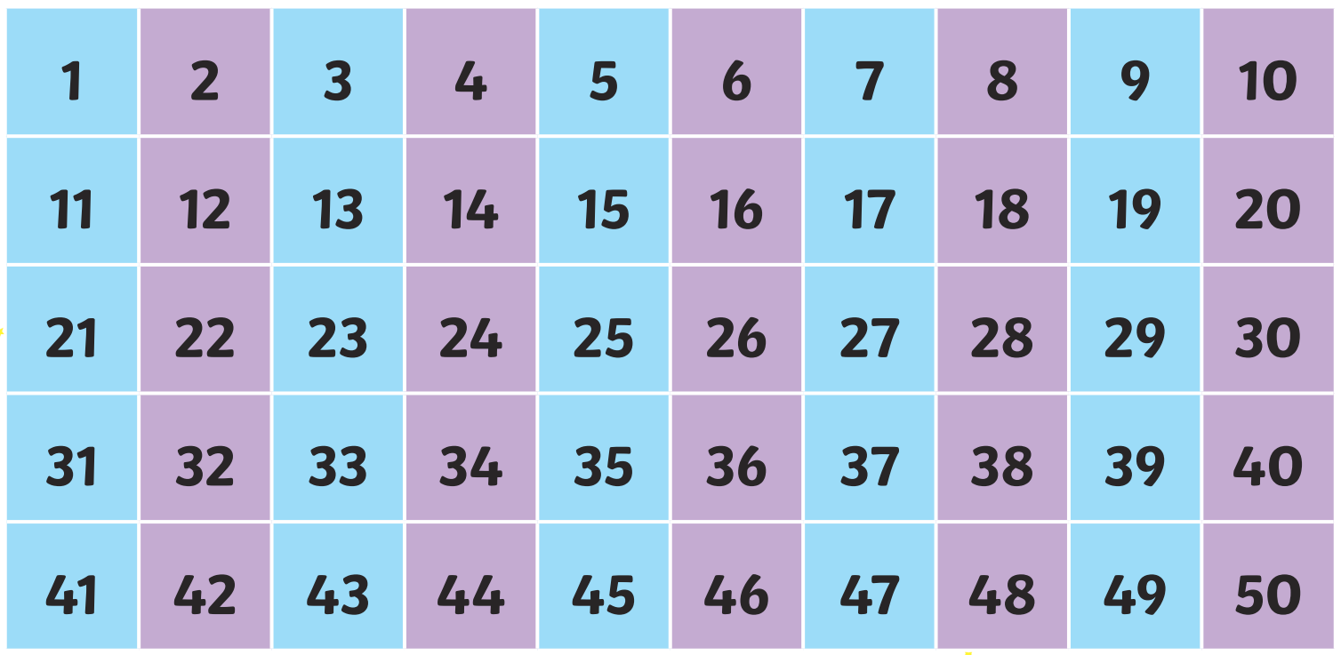
Counting in 2s – Blue/Green What do you notice?

Slide 16
Make this representation
Let’s count the cubes in twos.
DYNAMIC REPRESENTATION
Build up your own representation, ‘live’ in the lesson
Notes:
New Learning: Counting a set of objects in twos
Pupils should be familiar with skip counting in twos. This lesson is an opportunity to build upon their familiarity with the ‘chanting’ aspect of this by linking it to concrete and pictorial representations.
Practise skip counting in twos from zero to 50 a few times. You could mark the pattern on a number line and ask pupils to describe the pattern, e.g. that each jump ‘skips’ one number. Show pupils the representation on the slide, showing cubes on ten-frames. Discuss how the cubes could be counted. Pupils might suggest counting individually, or counting the groups of ten and then the extra ones, counting groups of two, etc. You could try each of these options and discuss which is more efficient and how they all result in the same answer.
Explain that the ten-frames make it easy to count in twos. Model counting the cubes in twos, with pupils chanting along. Draw a ring around each horizontal group of two and then count together in twos to check the total.
Give pupils the ‘ten-frames’ and some cubes and ask them to make the representation on the next slide (two full ten-frames and four more). Count the total as a class together, touching two cubes at a time.
Repeat with an odd number of cubes, e.g. 17. Discuss how to count the ‘odd’ one.

Slide 17
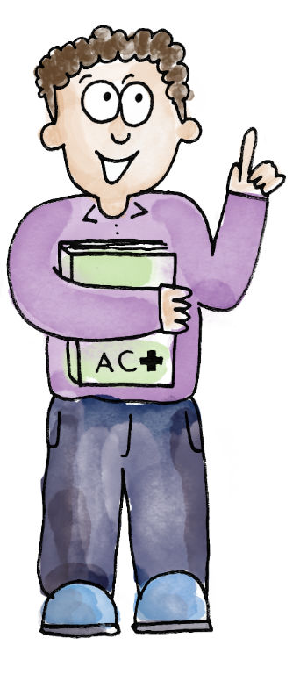
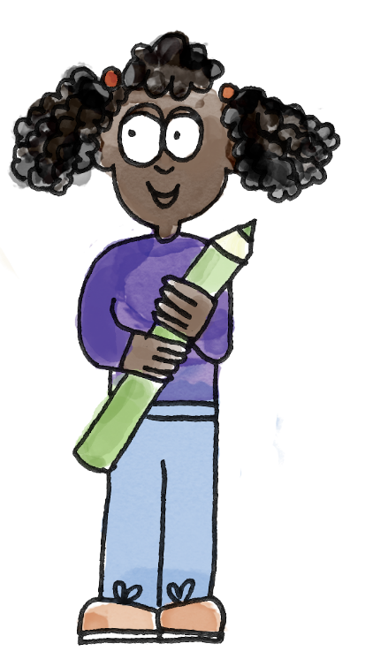
I’ve made my number on the ten-frames.
Two, four, six, […] 26.
You made the number 26.
Two, four, six, […] 26. You counted correctly. I did make the number 26!
groups of two groups of five
Notes:
Talk Task: Counting in twos
Pupils have the ‘ten-frames’ and cubes/counters.
Pupil A makes a number from one to 50 on the ten-frames. Pupil B counts in twos to find out what number has been made. Pupil A counts in twos to check. Pupils swap roles and repeat.

Slide 18
How could we count these cubes?
DYNAMIC REPRESENTATION
Build up your own representation, ‘live’ in the lesson
Notes:
Develop Learning: Counting a set of objects in fives
Choose pupils to share their sentences from the Talk Task and address any misconceptions (particularly pupils who counted two for the odd one in an odd number).
Show the cube representation on the slide.
How could we count the number of cubes?
As in the New Learning, you could try pupils’ suggestions and discuss.
Explain that you can count in fives, because there are five cubes in each column of a ten-frame. Model counting the cubes in fives, with pupils chanting along. Draw a ring around each vertical group of five and then count together in fives to check the total.
Discuss an example which is not a multiple of five, like the one shown on the next slide. Model counting all the full groups of five and then counting on (or deliberately model a mistake and have pupils suggest how to count).
Practise further examples as necessary.

Slide 19
Counting in 5s – Blue/Green What do you notice?

Slide 20
Can we still count in fives?
DYNAMIC REPRESENTATION
Build up your own representation, ‘live’ in the lesson
Notes:
Develop Learning: Counting a set of objects in fives
Choose pupils to share their sentences from the Talk Task and address any misconceptions (particularly pupils who counted two for the odd one in an odd number).
Show the cube representation on the slide.
How could we count the number of cubes?
As in the New Learning, you could try pupils’ suggestions and discuss.
Explain that you can count in fives, because there are five cubes in each column of a ten-frame. Model counting the cubes in fives, with pupils chanting along. Draw a ring around each vertical group of five and then count together in fives to check the total.
Discuss an example which is not a multiple of five, like the one shown on the next slide. Model counting all the full groups of five and then counting on (or deliberately model a mistake and have pupils suggest how to count).
Practise further examples as necessary.

Slide 21
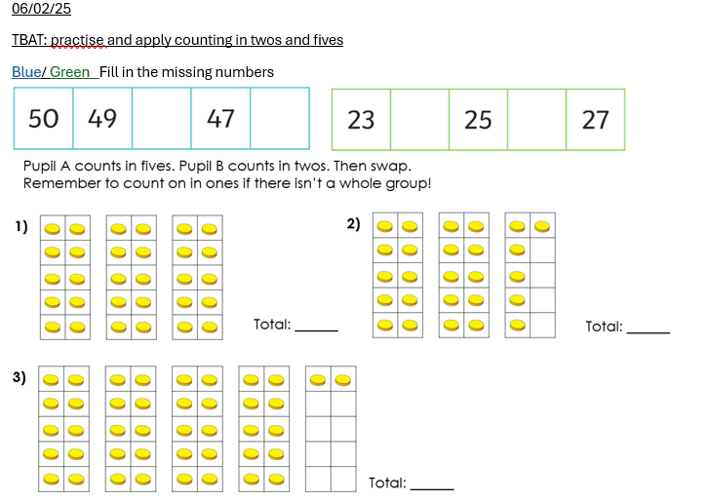
To practise and apply counting in twos and fives
Pupil A counts in fives.
Pupil B count in twos.
Swap for each question.
Remember to count on in ones if there isn’t a whole group.
Notes:
Independent Task
Pupils have both pages of the Task Sheet. Pupil A counts the representation in fives. Pupil B counts in twos. They check they have the same total. They then swap roles for the next question.
Possible adaptations:
The groups of two or five could be pre-marked to help pupils see them.
Pupils could choose their own numbers to represent. They could be prompted to think about which numbers would be best to count in twos or fives and explain why.

Slide 22
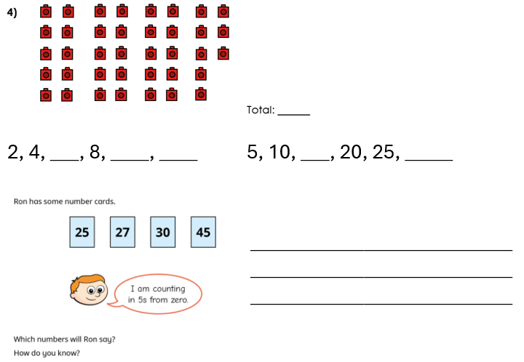
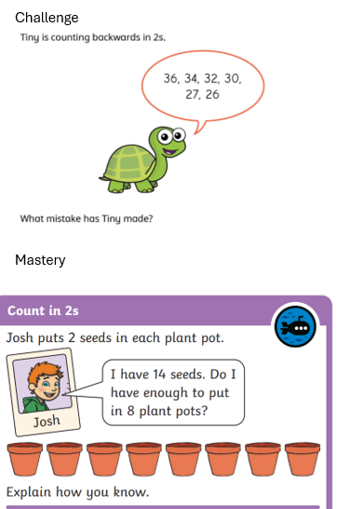

Slide 23
Would you choose to count in twos or fives? Why?
Notes:
Plenary: Reasoning
Show the representations of 25 and 32 on the slide.
For each representation, would it be better to count in twos or fives? Why?
Give pupils time to discuss. Take feedback, expecting all pupils to explain their answers.

Slide 24
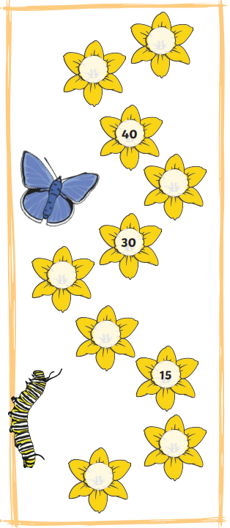
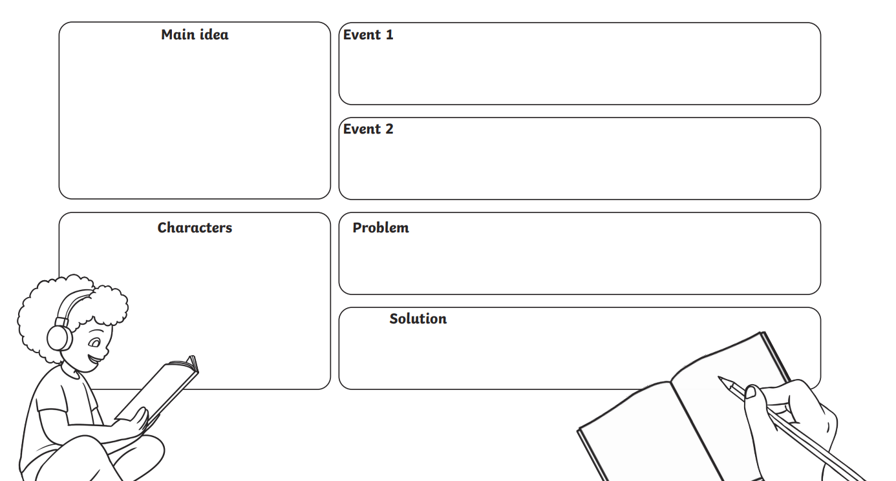
Independent Challenges:
Narrative Zone
Maths Zone
Complete the missing numbers. Use the number grid to help you
Plan a superhero story.
Enquiry Zone
Creative Zone
Draw a cartoon drawing of your super hero. Include a sound.
Read the comics to get some ideas for your own

Slide 25
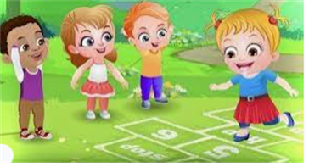
Break

Slide 26
PE – TBAT: create yoga poses using a hoop
Success Criteria:
Concentrate on breathing whilst in the pose.
Focus on something still when balancing.

Slide 27
Breath
Your hoop is a rocket ship and today we will be exploring space!
When you breathe in, lift your hoop above your head
When you breathe out, slowly lower it to the ground.
Touch down
Jog around, avoiding the hoops. When a body part is called out, find a hoop and put that body part in it.

Slide 28
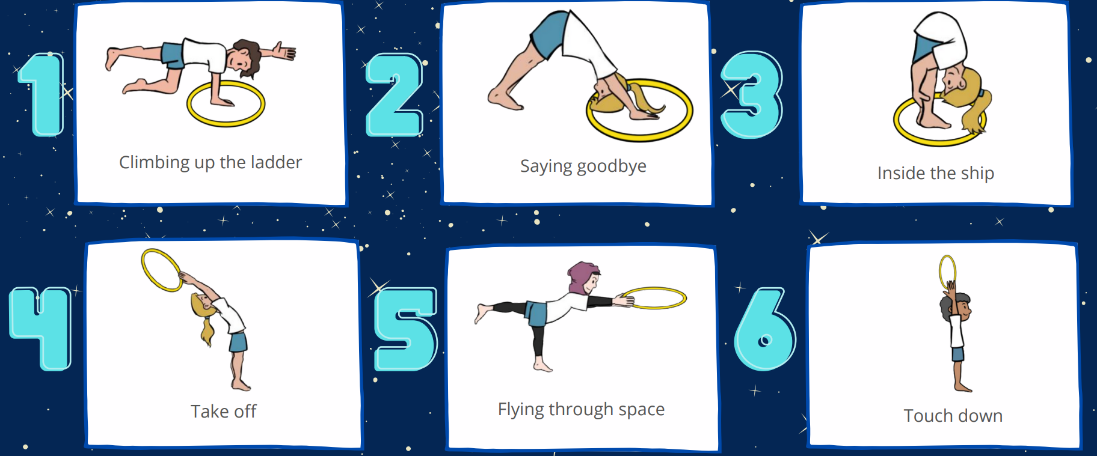
Space poses
Learn the poses

Slide 29
Take off
When the music stops. Find a space hoop and complete one of your poses.
Plenary
Sit in your hoop and think about how you’ve felt doing space yoga. Take some deep breaths.

Slide 30
Lunch

Slide 31
Today's Alien greeting is.......
briep

Slide 32
Toothbrushing

Slide 33
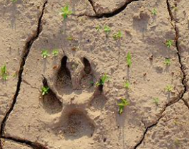
Art 3 in 3- Can you guess what has created these prints?
TBAT: print with a foam board tile to create a pattern .
Thursday 6th February 2025

Slide 34
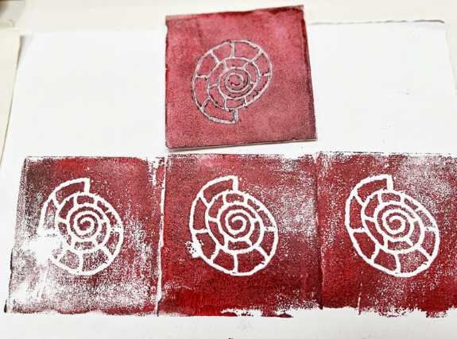
Art
TBAT: print with a foam board tile to create a pattern .
Thursday 6th February 2025
Last week we created patterns on foam tiles.
Today we will use our tiles to create prints.

Slide 35
Art
TBAT: print with a foam board tile to create a pattern .
Thursday 6th February 2025
Let's look at some printing techniques.

Slide 36
Art
TBAT: print with a foam board tile to create a pattern .
Thursday 8th February 2023

Slide 37
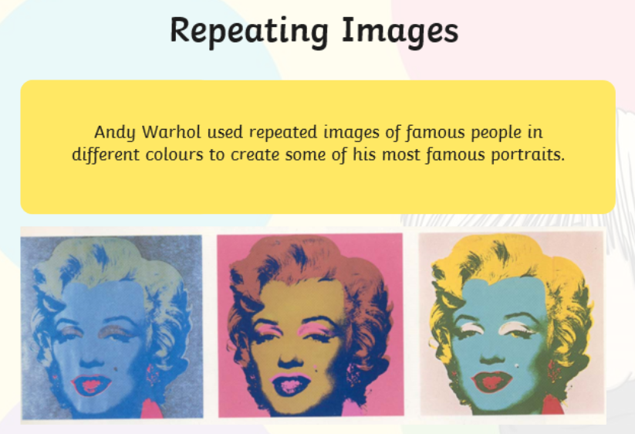
Art
TBAT: print with a foam board tile to create a pattern .
Thursday 6th February 2025
A famous artist called Andy Warhol used prints to create pieces of art.

Slide 38
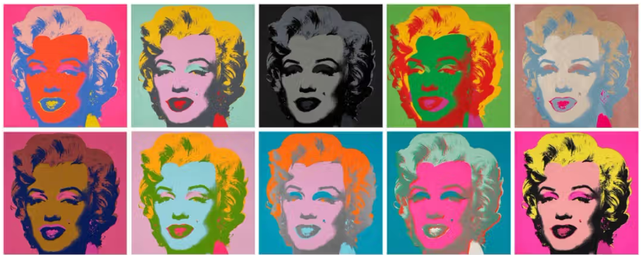
What do you notice? How could you recreate this using your tile?

Slide 39
Art- Let's explore!
TBAT: print with a foam board tile to create a pattern .
Thursday 6th January 2025
Cover the tile in a thin coat of paint.
Gently press the tile onto the paper.
Choose another colour, and re- paint the tile.
Experiment with different patterns and colour combinations.

