Slide 1
Thursday 27th February 2025
27/2/25

Slide 2
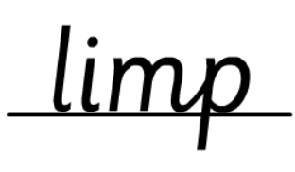
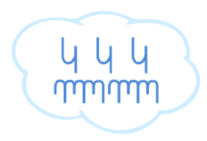
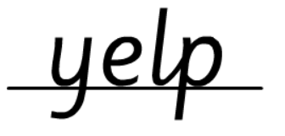
Morning Challenges:
Name writing

Slide 3
Revisit and review
Wednesday 6th March 2024
6/3/24
Today's Grapheme
are

Slide 4
Recap:
air igh ear a-e u oul
or er

Slide 5
Revisit and review
What are the digraphs?
shake
firefighter
worm
worse
could
octopus
Segment these
words and read them
Blend and say words

Slide 6
Focus words
sh-are
s-qu-are
s-p-are
Sounds out these
words and read them

Slide 7
Focus words
share
square
spare
Read these words on sight

Slide 8
Focus words
spare
square
share
care
stare
Read, sound talk and blend
And again... FASTER!

Slide 9
Revisit and review
once
their
oh
our
tricky words
laugh
Read the tricky words

Slide 10
Now let's read this sentence!​
What digraphs can you see?
What tricky words can you see?

Slide 11
Let's spell!
How many sounds? Write it.
tricky words
share square laugh
Listen to the sentence, say it, write it and read it!
Challenge
Extend the sentence using 'and'

Slide 12
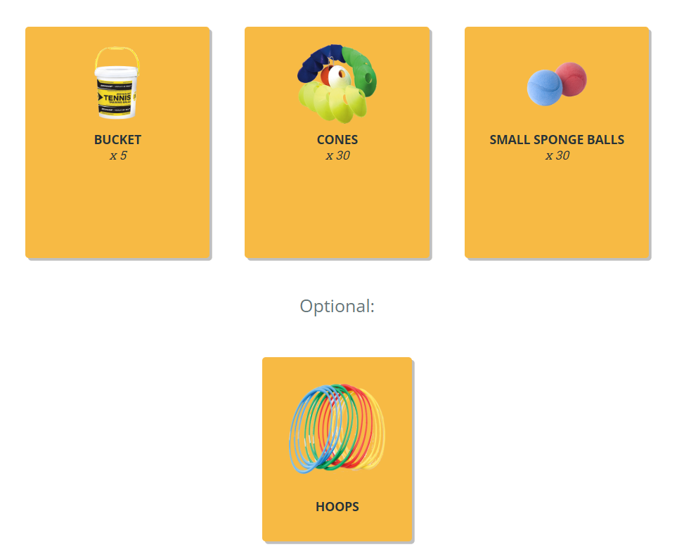
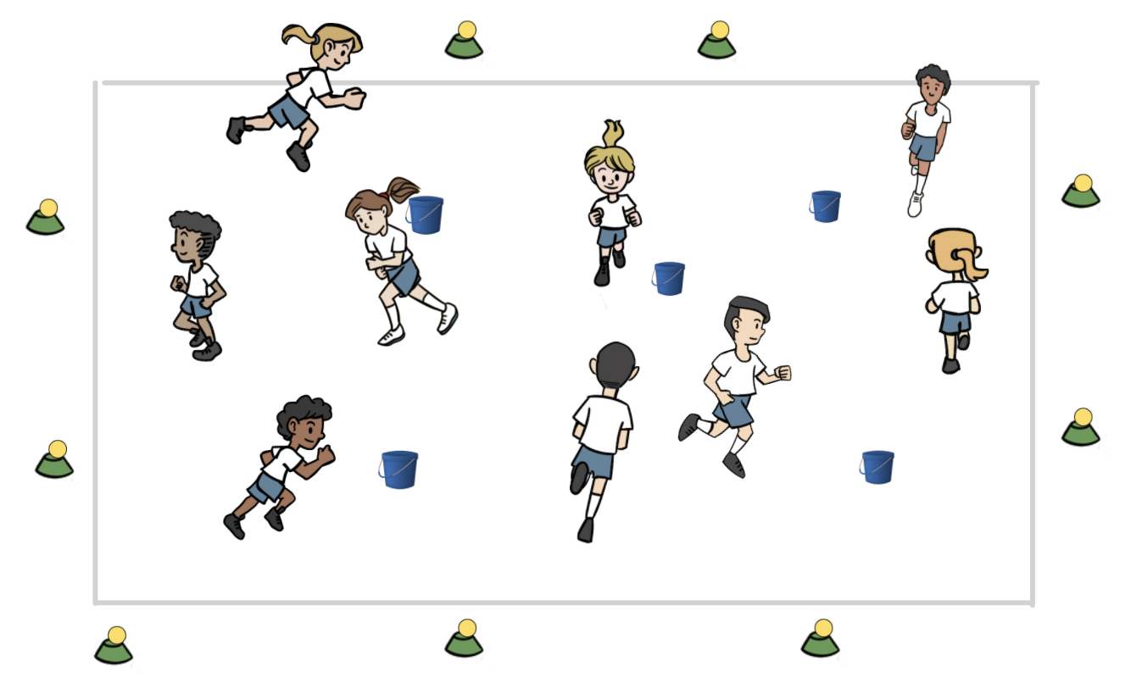
Warm up! Bucketball
TBAT – develop rolling and throwing a ball towards a target
2 in 2
Why do we warm –up our bodies?
How can we warm-up our bodies?
Get a ball and one cone and put the ball on top of their cone around the outside of the teaching space.
Place 5 buckets/hoops inside the area
Jog around – say STOP! Get a ball and put it into the bucket/hoop
Repeat but get the ball out and put it onto a cone
CHALLENGE
Can you throw it into the bucket/hoop?

Slide 13
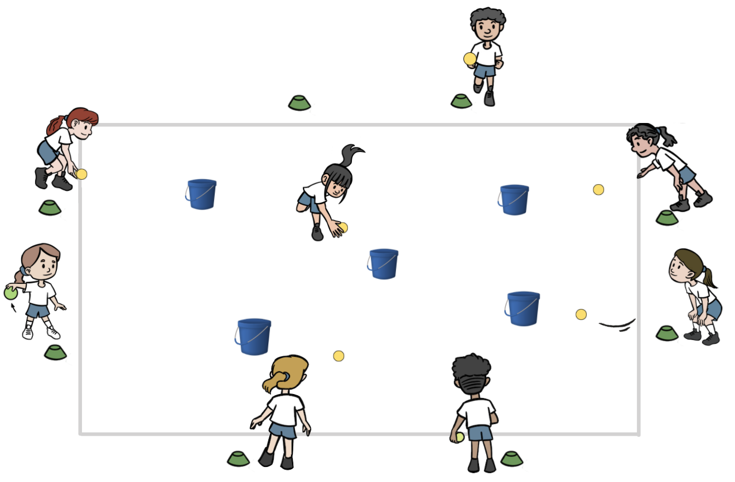
TBAT – develop rolling and throwing a ball towards a target
HIT THE BUCKET!
Stand at your cone around the outside of the space.
Roll your ball to hit one of the buckets. Each time a ball hits a bucket, move to a new cone and take aim at another bucket.
Begin standing with feet together. Set forward with your opposite foot to throwing arm. Bend low to the ground as you roll the ball. Hands near the ground when the ball is released. Fingertips follow in the direction of your target.

Slide 14
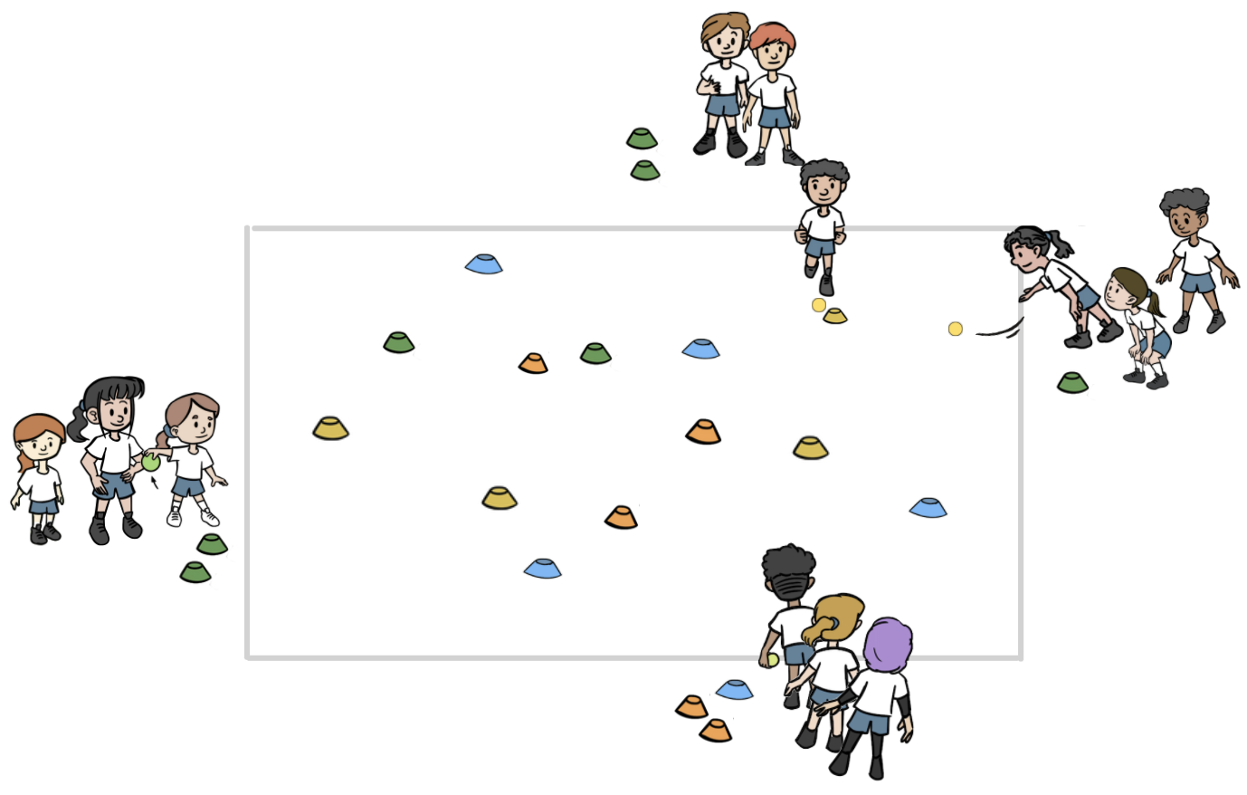
TBAT – develop rolling and throwing a ball towards a target
CONE BALL
Remove the buckets and place 20 cones in the area.
Get into groups of three with one ball.
Stand in a line around the outside of the teaching space.
Roll the ball to hit a cone, if it Is hit take it back to your group.
Will you go for the cones further away or closer to you first?
What technique should they use for the cones that are further away?

Slide 15
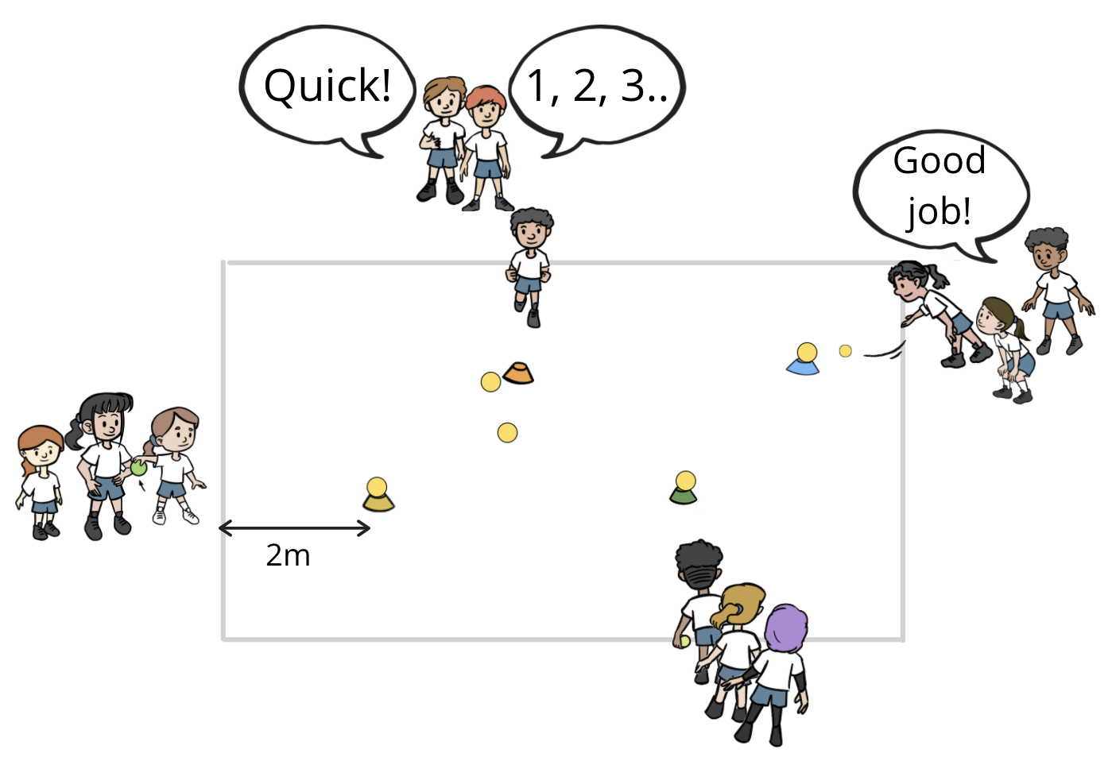
TBAT – develop rolling and throwing a ball towards a target
TOPPLE BALL
Each group of three needs two balls and one cone.
Take turns rolling the ball to topple the other ball off the cone.
After a few turns, try throwing the ball to topple the other ball off the cone.
When the ball on top falls, you must chase it down and grab it within 5 seconds to win a point for their team.
CHALLENGE
Place the cone and ball further away – can you hit it now?

Slide 16
TBAT – develop rolling and throwing a ball towards a target
Plenary
What did you have to do differently when you were aiming at a target that was further away?
Who used kind words, was supportive and honest?

Slide 17
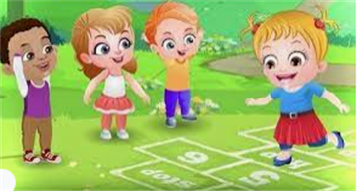
Break

Slide 18
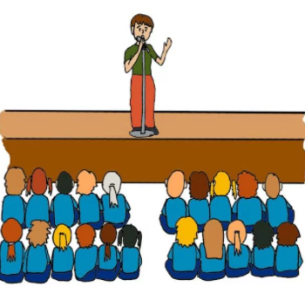
Assembly

Slide 19
Lunch

Slide 20
Today's Alien language is.......

Slide 21
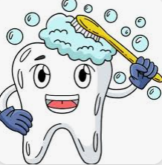
Toothbrushing

Slide 22
Thursday 27th February 2025
3 in 3
What did Jasper do on Monday?
What other action did Jasper do when he 'raked'?
What was the size of Jaspers Beanstalk in the end?
Find words in the text to prove your answers.

Slide 23
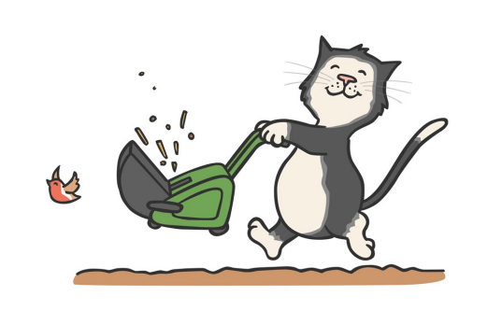
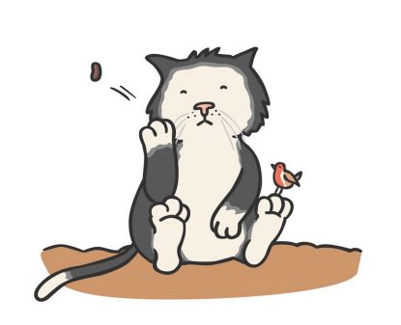
TBAT: create a freeze frame to show how a character is feeling.
Thursday 27th February 2025
Blue/ Green
Think of three words to describe how Jasper is feeling.
1..................................................
2..................................................
3...................................................
Think of three words to describe how Jasper is feeling.
1..................................................
2..................................................
3...................................................

Slide 24
TBAT: create a freeze frame to show how a character is feeling.
Thursday 27th February 2025
Today, we are going to take on the role of Jasper and think about how he was feeling at different points in the story.

Slide 25
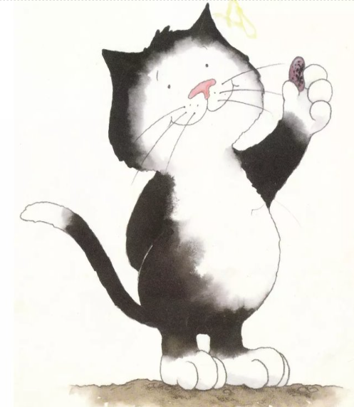
TBAT: create a freeze frame to show how a character is feeling.
Thursday 27th February 2025
Pretend to find a bean.......
How would you feel?
What facial expression could show this?

Slide 26
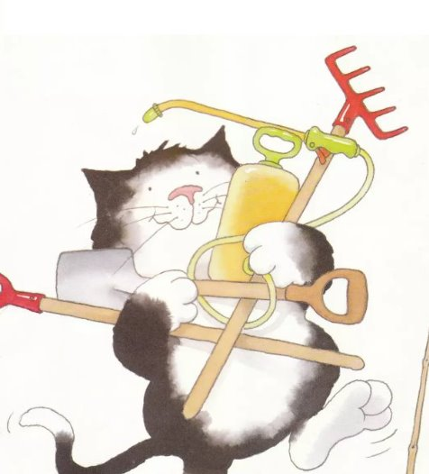
TBAT: create a freeze frame to show how a character is feeling.
Thursday 27th February 2025
Jasper is very busy looking after his bean.
How could you move to show how busy Jasper is?

Slide 27
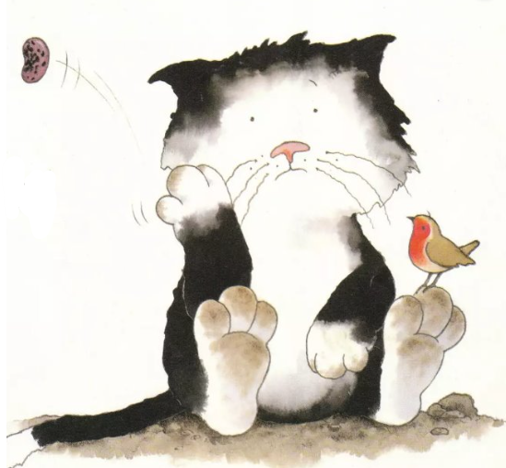
TBAT: create a freeze frame to show how a character is feeling.
Thursday 27th February 2025
Jasper's bean has not grown.
How would Jasper feel after all of that work?
Challenge: What words could you use to describe Jasper's emotion?

Slide 28
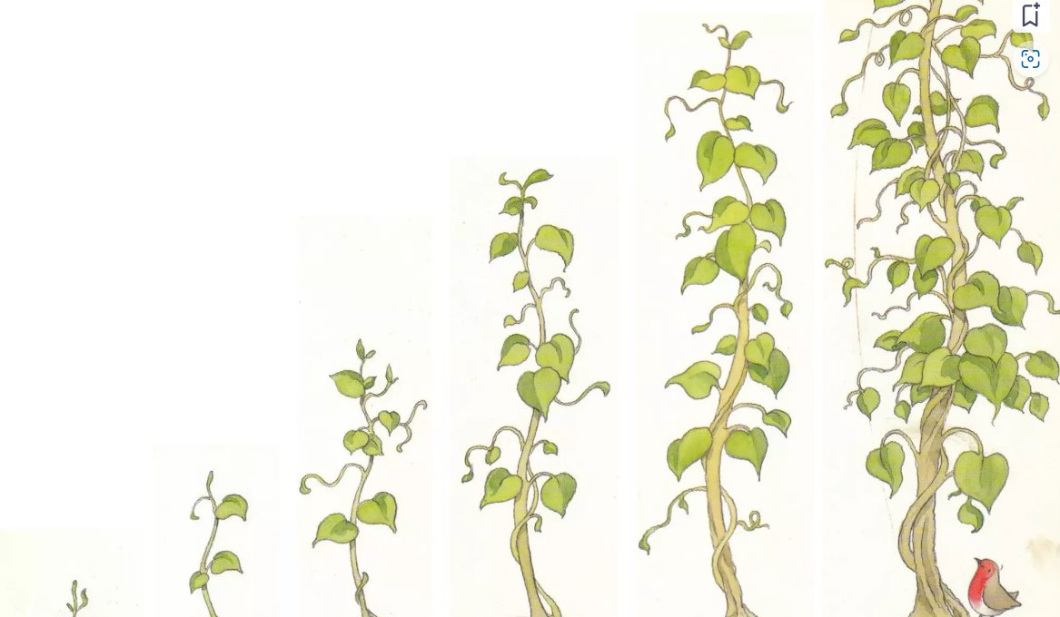
TBAT: create a freeze frame to show how a character is feeling.
Thursday 27th February 2025
Imagine you are Jasper and you have just discovered that the bean did grow in the end...........
Strike a pose to show Jaspers reaction.
Challenge: What words could you use to describe Jasper's emotion?

Slide 29
Break

Slide 30
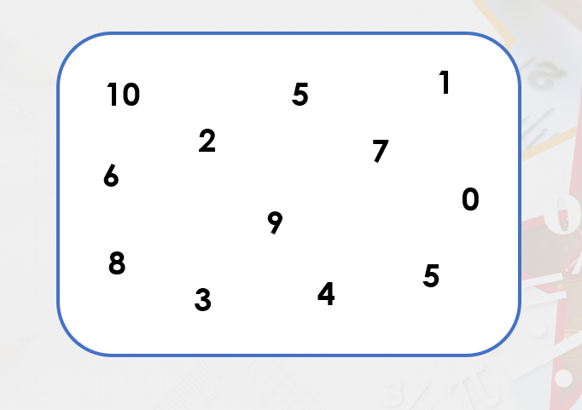
3 in 3- Find 3 pairs of numbers to make ten.
TBAT: add by making ten.
How can we write those as a number sentence?
…....... + …..... = ….........
…....... + …..... = ….........
…....... + …..... = ….........

Slide 31
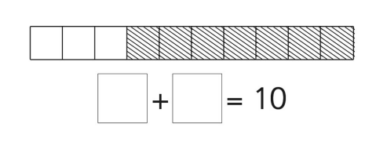
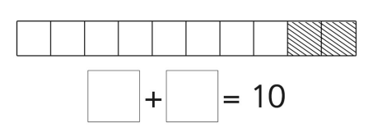
Blue/Green- Complete the number bond to ten.
TBAT: add by making ten.
Can you write these number sentence as a subtraction?

Slide 32
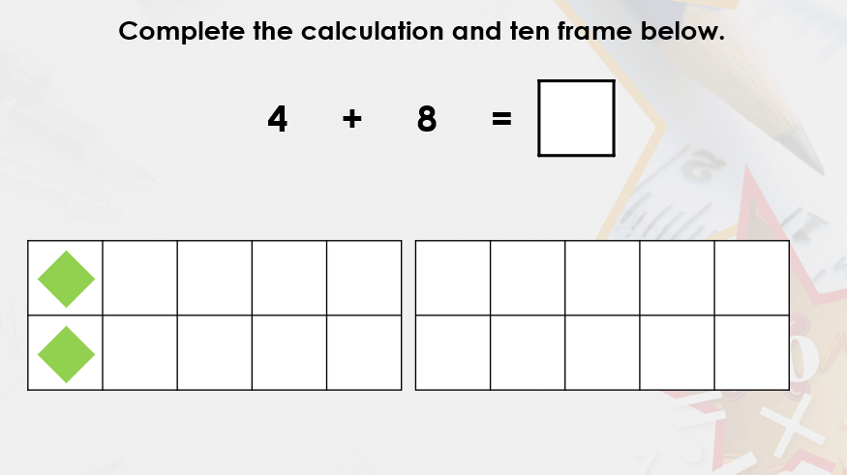
TBAT: add by making ten.

Slide 33
TBAT: add by making ten.
Can you show it on a bead string?

Slide 34
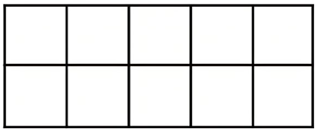
TBAT: add by making ten.
Prove it on the tens frames.

Slide 35
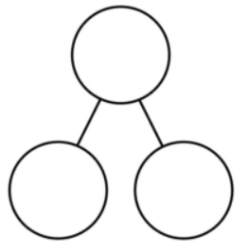
TBAT: add by making ten.
8

Slide 36
TBAT: add by making ten.

Slide 37
TBAT: add by making ten.
Craig is correct because.......
Craig is incorrect because.......

Slide 38
TBAT: add by making ten.

Slide 39
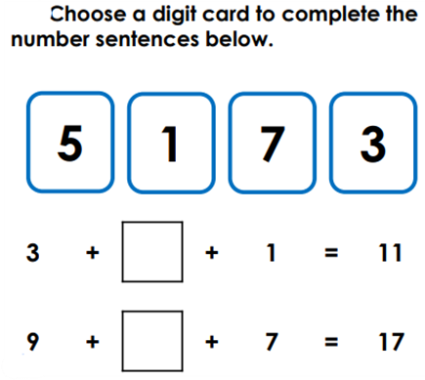
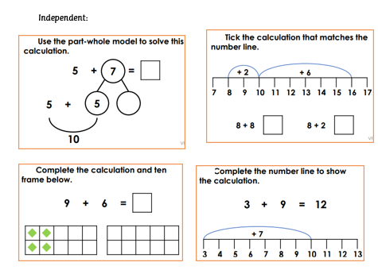
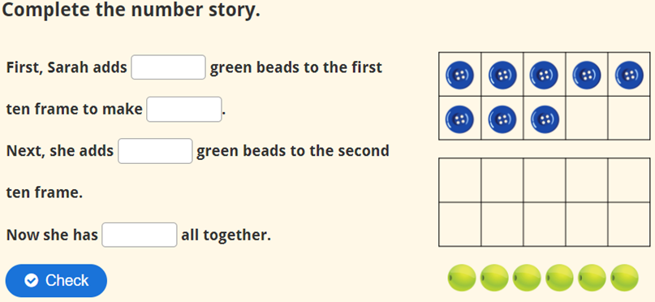
Challenge:
TBAT: add by making ten.
Independent:
RP:

Slide 40
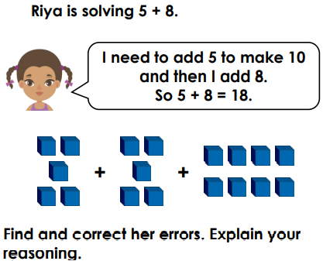
TBAT: add by making ten.
Mastery:
Mastery with greater depth:

