Slide 1
Monday 2nd February 2025
2/2/25

Slide 2
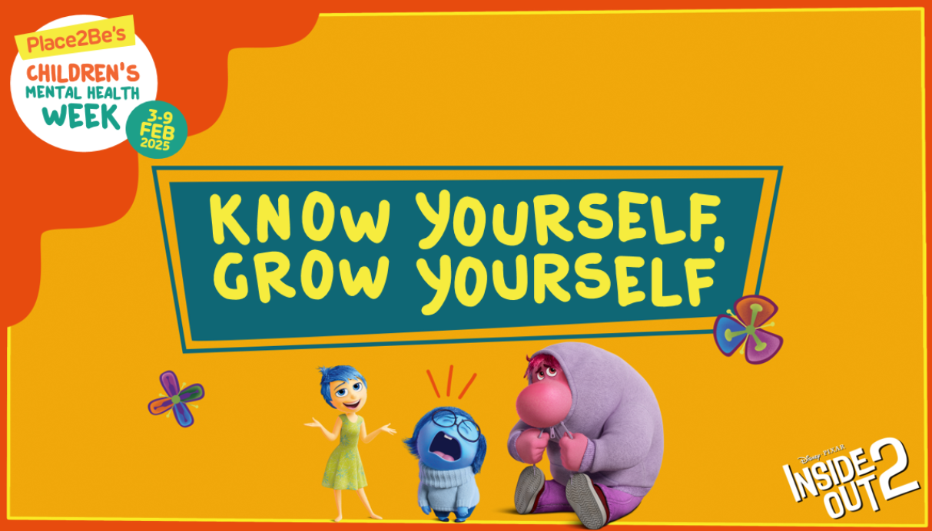
Children's Mental Health Week Parent Workshop

Slide 3
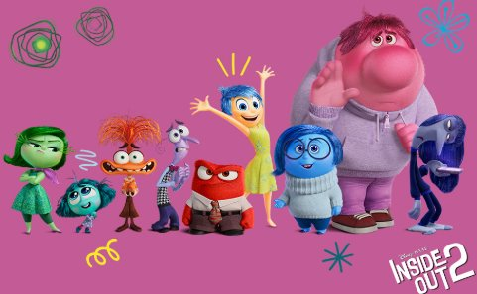
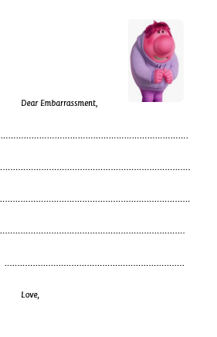
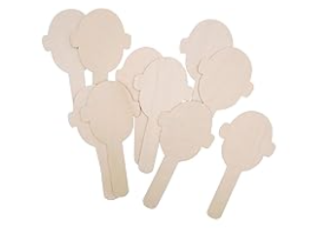
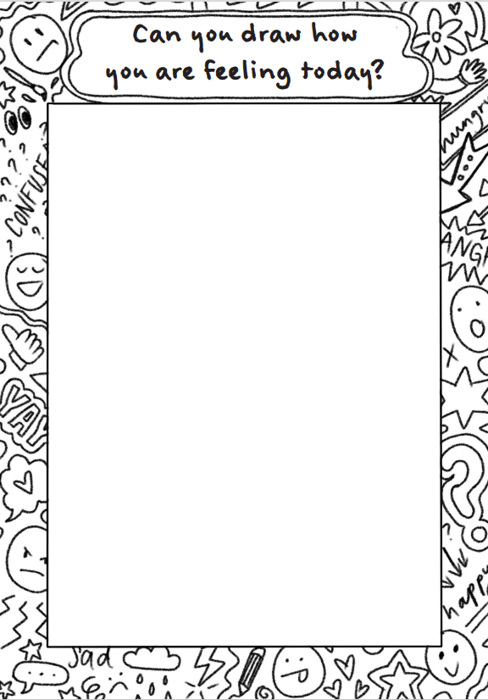
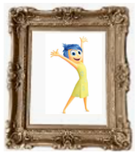
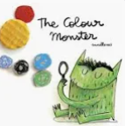
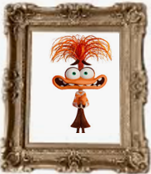
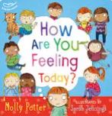
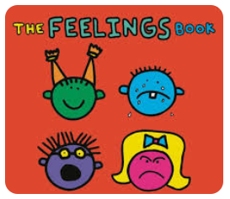
Write a letter to each character.
Collage the characters.
Create your own emotion stick puppet.
Write some scenarios where you might feel each emotion.
Share a story about emotions.
Draw how you are feeling.

Slide 4
Phonics
Monday 3rd February 2025
3/2/25
Revisit and review
Lesson focus:
Read words with the /oo/yoo phonemes

Slide 5
Recap
oo u ew
ue u-e ow

Slide 6
Revisit and review
Monday 3rd February 2025
3/2/25
Today's Graphemes
ou
ui

Slide 7
Where in the word?
Monday 3rd February 2025
3/2/25
What are the digraphs?
unicorn
blue
rule
chew
music
glue
Segment these
words and read them
Blend and say words

Slide 8
Focus words
Monday 3rd February 2025
3/2/25
y-ou-th
f-r-ui-t
b-r-ui-se
Sounds out these
words and read them

Slide 9
Focus words
Monday 3rd February 2025
3/2/25
youth
fruit
bruise
Sounds out these
words and read them

Slide 10
Focus words
Monday 3rd February 2025
3/2/25
youth
group
soup
fruit
juice
bruise
Read, sound talk and blend
And again... FASTER!

Slide 11
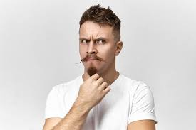
Revisit and review
any
Monday 3rd February 2025
3/2/25
many
water
again
tricky words
want
Read the tricky words?

Slide 12
Monday 3rd February 2025
3/2/25
Now let's read this sentence!​
What digraphs can you see?
What tricky words can you see?

Slide 13
Monday 3rd February 2025
3/2/25
Let's spell!
How many sounds? Write it.
tricky words
fruit group water
Listen to the sentence, say it, write it and read it!
Challenge
Extend the sentence using 'and'

Slide 14
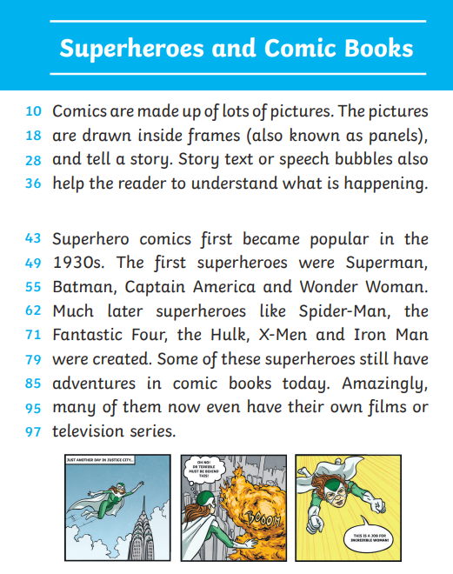
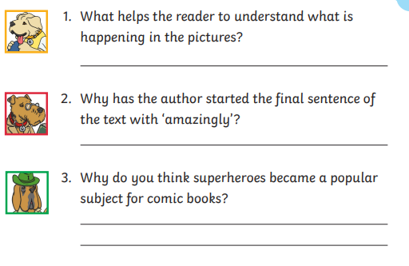
TBAT: identify the features of a comic strip.
Monday 3rd February 2025
3 in 3

Slide 15
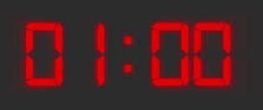
TBAT: identify the features of a comic strip.
Monday 3rd February 2025
Blue/ Green- Discuss with your partner, what you think about when you think of 'comics'?

Slide 16
TBAT: identify the features of a comic strip.
Monday 3rd February 2025

Slide 17
TBAT: identify the features of a comic strip.
Monday 3rd February 2025

Slide 18
TBAT: identify the features of a comic strip.
Monday 3rd February 2025

Slide 19
TBAT: identify the features of a comic strip.
Monday 3rd February 2025

Slide 20
TBAT: identify the features of a comic strip.
Monday 3rd February 2025

Slide 21
TBAT: identify the features of a comic strip.
Monday 3rd February 2025

Slide 22
TBAT: identify the features of a comic strip.
Monday 3rd February 2025

Slide 23
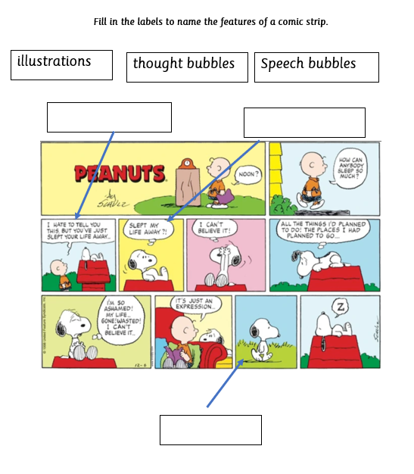
TBAT: identify the features of a comic strip.
Monday 3rd February 2025
Independent:
Challenge:

Slide 24
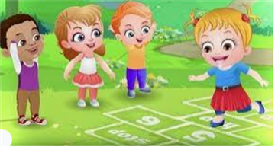
Break

Slide 25
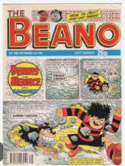
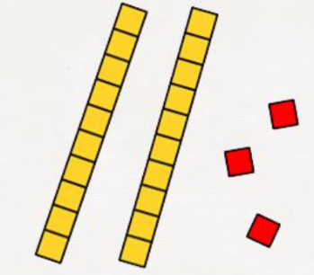
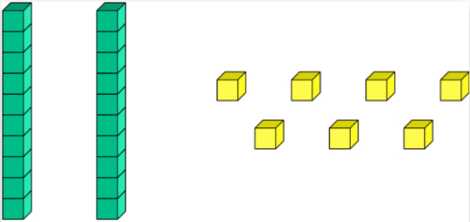
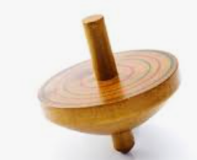
Independent Challenges:
Narrative Zone
Maths Zone
Write the numbers shown by the dienes.
Make your own number and ask a friend what number you have made.
Write a review of a copy of The Beano or The Dandy.
Enquiry Zone
Creative Zone
Explore what material would be best to make a spinner.
Collage the characters.

Slide 26
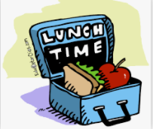
Lunch

Slide 27
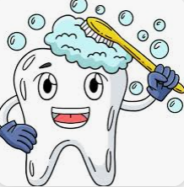
Toothbrushing

Slide 28
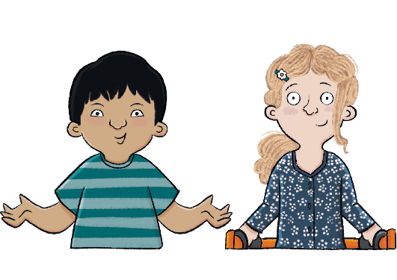
Unit 1: Toys Over Time
KQ: How are toys today different from toys in the past?
Notes:
Note: If you are using Ark Curriculum+ Science, pupils will have looked at material names and their properties. You may wish to incorporate some of that key vocabulary here, e.g. material, wood, plastic, glass, paper, fabric, and metal.

Slide 29
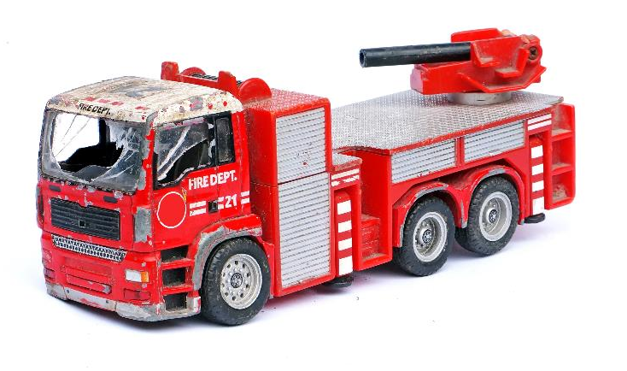
Lesson 5:
4 in 4
Which one of these words would you use to describe a toy from the past?
modern old new
This toy is _______________ and _____________. (Pick two.)
from the past broken modern
Notes:
Knowledge quiz 1.4: Pupils complete this in the Additional resource: Knowledge quizzes booklet to assess their knowledge retention from the previous lesson. They write their score in the chart also provided in the additional resource.

Slide 30
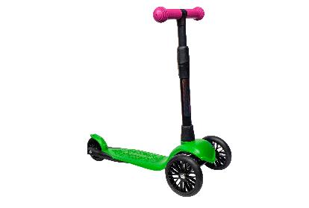
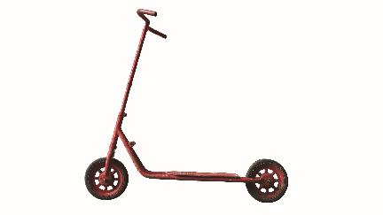
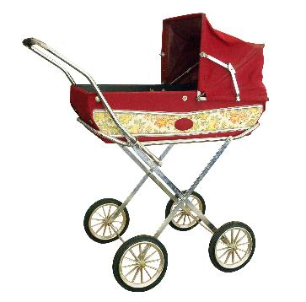
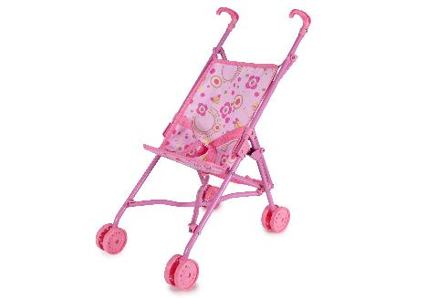
Lesson 5:
4 in 4
Circle the oldest toy.
Circle the most modern toy.

Slide 31
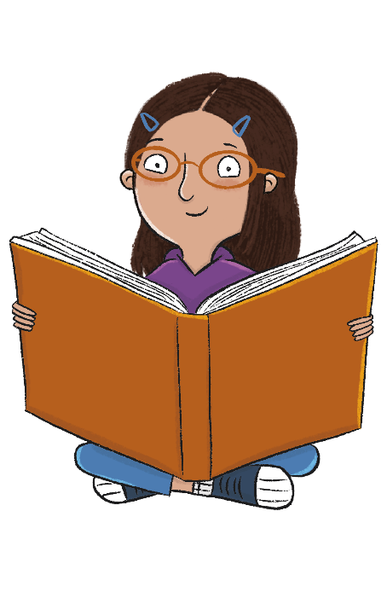
How are toys today similar to and different from toys in the past?
Notes:
Revisit the main enquiry question and the learning journey so far.

Slide 32
What different types of toys are there?
How do we know that some toys are from the past?
1
4
Can I describe my favourite toy?
How are toys today different from toys in the past?
2
5
Which toys did grown-ups play with?
Can we put toys in order?
3

Slide 33
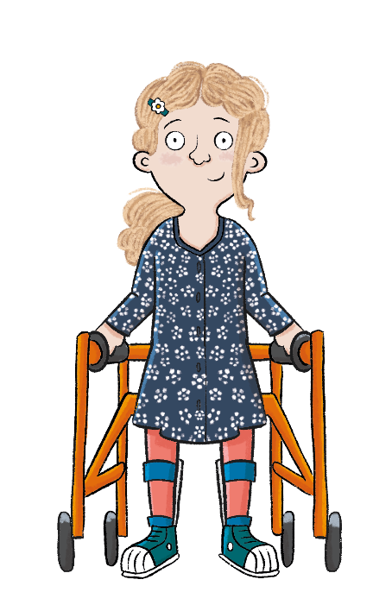
Lesson 5:
In this lesson, we are designing a toy that is safe and strong.
Notes:
Introduction: Share the lesson statement, and key term. Then share key knowledge and other key vocabulary with pupils—you may want to add images to the teaching slides to support exemplification and understanding of these words.

Slide 34
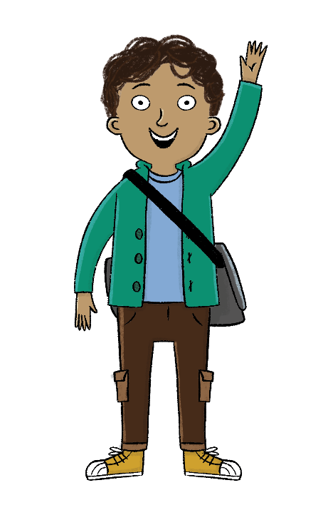
Lesson 5:
The key term for this lesson is material.
A material is what something is made from.
Notes:
To reinforce the definition of the key term ‘material’, you could refer back to Science lessons from Unit 1 (if taught). Alternatively, you could describe some different materials in the classroom, e.g. a coat (made from woollen fabric), a book (paper and cardboard), a pencil (wood and carbon/graphite), a pot (plastic).

Slide 35
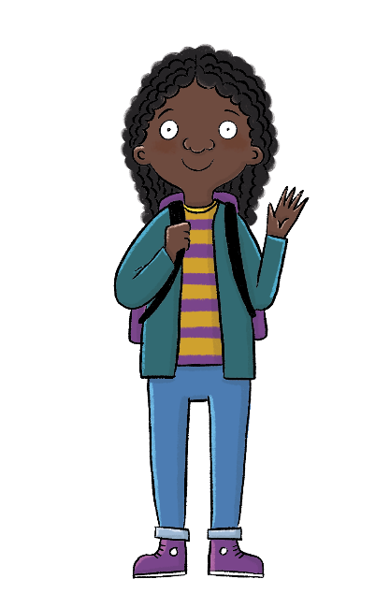
How are toys today different from toys in the past?
Lesson 5:
The material toys are made from has changed over time.
Toys have become safer and stronger.
material
technology

Slide 36
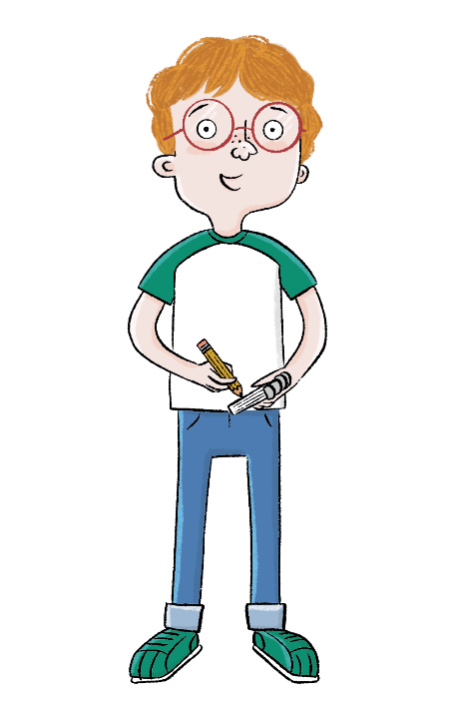
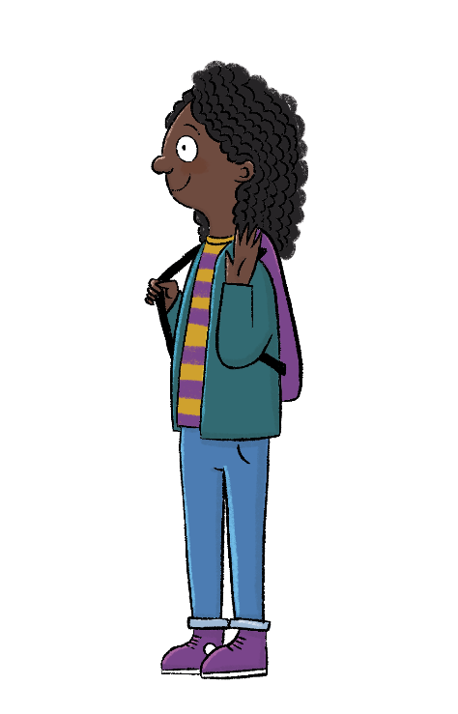
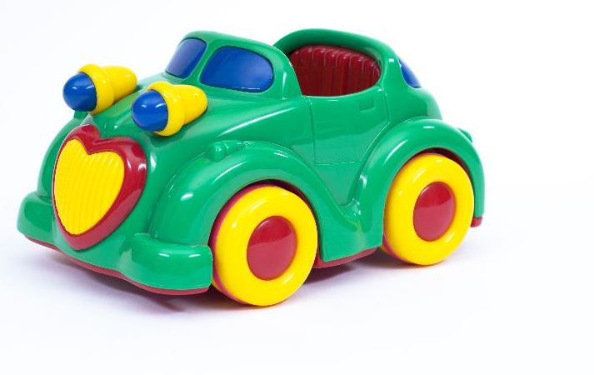
Blue/green
Lesson 5:
What material is this toy made from?
Can you see anything else in the classroom made from this material?
Notes:
Talk task: Ask pupils to look at the photo of a toy car and discuss these questions with their partner: ‘What material is this made from?’ and ‘Can you see anything else in the classroom made from this material?’. Pupils should be able to name it as plastic and spot other plastic classroom items. To support pupils if they are struggling to identify the material, give them a choice: plastic, wood, or glass. Recap plastic and its properties. Take feedback from the class on other plastic items in the classroom.

Slide 37
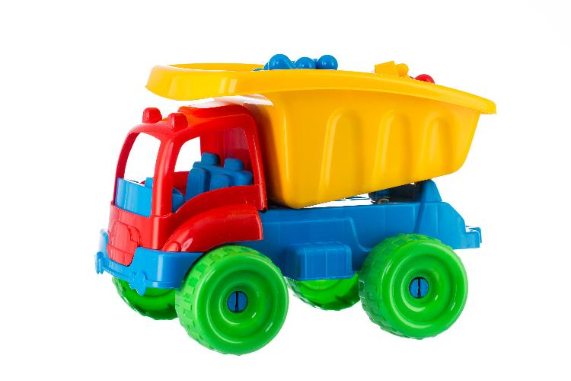
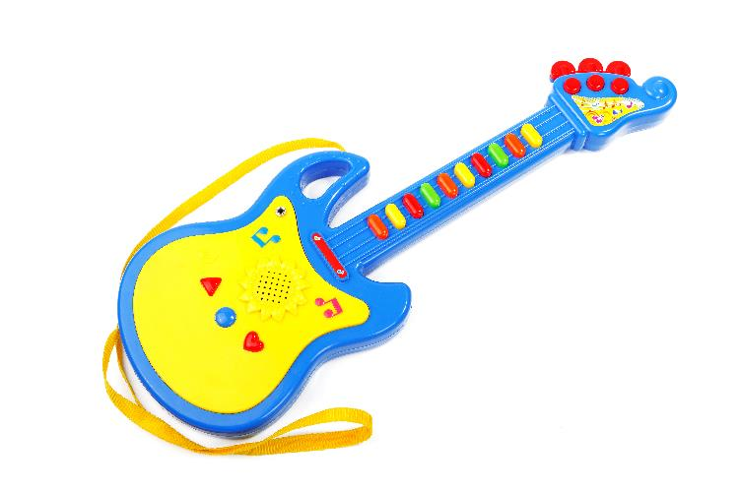
How have materials changed over time?
Lesson 5:
Plastic is a new material. In the past, toys were not made from plastic because it hadn’t been invented yet. Plastic is very strong and can easily be made into different shapes. This has made toys safer for children to play with.
Notes:
Read: ‘How have materials changed over time?’. Use the items that pupils pointed out in the classroom as being made from plastic to demonstrate how plastic is strong and how it can be made into many different shapes, from a bottle lid to the chairs they may be sitting on.

Slide 38
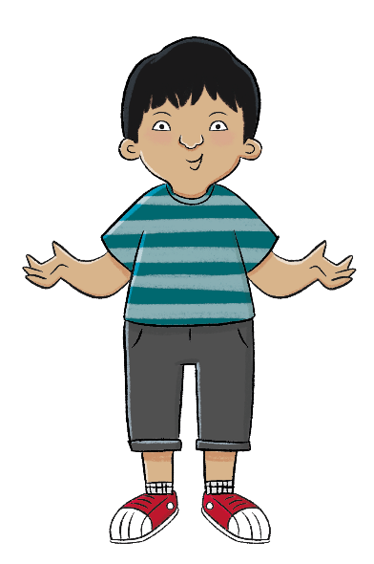
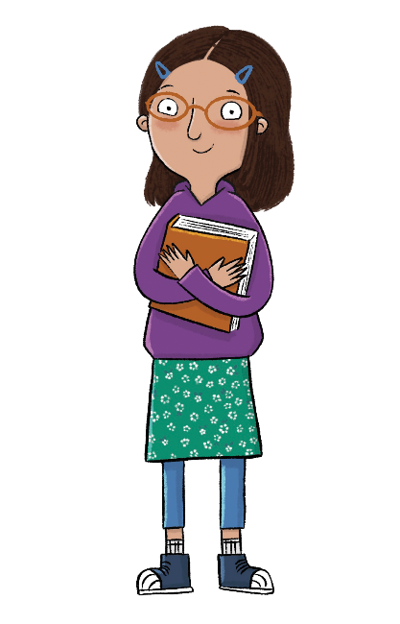
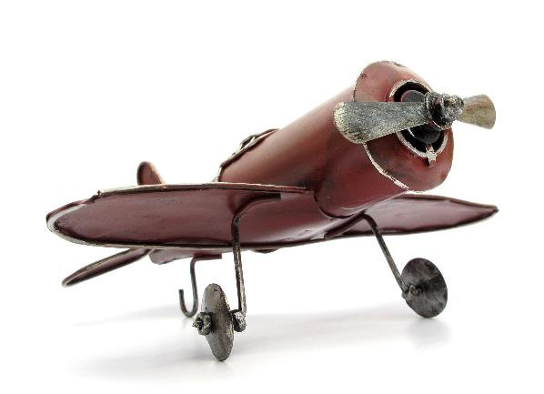
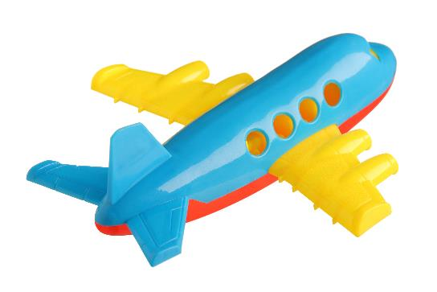
Lesson 5:
Which toy do you think is stronger?
Which toy do you think is safer?
Notes:
Talk task: Ask pupils to discuss in partners the questions: ‘Which toy do you think is stronger?’ and ‘Which toy do you think is safer?’. Explain that the old toy is made from metal and the other plane from plastic. The metal toy will rust and break more easily than the plastic toy. Metal is sharp so is less safe than the plastic. Then ask pupils which toy they think is from the past and which is modern? How do they know? Remind pupils that as plastic is a modern material, the righthand image must be modern and the left must be old.

Slide 39
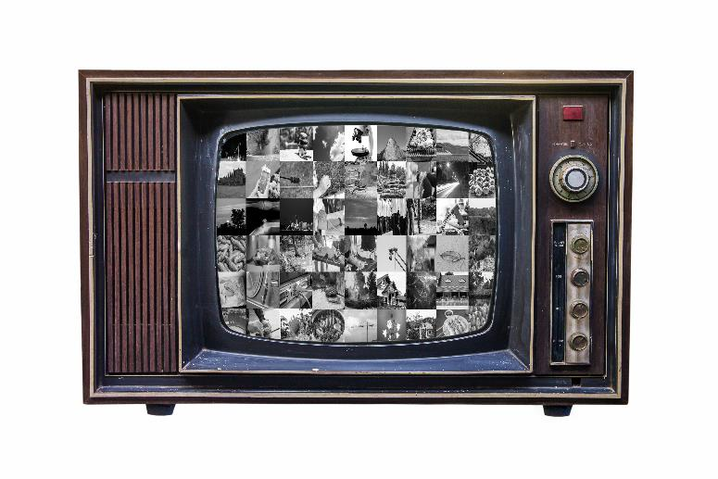
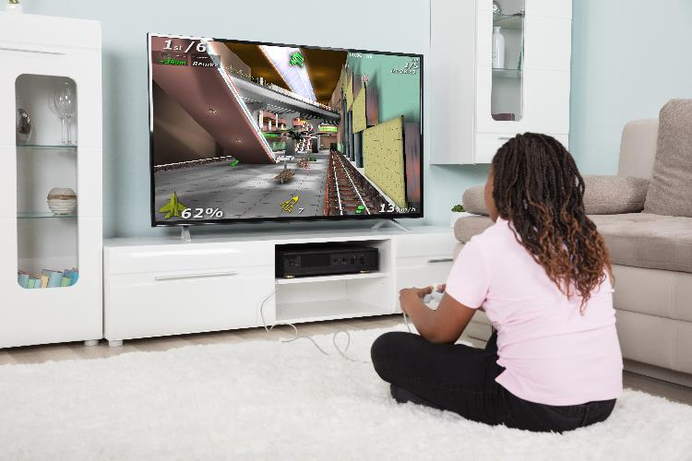
How has technology changed over time?
Lesson 5:
Technology has changed over time. TVs, tablets, and games consoles have got better and better over the years. Here is a TV from the past and a TV today.
Notes:
Read: ‘How has technology changed over time?’ slides. Stop at each slide and ask pupils to compare the similarities and differences between the two images. Explain some of the ways toys have improved: televisions used to be black and white, now they are bigger with a clearer picture in colour. Televisions in the past could only be used to watch programmes being broadcast at that time. Today televisions can be used to watch and record programmes, to browse or watch videos from the internet or to play games online or using games consoles.

Slide 40
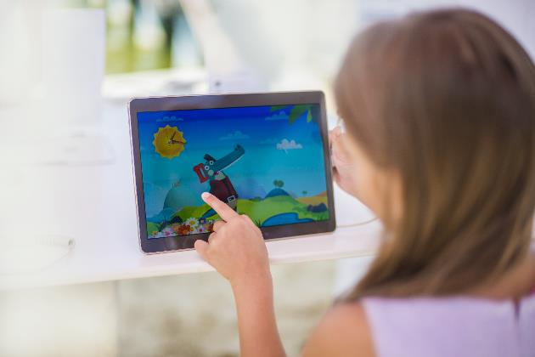
How has technology changed over time?
Lesson 5:
Here is a tablet from the past and a tablet today.

Slide 41
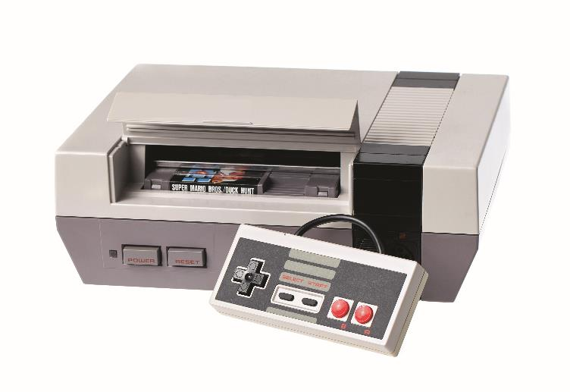
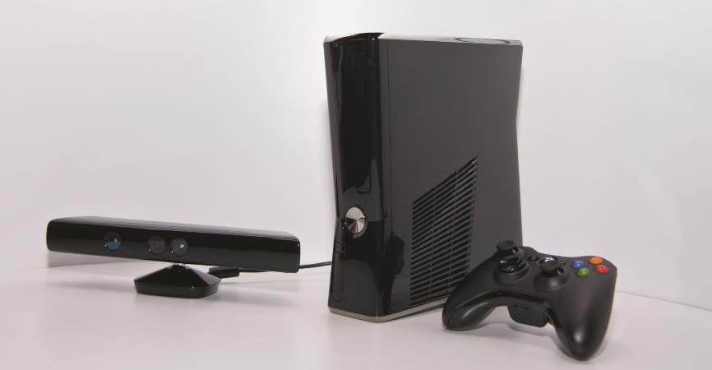
How has technology changed over time?
Lesson 5:
Here is a games console from the past and a games console today.

Slide 42
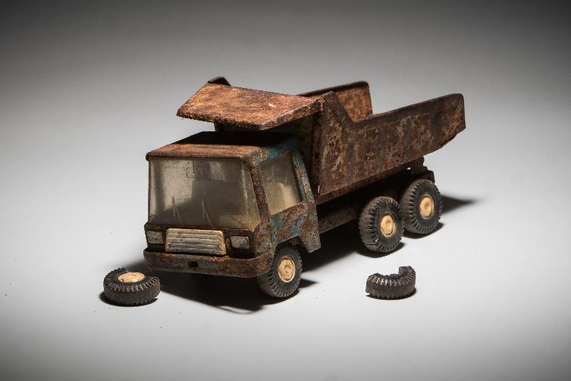
How have toys got safer?
Lesson 5:
Some toys in the past were not made as well as some toys today. The materials toys were made from were not as strong so they could break and hurt children.
Notes:
Read: ‘How have toys got safer?’. Explain to pupils that some toys in the past were not made as well as the toys today. The materials were not as strong so they could break and hurt children.

Slide 43
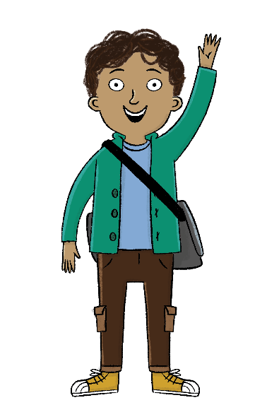
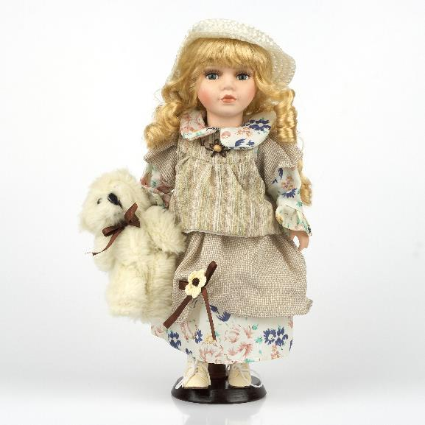
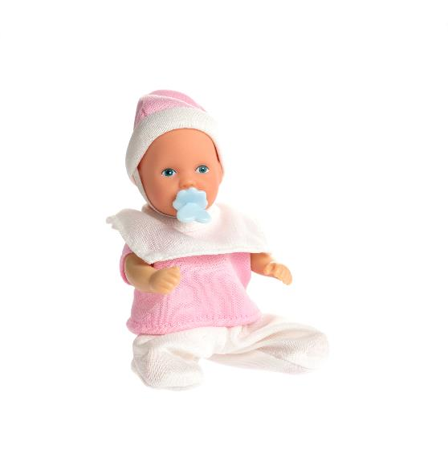
Lesson 5:
Which doll is safer?
Why?
Notes:
Talk task: Ask pupils to discuss in partners the questions: ‘Which doll is safer?’, ‘Why?’. Explain to pupils that the first doll’s face and hands are made from porcelain which can break easily and the pieces would be sharp. The second doll is made from plastic and doesn’t break easily. She can also be washed and kept clean.

Slide 44
Draw a toy that is strong and safe for this child.
Lesson 5:
Notes:
Write: Pupils should design a toy in their Workbooks. Explain that they need to design a toy for the young child in the photo that is safe and strong. Model this for pupils by thinking aloud what toy you will select and why. Model writing up labels such as ‘plastic’, ‘strong’, and ‘safe’. Challenge pupils to add labels themselves when they’ve finished their drawing. Support pupils by helping them choose a plastic toy from the classroom to draw from.

Slide 45
How are toys today different from toys in the past?
Lesson 5:
What material is new?
Why has plastic made toys safer?
Notes:
Learning review: Using the teaching slides, talk partners tell each other a response to the questions. Add further review questions if you wish to.

Slide 46
How are toys today different from toys in the past?
Lesson 5:
The material toys are made from has changed over time.
Toys have become safer and stronger.
material
technology

Slide 47
Independent Challenges:
Narrative Zone
Maths Zone
Write the numbers shown by the dienes.
Make your own number and ask a friend what number you have made.
Write a review of a copy of The Beano or The Dandy.
Enquiry Zone
Creative Zone
Explore what material would be best to make a spinner.
Collage the characters.

