Slide 1
Friday 28th February 2025
28/2/25

Slide 2
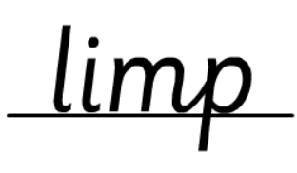
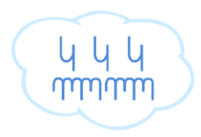
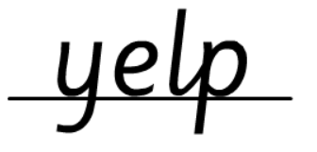
Morning Challenges:
Name writing

Slide 3
Phonics
Revisit and review
Lesson focus:
Read words with the /or/ phoneme

Slide 4
Revisit and review
Today's Grapheme
au/aur/oor/a

Slide 5
Recap:
or u oul are

Slide 6
Revisit and review
What are the digraphs?
snort
popcorn
unicorn
sport
sort
born
Segment these
words and read them
Blend and say words

Slide 7
Focus words
d-oor
f-l-oor
au-th-or
Sounds out these
words and read them

Slide 8
author
astronaut
dinosaur
poor talk
floor walk
door chalk
Focus words
Read, sound talk and blend
And again... FASTER!

Slide 9
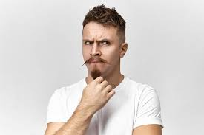
Revisit and review
our
once
their
laugh
tricky words
oh
Read the tricky words

Slide 10
Now let's read this sentence!​
What digraphs can you see?
What tricky words can you see?

Slide 11
Let's spell!
How many sounds? Write it.
tricky words
floor door their
Listen to the sentence, say it, write it and read it!
Challenge
Extend the sentence using 'and'

Slide 12
TBAT: Use ‘and’ to extend sentences.
Friday 28th February
3 in 3- Which of these words needs a capital letter?
elephant
june
book
london
robert
pizza

Slide 13
TBAT: Use ‘and’ to extend sentences.
Friday 1st March 2024
Blue/ Green- Put these days of the week in order.
Wednesday
Tuesday
Friday
Thursday
Friday
Sunday
Thursday
Saturday

Slide 14
TBAT: Use ‘and’ to extend sentences.
Friday 28th February
Can you remember what jobs Jasper did on each day of the week?

Slide 15
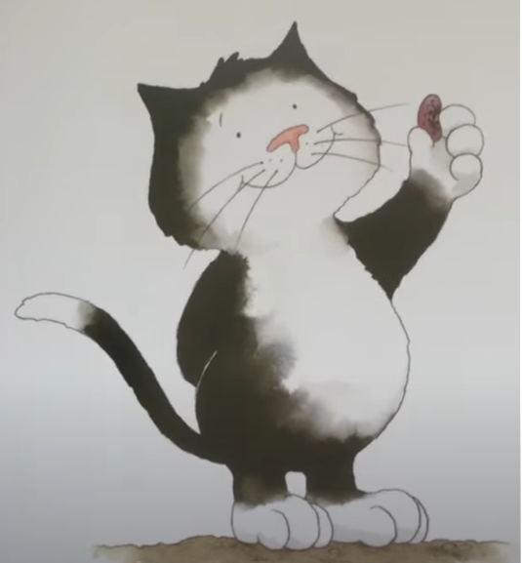
TBAT: Use ‘and’ to extend sentences.
Friday 28th February
.........................................................................
.........................................................................
….......................................................................
….......................................................................

Slide 16
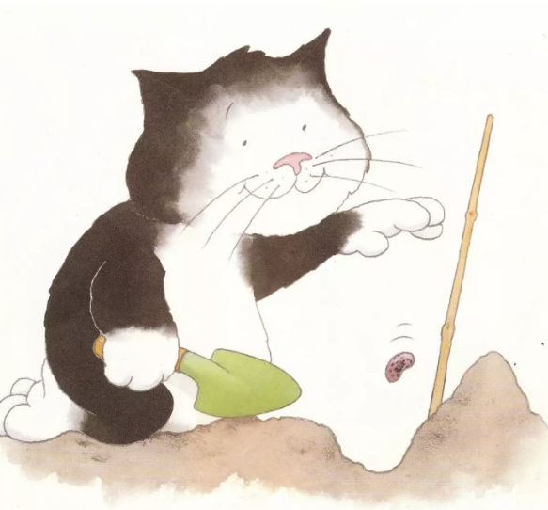
TBAT: Use ‘and’ to extend sentences.
Friday 28th February
.........................................................................
.........................................................................
….......................................................................
….......................................................................

Slide 17
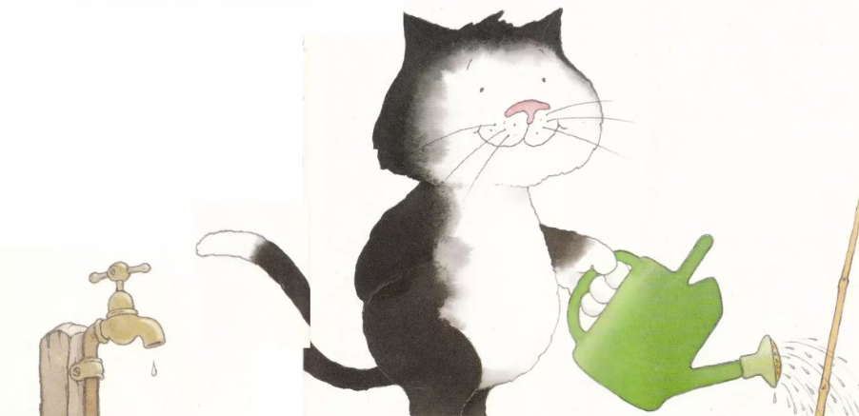
TBAT: Use ‘and’ to extend sentences.
Friday 28th February
.........................................................................
.........................................................................
….......................................................................
….......................................................................

Slide 18
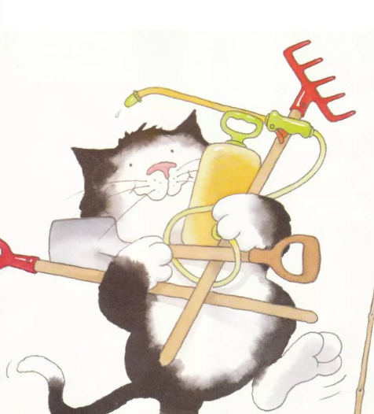
TBAT: Use ‘and’ to extend sentences.
Friday 28th February
.........................................................................
.........................................................................
….......................................................................
….......................................................................

Slide 19
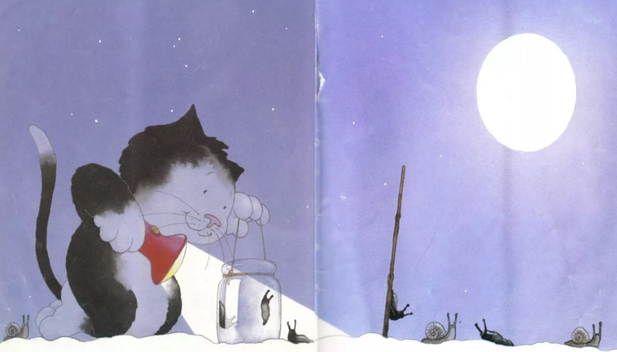
TBAT: Use ‘and’ to extend sentences.
Friday 28th February
.........................................................................
.........................................................................
….......................................................................
….......................................................................

Slide 20
TBAT: correctly spell the days of the week.
Friday 28th February
Challenge:
Can you extend one of the sentences to include ‘and’ twice?

Slide 21
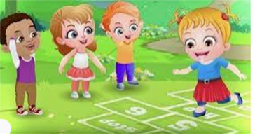
Break

Slide 22
5 in 5
TBAT: practise subtraction within 20.
Explain the strategy you used to work out each calculation.

Slide 23
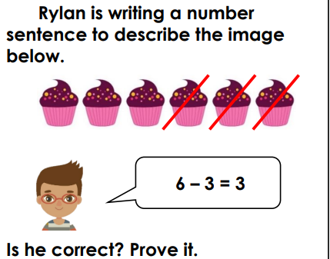
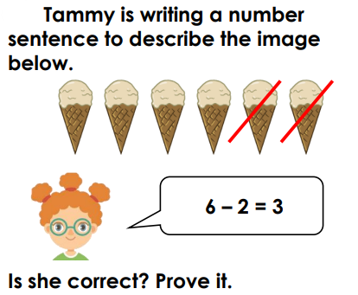
Blue/Green
TBAT: practise subtraction within 20.
Use concrete resources to prove your answer.

Slide 24
TBAT: practise subtraction within 20.
Can you prove it on the number line?

Slide 25
TBAT: practise subtraction within 20.

Slide 26
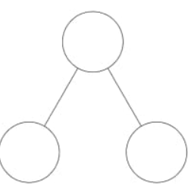
TBAT: practise subtraction within 20.
7
3
5
Is the 7 partitioned correctly to complete this calculation?

Slide 27
TBAT: practise subtraction within 20.
Prove it on a bead string.

Slide 28
TBAT: practise subtraction within 20.

Slide 29
TBAT: practise subtraction within 20.
Liam is correct because.......
Liam is incorrect because.......

Slide 30
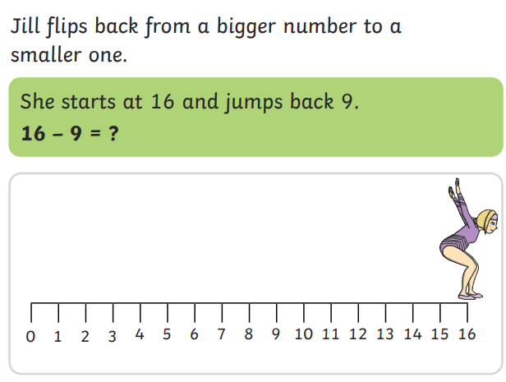
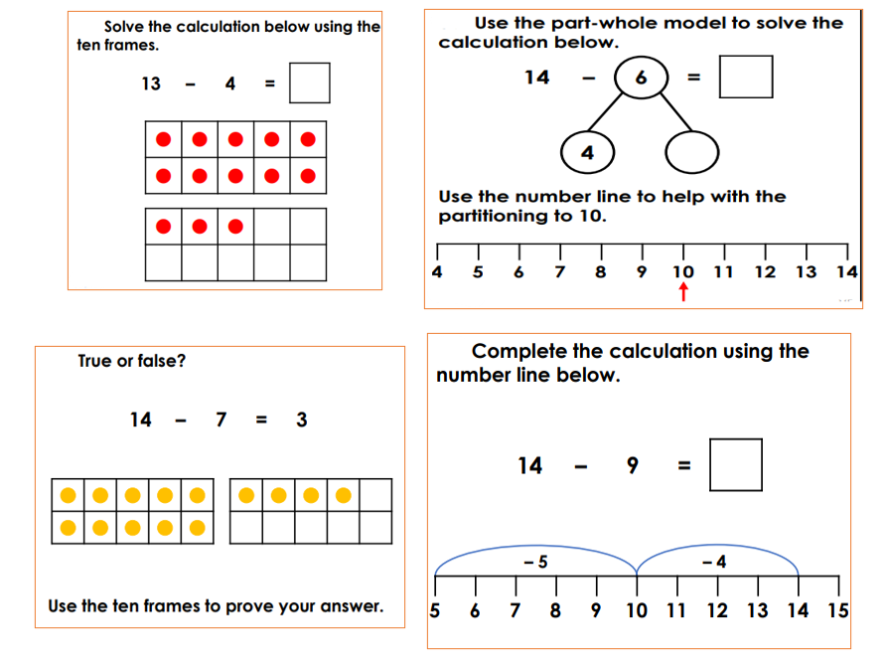
TBAT: practise subtraction within 20.
Challenge:
Independent:
RP:

Slide 31
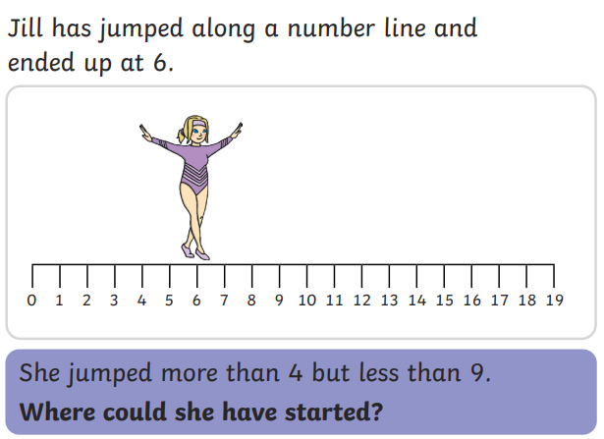
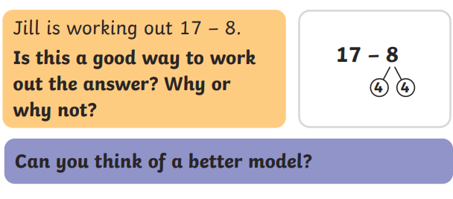
TBAT: practise subtraction within 20.
Mastery:
Mastery with greater depth:

Slide 32
Lunch

Slide 33
Today's Alien language is.......

Slide 34
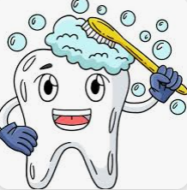
Toothbrushing

Slide 35
Singing and Golden Book assembly

Slide 36
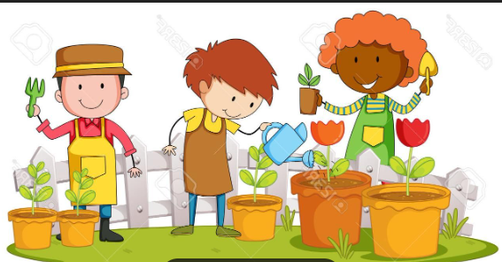
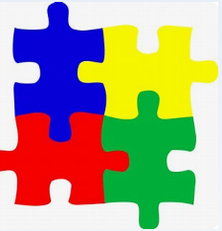
Enrichment

