Slide 1
Morning Challenge
membership ownership partnership
dictatorship championship craftsmanship fellowship apprenticeship citizenship sponsorship Are there any words you are unsure of? Use a dictionary to look them up and then use them in a sentence.

Slide 2
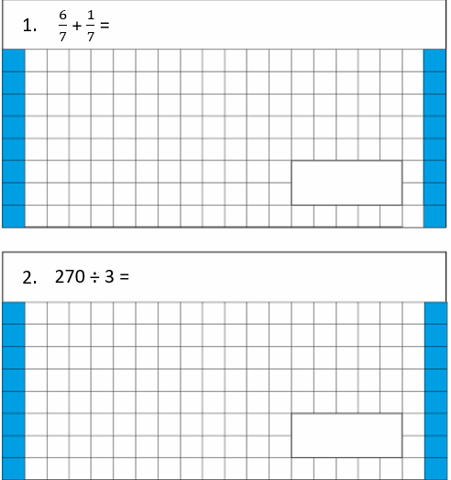
TBAT- apply divisibility tests for 2,3,4,5,6,9, 10 and 25
Challenge: Write 75% as a decimal.
3. 567.09 divided by 100 =[ ]

Slide 3
How do we know if a number is a multiple of 2? How do we know if a number is a multiple of 5? Challenge: How can we test if a number is divisible by 9?

Slide 4
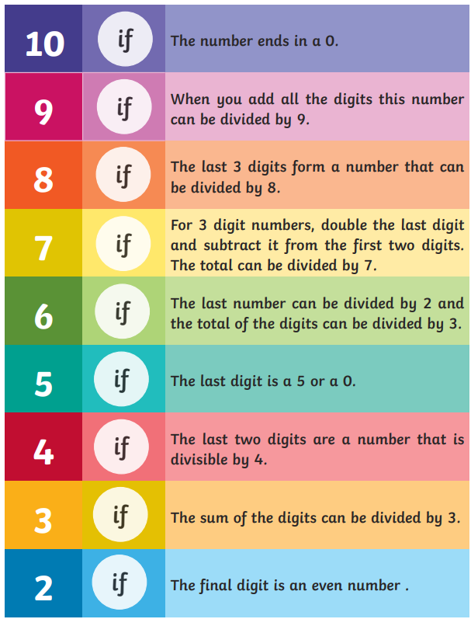

Slide 5
Whiteboard work:
Challenge: Select one of the numbers and explain why it is not divisible by 2.

Slide 6
Whiteboard work:
Challenge: Select one of the numbers and explain why it is not divisible by 3.

Slide 7
Whiteboard work:

Slide 8
Class work: Use divisibility rules to find which numbers in the box are factors of the number.

Slide 9
Paired work: Use divisibility rules to find which numbers in the box are factors of the number.

Slide 10
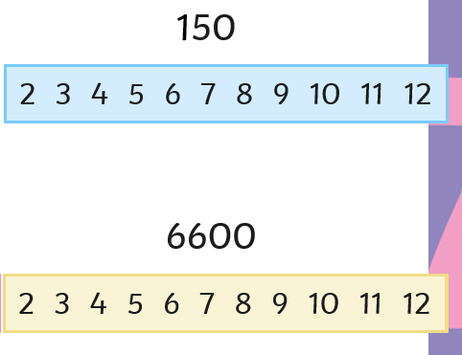
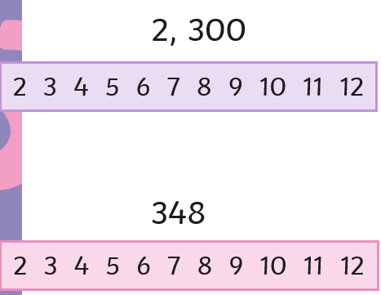
In books: Blue Green
Challenge:

Slide 11
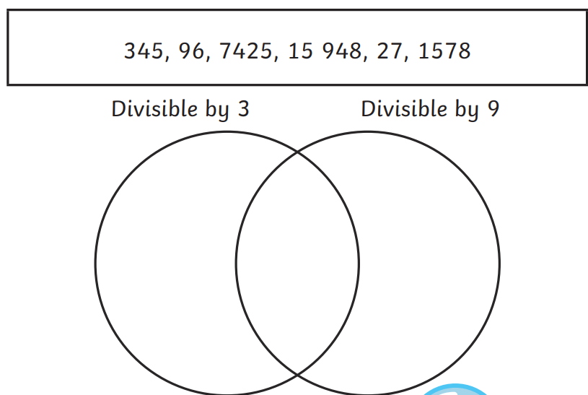
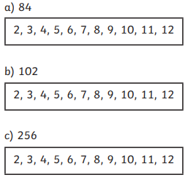
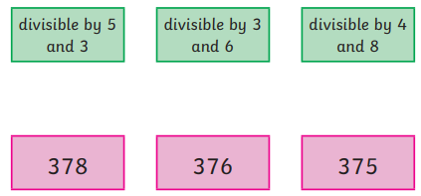
Independent:

Slide 12
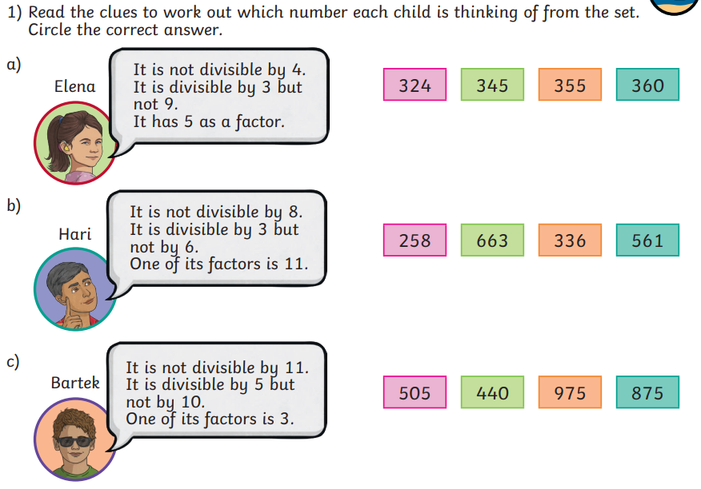
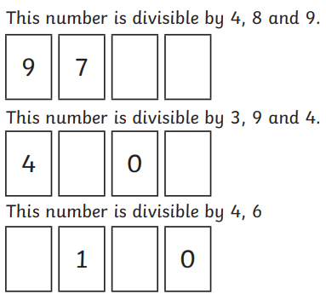
Challenge: Mastery:

Slide 13
Monday 20th January
TBAT- explore author's choice of language.
3 in 3
A rocket, launched yesterday from a private site in northern China, is missing. Yesterday the Internet was alive with rumours of a secret manned space mission. Today NASA and the Russian Federal Space Agency both confirmed that a rocket did take off but denied it was theirs. The rocket entered high orbit and then disappeared into “deep space”. No manned rocket has left earth’s orbit since Apollo 17 in 1972.
Find a word with a similar meaning to vanished.
2) Where did the rocket launch from?
3)What do you infer from 'deep space'?

Slide 14
Synonym Challenge:
anxious
manoeuvre
movement
mission
audacious
meander
deceive
adventurous
vast
big
amble
trick

Slide 15
Blue He smiled. He winked. He slinked. What sentence type has been used? Green My thoughts ran away with me. Should we sit inside? Why did the author follow the statement with a question?

Slide 16
Key Vocabulary: ambling valet nauseous

Slide 17
In groups read the text, decide who will read what parts. Read the text as a class. Highlight three parts of the text that you find interesting.

Slide 18
Class Work: Close to the entry was an absolute beauty: shiny and glossy, sleek and powerful, tempting us in. What is the 'beauty'? Why do you think this word was selected?

Slide 19
'My thoughts ran away with me.' What does this tell you about how the character is feeling at this time? 2) Find and copy a word with a similar meaning to 'love'. 3) 'Time stood still as his hand stretched up towards the neat row of key fobs.' Why has the author chosen the phrase; time stood still? 4) Find and copy a phrase that shows Liam felt anxious? 5) Find an example of a metaphor used to describe the car. 6) I saw a colourful rainbow arching across the sky and beckoning me towards the horizon. What do you think Liam wanted to do at this point and why? 7) What impression do you get of Liam? Use evidence from the text to support your answer.

Slide 20
Challenge: He smirked. He winked. He slinked. I smiled. I winced. I stood. Compare the two characters based on the sentences above. Salesman and Liam. What are the feelings and thoughts towards each other?

Slide 21
Word work: (continue planning sheet) Liam wants to say something grown up so that he isn't caught out, what may he say to the car salesman?

Slide 22
Word work: (continue planning sheet) Talk partners: What are the rules for using direct speech in our writing?

Slide 23
My thoughts ran away with me. Should we sit inside it? Is it locked? How fast would it go? Straight away, the salesman approached us and said, “I admire your taste.” I thought I should say something grown-up, so I took a deep breath and replied, “I’d like to test drive this one please.” (Box 2) Write a sentence that the car salesman might say to Liam and write Liam's response.

Slide 24
Lesson 3: Asking questions
Objectives
To explain how selection directs the flow of a program
I can explain that program flow can branch according to a condition
I can design the flow of a program that contains ‘if… then… else…’
I can show that a condition can direct program flow in one of two ways

Slide 25
Algorithms in action. Blue partner- ask the question, and green respond.
Introduction
Ask, “What is the capital of France?”
If the answer is “Paris” then
Say “Correct!”
If the answer is not “Paris” then
Say “Wrong answer!”

Slide 26
This is the same algorithm, however it is presented in a branching structure. Why is this easier to follow?
Ask, “What is the capital of France?”
Condition
Answer is Paris
True (Paris)
False (not Paris)
Say “Correct!”
Say “Wrong answer!”
Outcome if true
Outcome if false

Slide 27
Identifying outcomes
Activity 1
Question to be asked
Wait means an infinite loop is not needed
Where is the:
Condition
Outcome if the condition is true
Outcome if the condition is false
Outcome if condition is true (then)
Condition — the answer is the same as ‘12’
Outcome if condition is false (else)
Notes:
Screenshot from Scratch

Slide 28
Idenitfy if the various user inputs that could be entered in response to this question are true or false.
Activity 1
User input = yes
User input = 15
User input = 8
User input = twelve
User input = 12
True | False
12
8
15
yes
twelve
Challenge: We know that 'twelve' is the same as 12, but do you think the programme knows this?
Notes:
Screenshot from Scratch

Slide 29
Whiteboard work: Record your answers to the questions on the next three slides and be ready to discuss.

Slide 30
Talk partners:What happens if the condition is true?
Activity 1
A
B
Notes:
Screenshots from Scratch

Slide 31
Look at the algorithm, what happens if the condition is true?
Activity 1
A
B
Notes:
Screenshots from Scratch

Slide 32
What happens if the condition is false?
Activity 1
A
B
Notes:
Screenshots from Scratch

Slide 33
Create the algorithms and check your answers in the project: ncce.io/pg5b-3-a2-c
Activity 1

Slide 34
Did yours do the same as what happens on the next three slides?

Slide 35
What happens if the condition is true?
Activity 1
A
B
Notes:
Screenshots from Scratch

Slide 36
What happens if the condition is true?
Activity 1
A
B
Notes:
Screenshots from Scratch

Slide 37
What happens if the condition is false?
Activity 1
A
hippo1-a
hippo1-b
B
Notes:
Screenshots from Scratch

Slide 38
Activity 2
Designing outcomes
Talk partners: What does the displayed algorithm show?
Ask “Do you want me to change colour?”
Answer is yes
True
False
Change the colour by 50
Say, “OK!” for two seconds

Slide 39
Activity 2
Write an algorithm using the branching structure to show the question your sprite will ask, the condition, and the two different outcomes.​
​
You need to add the following to your worksheet:
Select a question that your sprite is going to ask the user.
Use an algorithm with a branching structure to identify:
The condition (if)
The outcome if the condition is true (then)
The outcome if the condition is false (else)

Slide 40
Designing different outcomes
Activity 2
Look at your partner’s branching algorithm.
Does it include:
The question that will be asked?
The condition (if)?
The outcome if the condition is true (then)?
The outcome if the condition is false (else)?
Notes:
Image source: https://pixabay.com/illustrations/list-icon-symbol-paper-sign-flat-2389219/

Slide 41
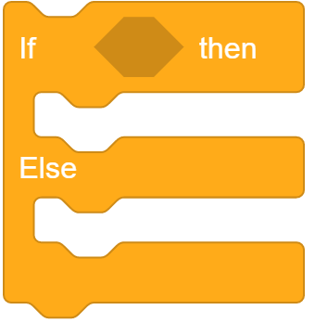
Programming different outcomes
Activity 3
Talk partners:
How will you make use of these blocks when you are implementing your algorithm?
Notes:
Screenshots from Scratch

Slide 42
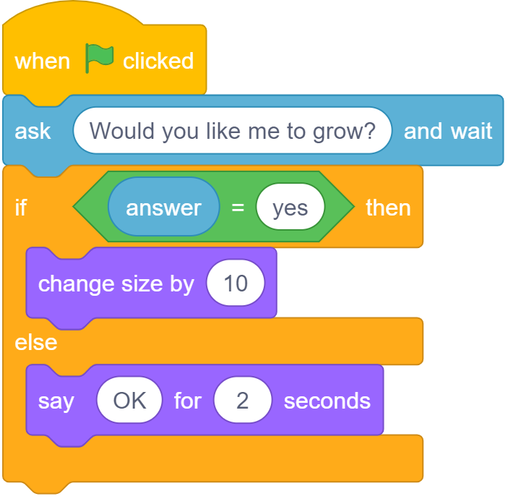
Programming different outcomes
Activity 3
How to construct a program that uses selection to direct the flow of a program.
Notes:
Video from Scratch

Slide 43
Which way?
Plenary
Talk partners: Predict what will happen if the user types in the following responses to the question:
12
11
Eleven
This program will return ‘11’ as the true condition, even though we know it is the wrong answer!

Slide 44
Next lesson
Summary
In this lesson, you…
Designed and created a program that uses the ‘if… then… else…’ structure for selection
Next lesson, you will…
Design and create a program that includes selection to meet the requirements of a given task

Slide 45
PE – Lesson 5

