Slide 1
Tuesday 21st January 2025
Morning challenge

Slide 2
Tuesday 21st January 2025 Word work
What is a prefix?
How many prefixes can you think of?
Has the prefix been used correctly in this sentence?
I have displaced my glasses.

Slide 3
What is a Prefix?
A prefix is added to the beginning of a word to make a new word.
Most prefixes are added to the beginning of root words without any changes in spelling.
Like this:
prefix
root word
prefix + root word
dis-
connect
disconnect
mis-
take
mistake
un-
cover
uncover

Slide 4
What is a Prefix?
It is important to understand the definitions of prefixes because they help us figure out the meanings of any new words we come across.
Think about the different words which can be created through adding the prefix dis-, like disconnect.
Make a list on your whiteboard.

Slide 5
What is a Prefix?
What does the prefix dis- mean?
dislike
Do not like something.
Break a connection so it is not connected any more.
disconnect
disobey
Do not follow a command.
It means ‘not’ or ‘the opposite of’.

Slide 6
What is a Prefix?
Think about the different words which can be created through adding the prefix mis-, like mistake.
Make a list on your whiteboard.

Slide 7
What is a Prefix?
What does the prefix mis- mean?
mistake
Do something wrong.
misread
Read something wrongly.
misplace
Put something in the wrong place.
It means ‘wrong’ or ‘false’.

Slide 8
What is a Prefix?
Think about the different words which can be created through adding the prefix un-, like uncover.
Make a list on your whiteboard.

Slide 9
What is a Prefix?
What does the prefix un- mean?
unhappy
Not happy.
unkind
Not kind.
uncover
To take a cover off so it is not covered.
It means ‘not’.

Slide 10
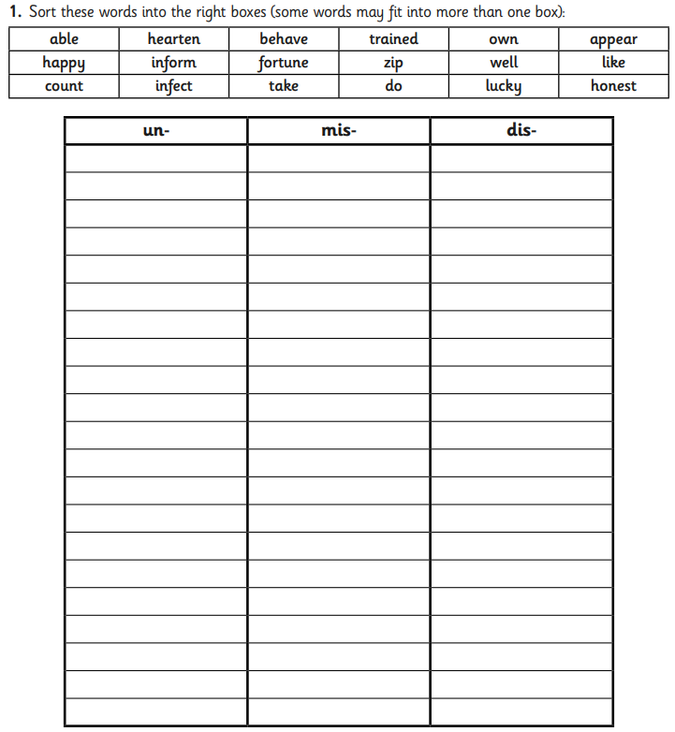
Tuesday 21st January 2025 Word work
Ch – choose one word from each column and include them into correctly punctuated sentences.

Slide 11
21.01.25
Times table practice
Times table spalt!
2 children, 1 calculation.
Who will splat the answer first?
8
80
32
96
24
48
16
40
64
72
8 Times Table Song | Skip Counting by 8 Multiplication Song
88
56

Slide 12
21.01.25
TBAT: place fractions on a number line
3 in 3
4/8 + 3/8 =
476 – 742 =
Which is largest 6 x 5 or 4 x 8?
Prove it.
Challenge
My jug holds 200 ml. I have poured in 125ml. How many more ml do I need to fill the jug?

Slide 13
21.01.25
TBAT: place fractions on a number line
Daily 10 - Mental Maths Challenge - Topmarks

Slide 14
21.01.25
TBAT: place fractions on a number line
Fractions recap

Slide 15
21.01.25
TBAT: place fractions on a number line

Slide 16
Labelling and Drawing Number Lines
Counting in Fractions
On your whiteboard, draw and label a number line showing fifths.
0
1 5
2 5
3 5
4 5
5 5

Slide 17
Labelling and Drawing Number Lines
Counting in Fractions
Draw and label this number line.
What do you notice about the numerator as you label the number line? .
The numerator increases by 1 each time.
What do you notice about the denominator as you label the number line? .
The denominator remains the same.
0
1 9
2 9
3 9
4 9
5 9
6 9
7 9
8 9
1
9 9

Slide 18
21.01.25
TBAT: place fractions on a number line
Blue
Green​

Slide 19
Labelling and Drawing Number Lines
I need to place 5 interval lines between the 0 and 1 on the number line. This will show me fifths.
I have drawn a number line to be labelled in fifths.
0
1 5
2 5
3 5
4 5
5 5
1
To divide the number line into fifths, 4 interval lines need to be drawn.
1 one-fifth, 2 one-fifths, 3 one-fifths, 4 one-fifths, 5 one-fifths
No!
This has divided the number line into 6 equal parts.
Is Jo correct?

Slide 20
Labelling and Drawing Number Lines
Counting in Fractions
Which of these number lines have correctly labelled the first interval?
It is important to count the intervals to be able to correctly label the first fraction.
1 8
1 7
1 9

Slide 21
Labelling and Drawing Number Lines
Counting in Fractions
Which of these labels are correct?
4 10
3 5
3 8

Slide 22
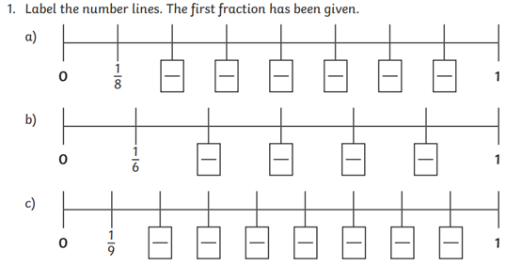
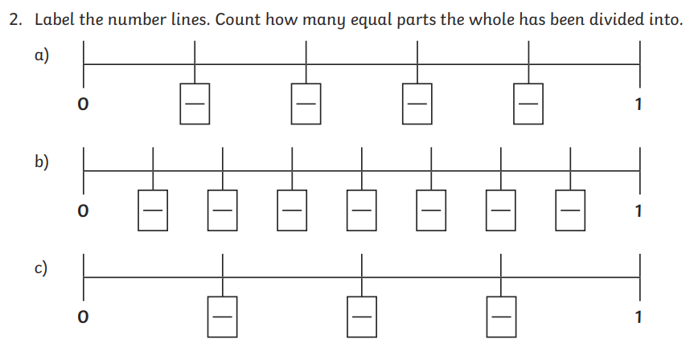
21.01.25
TBAT: place fractions on a number line
Independent
Challenge

Slide 23
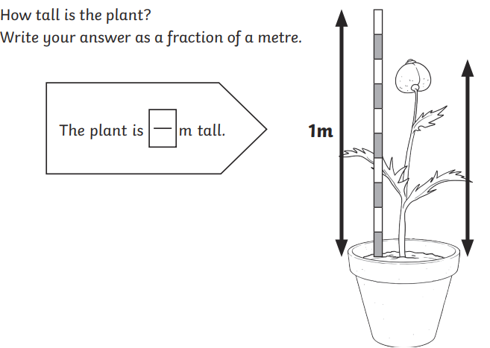
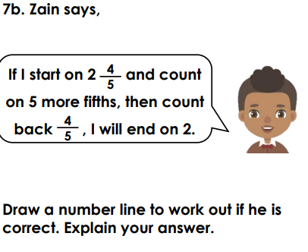
21.01.25
TBAT: place fractions on a number line
Independent
Mastery
Mastery with greater depth

Slide 24
Tuesday 21st January 2025
Spellings
Spelling thief
The spelling thief has taken some of the letters from our spelling words! Can you work out which letters are missing?
Write the correct spelling in your book.
g_rd_n_r
_im_ti_g
of_er_d
be_ef_ti_gf_oc_sed
Ch – place each word into a correctly punctuated sentence.

Slide 25
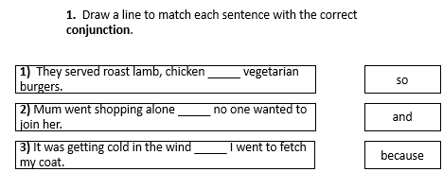
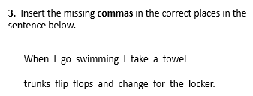
Tuesday 21st January TBAT: explore the shades of meaning of adjectives.
3 in 3
Reorder the sentence (from question 3) so that it no longer starts with a conjunction.

Slide 26
Tuesday 21st January TBAT: explore the shades of meaning of adjectives.
Summarise what we have learnt about Leaf so far in 2 sentences.
What are the best three words you can use to describe Leaf? Explain why Leaf is likely to be feeling lonely.

Slide 27
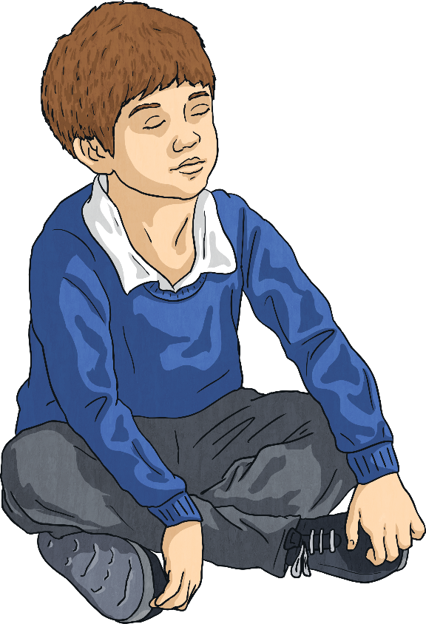
What Do You Think?
Close your eyes. Your teacher will read two sentences to you. Try to paint a picture in your head of what the sentence is saying.
The car bumped into the wall.
The car smashed into the wall.
In both of these sentences, the car hit a wall but which sentence made the accident sound worse?
We call this shades of meaning. Although words can mean the same, they have a different impact on the reader.

Slide 28
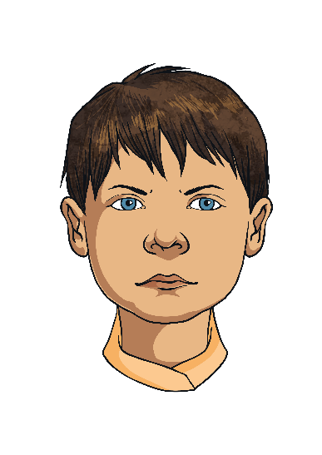
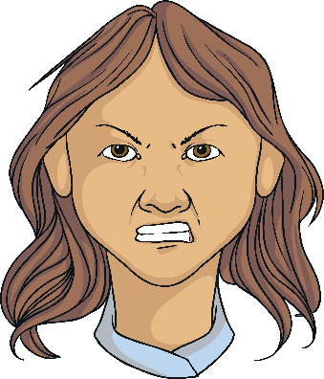
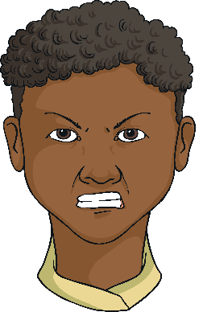
Shades of Meaning: Adjectives
Let’s explore this concept with adjectives. Who is the most annoyed?
Joe was cross.
Salma was irate.
Kevin was furious.
Although all of these adjectives mean that someone is annoyed, each choice changes how annoyed the person seems.

Slide 29
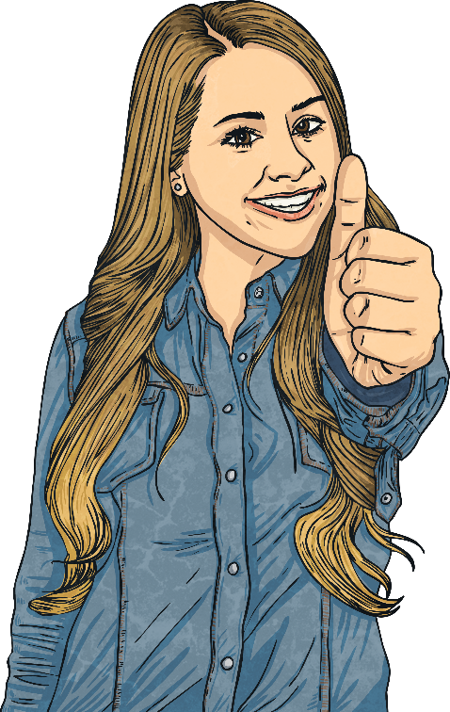
Add the Missing Adjectives
Add the missing words to this scale. Which adjectives would fit to give the right degree of meaning?
good
great
super
brilliant
excellent
phenomenal
terrific
Did you choose the same adjectives? Did you have different ideas?

Slide 30
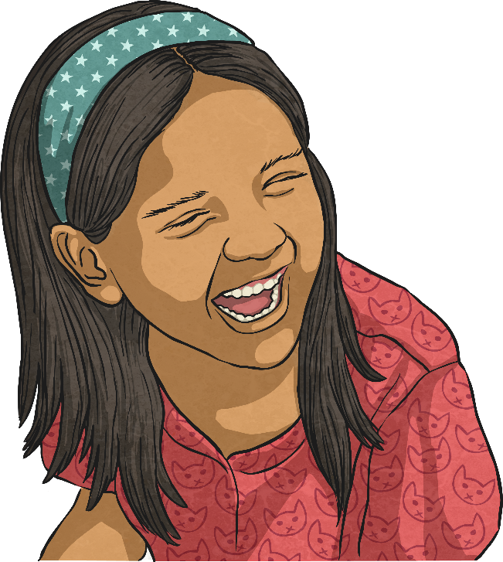
Add the Missing Adjectives
Add the missing words to this scale. Which adjectives would fit to give the right degree of meaning?
happy
cheerful
joyful
jovial
beaming
ecstatic
euphoric
Which adjectives did you choose?

Slide 31
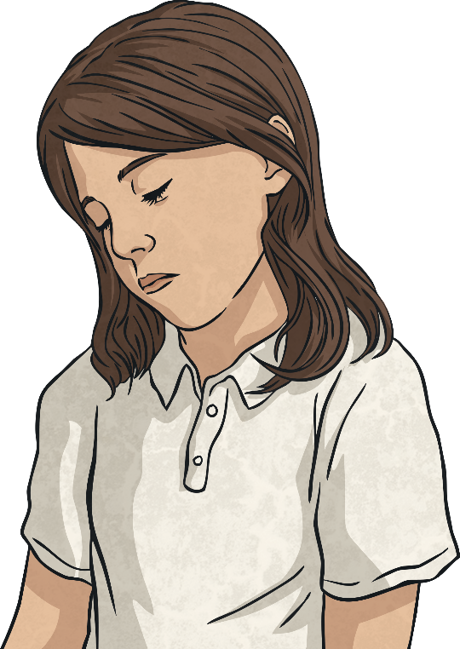
Add the Missing Adjectives
Add the missing words to this scale. Which adjectives would fit to give the right degree of meaning?
sad
upset
tearful
miserable
downcast
depressed
melancholy
despondent
Why might you choose to use one particular word rather than another within your writing?

Slide 32
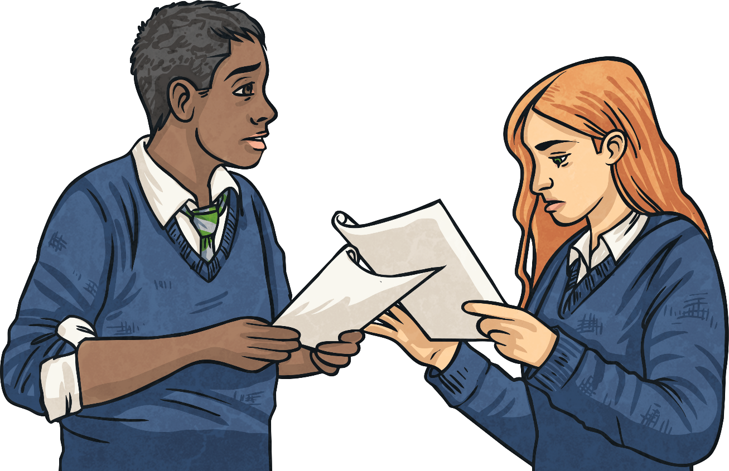
Change the Meaning
Look at this sentence:
Junaid was disappointed by his test results.
On a whiteboard, change the adjective ‘disappointed’ to show that Junaid was extremely unhappy with his test results.
Now, change the adjective again to show that Junaid was sad but not too bothered by his results.

Slide 33
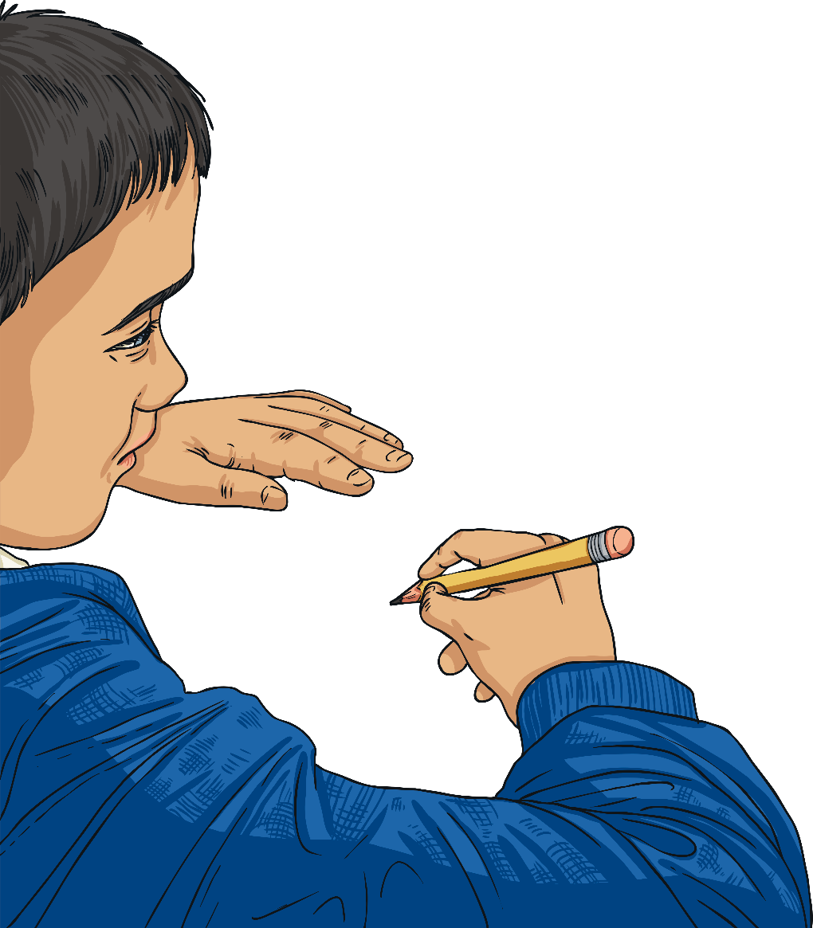
Change the Meaning
You could have had:
Junaid was disappointed with his test results.
Junaid was devastated by his test results.
Junaid was irked by his test results.

Slide 34
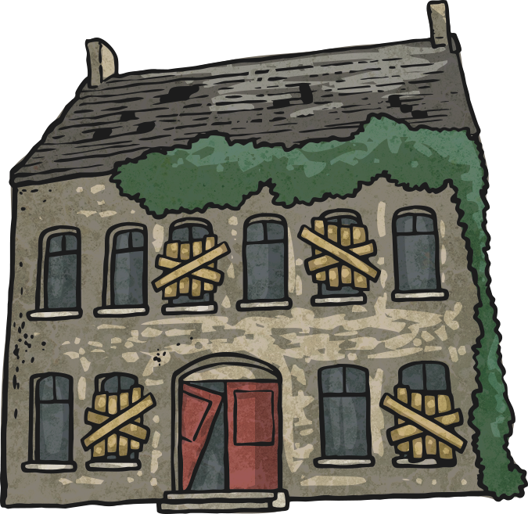
Change the Meaning
Look at this sentence:
Lydia was spooked by the haunted house.
On a whiteboard, change the adjective ‘spooked’ to show that Lydia was a little uneasy but not too scared by the haunted house.
Now, change the adjective again to show that Lydia was really scared of the haunted house.

Slide 35
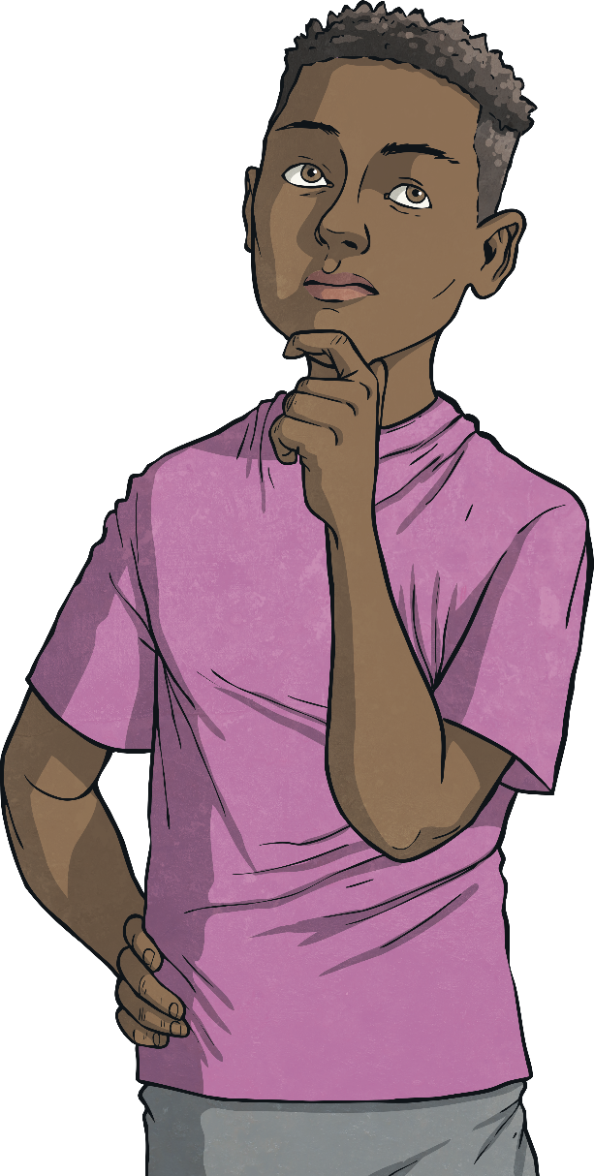
Change the Meaning
You could have had:
Lydia was spooked by the haunted house.
Lydia was worried by the haunted house.
Lydia was terrified by the haunted house.

Slide 36
Tuesday 21st January TBAT: explore the shades of meaning of adjectives.
Some of the words we thought of to describe the setting Leaf was in were: Beautiful
Colourful
Warm
Quiet
In pairs, can you think of synonyms for each of these words?

Slide 37
Tuesday 21st January TBAT: explore the shades of meaning of adjectives.
In groups, you are going to be given an adjective and synonyms to match it. I would like you to order these words – be prepared to justify why you have ordered them in this way:
Beautiful Colourful Warm Quiet Write your words in order in your book and explain why you have ordered them this way. Challenge – Write a sentence about Leaf in the tropical rainforest using a new word you have learnt today. Include a coordinating conjunction to extend your sentence.

Slide 38
Tuesday 21st January 2025
TBAT: Understand pitch through melody and develop a song.
The Collins Hub Educator > Library
Singing French – Lesson 3 – A douze

Slide 39
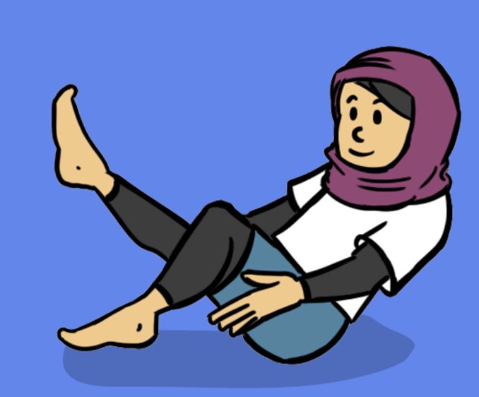
Tuesday 21st January 2025
PE – dance
TBAT: to use canon and unison to make our line dance look interesting.
This half term in P.E will be dance and fundamentals
- Changing for PE - Rules and expectations moving to PE - Move to the downstairs hall or outside
Get Set 4 PE - Lesson Plan -8 for Year 3 Dance

Slide 40
Tuesday 21st January 2025 TBAT: identify that commands have an outcome.
Key vocabulary
Scratch
Programming
Blocks
Commands
Code
Sprite
Learning objectives
I can create a program following a design and understand that each sprite is controlled by the commands I choose
I can predict the coding blocks used to move a sprite
I can match coding blocks to their actions

Slide 41
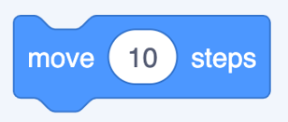
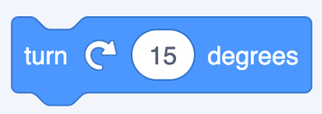
Tuesday 21st January 2025 TBAT: explore a new programming environment.
Blue – What will happen with this command?
Green – What will happen with this command?
Challenge – What is the name of the area you drag your command blocks to?

Slide 42
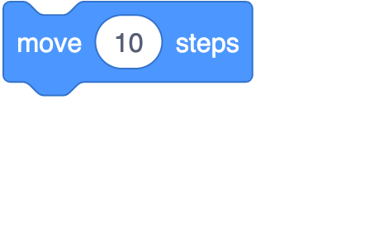
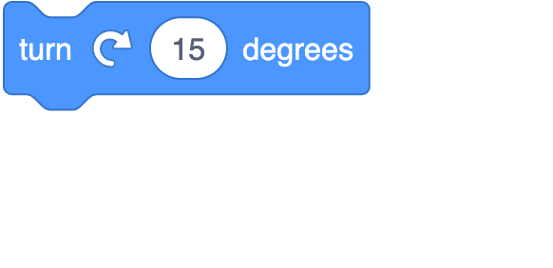
Talk partners What’s happening in this project?
Introduction
Use the blocks below to say what you think each sprite is doing.

Slide 43
Answers
Introduction
Fish
Crab
Pufferfish

Slide 44
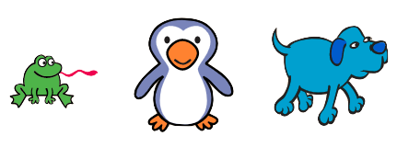
Open Scratch Moving more than one sprite
Activity 1
Delete Scratch the cat
Add three new sprites (hint: they are all animals)

Slide 45
Adding motion to multiple sprites
Activity 1

Slide 46
Follow this program design
Activity 1
 | Make the frog move 10 steps
 | Make the penguin turn clockwise
 | Make the dog turn anticlockwise
↻
↺

Slide 47
Which blocks?
Activity 2

Slide 48
Exploring more motion blocks
Activity 3
Try these blocks.
How are they different to the blocks you have already used?
What happens if you change the numbers within the blocks?

Slide 49
Match the blocks to the outcome
Activity 3
Sprite moves slowly to another part of the stage
Sprite points downwards
Sprite moves suddenly to another part of the stage

Slide 50
Ordering motion blocks
Plenary
This project uses three motion blocks. Which set of blocks are in the right order?
A
B
C

Slide 51
Assessment
How confident are you? (1–3)
I can create a program following a design and understand that each sprite is controlled by the commands I choose
I can predict the coding blocks used to move a sprite
I can match coding blocks to their actions
3 – Very confident
2 – Unsure
1 – Not confident
Notes:
Image source: https://pixabay.com/vectors/thumb-up-hand-like-confirm-go-top-307176

Slide 52
Thursday 21st January
TBAT: cut shapes directly into paper using scissors.
Does everybody see artwork in the same way?
Which features of artwork could people see differently?

Slide 53
Thursday 21st January
TBAT: cut shapes directly into paper using scissors.
Talking Points: Matisse Cut Outs (accessart.org.uk)

Slide 54
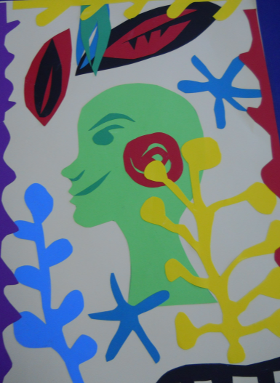
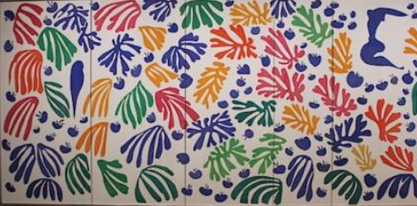
Thursday 21st January
TBAT: cut shapes directly into paper using scissors.
Look at the images. Using your scissors, cut different shapes and arrange them onto your page.
You do not need to use a pencil to sketch your ideas first.
What does your artwork mean to you? Explain what you have created at the bottom of your artwork.

