Slide 1
Tuesday 21st January 2025
21/1/25

Slide 2
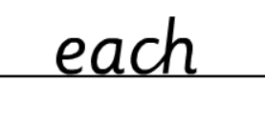
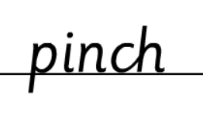
Morning Challenges:
Name writing

Slide 3
Phonics
Revisit and review
Tuesday 21st January 2025
25/1/25
TBAT
Read words with the /l/al grapheme

Slide 4
Revisit and review
Tuesday 21st January 2025
25/1/25
Today's Grapheme
al

Slide 5
Recap
le ph g y ea wh ow oe ou

Slide 6
Revisit and review
Tuesday 21st January 2025
25/1/25
What are the digraphs?
gentle
huge
carry
puddle
dry
goes
Segment these
words and read them
Blend and say words

Slide 7
Focus words
Tuesday 21st January 2025
25/1/25
t-o-t-al
f-i-n-al
e-qu-al
Sounds out these
words and read them

Slide 8
Focus words
Tuesday 21st January 2025
25/1/25
total
final
equal
Read these words on sight

Slide 9
Focus words
Tuesday 21st January 2025
25/1/25
total
equal
final
metal
pedal
Read, sound talk and blend
And again... FASTER!

Slide 10
Revisit and review
Ms
Tuesday 21st January 2025
25/1/25
Mrs
school
tricky words
Mr
Read the tricky words

Slide 11
Tuesday 21st January 2025
25/1/25
Now let's read this sentence!​
What digraphs can you see?
What tricky words can you see?

Slide 12
Tuesday 21st January 2025
25/1/25
Let's spell!
How many sounds? Write it.
tricky words
total petal call
Listen to the sentence, say it, write it and read it!
Challenge
Extend the sentence using 'and'

Slide 13
Maths
use number bonds to derive subtraction facts and teens facts
TBAT:

Slide 14
3 in 3 Which strategy would you use for each calculation?
6 + 2
13 + 6
Count on?
Number bonds?
‘Make 10’?
12 + 7
7 + 5
8 + 3
18 + 1
Challenge: Can you use your answers to write a subtraction for one of them?
Notes:
Do Now
Pupils discuss the strategies they would use to solve the addition calculations shown on the slide. Acknowledge different ways of doing the same calculation, e.g. one pupil may know 6 + 2 and another pupil might count on to calculate it.

Slide 15
TBAT: use number bonds to derive subtraction facts and teens facts
part
number bond
whole
related fact
known fact

Slide 16
Related facts
TBAT: use number bonds to derive subtraction facts and teens facts
If I know …
then I know …
+
=
–
=
+
=
–
=
Notes:
New Learning: Related facts
Introduce a context for a part-whole combination and partitioning, e.g.
Some bears are camping. Four bears are in the tent and three bears are at the campfire. How many bears are there altogether?
Represent this in the concrete, e.g. with pupils or with cubes.
Model how you can write an addition equation to show this, starting with the bears inside the tent or with the bears at the campfire. This makes two different equations with the same sum. Use the following sentence structure to express the commutative relationship, e.g.:
If I know three plus four is equal to seven, then I know four plus three is equal to seven.
How could we show this on a part-whole model? What are the parts/whole?
Follow pupils’ instructions to complete the part-whole model. Return to the story context and establish related subtraction facts, using ‘If I know … then I know …’ again.

Slide 17
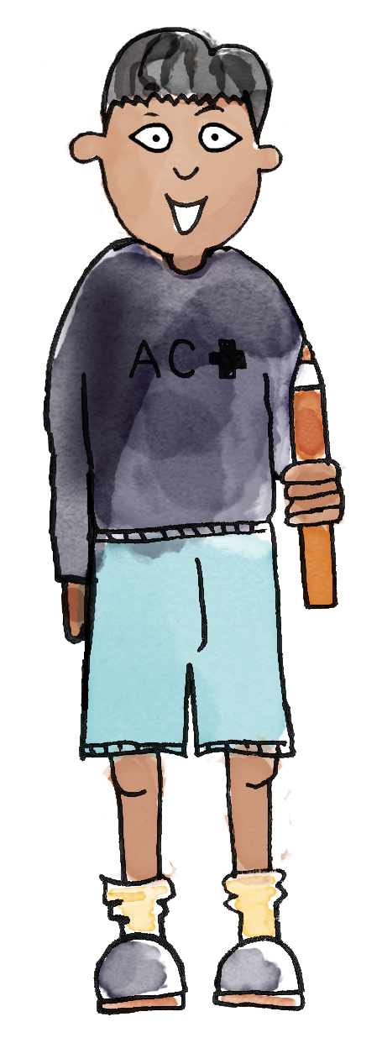
TBAT: use number bonds to derive subtraction facts and teens facts
Three is a part. Five is a part. Three plus five is equal to eight. The whole is eight.
So one equation is 3 + 5 = 8.
If we know 3 + 5 = 8, then we know 5 + 3 = 8.
part whole number bond known fact related fact
Notes:
Talk Task: Part-whole related facts
Each pair has a large part-whole model, ten cubes and the Task Sheet.
They take it in turns to identify the four related facts for each part-whole model on the sheet, modelling each fact using cubes on the large part-whole model. They use the sentence structure:
If I know three plus five is equal to eight, then I know five plus three is equal to eight.
If I know eight subtract three is equal to five, then I know eight subtract five is equal to three.
Think about how you will model this. What do you want pupils to say?

Slide 18
Deriving teens facts
How can we use the number bond 3 + 4 = 7 to find the whole when the parts are 13 and four?
7
4
3
4
13
Challenge: How can you use this information to calculate 17 – 4?
Notes:
Develop Learning: Deriving teens facts
This Develop Learning from Unit 5 about how the structure of teens numbers as a ten and some ones can help us calculate.
How can we use the number bond 3 + 4 = 7 to help us work out 13 + 4?
Model this using concrete manipulatives and complete the part-whole model.
Get pupils to build the numbers using cubes so that they can see and explore the similarities and differences. (You could also use the images on the next slide to support this.)
Build on the New Learning about related facts:
Which subtraction facts can you derive from the same part-whole models?
Model each fact using concrete manipulatives, and record them on the next slide.
Discuss another example if needed, e.g. use 2 + 5 to work out 12 + 5.

Slide 19
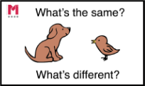
Blue/ Green What’s the same? What’s different?
7
4
3
17
4
13
Notes:
Develop Learning: Deriving teens facts
This Develop Learning from Unit 5 about how the structure of teens numbers as a ten and some ones can help us calculate.
How can we use the number bond 3 + 4 = 7 to help us work out 13 + 4?
Model this using concrete manipulatives and complete the part-whole model.
Get pupils to build the numbers using cubes so that they can see and explore the similarities and differences. (You could also use the images on the next slide to support this.)
Build on the New Learning about related facts:
Which subtraction facts can you derive from the same part-whole models?
Model each fact using concrete manipulatives, and record them on the next slide.
Discuss another example if needed, e.g. use 2 + 5 to work out 12 + 5.

Slide 20
If I know 13 + 4 = 17, what else do I know?
13
+
4
=
17
17
+
=
4
13
-
=
-
=
Notes:
Develop Learning: Deriving teens facts
This Develop Learning from Unit 5 about how the structure of teens numbers as a ten and some ones can help us calculate.
How can we use the number bond 3 + 4 = 7 to help us work out 13 + 4?
Model this using concrete manipulatives and complete the part-whole model.
Get pupils to build the numbers using cubes so that they can see and explore the similarities and differences. (You could also use the images on the next slide to support this.)
Build on the New Learning about related facts:
Which subtraction facts can you derive from the same part-whole models?
Model each fact using concrete manipulatives, and record them on the next slide.
Discuss another example if needed, e.g. use 2 + 5 to work out 12 + 5.

Slide 21
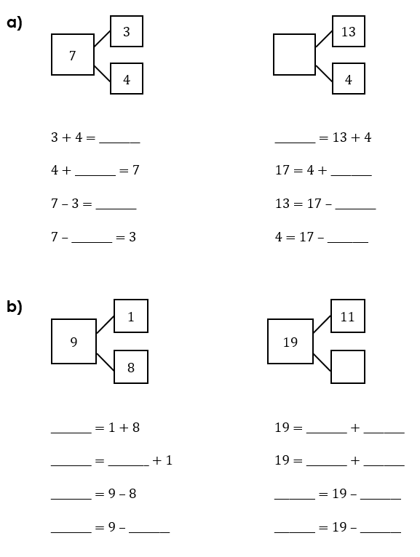
To use number bonds to derive subtraction facts and teens facts
Use cubes on a part-whole model to model each calculation.
Complete the missing information.
Notes:
Independent Task
Pupils work in pairs. Each pair has a large part-whole model, 20 interlocking cubes and the Task Sheet. They complete the missing information, each time modelling the relationship between the numbers using cubes on the part-whole model. Encourage pupils to talk about what they are doing (‘If I know … then I know …’) and to form a ‘unit of ten’ when calculating the teens facts to emphasise the structure of the numbers.
Possible adaptations:
Provide the Task Sheet fully completed for pupils to focus on moving cubes on the part-whole model and reasoning about the four possible equations for each example and the relationship between the ones facts and the teens facts. They could practise this to then share with the class.
Just provide part-whole models and require pupils to independently record related equations.

Slide 22
Are the equations correct?
How do you know?
3 + 4 = 7
7 + 4 = 3
7 – 4 = 3
3 – 4 = 7
I've written the related facts for this part-whole model!
7
4
3
Notes:
Plenary: Identifying misconceptions
The plenary addresses the misconception that the three numbers within a part-whole relationship can be positioned interchangeably in both addition and subtraction. Challenge pupils to use cubes to reason about how they know that one of the equations on the slide is incorrect.

Slide 23
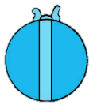
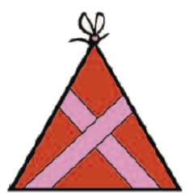
The ‘Make ten’ strategy on a ten-frame
8 + 6
Notes:
New Learning: Representing addition using ‘Make ten’ on a bead string
Show pupils the Big Picture from Unit 5, when they used the ‘Make ten’ strategy through ‘first, then, now’ stories. In this lesson, they move to a part-whole structure.
There are eight red presents and six blue presents. How many presents are there in total?
Can you remember a strategy to add numbers where the total is greater than ten?
We could use the ‘Make ten’ strategy. I know eight plus six is greater than ten because eight plus two is equal to ten and six is greater than two.
Use the next slide to model carrying out the calculation using ‘Make ten’ on a ten-frame.
What do we add to eight to make ten? How many are left from the six to add to ten?
Establish that we can partition the six into two and four. Eight and two make ten, then four more makes 14.
Introduce the same strategy on a bead string. (A pictorial representation is shown on the next slide.) Model moving groups of beads, e.g. a group of two, then a group of four, rather than individual beads, as this strategy is based on adding the complement to ten and then the rest of the addend, rather than counting on in ones.
Encourage pupils to discuss the similarities and differences between the two representations.

Slide 24
The ‘Make ten’ strategy on a bead string
How many beads do I need to add to eight to make ten?
8 + 6 =
Notes:
New Learning: Representing addition using ‘Make ten’ on a bead string
Show pupils the Big Picture from Unit 5, when they used the ‘Make ten’ strategy through ‘first, then, now’ stories. In this lesson, they move to a part-whole structure.
There are eight red presents and six blue presents. How many presents are there in total?
Can you remember a strategy to add numbers where the total is greater than ten?
We could use the ‘Make ten’ strategy. I know eight plus six is greater than ten because eight plus two is equal to ten and six is greater than two.
Use the next slide to model carrying out the calculation using ‘Make ten’ on a ten-frame.
What do we add to eight to make ten? How many are left from the six to add to ten?
Establish that we can partition the six into two and four. Eight and two make ten, then four more makes 14.
Introduce the same strategy on a bead string. (A pictorial representation is shown on the next slide.) Model moving groups of beads, e.g. a group of two, then a group of four, rather than individual beads, as this strategy is based on adding the complement to ten and then the rest of the addend, rather than counting on in ones.
Encourage pupils to discuss the similarities and differences between the two representations.

Slide 25
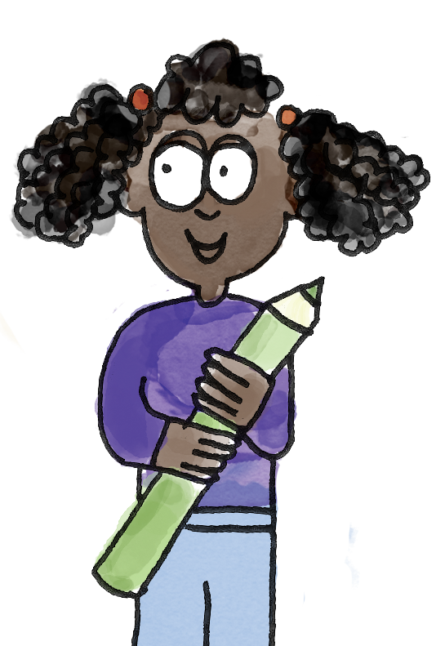
Using ‘Make ten’ on a bead string
I pick eight plus five.
I know I can use ‘Make ten’ because eight plus two is equal to ten, so eight plus five is greater than ten.
I make eight on the bead string first. Then five more. I can see I need two more beads to make ten. That leaves three more because five is made of two and three.
That’s thirteen in total.
Eight plus five is equal to 13.
partition part whole ‘Make ten’ addition subtraction
Notes:
Talk Task: Addition using ‘Make ten’ on a bead string
Pupil A picks an expression from the Task Sheet. They explain how they know they can use the ‘Make ten’ strategy to calculate it. Pupil B makes one of the numbers on a bead string then explains how to partition the second number to use the ‘Make ten’ strategy to add. Pupil A listens to check they agree, then says the full equation. Encourage pupils to move the beads in groups, first a group to make ten, and then whatever is left of the addend.

Slide 26
Subtract using ‘Make ten’ on a ten-frame
13 – 5 =
Notes:
Develop Learning: Representing subtraction using ‘Make ten’ on a bead string
Now present a subtraction problem, e.g. ‘There are 13 red and blue presents. Five are blue. How many are red?’ Get pupils to represent this on a part-whole model and establish the equation required (13 – 5 = ?).
What strategy could we use? How do you know this strategy would work?
We could use ‘Make ten’, because thirteen subtract three is ten, so the answer will be less than ten.
We can partition five into three and what?
Use the ten-frame to model subtracting three first then another two (cross out the three ‘loose’ presents, then the two at the top of the ten-frame), and how this can be recorded in numerals.
Then model this on a bead string (a pictorial representation is shown on the next slide). As with addition, move the beads in groups.
Have pupils discuss similarities and differences between the two representations.

Slide 27
Subtract using ‘Make ten’ on a bead string
How many beads must I subtract from 13 to make ten?
13 – 5 =
Notes:
Develop Learning: Representing subtraction using ‘Make ten’ on a bead string
Now present a subtraction problem, e.g. ‘There are 13 red and blue presents. Five are blue. How many are red?’ Get pupils to represent this on a part-whole model and establish the equation required (13 – 5 = ?).
What strategy could we use? How do you know this strategy would work?
We could use ‘Make ten’, because thirteen subtract three is ten, so the answer will be less than ten.
We can partition five into three and what?
Use the ten-frame to model subtracting three first then another two (cross out the three ‘loose’ presents, then the two at the top of the ten-frame), and how this can be recorded in numerals.
Then model this on a bead string (a pictorial representation is shown on the next slide). As with addition, move the beads in groups.
Have pupils discuss similarities and differences between the two representations.

Slide 28
To use a bead string to represent the ‘Make ten’ strategy
14 – 6
I moved the four white beads first, then two red beads, because six can be partitioned into four and two. There are eight beads left.
I took away four cubes first, to leave ten. Then I needed to subtract two more cubes, because six can be partitioned into four and two. I was left with eight.
Notes:
Independent Task
Ensure this is carefully modelled to pupils. Each pair has the Task Sheet, a bead string, a ten-frame and some cubes. Pupil A chooses a calculation and represents it on a bead string whilst Pupil B listens. Pupil B represents the same calculation on a ten-frame while Pupil A listens. They check they have arrived at the same answer. Pupils swap roles and repeat.
The purpose of this task is to encourage pupils to choose strategies and representations flexibly and see there is no one ‘right’ way of calculating.
Possible adaptations:
Pupils could just use the bead string in this task.
Pupils draw their own representations of the ‘Make ten’ strategy for subtraction.

Slide 29
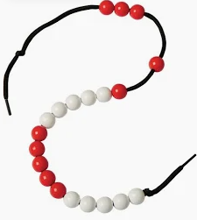
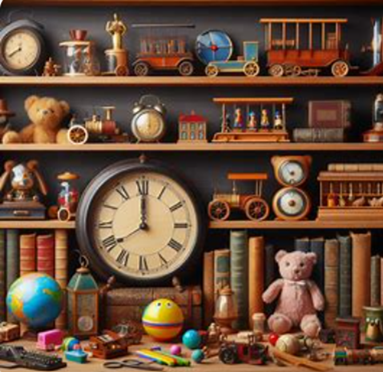
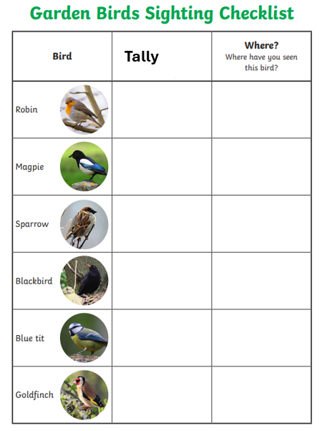
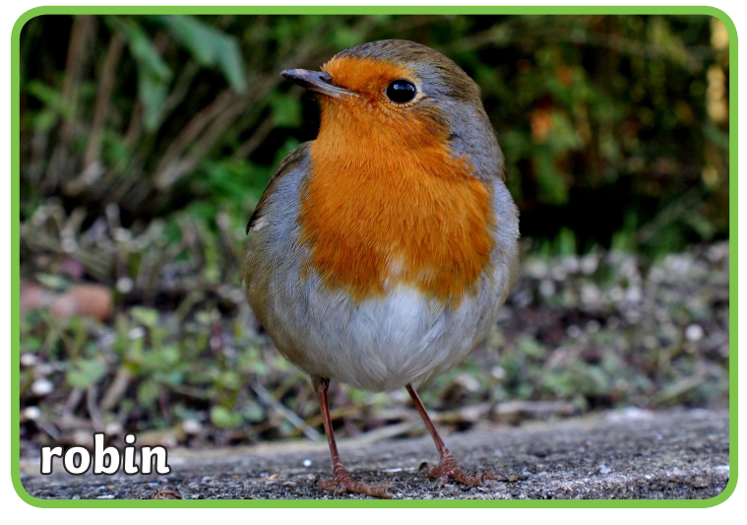
Independent Challenges:
Narrative Zone
Maths Zone
Describe the image.
What can you see?
Use the bead string to complete the calculations.
Enquiry Zone
Creative Zone
Create a tally of how many garden birds you see.
.
Sketch one of the birds and colour it in

Slide 30
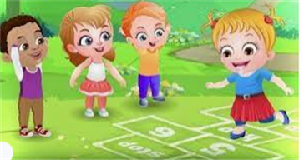
Break

Slide 31
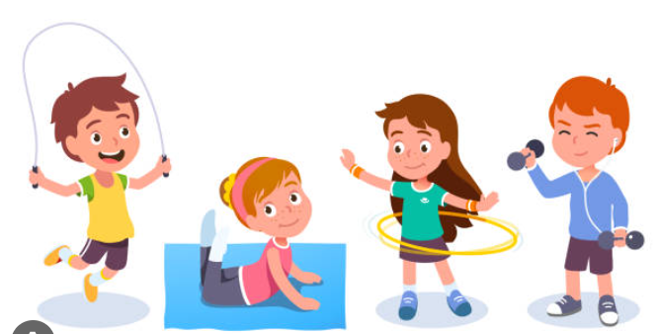
PE

Slide 32
Dance: TBAT: explore speeds and actions in our pirate inspired dance
Use clear actions
Use counts of 8 to help you stay in time to the music and each other

Slide 33
Warm up
Scrub the deck
Walk the plank
Onto the deck
Sharks
Shiver me timbers!
Now perform each action for 8 counts

Slide 34
Skill development
Sit in pairs and row your ship
Row on each beat
Add actions:
Pirate ships
In groups of 6, row your ship

Slide 35
Lunch

Slide 36
How do Christians talk to God?
Tuesday 21st January 2025
Lesson 3

Slide 37
Tuesday 21st January 2025
When Christians talk to God it is called prayer.
Prayer is different and special for every Christian.
Prayer can be silent.
Prayer can be loud.
Prayer can be public.
Prayer can be private.

Slide 38
Tuesday 21st January 2025
God
Even though Christians cannot see God they believe God is real because of their faith and they believe God can communicate with them through prayer.

Slide 39
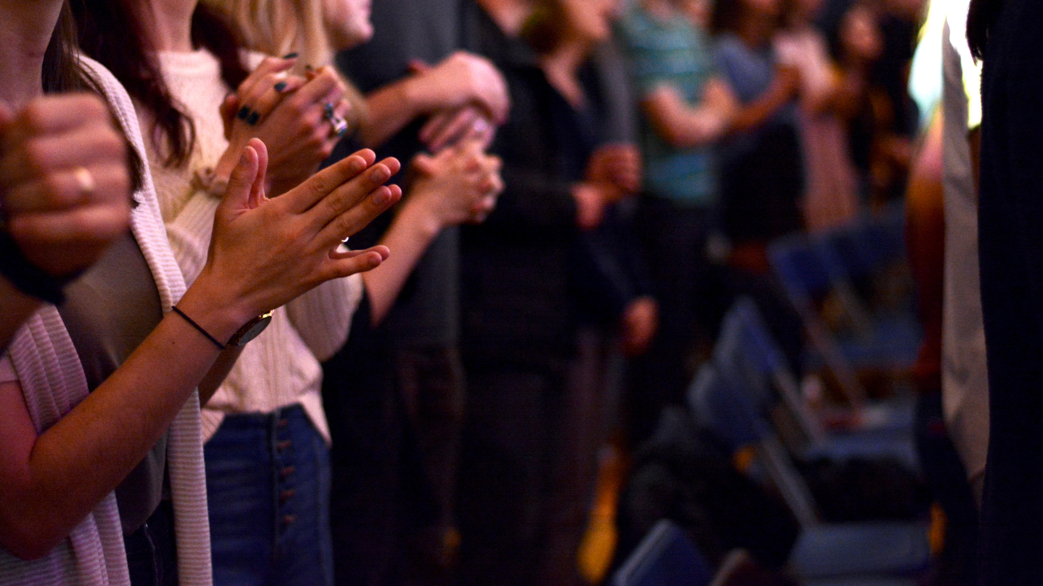
Sometimes when Christians want to pray they put their hands together as a sign they are praying.

Slide 40
Some Christians like to pray on their own.
Why do you think they might prefer that?

Slide 41
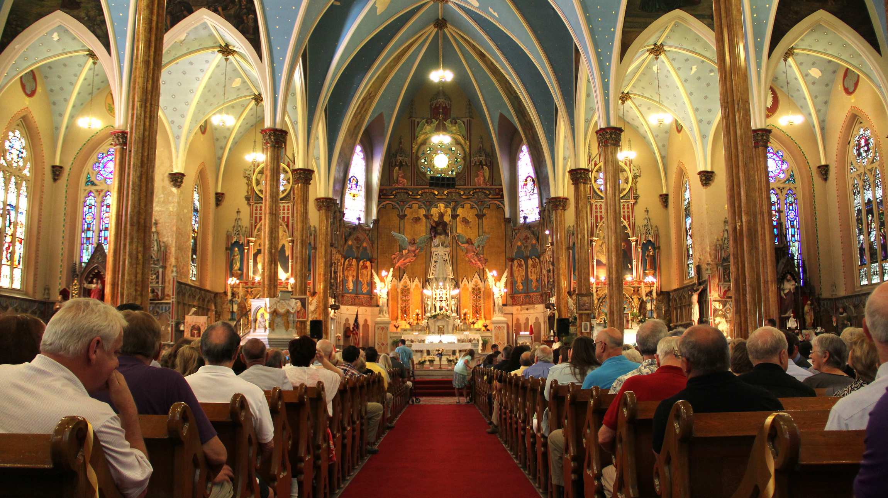
Some Christians like to pray with other people.
Why do you think they might prefer that?

Slide 42
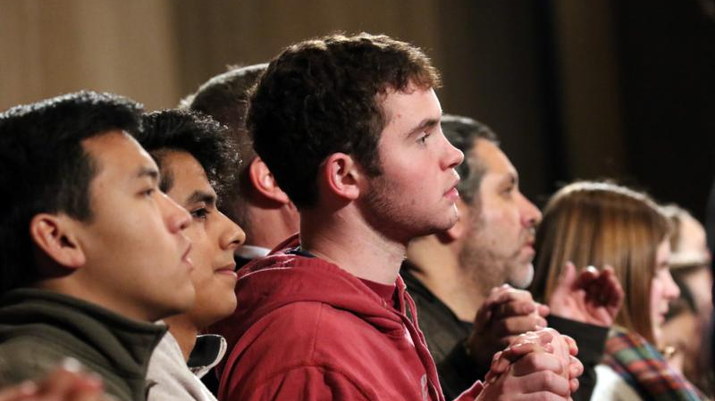
But does God respond to prayers?
Christians say yes, but not always in a clear way.
If a Christian prays for help they may get it in unexpected ways.

Slide 43
Tuesday 21st January 2025
How do Christians talk to God?
Through prayer.
It’s a very special form of communication because it needs faith for it to make sense.

Slide 44
Independent Challenges:
Narrative Zone
Maths Zone
Describe the image.
What can you see?
Use the bead string to complete the calculations.
Enquiry Zone
Creative Zone
Create a tally of how many garden birds you see.
.
Sketch one of the birds and colour it in

