Slide 1
Wednesday 20th November
Which are factors of 36? 3 5 6 8
3/8 5/8 ?/8 1 ?/8
£256 + £22.87 =
1kg = 1000g 2.5kg = _______g
> < =
4/5 ____ ½ 1/3 _____ ¼

Slide 2
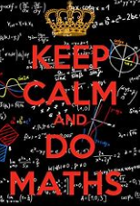
9:10-9:50 Maths Paper 3

Slide 3
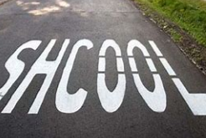
Spellings

Slide 4
11:00-11:15 Whiteboard Work 1) What is a pronoun? What is a possessive pronoun? Give three examples. 2) Hakon, who is the housecarl to the Earl, is a confident and fierce warrior. Write down the relative pronoun. 2b) What are the other relative pronouns? 3) Write an appropriate contraction to fill the gap below: I hope __________ arrived safely. 4) What punctuation can be used for parenthesis?

Slide 5
Noun | Verb | Adjective | Adverb
ball coat jumped is yellow
read book quietly great brightly

Slide 6
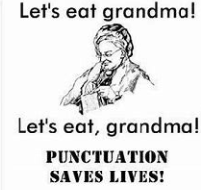
GPS Paper 11:15-12:00

Slide 7
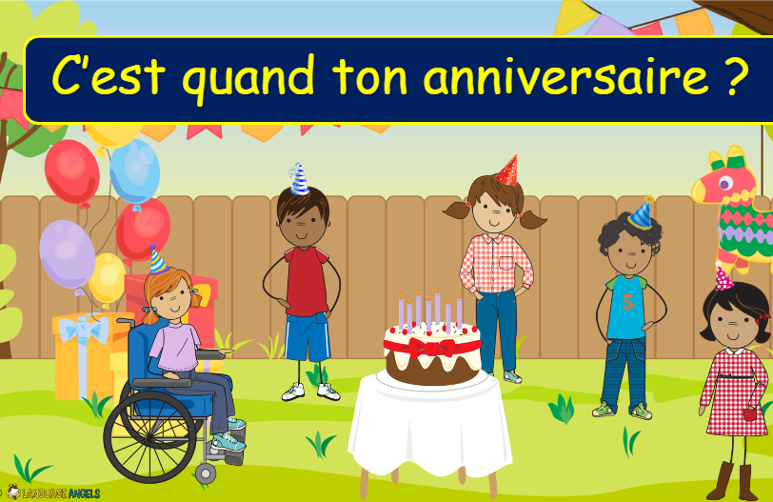
TBAT- recognise birthdays in French.
What is this question in English?

Slide 8
Class work: Recap

Slide 9
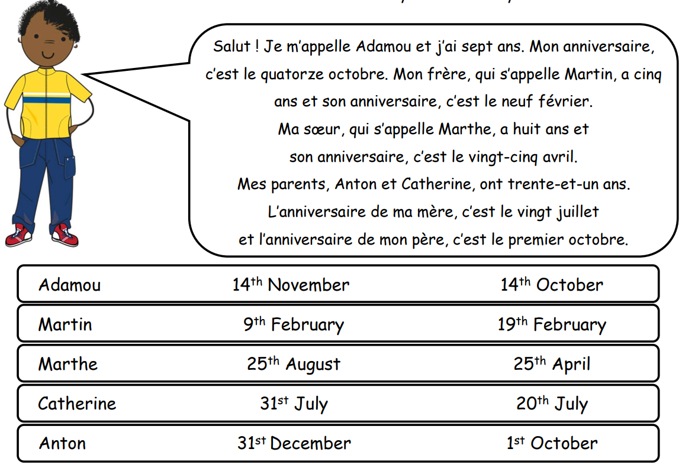
Reading activity

Slide 10
-Slide 6 + 9 for recap -Slides 11 + 12 -Partner work slide 13 -Class discussion slides 14 + 15 -Slide 18 listening activity -Slides 22-25: partner work. Before showing the answer, children use the calendar to say the date. Were you correct? - Complete the reading activity Challenge: C'est quand ton anniversaire?

Slide 11
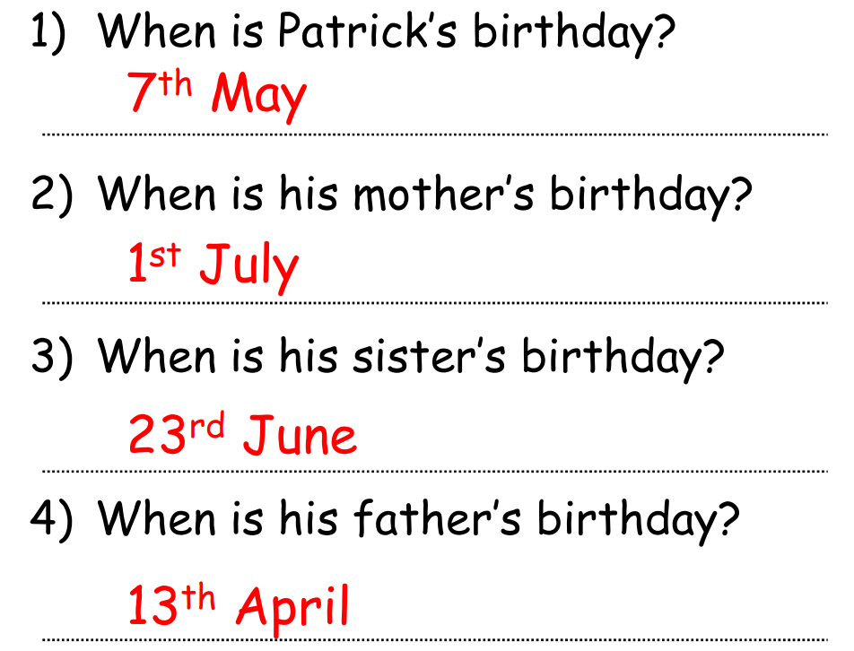

Slide 12
Wednesday 20th November 2023 Q – Whose shoe has the greatest friction.
3 in 3
There are three types of non-contact forces: gravitational force, electrostatic force and magnetic force.
Gravitational force is when one object is pushed or pulled by the force of gravity. On Earth, we can jump and we will come back down. But on the moon, if you jump hard enough, you would not come back down, you would float away into space! This is because there is less gravity on the moon than on Earth. Gravity pushes you and other things around us onto the ground.
Electrostatic force is static electricity in one object pushing or pulling another object. This force can be used to push or pull another object without touching. An example of electrostatic force is when you rub a balloon on your shirt or jumper, then move the balloon near some scraps of paper. The electrostatic force in the balloon will pull the paper onto the balloon! The scraps of paper sticking to the balloon is the electrostatic force keeping the paper on the balloon.
Magnetic force uses magnetic fields to push or pull another object. A magnetic object will pull or push other magnetic objects. Only some objects will be able to use magnetic force. A magnet is an example of magnetic force. Think about the magnets on a fridge. The magnet is pulling the metal on the front of the fridge.
What is a gravitational force?
How many types of non-contact forces are there?
What happens to objects when there is less gravity than on Earth?

Slide 13
Wednesday 20th November 2023 Q – Whose shoe has the greatest friction.
Vocabulary match Gravity A force that pulls objects towards the centre of a planet. Friction A force that pulls objects towards the centre of a planet. Mass The force that occurs when two surfaces slide or rub against each other, and it always works in the opposite direction to the motion of the object.
Weight The amount of matter in an object – this can be measured in grams and kilograms.

Slide 14
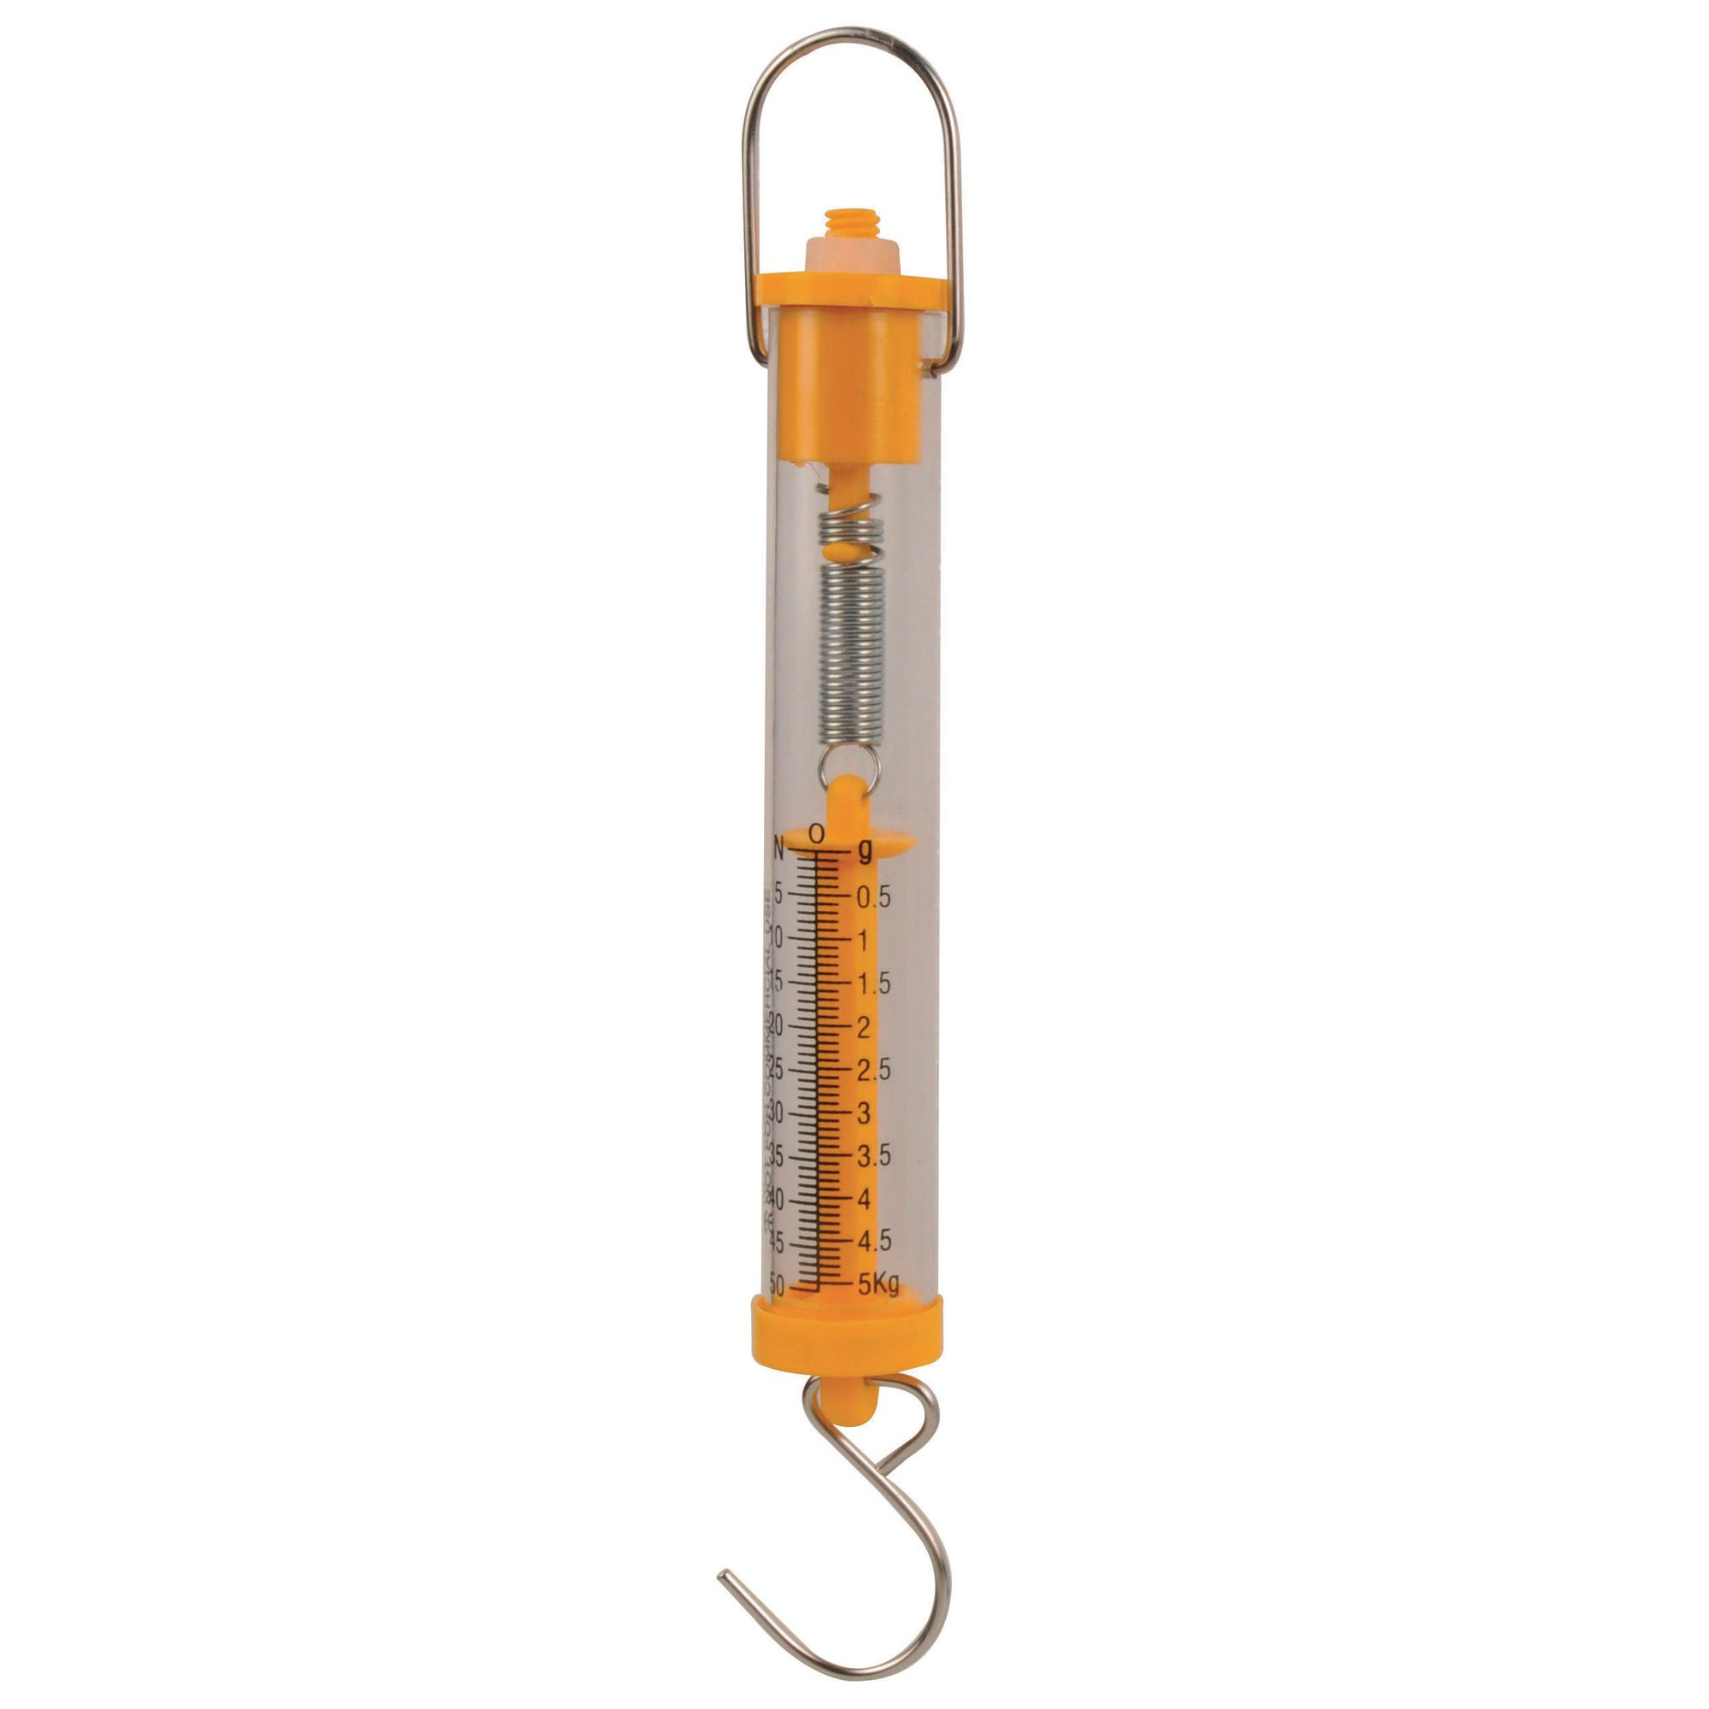
Wednesday 20th November 2023 Q – Whose shoe has the greatest friction.
Talk partners
Newton meter -
What do you think this device does?

Slide 16
Friction-BBC Bitesiz

Slide 19
Draw this table in your book to record your results in.
Whose shoe? | Amount of force (g)

Slide 20
