Slide 1
Wednesday 20th November 2024
20/11/24

Slide 2
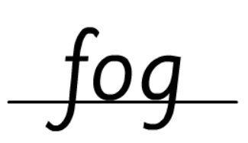
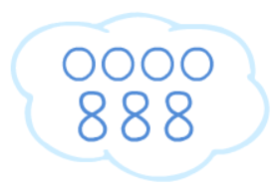
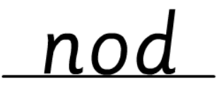
Morning Challenges:
Name writing

Slide 3
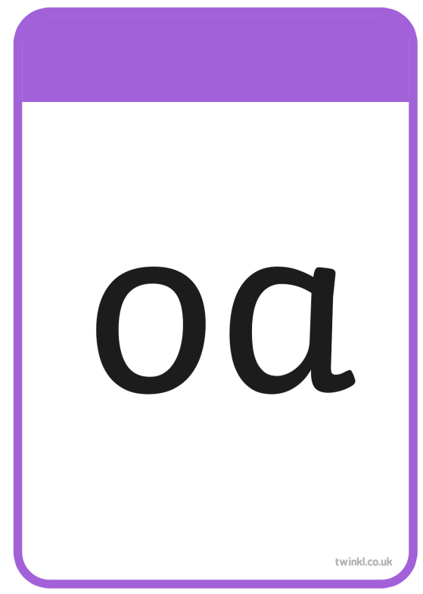
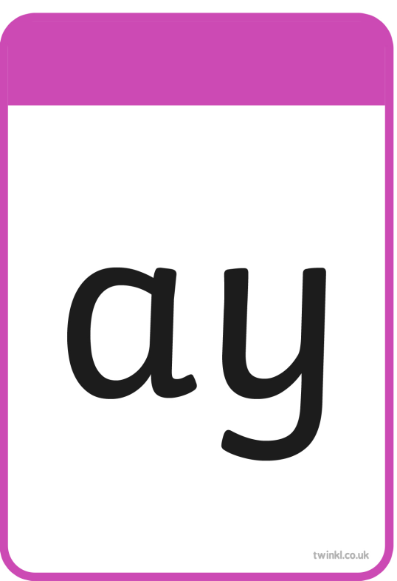
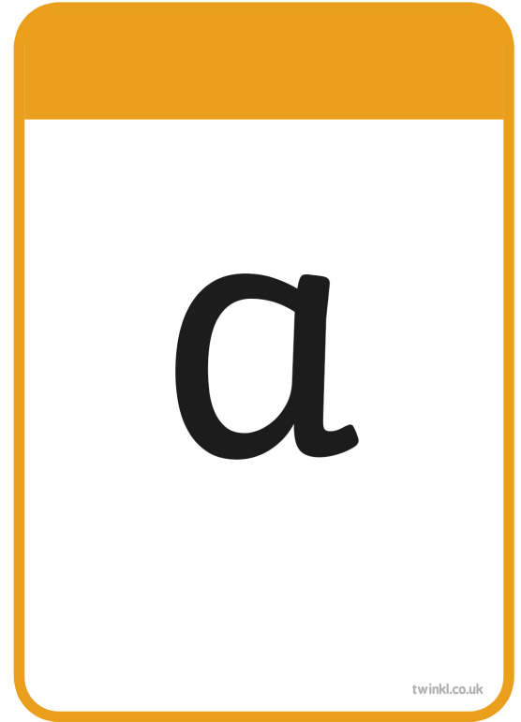
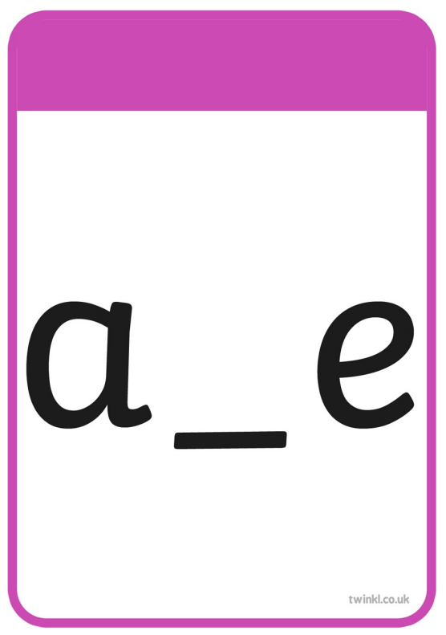

Slide 4
float

Slide 5
open

Slide 6
post

Slide 7
painting

Slide 8
found

Slide 9
belt

Slide 12
home

Slide 13
woke

Slide 14
stone

Slide 15
note

Slide 16
those

Slide 17
Explode

Slide 19
Write a sentence using these words
should
home woke

Slide 20
Number bonds to 8
5 in 3
0
4
8
4
3
2
8
6
7
8
1
5
Notes:
Do Now: Number bonds to 8
Pupils use a part-whole model and eight cubes to complete the Do Now task. They represent each part-whole model and fill in the missing number in each one. When a part is missing, they represent the whole using cubes and then move the correct number of cubes into a part to find the other part. This is intended to prepare pupils for Lessons 3 and 4.

Slide 21
TBAT: subtract by counting back using a number line or number track
first
now
less
take away
equation
represent
subtract
then
number track
number line

Slide 22
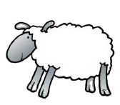
Can you think of a subtraction stories for these images?
whole subtract part is equal to part
$$−$$
$$=$$
Notes:
New Learning: Counting back using a number track
Recap the work from Year 2, in which pupils learnt the partitioning structure of subtraction, partitioning a whole into two parts. Focus on stories about the images on the slide.
Roleplay the scenario, on the next slide, with pupils. Practise first counting ‘one, two’ for the children who leave and then recounting the remaining group, and then practise counting back from thirteen: ‘twelve, eleven’ as the children leave.
How could we represent this story if we didn’t have the children here?
Pupils will make their own models of the situation using manipulatives and drawings and discuss the similarities and differences between their models. Discuss and make links between different representations with pupils, including part-whole models, counter and cube representations, bead strings and number tracks/number lines and pictures with elements crossed out.
Model the story on a number track, placing a counter or finger at 13 and then counting back two spaces (both counting ‘one, two’, and ‘twelve, eleven’ while holding up fingers to mark the two spaces moved) to represent the children leaving. Explain that we only use counting back when we are taking away small numbers. Use the next slide to model another example of a reduction story where one, two or three elements are being taken away from a teen number or 20.

Slide 23
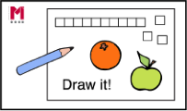
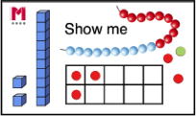
Counting back using a number track
First, there were 13 children sitting on the carpet.
Then, two children left.
Now, how many children are on the carpet?
1 | 2 | 3 | 4 | 5 | 6 | 7 | 8 | 9 | 10 | 11 | 12 | 13 | 14 | 15 | 16 | 17 | 18 | 19 | 20
whole subtract part is equal to part
$$−$$
$$=$$
Notes:
New Learning: Counting back using a number track
Recap the work from Year 2, in which pupils learnt the partitioning structure of subtraction, partitioning a whole into two parts. Focus on stories about the images on the slide.
Roleplay the scenario, on the next slide, with pupils. Practise first counting ‘one, two’ for the children who leave and then recounting the remaining group, and then practise counting back from thirteen: ‘twelve, eleven’ as the children leave.
How could we represent this story if we didn’t have the children here?
Pupils will make their own models of the situation using manipulatives and drawings and discuss the similarities and differences between their models. Discuss and make links between different representations with pupils, including part-whole models, counter and cube representations, bead strings and number tracks/number lines and pictures with elements crossed out.
Model the story on a number track, placing a counter or finger at 13 and then counting back two spaces (both counting ‘one, two’, and ‘twelve, eleven’ while holding up fingers to mark the two spaces moved) to represent the children leaving. Explain that we only use counting back when we are taking away small numbers. Use the next slide to model another example of a reduction story where one, two or three elements are being taken away from a teen number or 20.

Slide 24
Counting back using a number track
First, there were 12 pencils in the pot.
Then, I took three out to draw a picture.
Now, how many pencils are in the pot?
1 | 2 | 3 | 4 | 5 | 6 | 7 | 8 | 9 | 10 | 11 | 12 | 13 | 14 | 15 | 16 | 17 | 18 | 19 | 20
whole subtract part is equal to part
$$−$$
$$=$$
Notes:
New Learning: Counting back using a number track
Recap the work from Year 2, in which pupils learnt the partitioning structure of subtraction, partitioning a whole into two parts. Focus on stories about the images on the slide.
Roleplay the scenario, on the next slide, with pupils. Practise first counting ‘one, two’ for the children who leave and then recounting the remaining group, and then practise counting back from thirteen: ‘twelve, eleven’ as the children leave.
How could we represent this story if we didn’t have the children here?
Pupils will make their own models of the situation using manipulatives and drawings and discuss the similarities and differences between their models. Discuss and make links between different representations with pupils, including part-whole models, counter and cube representations, bead strings and number tracks/number lines and pictures with elements crossed out.
Model the story on a number track, placing a counter or finger at 13 and then counting back two spaces (both counting ‘one, two’, and ‘twelve, eleven’ while holding up fingers to mark the two spaces moved) to represent the children leaving. Explain that we only use counting back when we are taking away small numbers. Use the next slide to model another example of a reduction story where one, two or three elements are being taken away from a teen number or 20.

Slide 25
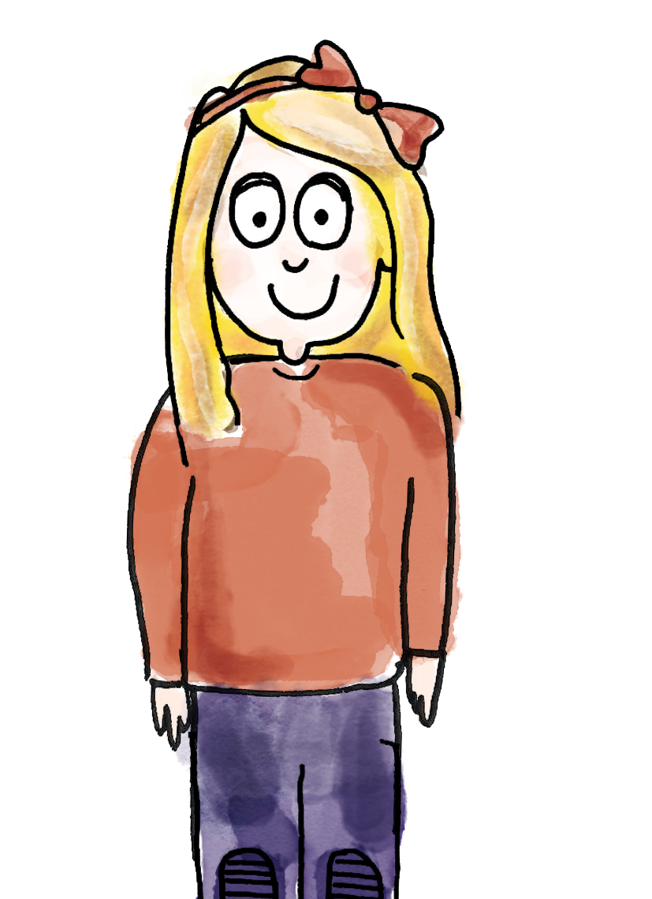
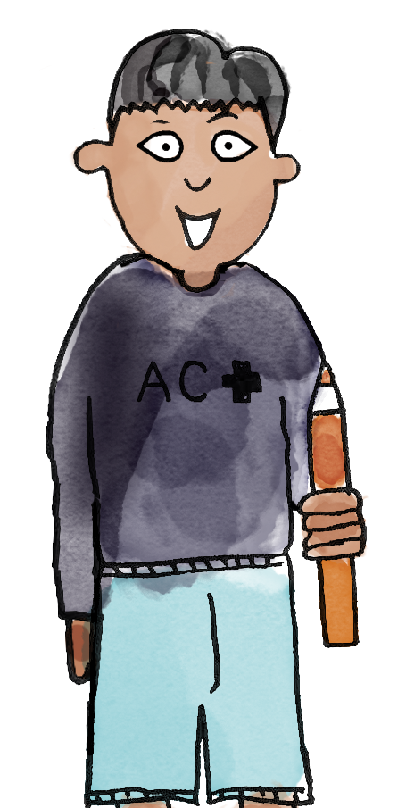
Counting back using a number track
First, there were 18 people on the bus.
Then, three people got off.
Now, how many people are on the bus?
So, first there were 18 people. Then, three people got off.
Now, there are 15 people on the bus..
18
3
1 | 2 | 3 | 4 | 5 | 6 | 7 | 8 | 9 | 10 | 11 | 12 | 13 | 14 | 15 | 16 | 17 | 18 | 19 | 20
first then now less represent subtract equation
number line number track take away
Notes:
Talk Task: Counting back using a number track
Pupils have two sets of number cards 11−20 and 1−3 (preferably with each set in a different colour so pupils can easily pick one of each) and a 1−20 number track.
Pupil A picks a card 11−20. Pupil B picks a card 1−3. Show the example of a ‘first, then, now’ story on the slide. Pupil A asks a ‘first, then, now’ (reduction) story question, using the numbers they have chosen.
Pupil B represents the story on the number track, finding the minuend (the number being subtracted from) and then moving their finger/counter back the correct number of places to complete the subtraction. They say the story and the answer. Pupils then swap roles.

Slide 26
Subtraction using a number line
First | Then | Now
–
?
First, there were 14 butterflies.
Then, one flew away.
Now, how many butterflies are there?
0
1
2
3
4
5
6
7
8
9
10
11
12
13
14
15
16
17
18
19
20
Notes:
Develop Learning: Subtraction using a number line
Explain that, just like with addition, we can also use a number line to represent subtraction, but that, this time, we need to find the starting amount and then make jumps back.
Model another reduction story involving a teen number or 20 and a subtrahend (the number being subtracted) of one, two or three. Model finding the minuend on the number line:
How many jumps do I need to make now? Which way along the number line do I jump?
Why do I need to make one jump?
You need to make one jump to the left because the numbers get smaller to the left and we’re taking away.
What number sentence would represent this story?
Record the same story as an abstract equation (14 − 1 = 13), ensuring pupils understand that the ‘−’ symbol shows here that we are subtracting/taking away from the initial amount.
Finally, represent the same relationship on a part-whole model.

Slide 27
Subtraction using a number line
0
1
2
3
4
5
6
7
8
9
10
11
12
13
14
15
16
17
18
19
20
whole subtract part is equal to part
$$−$$
$$=$$
Notes:
Develop Learning: Subtraction using a number line
Explain that, just like with addition, we can also use a number line to represent subtraction, but that, this time, we need to find the starting amount and then make jumps back.
Model another reduction story involving a teen number or 20 and a subtrahend (the number being subtracted) of one, two or three. Model finding the minuend on the number line:
How many jumps do I need to make now? Which way along the number line do I jump?
Why do I need to make one jump?
You need to make one jump to the left because the numbers get smaller to the left and we’re taking away.
What number sentence would represent this story?
Record the same story as an abstract equation (14 − 1 = 13), ensuring pupils understand that the ‘−’ symbol shows here that we are subtracting/taking away from the initial amount.
Finally, represent the same relationship on a part-whole model.

Slide 28
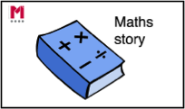
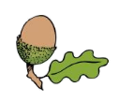
TBAT: subtract by counting back using a number line or number track
Recording ‘first, then, now’ stories
First | Then | Now
 | − | ?
0
1
2
3
4
5
6
7
8
9
10
11
12
13
14
15
16
17
18
19
20
whole subtract part is equal to part
$$−$$
$$=$$
Notes:
Independent Task: Recording ‘first, then, now’ stories
Pupils interpret the pictures on the Task sheet to tell maths stories. They then represent the story on the number line and write the corresponding abstract equation.
Possible adaptations:
Some pupils may find it helpful to represent the stories first using concrete manipulatives.
Some pupils can be provided a number line marked with some jumps from a starting point, to make their own stories and write the corresponding equations.

Slide 29
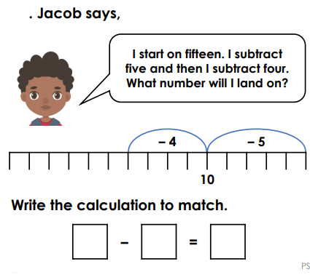
TBAT: subtract by counting back using a number line or number track
RP:
Notes:
Independent Task: Recording ‘first, then, now’ stories
Pupils interpret the pictures on the Task sheet to tell maths stories. They then represent the story on the number line and write the corresponding abstract equation.
Possible adaptations:
Some pupils may find it helpful to represent the stories first using concrete manipulatives.
Some pupils can be provided a number line marked with some jumps from a starting point, to make their own stories and write the corresponding equations.

Slide 30
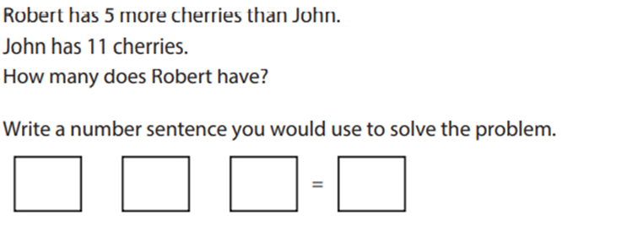
TBAT: subtract by counting back using a number line or number track
Challenge:
Notes:
Independent Task: Recording ‘first, then, now’ stories
Pupils interpret the pictures on the Task sheet to tell maths stories. They then represent the story on the number line and write the corresponding abstract equation.
Possible adaptations:
Some pupils may find it helpful to represent the stories first using concrete manipulatives.
Some pupils can be provided a number line marked with some jumps from a starting point, to make their own stories and write the corresponding equations.

Slide 31
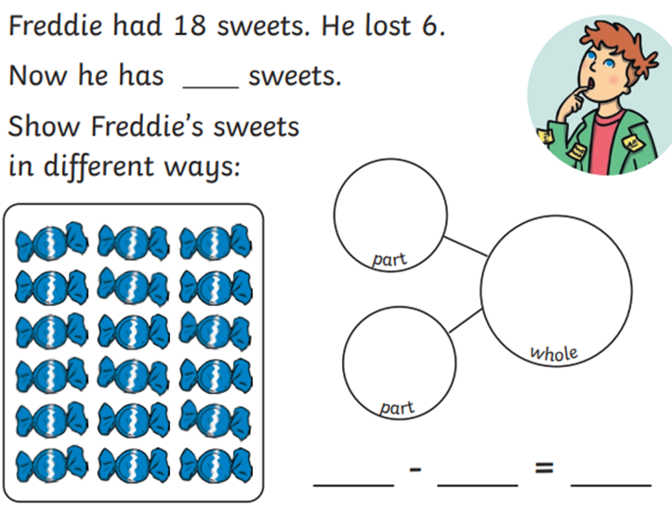
TBAT: subtract by counting back using a number line or number track
Mastery:
Notes:
Independent Task: Recording ‘first, then, now’ stories
Pupils interpret the pictures on the Task sheet to tell maths stories. They then represent the story on the number line and write the corresponding abstract equation.
Possible adaptations:
Some pupils may find it helpful to represent the stories first using concrete manipulatives.
Some pupils can be provided a number line marked with some jumps from a starting point, to make their own stories and write the corresponding equations.

Slide 32
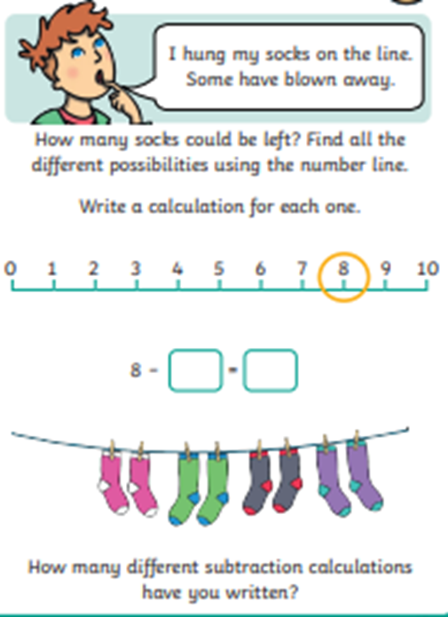
TBAT: subtract by counting back using a number line or number track
Mastery with greater depth:
Notes:
Independent Task: Recording ‘first, then, now’ stories
Pupils interpret the pictures on the Task sheet to tell maths stories. They then represent the story on the number line and write the corresponding abstract equation.
Possible adaptations:
Some pupils may find it helpful to represent the stories first using concrete manipulatives.
Some pupils can be provided a number line marked with some jumps from a starting point, to make their own stories and write the corresponding equations.

Slide 33
Unexpected unknown
First, there were 15 chocolates in the box.
Then, I ate some.
Now, there are 12 chocolates in the box.
How many did I eat?
Notes:
Plenary: Unexpected unknown
Tell the story, where the unknown is in a non-standard position.
Pupils have a go at modelling the story with a partner. They may identify 15 as a starting point on the number line and then count how many jumps to get to 12.

Slide 34
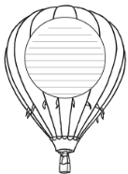
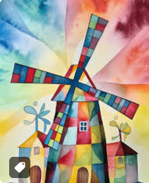
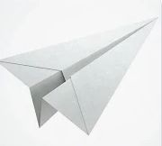
Independent Challenges:
Narrative Zone
Maths Zone
Practise subtraction within 20 by counting back on the number line.
Write some subtraction equations to show this.
What is your favourite mode of transport and why?
Enquiry Zone
Creative Zone
Make a paper aeroplane out of scrap paper.
Put your name on it and we will throw them and see whose goes furthest later.
Design and decorate a windmill

Slide 35
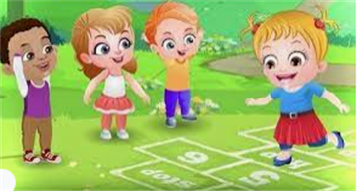
Break

Slide 36
Lunch

Slide 37
TBAT: Develop mouse skills
Year 1 – Computing systems and networks – Technology around us
Notes:
Last updated: 03-06-21
Resources are updated regularly — the latest version is available at: ncce.io/tcc.
This resource is licensed under the Open Government Licence, version 3. For more information on this licence, see ncce.io/ogl.

Slide 38
Objectives
Lesson 3: Developing mouse skills
To use a mouse in different ways
I can use a mouse to open a program
I can click and drag to make objects on a screen
I can use a mouse to create a picture

Slide 39
Can you name the main parts of these computers?
Introduction
3 in 3

Slide 40
What is this part of a computer called?
3 in 3
Introduction 1
Screen
The screen shows what the computer is doing.
Notes:
Take suggestions from the learners and click to animate what the part is and what it does.
https://pixabay.com/vectors/computer-desktop-workstation-office-158675/
https://pixabay.com/vectors/laptop-notebook-mobile-computer-154091/

Slide 41
What is this part of a computer called?
3 in 3
Introduction
Keyboard
The keyboard lets you type letters and numbers.
Notes:
Take suggestions from the learners and click to animate what the part is and what it does.
https://pixabay.com/vectors/computer-desktop-workstation-office-158675/
https://pixabay.com/vectors/laptop-notebook-mobile-computer-154091/

Slide 42
What is this part of a computer called?
3 in 3
Introduction
Mouse
The mouse lets you select and move objects. On a laptop, this is called a trackpad.
Notes:
Take suggestions from the learners and click to animate what the part is and what it does.
https://pixabay.com/vectors/computer-desktop-workstation-office-158675/
https://pixabay.com/vectors/laptop-notebook-mobile-computer-154091/

Slide 43
What is this part of a computer called?
3 in 3
Introduction
Base unit
The base unit stores and processes information.
Notes:
Take suggestions from the learners and click to animate what the part is and what it does.
https://pixabay.com/vectors/laptop-notebook-mobile-computer-154091/

Slide 44
Using the computer mouse or trackpad
Activity 1
Not all computer mice or trackpads look the same, but they do the same thing.
Notes:
Show images of different computer mice and trackpads. Invite learners to explain how they are different. Responses should include:
Some have wires, some don’t
Some have buttons, some don’t
Some are part of the computer, others are connected to it
Emphasise that even though each device looks different, they all perform the same function.
Wired mouse: https://pixabay.com/vectors/computer-mouse-computer-device-152249/
Single button mouse: https://pixabay.com/photos/workplace-mouse-computer-apple-2341642/
Wireless mouse: https://pixabay.com/vectors/computer-mouse-hardware-wheel-click-23266/
Two button trackpad: https://pixabay.com/vectors/mousepad-finger-mouse-pad-point-160223/

Slide 45
Creating a picture
Activity 1
Before you can begin creating pictures, you need to open a program.
To do this, you will need to double-click using your mouse.
Notes:
Click to animate the double-click.
Screenshot: paintz.app

Slide 46
Double-clicking
Activity 1
Let’s practice double-clicking, without using a computer mouse!
Notes:
Click to animate the double-click.
Screenshot: paintz.app

Slide 47
Log in and open Paintz.app
Activity 1
Open the browser using double-click.
Open
paintz.app
Notes:
Click to animate the double-click.
Screenshot: paintz.app

Slide 48
Activity 1
Click on the brush tool
Notes:
In the Paintz program demonstrate the paint brush tool in the toolbar.
Screenshot: https://paintz.app

Slide 49
Activity 2
Choose a brush colour
Notes:
In the Paintz program demonstrate changing the brush colour in the toolbar.
Screenshot: https://paintz.app

Slide 50
Activity 2
Choose how thick you want your brush to be
Notes:
In the Paintz program demonstrate the changing the line thickness in the toolbar.
Screenshot: https://paintz.app

Slide 51
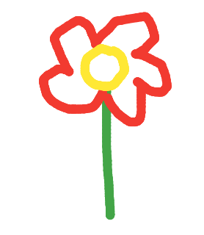
Activity 2
Click and drag to paint a picture!
Notes:
In the Paintz program demonstrate drawing a simple picture.
Screenshot: https://paintz.app

Slide 52
Activity 2
Explorer task: Try out some of the other tools. What can you do with these?
Notes:
Screenshot: https://paintz.app

Slide 53
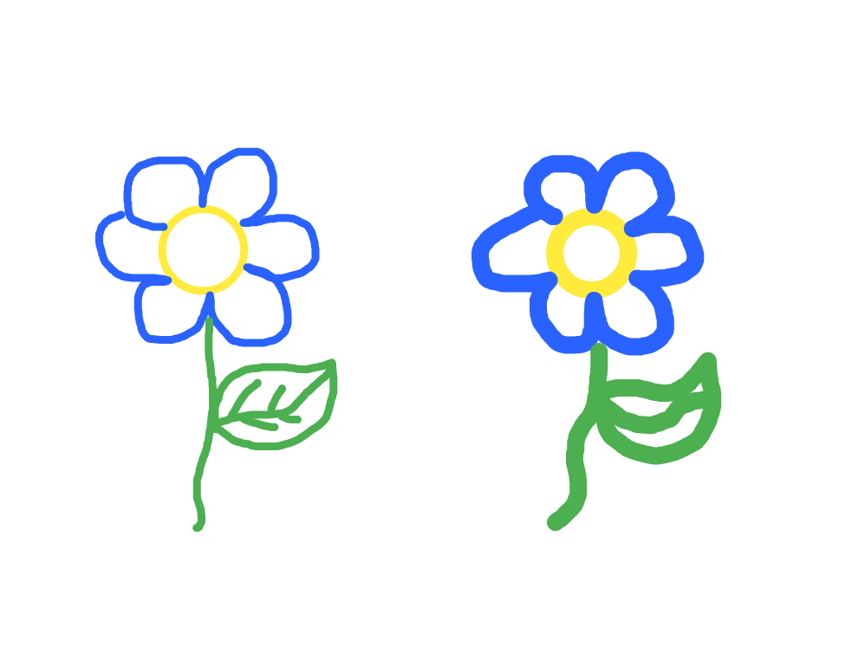
What’s been changed?
Plenary
What tool has been used to change the way the image was drawn?
Notes:
Answer: Line thickness has been increased.
Screenshot: https://paintz.app

Slide 54
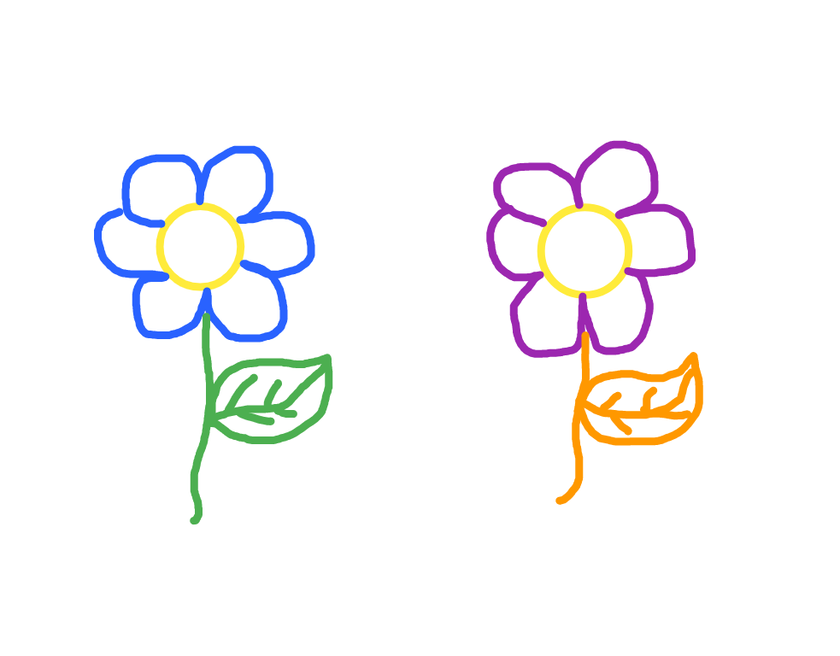
What’s been changed?
Plenary
What tool has been used to change the way the image was drawn?
Notes:
Answer: Line colour has been changed.
Screenshot: https://paintz.app

Slide 55
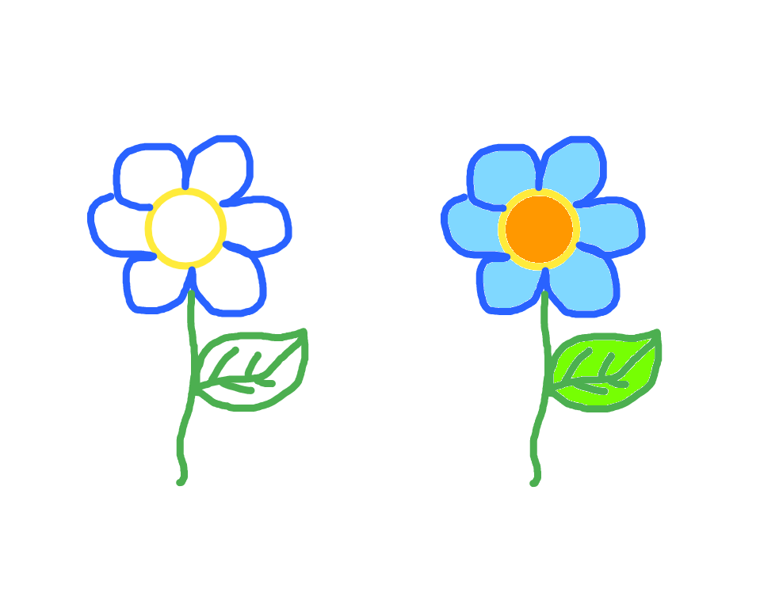
What’s been changed?
Plenary
What tool has been used to change the way the image was drawn?
Notes:
Answer: Fill tool has been used.
Screenshot: https://paintz.app

Slide 56
Independent Challenges:
Narrative Zone
Maths Zone
Practise subtraction within 20 by counting back on the number line.
Write some subtraction equations to show this.
What is your favourite mode of transport and why?
Enquiry Zone
Creative Zone
Make a paper aeroplane out of scrap paper.
Put your name on it and we will throw them and see whose goes furthest later.
Design and decorate a windmill

