Slide 1
Tuesday 19th November 2024
19/11/24

Slide 2
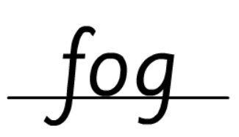
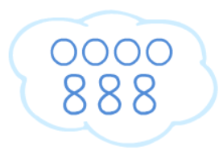
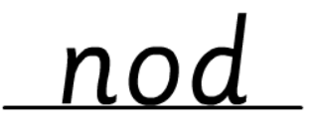
Morning Challenges:
Name writing

Slide 3
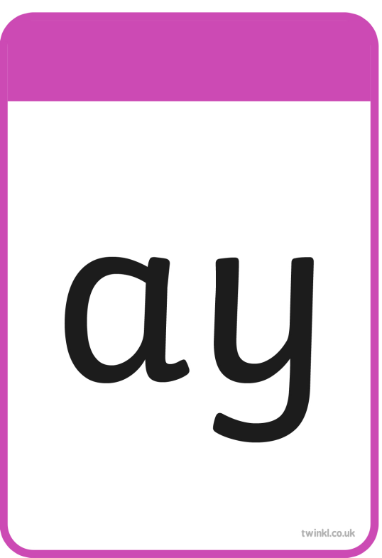
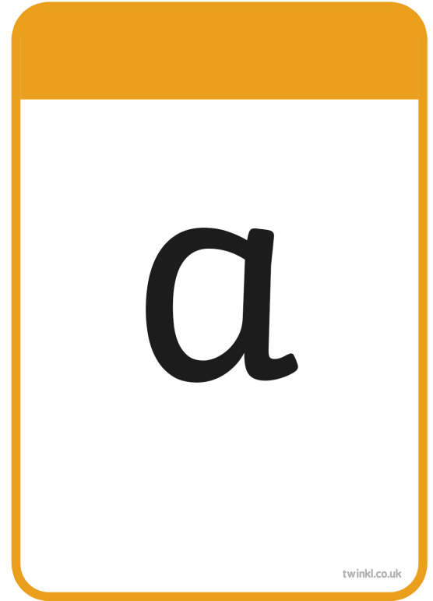
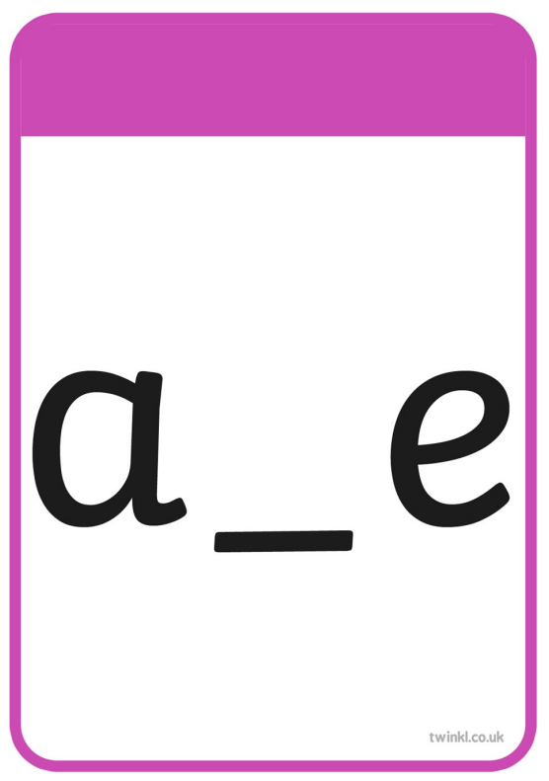

Slide 4
fright

Slide 5
child

Slide 6
tie

Slide 7
powder

Slide 8
milk

Slide 9
steep

Slide 10
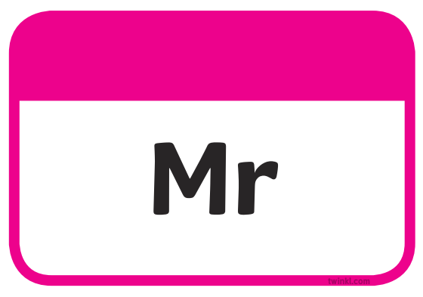

Slide 13
time

Slide 14
ripe

Slide 15
inside

Slide 16
prize

Slide 17
slide

Slide 18
like

Slide 19
I would like a ride in a hot air balloon.

Slide 20
Write a sentence using these words
would
time like

Slide 21
TBAT: Retrieve information from a text
3 in 3
Which sentence is written correctly?
The people were happy to get on the plane
The peepl were happy to get on the plane.
The people were happy to get on the plane.

Slide 22
TBAT: Retrieve information from a text
Blue/ green
What does retrieve mean?
What does it mean to retrieve when we are reading?

Slide 23
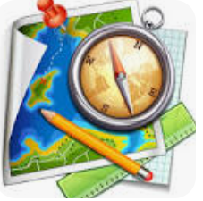
TBAT: Retrieve information from a text
Vocabulary
Navigator - Someone who plans the directions.
Practising – to do something lots until you are really good at it.
Mechanic – Someone who can fix cars or planes .

Slide 24
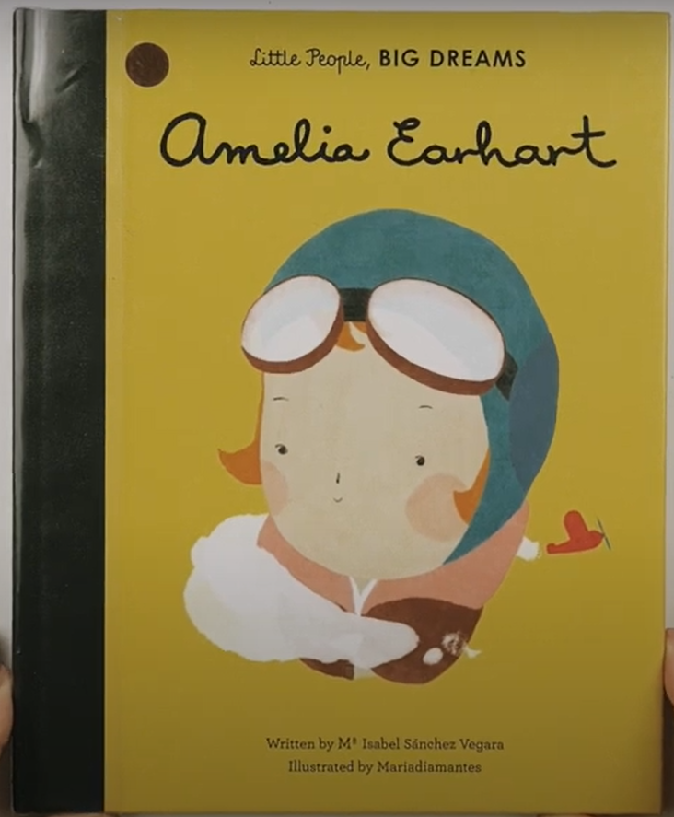

Slide 25
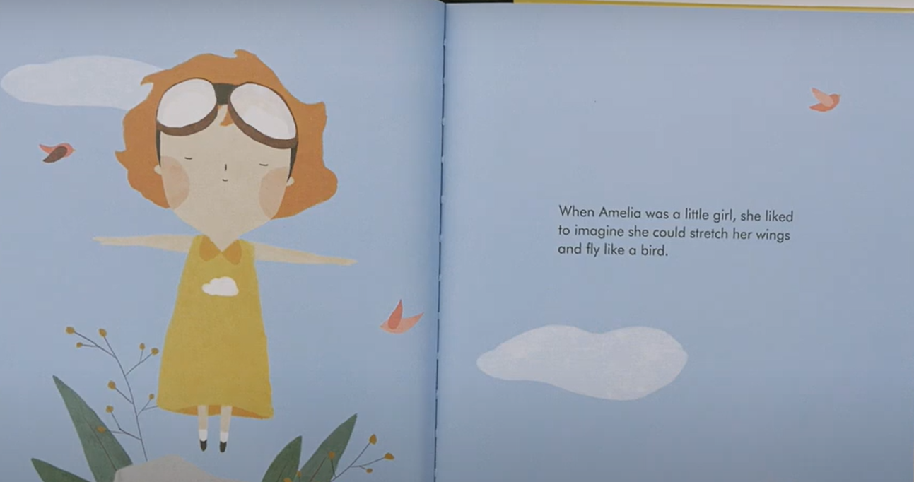

Slide 26
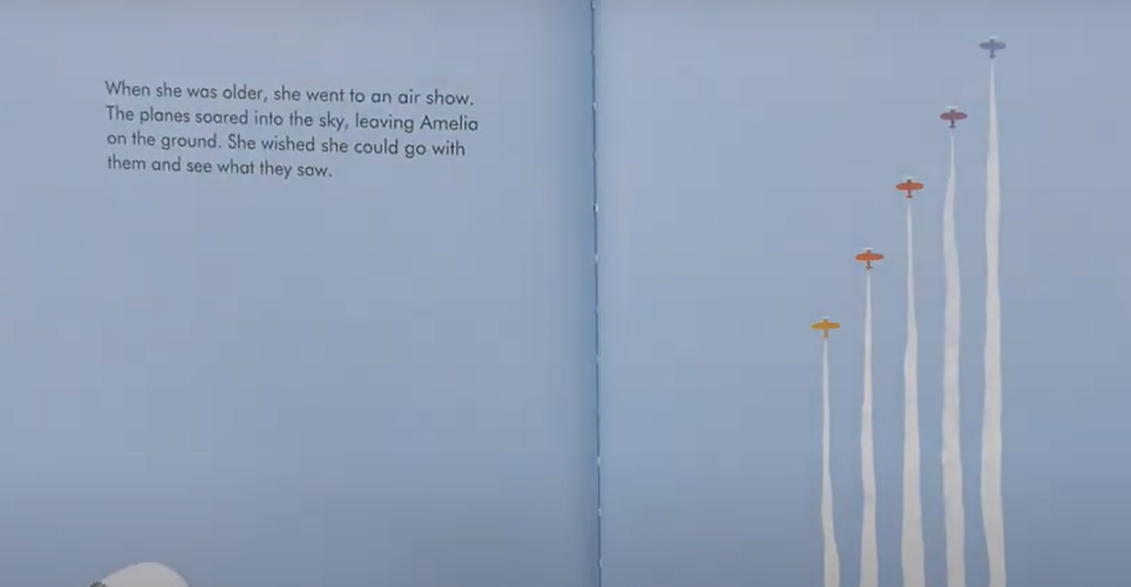

Slide 27
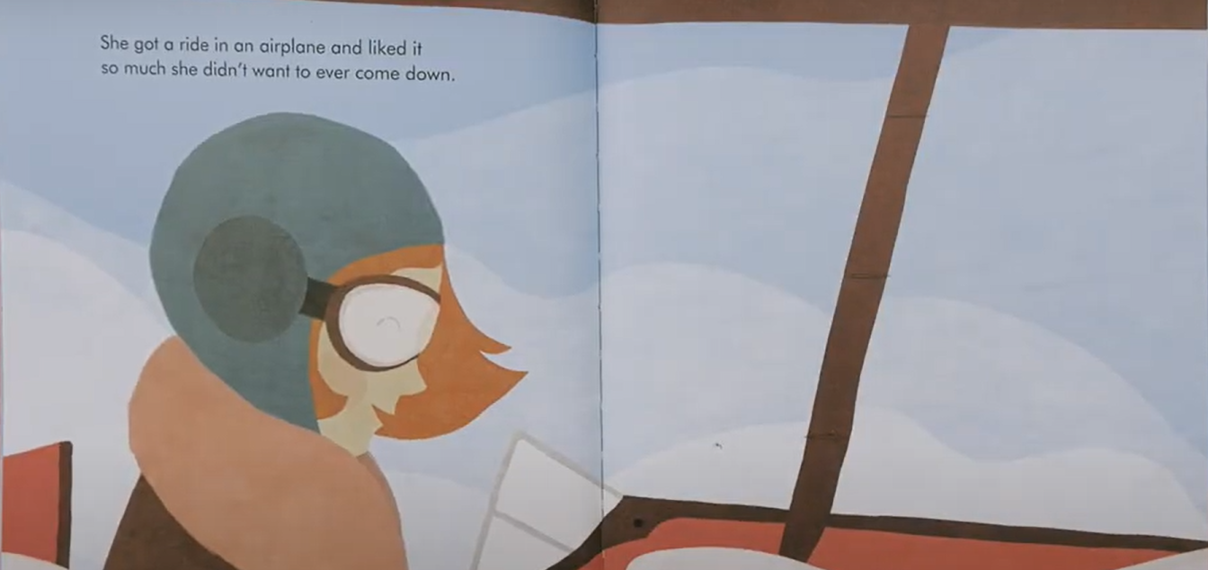

Slide 28
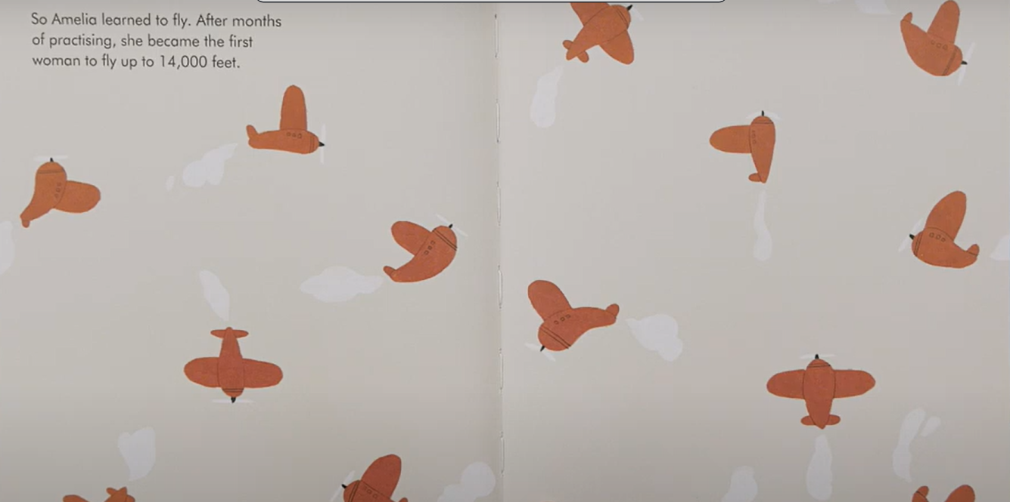

Slide 29
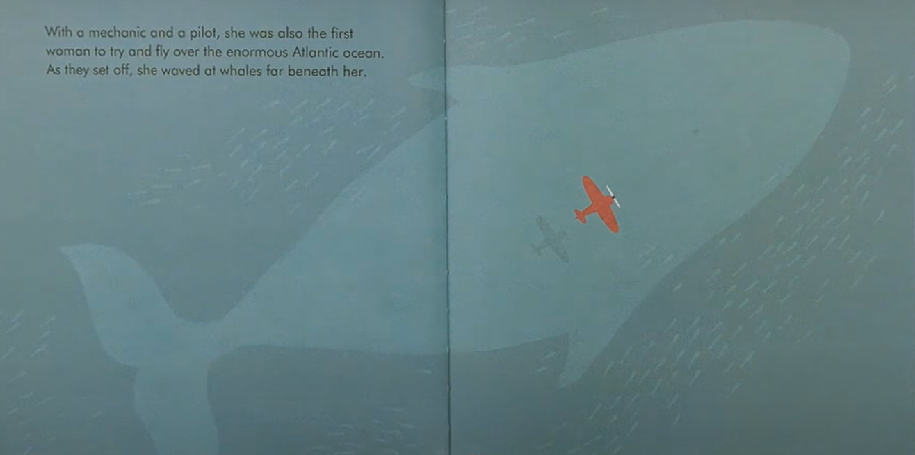

Slide 30
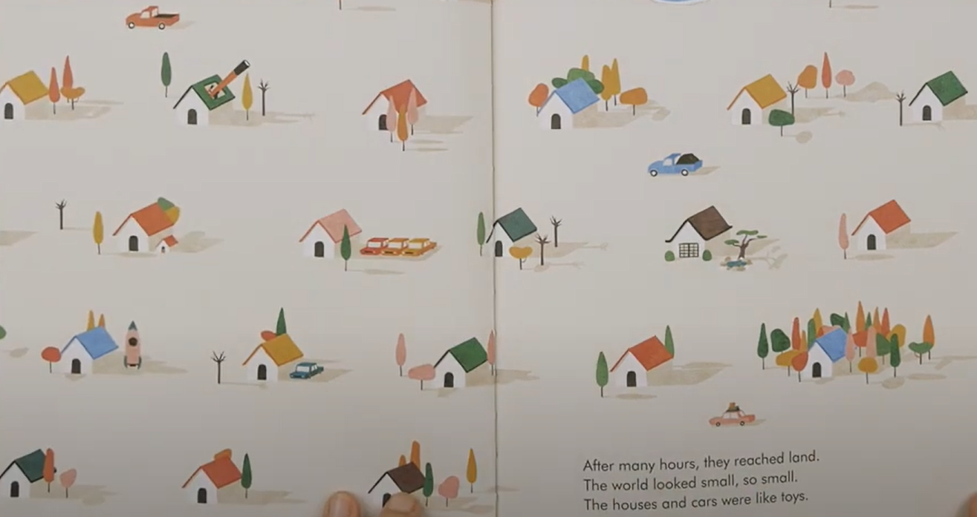

Slide 31
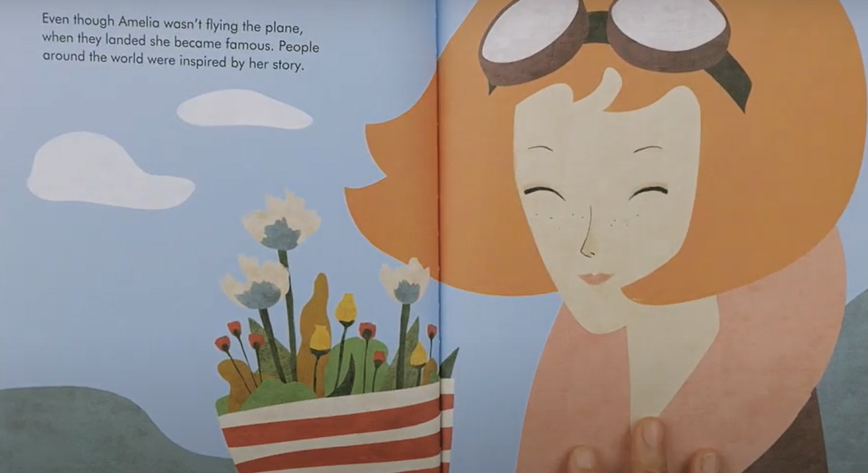

Slide 32
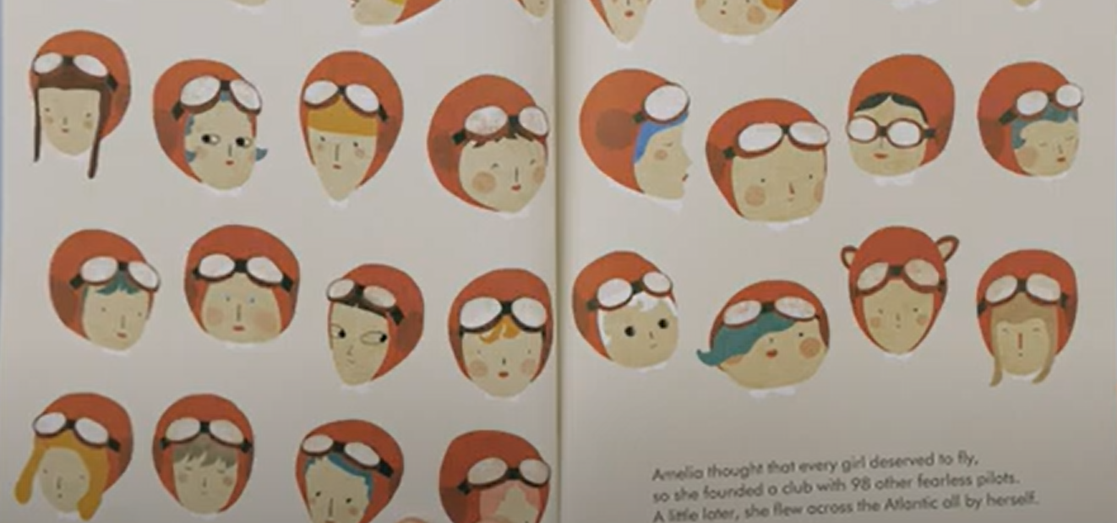

Slide 33
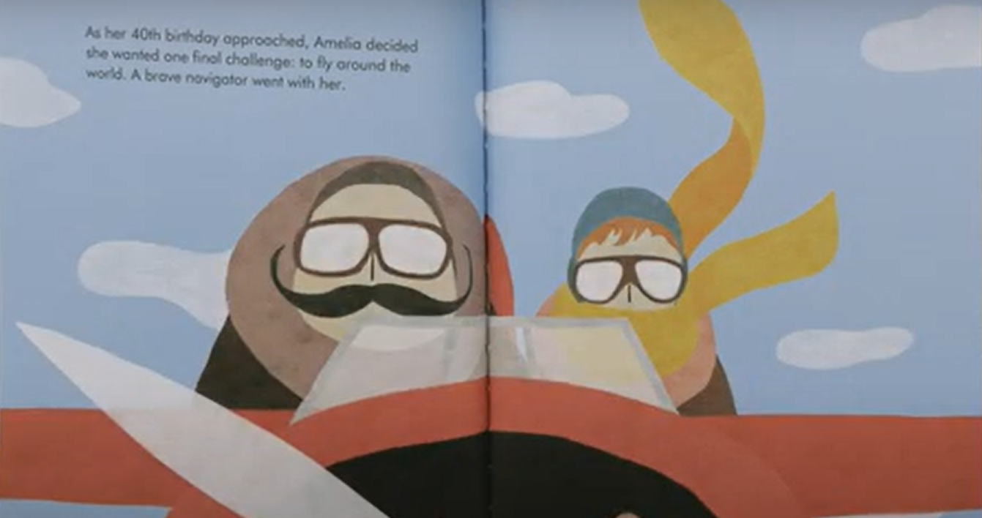

Slide 34
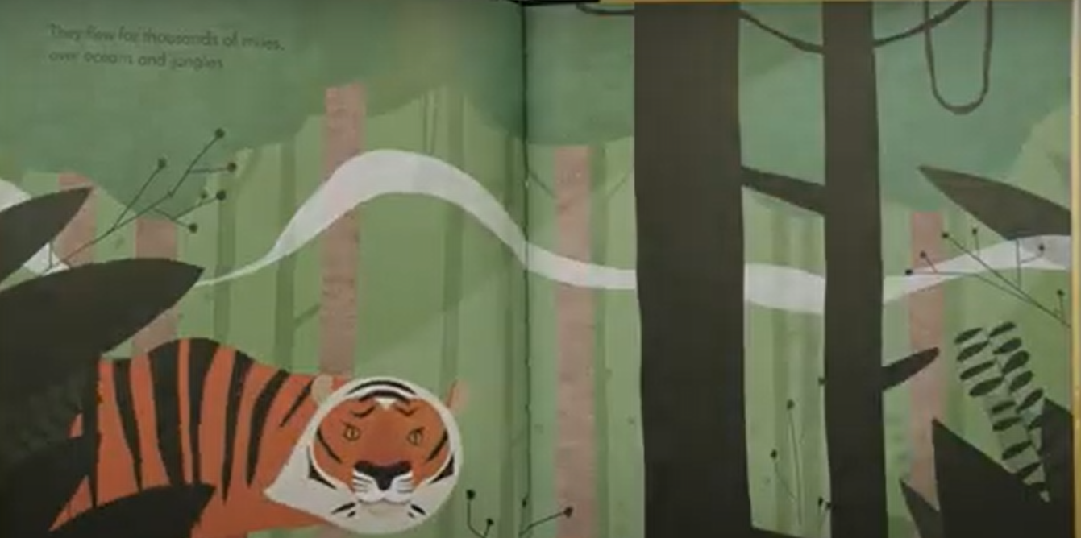

Slide 35
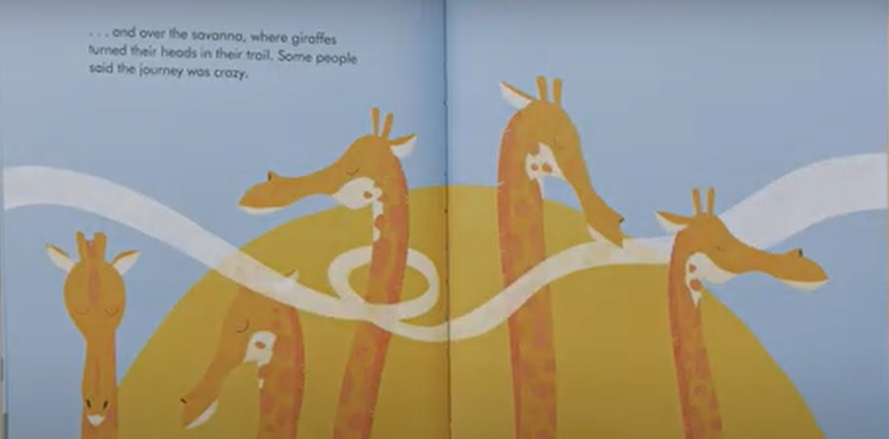

Slide 36
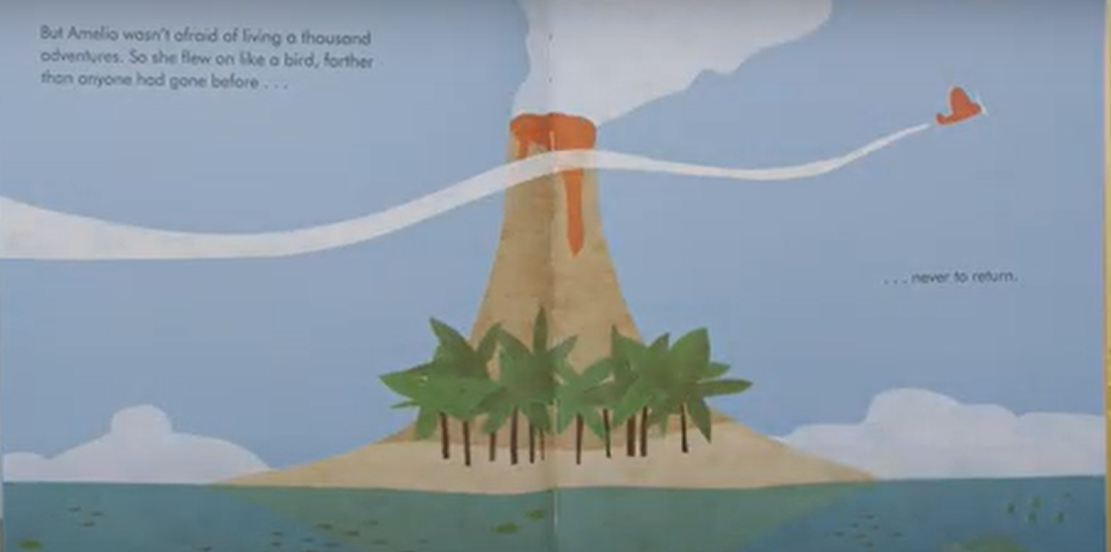

Slide 37
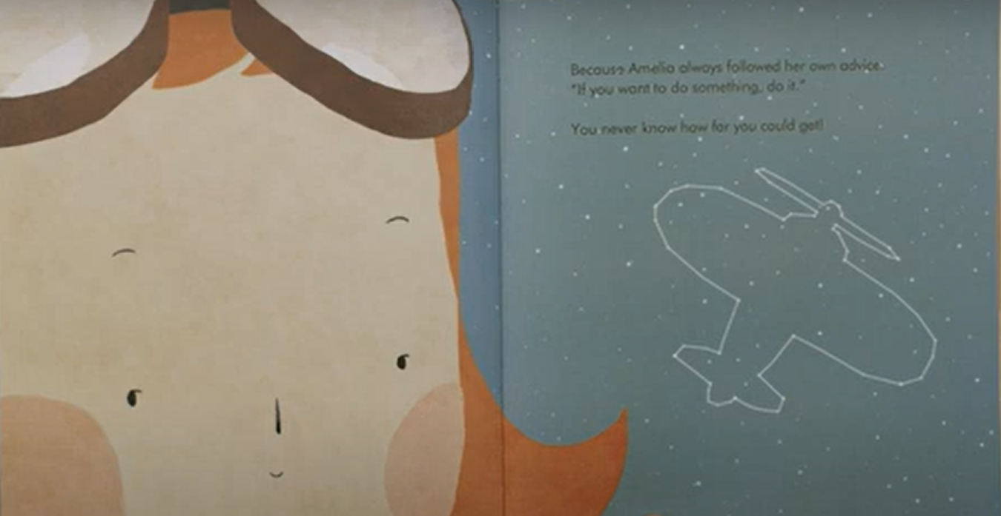

Slide 39
What was Amelia famous for?
Being the first woman to fly up to 14,000 feet and attempt to cross the Atlantic
Inventing the aeroplane
Flying a plane solo

Slide 40
What did Amelia try to do as her last challenge?
Fly across America
Fly around the world
Fly over the biggest ocean

Slide 41
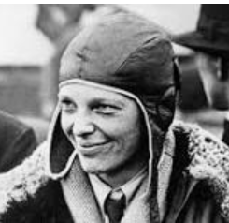
You are going to retrieve information. Let’s read it together.
Amelia Earhart
Amelia Earhart was a brave woman who loved to fly. She was born in 1897 in Kansas.
One day, Amelia saw a plane and she wanted to fly. In 1923 she was one of the first women to get her pilot’s license.
Amelia flew across the USA and set many records but she wanted to do more.
In 1937 she tried to fly around the world. Her plane went missing and she was never found.

Slide 42
When was Amelia born?
Let’s find it together

Slide 43
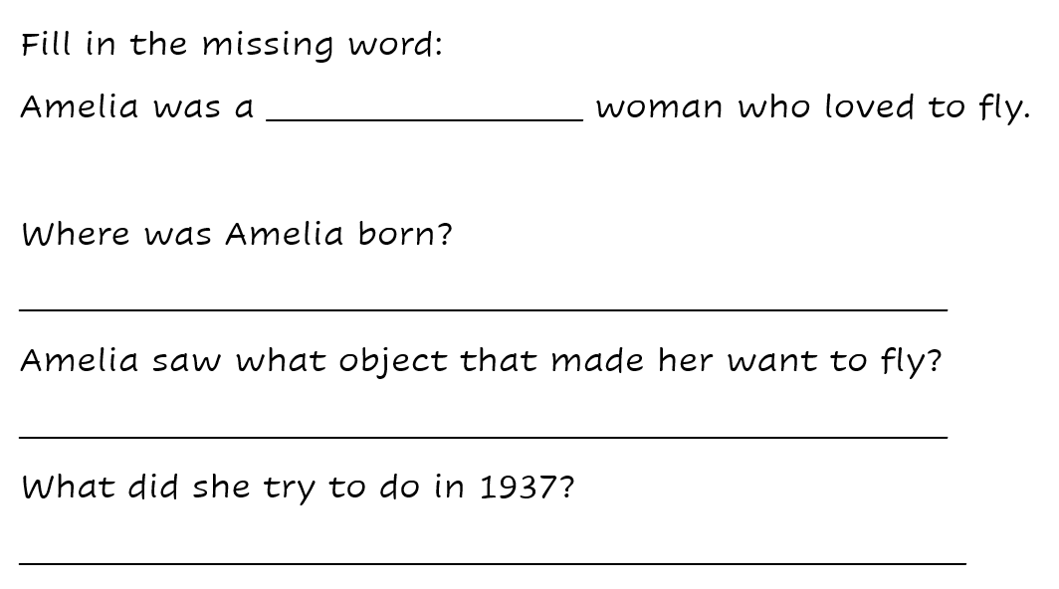
Your task

Slide 45
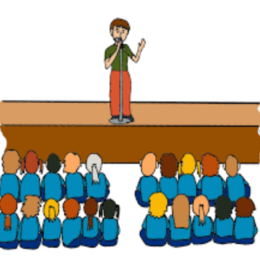
Assembly

Slide 46
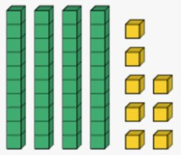
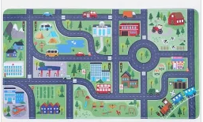
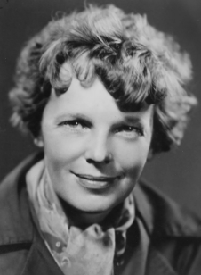
Independent Challenges:
Narrative Zone
Maths Zone
Use dienes to explore how a known fact changes when a 'ten' is added.
What is your favourite mode of transport and why?
Enquiry Zone
Creative Zone
Can you be a lollipop person and help your friends cross the road?
What places can you find on the mat that would be safe places to cross?
Can you create a portrait of Amelia Earhart.

Slide 47
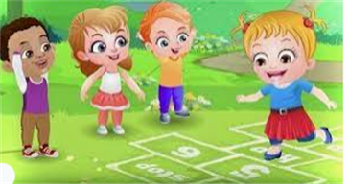
Break

Slide 48
Warm Up
TBAT: explore changing directions and dodging.
Tuesday 19th November 2024
Me and My shadow:
One pupils moves around the space in a variety of ways (hopping, crawling, skipping) and their partner copies everything they do.

Slide 49
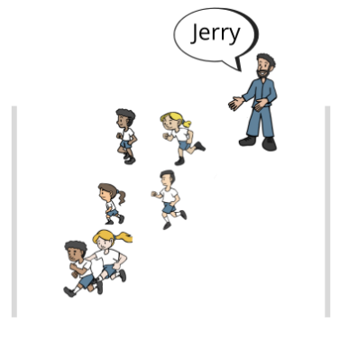
Skills Development
TBAT: explore changing directions and dodging.
Tuesday 19th November 2024
Tom and Jerry

Slide 50
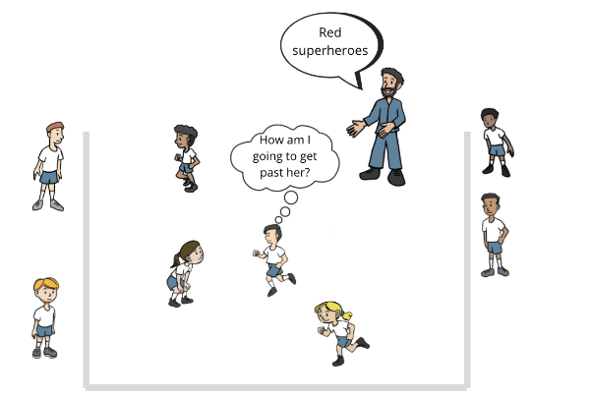
Skills Development
TBAT: explore changing directions and dodging.
Tuesday 19th November 2024
Superheroes and Villains

Slide 51
Plenary
TBAT: explore changing directions and dodging.
Tuesday 19th November 2024
What top tip would you give to someone changing direction?
How can they do it safely?

Slide 52
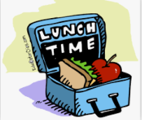
Lunch

Slide 53
RE KQ: What is stewardship?
3 in 3
Give your partner 3 facts you have learned about Islam so far!

Slide 54
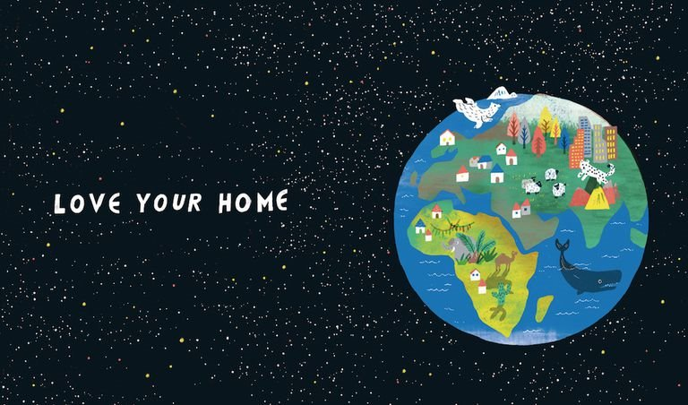
RE KQ: What is stewardship?
Blue/Green
What are some things we do to help look after our planet?

Slide 55
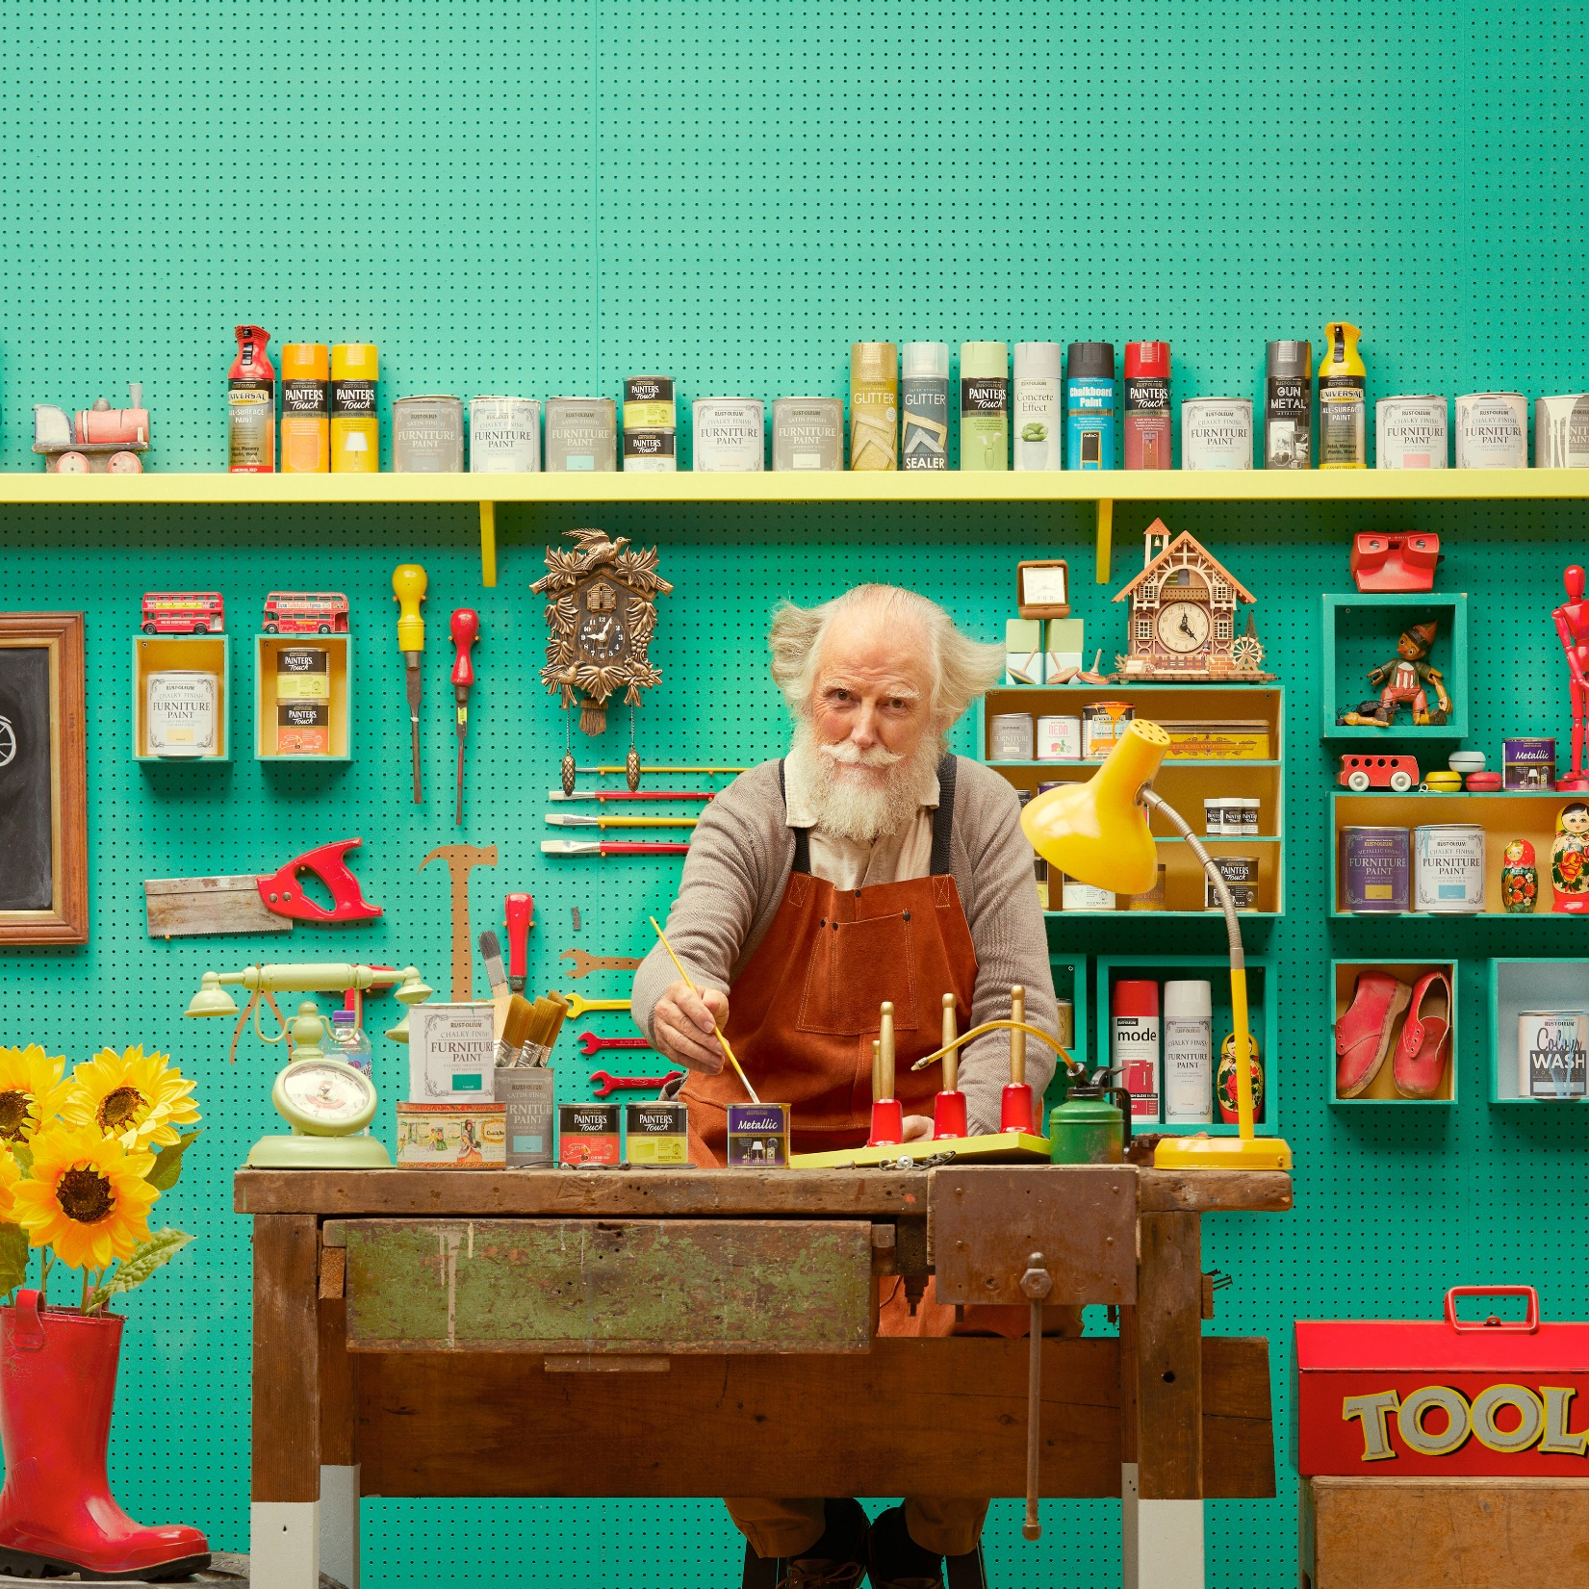
Imagine someone had spent a lot of time and effort making you a new toy.
They’d designed it themselves and made sure it was just right for you!

Slide 56
You would want to make sure you did everything you can to keep it safe and look after it.
You might even want to pass it on to your own children one day!

Slide 57
That’s a bit like how Muslims feel about the world we live in.
They believe that Allah made it especially for us to live in.
They believe Allah put us in charge of it, to look after it.

Slide 58
Although Muslims believe that Allah was the creator, they believe Allah made humans the stewards of earth.
A steward is someone who cares for and looks after something.

Slide 59
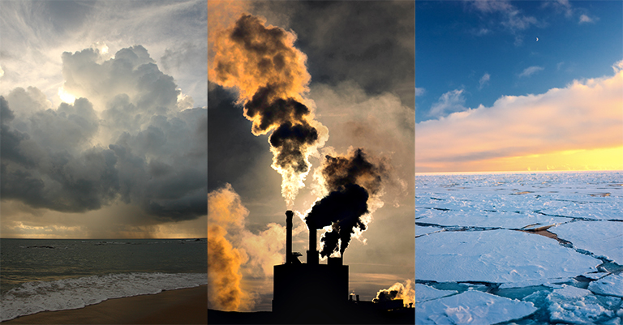
Unfortunately we haven’t always been the best stewards of the world around us.
Pollution and waste have caused lots of damage to our planet in recent years.

Slide 60
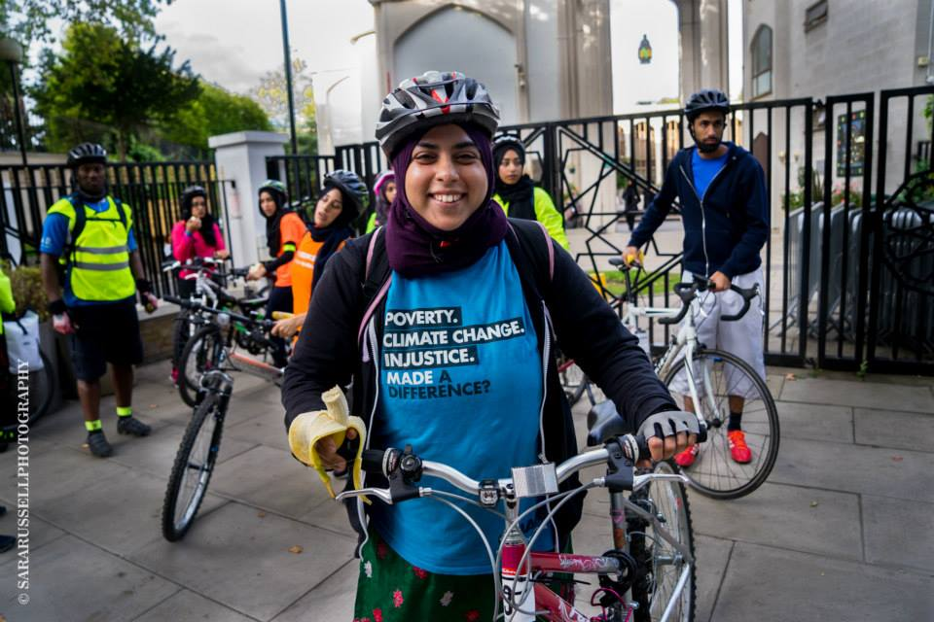
Muslims take their duty of stewardship very seriously.
If Allah created the world they believe they have to do their best to look after it.
How could Muslims help make sure the world is a good place for us to live?

Slide 61
So what have we learned today?
What is stewardship?
Why do Muslims feel called to look after our planet?

Slide 62
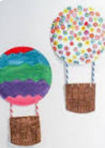
Independent Challenges:
Narrative Zone
Maths Zone
What is your favourite mode of transport and why?
Enquiry Zone
Creative Zone
Can you be a lollipop person and help your friends cross the road?
What places can you find on the mat that would be safe places to cross?
Can you make a hot air balloon out of your paper plate?

