Slide 1
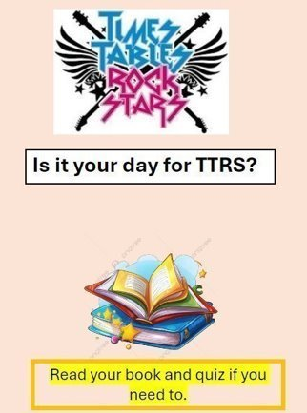
Monday 21st October Morning challenge
456 + 122 =
40.9 + 111 =
562.85 + 2, 000 =
555 – 333 =
56.78 - 12.3 =
8, 373 – 2, 001 =
85 x 100 =
7, 287 divided by 100 =
8.076 x 1, 000 =
827 divided by 1, 000=

Slide 2
Monday 21st October Morning challenge
Voyagers: Complete RE comic strip.

Slide 3
Monday 21st October Reading café
What is the most memorable book you have read and why?

Slide 4
Monday 21st October Reading café How do we teach reading at Ormiston Herman Academy? - Phonics - Reading lessons (2-week cycle) - 3 in 3s - End of KS2 tests

Slide 5
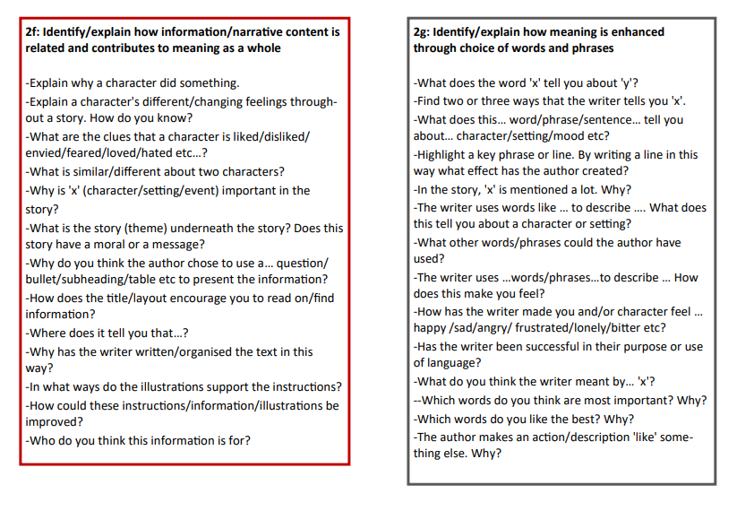
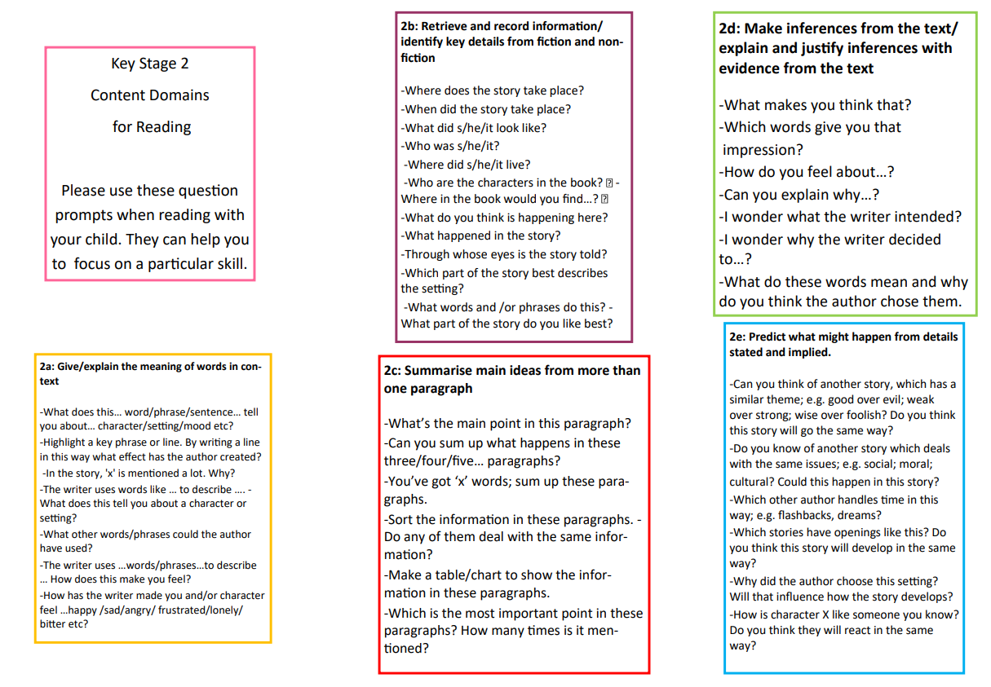

Slide 6
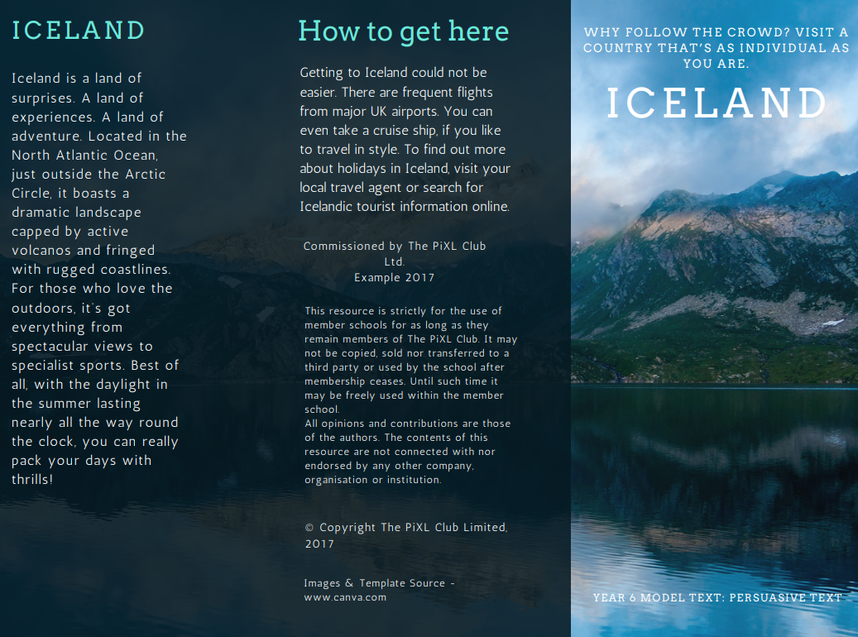

Slide 7
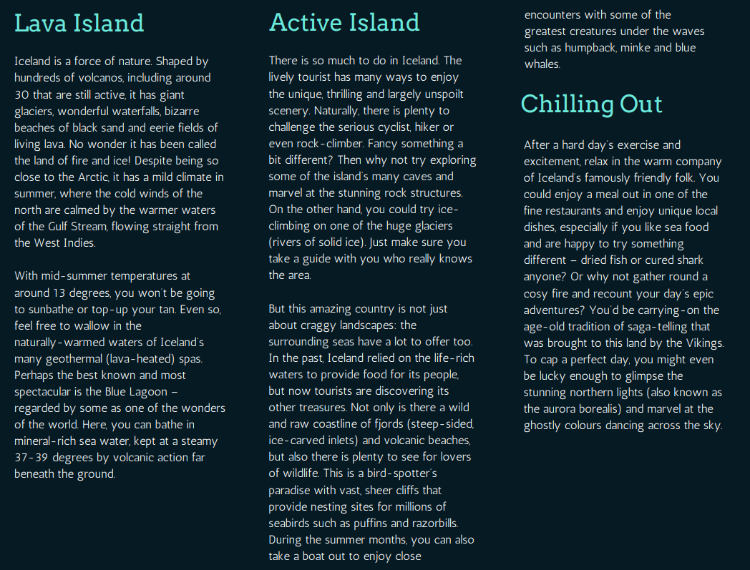

Slide 8
Reading domains activity: Inference – look at the pictures of Iceland. What inferences can you make? How do you know? Retrieval – Answer the questions about the text. Retrieve the answers from the text. Word choice – Look at the questions. Think about why those words have been selected. Comparisons – What's similar? What's different?

Slide 9
Monday 21st October TBAT: answers questions on the domains of reading. Independent: 1. Name two ways you can get to Iceland. 2. Which word is closest in meaning to the word marvel? Bored Wonder Laugh 3. Where can you go to keep warm in Iceland? 4. ”…marvel at the ghostly colours dancing across the sky.” How does this phrase make you feel? 5. Read through the travel brochure, what similarities and differences are there within the country of Iceland? 6. Iceland is a magical place to visit. How do you know?

Slide 10
Handwriting 10.50 - 11.10 Monday 21st October TBAT: practise joins consistently. Scent
Science
Scissors Descend
Fascinate
Can you put these words into a sentence?
Privilege
Opportunity
Dictionary
Vegetable
Yacht

Slide 11
Complete the 7x tables beginning with the easiest number.

Slide 12
7 Times Table Song | The Bare Necessities | Laugh Along and Learn (youtube.com)

Slide 13
TBAT- use column method for subtraction. 3 in 3 1) What is the value of the digit 8 in each number: a) 8, 766 b) 238 c) 816, 000 2) 7x ? = 49 3) 567 + 1, 002 =
Challenge: There are 45 pencils in a box. If there are 9 boxes, how many pencils are there alogether?

Slide 14
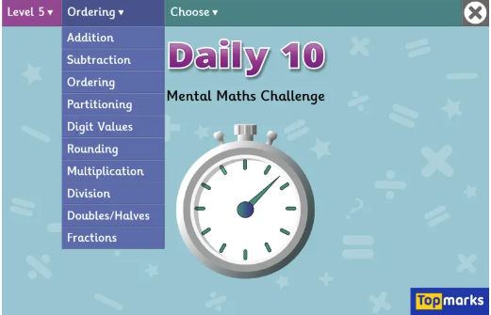
Daily 10 x 7s
Daily 10 - Mental Maths Challenge - Topmarks

Slide 15
Why would you use a mental method for these problems? Blue 12, 872 – 1, 001= Green 45, 014 – 4, 001= Challenge: How could you check that your answer is correct? Prove it.

Slide 16
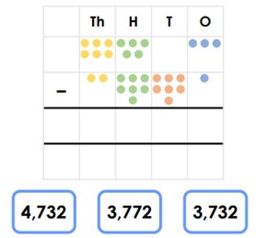
Class Work:

Slide 17
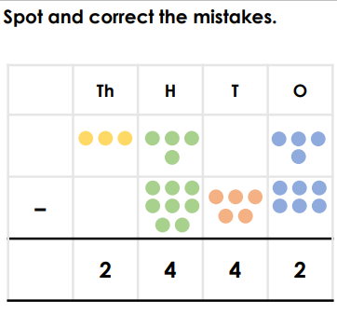

Slide 19
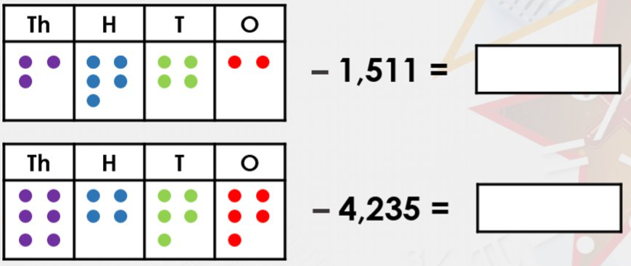
Blue Green

Slide 21
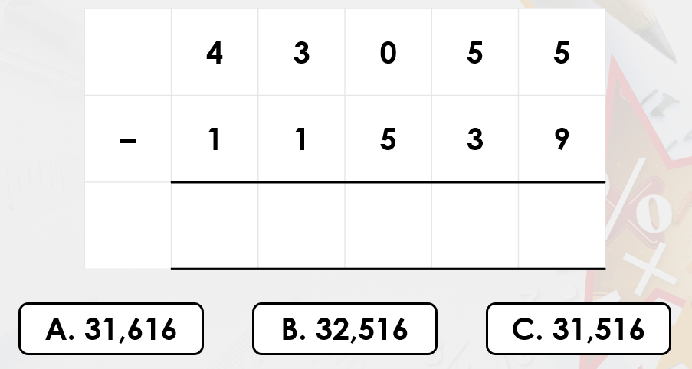
Which answer do you think will be correct and why?
Use your whiteboard to check.

Slide 22
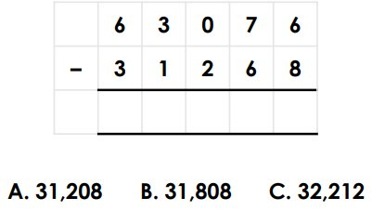
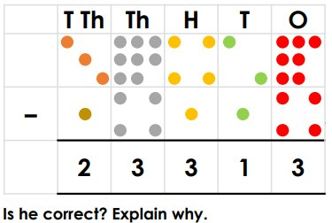
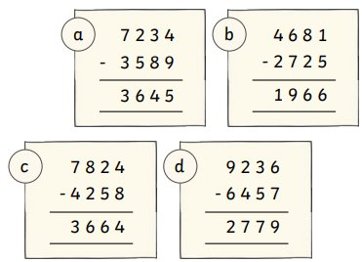
Independent:
1) 5, 356 – 1, 019 =
2) 63, 526 – 8, 628 =
Identify the mistakes.

Slide 23
Challenge:
Mastery:

Slide 24
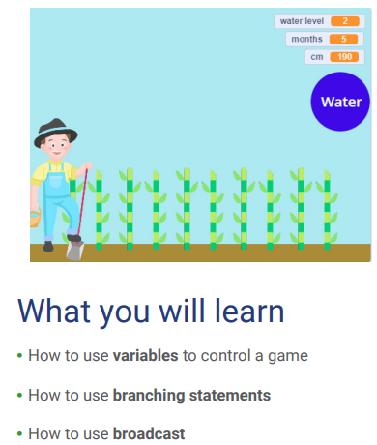
TBAT- use coding to create a clicker game.
Talk partners:
What does coding mean?
Give an example of coding.
Copy and paste the link from Teams into the search engine.
Scratch - Imagine, Program, Share (mit.edu)
In pairs, work through the instructions to complete your own clicker game.
Challenge:

Slide 25
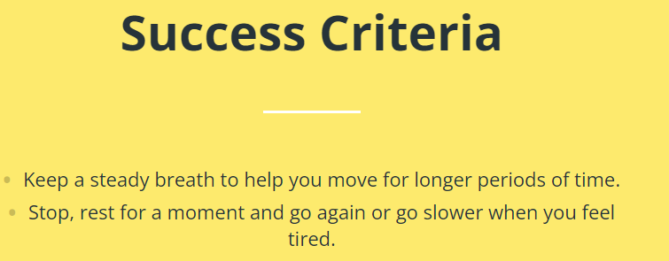
Stamina is the ability to keep moving for a long period of time without a rest.
Talk partners: How does skipping help to develop stamina?

