Slide 1
Monday 21st October 2024
21.10.24

Slide 2
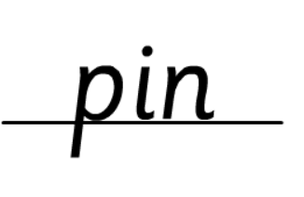
Morning Challenges:
Name writing

Slide 3
Monday 21st October 2024

Slide 4
KS1 Spelling Rule 23: ‘air’, ‘are’, ‘ear’ TBAT: explore alternative spellings of the /air/ phoneme.
Monday 21st October 2024
Commissioned by The PiXL Club Ltd.
December 2017
This resource is strictly for the use of member schools for as long as they remain members of The PiXL Club. It may not be copied, sold nor transferred to a third party or used by the school after membership ceases. Until such time it may be freely used within the member school.
All opinions and contributions are those of the authors. The contents of this resource are not connected with nor endorsed by any other company, organisation or institution.
© Copyright The PiXL Club Limited, 2017

Slide 5
1) Rule 23: Explanation
TBAT: explore alternative spellings of the /air/ phoneme.
Monday 21st October 2024
The ‘air’ sound is usually spelt ‘air’ or ‘are’.
stair chair hair
hare stare care

Slide 6
1) Rule 23: Explanation
TBAT: explore alternative spellings of the /air/ phoneme.
Monday 21st October 2024
The ‘air’ sound is sometimes spelt ‘ear’.
bear swear pear

Slide 7
2) Rule 23: Examples
TBAT: explore alternative spellings of the /air/ phoneme.
Monday 21st October 2024
Think: how is the ‘air’ sound spelt in these words?
fair
dare
wear
air
rare
spare

Slide 8
3) Rule 23: Practise
TBAT: explore alternative spellings of the /air/ phoneme.
Monday 21st October 2024
Add the ‘air’ sound to these words.
Think: does it look right?
Starter
ch ___
d ___
t ___
sc ___

Slide 9
3) Rule 23: Practise
TBAT: explore alternative spellings of the /air/ phoneme.
Monday 21st October 2024
Add the ‘air’ sound to these words.
Which can be spelt in more than one way?
Challenge 1
st ___
gl ___
b ___
rep ___

Slide 10
3) Rule 23: Practise
TBAT: explore alternative spellings of the /air/ phoneme.
Monday 21st October 2024
Complete each sentence with a word that contains the ‘air’ sound.
Challenge 2
I came last in the race but I didn’t ______.
I didn’t want to ______ my toys with anyone.
I brushed my _____ and chose a top to _____.

Slide 11
Choose a word and put it in a sentence.
TBAT: explore alternative spellings of the /air/ phoneme.
Monday 21st October 2024
/air/ sound spelt ‘are’
/air/ sound spelt ‘ear’
/air/ sound spelt ‘air’
fair
pair
chair
stair
care
scare
share
square
bear
pear
wear

Slide 12
Movement break
Transportation Song | Transportation for kids | The Singing Walrus - YouTube

Slide 13
TBAT: retrieve information from a text.
Monday 21st October 2024
3 in 3 – Match the lowercase letter to its capital letter.
f
r
R
S
s
F
Challenge: Choose a pair and think of words which would begin with the lower case and which would begin with a capital.

Slide 14
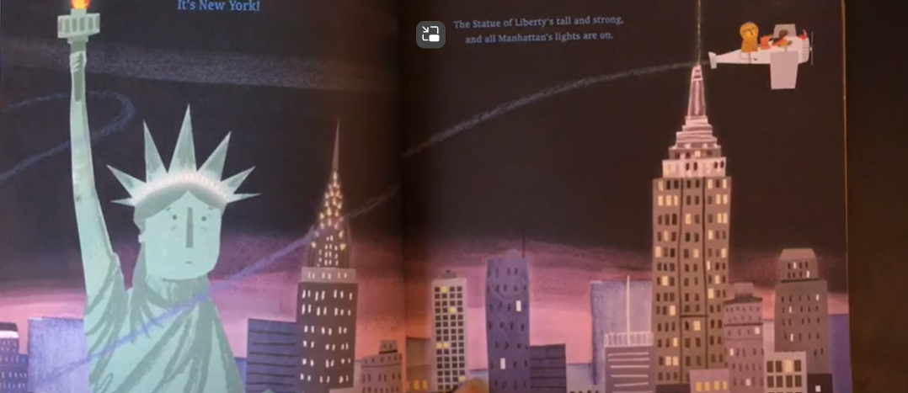
TBAT: retrieve information from a text.
Monday 21st October 2024
Blue/ Green
Emma Jane soared over the blazing lights of New York.
Find a word that means flew.
Find a word that means bright.
Challenge: Can you think of any other words that mean flew or bright?

Slide 15
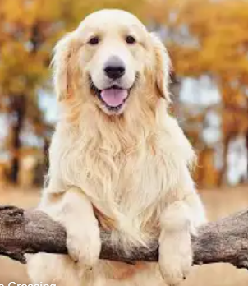
TBAT: retrieve information from a text.
Monday 21st October 2024
Today we are going to retrieve information from a text.
Retrieve means to bring back.
So, when we retrieve information we have to go to the text and bring back the information.
Think about a dog chasing after a stick to the text and bringing back the information.

Slide 16
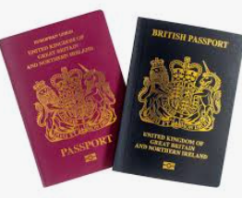
TBAT: retrieve information from a text.
Monday 21st October 2024
What is a passport?
Have you ever seen one before?
What sort of information will be on here?
What does personal information mean?

Slide 17
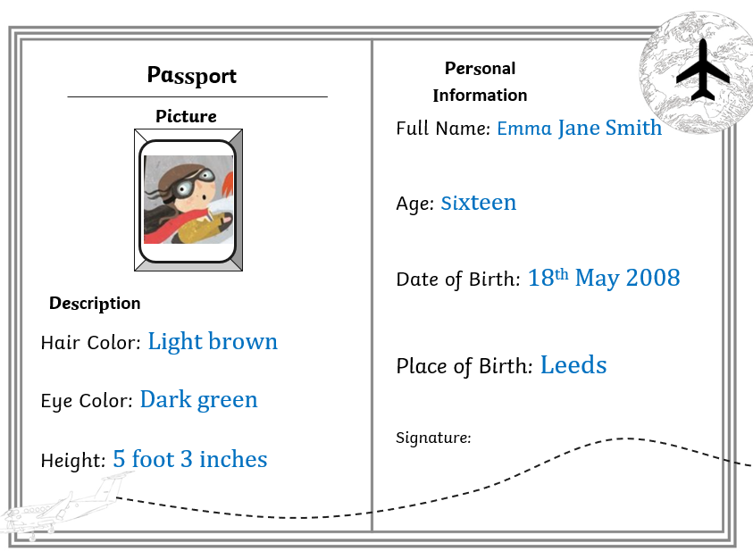
TBAT: retrieve information from a text.
Monday 21st October 2024
Here is a copy of Emma Jane's passport.
Let's find out more information about Emma Jane.

Slide 18
Multiple Choice question
TBAT: retrieve information from a text.
Monday 21st October 2024
What information is not on Emma Janes passport?
Height
Address
Hair colour

Slide 19
TBAT: retrieve information from a text.
Monday 21st October 2024
What colour are Emma Janes eyes?
Find the answer in the text

Slide 20
TBAT: retrieve information from a text.
Monday 21st October 2024
What year was Emma Jane born?
Find it in the text.

Slide 21
TBAT: retrieve information from a text.
Monday 21st October 2024
What is Emma Jane's last name?
What is another word for last name?

Slide 22
TBAT: retrieve information from a text.
Monday 21st October 2024
In your book:
Find the answer and highlight the answer in the text.
1. How old is Emma Jane?
………………………………………………………………………………………………
2. What is the colour of Emma Jane's hair?
……………………………………………………………………………………………..
3. What month was Emma Jane born in?
………………………………………………………………………………………………
Challenge:
Where was Emma Jane born?
Explain how you know.

Slide 23
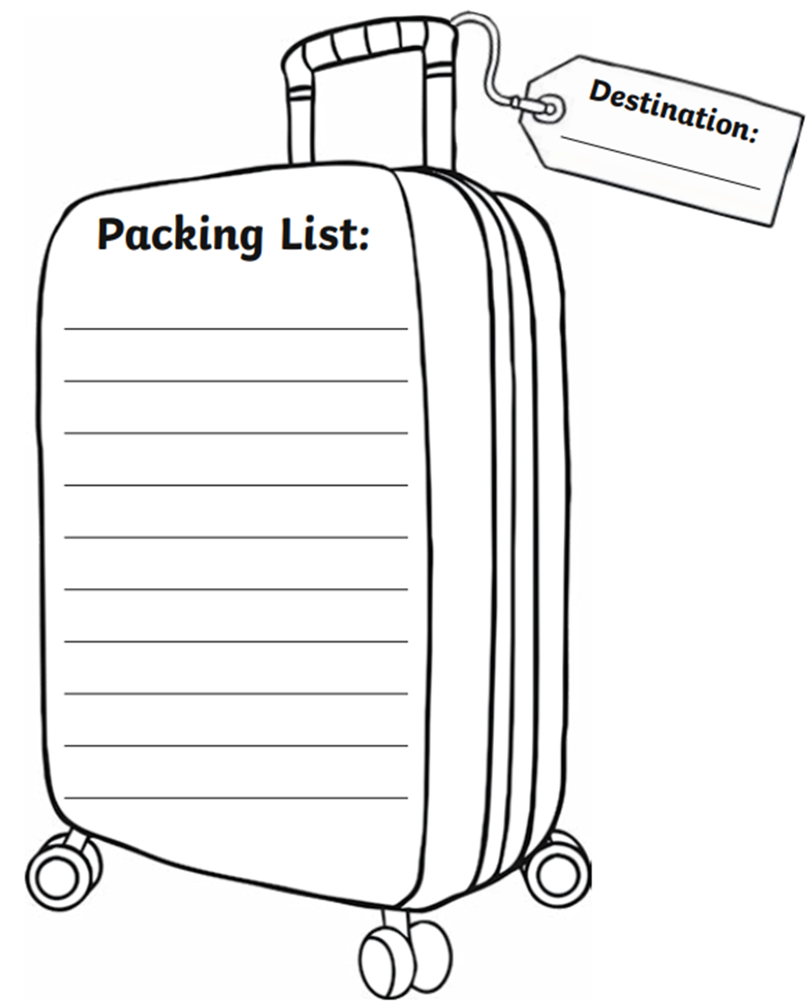
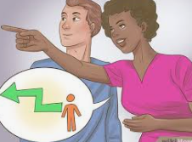
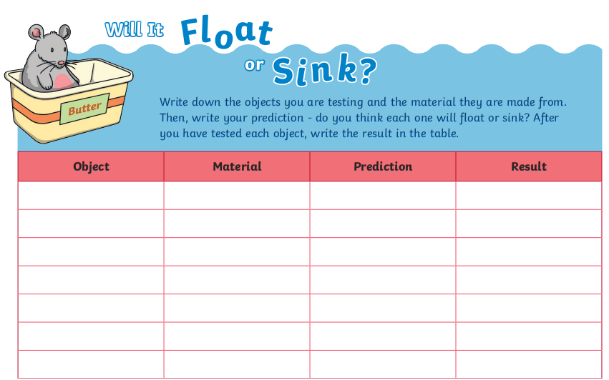
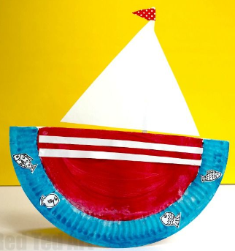
Independent Challenges:
Narrative Zone
Maths Zone
Emma Jane is off on her aeroplane, and she needs to know what to pack.
Write a list of what she would need to pack for her journey.
Can you direct your friend from where they are standing to the door? Use quarter turns and forwards, backwards, left and right.
Enquiry Zone
Creative Zone
Explore the materials to decide which would be the best to build a boat.
Make your paper plate into a boat!

Slide 24
Lunch

Slide 25
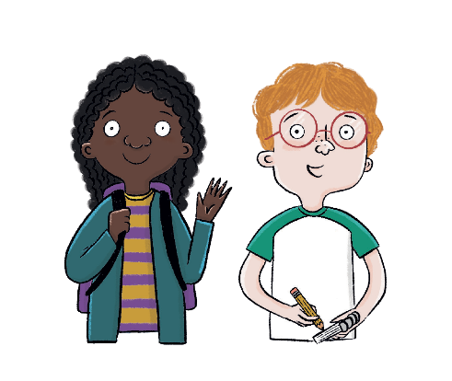
Unit 2: Transport and Travel
KQ: How have boats changed over time?

Slide 26
Lesson 3:
4 in 4
Modern means ____________.
from the present from the past
The very first type of transport was the ___________.
car plane boat
Notes:
Knowledge quiz 2.2: Pupils complete this in the Additional resource: Knowledge quizzes booklet to assess their knowledge retention from the previous lesson. They write their score in the chart also provided in the additional resource.

Slide 27
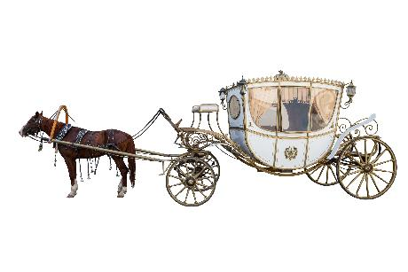
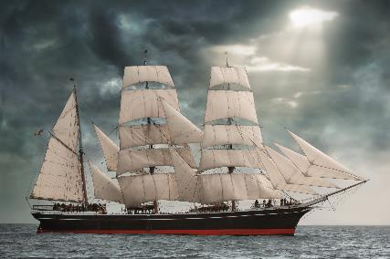
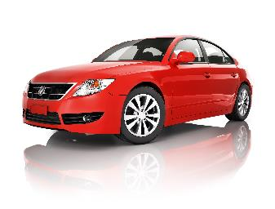
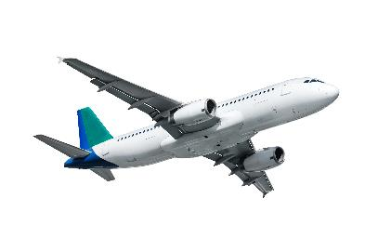
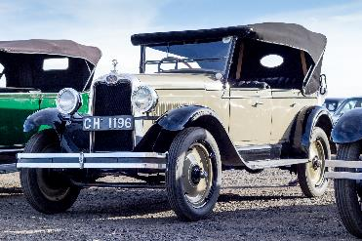
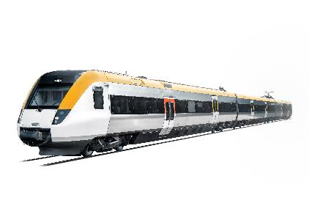
Lesson 3:
4 in 4
Circle the modern type of transport.
Circle the type of transport that is from the past.

Slide 28
Lesson 3:
Modern means ____________.
from the present from the past
The very first type of transport was the ___________.
car plane boat

Slide 29
Lesson 3:
Circle the modern type of transport.
Circle the type of transport that is from the past.

Slide 30
How has transport changed over time?
Notes:
Revisit the main enquiry question and the learning journey so far.

Slide 31
How do we travel around today?
How has road transport changed?
1
What transport did people use in the past?
How have bicycles changed since they were first invented?
2
How have boats changed over time?
How has air travel changed over time?
3
How were the first trains different from trains today?
Why can we only find some types of transport in certain areas?
How did trains change people's lives?
How have humans travelled in space?

Slide 32
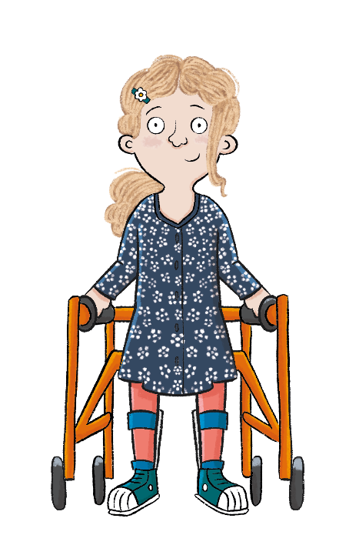
Lesson 3:
In this lesson, we are learning that boats changed to become faster and safer to travel in.
Notes:
Introduction: Share the lesson statement, and key term. Then share key knowledge and other key vocabulary with pupils—you may want to add images to the teaching slides to support exemplification and understanding of these words. (You may want to explain the meaning of ‘vehicle’ here as pupils have used ‘type of transport’ until now, but ‘vehicle’ is used throughout this lesson.)

Slide 33
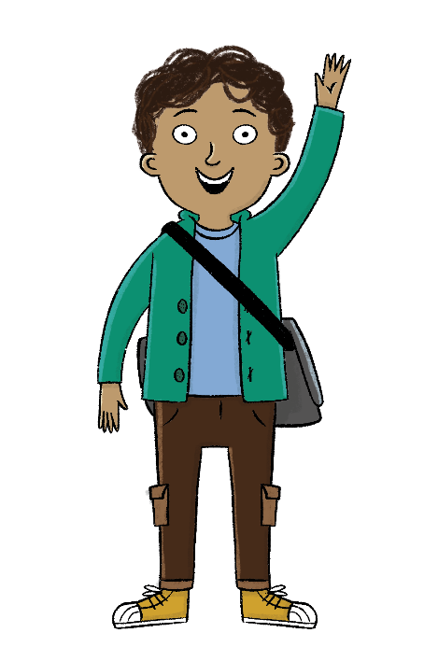
Lesson 3:
The key term for this lesson is
engine.
An engine is the part of a vehicle that produces power to make it move.
Blue/green
Can you think of any modes of transport that do not have an engine?
Can you think of any modes of transport that have an engine?
Notes:
To support understanding of the key term ‘engine’ you may wish to share images of engines with pupils or play them a short video.

Slide 34
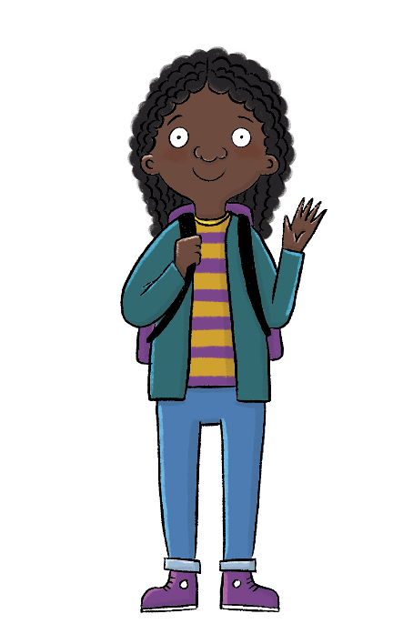
How have boats changed over time?
Lesson 3:
The boat was the first type of transport.
Boats can be powered by people, engines, wind, or the Sun.
Over time, new inventions have made boat journeys faster and safer.
boat
engine
power
ship
solar

Slide 35
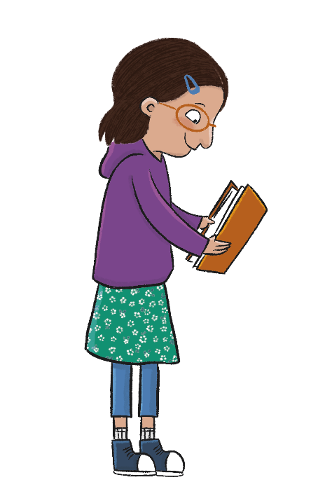
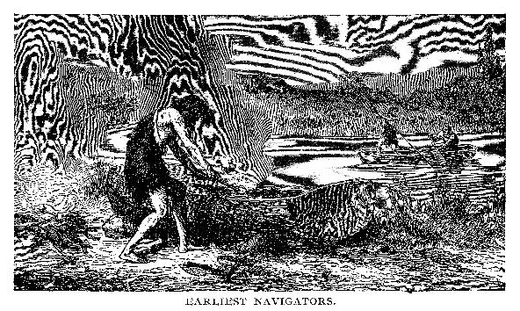
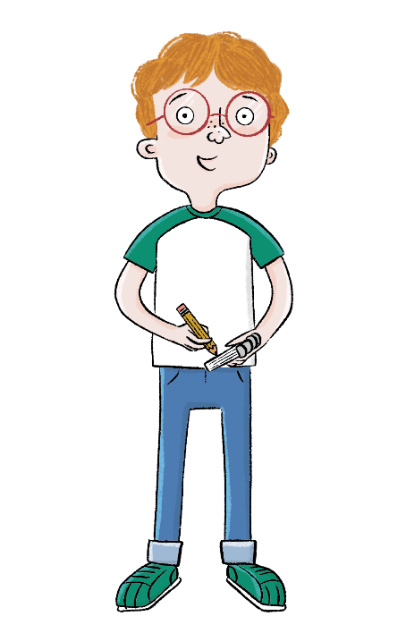
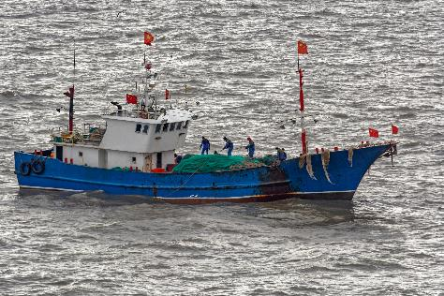
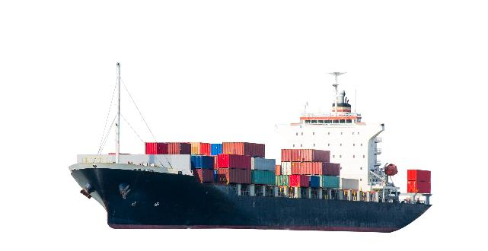
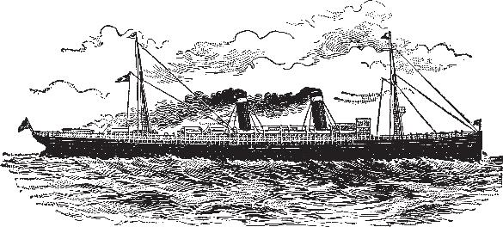
Lesson 3:
Which of these boats do you think are from the past and which do you think are from the present? Why?
Are any types of boats from the past still used today?
Notes:
Talk task: Ask pupils to discuss the questions ‘Which of these boats do you think are from the past and which do you think are from the present?’ and ‘Why?’. Pupils should look at the images on the two slides and discuss their ideas. Another way of completing this task would be to ask pupils to sit in a circle, enlarge and print off all the images from the slides to hand around and to group as a class. Once you’ve decided on the boats in the two groups, ask pupils the question: ‘Are any types of boats from the past still used today?’. Explore ideas with pupils but don’t correct misconceptions yet as the lesson will work through boats of the past, present, and boats used in both times. Pupils will get a chance to review their thoughts from this Talk task later in the lesson so you may wish to keep a record of current ideas.

Slide 36
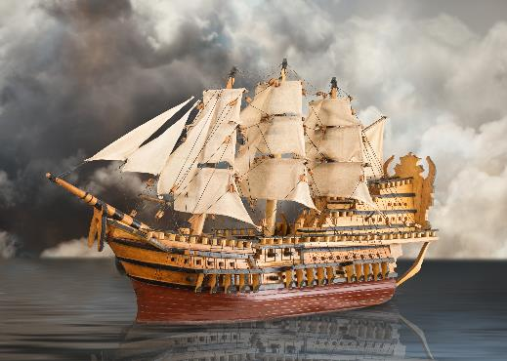
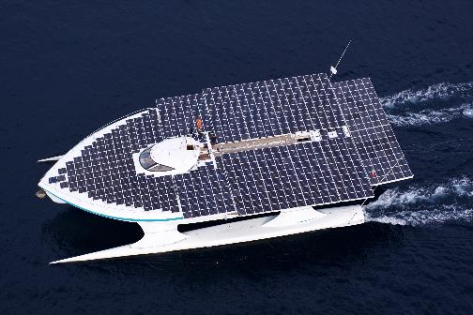
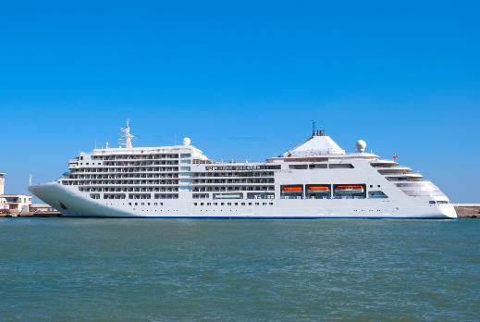
Which of these boats do you think are from the past and which do you think are from the present? Why?
Are any types of boats from the past still used today?
Lesson 3:

Slide 37
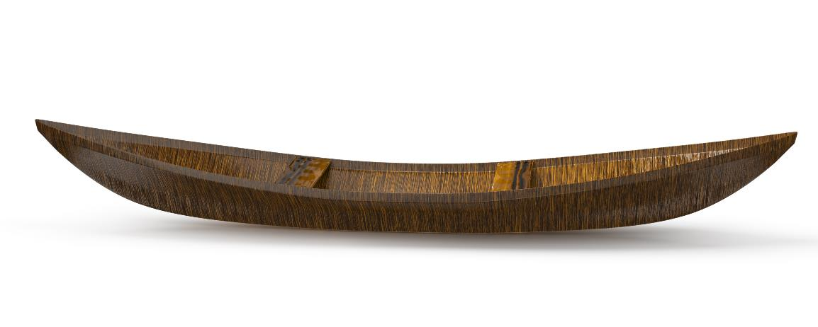
The history of boats
Lesson 3:
For many, many years people have used boats to move goods and people across water.
Today the word boat means a small craft used for fun or for carrying small loads.
Notes:
Read: ‘The history of boats’. As you read through the slides you may wish to use the printed images of boats from the Talk task ordered chronologically and displayed to support pupils. As you read through the slides, stop to ask pupils questions to discuss what they have learned. These could be questions such as:
What was the first canoe made from?
Why do people use canoes and sailing boats today?
What made sailing ships move?
Can you see the steam on the steam ship image?
What do container ships carry?
Which ships have shops and cinemas?
What do fishing boats do?
What do solar-powered ships use to help them move?
More images and videos of the different boats will help understanding and consolidation.

Slide 38
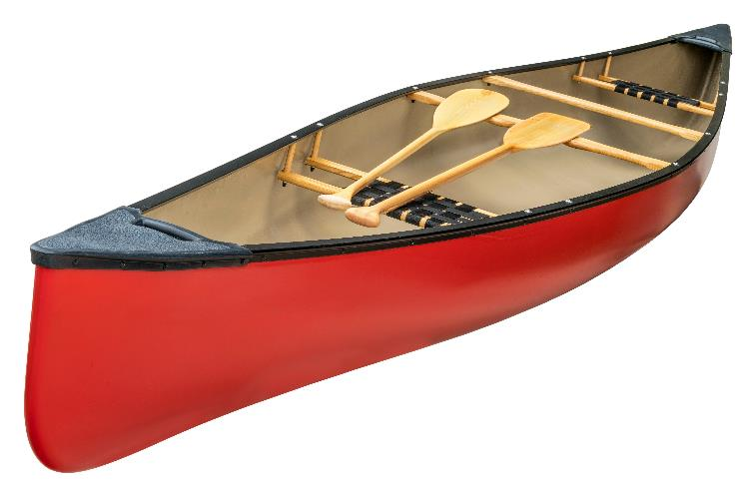
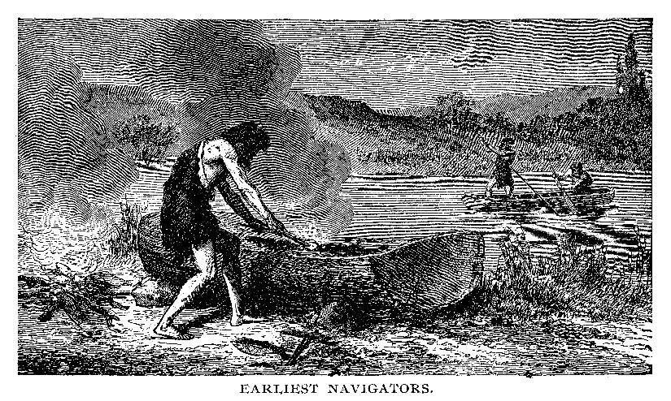
The history of boats
Lesson 3:
The first boats were simple rafts made from logs tied together and wooden canoes which were carved out of logs. People used oars or paddles to move the boats.
Today people still use canoes but mostly for fun.

Slide 39
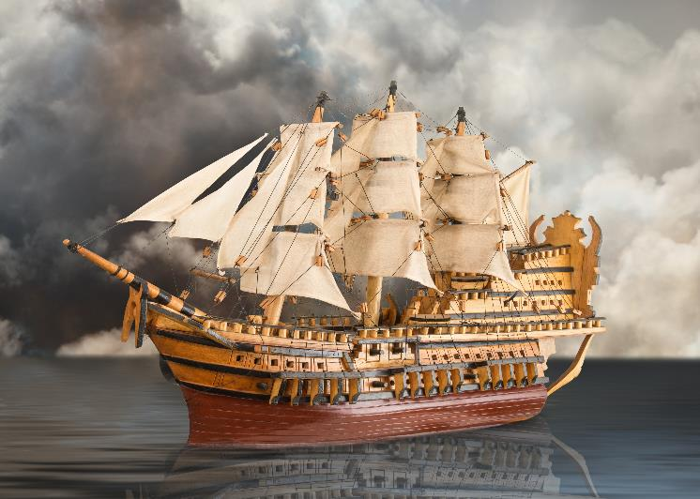
The history of boats
Lesson 3:
Later, people built larger boats called ships which could travel longer distances. Sailing ships relied on the wind to move them across the sea.
Sailing boats are still used today but mostly for fun.

Slide 40
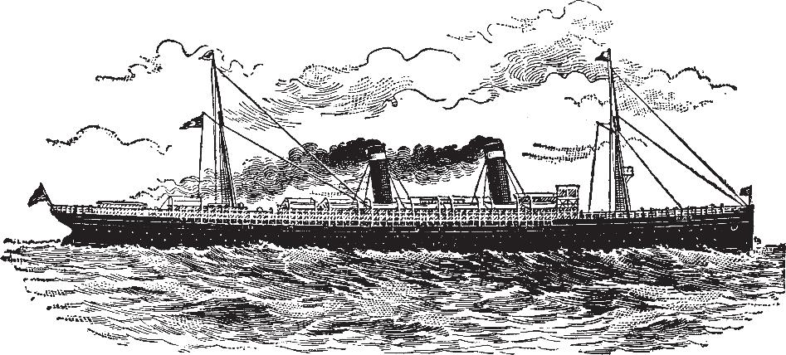
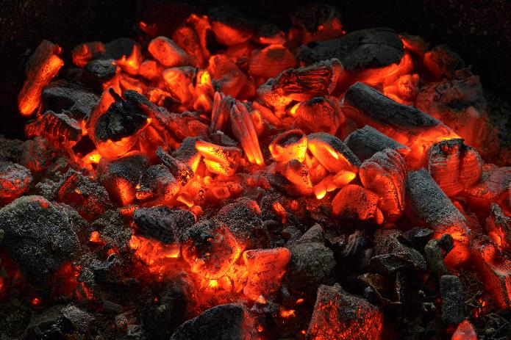
The history of boats
Lesson 3:
Steamships were powered by steam engines. Steam was made from burning coal. The steam powered the ship’s engine which moved it through the water.

Slide 41
The history of boats
Lesson 3:
Today, most ships are powered by diesel engines. Container ships travel long distances carrying goods in huge, metal boxes which are stacked on the deck.
goods

Slide 42
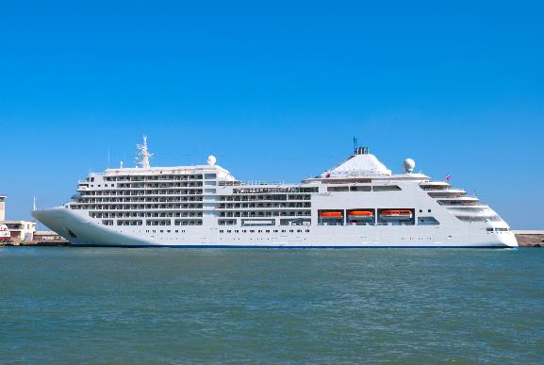
The history of boats
Lesson 3:
Cruise ships are modern ships that carry many hundreds of people on floating holidays. The ship has restaurants, shops, and even cinemas!
Smaller, modern fishing boats are also powered by engines.

Slide 43
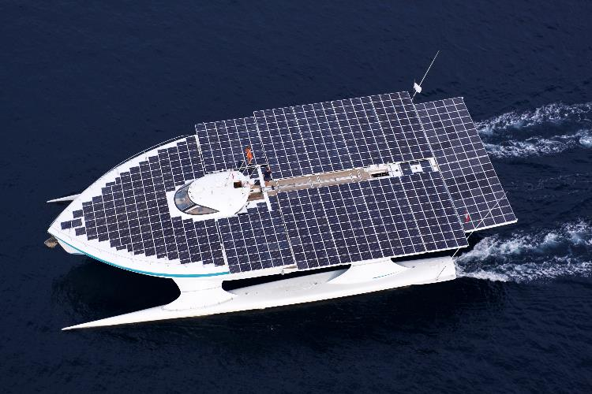
The history of boats
Lesson 3:
Recently, people have invented solar-powered ships. These ships use energy from the Sun to move them through the water.
Over time, boat journeys have become faster and safer.

Slide 44
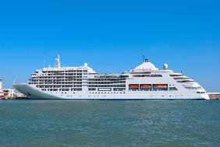
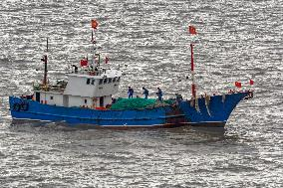
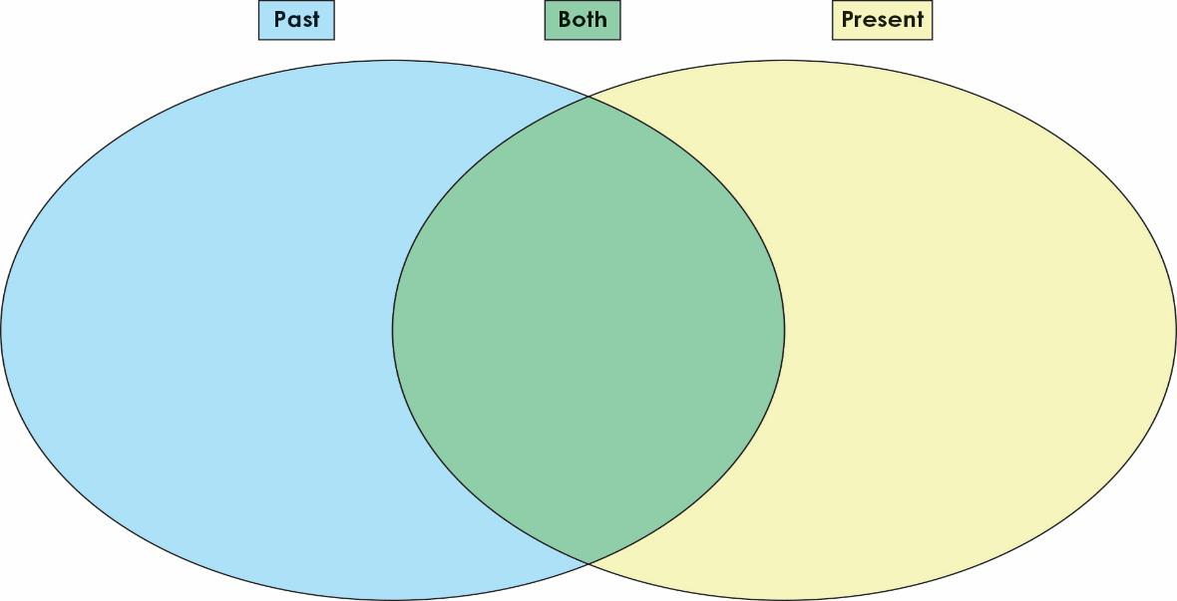
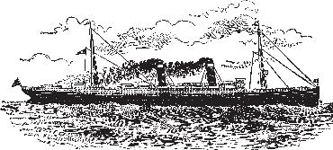
Sort the boats into the diagram.
Lesson 3:
Notes:
Retrieval: Working either as a whole class or in smaller groups, provide each pupil with a set of the cards from Additional resource: Boat picture cards. Challenge pupils to organise the pictures into the Venn diagram in their pupil workbooks. Pupils should sort the boats into groups of ‘Past’, ‘Present’, or ‘Both’ (where the boat is still being used today). You may wish to model this task during circle time with pupils before sending them to complete the task in their pupil workbooks. Support pupils by pre-sticking an image in each group to show example answers. Challenge pupils by asking them if they can label each type of boat and describe the job of each boat to their partner. Answers are provided on the following slide.

Slide 45
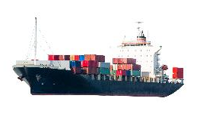
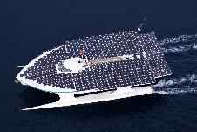
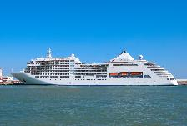
Sort the boats into the diagram.
Lesson 3:

Slide 46
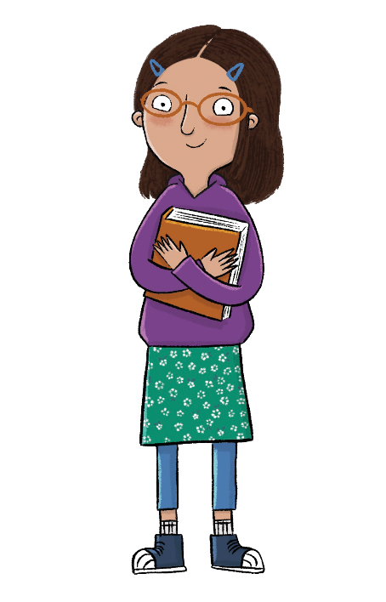
How have boats changed over time?
Lesson 3:
Can you name a boat from the past?
Can you name a boat that is used today?
Can you name a boat that is powered by the wind?
Notes:
Learning review: Using the teaching slides, talk partners tell each other a response to the questions. Add further review questions if you wish to.

Slide 47
How have boats changed over time?
Lesson 3:
The boat was the first type of transport.
Boats can be powered by people, engines, wind, or the sun.
Over time, new inventions have made boat travel faster and safer.
boat
engine
power
ship
solar
Notes:
Note: For the following lesson, you may wish to plan a trip to take pupils on a train journey, to experience trains first hand.

Slide 48
Key Question: What makes me and others around me special?
Monday 21st October 2024
Blue/
Green

Slide 49
Key Question: What makes me and others around me special?
Monday 21st October 2024

Slide 50
Key Question: What makes me and others around me special?
Monday 21st October 2024

Slide 51
Key Question: What makes me and others around me special?
Monday 21st October 2024

Slide 52
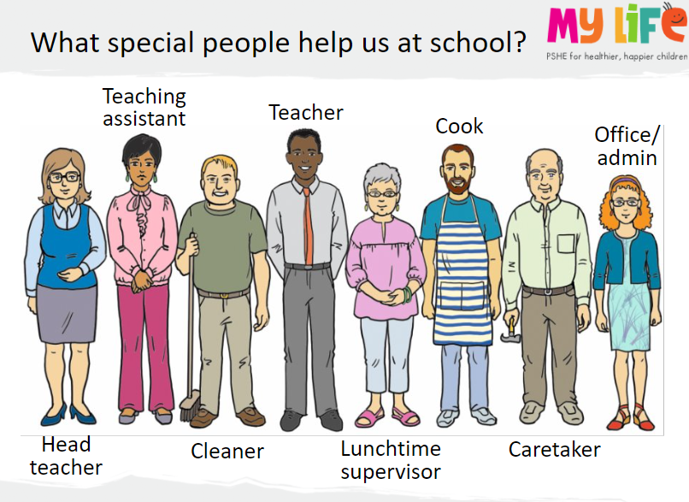
Key Question: What makes me and others around me special?
Monday 21st October 2024

Slide 53
Key Question: What makes me and others around me special?
Monday 21st October 2024

Slide 54
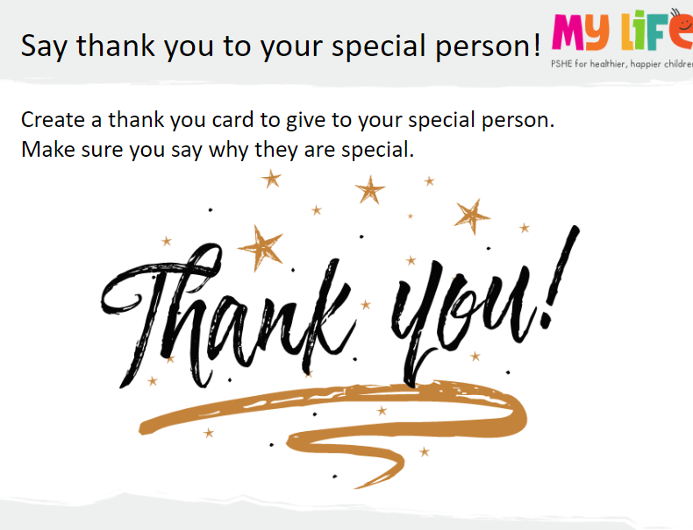
Key Question: What makes me and others around me special?
Monday 21st October 2024

Slide 55
Independent Challenges:
Narrative Zone
Maths Zone
Emma Jane is off on her aeroplane, and she needs to know what to pack.
Write a list of what she would need to pack for her journey.
Can you direct your friend from where they are standing to the door? Use quarter turns and forwards, backwards, left and right.
Enquiry Zone
Creative Zone
Explore the materials to decide which would be the best to build a boat.
Make your paper plate into a boat!

Slide 56
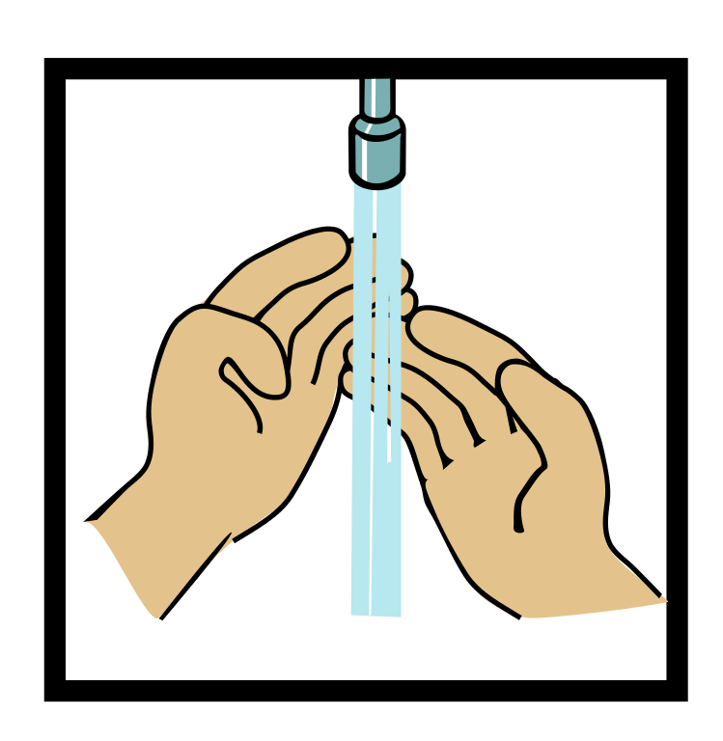
Home time
1.
2.
3.
4.
Wash hands
Collect bags , lunch boxes and water bottles.
Collect jumpers
Collect any letters/ reading books from the teachers.
Line up at the door.

