Slide 1
Wednesday 8th May 2024
8/5/24

Slide 2
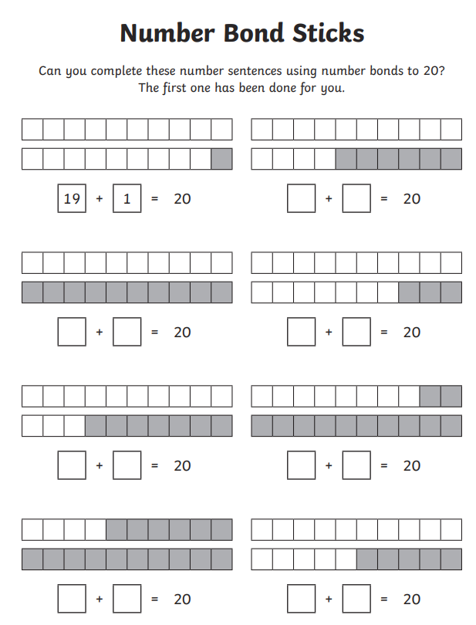
Morning Challenges
Name writing practise.
Number bonds within 20.
Read a book

Slide 3
Revisit and review
Today's Grapheme
ure/air

Slide 4
Revisit and review

Slide 5
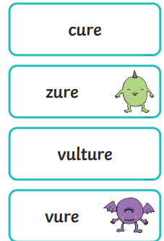
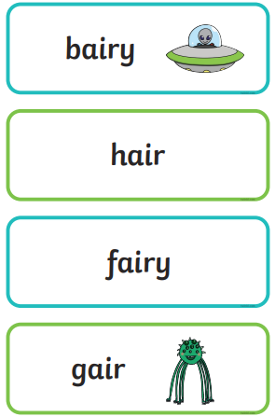
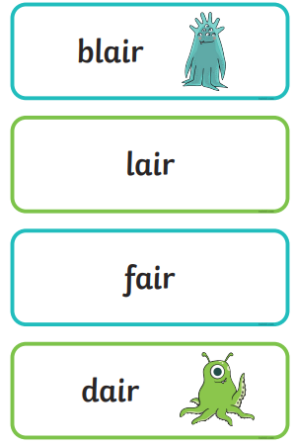
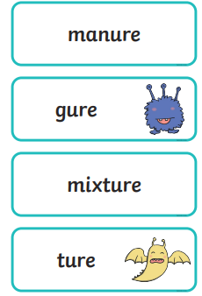
Real or Nonsense words? Read the words and underline the 'ure and air' phonemes
CHALLENGE
Write the real words in a sentence

Slide 6
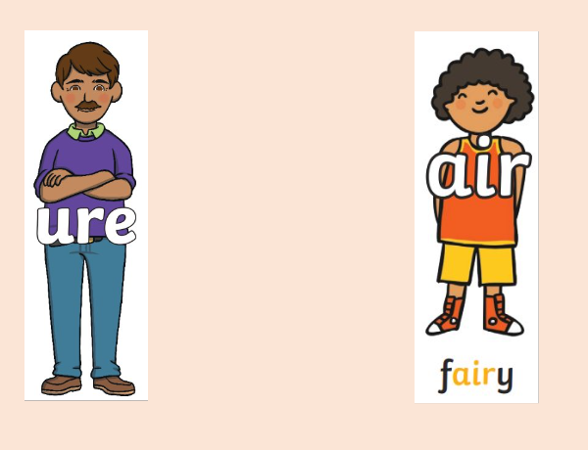
Read the sentences and list the words with the 'air phoneme
What did Claire do to her hair?
Where did Claire go? Did she like it?

Slide 7
Read the sentences and list the words with the 'ure phoneme
What was wrong with Hure?
What did the Doctor do?

Slide 8
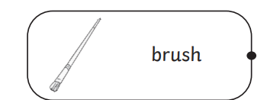
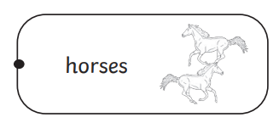
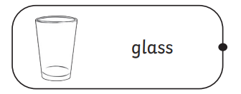
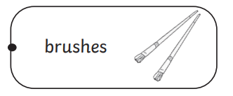
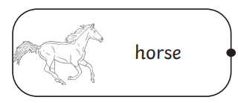
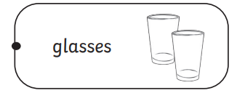
Wednesday 8th May 2024
8/5/24
TBAT: plan a story.
3 in 3- Match the singulars to the plurals.

Slide 9
TBAT: plan a story.
Wednesday 8th May 2024
8/5/24
Blue/ Green
Discuss with your partner;
What is your favourite story?
Who are the main characters?
What happens in the beginning, middle and end?

Slide 10
TBAT: plan a story.
Wednesday 8th May 2024
8/5/24
When we write a story, we need to think about the beginning, middle and end.
Last week, we started by writing the beginning of the story.
How to Write a Story for kids - YouTube

Slide 11
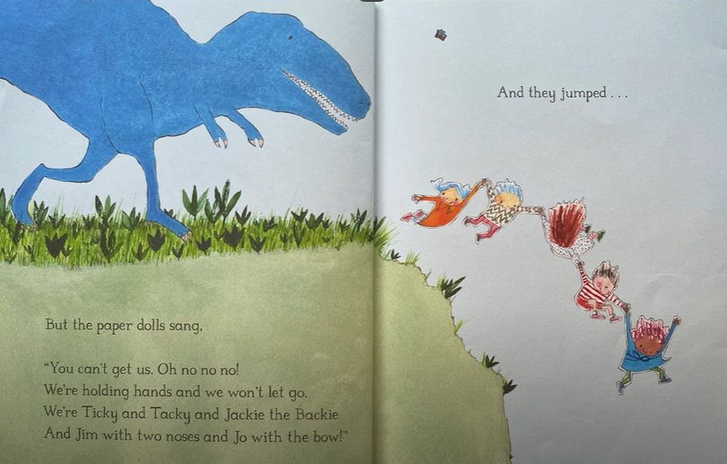
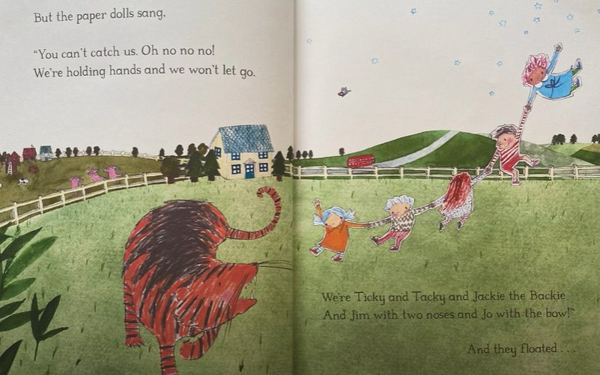
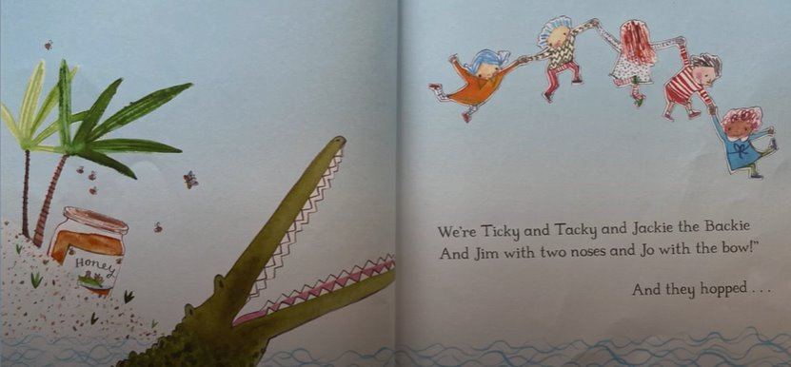
TBAT: plan a story.
Wednesday 8th May 2024
8/5/24
The Middle
In the middle of the story, the Paper Dolls go on different adventures; they run from a dinosaur, a crocodile and a tiger.
Discuss with your partner, 3 different adventures that your paper dolls will go on.

Slide 12
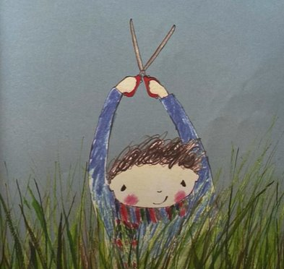
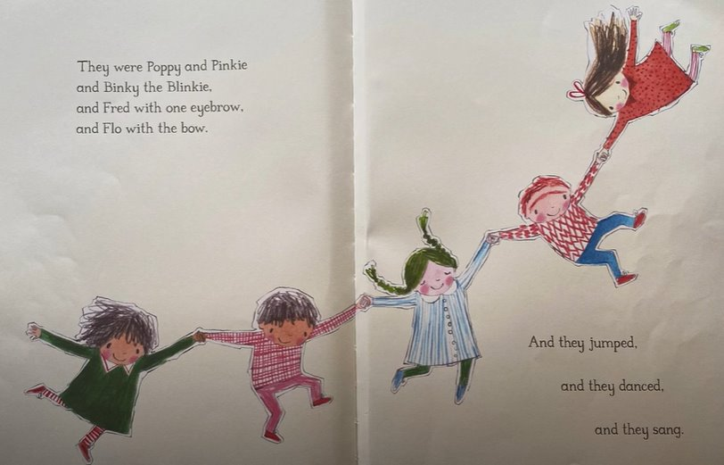
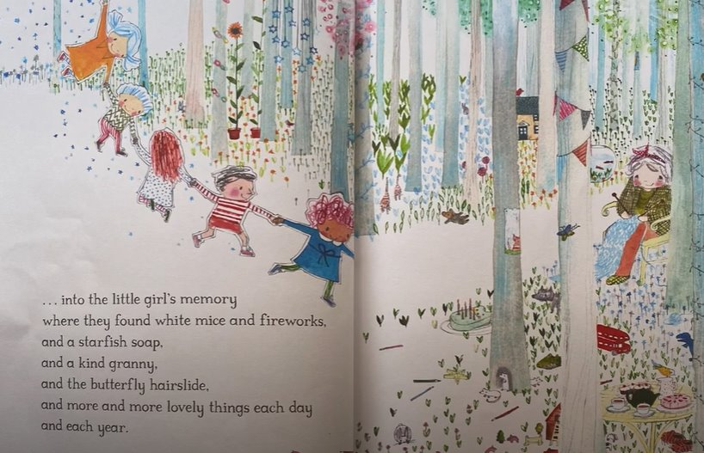
TBAT: plan a story.
Wednesday 8th May 2024
8/5/24
The End
At the end of the story, the Paper Dolls get snipped into pieces but remain in the girls memory. She grows up and teacher her daughter to make paper dolls.
Discuss with your partner, how your story will end.
Will the paper dolls get snipped?
Or maybe, they will escape.......

Slide 13
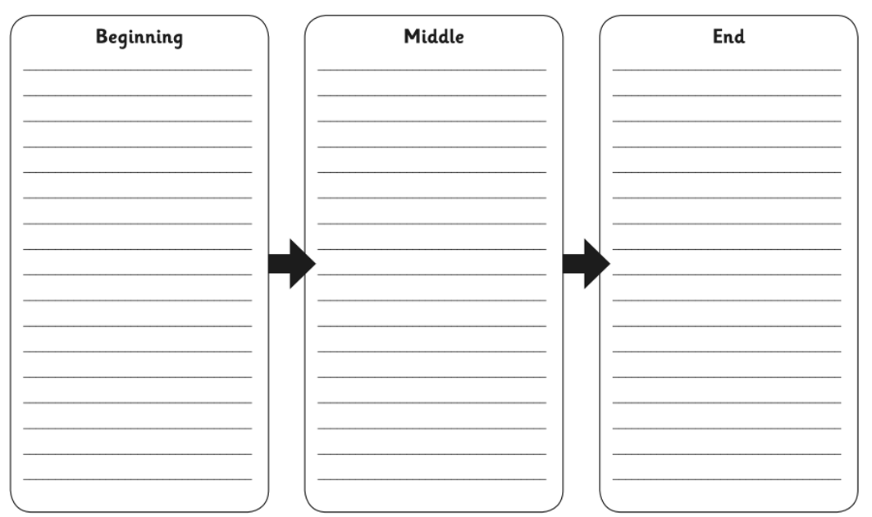
TBAT: plan a story.
Wednesday 8th May 2024
8/5/24
Independent: On your plan, write notes of what will happen at each stage of your story.
Challenge: Can you list any of the describing words that will be used in your story?

Slide 14
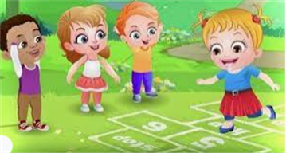
Break

Slide 15
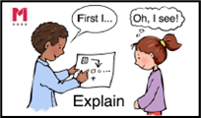
Match the expression to the representation
3 in 3
9 + 6
5 + 12
11 + 3
0
5
10
15
20
0
1
2
3
4
5
6
7
8
9
10
11
12
13
14
15
Notes:
Do Now: Match the representation
Show pupils the expressions and representations on the slide.
Which representation matches which expression? How do you know?
Pupils discuss and then share their answers.
Pupils could create their own alternative representations for each expression.

Slide 16
To identify addition and subtraction fact families
subtract
add
equal
part
ones
whole
Dienes

Slide 17
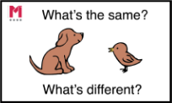
How could you represent this equation?
7 + 6 = 13
13 = 6 + 7
Are both equations correct?
Notes:
New Learning: Identifying related addition equations
Ask pupils to look at the first equation on the slide: 7 + 6 = 13. Encourage them to show how they can represent it, using Dienes and a part-whole model (although other representations can also be used). Pupils should use language to describe that the two parts (6 and 7) added together are equal to the whole (13). Then ask pupils to look at 13 = 6 + 7.
What’s the same? What’s different?
Are both equations correct?
Establish that the order of the numbers has changed. Encourage pupils to note that the equation is still showing that the whole (13) is equal to the sum of the two parts (6 and 7).
On the next slide, ask pupils to consider the child’s claim that ‘it doesn’t matter where you put the numbers in an addition equation’. Draw their attention to the four equations shown.
Do you agree or disagree with the child’s statement? Why?
It is important that pupils are given time to explore this and explain their reasoning supported with manipulatives. Establish that two of the equations are incorrect. Talk about the meaning of the ‘=’ symbol, and that each side must be equal to the other. Explore the other correct addition equations that can be written using the numbers six, seven and 13 (there should be four, two with 13 before ‘=’, and two with 13 after ‘=’).

Slide 18
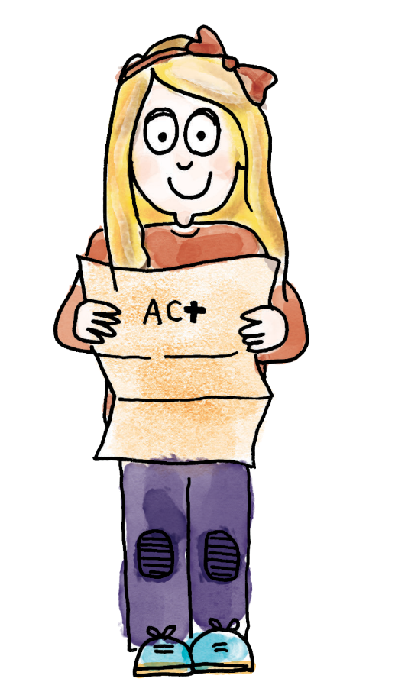
Is this statement correct?
It doesn't matter where you put the numbers in an addition equation. It's always correct!
7 + 6 = 13
13 = 6 + 7
13 + 6 = 7
6 = 13 + 7
Notes:
New Learning: Identifying related addition equations
Ask pupils to look at the first equation on the slide: 7 + 6 = 13. Encourage them to show how they can represent it, using Dienes and a part-whole model (although other representations can also be used). Pupils should use language to describe that the two parts (6 and 7) added together are equal to the whole (13). Then ask pupils to look at 13 = 6 + 7.
What’s the same? What’s different?
Are both equations correct?
Establish that the order of the numbers has changed. Encourage pupils to note that the equation is still showing that the whole (13) is equal to the sum of the two parts (6 and 7).
On the next slide, ask pupils to consider the child’s claim that ‘it doesn’t matter where you put the numbers in an addition equation’. Draw their attention to the four equations shown.
Do you agree or disagree with the child’s statement? Why?
It is important that pupils are given time to explore this and explain their reasoning supported with manipulatives. Establish that two of the equations are incorrect. Talk about the meaning of the ‘=’ symbol, and that each side must be equal to the other. Explore the other correct addition equations that can be written using the numbers six, seven and 13 (there should be four, two with 13 before ‘=’, and two with 13 after ‘=’).

Slide 19
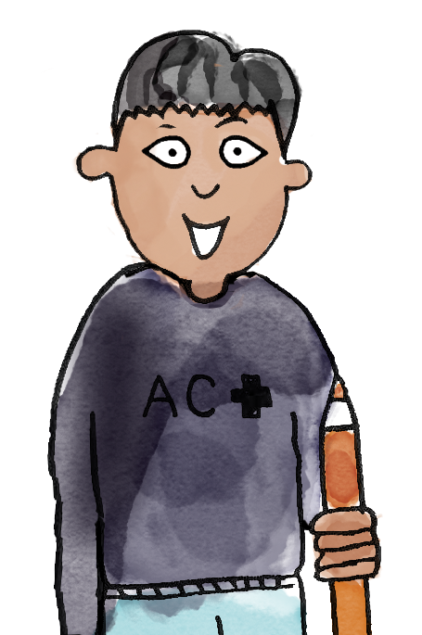
B/G
15 + 4 = 19 is a correct statement. I know this because when I add four to 15, it is equal to 19.
It doesn't matter which way round we add the parts.
So we could write 4 + 15 = 19.
19 is the whole. This is equal to adding the parts 15 and four.
We can write this as 19 = 15 + 4.
add subtract part whole equal ones Dienes
Notes:
Talk Task: Identifying related addition equations
Pupils have the Task Sheet, a part-whole model and a manipulative such as Dienes, cubes or counters. They discuss and record sets of equivalent addition equations, using manipulatives on a part-whole model to support their reasoning.

Slide 20
Exploring related subtraction equations
6
13
7
–
=
–
=
Notes:
Develop Learning: Exploring related subtraction equations
Return to the part-whole model from the New Learning (13, six, seven).
Can you write a subtraction equation with these same numbers?
Using concrete manipulatives and a part-whole model, model subtracting one part from the whole to leave the other part and writing this in the abstract (13 – 6 = 7). This is a good opportunity to reinforce and apply the pupils’ prior learning about regrouping.
Can you write another subtraction equation using the same numbers?
Establish that we can subtract the other part (seven) from the whole: 13 – 7 = 6.
Explore the misconception addressed on the next slide, that we can put the same three numbers anywhere in a subtraction equation and it will be correct. Use a concrete representation to show this to be incorrect.
Together, identify all four possible subtraction equations using six, seven and 13.

Slide 21
Is Jasmine correct?
Jasmine has found that 13 − 7 = 6.
She has used this to write the equation 13 = 6 − 7.
13 = 6 – 7
Notes:
Develop Learning: Exploring related subtraction equations
Return to the part-whole model from the New Learning (13, six, seven).
Can you write a subtraction equation with these same numbers?
Using concrete manipulatives and a part-whole model, model subtracting one part from the whole to leave the other part and writing this in the abstract (13 – 6 = 7). This is a good opportunity to reinforce and apply the pupils’ prior learning about regrouping.
Can you write another subtraction equation using the same numbers?
Establish that we can subtract the other part (seven) from the whole: 13 – 7 = 6.
Explore the misconception addressed on the next slide, that we can put the same three numbers anywhere in a subtraction equation and it will be correct. Use a concrete representation to show this to be incorrect.
Together, identify all four possible subtraction equations using six, seven and 13.

Slide 22
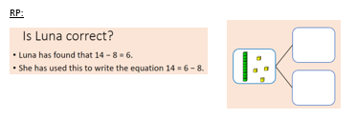
To identify addition and subtraction fact families
Find all the possible addition and subtraction equations to represent these numbers.
Make sure you check your working.
15
8
19
12
4
4
Notes:
Independent Task: All the possibilities
Pupils have the Task Sheet, a part-whole model and some cubes or counters. They represent each relationship using manipulatives and use this to support them in recording all the possible addition and subtraction equations for each set of numbers.
Possible adaptations:
Pupils could use a balance scale to physically ‘balance’ cubes to support their understanding of a written equation (and the meaning of the ‘=’ symbol).
Challenge pupils to record the equations independently without the frames on the sheet. Can they still find all the possibilities?

Slide 23
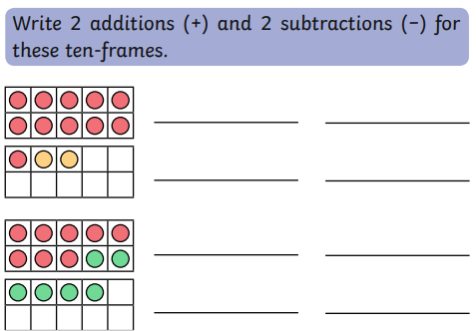
To identify addition and subtraction fact families
Challenge:
Notes:
Independent Task: All the possibilities
Pupils have the Task Sheet, a part-whole model and some cubes or counters. They represent each relationship using manipulatives and use this to support them in recording all the possible addition and subtraction equations for each set of numbers.
Possible adaptations:
Pupils could use a balance scale to physically ‘balance’ cubes to support their understanding of a written equation (and the meaning of the ‘=’ symbol).
Challenge pupils to record the equations independently without the frames on the sheet. Can they still find all the possibilities?

Slide 24
To identify addition and subtraction fact families
Mastery:
Notes:
Independent Task: All the possibilities
Pupils have the Task Sheet, a part-whole model and some cubes or counters. They represent each relationship using manipulatives and use this to support them in recording all the possible addition and subtraction equations for each set of numbers.
Possible adaptations:
Pupils could use a balance scale to physically ‘balance’ cubes to support their understanding of a written equation (and the meaning of the ‘=’ symbol).
Challenge pupils to record the equations independently without the frames on the sheet. Can they still find all the possibilities?

Slide 25
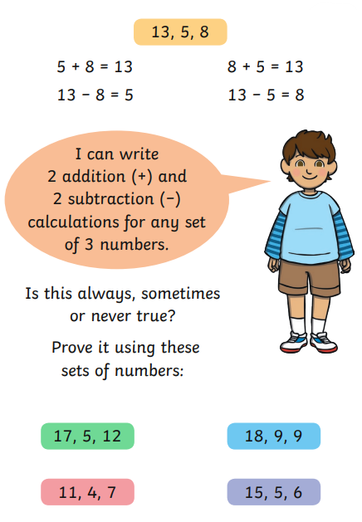
To identify addition and subtraction fact families
Mastery with greater depth:
Notes:
Independent Task: All the possibilities
Pupils have the Task Sheet, a part-whole model and some cubes or counters. They represent each relationship using manipulatives and use this to support them in recording all the possible addition and subtraction equations for each set of numbers.
Possible adaptations:
Pupils could use a balance scale to physically ‘balance’ cubes to support their understanding of a written equation (and the meaning of the ‘=’ symbol).
Challenge pupils to record the equations independently without the frames on the sheet. Can they still find all the possibilities?

Slide 26
Lunch

Slide 27
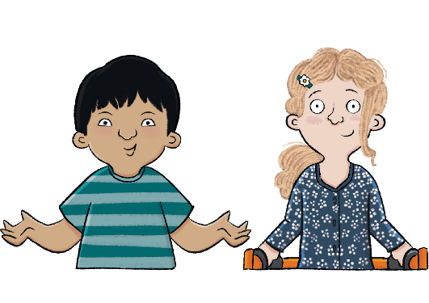
Unit 1: Toys Over Time
Key Question: How do we know that some toys are from the past?

Slide 28
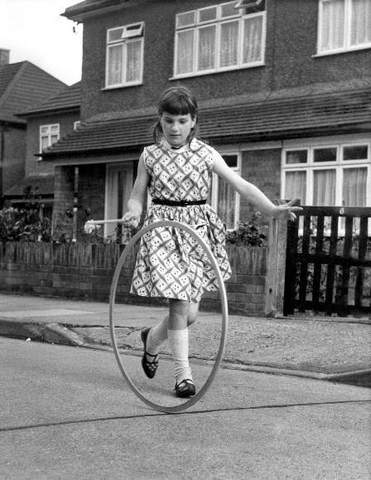
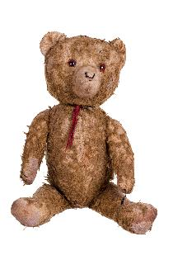
Lesson 4:
3 in 3
What does the ‘past’ mean?
not happened yet already happened happening now
What is the name of the toy in this photo?
hula hoop
modelling clay
remote-controlled car
3. Which of these toys would not have been played with in the 1950s?
Notes:
Knowledge quiz 1.3: Pupils complete this in the Additional resource: Knowledge quizzes booklet to assess their knowledge retention from the previous lesson. They write their score in the chart also provided in the additional resource.

Slide 29
Lesson 4:
Blue/Green
Can you think of a toy that would have been played in the 1950s and is also played with today?
Blue:
Green:

Slide 30
How are toys similar to and different from toys in the past?
Notes:
Revisit the main enquiry question and the learning journey so far.

Slide 31
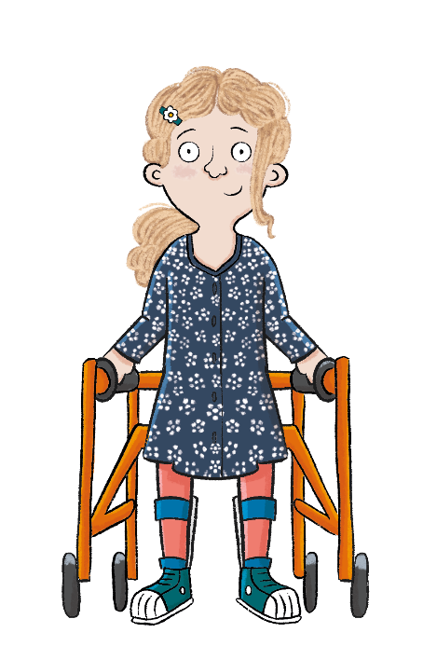
Lesson 4:
In this lesson, we are comparing old and new toys. How are they the same? How are they different?

Slide 32
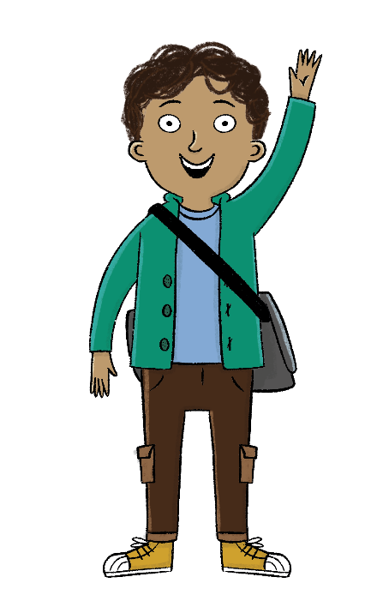
Lesson 4:
The key term for this lesson is
modern.
Modern means new, or from the present day.
Notes:
To reinforce the definition of the key term ‘modern’, you could do a call and response with your pupils such as, ‘Modern means ...’, ‘New!’.

Slide 33
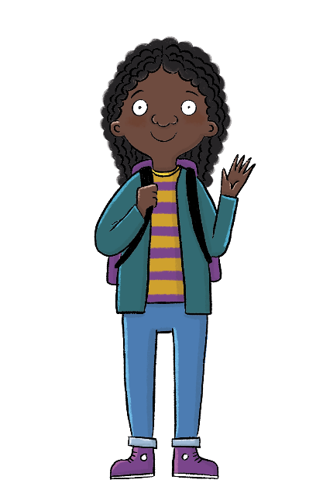
How do we know that some toys are from the past?
Lesson 4:
Toys from the past and modern toys are similar in some ways.
Toys from the past and modern toys are different in some ways.
modern
present
past

Slide 34
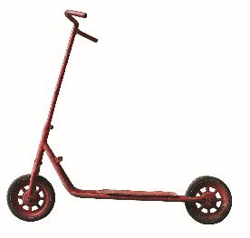
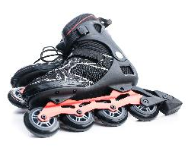
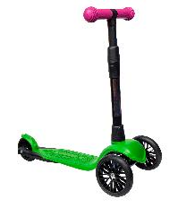
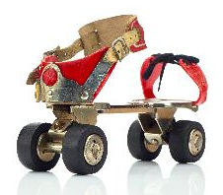
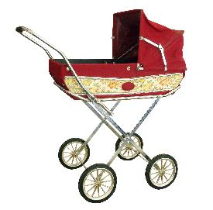
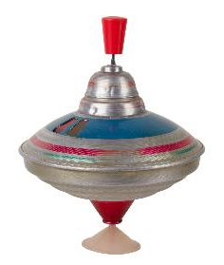
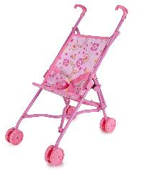
History detectives
Lesson 4:
Which toys are from the past and which toys are modern?
From the past
Modern
Notes:
Group task: Explain that today we are becoming history detectives. We will be deciding which toys are modern/new (from the present) and which ones are from the past. Ask pupils the questions: ‘What is the same about these toys?’, ‘What is different?’, ‘Which one do you think is old?’, ‘Which one do you think is new?’, ‘Why?’ for each pair of toys. Draw pupils’ attention to design, materials, and how the toys move, as well as to what the toys look like. You may wish to ask pupils to discuss the questions with their partners before taking feedback or doing a class vote. Extend the group task to support pupils further by printing the Additional resource: Old or new? flashcards. Pupils should sort the cards into groups of toys from the past and modern toys. Review as a class and address any misconceptions before moving on. For some pupils, you may wish to keep the completed groups in front of them, as a support for the Write task that comes next.

Slide 35
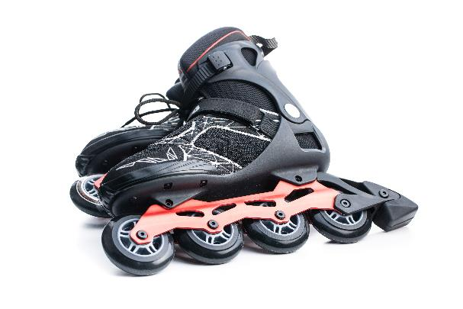
Which toys are from the past and which toys are modern? Tick one box for each toy.
Lesson 4:
From the past
From the past
Modern
Modern
Notes:
Write: Pupils should now complete the activity in their Workbooks. Can they tick the correct box to say if a toy is from the past or modern? Before pupils begin, you may wish to model how to complete the task using the first slide of the activity. Answers are on the following slides.

Slide 36
Which toys are from the past and which toys are modern? Tick one box for each toy.
Lesson 4:
From the past
From the past
Modern
Modern

Slide 37
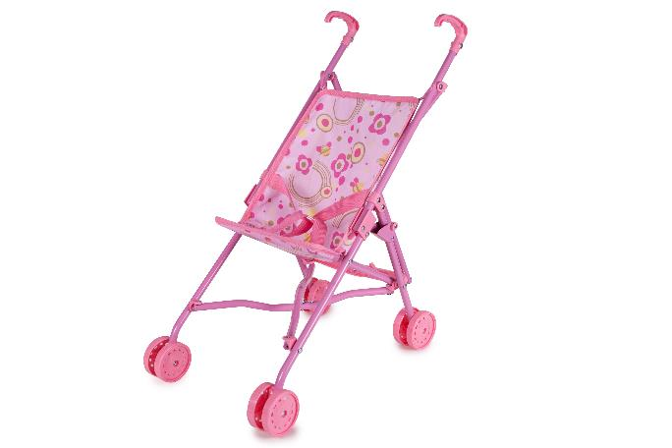
Which toys are from the past and which toys are modern? Tick one box for each toy.
Lesson 4:
From the past
From the past
Modern
Modern

Slide 38
Which toys are from the past and which toys are modern? Tick one box for each toy.
Lesson 4:
From the past
From the past
Modern
Modern

Slide 39
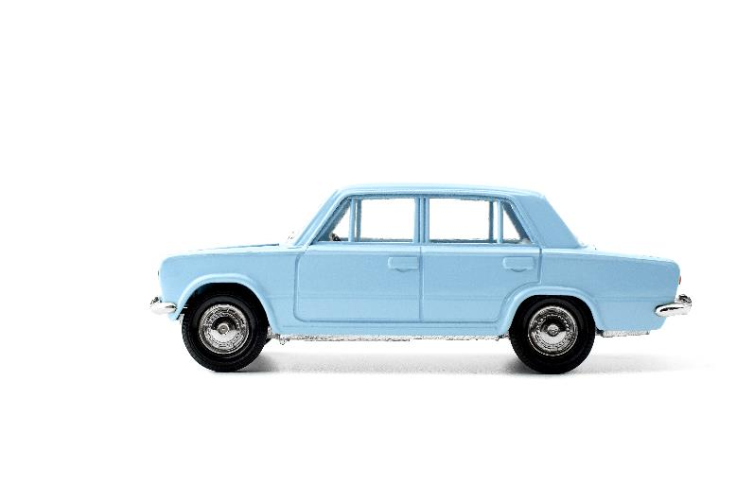
Draw a modern toy car here.
Lesson 4:
From the past
From the past
Modern
Modern
Notes:
Write: Pupils should look at the car from the past before drawing a picture of a modern toy car in the box provided in their Workbooks. To increase the challenge, they could label it.

Slide 40
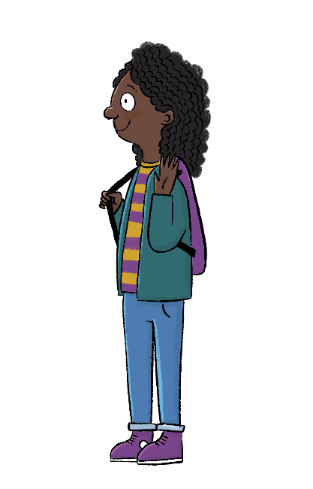
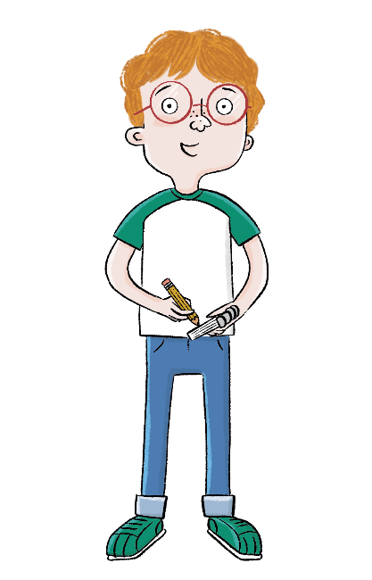
Lesson 4:
How are the toys similar?
How are the toys different?
Notes:
Talk task: To review the Write activity, ask pupils the questions, ‘How are the toys similar?’ and ‘How are the toys different?’. Draw pupils’ attention to design, materials, and how the toys move, as well as to what the toys look like.

Slide 41
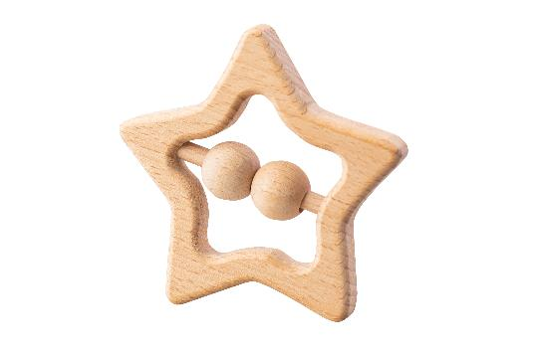
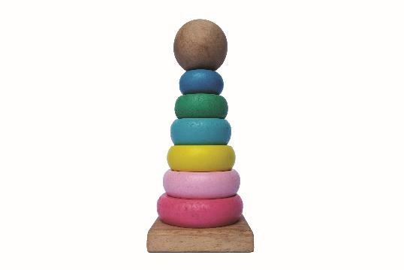
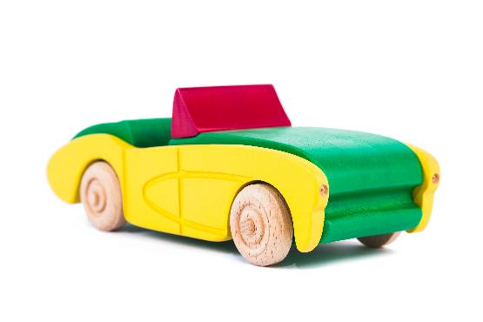
Are all wooden toys old?
Lesson 4:
These toys are made from wood, but they are modern!
Notes:
Read: ‘Are all wooden toys old?’ and ‘Are all broken or dirty toys old?’. Explain that not all wooden toys are old and not all broken/dirty toys are old either. This is another opportunity to address any misconceptions that may have arisen from the Write task. Ensure pupils understand that, on the whole, children in the past had fewer toys and needed to take care of them.

Slide 42
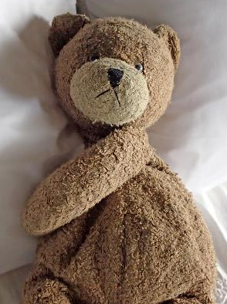
Are all broken or dirty toys old?
Lesson 4:
These toys are all broken or dirty, but they are modern!

Slide 43
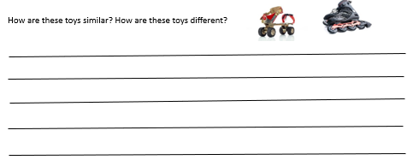
Independent
Challenge

Slide 44
How do we know that some toys are from the past?
Lesson 4:
Which toys have changed the least?
Which toys have changed the most?
Notes:
Learning review: Using the teaching slides, talk partners tell each other a response to the questions. Add further review questions if you wish to.

Slide 45
TBAT: add and delete a sprite.
Wednesday 10th May 2023

Slide 46
TBAT: add and delete a sprite.
Wednesday 10th May 2023
Blue/ Green
What is wrong with these pictures?
How could they be improved?

Slide 47
TBAT: add and delete a sprite.
Wednesday 10th May 2023

Slide 48
TBAT: add and delete a sprite.
Wednesday 10th May 2023

Slide 49
TBAT: add and delete a sprite.
Wednesday 10th May 2023

Slide 50
Match the program
Plenary
1.
2.
3.
Which program matches the starfish’s movement?
Notes:
Answer: Program 2
Screenshots from app

Slide 51
Match the program
Plenary
1.
2.
3.
Which program matches the butterfly’s movement?
Notes:
Answer: program 3

Slide 52
Match the program
Plenary
1.
2.
3.
Which program matches the crab’s movement?
Notes:
Answer: program 1

Slide 53
Home time
1.
2.
3.
4.
Wash hands
Collect bags , lunch boxes and water bottles.
Collect jumpers
Collect any letters/ reading books from the teachers.
Line up at the door.

