Slide 1
Tuesday 7th May 2024
7/5/24

Slide 2
Morning Challenges
Name writing practise.
Phase 5 phonics practise.
Read a book.

Slide 3
Revisit and review
Today's Grapheme
wh/ph

Slide 4
Revisit and review

Slide 5
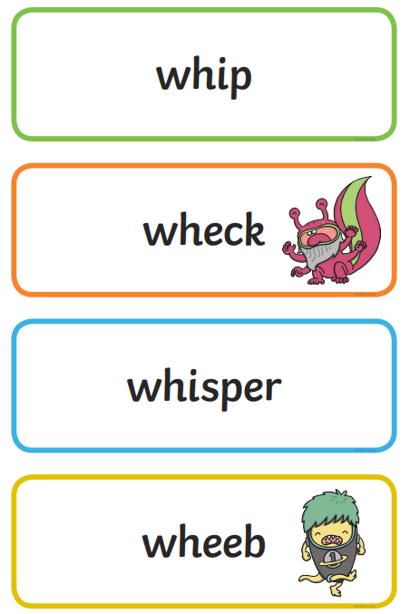
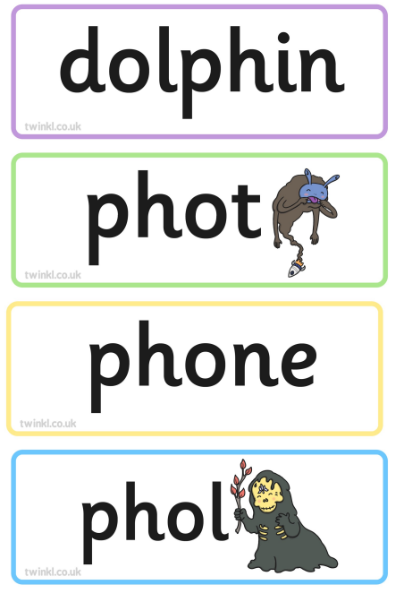
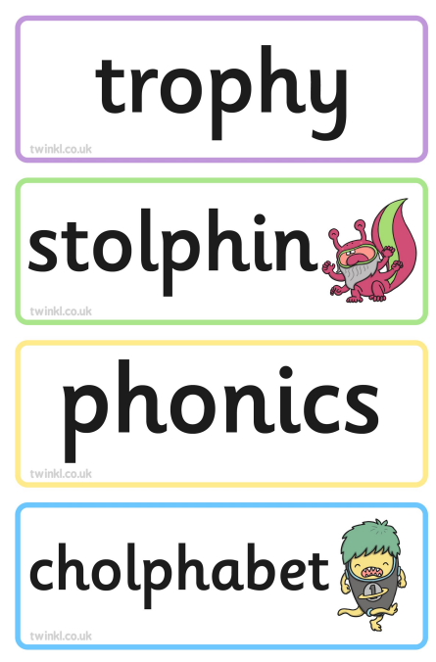
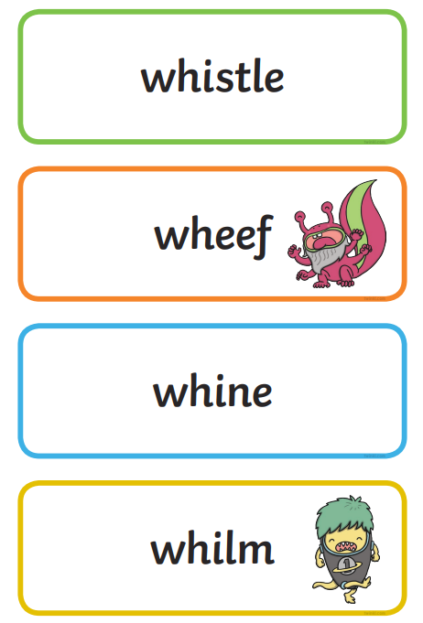
Real or Nonsense words? Read the words and underline the 'oa' phonemes
CHALLENGE
Write the real words in a sentence

Slide 6
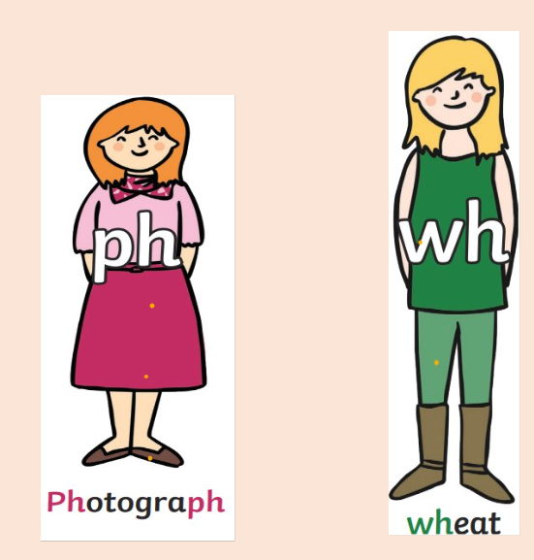
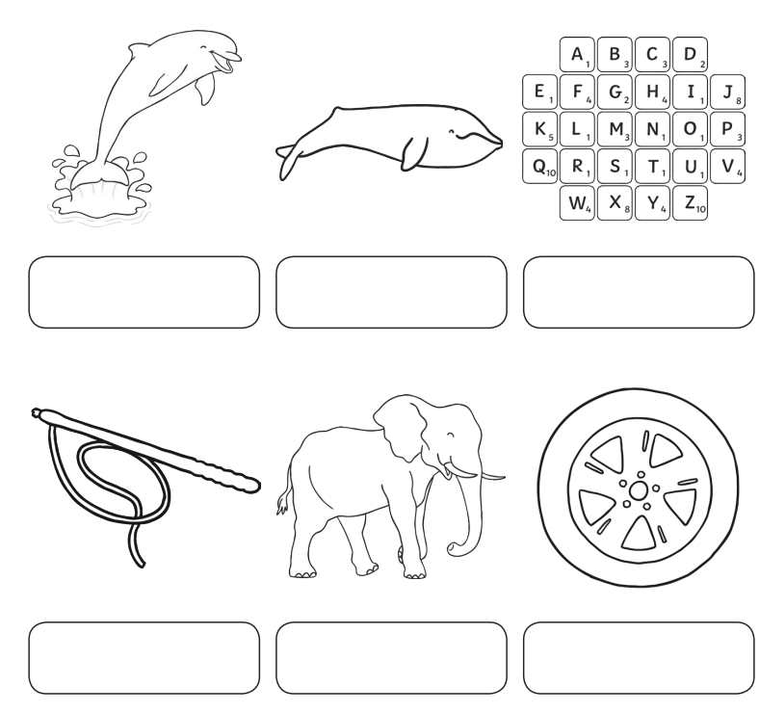
'wh' or 'ph' grapheme?
Something you move in your hand

Slide 7
'wh' and 'ph' graphemes
photograph phope where what whip phipe dolphin
finph white whige phint whint when elephant phantom
Challenge
Can you write these words in a sentence?

Slide 8
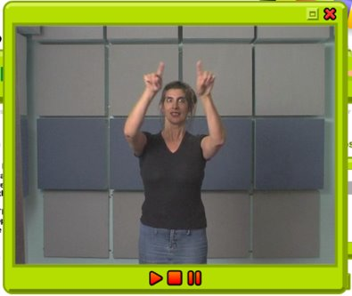
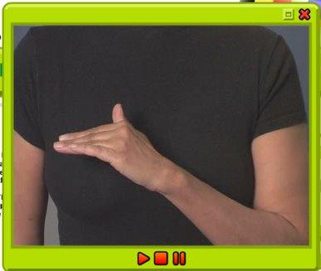
TBAT: practise a horizontal join to no ascender. /op/ /oy/
Tuesday 7th March 2024
7/04/24
Warm up
Gross- Spirals in the air
Fine- Hand bend

Slide 9
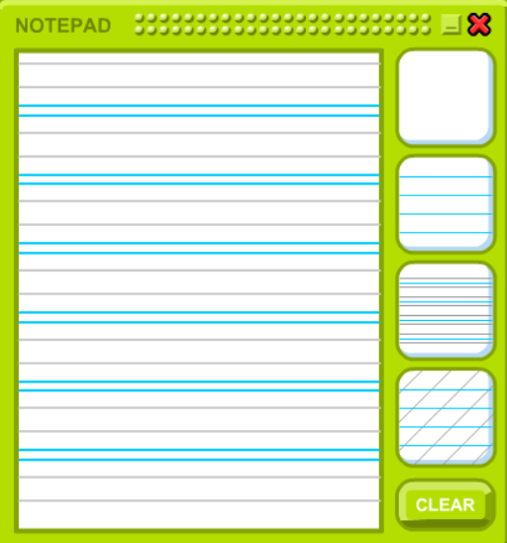
TBAT: practise a horizontal join to no ascender. /op/ /oy/
Tuesday 7th May 2024
7/05/24

Slide 10
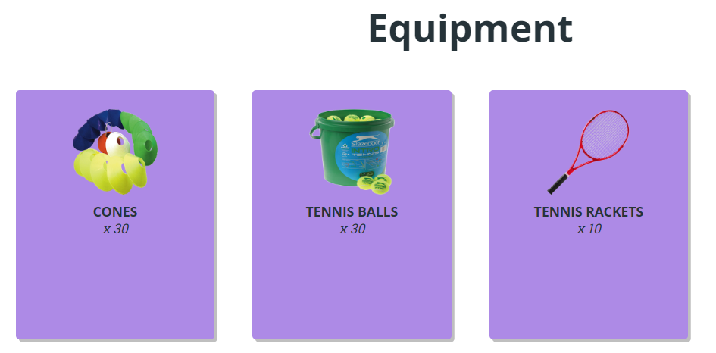
TBAT – develop collecting a ball
2 in 2
What is the job of the bowler?
How many bowlers can you have?

Slide 11
TBAT – develop collecting a ball
Warm-up
Change it
A You need a cone that they stand next to in a space.
B Jog around the area, touching the cones with your hands as you move.
C Then get a ball and carry it to a cone and place it on top then move to a new cone to collect a ball and repeat.
D Now complete three throws and catches on the spot before moving to a new cone.

Slide 12
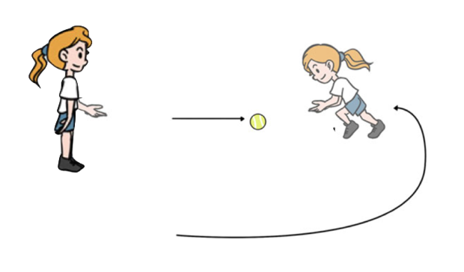
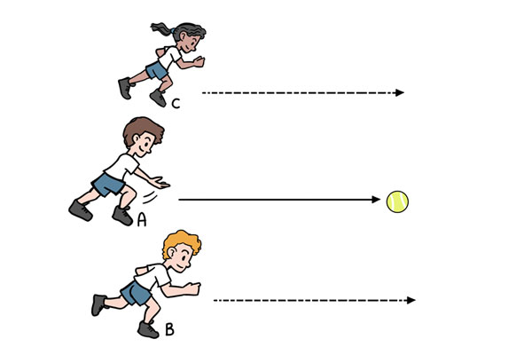
TBAT – develop collecting a ball
Skill development
Get around
Roll the ball in any direction. Then run to overtake the ball, get your feet behind it and collect it. .
Beat me!
Groups of three with one ball between you.
One pupil begins in the middle and rolls the ball forwards.
The other two pupils race to collect the ball and throw it back to the start pupil.
Three rolls then change roles.

Slide 13
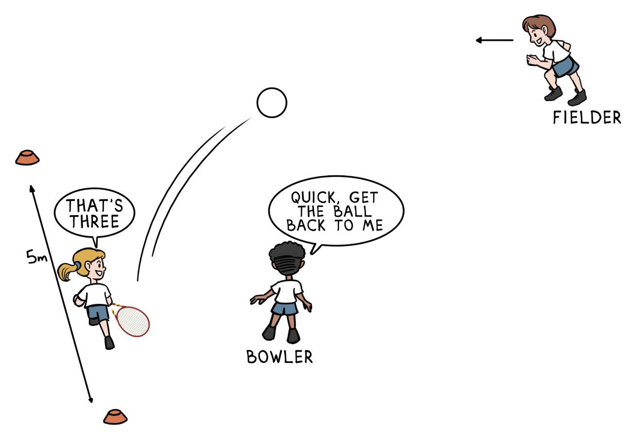
TBAT – develop collecting a ball
Skill development
Fielders
Groups of three, with two cones, one racket and one tennis ball.
One pupil is the bowler, one a fielder and one a batter who begins at the cone.
The bowler underarm throws the ball to the batter, who hits it out into the field using the racket after one bounce.
The fielder must collect the ball and get it back to the bowler as quickly as possible. At the same time, the batter runs between the cones, scoring one point for each run and stopping once the bowler has the ball.
Three turns then swap over.

Slide 14
TBAT – develop collecting a ball
Plenary
True or false?
When batting, I should hit towards the fielders.
The bowler is on the fielding team.
When fielding, I should return the ball quickly by throwing it back.
Watching the ball as it comes towards me will help me collect it.
My job as a fielder is to stop the batter scoring.

Slide 15
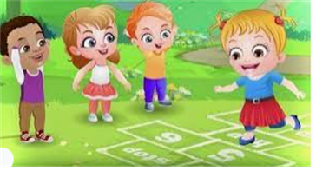
Break

Slide 16
Identify the missing numbers
3 in 3
2, 4, 6, ______, 10, 12, ______, 16, 18, ______
5, 10, 15, 20, ______, 30, 35, ______, 45, ______
10, 20, 30, ______, 50, 60, ______, 80, ______, 100
Notes:
Do Now: Missing number patterns
Pupils each have a bead string. Show pupils the number patterns on the slide. They use their bead string to make each number in the pattern and identify the missing numbers.

Slide 17
To solve word problems
part
whole
subtract
add

Slide 18
Representing word problems
Mr Geppetto has 49 paintbrushes in his workshop.
Eight of them are old so he throws them away.
How many does he have now?
Notes:
New Learning: Representing word problems
Note: this lesson provides pupils with the opportunity to apply their learning on the part-whole model, and the addition and subtraction strategies they have learnt this year, to solve problems. Make connections between different pupils’ representations and strategies.
Present the problem on the slide.
How could we represent this problem to help us to solve it?
Pupils could have different manipulatives to explore and share their ideas. Take feedback.
How could I represent this problem on a part-whole model?
Pupils may have different ideas; use this time to explore them (e.g. a discussion around whether 49 and eight are both ‘parts’ or whether one is the ‘whole’). Explain that the part-whole model can help us to work out the equation we need to solve the problem.
49 is the whole because that is the total number of paintbrushes. Mr Geppetto throws eight of them away; that is a part. We need to find the remaining part.
Record 49 and eight on the part-whole model.
What calculation will help us find the remaining part?
Record 49 – 8 = __
Note: this New Learning focuses on representing the problem and identifying the calculation. In the Develop Learning, pupils go on to solve the equations.
Repeat the process for the addition problem on the next slide.

Slide 19
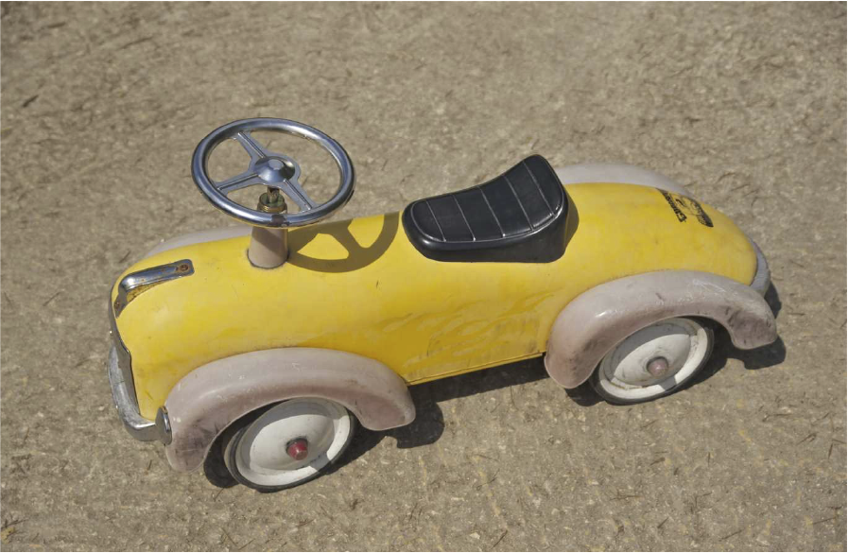
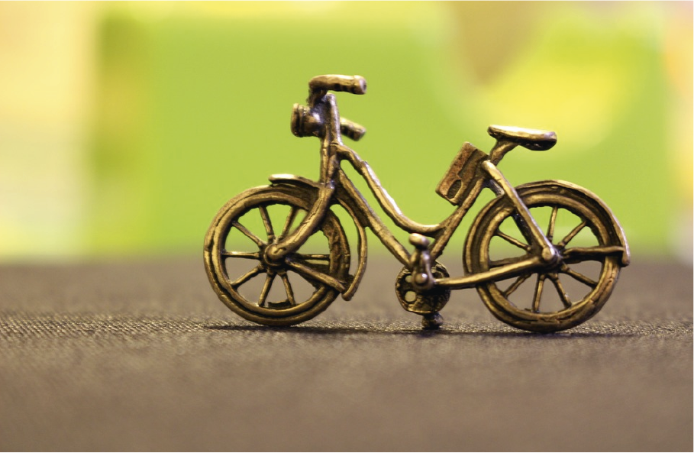
Representing word problems
Mr Geppetto is making new toys.
A toy car is 24 cubes long.
A toy bike is eight cubes long.
What is the total length of the two toys?
Notes:
New Learning: Representing word problems
Note: this lesson provides pupils with the opportunity to apply their learning on the part-whole model, and the addition and subtraction strategies they have learnt this year, to solve problems. Make connections between different pupils’ representations and strategies.
Present the problem on the slide.
How could we represent this problem to help us to solve it?
Pupils could have different manipulatives to explore and share their ideas. Take feedback.
How could I represent this problem on a part-whole model?
Pupils may have different ideas; use this time to explore them (e.g. a discussion around whether 49 and eight are both ‘parts’ or whether one is the ‘whole’). Explain that the part-whole model can help us to work out the equation we need to solve the problem.
49 is the whole because that is the total number of paintbrushes. Mr Geppetto throws eight of them away; that is a part. We need to find the remaining part.
Record 49 and eight on the part-whole model.
What calculation will help us find the remaining part?
Record 49 – 8 = __
Note: this New Learning focuses on representing the problem and identifying the calculation. In the Develop Learning, pupils go on to solve the equations.
Repeat the process for the addition problem on the next slide.

Slide 20
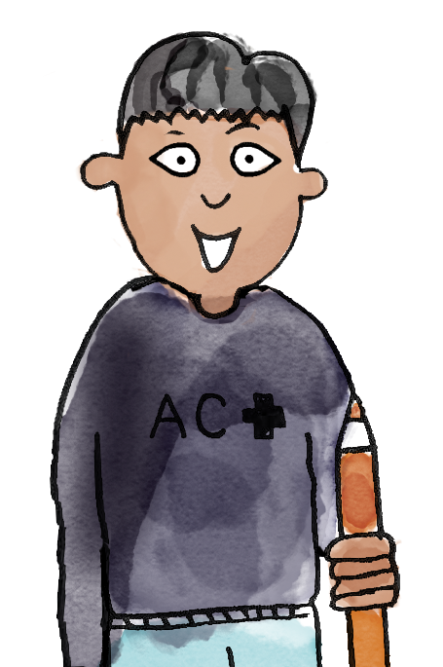
Hugo has 27 stickers.
Safiya has nine stickers.
How many stickers do they have in total?
I think this part-whole model matches the problem.
The two children represent two parts and we want to find the whole.
27
So the calculation will be 27 + 9.
9
part whole add subtract

Slide 21
Solving word problems
Mr Geppetto has 49 paintbrushes in his workshop.
Eight of them are old so he throws them away.
How many does he have now?
49 – 8 = ______
I can check my answer using the inverse.
Notes:
Develop Learning: Solving word problems
Now return to the problems from the New Learning in order to calculate the answers. Recap how you decided the correct calculation to solve the first problem, then ask:
What strategy could we use to calculate 49 subtract eight?
Give pupils an opportunity to discuss their strategies. An efficient strategy to draw attention to would be using number bonds (‘If I know that 9 – 8 = 1, then I know 49 – 8 = 41’).
How could we check our answer is correct?
Pupils may suggest doing the calculation again using a different strategy.
How can we use the inverse to check our answer?
Recap how to add our answer (one ‘part’) to the other ‘part’ to see if we find the same whole.
Repeat with the addition problem on the next slide.

Slide 22
Solving word problems
Mr Geppetto is making new toys.
A toy car is 24 cubes long.
A toy bike is eight cubes long.
What is the total length of the two toys?
24 + 8 = ______
I can check my answer using the inverse.
Notes:
Develop Learning: Solving word problems
Now return to the problems from the New Learning in order to calculate the answers. Recap how you decided the correct calculation to solve the first problem, then ask:
What strategy could we use to calculate 49 subtract eight?
Give pupils an opportunity to discuss their strategies. An efficient strategy to draw attention to would be using number bonds (‘If I know that 9 – 8 = 1, then I know 49 – 8 = 41’).
How could we check our answer is correct?
Pupils may suggest doing the calculation again using a different strategy.
How can we use the inverse to check our answer?
Recap how to add our answer (one ‘part’) to the other ‘part’ to see if we find the same whole.
Repeat with the addition problem on the next slide.

Slide 23
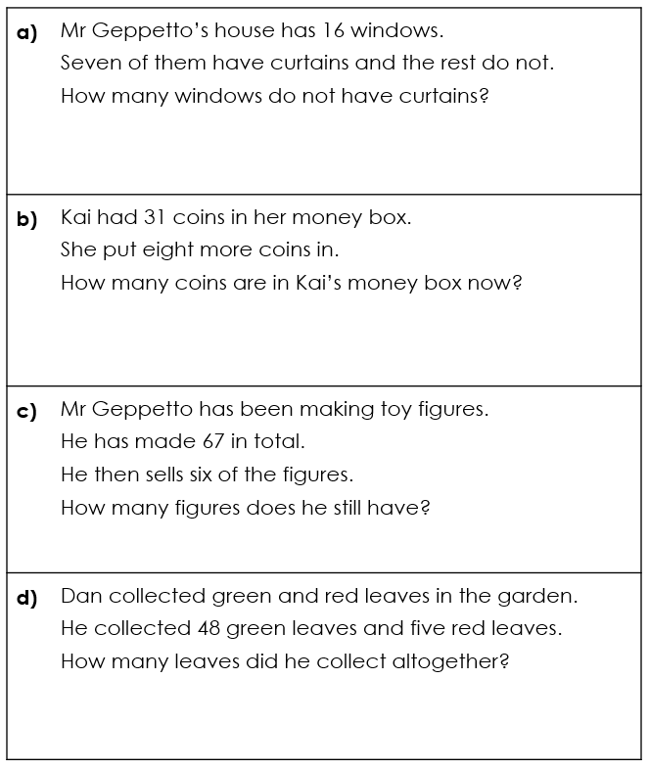
To solve word problems
For each problem:
represent it using manipulatives
write an equation
Notes:
Independent Task: Solving addition and subtraction word problems
Pupils have the Task Sheet, a part-whole model and a range of manipulatives, e.g. a bead string, Dienes, interlocking cubes. They represent each of the problems and write an equation to solve each one.
Possible adaptations:
Pupils could be given increased scaffolding, e.g. a partially completed part-whole model.
Pupils could write their own problems. You could challenge them to write a problem for a specific strategy, e.g. Can you write a problem I could use the ‘Make ten’ addition to solve?

Slide 24
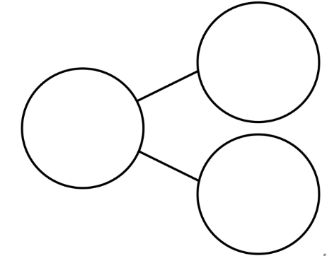
To solve word problems
Challenge : Which part whole model will help solve this calculation?
6
9
3
26
35
9
20
26
6
Notes:
Independent Task: Solving addition and subtraction word problems
Pupils have the Task Sheet, a part-whole model and a range of manipulatives, e.g. a bead string, Dienes, interlocking cubes. They represent each of the problems and write an equation to solve each one.
Possible adaptations:
Pupils could be given increased scaffolding, e.g. a partially completed part-whole model.
Pupils could write their own problems. You could challenge them to write a problem for a specific strategy, e.g. Can you write a problem I could use the ‘Make ten’ addition to solve?

Slide 25
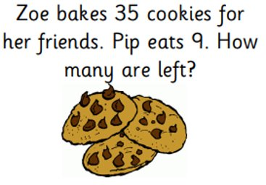
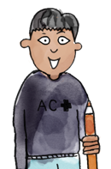
To solve word problems
Mastery : What mistake has Charlie made?
To solve this I will first take away the 5 ones to get back to 30. Then I need to take away 3 more.
Notes:
Independent Task: Solving addition and subtraction word problems
Pupils have the Task Sheet, a part-whole model and a range of manipulatives, e.g. a bead string, Dienes, interlocking cubes. They represent each of the problems and write an equation to solve each one.
Possible adaptations:
Pupils could be given increased scaffolding, e.g. a partially completed part-whole model.
Pupils could write their own problems. You could challenge them to write a problem for a specific strategy, e.g. Can you write a problem I could use the ‘Make ten’ addition to solve?

Slide 26
To solve word problems
Mastery with greater depth :
Notes:
Independent Task: Solving addition and subtraction word problems
Pupils have the Task Sheet, a part-whole model and a range of manipulatives, e.g. a bead string, Dienes, interlocking cubes. They represent each of the problems and write an equation to solve each one.
Possible adaptations:
Pupils could be given increased scaffolding, e.g. a partially completed part-whole model.
Pupils could write their own problems. You could challenge them to write a problem for a specific strategy, e.g. Can you write a problem I could use the ‘Make ten’ addition to solve?

Slide 27
Lunch

Slide 28
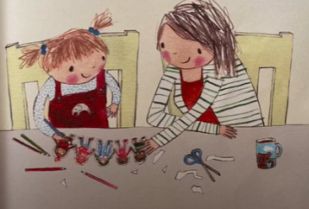
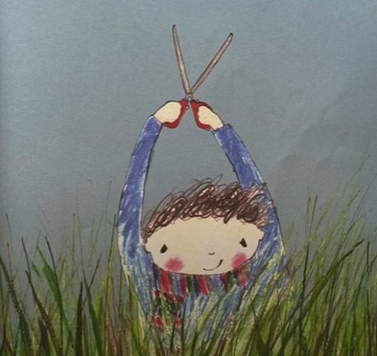
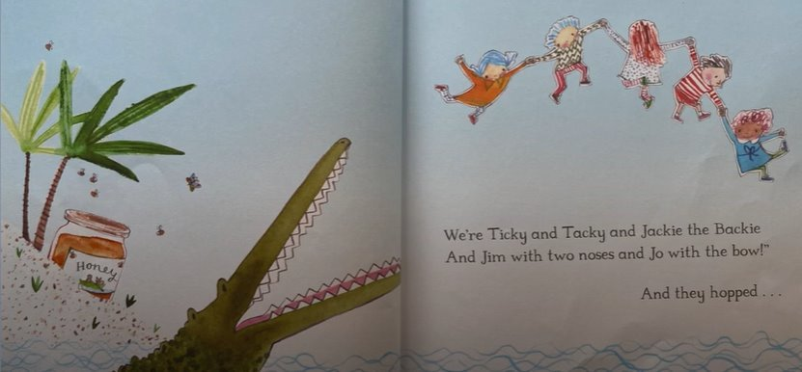
Tuesday 7th May 2024
7/5/24
TBAT: improve a sentence using interesting vocabulary.
3 in 3- Put these events from the story in order.
Challenge: Summarise what happens in the beginning, in the middle and at the end of the story.

Slide 29
TBAT: improve a sentence using interesting vocabulary.
Tuesday 7th May 2024
7/5/24
Blue/ Green
What were the names of the paper dolls?
What creatures did the animals meet on their adventures?

Slide 30
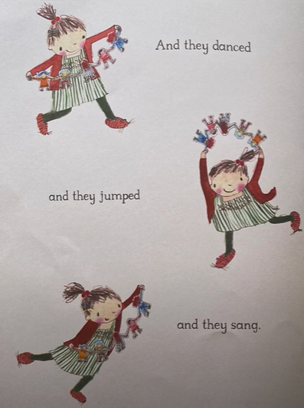
TBAT: improve a sentence using interesting vocabulary.
Tuesday 7th May 2024
7/5/24
And they danced and they jumped, and they sang.
How could we make this more interesting?
Can you think of other words for
danced,
jumped,
sang

Slide 31
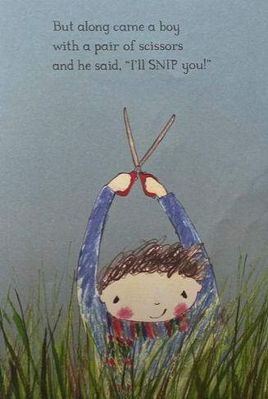
TBAT: improve a sentence using interesting vocabulary.
Tuesday 7th May 2024
7/5/24
But the boy came along with a pair of scissors and he said , "I'll snip you!"
Are there any words we could include in this sentence to make it more interesting?
How could we describe the boy or the scissors?

Slide 32
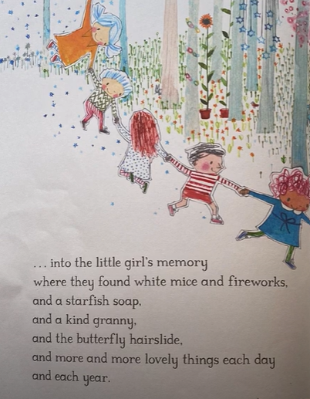
TBAT: improve a sentence using interesting vocabulary.
Tuesday 7th May 2024
7/5/24
…..and more and more lovely things each day and each year.
Are there any other words we could use instead of lovely?

Slide 33
TBAT: improve a sentence using interesting vocabulary.
Tuesday 7th May 2024
7/5/24
Independent:
Challenge:

Slide 34
Lesson 4 What do Muslims do on Hajj?

Slide 35
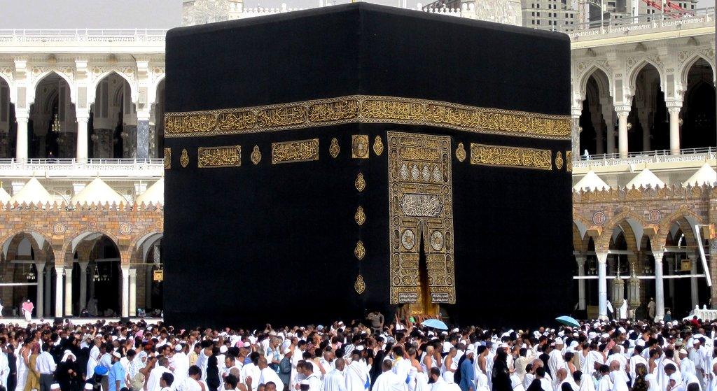
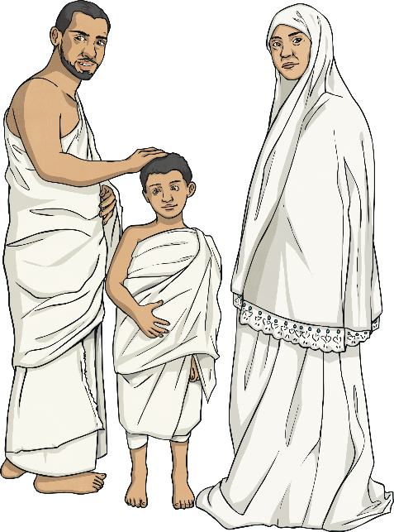
Last lesson we saw the Ka’bah they walk around seven times.

Slide 36
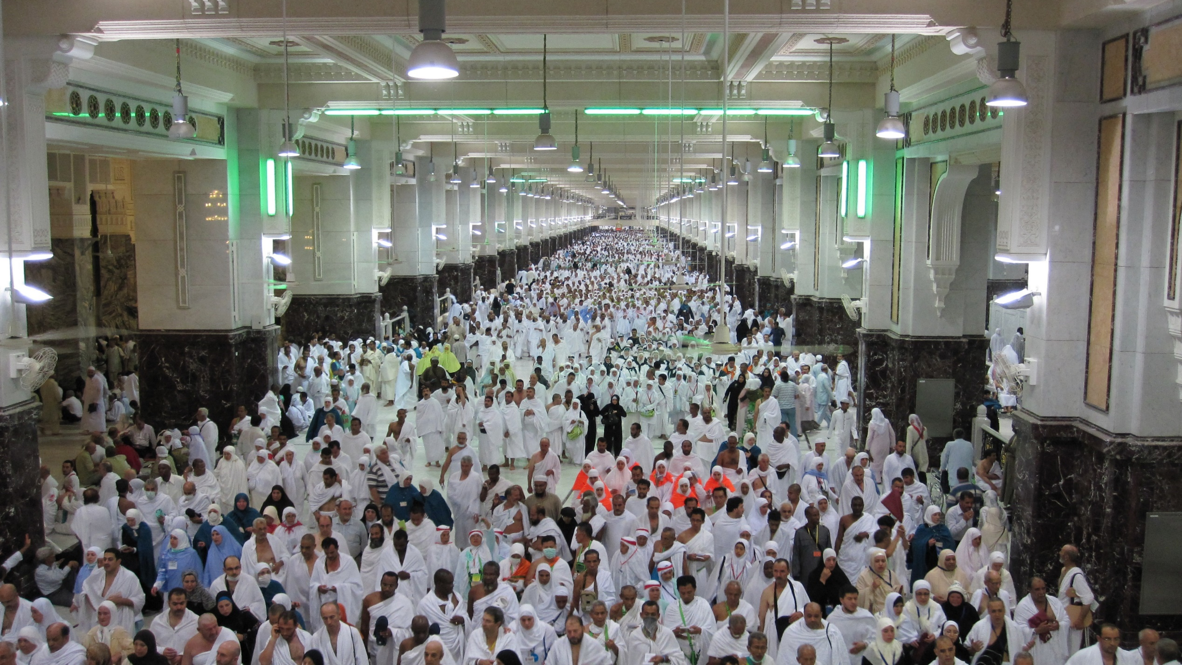
And we looked at the two special hills they have to walk between seven times.

Slide 37
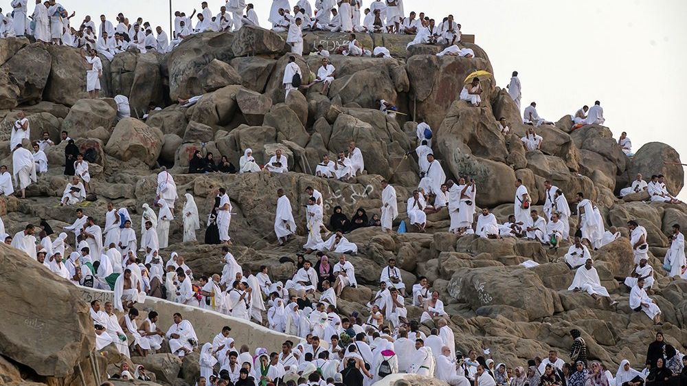
Next pilgrims at Hajj go to Mount Arafat. When they get here they pray and spend the night at this holy place.

Slide 38
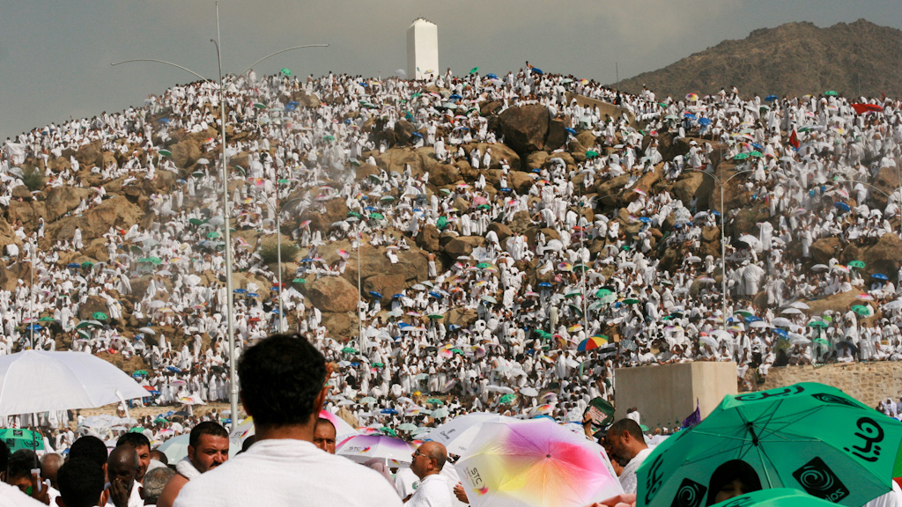
Many Muslims believe this is where the Prophet Muhammed gave his last speech

Slide 39
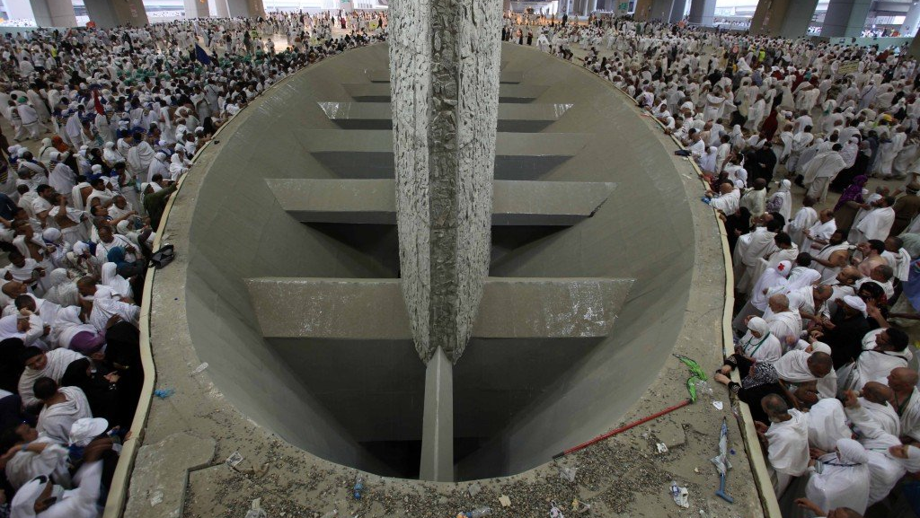
Next the pilgrims go to Mina to perform jamarat.
They throw pebbles at these huge stone pillars which represent the Devil.

Slide 40
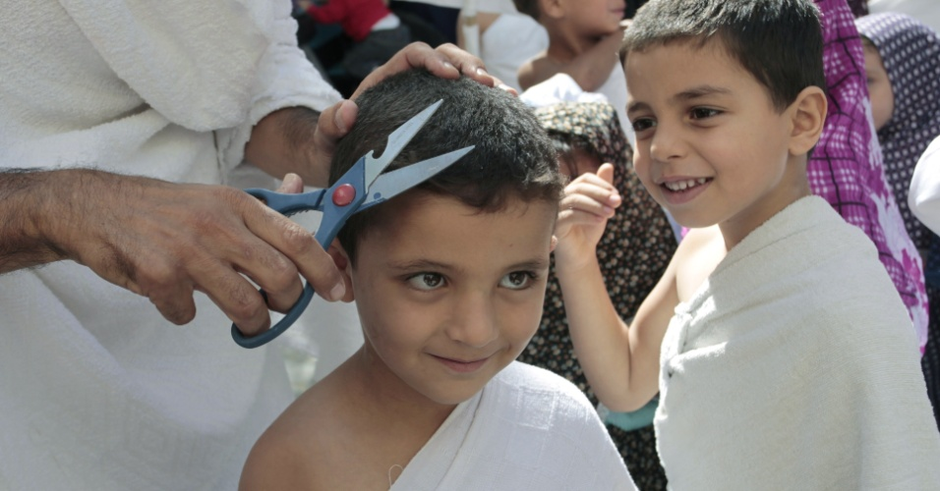
Once they have done this pilgrims have their hair cut to show they have completed the Hajj

Slide 41
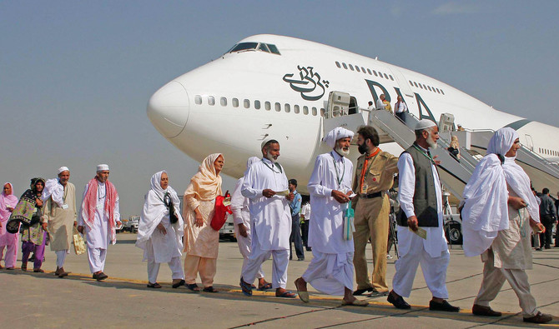
Finally pilgrims go back to the airport to head home on the special Hajj flights that are arranged.

Slide 42
TBAT –
TBAT – Relate pitch changes to graphic symbols and perform pitch changes vocally
Key vocabulary
Pitch – high/low higher/lower step/leap/slide
2 in 2
Name 2 levels of pitch
What does beat mean?

Slide 43
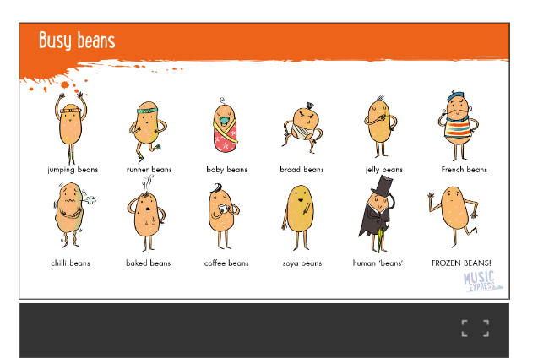
Warm up!
TBAT –
TBAT – Relate pitch changes to graphic symbols and perform pitch changes vocally
Collins Connect

Slide 44
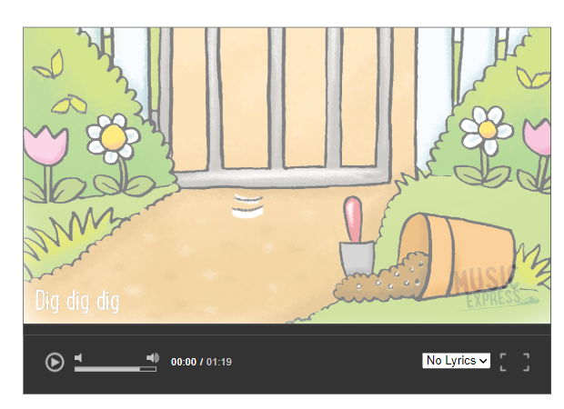
DIG DIG DIG!
TBAT –
TBAT – Relate pitch changes to graphic symbols and perform pitch changes vocally

Slide 45
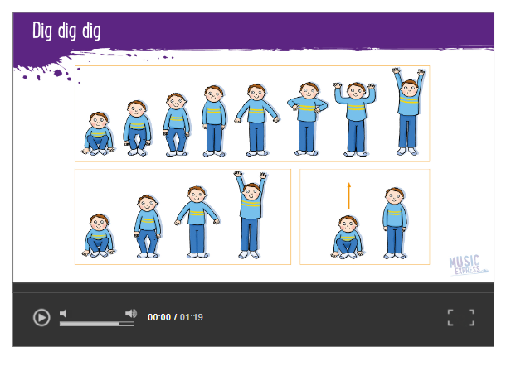
DIG DIG DIG!
TBAT – Relate pitch changes to graphic symbols and perform pitch changes vocally
PARTNER WORK
What movements do you think these pictures are showing you?

Slide 46
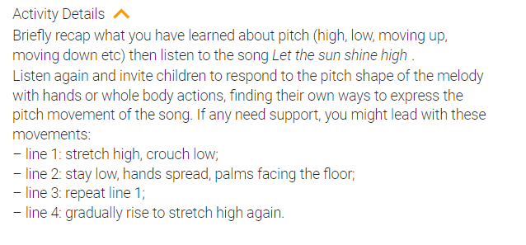
LET THE SUN SHINE HIGH!
TBAT – Relate pitch changes to graphic symbols and perform pitch changes vocally

Slide 47
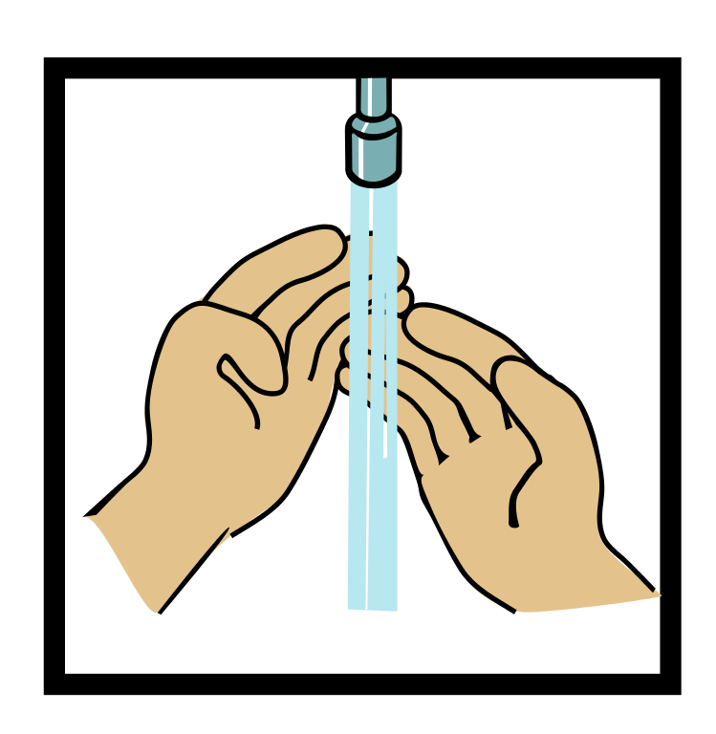
Home time
1.
2.
3.
4.
Wash hands
Collect bags , lunch boxes and water bottles.
Collect jumpers
Collect any letters/ reading books from the teachers.
Line up at the door.

