Slide 1
Wednesday 9th May 2024
9/5/24

Slide 2
Morning Challenges
Name writing practise.
Reading comprehension.
Read a book

Slide 3
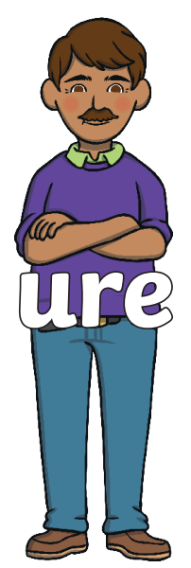
Revisit and review

Slide 4
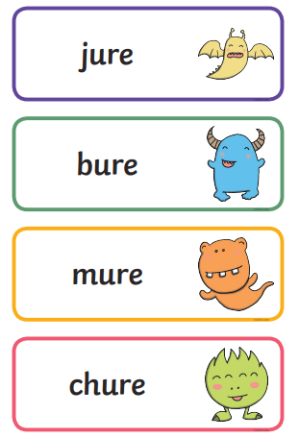
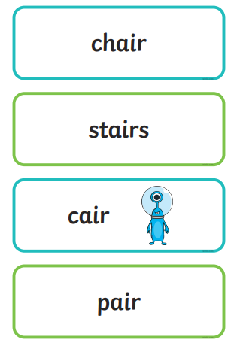
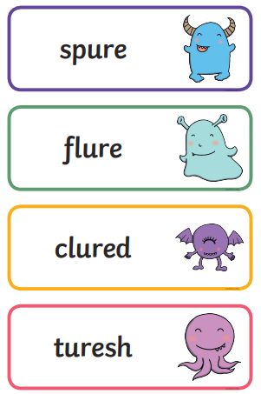
Real or Nonsense words? Read the words and underline the 'ure and air' phonemes
CHALLENGE
Write the real words in a sentence

Slide 5
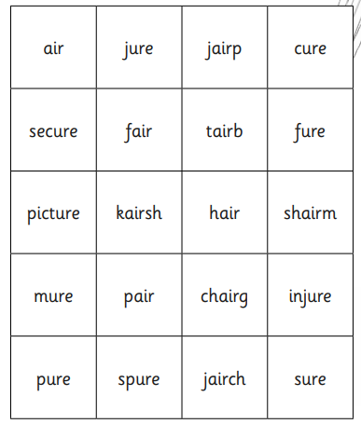
Where are the 'real' words?
CHALLENGE
Can you write the real words in
a sentence

Slide 6
Buried Treasure (phonicsplay.co.uk)

Slide 7
TBAT: write a story based on The Paper Dolls.
Thursday 9th May 2024
9/5/24
3 in 3- Sort the words into the table.
-s | -es
table
church
jar
fish
box
fork

Slide 8
TBAT: write a story based on The Paper Dolls.
Thursday 9th May 2024
9/5/24
Blue/ Green- How can the sentence be improved by changing the underlined word?
The squirrel ran across the road.
The children laughed as they played on the park.

Slide 9
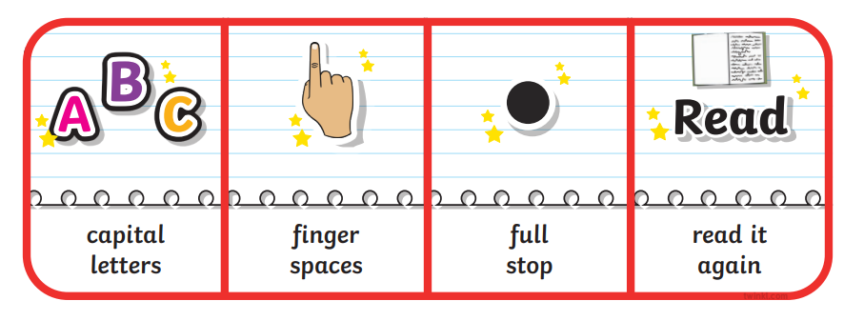
TBAT: write a story based on The Paper Dolls.
Thursday 9th May 2024
9/5/24
Today we are going to write the middle of our story.
Use your plan to write in full sentences of what will happen.

Slide 10
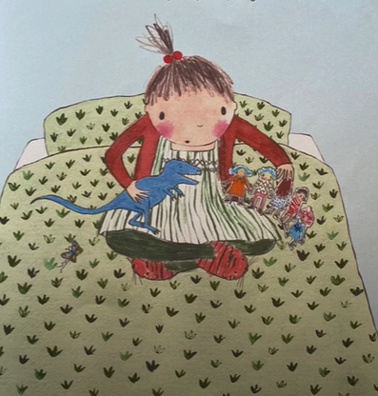
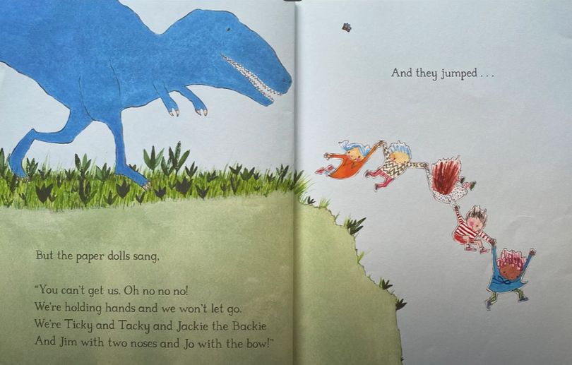
TBAT: write a story based on The Paper Dolls.
Thursday 9th May 2024
9/5/24
What is the first adventure the paper dolls go on?
How can you make it sound exciting?

Slide 11
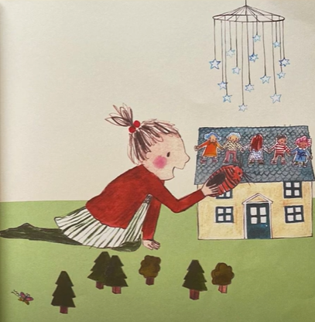
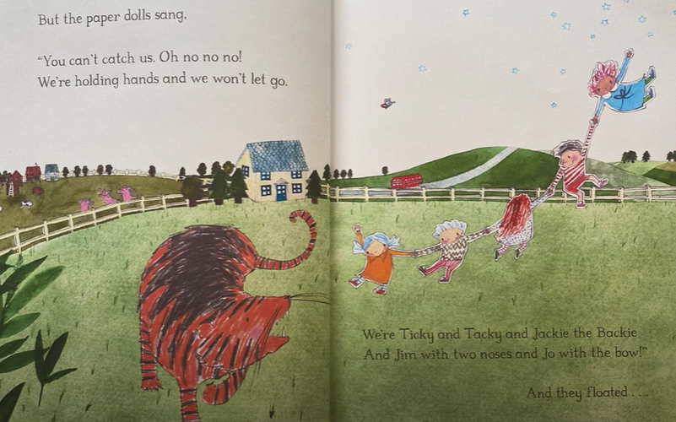
TBAT: write a story based on The Paper Dolls.
Thursday 9th May 2024
9/5/24
What is the second adventure the paper dolls go on?
How can you describe the creature they meet?

Slide 12
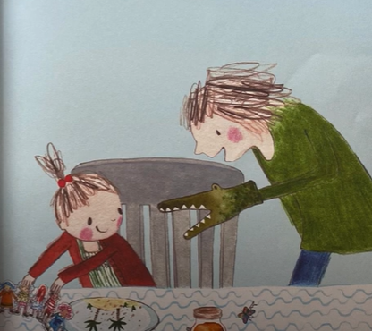
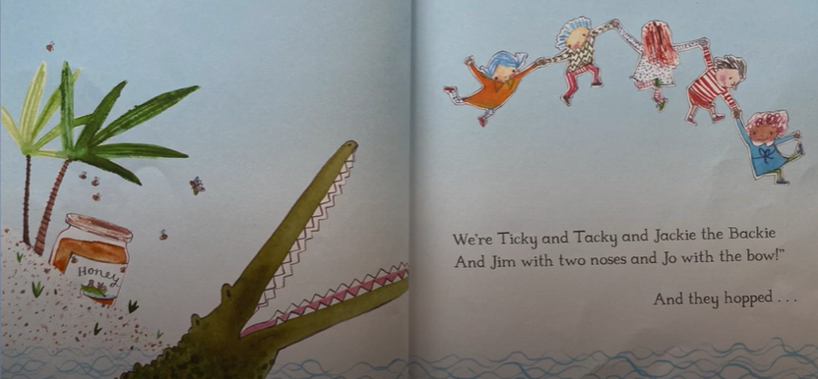
TBAT: write a story based on The Paper Dolls.
Thursday 9th May 2024
9/5/24
What is the third adventure the paper dolls go on?

Slide 13
TBAT: write a story based on The Paper Dolls.
Thursday 9th May 2024
9/5/24
Re-read your work, have you remembered;
Capital letters,
Finger spaces,
End punctuation, (. ? !)
Challenge: Can you change any of the vocabulary to make your story more interesting?

Slide 14
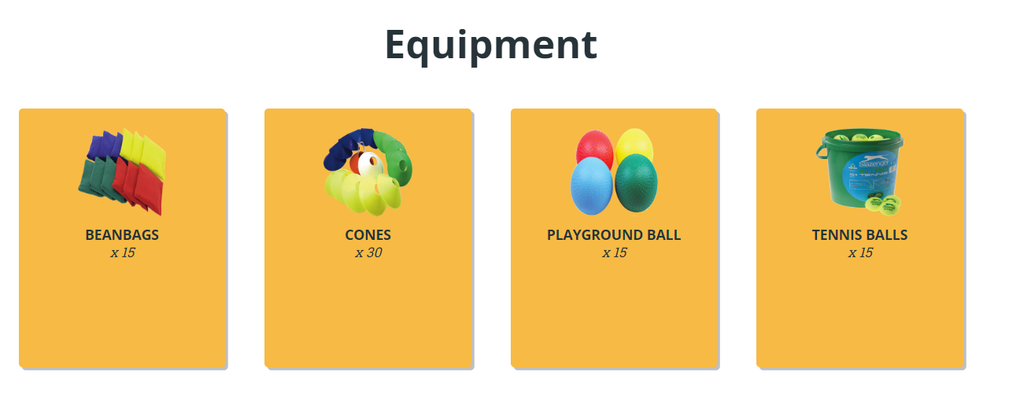
TBAT – explore catching with two hands
2 in 2
Name 2 warm-ups
What must we do with our arm when throwing a ball?

Slide 15
TBAT – explore catching with two hands
Warm-up
The tortoise and the hare
Take a cone and stand in space.
You are a tortoise with a cone, resting the cone on your back as a shell.
You are a hare with a band, tucking the band in your shorts as a tail.
A On signal, tortoises move around slowly with your balanced cone on their back for 1 minute. Hares move around quickly.
.
B Swap roles
C. If you are holding a cone jump side to side over it whilst the others practice throwing and catching a band on the spot.
When you hear 'change' place your equipment on the floor and quickly change roles.

Slide 16
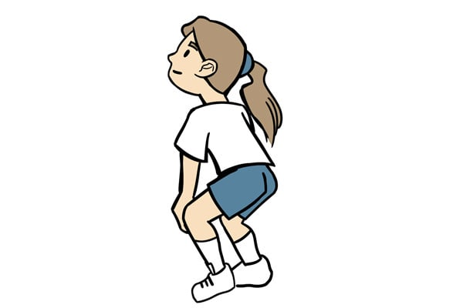
TBAT – explore catching with two hands
Skill development
Exploring catching
A Select a piece of equipment and throw and catch to yourselves in a space, exploring different catches from different heights.
B Swap your equipment and explore catching with a new item.
C Show the 'ready position' and highlight that being in this position helps to prepare to catch.

Slide 17
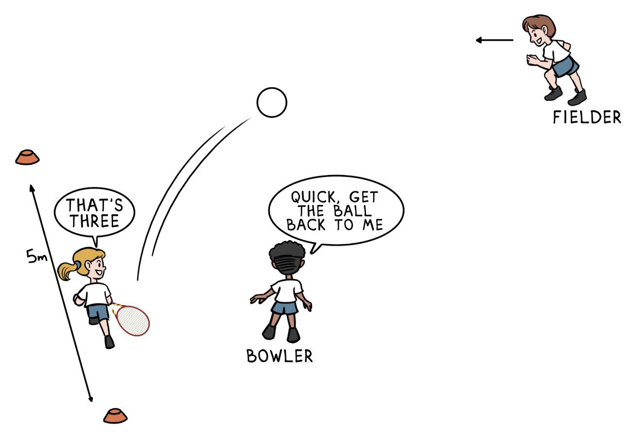
TBAT – explore catching with two hands
Skill development
Alphabet catch
In pairs with one playground ball, take turns at dropping the ball and catching it after one bounce.
If you catch the ball, you continue. After each catch your partner must say each letter from the alphabet in the correct order.
What letter can you reach?

Slide 18
TBAT – explore catching with two hands
Plenary
How can I catch safely?

Slide 19
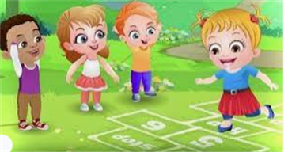
Break

Slide 20
Lunch

Slide 21
Exploring related subtraction equations
6
13
7
Notes:
Develop Learning: Exploring related subtraction equations
Return to the part-whole model from the New Learning (13, six, seven).
Can you write a subtraction equation with these same numbers?
Using concrete manipulatives and a part-whole model, model subtracting one part from the whole to leave the other part and writing this in the abstract (13 – 6 = 7). This is a good opportunity to reinforce and apply the pupils’ prior learning about regrouping.
Can you write another subtraction equation using the same numbers?
Establish that we can subtract the other part (seven) from the whole: 13 – 7 = 6.
Explore the misconception addressed on the next slide, that we can put the same three numbers anywhere in a subtraction equation and it will be correct. Use a concrete representation to show this to be incorrect.
Together, identify all four possible subtraction equations using six, seven and 13.

Slide 22
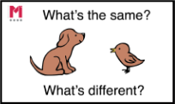
Use ‘Make ten’ to solve these calculations
3 in 3
28 + 7
25 – 7
45 – 7
Notes:
Do Now: Addition and subtraction using ‘Make ten’
Show pupils the calculations on the slide. They solve them using the ‘Make ten’ strategy on a bead string.
What will you partition seven into when you’re adding it to 18 to ‘Make ten’?
Ask pupils what similarities and differences they notice about the numbers.

Slide 23
To solve problems in context using addition and subtraction
add
‘Make ten’
subtract
cost
more
Dienes
less

Slide 24
Making bracelets for the school fair
 | red bead | 7 p
 | blue bead | 4 p
 | green bead | 8 p
 | yellow bead | 5 p
 | black bead | 2 p
r
b
g
r
g
r
b
g
y
b
0
10
20
30
40
50
60
70
80
90
100
Notes:
New Learning: Making bracelets at the school fair
Note: it is important that pupils are comfortable with a range of strategies, so you should consider a range of approaches with differing representations, such as number lines, part-whole models and Dienes.
Introduce the context: pupils will be making bracelets to sell at the school fair. There are different types of beads; each one has a different price. Show pupils the price list on the slide and check understanding of the context:
How much does a __ bead cost? Which is the most expensive bead? The cheapest?
Then move on to designing a bracelet and finding the cost, first with two beads. Use real beads on a string, or coloured cubes to represent the beads.
I want to make a bracelet using a red bead and a green bead. How much would it cost?
Give pupils a chance to discuss and calculate.
How did you calculate the cost of my bracelet? Did you use addition or subtraction?
Which strategy did you use?
Model using ‘Make ten’ to find the total of 7 p and 8 p.
Then add a blue bead on to the bracelet (4 p).
Do we need to add all the costs again? Why/why not?
Repeat with further examples and challenge pupils to calculate the cost.

Slide 25
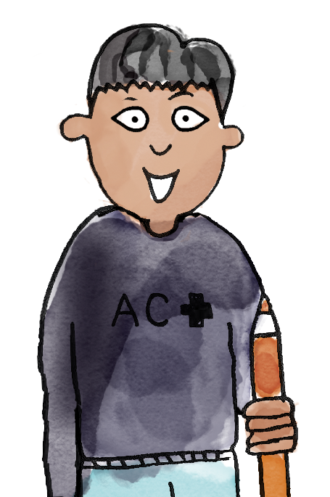
 | red bead | 7 p
 | blue bead | 4 p
 | green bead | 8 p
 | yellow bead | 5 p
 | black bead | 2 p
r
b
I choose this bracelet.
A blue bead costs 4 p and a red bead costs 7 p.
You need to calculate four plus seven.
g
B/G
y
b
b
r
I know that four plus six is ten, and seven is one more than six, so the answer is 11 p.
I used the 'Make ten' strategy.
add subtract ‘Make ten’ more less cost Dienes
Notes:
Talk Task: Finding the cost of a bracelet
Pupils have the Task Sheet (provided in colour and B&W).
Pupil A chooses a bracelet, finds the cost of each bead and tells Pupil B the calculation required. Pupil B calculates the addition and explains the calculation strategies they are using (e.g. known facts, ‘Make ten’). Pupils swap roles and repeat.
Consider whether you want pupils to calculate mentally or whether you will provide manipulatives or other representations, such as a number line.

Slide 26
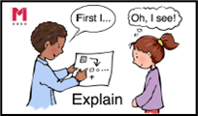
This bracelet costs 24 p
 | red bead | 7 p
 | blue bead | 4 p
 | green bead | 8 p
 | yellow bead | 5 p
 | black bead | 2 p
r
g
r
b
y
b
g
y
I no longer want the yellow bead.
How can we work out the new cost?
b
0
10
20
30
40
50
60
70
80
90
100
Notes:
Develop Learning: Removing beads and adding constraints
Use the Develop Learning to explore contexts which require subtraction, such as a bracelet from which you want to remove a bead (see the slide).
Can you think of two different ways to find the new cost of the bracelet?
Allow pupils time to discuss and take feedback. Suggestions might include adding the blue, green and red beads again or subtracting the cost of a yellow bead from 24 p.
Use the next slide to introduce the context for the Independent Task, where pupils have 20 p to design their own bracelet.
You have 20 p to spend on beads and your task is to spend all of your money. Which beads could you buy? How many different options can you find?
Give pupils an opportunity to consider the problem and then take some feedback on strategies and ideas before pupils work on the problem in the Independent Task.

Slide 27
You have 20 p to spend
 | red bead | 7 p
 | blue bead | 4 p
 | green bead | 8 p
 | yellow bead | 5 p
 | black bead | 2 p
r
b
Your task is to spend all your money!
What beads could you buy for 20 p?
g
y
b
0
10
20
30
40
50
60
70
80
90
100
Notes:
Develop Learning: Removing beads and adding constraints
Use the Develop Learning to explore contexts which require subtraction, such as a bracelet from which you want to remove a bead (see the slide).
Can you think of two different ways to find the new cost of the bracelet?
Allow pupils time to discuss and take feedback. Suggestions might include adding the blue, green and red beads again or subtracting the cost of a yellow bead from 24 p.
Use the next slide to introduce the context for the Independent Task, where pupils have 20 p to design their own bracelet.
You have 20 p to spend on beads and your task is to spend all of your money. Which beads could you buy? How many different options can you find?
Give pupils an opportunity to consider the problem and then take some feedback on strategies and ideas before pupils work on the problem in the Independent Task.

Slide 28
To solve problems in context using addition and subtraction
 | red bead | 7 p
 | blue bead | 4 p
 | green bead | 8 p
 | yellow bead | 5 p
 | black bead | 2 p
r
How many different sets of beads can you find that cost 20 p?
b
g
y
b
Notes:
Independent Task: Exploring addition and subtraction within a context
Pupils have the Task Sheet (provided in colour and B&W) and manipulatives such as a bead string and cubes. A pair of ten-frames may support pupils in finding beads that sum to 20 (see resource bank). This task lends itself well to having constraints added, e.g. Can you use just two different types of bead? Can you use just one type of bead? These can either simplify the task or add a challenge!
Possible adaptations:
Add constraints to provide increased or decreased challenge.
Some pupils might need a ‘way in’, e.g. a suggestion for the start of a bracelet.

Slide 29
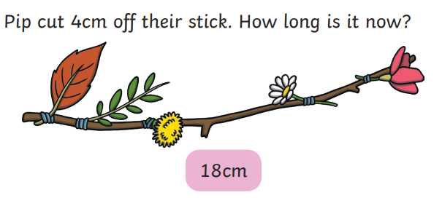
To solve problems in context using addition and subtraction
Challenge:
Notes:
Independent Task: Exploring addition and subtraction within a context
Pupils have the Task Sheet (provided in colour and B&W) and manipulatives such as a bead string and cubes. A pair of ten-frames may support pupils in finding beads that sum to 20 (see resource bank). This task lends itself well to having constraints added, e.g. Can you use just two different types of bead? Can you use just one type of bead? These can either simplify the task or add a challenge!
Possible adaptations:
Add constraints to provide increased or decreased challenge.
Some pupils might need a ‘way in’, e.g. a suggestion for the start of a bracelet.

Slide 30
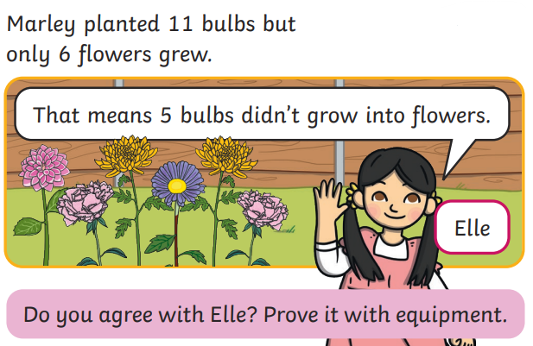
To solve problems in context using addition and subtraction
Mastery:
Notes:
Independent Task: Exploring addition and subtraction within a context
Pupils have the Task Sheet (provided in colour and B&W) and manipulatives such as a bead string and cubes. A pair of ten-frames may support pupils in finding beads that sum to 20 (see resource bank). This task lends itself well to having constraints added, e.g. Can you use just two different types of bead? Can you use just one type of bead? These can either simplify the task or add a challenge!
Possible adaptations:
Add constraints to provide increased or decreased challenge.
Some pupils might need a ‘way in’, e.g. a suggestion for the start of a bracelet.

Slide 31
To solve problems in context using addition and subtraction
Mastery with greater depth:
Notes:
Independent Task: Exploring addition and subtraction within a context
Pupils have the Task Sheet (provided in colour and B&W) and manipulatives such as a bead string and cubes. A pair of ten-frames may support pupils in finding beads that sum to 20 (see resource bank). This task lends itself well to having constraints added, e.g. Can you use just two different types of bead? Can you use just one type of bead? These can either simplify the task or add a challenge!
Possible adaptations:
Add constraints to provide increased or decreased challenge.
Some pupils might need a ‘way in’, e.g. a suggestion for the start of a bracelet.

Slide 32
Break

Slide 33
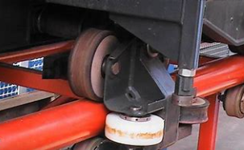
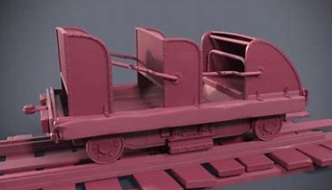
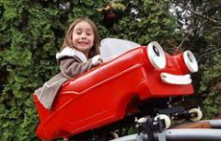
Art - 3 in 3
TBAT: use junk modelling techniques to make a rollercoaster carriage.
Today we are going to build the carriages for our roller coaster, think about the resources you use for the …......
wheels
cart
passenger

Slide 34
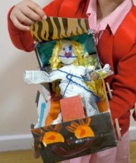
Art
TBAT: use junk modelling techniques to make a rollercoaster carriage.
You will need to use a range of resources to create your roller coaster carriage.
Think about the shape you are trying to create and how you are going to join your pieces together.

Slide 35
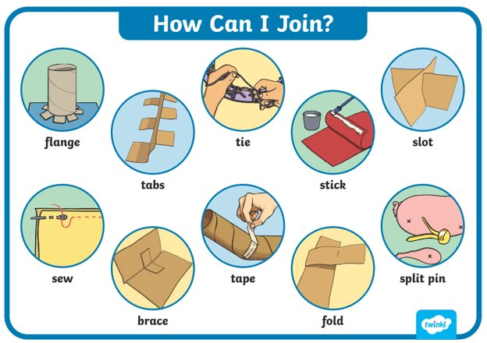
TBAT: use junk modelling techniques to make a rollercoaster carriage.
Let's look at some of these joining techniques more closely.

Slide 36
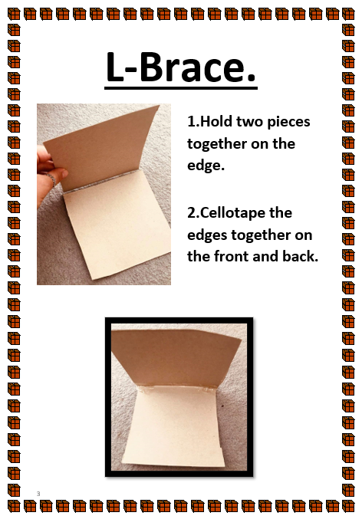
TBAT: use junk modelling techniques to make a rollercoaster carriage.

Slide 37
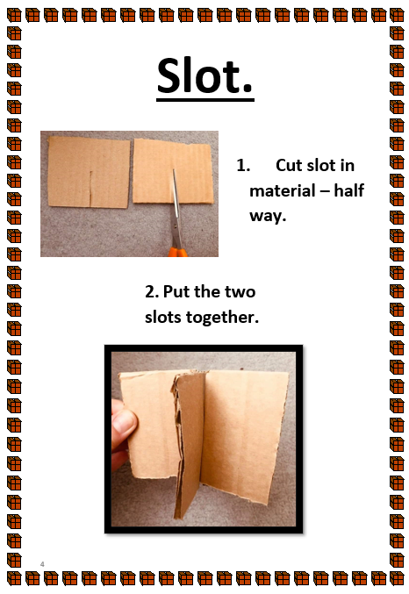
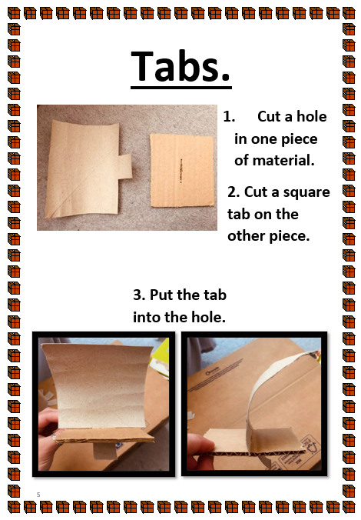
TBAT: use junk modelling techniques to make a rollercoaster carriage.

Slide 38
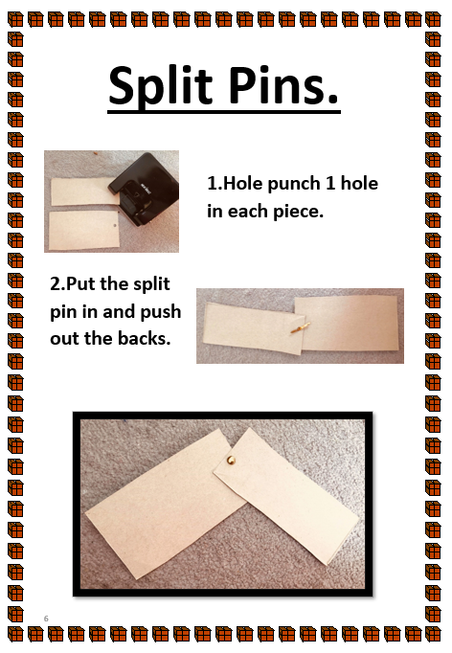
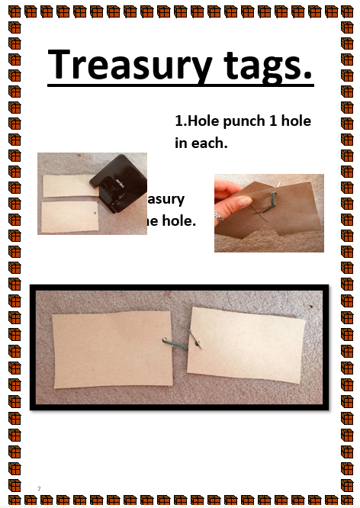
TBAT: use junk modelling techniques to make a rollercoaster carriage.

Slide 39
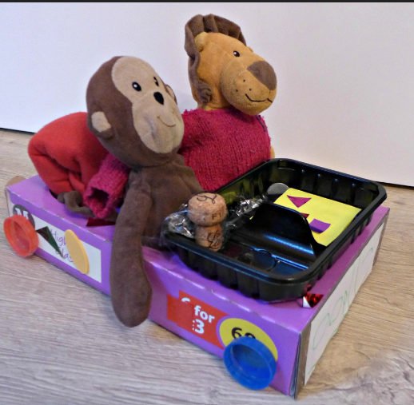
TBAT: use junk modelling techniques to make a rollercoaster carriage.
Now explore the resource and create your roller coaster carriage.

Slide 40
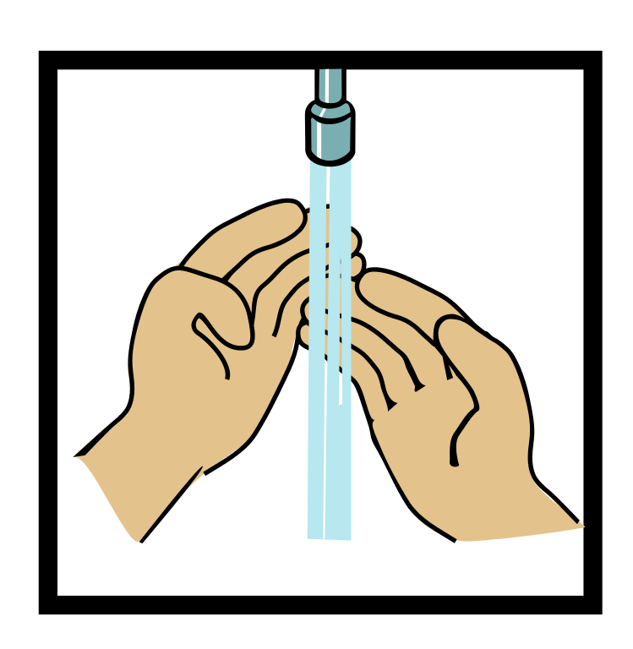
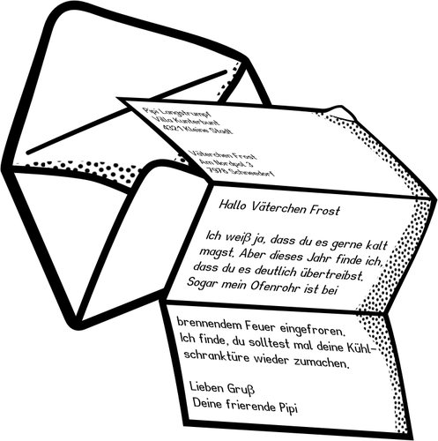
Home time
1.
2.
3.
4.
Wash hands
Collect bags , lunch boxes and water bottles.
Collect jumpers
Collect any letters/ reading books from the teachers.
Line up at the door.

