Slide 1
Thursday 2nd May 2024
2/05/24

Slide 2
Morning Challenges
Name writing practise.
Tricky word practise.
Read a book

Slide 3
Revisit and review
Today's Graphemes
oi/oy

Slide 4
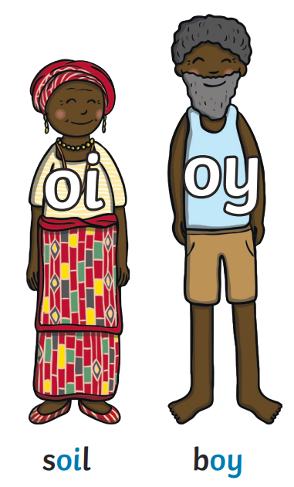
Revisit and review
The 'oi' family

Slide 5
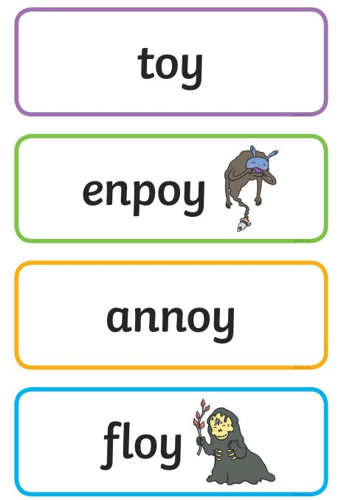
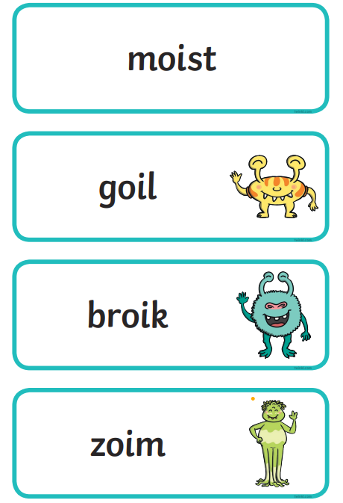
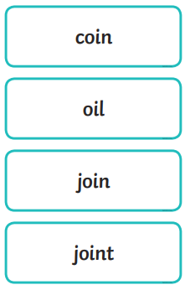
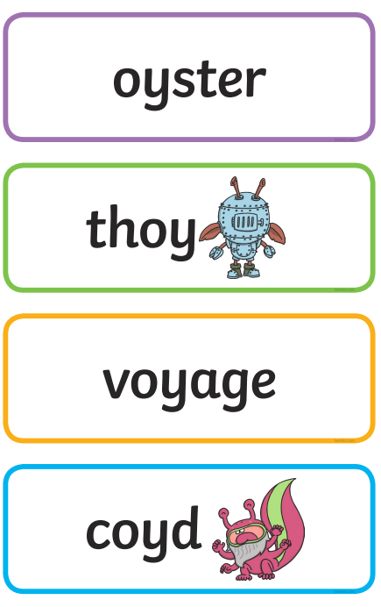
Real or Nonsense words? Read the words and underline the 'oi' phonemes
CHALLENGE
Write the real words in a sentence

Slide 6
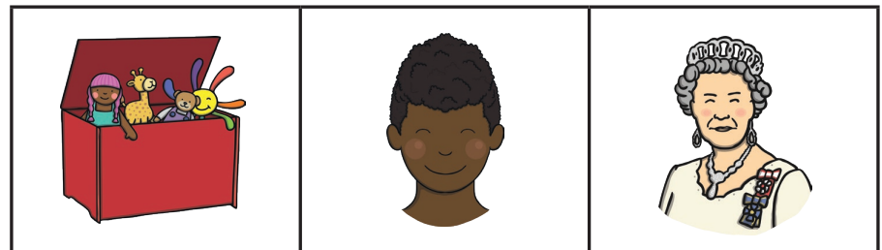
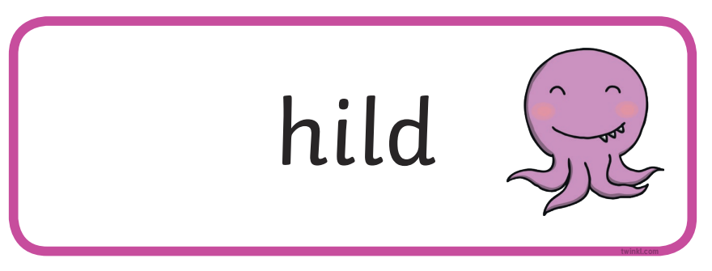
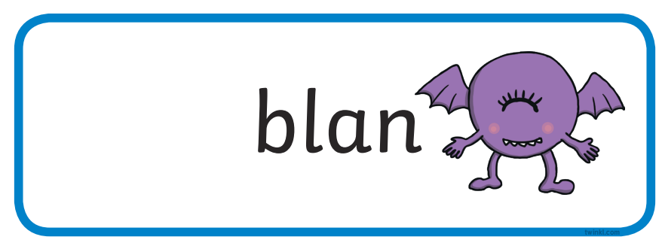
Match the correct real and nonsense words to the pictures
Royal
boyt
boy
toys
noyp
ruler
CHALLENGE
Write sentences using the real and nonsense words

Slide 7
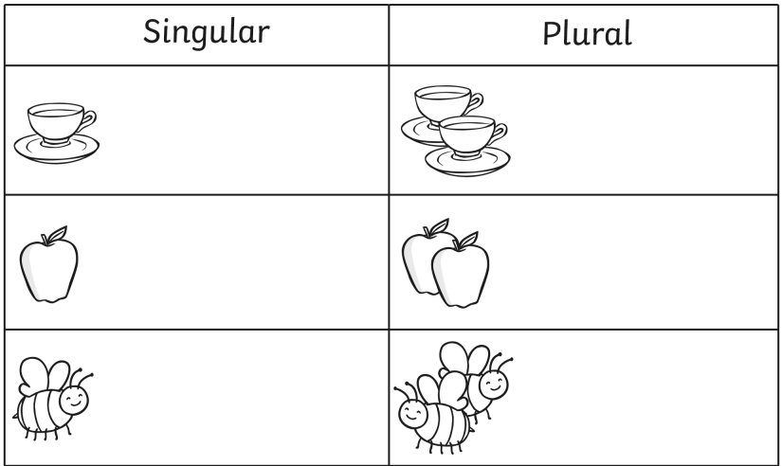
TBAT: use physical movement to re-tell a story.
Thursday 2nd May 2024
3 in 3- What words should go in each box?

Slide 8
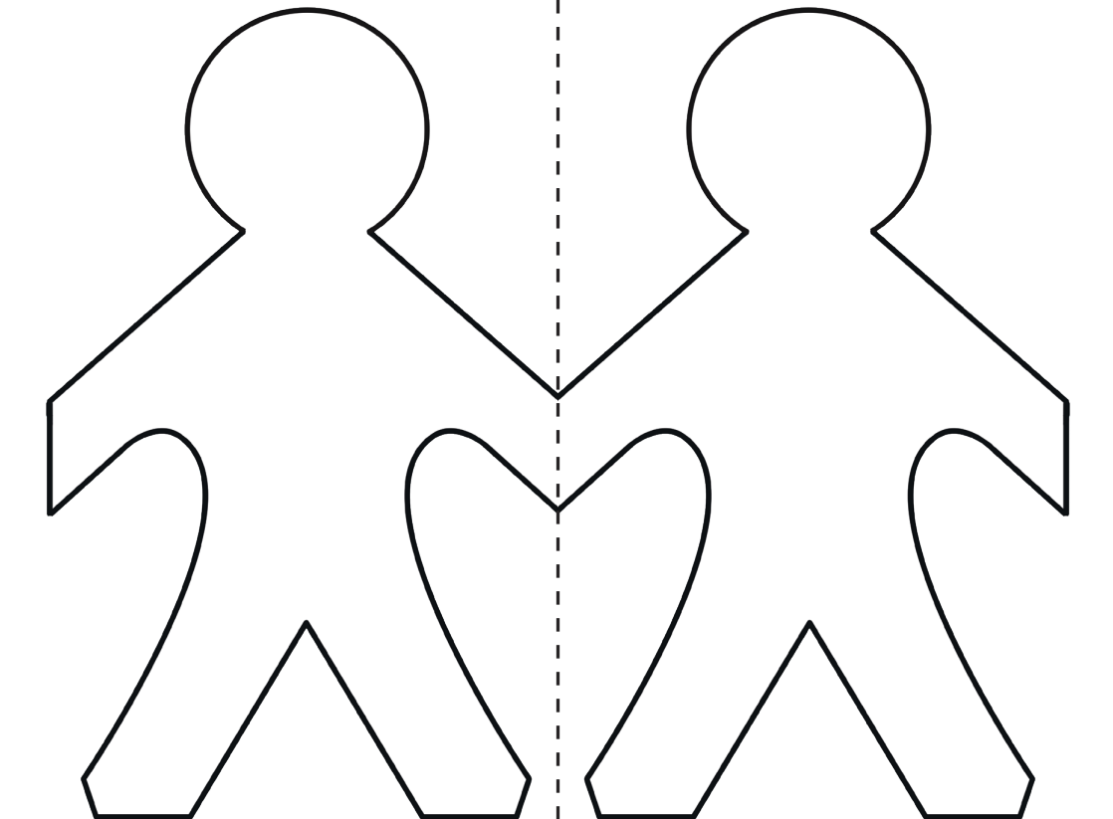
TBAT: use physical movement to re-tell a story.
Thursday 2nd May 2024
Blue/ Green
With your partner, think of an adventure these paper dolls could go on.
What are the paper dolls called?
Where do they go?
How does the adventure end?

Slide 9
TBAT: use physical movement to re-tell a story.
Thursday 2nd May 2024
Imagine you are Rosie who has a creative and fun imagination, and you are off on an adventure!
Listen to these stories and use your movements to re-tell what you are hearing?
How can you show what is happening?

Slide 10
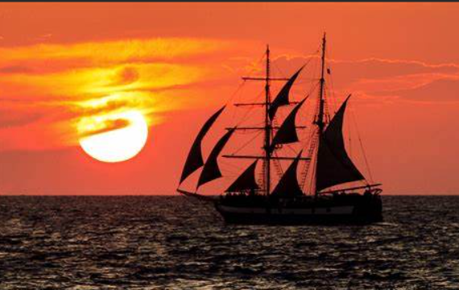
TBAT: use physical movement to re-tell a story.
Thursday 2nd May 2024
You are set to sail on a ship around the world, the conditions are peaceful and calm when all of a sudden a storm blows in.
You begin to feel sea sick and lose your balance as the ship rides over the waves.
All of a sudden a crocodile jumps aboard and you have to fight it off…

Slide 11
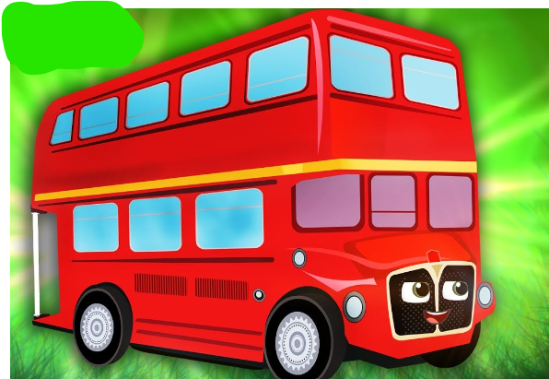
TBAT: use physical movement to re-tell a story.
Thursday 2nd May 2024
You are about to embark on a magic red bus which can travel to anywhere in the world.
This red bus is full of your class mates and you feel very excited to be travelling on a trip together.
The bus travels through the sky, under the twinkling stars when all of a sudden Dinosaur jumps on top of the bus…

Slide 12
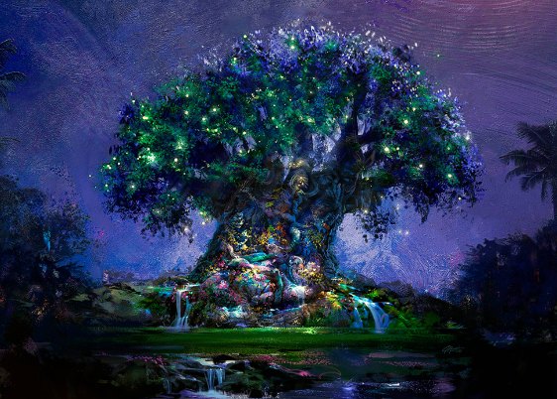
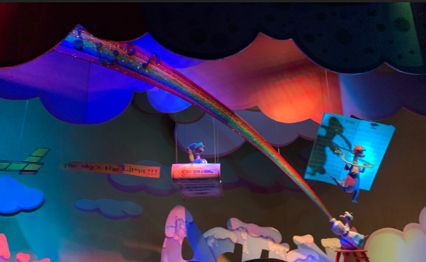
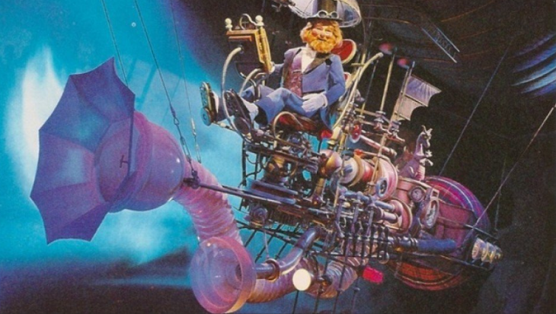
TBAT: use physical movement to re-tell a story.
Thursday 2nd May 2024
Can you re-tell a story for your friends to re-tell through movement?

Slide 13
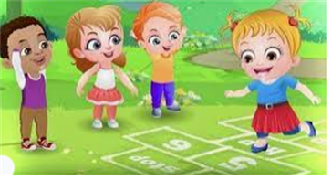
Break

Slide 14
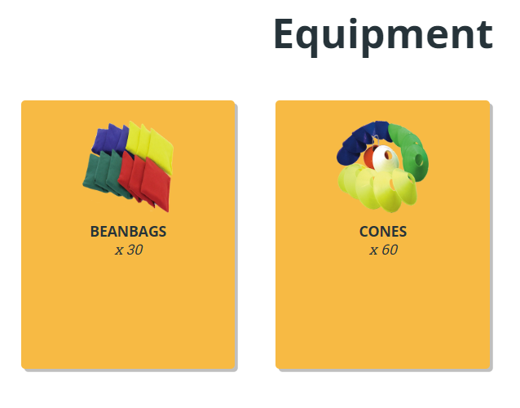
TBAT – throwing with accuracy towards a target
2 in 2
What does 'warm-up- mean?
How could we move a ball to hit a target?

Slide 15
TBAT – throwing with accuracy towards a target
Beanbag balance
On the signal, move around the teaching space in a variety of ways e.g. walk, sidestep, jog.
B Get a beanbag and explore balancing the beanbag as you move around.
You could try to balance the beanbag on their: head, shoulder, forearm, hand, elbow, back.

Slide 16
TBAT – throwing with accuracy towards a target
Moving target:
A
Get in pairs with one beanbag and two cones each.
Stand approx. 3-4 metres apart and place the first cone (base) by your feet and then the second cone (target) anywhere between you and your partner.
Aim to throw your beanbag to hit the target cone.
After you hit your cone, move it to another space between you and your partner
B
Pupils to set their score in 1 minute for how many targets they can hit.

Slide 17
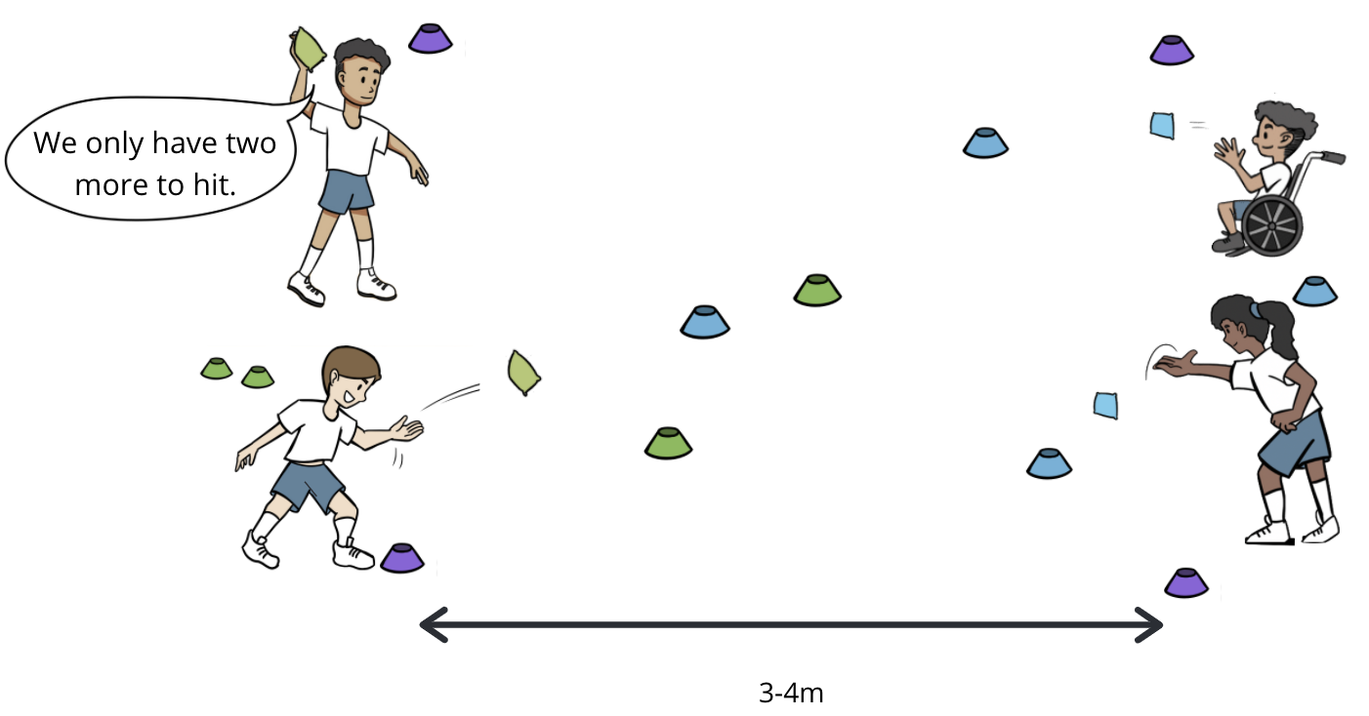
TBAT – throwing with accuracy towards a target
Sink the ship
Work in groups of four to play 2v2.
Have one beanbag each and 8 cones between them.
Stand in a square 3-4 metres apart, within the square, place two sets of coloured cones.
. On the signal teams compete to hit their allocated colour cones first.
When they hit one of their target cones, they bring it back to their base.

Slide 18
TBAT – throwing with accuracy towards a target
PLENARY
What can help throwing with accuracy towards a target?

Slide 19
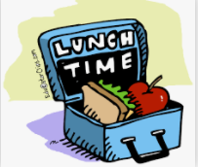
Lunch

Slide 20
Which of these expressions match the ten-frames?
3 in 3
9 + 5
6 + 8
10 + 4
5 + 9
8 + 6
4 + 10
7 + 7
Notes:
Do Now: ‘Make ten’
Show pupils the ten-frames and expressions on the slide.
Which of these expressions could match these ten-frames?
All of the expressions sum to 14, so they can all be represented by the same ten-frame image.

Slide 21
To add ones to a 2-digit number with regrouping
add
‘Make ten’
group of ten
regroup
ones
Dienes

Slide 22
Which of these have a value greater than ten?
How do you know?
7 + 4
1 + 7
8 + 2
5 + 6
4 + 5
8 + 5
3 + 8
3 + 6
5 + 5
Notes:
New Learning: Adding ones to a 2-digit number using ‘Make ten’
Show pupils the expressions on the slide.
Which of these expressions have a value greater than ten? How do you know?
Recap the ‘Make ten’ strategy for addition, modelling on a bead string.
On the next slide, ask pupils to consider how to solve the equation __ = 46 + 7, where the sum of the ones is greater than ten. They might suggest counting on seven from 46. You could model this on a bead string, adding one bead on at a time until you have added seven.
Could we use the ‘Make ten’ strategy to add seven onto 46? Explain!
Model using the ‘Make ten’ strategy, partitioning the seven into four and three. Demonstrate this on a bead string, with pupils moving the beads on their own bead strings as you discuss the strategy. Use the next slide to show this on a number line. An explanation will be similar to the following:
Six plus seven is greater than ten. Six plus four makes ten. We can partition seven into four and three. 46 plus four is 50, plus three more makes 53.
Repeat with further examples, e.g. 38 + 5, 27 + 6.

Slide 23
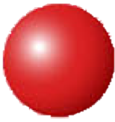
How could we calculate this sum?
______ = 46 + 7
Notes:
New Learning: Adding ones to a 2-digit number using ‘Make ten’
Show pupils the expressions on the slide.
Which of these expressions have a value greater than ten? How do you know?
Recap the ‘Make ten’ strategy for addition, modelling on a bead string.
On the next slide, ask pupils to consider how to solve the equation __ = 46 + 7, where the sum of the ones is greater than ten. They might suggest counting on seven from 46. You could model this on a bead string, adding one bead on at a time until you have added seven.
Could we use the ‘Make ten’ strategy to add seven onto 46? Explain!
Model using the ‘Make ten’ strategy, partitioning the seven into four and three. Demonstrate this on a bead string, with pupils moving the beads on their own bead strings as you discuss the strategy. Use the next slide to show this on a number line. An explanation will be similar to the following:
Six plus seven is greater than ten. Six plus four makes ten. We can partition seven into four and three. 46 plus four is 50, plus three more makes 53.
Repeat with further examples, e.g. 38 + 5, 27 + 6.

Slide 24
How could we calculate this sum?
46 + 7 = ______
+ 4
+ 3
0
10
20
30
40
50
60
46
Notes:
New Learning: Adding ones to a 2-digit number using ‘Make ten’
Show pupils the expressions on the slide.
Which of these expressions have a value greater than ten? How do you know?
Recap the ‘Make ten’ strategy for addition, modelling on a bead string.
On the next slide, ask pupils to consider how to solve the equation __ = 46 + 7, where the sum of the ones is greater than ten. They might suggest counting on seven from 46. You could model this on a bead string, adding one bead on at a time until you have added seven.
Could we use the ‘Make ten’ strategy to add seven onto 46? Explain!
Model using the ‘Make ten’ strategy, partitioning the seven into four and three. Demonstrate this on a bead string, with pupils moving the beads on their own bead strings as you discuss the strategy. Use the next slide to show this on a number line. An explanation will be similar to the following:
Six plus seven is greater than ten. Six plus four makes ten. We can partition seven into four and three. 46 plus four is 50, plus three more makes 53.
Repeat with further examples, e.g. 38 + 5, 27 + 6.

Slide 25
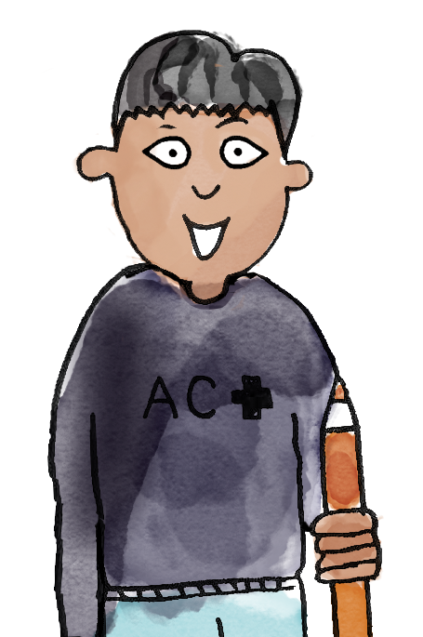
I choose 37 + 4.
I have made 37 on the bead string.
37 has seven ones.
Seven add three makes ten.
Move three beads first. That makes 40.
Then move one more bead, so that you've added four.
B/G
37 plus four is equal to 41.
add ‘Make ten’ group of ten ones regroup Dienes
Notes:
Talk Task: Adding ones to a 2-digit number using ‘Make ten’
Pupils have the Task Sheet and a bead string.
Pupil A selects an expression from the sheet and makes the first addend on the bead string. Pupil B identifies how to partition the second addend to ‘Make ten’. They tell Pupil A how to move the beads in two groups. Pupil A moves the beads and then states the whole equation. Pupils swap roles and repeat. Attention should be paid to checking that pupils are using the ‘Make ten’ strategy rather than adding in ones.

Slide 26
How else could we represent this equation?
______ = 46 + 7
Notes:
Develop Learning: Adding ones to a 2-digit number with regrouping
Return to the equation 46 + 7 = __ from the New Learning. Explain that we could also represent this using Dienes on a part-whole model. Model this using a visualiser or large magnetic Dienes.
How do I make the number 46 using Dienes? How do I make seven using Dienes?
Model combining the two parts in the whole, keeping the 46 and the seven separate so pupils can easily see the two parts. You could discuss what the value of the whole is at this point, counting the four tens and then on in ones to 53. Then ask whether another group of ten could be made from the ones. Demonstrate how this is the same as the ‘Make ten’ strategy from the New Learning, where pupils added four onto 46 to make 50.
We can regroup ten ones for one ten. Now we have five groups of ten and three ones. 46 plus seven is equal to 53.

Slide 27
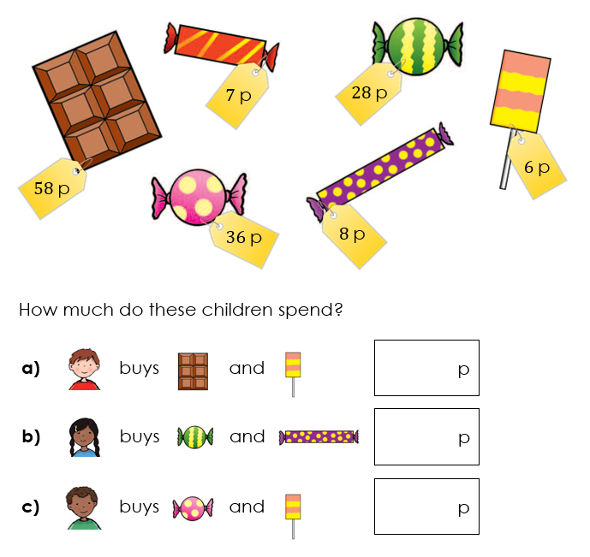
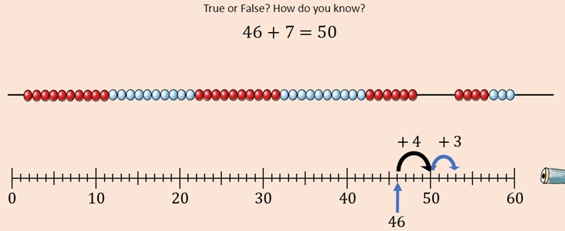
To add ones to a 2-digit number with regrouping
Use Dienes on a part-whole model to represent what each child spends.
RP:
Notes:
Independent Task: Adding 2-digit numbers and ones with regrouping
Pupils have the Task Sheet, a large part-whole model and Dienes. They calculate the total cost of each child’s sweets by representing each amount on a part-whole model. They practise regrouping ten ones for one ten, describing this to a partner.
Possible adaptations:
Pupils could continue to use a bead string and the ‘Make ten’ strategy.
Provide pupils with a pictorial representation of the Dienes to match to each problem. They then copy this with concrete Dienes to find the solution.

Slide 28
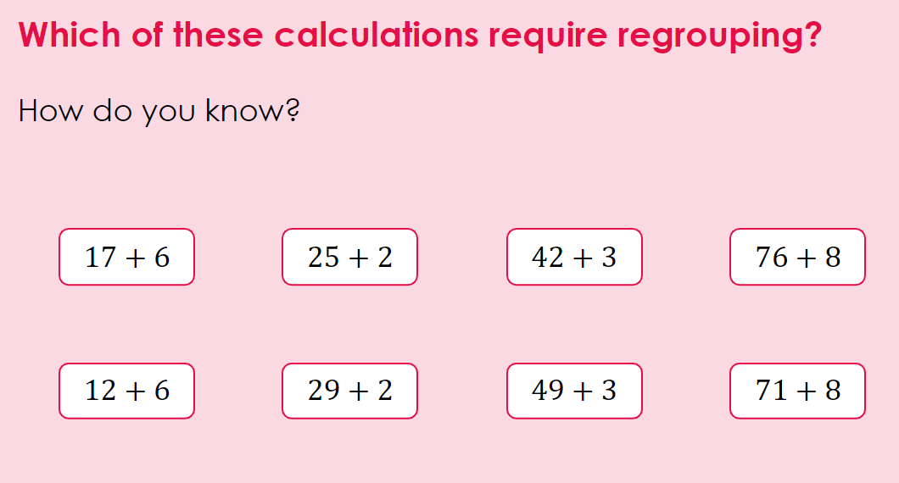
To add ones to a 2-digit number with regrouping
Challenge:
Notes:
Independent Task: Adding 2-digit numbers and ones with regrouping
Pupils have the Task Sheet, a large part-whole model and Dienes. They calculate the total cost of each child’s sweets by representing each amount on a part-whole model. They practise regrouping ten ones for one ten, describing this to a partner.
Possible adaptations:
Pupils could continue to use a bead string and the ‘Make ten’ strategy.
Provide pupils with a pictorial representation of the Dienes to match to each problem. They then copy this with concrete Dienes to find the solution.

Slide 29
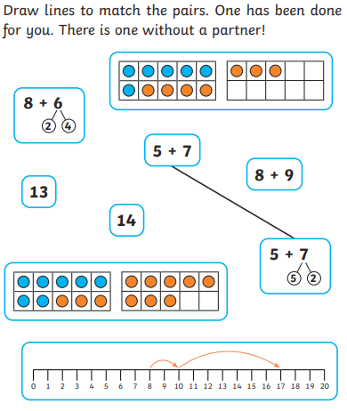
To add ones to a 2-digit number with regrouping
Mastery:
Notes:
Independent Task: Adding 2-digit numbers and ones with regrouping
Pupils have the Task Sheet, a large part-whole model and Dienes. They calculate the total cost of each child’s sweets by representing each amount on a part-whole model. They practise regrouping ten ones for one ten, describing this to a partner.
Possible adaptations:
Pupils could continue to use a bead string and the ‘Make ten’ strategy.
Provide pupils with a pictorial representation of the Dienes to match to each problem. They then copy this with concrete Dienes to find the solution.

Slide 30
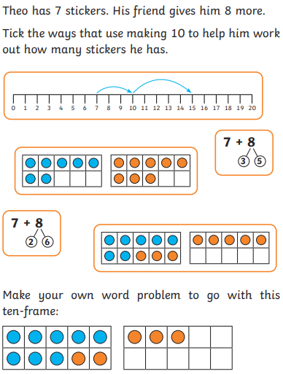
To add ones to a 2-digit number with regrouping
Mastery with greater depth:
Notes:
Independent Task: Adding 2-digit numbers and ones with regrouping
Pupils have the Task Sheet, a large part-whole model and Dienes. They calculate the total cost of each child’s sweets by representing each amount on a part-whole model. They practise regrouping ten ones for one ten, describing this to a partner.
Possible adaptations:
Pupils could continue to use a bead string and the ‘Make ten’ strategy.
Provide pupils with a pictorial representation of the Dienes to match to each problem. They then copy this with concrete Dienes to find the solution.

Slide 31
Break

Slide 32
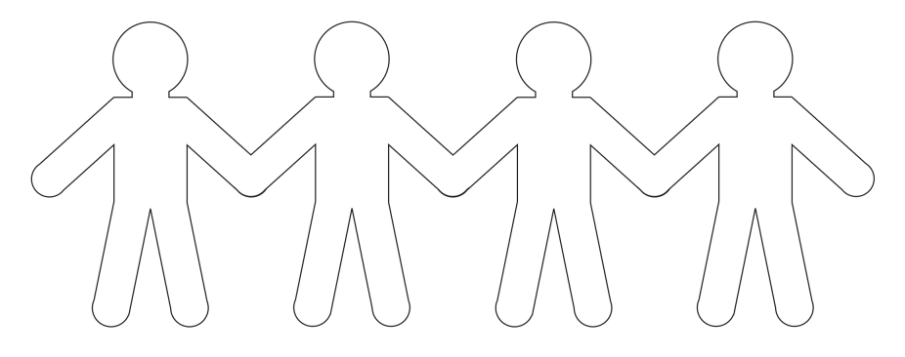
Art
TBAT: use drawing and different materials creatively to design and make paper dolls.
The Paper Dolls by Julia Donaldson - a read-aloud read along audiobook by Tippy Toes Nook (youtube.com)
Today we are going to make our own paper dolls like in our story 'The Paper Dolls' in Literacy.

Slide 34
Think about what the dolls will look like.
What colours will you use?
What will they wear?
What will their faces look like?

Slide 35
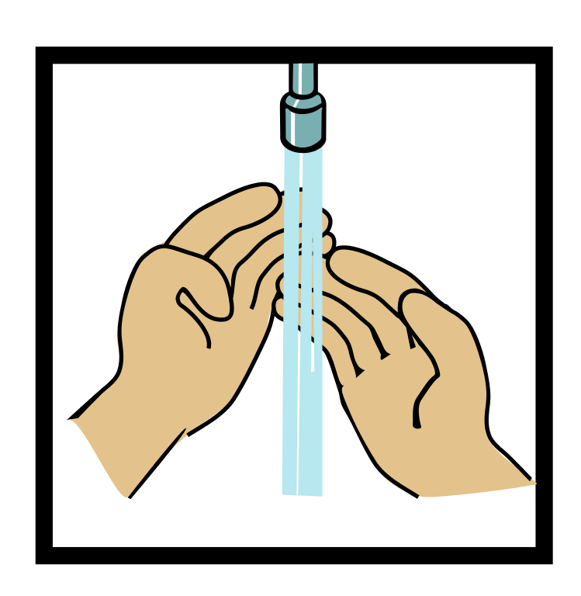
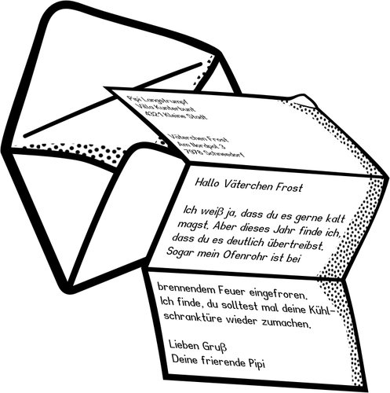
Home time
1.
2.
3.
4.
Wash hands
Collect bags , lunch boxes and water bottles.
Collect jumpers
Collect any letters/ reading books from the teachers.
Line up at the door.

