Slide 1
Friday 3rd May 2024
3/05/24

Slide 2
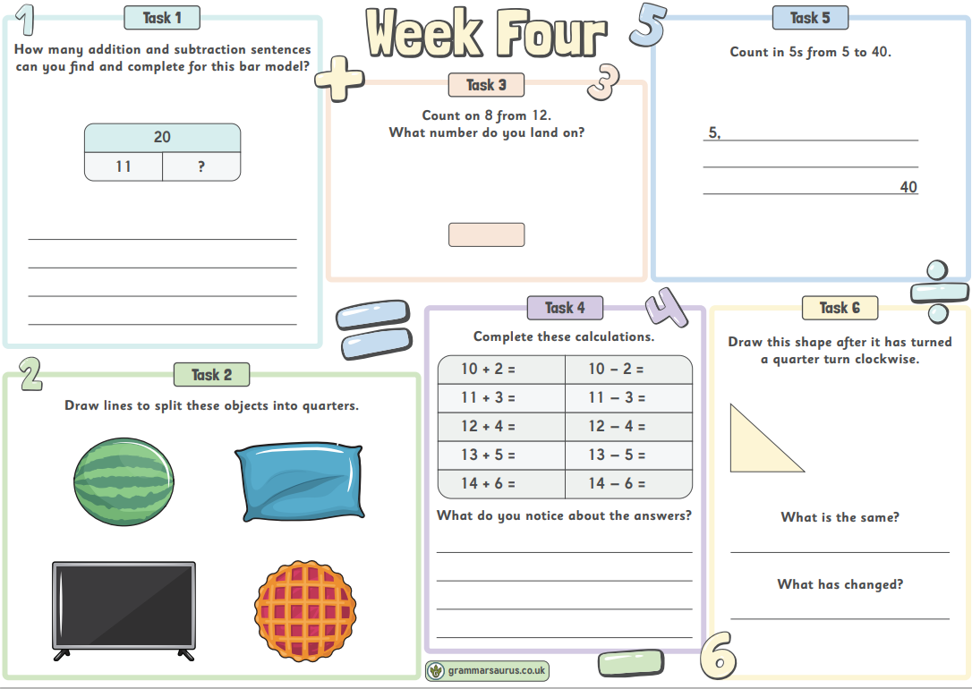
Morning Challenges
Name writing practise.
2.Maths activities.
4.Read a book

Slide 3
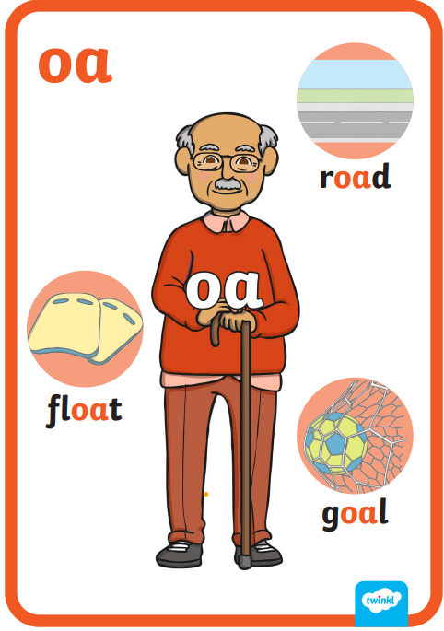
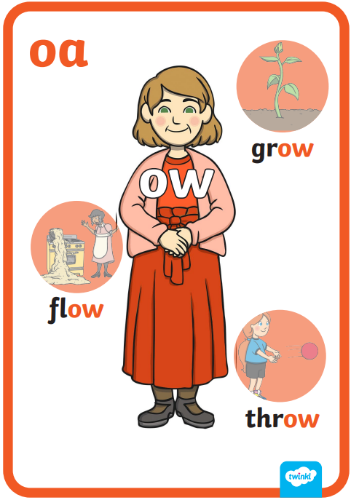
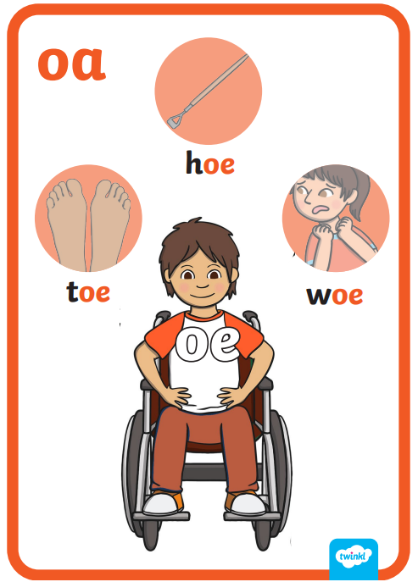
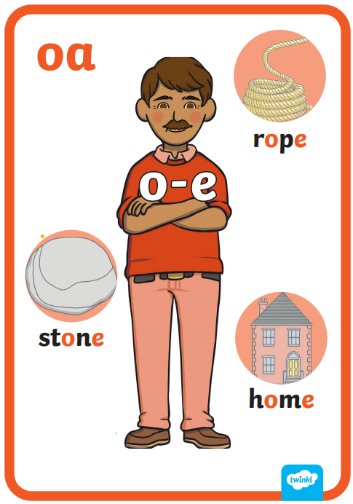
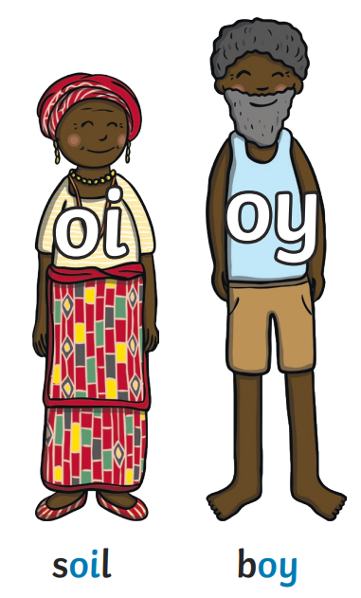
Revisit and review

Slide 4
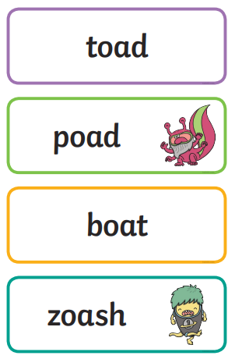
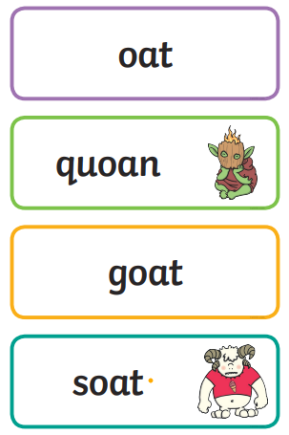
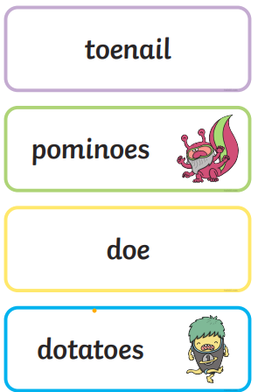
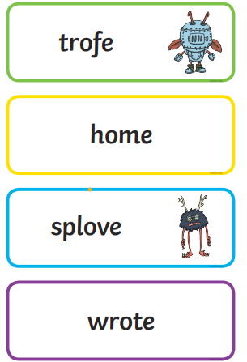
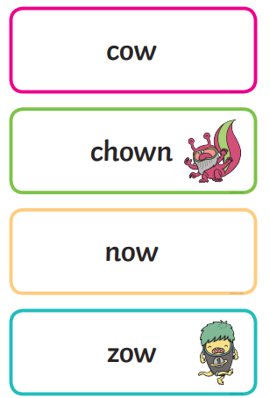
Real or Nonsense words? Read the words and underline the 'oa' phonemes
CHALLENGE
Write the real words in a sentence

Slide 5
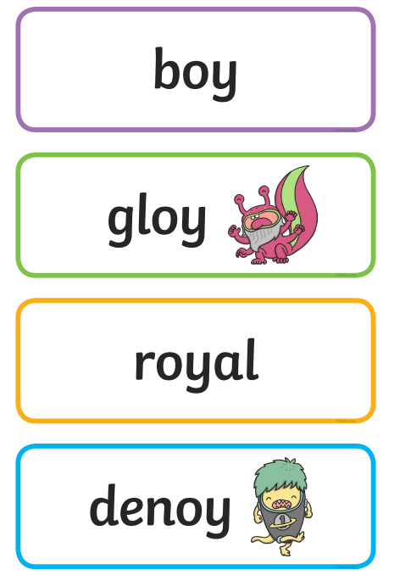
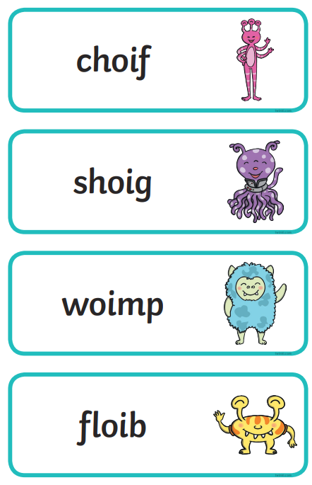
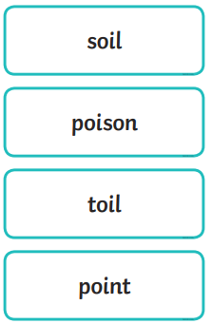
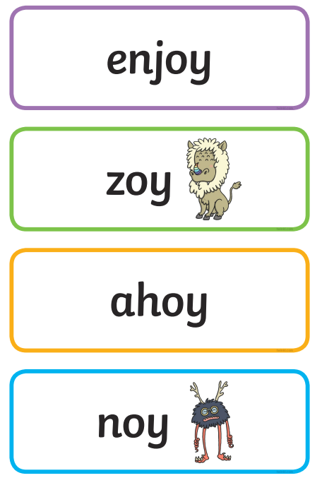
Real or Nonsense words? Read the words and underline the 'oi' phonemes
CHALLENGE
Write the real words in a sentence

Slide 6
Dragons Den (phonicsplay.co.uk)

Slide 7
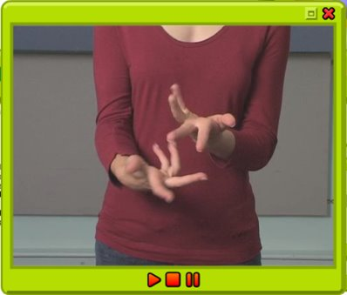
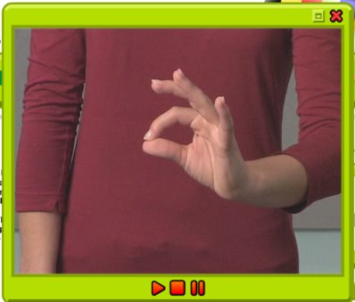
TBAT: practise a diagonal join with no ascender /ime/ /ine/
Friday 15th March 2024
15/3/24
Warm up
Gross- Soft and spiky arms
Fine- Little hoops

Slide 8
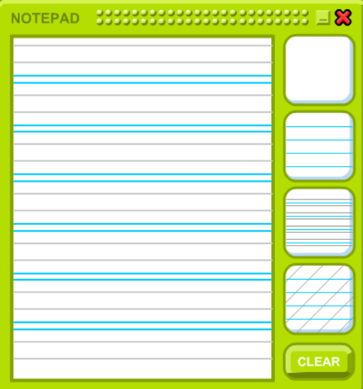
TBAT: practise a diagonal join with no ascender /ime/ /ine/
Friday 15th March 2024
15/3/24

Slide 9
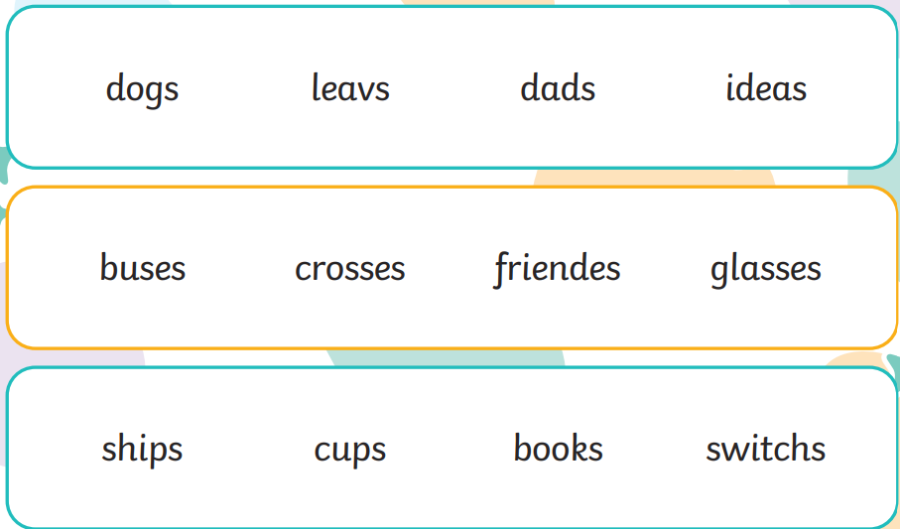
TBAT: write own version of a Paper Dolls adventure.
Friday 3rd May 2024
3 in 3- Circle the incorrect spelling in each row.

Slide 10
TBAT: write own version of a Paper Dolls adventure.
Friday 3rd May 2024
Blue/ Green
You are going to write your own version of this story.
We will write the beginning of the story together and the rest next week.
Tell your partner :
Who is the main character?
What is the name of the paper dolls?
What do they like to do together?

Slide 11
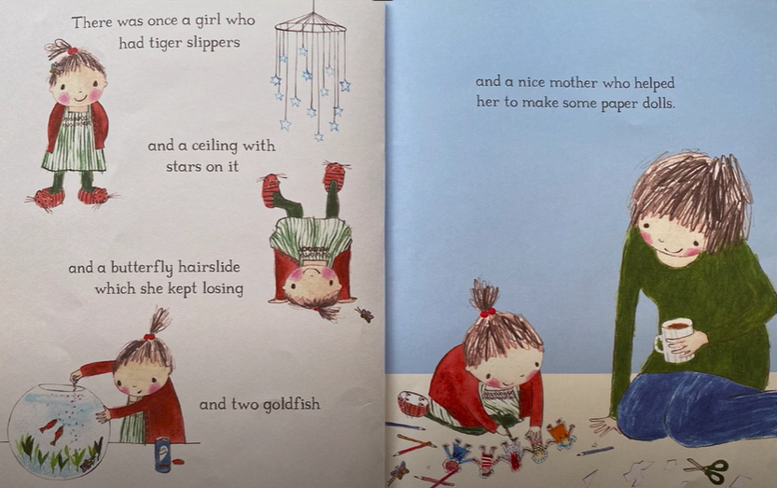
TBAT: write own version of a Paper Dolls adventure.
Friday 3rd May 2024
Who is the main character?
There once was ......................................................
Who had ......................................................
…...................................................
…...................................................
…...................................................
Who helped to make some paper dolls.

Slide 12
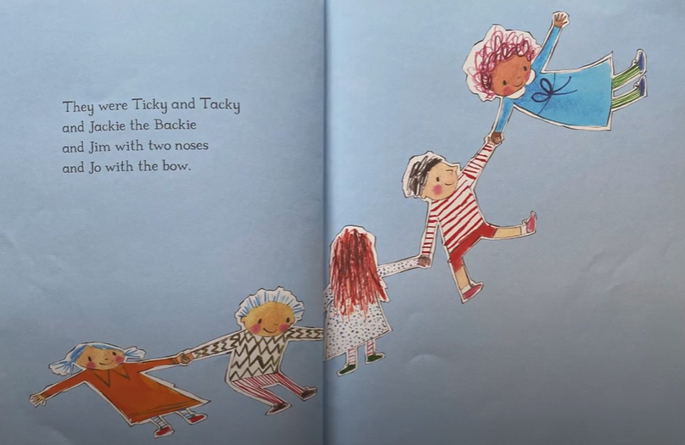
TBAT: write own version of a Paper Dolls adventure.
Friday 3rd May 2024
What are the names of the Paper Dolls?
They were.................................
and ….......................................
and..........................................
and …........................................
Can you make the names rhyme?

Slide 13
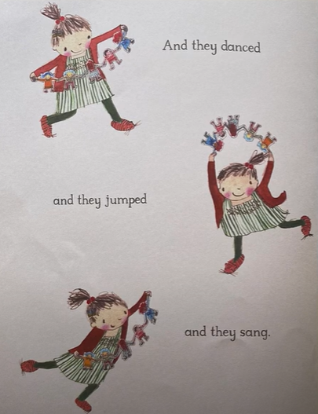
TBAT: write own version of a Paper Dolls adventure.
Friday 3rd May 2024
What do they like to do together?
And they.......................
and they …........................
and they...........................

Slide 14
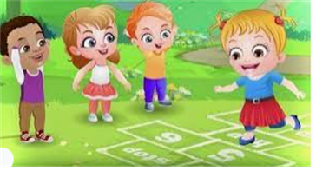
Break

Slide 15
Subtraction equations
Think of 3 subtraction equations can you make using these ten-frames?
3 in 3
Example:
14 – 5 = 9
Notes:
Do Now: ‘Make ten’
Show pupils the ten-frames on the slide.
Which subtraction equations can you make that have 14 as the whole?
What will be left on the ten-frame when you have subtracted?
Give pupils a chance to explore and then take feedback.

Slide 16
To subtract ones from a 2-digit number with regrouping
subtract
‘Make ten’
group of ten
regroup
Dienes
ones

Slide 17
Which of these have an answer less than ten?
How do you know?
14 – 3
16 – 4
13 – 2
12 – 1
16 – 7
14 – 5
13 – 9
12 – 8
Notes:
New Learning: Subtracting ones from a 2-digit number using ‘Make ten’
Show pupils the expressions on the slide.
Which of these expressions have a value less than ten? How do you know?
Recap the ‘Make ten’ strategy for subtraction, modelling on a bead string.
On the next slide, ask pupils to consider how to solve the equation 32 – 5. They might suggest counting back five from 32. You could model this on a bead string, subtracting one bead at a time until you have subtracted five.
Could we use the ‘Make ten’ strategy to subtract five from 32? Explain.
Model using the ‘Make ten’ strategy, partitioning the five into two and three. Demonstrate this on a bead string, with pupils moving the beads on their own bead strings as you discuss the strategy. Use the next slide to show this on a number line. An explanation will be similar to the following:
It is easy to subtract two from 32 first. Then we must take another three from 30, as we want to subtract five altogether. 32 subtract two is 30 and 30 subtract three is 27.
Repeat with further examples, e.g. 43 – 6, 61 – 4.

Slide 18
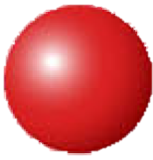
How could we calculate the answer?
32 – 5 = ______
Notes:
New Learning: Subtracting ones from a 2-digit number using ‘Make ten’
Show pupils the expressions on the slide.
Which of these expressions have a value less than ten? How do you know?
Recap the ‘Make ten’ strategy for subtraction, modelling on a bead string.
On the next slide, ask pupils to consider how to solve the equation 32 – 5. They might suggest counting back five from 32. You could model this on a bead string, subtracting one bead at a time until you have subtracted five.
Could we use the ‘Make ten’ strategy to subtract five from 32? Explain.
Model using the ‘Make ten’ strategy, partitioning the five into two and three. Demonstrate this on a bead string, with pupils moving the beads on their own bead strings as you discuss the strategy. Use the next slide to show this on a number line. An explanation will be similar to the following:
It is easy to subtract two from 32 first. Then we must take another three from 30, as we want to subtract five altogether. 32 subtract two is 30 and 30 subtract three is 27.
Repeat with further examples, e.g. 43 – 6, 61 – 4.

Slide 19
How could we calculate the answer?
32 – 5 = ______
– 3
– 2
0
10
20
30
40
50
60
32
Notes:
New Learning: Subtracting ones from a 2-digit number using ‘Make ten’
Show pupils the expressions on the slide.
Which of these expressions have a value less than ten? How do you know?
Recap the ‘Make ten’ strategy for subtraction, modelling on a bead string.
On the next slide, ask pupils to consider how to solve the equation 32 – 5. They might suggest counting back five from 32. You could model this on a bead string, subtracting one bead at a time until you have subtracted five.
Could we use the ‘Make ten’ strategy to subtract five from 32? Explain.
Model using the ‘Make ten’ strategy, partitioning the five into two and three. Demonstrate this on a bead string, with pupils moving the beads on their own bead strings as you discuss the strategy. Use the next slide to show this on a number line. An explanation will be similar to the following:
It is easy to subtract two from 32 first. Then we must take another three from 30, as we want to subtract five altogether. 32 subtract two is 30 and 30 subtract three is 27.
Repeat with further examples, e.g. 43 – 6, 61 – 4.

Slide 20
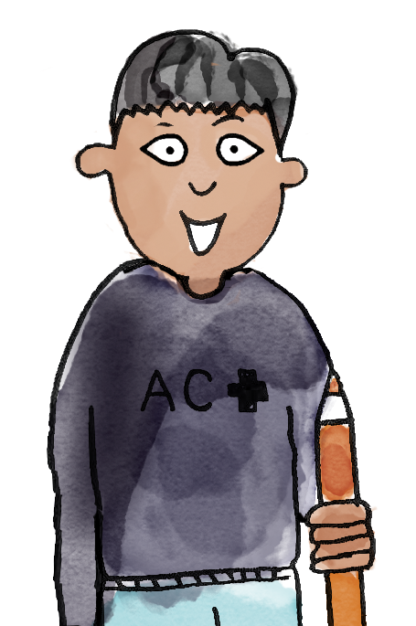
I choose 32 – 4.
I have made 32 on the bead string.
It’s easy to subtract two from 32.
Partition four into two and two.
Subtract two beads first. That makes 30.
Then subtract another two, so that you’ve subtracted four.
B/G
32 subtract four is equal to 28.
subtract ‘Make ten’ group of ten ones regroup Dienes
Notes:
Talk Task: Subtracting ones from a 2-digit number using ‘Make ten’
Pupils have the Task Sheet and a bead string.
Pupil A selects an expression from the sheet and makes the minuend on the bead string. Pupil B identifies how to partition the subtrahend (part to be subtracted) to ‘Make ten’. They tell Pupil A how to move the beads in two groups. Pupil A moves the beads and then states the whole equation. Pupils swap roles and repeat.

Slide 21
How else could we represent this equation?
32 – 5 = ______
Notes:
Develop Learning: Subtracting ones from a 2-digit number with regrouping
Return to the equation 32 – 5 = __ from the New Learning. Explain that we could also represent this using Dienes on a part-whole model. Model this using a visualiser or large magnetic Dienes.
How do I make 32 using Dienes? Where should I place it on the part-whole model? Why?
32 has three tens and two ones. In this equation, 32 is the whole. When we subtract, we start with the whole and subtract a part.
Model beginning to subtract five but being unable as there are only two ones.
There are only two ones in 32, but we need to subtract five ones. What could we do?
Give pupils a chance to think, discuss and share their ideas. Then explain:
We can regroup one ten for ten ones because they have an equal value. Now we have two tens and 12 ones. 12 ones subtract five ones is seven ones. Two tens and seven ones is 27. The missing part is 27.
Model this on the part-whole model to create one part of five and the remaining part of 27.

Slide 22
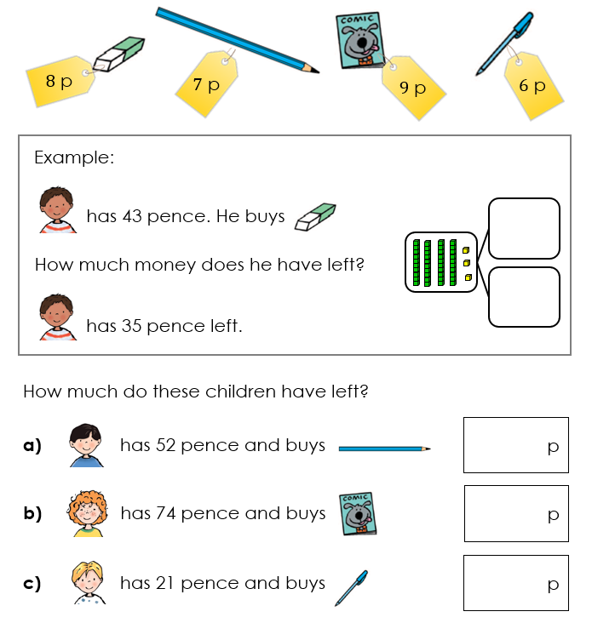
To subtract ones from a 2-digit number with regrouping
Use Dienes to represent how much money each child has left.
Do you need to regroup one ten for ten ones?
Notes:
Independent Task: Subtracting a 2-digit number and ones with regrouping
Pupils have the Task Sheet, a large part-whole model and Dienes. They calculate how much money each pupil has left, representing each calculation with Dienes on the part-whole model. They practise regrouping one ten for ten ones, describing this to a partner.
Possible adaptations:
Pupils could continue to use a bead string and the ‘Make ten’ strategy.
Provide pupils with a pictorial representation of the Dienes to match to each problem. They then copy this with concrete Dienes to find the solution.

Slide 23
To subtract ones from a 2-digit number with regrouping
RP:
Notes:
Independent Task: Subtracting a 2-digit number and ones with regrouping
Pupils have the Task Sheet, a large part-whole model and Dienes. They calculate how much money each pupil has left, representing each calculation with Dienes on the part-whole model. They practise regrouping one ten for ten ones, describing this to a partner.
Possible adaptations:
Pupils could continue to use a bead string and the ‘Make ten’ strategy.
Provide pupils with a pictorial representation of the Dienes to match to each problem. They then copy this with concrete Dienes to find the solution.

Slide 24
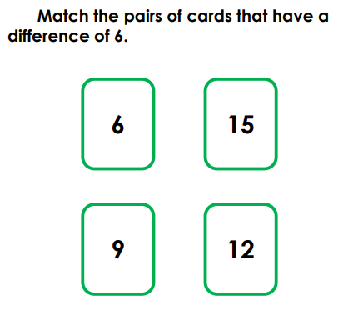
To subtract ones from a 2-digit number with regrouping
Challenge: Mastery:
Prove your answer.
Notes:
Independent Task: Subtracting a 2-digit number and ones with regrouping
Pupils have the Task Sheet, a large part-whole model and Dienes. They calculate how much money each pupil has left, representing each calculation with Dienes on the part-whole model. They practise regrouping one ten for ten ones, describing this to a partner.
Possible adaptations:
Pupils could continue to use a bead string and the ‘Make ten’ strategy.
Provide pupils with a pictorial representation of the Dienes to match to each problem. They then copy this with concrete Dienes to find the solution.

Slide 25
To subtract ones from a 2-digit number with regrouping
Mastery with greater depth:
Notes:
Independent Task: Subtracting a 2-digit number and ones with regrouping
Pupils have the Task Sheet, a large part-whole model and Dienes. They calculate how much money each pupil has left, representing each calculation with Dienes on the part-whole model. They practise regrouping one ten for ten ones, describing this to a partner.
Possible adaptations:
Pupils could continue to use a bead string and the ‘Make ten’ strategy.
Provide pupils with a pictorial representation of the Dienes to match to each problem. They then copy this with concrete Dienes to find the solution.

Slide 26
Represent this equation on a part-whole model
What is the whole and what is one part?
32 – 5 = 27
What other equations can you make using these three numbers?
Notes:
Plenary: Relating addition to subtraction
Return to the equation from the New Learning and Develop Learning: 32 – 5 = 27.
How can I represent this equation on the part-whole model?
What is the whole? What is a part?
Which other equations could you write using these three numbers?
Can you show me on a bead string that you are correct?

Slide 27
Lunch

Slide 28
Golden Book and Singing Assembly

Slide 29
Home time
1.
2.
3.
4.
Wash hands
Collect bags , lunch boxes and water bottles.
Collect jumpers
Collect any letters/ reading books from the teachers.
Line up at the door.

