Slide 1
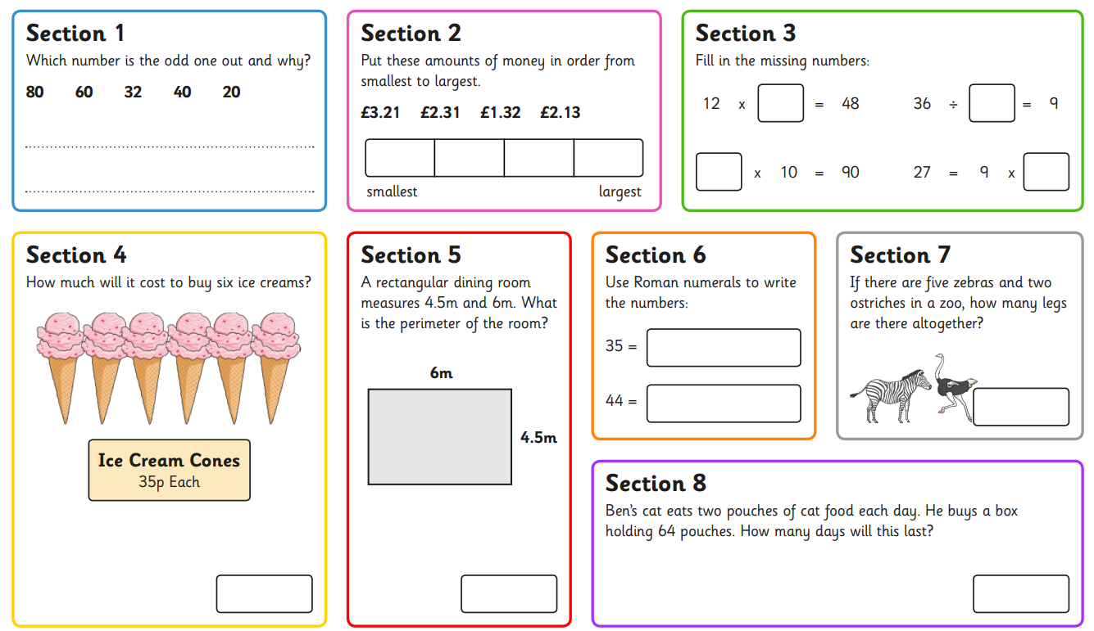
Thursday 9th May
Morning Challenge

Slide 2
Thursday 9th May
TBAT: create an Islamic tile.
Why is Allah never drawn in artwork?
How is Allah represented in artwork instead of being drawn?

Slide 3
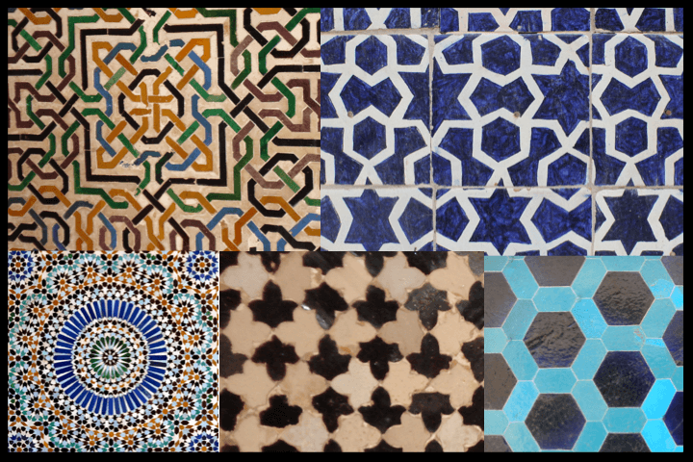
What shapes can you see in these patterns?

Slide 4
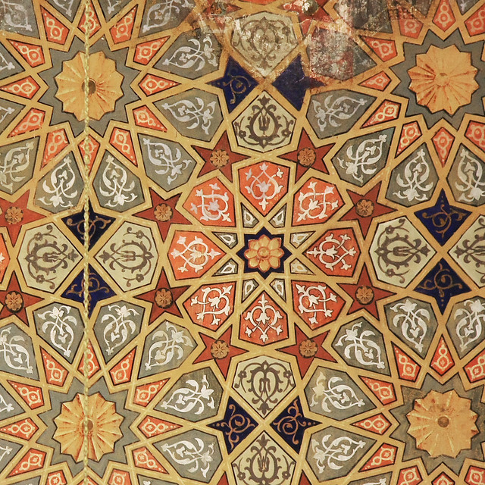
Do you see how this pattern is symmetrical?

Slide 5
Let’s put the lines of symmetry on this one.

Slide 6
Let’s model a possible design together before we start on our own

Slide 7
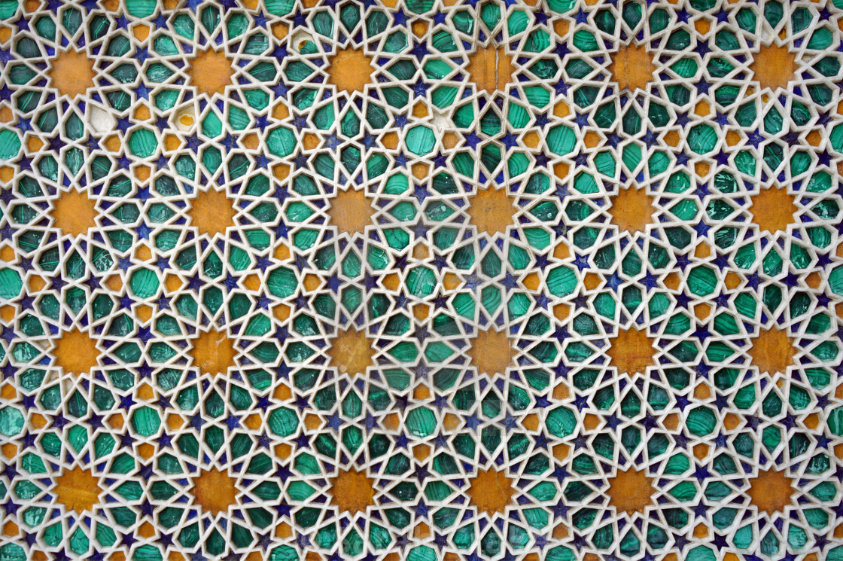
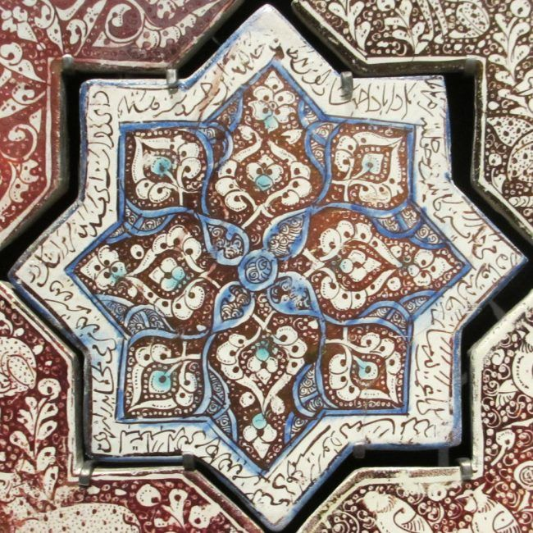
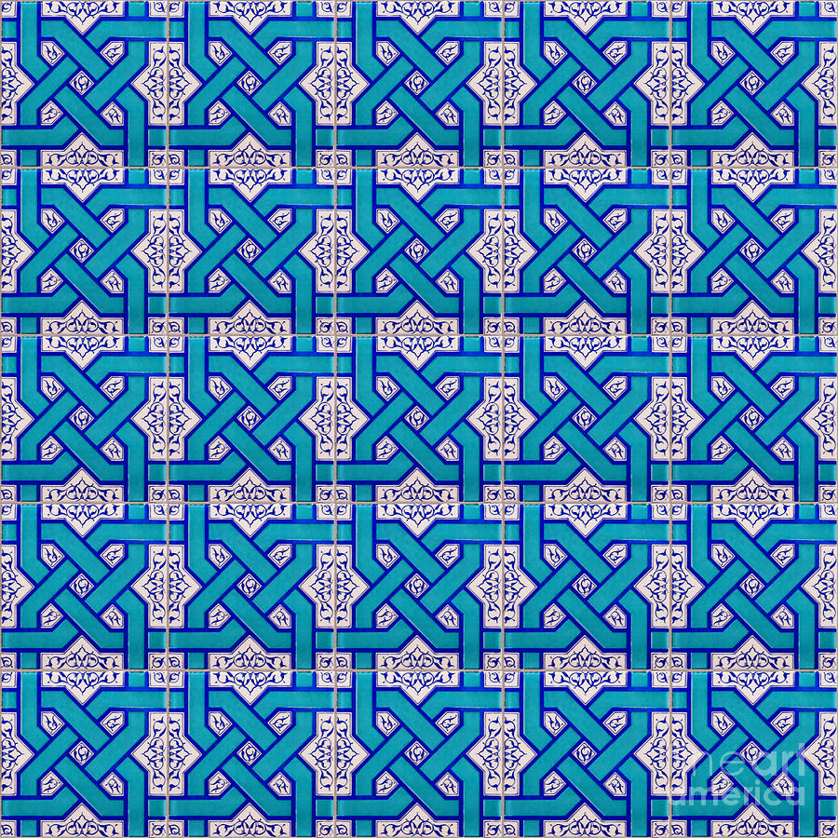
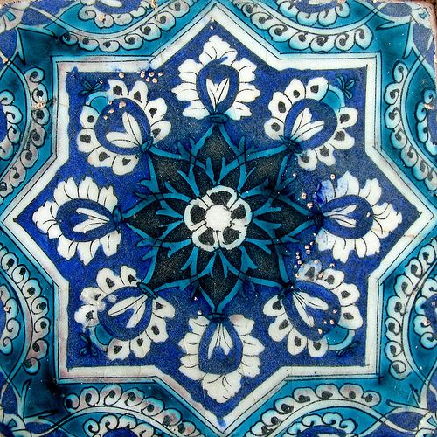
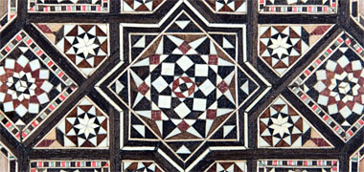

Slide 8
Thursday 9th May 2024
09.05.24
TBAT: read and interpret pictograms.
Daily 10 - Mental Maths Challenge - Topmarks
Key Vocabulary
Pictogram
Symbol
Result
Tally
Total

Slide 9
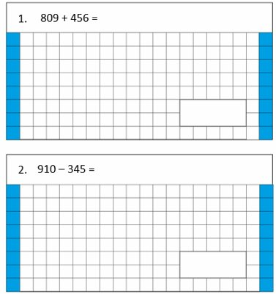
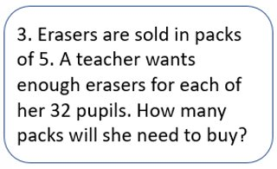
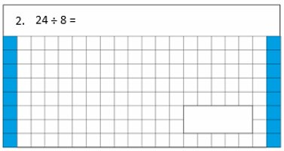
Tuesday 8th May 2024
08.05.24
TBAT: read and interpret pictograms.
2/3 of 36 =
Challenge
Double the answer of question 1 and 2.

Slide 10
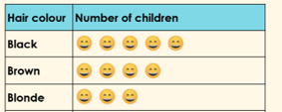
Thursday 9th May 2024
09.05.24
TBAT: read and interpret pictograms.
Partner Talk​
Discuss how you would read the following pictograms.
How many children are there in the class?
Challenge: How many pieces of fruit are there in total?

Slide 11
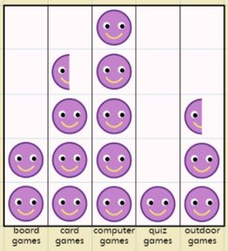
Thursday 9th May 2024
09.05.24
TBAT: read and interpret pictograms.
Solve the following calculation.
Blue
How many children in the class like card games?
Green
How many children
in the class like
outdoor games?
Challenge: How many children are there in the class altogether?

Slide 12
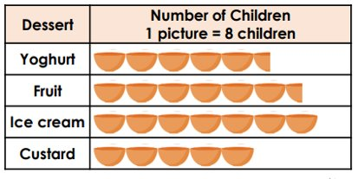
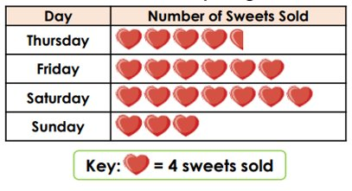
Thursday 9th May 2024
09.05.24
TBAT: read and interpret pictograms.
RP:
1) How many children had Yoghurt?
2) How many children had Yoghurt, Fruit, Ice Cream and Custard?
Independent –
How many sweets have been sold on Sunday?
What was the most popular day to buy sweets?
What was the least popular day to buy sweets?
How many people bought sweets on Thursday?

Slide 13
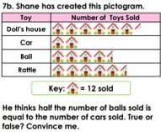
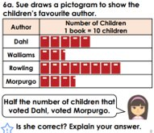
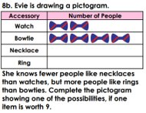
Mastery Challenge
Great Depth

Slide 14
Thursday 9th May
Spelling thief C_e_tu_e Pi_t_r_ Na_u_e f_rn_t_r_ mo_s_u_e
Challenge Can you rewrite the sentence below and unjumble the spelling word? A fortune-teller may look into the tuertuf to tell you your fortune.

Slide 15
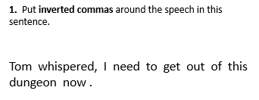
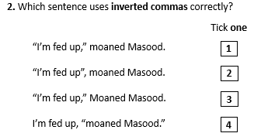
Thursday 9th May
TBAT: write the problem and resolution of my narrative.
3 in 3
If Chris was shouting, which punctuation mark would you replace with an exclamation mark?

Slide 16
Thursday 9th May
TBAT: write the problem and resolution of my narrative.
What has happened so far in your story? What do you think the problem is in the story?
Explain how you could show and not tell the reader that someone is getting angry and upset?

Slide 17
Example Beginning: Stanley (I) Inside the dark pyramids. Hieroglyphs on the towering walls. Feeling nervous about finding the scrolls. Build Up: Exited the tomb telling Sir Hawara I found the scrolls! Amisi told me I have been working for thieves. She felt betrayed. I felt confused. Problem: I overhear Sir Hawara's plan to leave me inside the tomb. He is a nasty thief! I feel lonely and disappointed. Resolution: I go along with the plan, but I lead the thieves in the wrong direction. I feel smug to have pulled it off! Sir Hawara is arrested. Ending: I travel home to see my family. I feel emotional to see everyone.

Slide 18
Thursday 9th May
TBAT: write the problem and resolution of my narrative.
Recap: In the darkness, I stood silently. With only narrow rays of sunlight shining through the cracks of the towering pyramid walls, looking around for the scrolls was a difficult job. I kept thinking about Sir Hawara waiting outside of the pyramid for me. Nervously, I wandered round in the dusty pyramid before I finally found the scrolls!
As I exited the pyramid, I could see Sir Hawara waiting impatiently.
"WELL... have you found them?!" he questioned.
I was excited to tell him exactly where the scrolls were. His eyes lit up as I told him the news. After I had spoken to Sir Hawara, I turned to see Amisi. She had a look of disappointment on her face as she told me I had been working for thieves. I tried to question her, feeling confused with what she had told me, but she walked off without looking back.

Slide 19
Thursday 9th May
TBAT: write the problem and resolution of my narrative.
I found myself at Sir Hawara's tent. The smell of smoke filled my nostrils while I slipped into the dark shadows to protect myself. I had to find out for myself whether he was a thief. It wasn’t long before I heard him whispering to his henchmen about his plot to leave me stranded in the pyramid! I couldn’t believe it. I was feeling so lonely being in Egypt on my own without my family. Amisi was right. Sir Hawara was the biggest thief in Egypt. I had to stop him.
The next morning, I showed Sir Hawara exactly where the scrolls were inside the pyramid. However, he didn’t know I had my own plan. I led him straight towards the guards who arrested him immediately. The look of relief filled Amisi's face. I am SO glad my plan worked. The scrolls were kept safe and more importantly I was safe!

Slide 20
Thursday 9th May 2024
9.05.24
TBAT: realise why you shouldn't make assumptions.
Partner Talk
What is a stereotype?
How would you describe to someone who doesn't know what a stereotype is?

Slide 21
Thursday 9th May 2024
9.05.24
TBAT: realise why you shouldn't make assumptions.
Today we are going to look at a made up land of Grinadod.
In this land they are certain there prejudices are correct.
What is a prejudice?

Slide 22
That’s stereotyping!
Welcome to the Land of Grinadod!
People here have strong opinions!
Notes:
Ask pupils to briefly imagine this land.

Slide 23
That’s stereotyping!
To find out what they think of you here, decide whether you are left- or right-handed and what colour your eyes and hair are.
Notes:
Help pupils to be clear!

Slide 24
That’s stereotyping!
This is what they think in Grinadod.
If you are left-handed, you don’t like animals.
If you are right-handed, you are a very quiet person.

Slide 25
That’s stereotyping!
This is what they think about you in Grinadod, based on your hair colour:
Hair colour | What you think
Blonde | You wish you could go to school at the weekends because it’s so much fun!
Brown | You think PE should be banned.
Black | You wish you could do spelling tests every day at school.
Red | You fall asleep at school every day.
Other | You wish school was a place where talking wasn’t allowed!

Slide 26
That’s stereotyping!
This is what they think about you in Grinadod, based on your eye colour:
Eye colour | What you are like
Blue | Really secretive
Hazel | Really good at music and singing
Brown | Really good at building
Green | Really religious
Grey | Really bad at running
Other | Really mean

Slide 27
Imagine you are from the land of Grinadod!
Thursday 9th May 2024
9.05.24
TBAT: realise why you shouldn't make assumptions.
You must now assume something that the people from Grinadod would assume if they had never met you before.

Slide 28
Thursday 9th May 2024
9.05.24
TBAT: realise why you shouldn't make assumptions.
Finish these sentences
It is unkind to assume things about people because...
People may feel ____________ if you assume things about them.

Slide 29
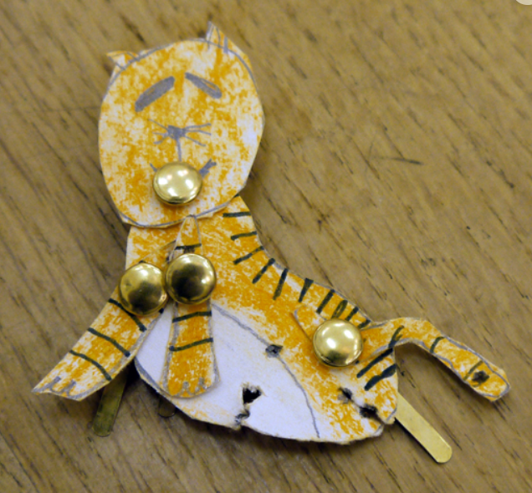
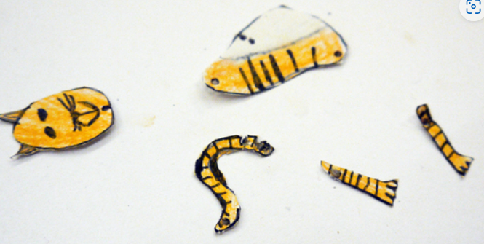
Thursday 9th May
TBAT: Create an animal using drawing and making. Today, we are going to create our own moveable animals. Talk to your partner, how might we do this? What animal would you like to make? Remember animals can include humans.

Slide 30
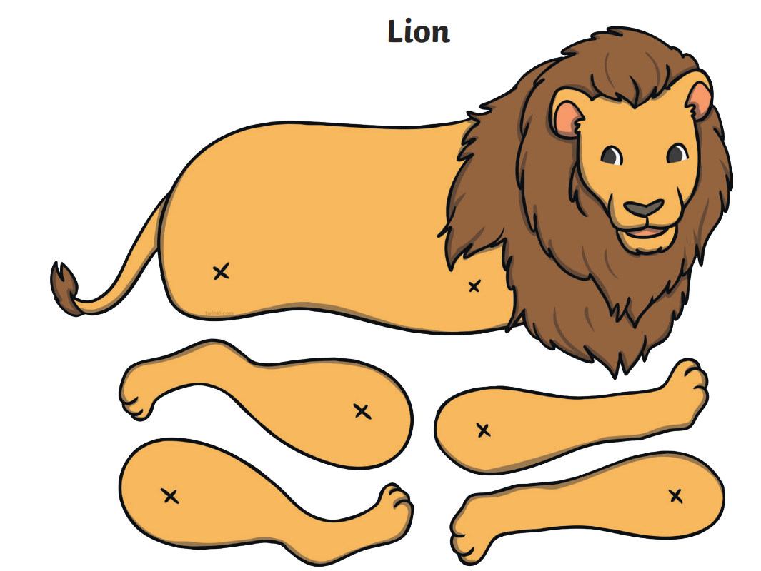
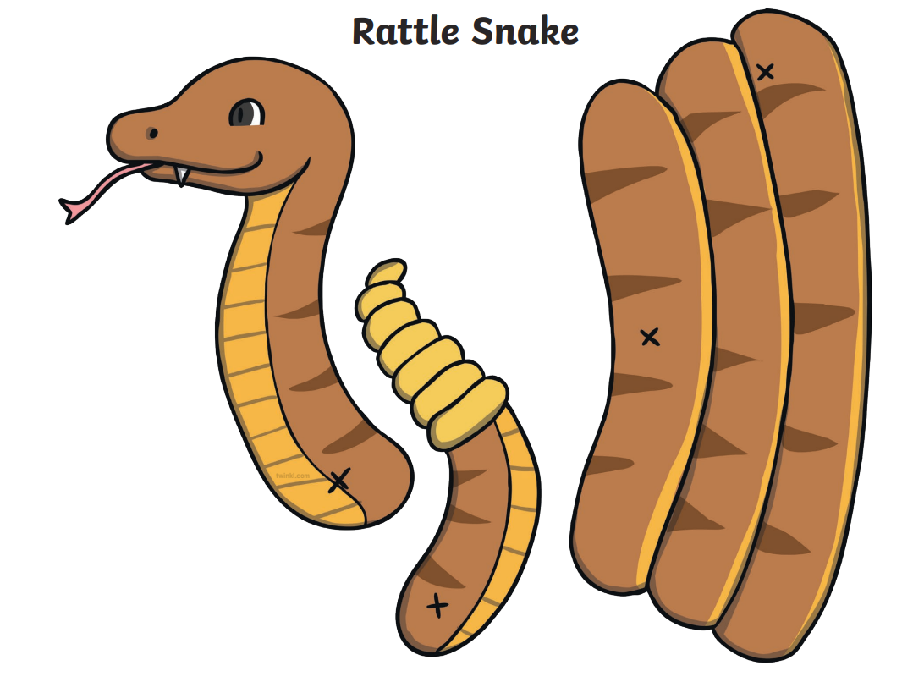
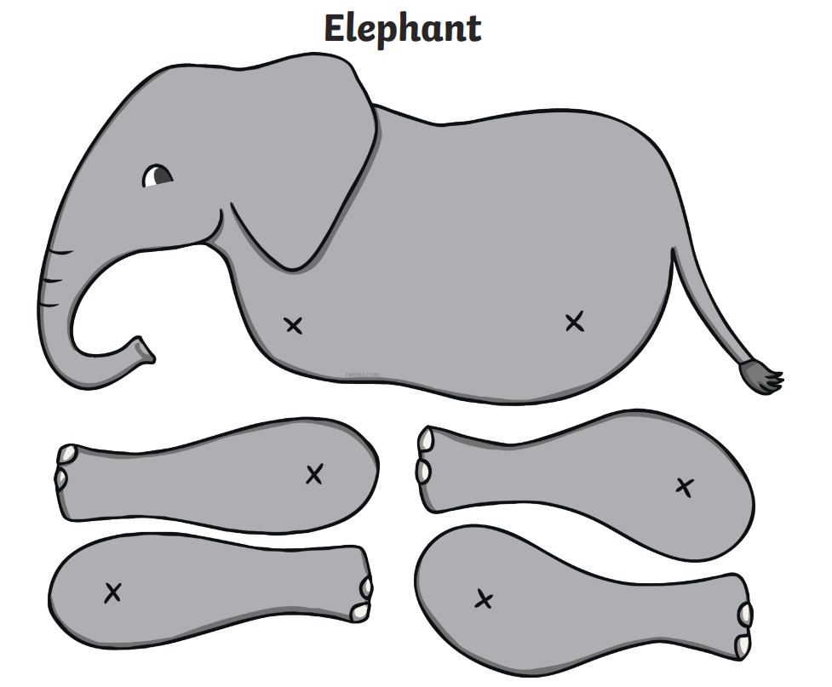
Thursday 9th May
TBAT: Create an animal using drawing and making. 1. Draw each individual part of your animal. 2. Colour it neatly. 3. Cut it out. 4. Join them together using split pins.

Slide 31
TBAT: apply sending and receiving skills in games.
This half term in P.E will be Cricket and Balls Skills
- Changing for PE - Rules and expectations moving to PE - Move to the downstairs hall or outside Get Set 4 PE - KS2 OAA (getset4education.co.uk)

